Slide 1

IS-201 - Database Chapter 6 – Database Design Using the E-R Model
Part(2) of (4)
DAW MAY THU KYAW
LECTURER
Faculty of Information Science

Slide 2
Outlines
Complex Attributes
Mapping Cardinalities

Slide 3
Complex Attributes
Attribute types:
Simple and composite attributes.
Single-valued and multivalued attributes
Example: multivalued attribute: phone_numbers
Derived attributes
Can be computed from other attributes
Example: age, given date_of_birth
Domain – the set of permitted values for each attribute

Slide 4
Composite Attributes
Composite attributes allow us to divided attributes into subparts (other attributes).

Slide 5
Representing Complex Attributes in ER Diagram

Slide 6
Mapping Cardinality Constraints
Express the number of entities to which another entity can be associated via a relationship set.
Most useful in describing binary relationship sets.
For a binary relationship set the mapping cardinality must be one of the following types:
One to one
One to many
Many to one
Many to many

Slide 7
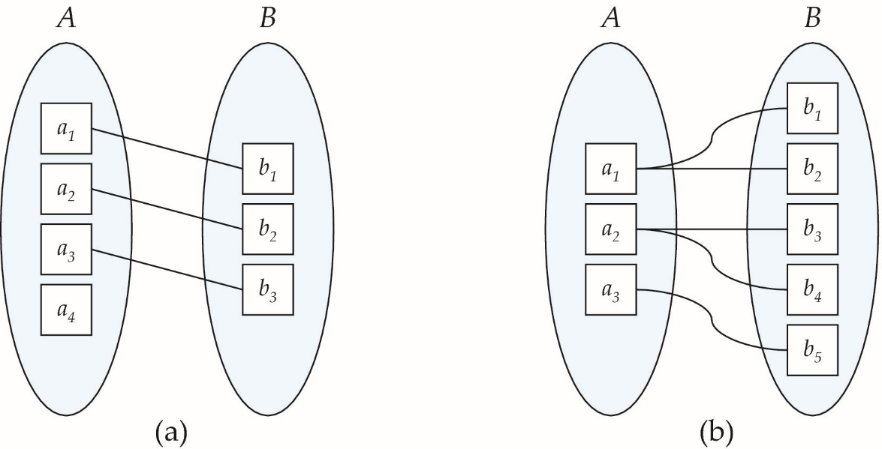
Mapping Cardinalities
One to one
One to many
Note: Some elements in A and B may not be mapped to any elements in the other set

Slide 8
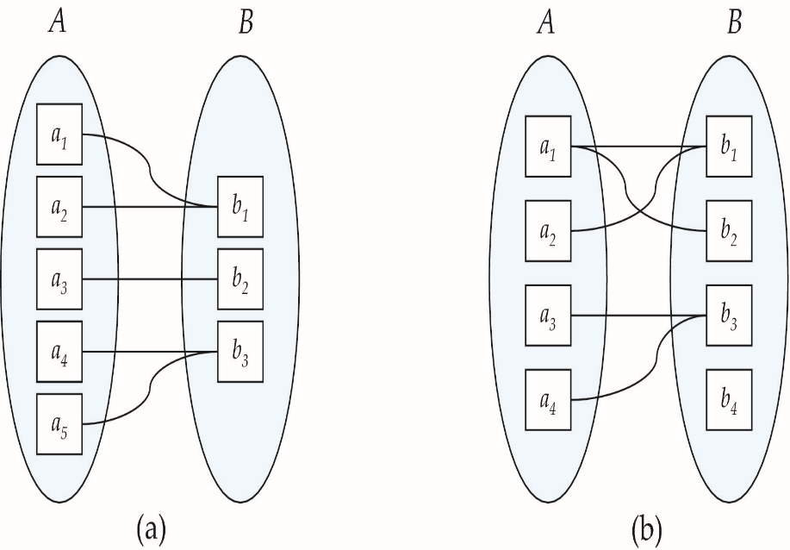
Mapping Cardinalities
Many to one
Many to many
Note: Some elements in A and B may not be mapped to any
elements in the other set

Slide 9
Representing Cardinality Constraints in ER Diagram
We express cardinality constraints by drawing either a directed line (→), signifying “one,” or an undirected line (—), signifying “many,” between the relationship set and the entity set.
One-to-one relationship between an instructor and a student :
A student is associated with at most one instructor via the relationship advisor
A student is associated with at most one department via stud_dept

Slide 10
One-to-Many Relationship
one-to-many relationship between an instructor and a student
an instructor is associated with several (including 0) students via advisor
a student is associated with at most one instructor via advisor,

Slide 11
Many-to-One Relationships
In a many-to-one relationship between an instructor and a student,
an instructor is associated with at most one student via advisor,
and a student is associated with several (including 0) instructors via advisor

Slide 12
Many-to-Many Relationship
An instructor is associated with several (possibly 0) students via advisor
A student is associated with several (possibly 0) instructors via advisor

Slide 13
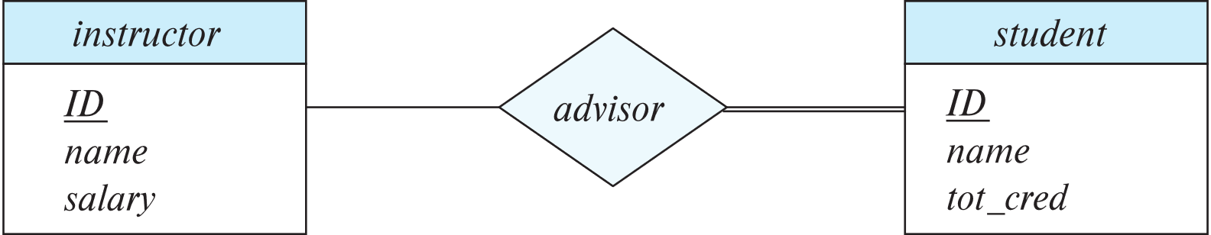
Total and Partial Participation
Total participation (indicated by double line): every entity in the entity set participates in at least one relationship in the relationship set
participation of student in advisor relation is total
every student must have an associated instructor
Partial participation: some entities may not participate in any relationship in the relationship set
Example: participation of instructor in advisor is partial

Slide 14
Notation for Expressing More Complex Constraints
A line may have an associated minimum and maximum cardinality, shown in the form l..h, where l is the minimum and h the maximum cardinality
A minimum value of 1 indicates total participation.
A maximum value of 1 indicates that the entity participates in at most one relationship
A maximum value of * indicates no limit.

Slide 15
Notation for Expressing More Complex Constraints(Cont.)
Example
Instructor can advise 0 or more students. A student must have 1 advisor; cannot have multiple advisors

Slide 16
Next Lecture
Primary Key
Removing Redundant Attributes in Entity Sets
Reduction to Relational Schemas

