Slide 1
Analyze raw data into insights for a drilling case report.

Slide 2
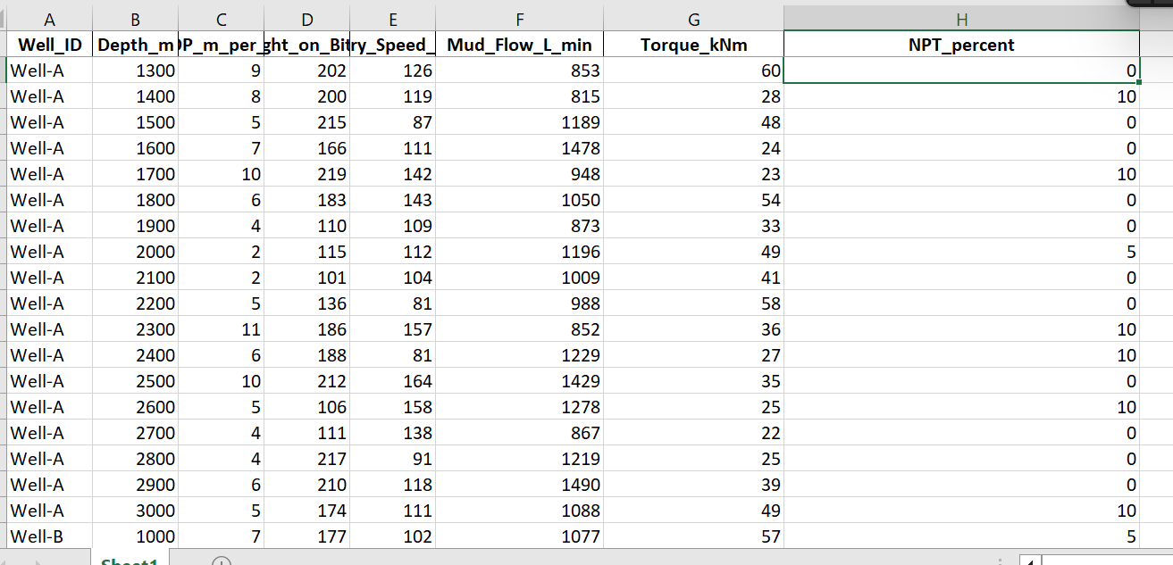
Raw Data

Slide 3
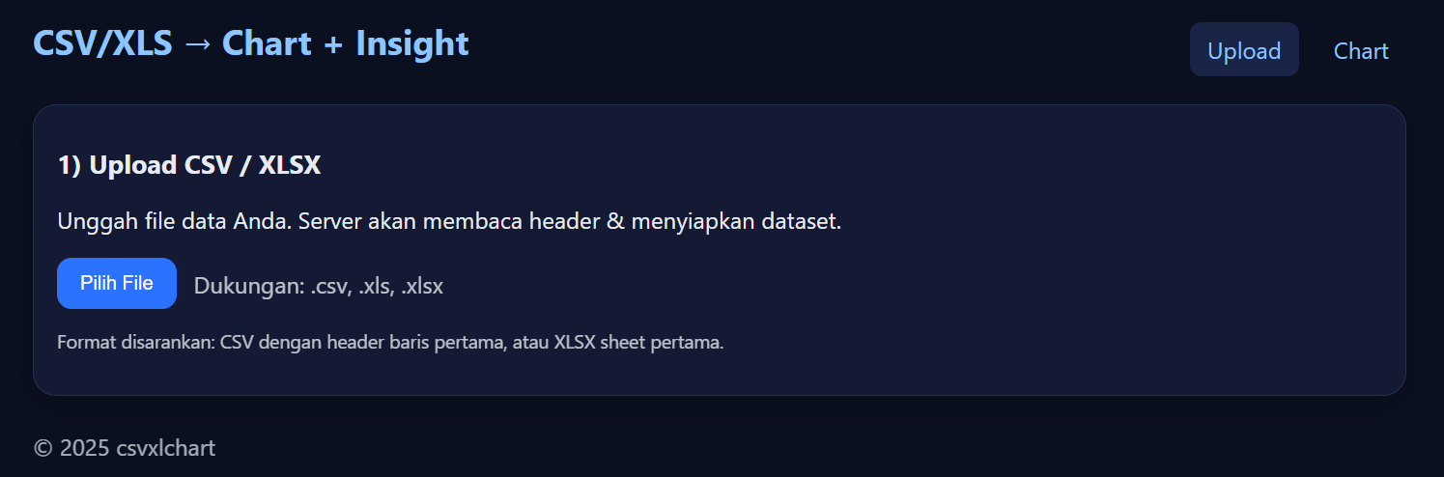
Upload xls/csv

Slide 4
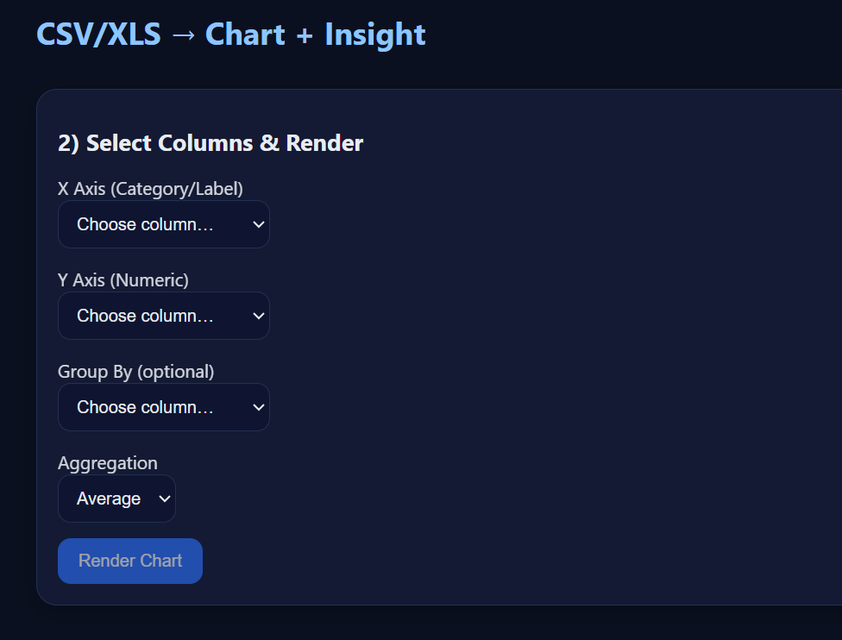
Select x,y axis and grouping

Slide 5
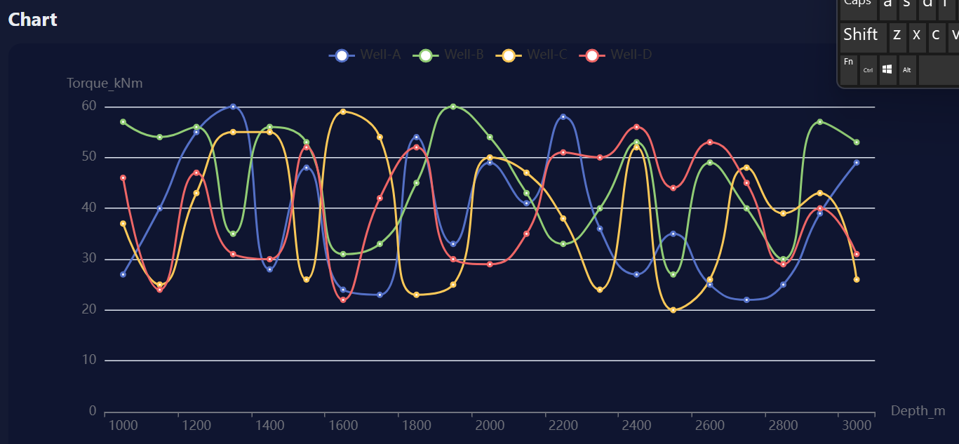
Chart

Slide 6
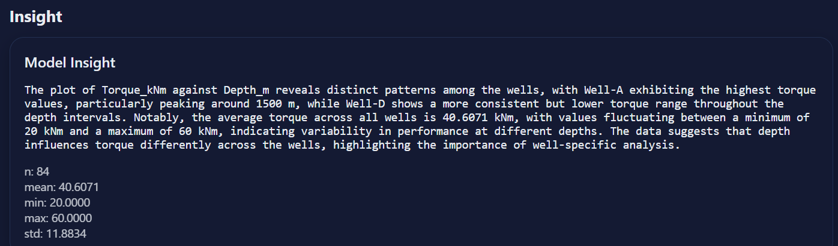
Insight

