Slide 1
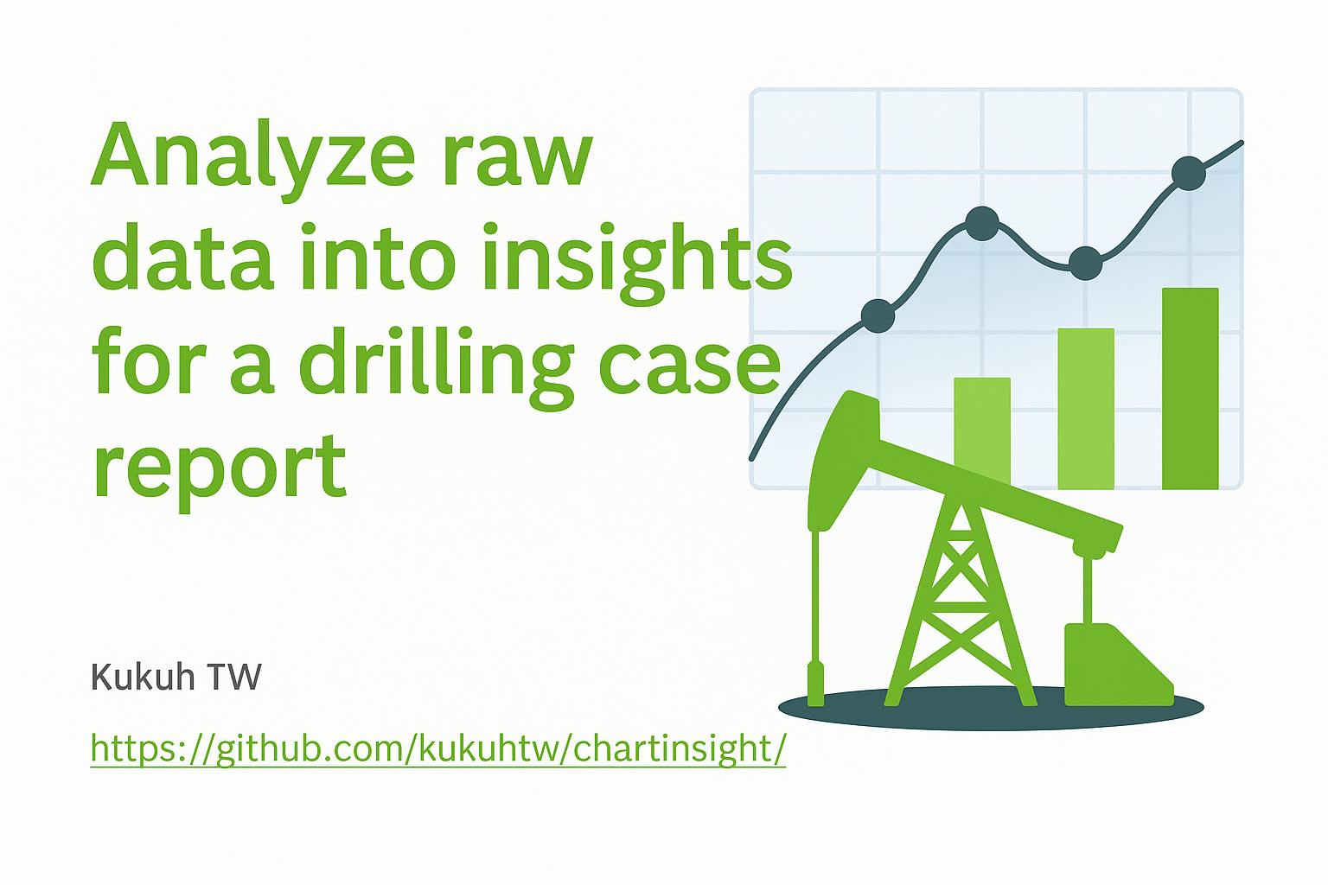
Kukuh TW
https://github.com/kukuhtw/chartinsight/

Slide 2
Whats it is ?
ChartInsight is a lightweight web app that transforms CSV/XLSX data into interactive charts and AI-powered insights. Upload your dataset, choose X and Y axes, add optional grouping and aggregation, and instantly get visualizations with natural language explanations generated by GPT

Slide 3
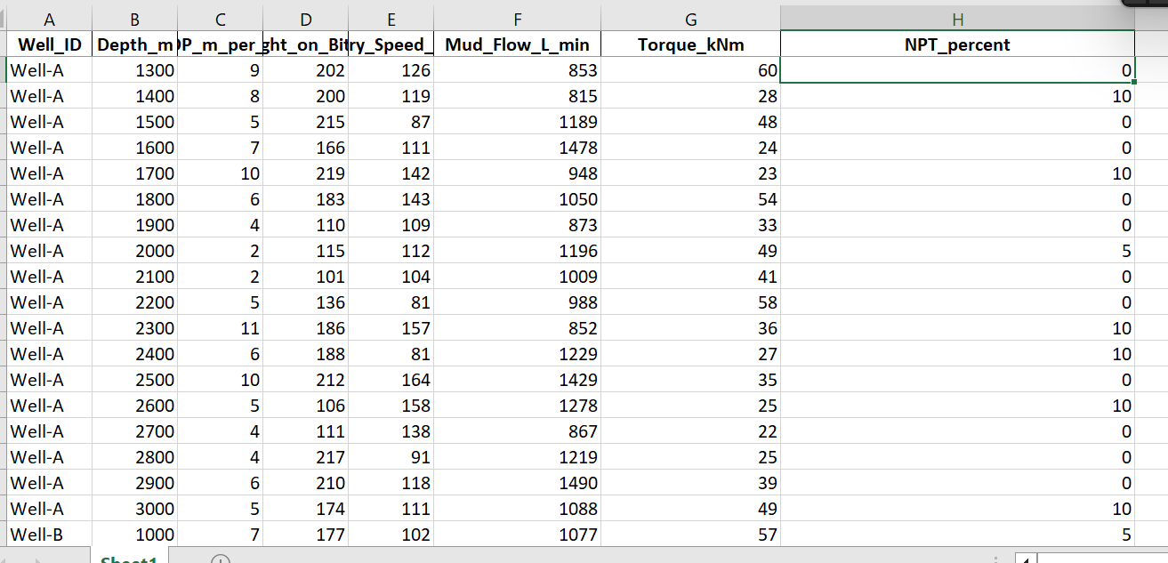
Raw Data

Slide 4
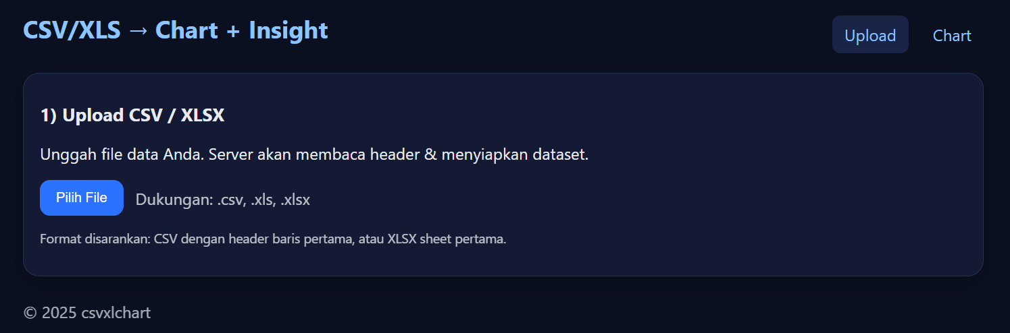
Upload xls/csv

Slide 5
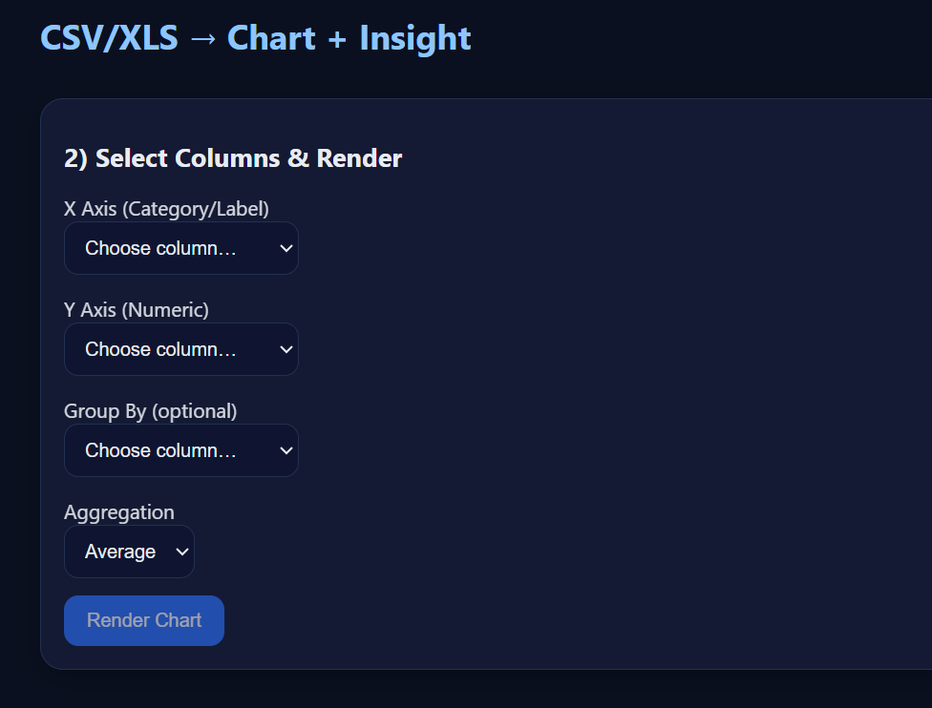
Select x,y axis and grouping

Slide 6
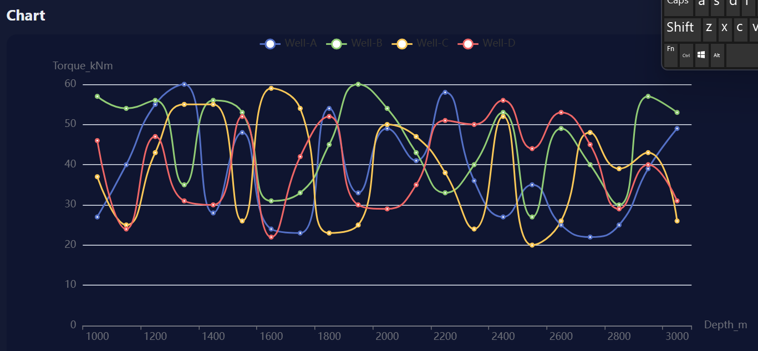
Chart

Slide 7
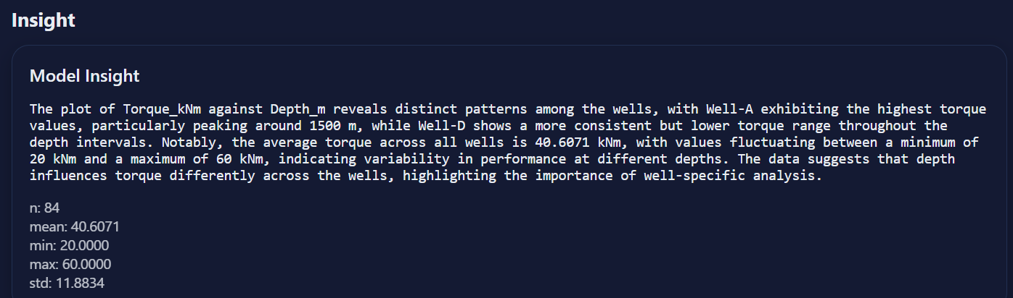
Insight

