Slide 1
MCP-RAG : Multi-Context Protocol + Retrieval-Augmented Generation with Data Visualization
Proof of Concept for Oil & Gas Industry
Kukuh TW - https://www.linkedin.com/in/kukuhtw/
https://github.com/kukuhtw/mcp_rag_go

Slide 2
Problem Statement
Oil & Gas industry data is fragmented across multiple silos: drilling, production, HSSE, POs, technical docs.
Answering a simple business question requires manual collection and analysis.
No integrated way to visualize the answer for quick decision-making.
https://github.com/kukuhtw/mcp_rag_go

Slide 3
Introducing MCP and RAG
Multi-Context Protocol (MCP): routes natural language queries to the right backend service.
Retrieval-Augmented Generation (RAG): augments LLM answers with factual retrieved documents and citations.
https://github.com/kukuhtw/mcp_rag_go

Slide 4
The Solution — MCP-RAG Go
Go-based AI framework combining MCP routing with RAG document retrieval.
Supports cross-domain queries: drilling, production, POs, HSSE, timeseries.
Streaming chat via SSE with step-by-step answers.
Plan normalization for precise tool calls.
Answers enhanced with data visualizations (charts, trends, graphs).
https://github.com/kukuhtw/mcp_rag_go

Slide 5
Example — Text + Visualization
User Question: 'What was the production of WELL_A12 during September 2025?'
System Answer: Total production 12,300 barrels, daily average 410 barrels.
Visualization: Time-series chart showing daily production trends.
https://github.com/kukuhtw/mcp_rag_go

Slide 6
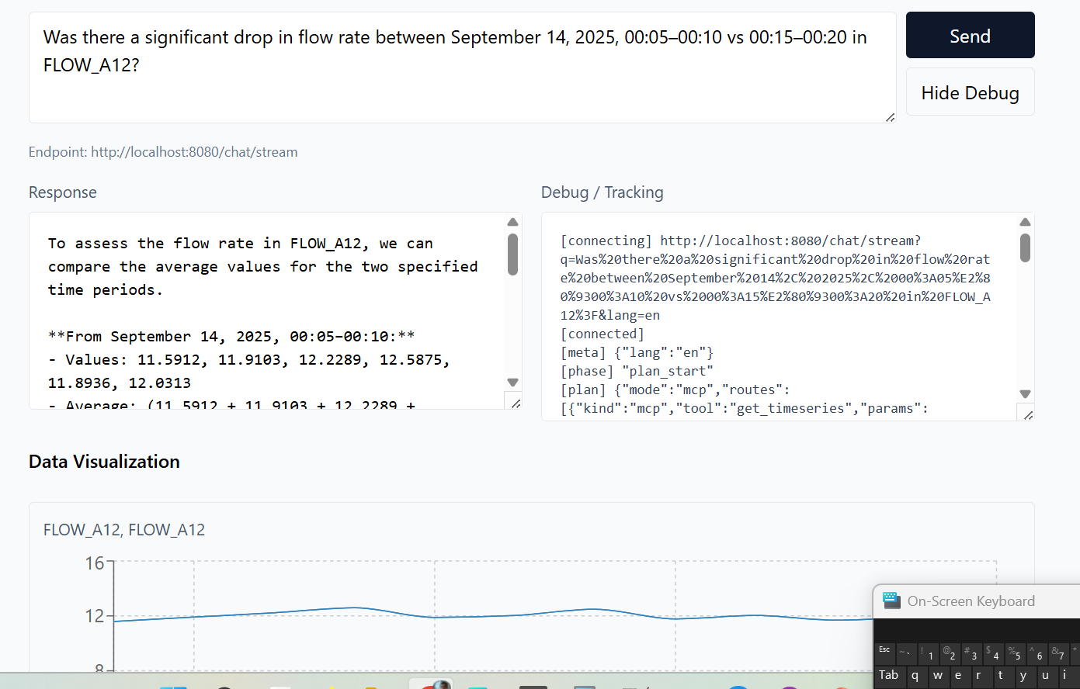
Example — Text + Visualization
https://github.com/kukuhtw/mcp_rag_go

Slide 7
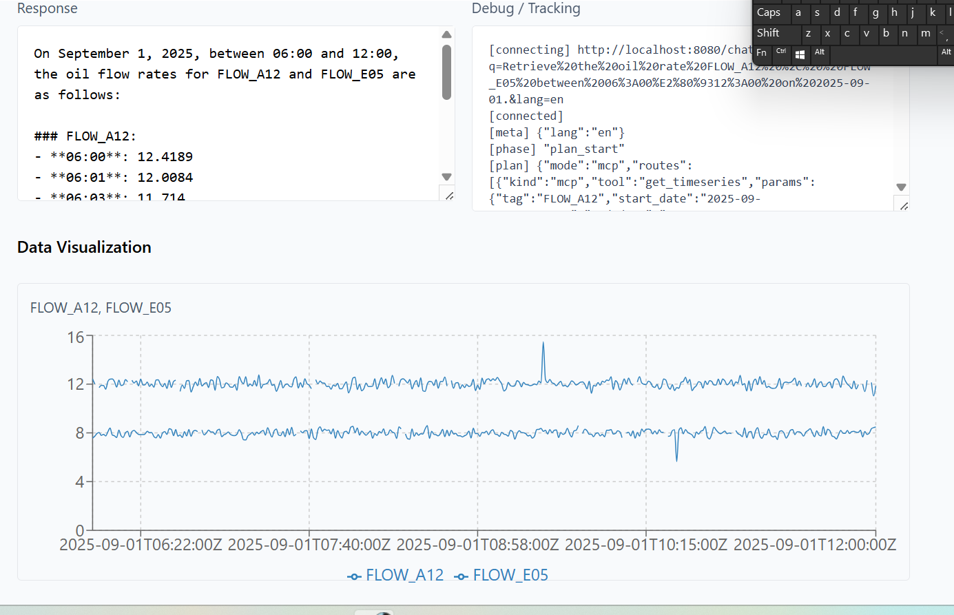
Example — Text + Visualization
https://github.com/kukuhtw/mcp_rag_go

Slide 8
Architecture & Data Flow
Frontend: React + Tailwind, renders text + visualizations.
Backend: Go API, SSE streaming, MCP router.
MCP Router & Tools: connect to drilling, PO, HSSE, production, timeseries.
RAG Layer: BM25 + embeddings search, document chunks.
Visualization Engine: generates charts embedded in answers.
Flow: Query → Route → Retrieve → Visualize → Streamed Answer.
https://github.com/kukuhtw/mcp_rag_go

Slide 9
Benefits
Speed: Seconds instead of hours for cross-domain answers.
Accuracy: Retrieval + citations ensure trustworthy outputs.
Clarity: Visualizations reveal patterns instantly.
Scalability: Easily add new data domains and visualization types.
Decision Support: Combine text + charts for faster decisions.
https://github.com/kukuhtw/mcp_rag_go

Slide 10
Technical Stack
Backend: Go (Golang).
Frontend: React + Tailwind.
Database: MySQL (domain + doc_chunks).
RAG: BM25 + vector similarity.
Visualization: Chart.js / D3.js.
Streaming: SSE phases (plan, data, visualization, answer).
https://github.com/kukuhtw/mcp_rag_go

Slide 11
Summary
Problem: fragmented data slows down insights.
Solution: MCP-RAG Go unifies access with MCP routing + RAG retrieval.
Innovation: Answers enhanced with data visualizations.
Impact: Faster, clearer, and more reliable decisions in oil & gas operations.
https://github.com/kukuhtw/mcp_rag_go

