Slide 1

Readable and Reusable Code Hints
By Giedrius Tumelis
Software Engineer
www.inkodus.lt

Slide 2

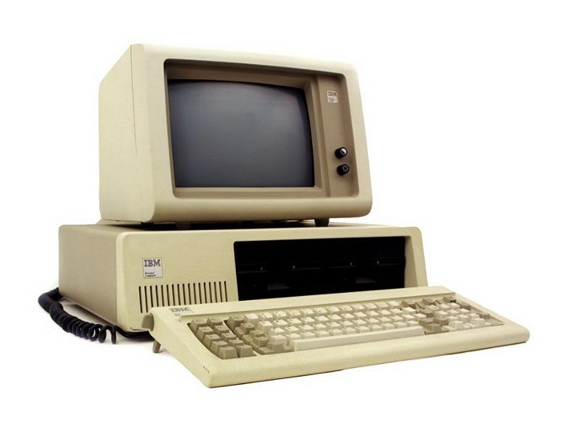
Human and computer comparison
Human Advantages
Creativity
Non standard situation handling
Moral and strategic decisions
Computer Advantages
Faster
Prone to boring and repeating tasks
Prone to accidental mistakes

Slide 3
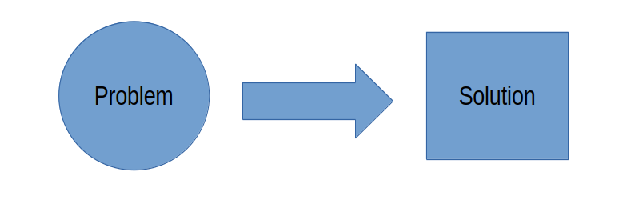
Problem and solution
Developing is not about writing a code, but about solving problems.

Slide 4
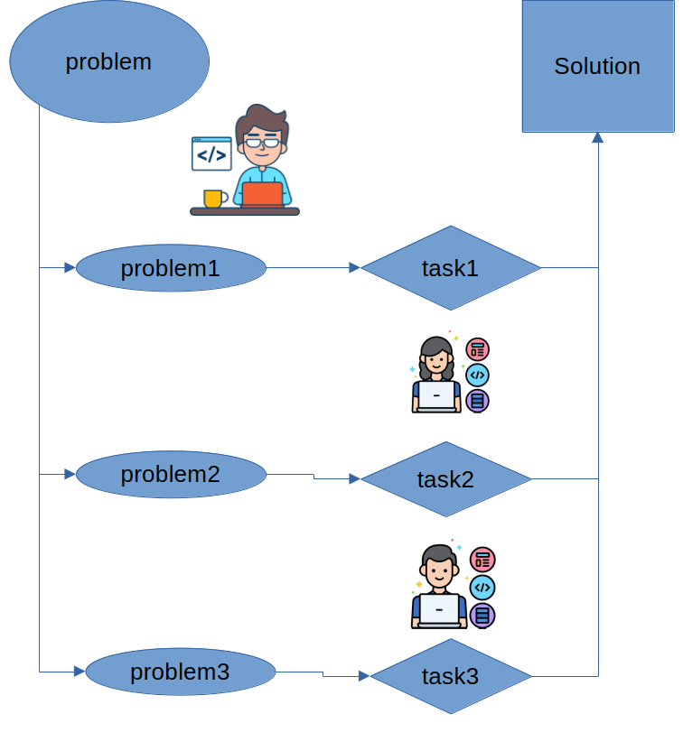
Problem break down
Problem solution consists of
Breaking problem to smaller parts
Formulating tasks
Assignments of tasks to team members.

Slide 5
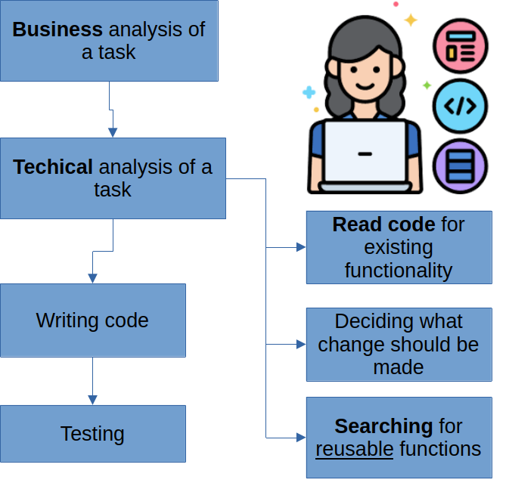
Task development process
Business analysis
Technical analysis
  Read code for existing functionality
  Deciding what change to be made
  Searching for reusable functions
Writing code
Testing

Slide 6
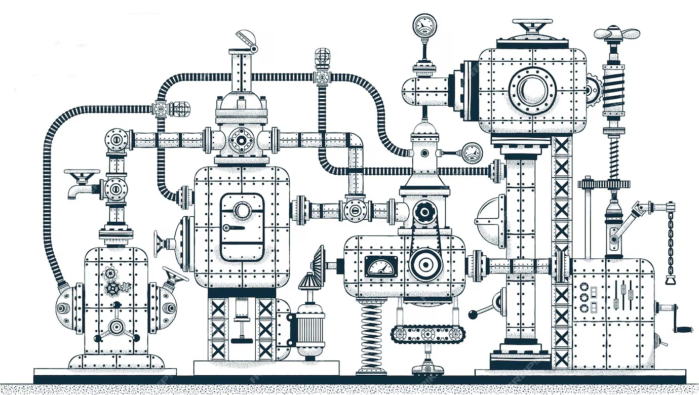
It system quality
Functional quality
Code style quality

Slide 7
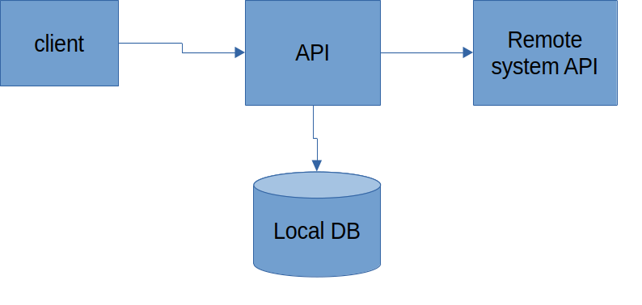
Example task
Create API endpoint for searching products with amounts in remote system, with a price from local database having applied VAT.
Take products data from remote system using search parameter
Load corresponding products in local system
Merge remote and local products data
Apply VAT

Slide 8
imperfect implementation
class CalculatorService
{
…
...
/**
* @return Product[]
*/
public function getProducts(string $requestData) : array {
$products = $this->apiService->getProducts($requestData);
foreach ($products as $product) {
$product->price = $product->price * ( 1 + $this->vatPercent);
}
return $products;
}
}
class Controller
{
…
...
/**
* @return Product[]
*/
public function getProducts(RequestInterface $request) : array {
$params = $request->getBody();
return $this->calculator->getProducts($params);
}
}

Slide 9
imperfect implementation (2)
class APIService
{
...
public function getApiData(string $filter) : array
{
$response = $this->client->request('GET', 'api_endpoint/products', [
'query' => ['filter'=>$filter]
]);
$json = $response->getBody()->getContents();
return json_decode($json, true);
}
...
…
...
/**
* @return Product[]
*/
public function getProducts(string $filter) : array {
$data = $this->getApiData($filter);
// ---------------------------------------------------------------------------
$skus = [];
foreach ($data as $product) {
$skus[] = $product['sku'];
}
$products = $this->dbService->getProducts($skus);
// ----------------------------------------------------------------------------
/** @var Product[] $productsMap */
$productsMap = [];
foreach ($products as $product) {
$productsMap[$product->sku] = $product;
}
foreach ($data as $apiProduct) {
$productsMap[$apiProduct['sku']]->quantity = $apiProduct['amount'];
}
return $products;
}
}

Slide 10
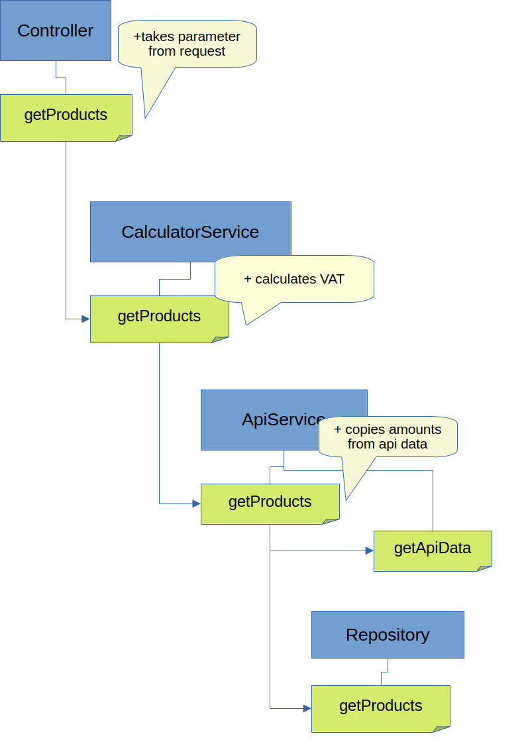
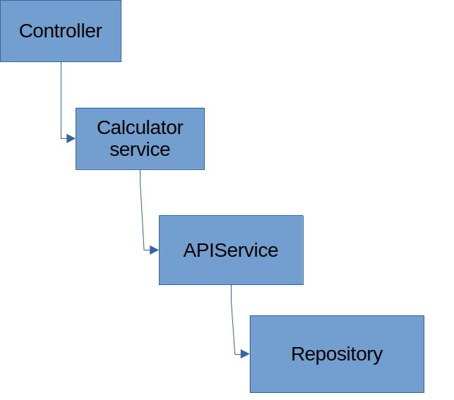
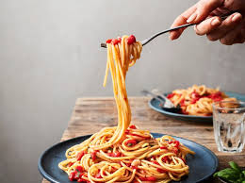
Imperfect implementation
architecture

Slide 11
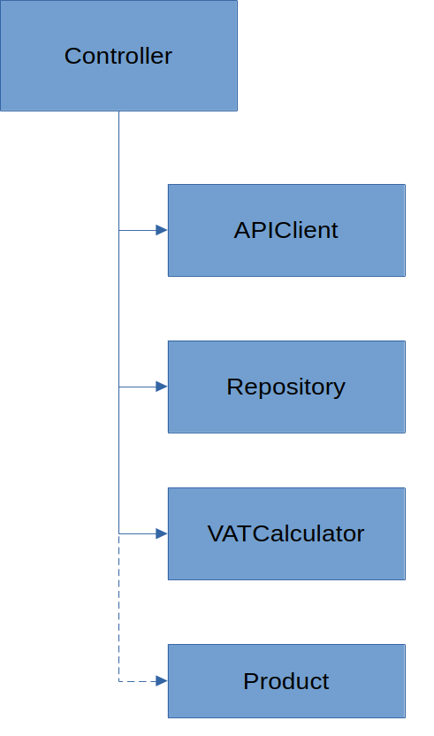
Better implementation example
class Controller
{
private ApiClient $apiClient;
private Repository $repository;
private VATCalculator $vatCalculator;
public function __construct(ApiClient $apiClient, Repository $repository, VATCalculator $vatCalculator)
{
$this->apiClient = $apiClient;
$this->repository = $repository;
$this->vatCalculator = $vatCalculator;
}
…
}

Slide 12
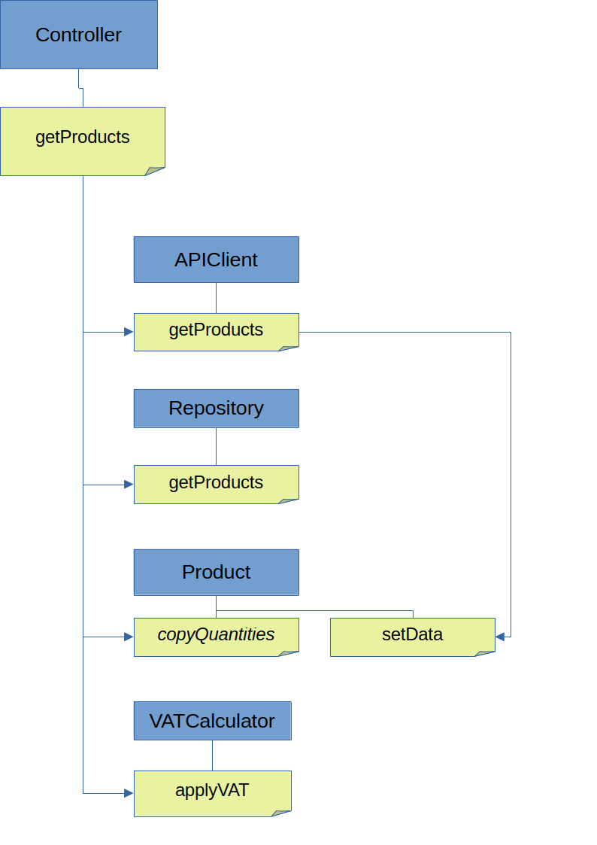
Better implementation call hierarchy
class Controller
{
….
/**
* @return Product[]
*/
public function getProducts(RequestInterface $request) : array {
$params = $request->getBody();
$products = $this->apiClient->getProducts($params);
$skus = [];
foreach ($products as $product) {
$skus[] = $product->sku;
}
$dbProducts = $this->repository->getProducts($skus);
Product::copyQuantities($dbProducts, $products);
$this->vatCalculator->applyVat($dbProducts);
return $dbProducts;
}
}

Slide 13
Explicit and implicit execution
Explicit
Dirrect calls
Pass data through function parameters
Lambda expressions
Implicit
Polymorphism
Events
Reflection
Abstraction contexts

Slide 14


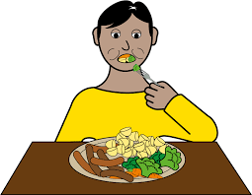
Lambda expressions
Filter
  Separate wrong data
  Search what we need
Map
  Extract properties
  Build new objects
Reduce
  Min
  Max
  Sum
  Count

Slide 15
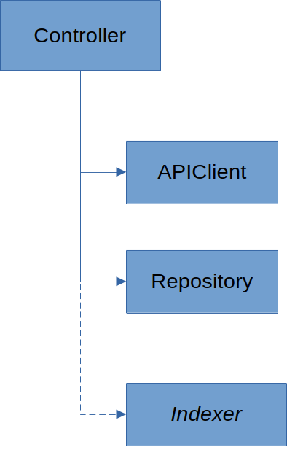
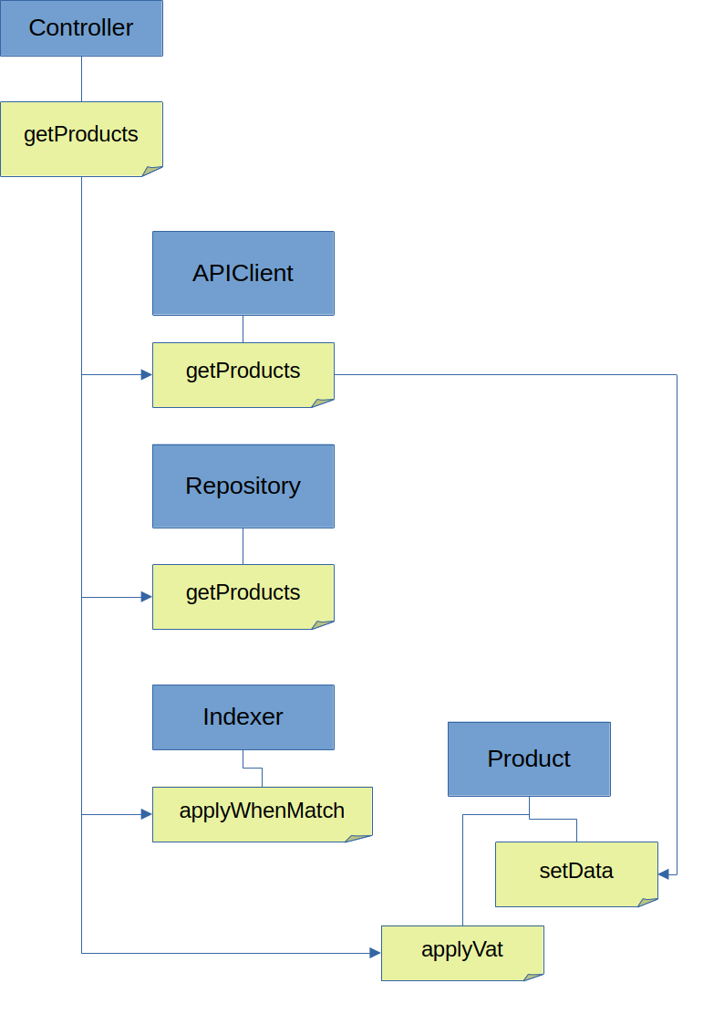
Even better example
class Controller
{
…
...
public function getProducts(RequestInterface $request): array
{
$params = $request->getBody();
$apiProducts = $this->apiClient->getProducts($params);
$skus = array_map(fn($product) => $product->sku, $apiProducts);
$dbProducts = $this->repository->getProducts($skus);
Indexer::applyWhenMatch(
$dbProducts,
$apiProducts,
fn($product) => $product->getSku(),
fn($product) => $product->getSku(),
fn(Product $dbProduct, Product $apiProduct) => $dbProduct->setQuantity($apiProduct->quantity));
return array_map(fn($product) => $product->applyVat($this->vat), $dbProducts);
}

Slide 16
Example sources
https://github.com/kukulis/readable-example

Slide 17
Conclusions
Code quality improves IT system functionality quality on big projects
and on a long run projects
Code quality is better when components are more reusable
Code quality is better when you may read code and compare the task requirement
by doing that.
Correct abstraction context hides less important aspects of the code and displays
essential functionality aspects.
Deeper call hierarchies makes code less readable.
Lambda expressions shortens verbosity of the code and standartizes code interpretation.

Slide 18

Thank You!
Let’s stay in touch on LinkedIn
www.inkodus.lt

