Slide 1
Flix Premiere
Web App Product Development Architecture
Prepared by Alexander Adu-Sarkodie
Flix Premiere Confidential

Slide 2
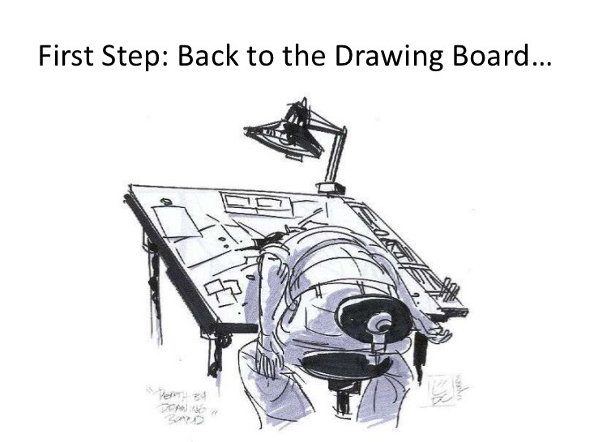

Slide 3
Platform Architecture
User data
Web App UI / API
Personalization
iPhone
X-BOX
PS(n)
ROKU
iPad
WII
Google TV
AppleTV
TIVO
Wearables
Public
YouView
DRM
Streaming API
QoS Logging
Consumer electronics
CDN management
AWS cloud services
CDN boxes
CDN edge servers
Content encoding
Flix Premiere Confidential

Slide 4
Product Roadmap Pipeline
MVP
Private Beta
Public Beta
Launch
Flix Premiere Confidential

Slide 5
MVP – Phase 1
Web App UI
Streaming API
AWS / CDN Hosting
User Personalization
Payment Gateway
Social Network Integration
Transcoding/Codec, Bitrate + HTML5 Player Distribution Standards
Stable REST API (Mean Web Stack)
Google Analytics
Flix Premiere Confidential

Slide 6
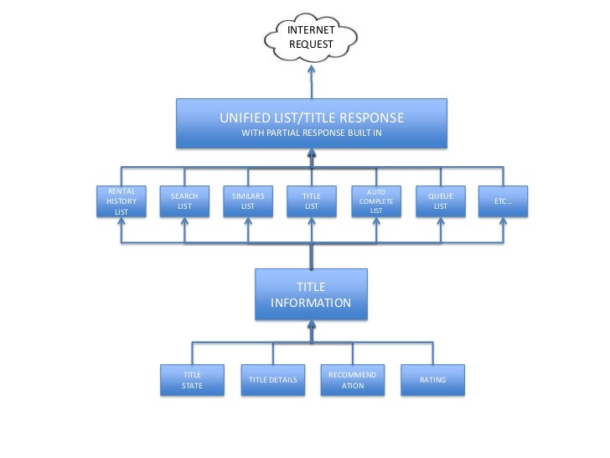

Slide 7
Streaming / Download Cost Benefit Analysis
Service | Cost | Benefits | Issues
Streaming ( as in rental service like Netflix ) | Low price for consumers, revenue share for Digital Rights | Single Copy ,Satisfactory content producers | Network latency , Scalability issues
Download ( as in buy like iTunes ) | Content rights, Pricey model for users | Content ownership, offline non linear experience on multiple devices | DRM / Digital Locker to restrict to specific number of devices and people.
Flix Premiere Confidential

Slide 8
AWS hosting - Estimated Cost
Size | Cost | Storage | Transfers | Requests
Low | $0.15 | 10 GB | 1 GB | 5,300
Medium | $2.87 | 100 GB | 10 GB | 53,000
High | $39.63 | 1 TB | 100 GB | 5,030,000
Flix Premiere Confidential

Slide 9
DRM
Digital rights management (DRM) is a term for access control technologies that are used by hardware manufacturers, publishers, copyright holders and individuals to limit the use of digital content.
The term is used to describe any technology that inhibits the use of digital content that is not desired or intended by the content provider. Note, the term does not generally refer to other forms of copy protection, which can be circumvented without modifying the file or device, such as serial numbers or keyfiles.
Flix Premiere Confidential

Slide 10
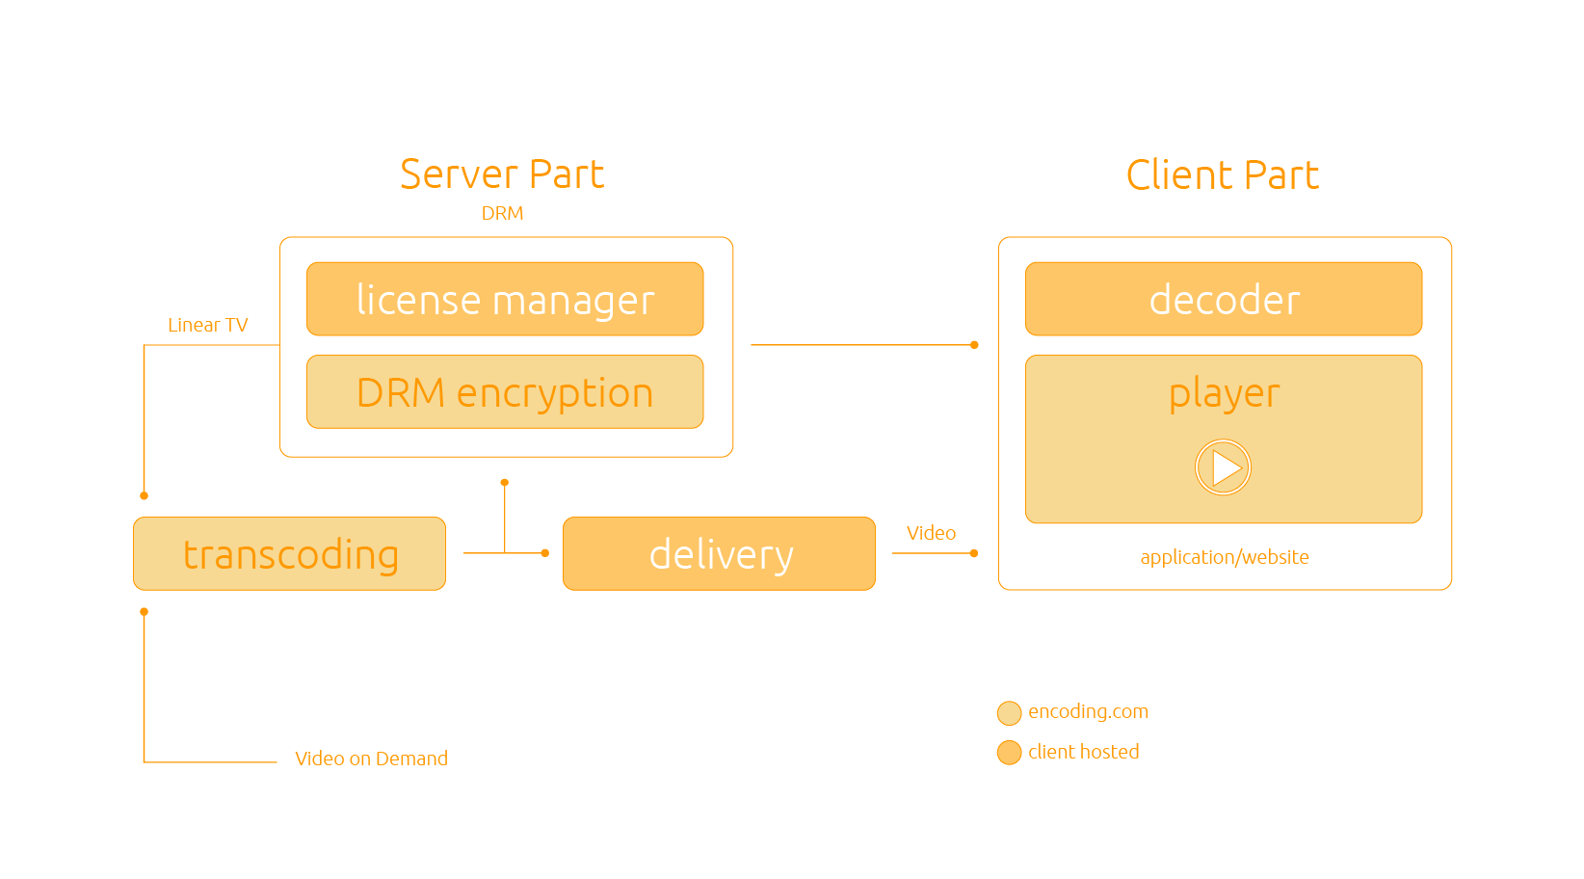
Flix Premiere Confidential

Slide 11
The popularity of peer-to-peer file sharing tools have also created copyright challenges for content creators. It has made unauthorized distribution of copyrighted digital media (also called digital piracy) much easier.
DRM technologies enable content publishers to enforce their own access policies on content, like restrictions on copying or viewing.
Flix Premiere Confidential

Slide 12
DRM Methods
Restrictive Licensing Agreements: The access to digital materials, copyright and public domain is controlled. Some restrictive licenses are imposed on consumers as a condition of entering a website or when downloading software.
Encryption, scrambling of source material, and embedding of a tag: This technology is designed to control access and reproduction of online information. This includes prohibiting creating of backup copies for personal use.
Flix Premiere Confidential

Slide 13
Leading DRM Platforms
As with many platform technologies, DRM is quite fragmented in the desktop, OTT (In broadcasting, over-the-top content [OTT] refers to delivery of audio, video, and other media over the Internet without the involvement of a multiple-system operator in the control or distribution of the content) and mobile space. Keeping up with new devices, new platforms and new circumvention methods, as well as varying end-user technologies, provides a challenge for content creators. The rapid spread of the new HTML5 video format is also complicating a single reliable DRM system to meet the copyright holder requirements.
While it would be ideal to have a unified DRM technology that can cover the widest range of use cases, there is not one universal platform for all devices and not one common standard. However, the most widely used content protection tools in the online video space are the following:
Flix Premiere Confidential

Slide 14
Google Widevine: Widevine DRM is a recently acquired by Google developer of content protection solutions. Its popularity is due to the support of a broad range of consumer devices (TVs, game consoles, Android, iOS devices).
Microsoft PlayReady: Microsoft PlayReady is a successor of Windows Media DRM, one of the first content protection schemes. It is installed on most of Connected TV devices (LG, Samsung, etc.) Windows operating systems, Windows mobile and Xbox.
Adobe Primetime: Due to its popularity (most videos on the Web are formatted as Adobe Flash), this is a good solution to protect content in Web browsers and on PCs.
Apple FairPlay: This DRM solution is designed to encrypt content packaged using HLS and is intended for use with all iOS devices, Apple TV, QuickTime and for content stored locally on Apple Music.
Flix Premiere Confidential

Slide 15
Encrypted Media Extensions
This API based encryption scheme is not tied to any specific vendor or DRM scheme, and has become an emerging means of encrypting HTML5 video, including adaptive bitrate video within HTML5.
Flix Premiere Confidential

Slide 16
Adaptive bitrate streaming
ABS is a method of video streaming over HTTP where the source content is encoded at multiple bit rates, then each of the different bit rate streams are segmented into small multi-second parts.
The streaming client is made aware of the available streams at differing bit rates, and segments of the streams by a manifest file.
When starting, the client requests the segments from the lowest bit rate stream. If the client finds the download speed is greater than the bit rate of the segment downloaded, then it will request the next higher bit rate segments. Later, if the client finds the download speed for a segment is lower than the bit rate for the segment, and therefore the network throughput has deteriorated, then it will request a lower bit rate segment. The segment size can vary depending on the particular implementation, but they are typically between two 2 and ten 10 seconds.
Flix Premiere Confidential

Slide 17
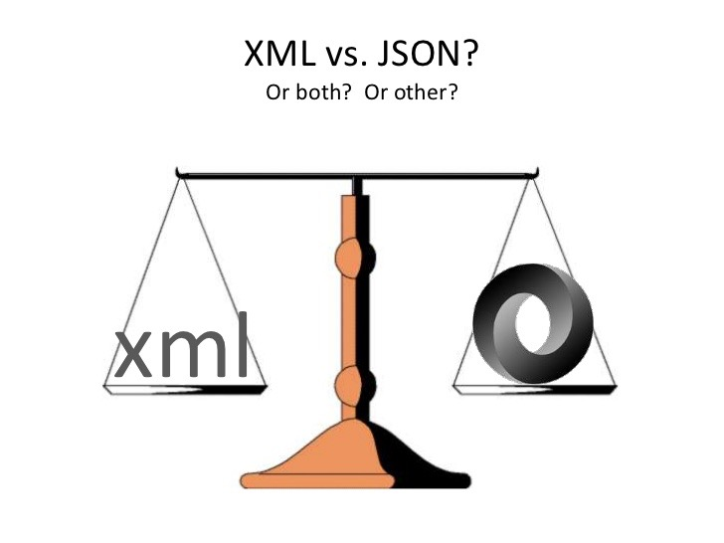

Slide 18


Slide 19
Prepared by
alex@flixpremiere.com
Flix Premiere Confidential

