Slide 1
SPRING SECURITY

Slide 2
Spring Security
Highly customizable authentication and access-control framework.
Focuses on providing both authentication and authorization
“Authentication”
  The process of establishing a user, device or some other system which can perform an action in the application
“Authorization”
  The process of deciding whether a principal is allowed to perform an action within the application.
  authorization is done after authentication process.
  Once the user is authenticated they may have one or more “roles”

Slide 3
@EnableWebSecurity
Should be always added to the application .
Can also be used to disable the default security configuration.
  Allows to customize by adding external properties
  A Bean of type WebSecurityConfigurerAdapter is created
  Spring finds bean with @Configuration and automatically apply Security

Slide 4
Spring Security Modules
  <dependency>
    <groupId>org.springframework.boot</groupId>
    <artifactId>spring-boot-starter-security</artifactId>
  </dependency>
  <dependency>
    <groupId>org.springframework.security</groupId>
    <artifactId>spring-security-test</artifactId>
    <scope>test</scope>
  </dependency>

Slide 5
Disabling the Auto-Configuration
Can discard the security auto-configuration and add custom Configuration
  @SpringBootApplication(exclude = { SecurityAutoConfiguration.class })
  public class SpringBootSecurityApplication {
  public static void main(String[] args) {
  SpringApplication.run(SpringBootSecurityApplication.class, args);
  }
  }

Slide 6
WebSecurityConfigurerAdapter
A base class for creating a WebSecurityConfigurer instance.
Can do customization by overriding methods
configure(HttpSecurity)
  Defines the mapping of secured URLs or path that will determine if the user can access specific pages.
configure(AuthenticationManagerBuilder).
  Defines how the security will handle the retrieval of user information commonly in the database.

Slide 7
HTTP Security
authorizeRequests()
  Provided by HttpSecurity
  To Define custom requirements for URLs
  Can add multiple children to this method.
  The matchers are considered in the order they were declared.
  http.authorizeRequests()
  .anyRequest().authenticated()
  .and().httpBasic();

Slide 8
AuthenticationManagerBuilder
AuthenticationManagerBuilder
  Used to create an Authentication Manager
Authentication Manager
  Used to authenticate the passed Authentication object,
  Allows building in memory authentication
  Can also use LDAP authentication
  Can also use JDBC based authentication,

Slide 9
Form Login
  @Configuration
  public class SecurityConfig extends WebSecurityConfigurerAdapter {
  @Override
  protected void configure(HttpSecurity http) throws Exception {
  http.authorizeRequests().antMatchers("/first").authenticated().and().formLogin();
  }
  @Override
  protected void configure(AuthenticationManagerBuilder auth) throws Exception {
  auth.inMemoryAuthentication().withUser("ramesh").password("{noop}ramesh").roles("USER");
  }

Slide 10
Controller
  @RestController
  public class ProjectController {
  @GetMapping("/first")
  public String getSecuredMessage(Principal user) {
  return "Welcome to Secured Page"+user.getName();
  }
  @GetMapping("/second")
  public String getUnSecuredMessage() {
  return "Welcome to UN-Secured Page";
  }
  }

Slide 11
CSRF
  Its a web security vulnerability that allows an attacker to induce users to perform actions that they do not intend to perform.
  It allows an attacker to partly circumvent the same origin policy, which is designed to prevent different websites from interfering with each other.
Should be used for protecting any request that could be processed by a browser by normal users.
If a service is used by non-browser clients, CSRF protection can be disabled

Slide 12
Sample Security Config
  http.authorizeRequests()
  .antMatchers("/","/*.html","/h2/**")
  .permitAll().
  antMatchers("/first")
  .authenticated().and()
  .httpBasic().and()
  .csrf().
  disable();

Slide 13
Sample Security Configurations
  http.authorizeRequests()
  .antMatchers("/","/*.html","/h2/**")
  .permitAll().
  antMatchers("/first")
  .authenticated().and()
  .formLogin().and().logout().logoutSuccessUrl("/first")
  .invalidateHttpSession(true)
  .deleteCookies("JSESSIONID").and().csrf().
  disable();

Slide 14
Method Level Security
Spring Security supports authorization semantics at the method level.
Service layer can be secured by which roles are able to execute a particular method – and test it using dedicated method-level security test support.

Slide 15
Method Level Security
  @Configuration
  @EnableGlobalMethodSecurity( securedEnabled = true,)
  public class SecurityConfig extends WebSecurityConfigurerAdapter {
  protected void configure(HttpSecurity http) throws Exception {
  // required configurations
  }
  protected void configure(AuthenticationManagerBuilder auth) throws Exception {
  // required configurations
  }
  }

Slide 16
@Secured
Used to specify a list of roles on a method.
  User with only role can access that method
  @GetMapping(“/srch")
  @Secured("ROLE_ADMIN")
  public String message() {
  return "Hello, World!";
  }
  }

Slide 17
Example
  @RestController
  @RequestMapping("book")
  public class BookController {
  @GetMapping("anonymous")
  @Secured("ROLE_ANONYMOUS")
  public String anonymously() { return "Hello, World!"; }

Slide 18
Method Security
@RolesAllowed
  is a standard annotation
  @Secured
  is spring security only.
  @PermitAll
  public String anonymously() {
  return "Hello, World!"; }
  @RolesAllowed({"ROLE_ADMIN"})
  public String hasRole() {
  return "Hello, World!";
  }

Slide 19
Using Rest Template-With Security
  @Bean
  public RestTemplate template() {
  RestTemplate template = new RestTemplate();
  template.getInterceptors().add(interceptor());
  return template;
  }
  @Bean
  public BasicAuthenticationInterceptor interceptor() {
  return new BasicAuthenticationInterceptor("india", "india");
  }

Slide 20
Using Rest Template-With Security
  @Bean
  public HttpHeaders headers() {
  HttpHeaders headers = new HttpHeaders();
  headers.setAccept(Arrays.asList(MediaType.APPLICATION_JSON));
  return headers;
  }
  @Bean
  public HttpEntity entity() {
  HttpEntity <String> entity = new HttpEntity<String>(headers());
  return entity;
  }

Slide 21
Using Rest Template-With Security
  @Bean
  public MedicalServiceClient client() {
  return new MedicalServiceClient();
  }
  @Bean
  public Medicine medicine() {
  return new Medicine(899L,"Glycomet",45.00,35);
  }
  }

Slide 22
Using Rest Template-With Security
  public class MedicalServiceClient {
  @Autowired
  private RestTemplate template;
  @Autowired
  private HttpEntity entity;
  @Autowired
  private Medicine medicine;
  private final String url = "http://localhost:8080/medicines";

Slide 23
Using Rest Template-With Security
  public String useGetAll() {
  return this.template.exchange(url,HttpMethod.GET,entity,String.class).getBody();
  }
  public Medicine usePostMethod() {
  return this.template.postForEntity(url,medicine,Medicine.class).getBody();
  }

Slide 24
SECURITY USING JDBC

Slide 25
Security Configuration
Spring security Default Configuration expects following two tables
Users
  Used for Storing username, passwords
Authorities
  Used for storing the associated roles.
data.sql and schema.sql are added in the resources folder

Slide 26
Sql Files
Can two files namely data.sql and schema.sql in your src/main/resources folder
These files will be automatically executed on startup.
schema.sql
  Can be rdbms specific file -schema-h2.sql , schema-mysql
  It will create schema:
data.sql
  Can be used to initialize new data.

Slide 27
data.sql
  insert into users (username, password,enabled) values ('india','$2a$10$P.9MaemE6x38wnZer4qauO8Dl9pixQEZ27.yEQglTtyjdmJBRtTFS',true);
  insert into authorities (username, authority) values ('india', 'ROLE_USER');
  insert into test.users (username, password, enabled) values ('nepal','$2a10$t4kkrerTgJlcvTj7QresWuBqAsnxVxMxaJ6UzlXCaP/HSdDraO5QC',true);
  insert into authorities (username, authority) values ('nepal', 'ROLE_ADMIN');

Slide 28
schema.sql
  CREATE TABLE `test`.`users` ( `username` varchar(50) NOT NULL, `password` varchar(200) NOT NULL, `enabled` tinyint(1) NOT NULL, PRIMARY KEY (`username`))
  CREATE TABLE `test`.`authorities` ( `username` varchar(50) NOT NULL, `authority` varchar(50) NOT NULL, KEY `fk_authorities_users` (`username`), CONSTRAINT `fk_authorities_users` FOREIGN KEY (`username`) REFERENCES `users` (`username`))

Slide 29
Application.properties
  spring.datasource.url=jdbc:mysql://localhost:3306/test
  spring.datasource.username=root
  spring.datasource.password=srivatsan
  spring.datasource.driver-class-name=com.mysql.cj.jdbc.Driver
  spring.jpa.hibernate.ddl-auto=update
  spring.jpa.hibernate.naming.physical-strategy
  =org.hibernate.boot.model.naming.PhysicalNamingStrategyStandardImpl

Slide 30
Pass Word Encoder
  public static void main(String[] args) {
  BCryptPasswordEncoder encoder = new BCryptPasswordEncoder();
  String encoded = encoder.encode("india");
  System.out.println(encoded);
  encoded = encoder.encode("nepal");
  System.out.println(encoded);
  }

Slide 31
Rest Controller
  @RestController
  public class ProjectController {
  @GetMapping("/first")
  @Secured(value="ROLE_USER")
  public String getSecuredMessage(Principal user) {
  return "Welcome to Secured Page"+user.getName();
  }
  }
  }

Slide 32
Security Config
  @Configuration
  @EnableGlobalMethodSecurity( securedEnabled = true)
  public class SecurityConfig extends WebSecurityConfigurerAdapter {
  @Autowired
  private DataSource customDataSource;
  @Override
  protected void configure(AuthenticationManagerBuilder auth) throws Exception {
  auth.jdbcAuthentication().passwordEncoder(new BCryptPasswordEncoder()).dataSource(this.customDataSource);
  }
  @Bean
  public JdbcUserDetailsManager jdbcUserDetailsManager() {
  return new JdbcUserDetailsManager(dataSource);
  }
  }

Slide 33
JDBC Custom Security Configuration
  @Override
  protected void configure(AuthenticationManagerBuilder auth) throws Exception {
  String query1 = "select userName,password,enabled from users where userName = ?";
  String query2 = "select userName,authority from authorities where userName=?";
  auth.jdbcAuthentication()
  .dataSource(this.customDataSource)
  .authoritiesByUsernameQuery(query1)
  .authoritiesByUsernameQuery(query2)
  .passwordEncoder(new BCryptPasswordEncoder());
  }

Slide 34
SECURITY OAUTH2

Slide 35
OAuth
OAuth is a secure authorization protocol
  Provides authorization flows for web and desktop applications, and mobile devices.
  Used for authorization of third party application to access the user data without exposing their password.

Slide 36
OAuth2 Roles
Client
  A Third-Party Application
  The application that is attempting to get access to the user's account.
  It needs to get permission from the user before it can do so.
Resource Server
  A Application Programming Interface
  Server is the API server used to access the user's information.

Slide 37
OAuth2 Roles
The Authorization Server
  The server that presents the interface where the user approves or denies the request.
  May be the same server as the API server, but often built as a separate component.
The User
  Is the Resource Owner
  Person who is giving access to some portion of their account.

Slide 38
OAuth2 Grant Types
Authorization Code
  used with server-side Applications
Used by confidential and public clients to exchange an authorization code for an access token.
  After the user returns to the client via the redirect URL
  The application will get the authorization code from the URL
  Will use it to request an access token.

Slide 39
OAuth2 Grant Types
Client Credentials
  used with Applications API access
Used by clients to obtain an access token outside of the context of a user.
Used by clients to access resources about themselves rather than to access a user's resources.

Slide 40
OAuth2 Grant Types
Refresh Token
  Used by clients to exchange a refresh token for an access token when the access token has expired.
  Allows clients to continue to have a valid access token without further interaction with the user.

Slide 41
Password
Resource Owner Password Credentials
  used with trusted Applications, such as those owned by the service itself
  Used to exchange a user's credentials for an access token.
  The client application has to collect the user's password and send it to the authorization server
  user’s password is used for as long as it takes to get the access token
    Once the token is received it can store and use the access token instead.

Slide 42
Password Grant
Simplest OAuth grants
The application presents a traditional username and password login form to collect the user’s credentials
Uses that data and makes a POST request to the server and gets an access token.
The Post request has following parameters
  Grant-type
  userName
  Password
  Client Id
  Client Secret
  Scope

Slide 43
Password Grant Request Parameters
grant_type=password
  To denote the usage of Password grant type
Username
  The user’s username that they entered in the application
Password
  The user’s password that they entered in the application
client_id
  Public identifier of the application that the developer obtained during registration
client_secret (optional)
  If the application is a “confidential client” (not a mobile or JavaScript app), then the secret is included as well.
scope (optional)
  If the application is requesting a token with limited scope

Slide 44
Access
Access token in the same format for all grant types.
  {
  "access_token": "MTQ0NjOkZmQ5OTM5NDE9ZTZjNGZmZjI3",
  "token_type": "bearer",
  "expires_in": 3600,
  "scope": "create"
  }

Slide 45
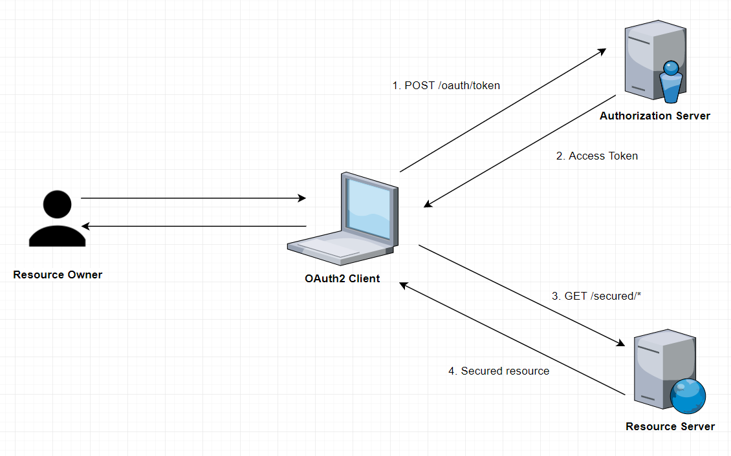
How it Works

Slide 46
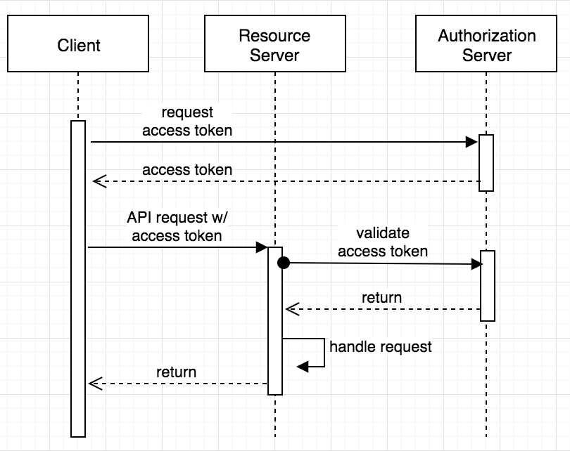
Sequence Diagram

Slide 47
Resource
  @RestController
  @RequestMapping("/api/customers")
  public class CustomerController {
  @Autowired
  private Customer customer;
  @GetMapping(“/{userId}")
  public Customer getCustomerProfile(@PathVariable("userId") String userId) {
  return getCustomer(userId);
  }
  }

Slide 48
Resource Server - Secured
  @Configuration
  @EnableResourceServer
  public class OAuth2ResourceServerConfig extends ResourceServerConfigurerAdapter {
  @Override
  public void configure(HttpSecurity http) throws Exception {
  http.anonymous().disable()
  .requestMatchers().antMatchers("/api/customers/**")
  .and().authorizeRequests()
  .antMatchers("/api/customers/**").access("hasRole('ADMIN')");
  }
  }

Slide 49
Spring Oauth API
  @EnableResourceServer
  Convenient annotation for OAuth2 Resource Servers
  Enabling a Spring Security filter
ResourceServerConfigurerAdapter
  Acts as an Interface for @EnableResourceServer classes.
  Implemented to configure :
    Access rules
    Paths that are protected by OAuth2 security.

Slide 50
WebSecurityConfigurerAdapter
  @Configuration
  @EnableWebSecurity
  public class OauthSecurityConfiguration extends WebSecurityConfigurerAdapter {
  @Autowired
  public void globalUserDetails(AuthenticationManagerBuilder auth) throws Exception {
  auth.inMemoryAuthentication()
  .withUser("india").password("{noop}india").roles("ADMIN").and()
  .withUser("nepal").password("{noop}nepal").roles("USER");
  }

Slide 51
WebSecurityConfigurerAdapter
  @Override
  protected void configure(HttpSecurity http) throws Exception {
  http
  .csrf().disable()
  .anonymous().disable()
  .authorizeRequests()
  .antMatchers("/oauth/token").permitAll();
  }
  @Override
  @Bean
  public AuthenticationManager authenticationManagerBean() throws Exception {
  return super.authenticationManagerBean();
  }

Slide 52
WebSecurityConfigurerAdapter
  @Bean
  public TokenStore tokenStore() {
  return new InMemoryTokenStore();
  }
  }

Slide 53
Spring Oauth API
@EnableAuthorizationServer
  Used for enabling an Authorization Server
/oauth/authorize
  The user is responsible for securing the Authorization Endpoint
  Spring Security features are used for this
/oauth/token
  The Token Endpoint will be automatically secured using HTTP Basic authentication on the client's credentials.
  Clients must be registered by providing a
  AuthorizationServerConfigurers.

Slide 54
Spring Oauth API
AuthorizationServerConfigurerAdapter
  Adapter class for AuthorizationServerEndpointsConfigurer
  Configure the properties and enhanced functionality of the Authorization Server endpoints
  Its implemented by Class
TokenStore
  Persistence interface for OAuth2 tokens.
  Implementation of token services that stores tokens in memory.
AuthenticationManagerBean
  Exposed as a bean
  To be used with AuthenticationManagerBuilder

Slide 55
Authorization Server
  @Configuration
  @EnableAuthorizationServer
  public class OAuth2AuthServerConfiguration extends
  AuthorizationServerConfigurerAdapter {
  @Autowired
  private TokenStore tokenStore;
  @Autowired
  private AuthenticationManager authenticationManager;

Slide 56
Authorization Server
  @Override
  public void configure(ClientDetailsServiceConfigurer clients) throws Exception {
  clients.inMemory()
  .withClient("my-trusted-client")
  .authorizedGrantTypes("password", "authorization_code", "refresh_token", "implicit")
  .scopes("read", "write", "trust")
  .secret("{noop}secret")
  .accessTokenValiditySeconds(3000).
  refreshTokenValiditySeconds(6000);
  }

Slide 57
Authorization Server
  @Override
  public void configure(AuthorizationServerEndpointsConfigurer endpoints) throws Exception {
  endpoints.tokenStore(tokenStore).authenticationManager(authenticationManager);
  }
  }

Slide 58
Testing with Postman
Make a post call to the url http://localhost:4040/oauth/token
Select Authorization , and basic authentication
  Add the UserName : my-trusted-client ( Refer Slide No :57)
  Add the password : secret ( Refer Slide No :57)
Select Body form-url-endcoded and key and values , the following keys with respective values
  grant_type : password
  Username : india
  Password : india
  Will get the JWT Token

Slide 59
Testing with Postman
  Access resource using uri
    Select params tab and add access_token as a parameter
  http://localhost:4040/api/customers/customer/1?access_token=37ec591b-bae9-46ac-8e5a-573e82cb0630

Slide 60
Maven Dependency
<dependency>
<groupId>org.springframework.cloud</groupId>
<artifactId>spring-cloud-starter-oauth2</artifactId> </dependency>

Slide 61
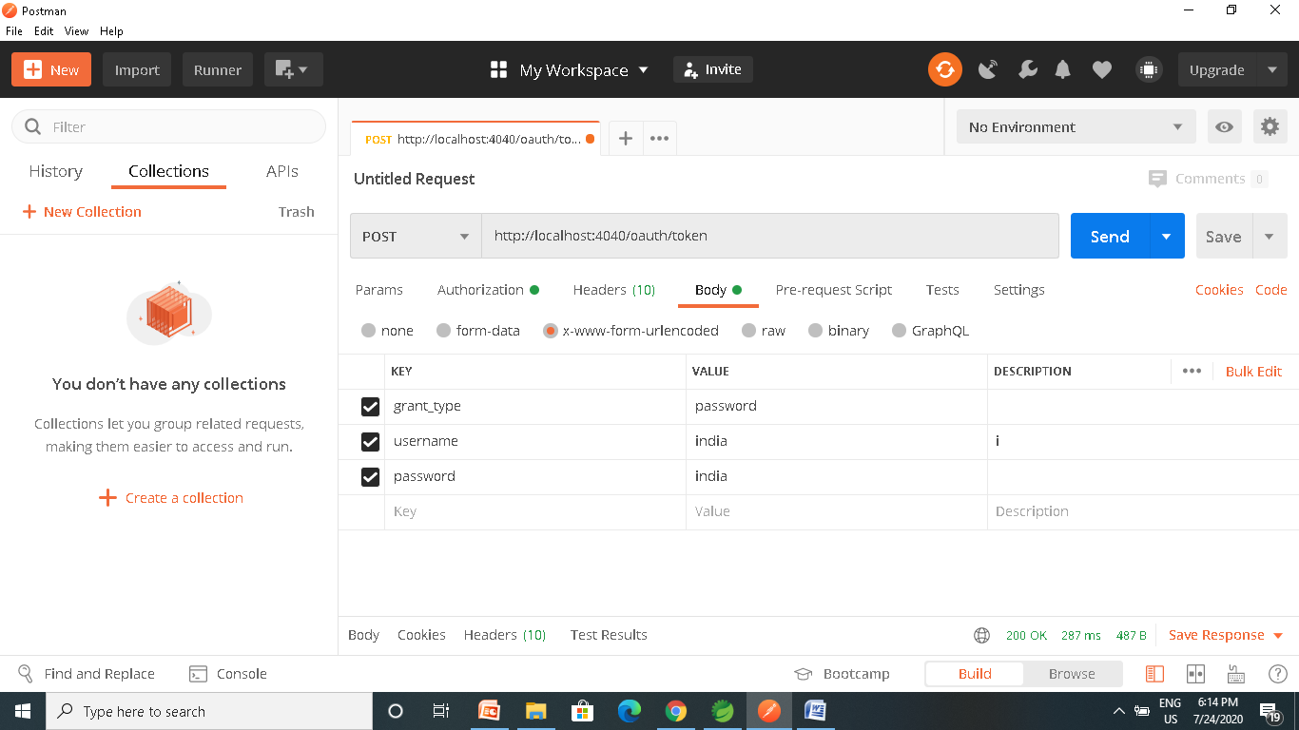
Testing with Postman

Slide 62
Testing with Postman

Slide 63
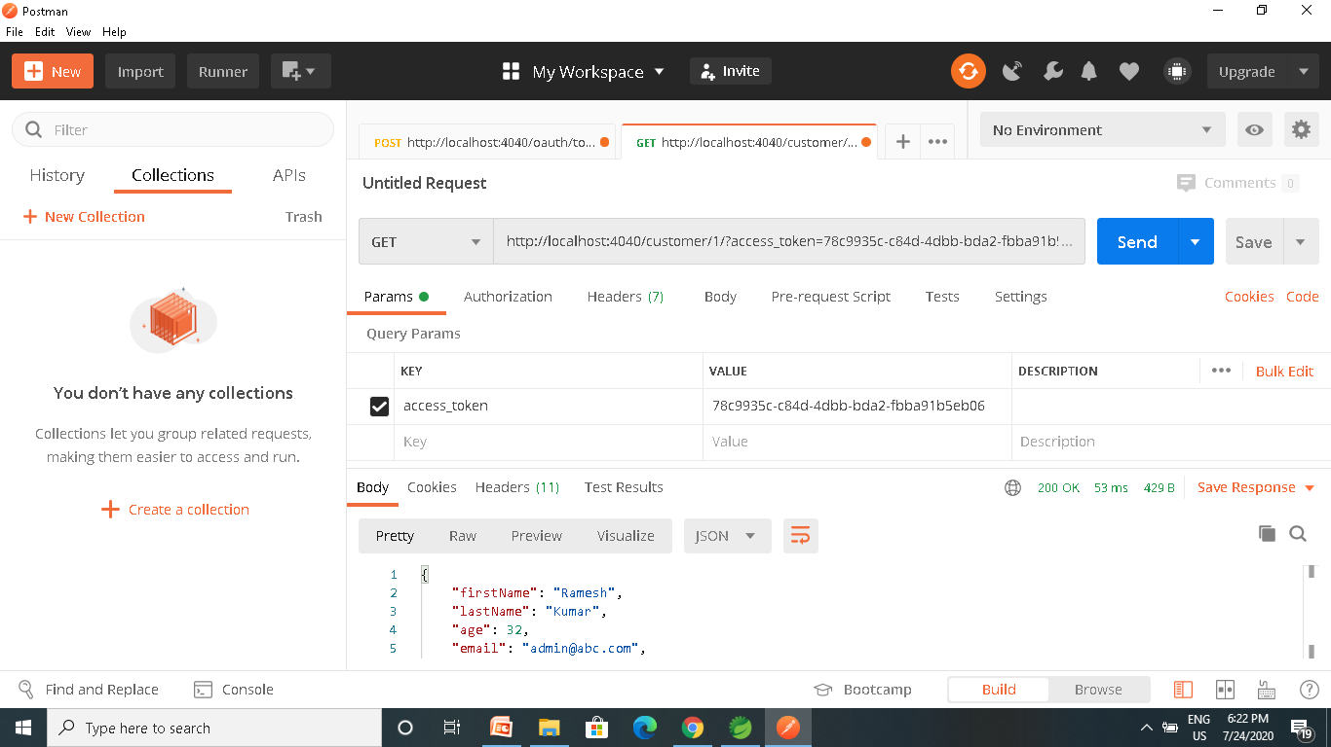

Slide 64
Zuul Route Configuration
  zuul:
  host:
  socket-timeout-millis: 2000000
  add-host-header: true
  add-proxy-headers: true
  ribbon:
  eager-load:
  enabled: true

Slide 65
To add a prefix to all mappings, set zuul.prefix to a value, such as /api. By default, the proxy prefix is stripped from the request before the request is forwarded by (you can switch this behavior off with zuul.stripPrefix=false). You can also switch off the stripping of the service-specific prefix from individual routes, as shown in the following example:
application.yml.
zuul: routes: users: path: /myusers/** stripPrefix: false
zuul.stripPrefix only applies to the prefix set in zuul.prefix. It does not have any effect on prefixes defined within a given route’s path.
In the preceding example, requests to /myusers/101 are forwarded to /myusers/101 on the users service.

Slide 66
Zuul Route Configurations
  api:
  path: /api/**
  service-id: resource
  sensitiveHeaders:
  strip-prefix: false
  url: http://localhost:5050/

Slide 67
Sensitive Headers
A blacklist, and the default is not empty.
To Make Zuul send all headers it should be set to the empty list.
  Can pass cookie or authorization headers to back end.

Slide 68
SPRING ACTUATOR

Slide 69
Spring Boot Actuator
Exposes REST endpoints that can be consumed to manage and monitor application.
Monitor application health, application bean details, version details, thread dumps, logger details etc
Can restrict these endpoints to be consumed by authorized users only and Spring provides easy way to secure your REST endpoints.

Slide 70
actuator End Point
actuator
  It provides a hypermedia-based discovery page for the other endpoints.
  It is required to have Spring HATEOS on the classpath to enable it.
  By default it is sensitive and hence requires username/password for access or may be disabled if web security is not enabled.
Beans
  It displays complete beans configured in the app.
Configprops
  It displays a collated list of all @ConfigurationProperties.

Slide 71
actuator End Point
Health
    It shows application health information
  management.endpoint.health.show-details:=always
Info
  It displays arbitrary application info.
Loggers
  It shows and modifies the configuration of loggers in the application.
metrics:
  It shows metrics information for the current application.
Mappings
  It displays a collated list of all @RequestMapping paths.

Slide 72
Actuator Endpoints
health and info can be accessed
  Other endpoints are disabled by default
management.endpoints.web.exposure.include=*.
  Will enable all of them
  Can also list endpoints which should be enabled
To expose all enabled endpoints except one (for example /loggers), we use:
  management.endpoints.web.exposure.include=*
  management.endpoints.web.exposure.exclude=loggers
  management.security.enabled=false

Slide 73
Securing Actuator Endpoint
  @Bean
  public SecurityWebFilterChain securityWebFilterChain(
  ServerHttpSecurity http) {
  return http.authorizeExchange()
  .pathMatchers("/actuator/**").permitAll()
  .anyExchange().authenticated()
  .and().httpBasic().build();
  }

Slide 74
SPRING SLEUTH

Slide 75
Sleuth
Capable of enhancing logs
Spring Cloud Sleuth uses Brave as the tracing library
  Adds unique ids to each web request that enters the application.
  Has added support for sharing these ids across thread boundaries.
  Provides trace and span ids
    Can be used to pinpoint exactly when and where application processes a request.
    Making reading logs much easier.
Added through spring boot starter project.
Zipkin Cient Module is also added

Slide 76
Trace and Span
Trace
  A single request or job that is triggered in an application.
  All the various steps in that request, even across application and thread boundaries, will have the same traceId.
Spans
  As sections of a job or request.
  A single trace can be composed of multiple spans each correlating to a specific step or section of the request.

Slide 77
Log Format
This data follows the format
[application name, traceId, spanId, export]
Application name
  Name as set in the properties file
  Used to aggregate logs from multiple instances of the same application.
TraceId
  This is an id that is assigned to a single request, job, or action.
  Each unique user initiated web request will have its own traceId.

Slide 78
Log Format
SpanId
  Tracks a unit of work.
  A request may consists of multiple steps.
  Each step could have its own spanId and be tracked individually.
  By default, any application flow will start with same TraceId and SpanId.
Export
  A boolean property
  To indicate whether or not this log was exported to an aggregator like Zipkin.

Slide 79
Installing Zipkin
Download the latest Zipkin server from maven repository
  https://zipkin.io/pages/quickstart
  Under Java choose latest release
Run the executable jar file using below command.
  java -jar zipkin-server-1.30.3-exec.jar
Zipkin server starts with default configuration.
After Startup , the Web UI is at http://localhost:9411/zipkin/.

Slide 80
Zipkin
Has Four modules
Collector
  Once any component sends the trace data arrives to Zipkin collector daemon
  , it is validated, stored, and indexed for lookups by the Zipkin collector.
Storage
  store and index the lookup data in backend. Cassandra, ElasticSearch and MySQL are supported.
Search
  This module provides a simple JSON API for finding and retrieving traces stored in backend. The primary consumer of this API is the Web UI.
Web UI
  – A very nice UI interface for viewing traces.

Slide 81
Tracer
  @Autowired
  private Tracer tracer;
  Span newSpan = tracer.nextSpan().name("newSpan").start();
  try (SpanInScope ws = tracer.withSpanInScope(newSpan.start())) {
  try {
  Thread.sleep(1000L);
  } catch (InterruptedException e) {
  e.printStackTrace();
  }
  } finally {
  newSpan.finish();
  }

Slide 82
ELK

Slide 83
Why Log Analysis
In cloud-based environment infrastructures, performance, and isolation is very important.
The performance of virtual machines in the cloud may vary based on the specific loads, environments, and number of active users in the system.
Reliability and node failure can become a significant issue.
Log management helps DevOps engineers, system admin to make better business decisions.
Log analysis via Elastic Stack or similar tools is important.

Slide 84
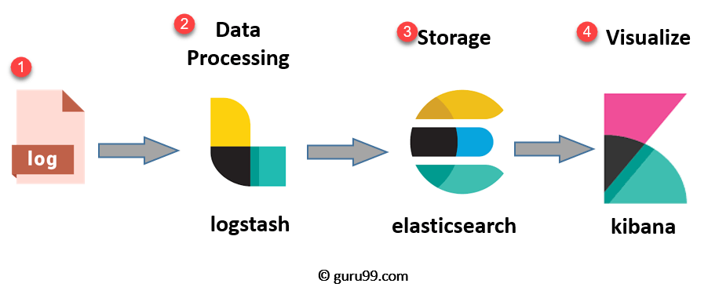
ELK Stack Architecture
Netflix, LinkedIn, Tripware, Medium all are using ELK stack for their business
Used when logs from various Apps of an enterprise converge into a single ELK instance

Slide 85
ELK
Logstash
  Collect logs and events data.
  Parses and transforms data
ElasticSearch
  The transformed data from Logstash is Stored, Search, and indexed.
Kibana
  Uses Elasticsearch DB to Explore, Visualize, and Share
Beats.
  Component for Data collection
This led Elastic to rename ELK as the Elastic Stack.

Slide 86
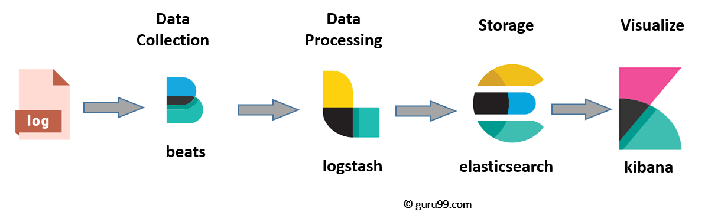
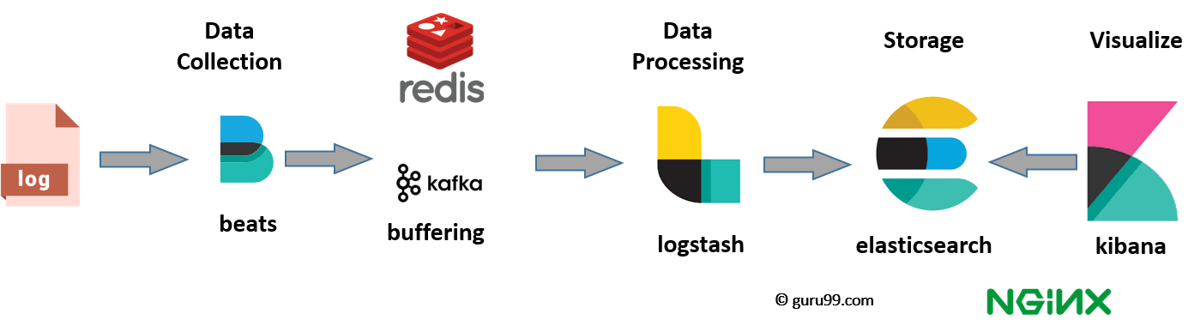
ELK stack el e

Slide 87
Elasticsearch
A NoSQL database.
Based on Lucene search engine
Has built in RESTful APIS.
Simple deployment, maximum reliability, and easy management.
Can do advanced queries and perform detail analysis
Stores all the data centrally.
It is helpful for executing a quick search of the documents.

Slide 88
Features of Elastic search:
Open source search server is written using Java
Used to index any kind of heterogeneous data
Full-Text Search
Sharded, replicated searchable, JSON document store
  Sharding is database partitioning
  Separates very large databases the into smaller, faster, more easily managed parts called data shards
Multi-language & Geolocation support

Slide 89
Elastic Search
A cluster is a collection of nodes which together holds data and provides joined indexing and search capabilities.
Node
  A node is an elasticsearch Instance.
  It is created when an elasticsearch instance begins.

Slide 90
Elastic Search
Index
  An index is a collection of documents which has similar characteristics.
  e.g., customer data, product catalog.
  It is very useful while performing indexing, search, update, and delete operations.
  It allows you to define as many indexes in one single cluster.

Slide 91
Elastic Search
Document
  It is the basic unit of information which can be indexed. It is expressed in JSON (key: value) pair. '{"user": "nullcon"}'. Every single Document is associated with a type and a unique id.
Shard
  Every index can be split into several shards to be able to distribute data.
  The shard is the atomic part of an index, which can be distributed over the cluster if you want to add more nodes.

Slide 92
LOGSTASH

Slide 93
Logstash
  Logstash is the data collection pipeline tool.
  Collects data inputs and feeds into the Elasticsearch.
  Gathers all types of data from the different source and makes it available for further use.
  Used unify data from disparate sources and normalize the data into your desired destinations.
  It allows to cleanse and democratize all your data for analytics and visualization of use cases.

Slide 94
Components of Logstash
Input:
  passing logs to process them into machine understandable format
Filters
  It is a set of conditions to perform a particular action or event
Output
  : Decision maker for processed event or log

Slide 95
Features of Logstash
Events are passed through each phase using internal queues
Allows different inputs for logs
Filtering/parsing for your logs
Advantage of Logstash
  Offers centralize the data processing
  It analyzes a large variety of structured/unstructured data and events
  Offers plugins to connect with various types of input sources and platforms

Slide 96
Kibana
Data visualization which completes the ELK stack.
Can perform advanced data analysis and visualize data in a variety of tables, charts, and maps with Elasticsearch documents
Has dashboard which
  interactive diagrams
  geospatial data
  graphs to visualize complex queries

Slide 97
Search Types
Free text searches
  It is used for searching a specific string
Field-level searches
  It is used for searching for a string within a specific field
Logical statements
  It is used to combine searches into a logical statement.
Proximity searches
  It is used for searching terms within specific character proximity.

Slide 98
Executing KLK Stack
Run the elasticsearch.bat using the command prompt.
  Elasticsearch can then be accessed at localhost:9200
Modify the kibana.yml to point to the elasticsearch instance.
Uncomment the kibana.yml
  elasticsearch.url: "http://localhost:9200"
Run the kibana.bat using the command prompt.
  kibana UI can then be accessed at localhost:5601

Slide 99
Executing KLK Stack
Run logstash using the command
  logstash -f .\..\config\logstash.conf
http://localhost:9200/_cat/indices
GET /_cat/indices/<index>
GET /_cat/indices

Slide 100
Configuring Logstash
Logstash Configuration file consists of three section: input, filter and output.
Each section contains plugins that do relevant part of the processing
  Should be saved into logstash.conf config file.
Once the config file is in place and Elasticsearch is running, can run Logstash

Slide 101
Logstash-conf file
  input {
  file {
  type => "java"
  path => "C:/elk/*.log"
  codec => multiline {
  pattern => "^%{YEAR}-%{MONTHNUM}-%{MONTHDAY} %{TIME}.*" negate => "true"
  what => "previous"
  }
  }
  }

Slide 102
Logstash-conf file
  output {
  stdout {
  codec => rubydebug
  }
  elasticsearch {
  hosts => ["localhost:9200"] } }
  Start logstash using the command prompt
  logstash -f logstash.conf

Slide 103
Spring Boot Actuator
Spring Boot Actuator has started using Micrometer as metrics facade.
Simplifies and standardizes application metrics
Can exporting metrics to Elasticsearch
  <dependency>
  <groupId>io.micrometer</groupId>
  <artifactId>micrometer-registry-elastic</artifactId>
  </dependency>
  management.metrics.export.elastic.host=
  http://<elastic-host>:<elastic-port>

