Slide 1
RPM Display For BLDC Motor With Speed Controller

Slide 2
PROBLEM STATEMENT
This project is used to control and measure the BLDC motor speed by using an IR speed sensor mechanism. There is a need for controlling a DC motor speed in industries that uses drilling, spinning, lathes, elevators etc. therefore this system provides an efficient mechanism for increasing or decreasing the speed.

Slide 3
PROPOSED SYSTEM
The project comprises of three phases. The first one is input phase where desired speed is entered using switches. The second phase i.e. processing enables a RPM reference of motor by interfacing IR sensor mounted on shaft and microcontroller of 8051 family in the circuit. Microcontroller generates PWM pulses according to the input or switches to regulate the supply of DC power to motor. And the last phase i.e. output uses an opto-isolator and a MOSFET for driving BLDC motor. The IR sensor measures the speed and sends it to microcontroller that displays it on LCD.

Slide 4






PROJECT DEVELOPMENT STAGES
Programming
Component Mapping & Soldering
PCB Printing & Connectivity Testing
Components Procurement
Circuit Design
Choosing Microcontroller

Slide 5
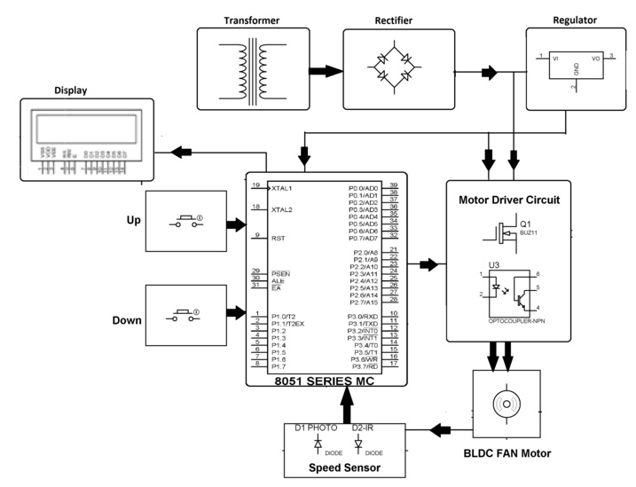
BLOCK DIAGRAM

Slide 6
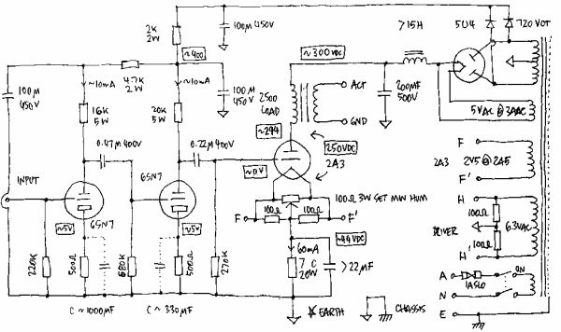
CIRCUIT DESIGN
A circuit is actually any loop through which matter is carried. For an electronic circuit, the matter carried is the charge by electronics and the source of these electrons is the positive terminal of the voltage source .When this charge flows from the positive terminal, through out the loop and reaches the negative terminal, the circuit is said to be completed. However this circuit consists of a number of components which affects the flow of charge in many ways. Some may provide hindrance to the flow of charge, some simple store or dissipate charge. Some require external source of energy, some supply energy.
Circuit Design Tools:
Eagle, Kicad, Proteus
Circuit Digest Capacitor Calculator
Nevon Express Resistor Color Code Calculator

Slide 7
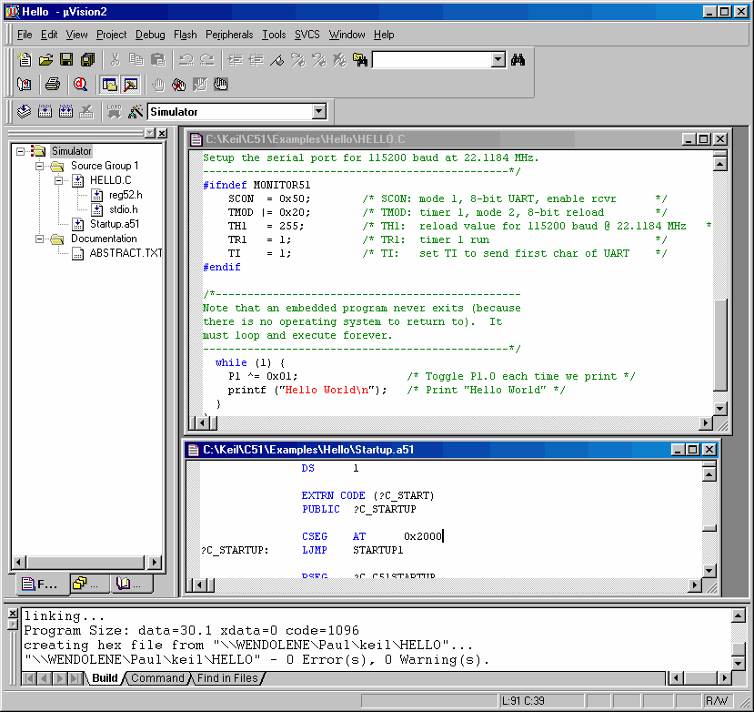
PROGRAMMING
Keil MicroVision software is an integrated development environment (IDE), which integrated a text editor to write programs, a compiler and it will convert your source code to hex files too. Keil development tools for the 8051 Microcontroller Architecture support every level of software developer from the professional applications engineer to the student just learning about embedded software development. The industry-standard Keil C Compilers, Macro Assemblers, Debuggers, Real-time Kernels, Single-board Computers, and Emulators support all 8051 derivatives and help you get your projects completed on schedule.

Slide 8


WHAT IS EMBEDDED C LANGUAGE ?
Embedded C is the most popular programming language in the software field for developing electronic gadgets. Each processor is associated with embedded software. Embedded C Programming plays a major role in performing specific functions by the processor. Embedded C Programming plays a major role in performing specific functions by the processor. In our day-to-day life, we frequently use many electronic devices such as washing machines, mobile phones, digital camera and so on will work based on microcontrollers that are programmed by embedded C.

Slide 9
HARDWARE & SOFTWARE REQUIREMENTS
Hardware 8051 Microcontroller IR Receiver Transmitter Motor Motor Driver Crystal Oscillator Resistors Capacitors Transistors Cables and Connectors PCB and Bread Board
Transformer/Adapter Diodes LED IC
Software Keil µVision IDE
Programming Language: C

Slide 10
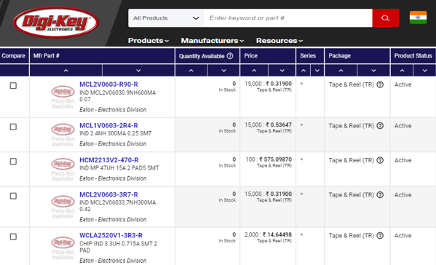
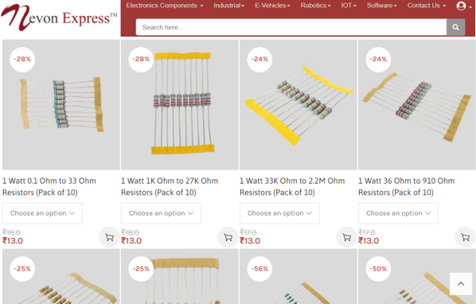
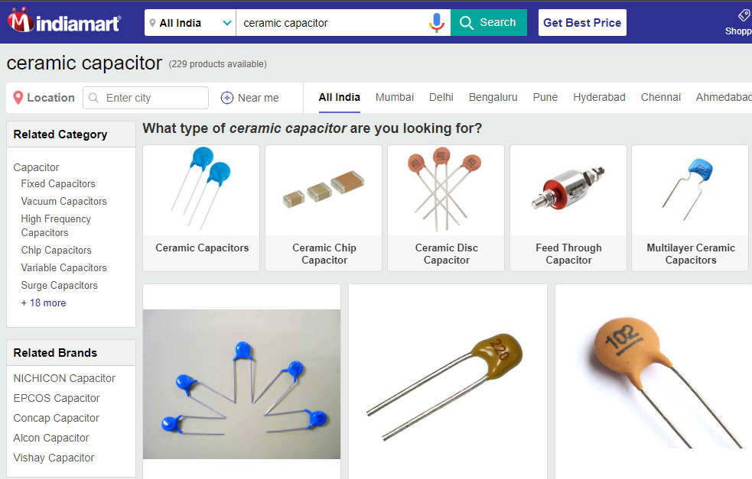
Basic Electronics Components
Basic Electronic Components are: resistor, capacitor, transistor, diode, operational amplifier, resistor array, logic gate etc. These are of 2 types: Passive and Active Components. Both these types of components can be either Through-Hole or SMD. One can buy these components easily online from websites like www.nevonexpress.in, www.digikey.in, www.indiamart.com,etc.

Slide 11
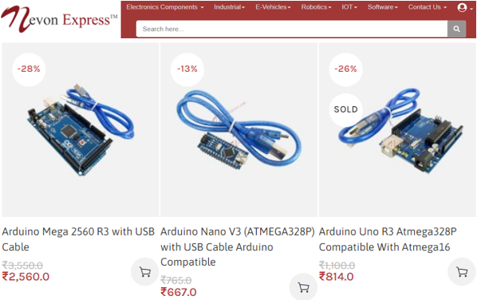
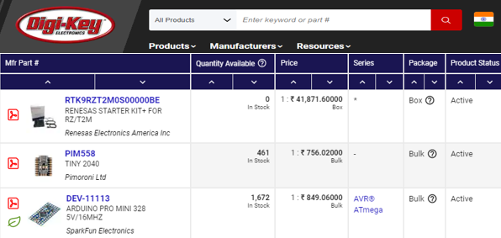
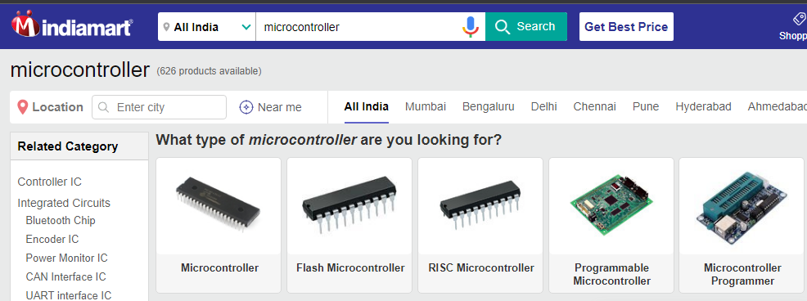
Microcontrollers & Development Boards
A microcontroller is a compact integrated circuit designed to govern a specific operation in an embedded system. A typical microcontroller includes a processor, memory and input/output (I/O) peripherals on a single chip. A development board is a printed circuit board with circuitry and hardware designed to facilitate experimentation with a certain microcontroller. Also there are certain hardware circuits that greatly aid testing and debugging such as pushbuttons and LEDs. One can buy these components easily online from websites like www.nevonexpress.in, www.digikey.in, www.indiamart.com,etc.

Slide 12
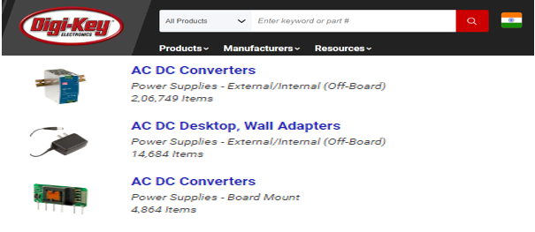
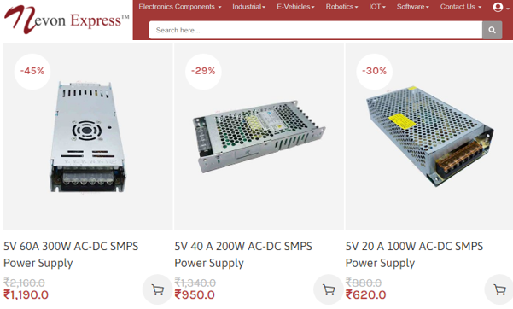
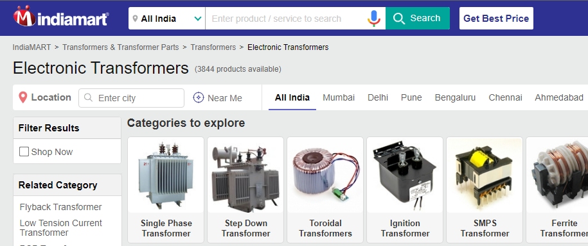
Transformers & Power Supply
A power supply is an electrical device that supplies electric power to an electrical load. The main purpose of a power supply is to convert electric current from a source to the correct voltage, current, and frequency to power the load. One can buy them easily online from websites like www.nevonexpress.in, www.digikey.in, www.indiamart.com,etc.

Slide 13
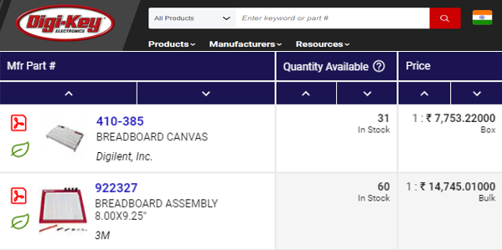
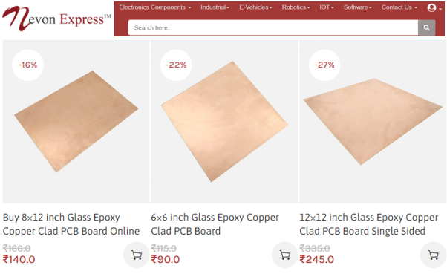
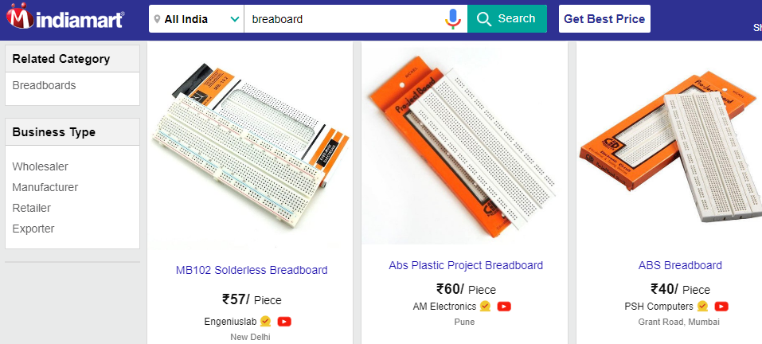
PCB & Breadboards
A printed circuit board (PCB) is a laminated sandwich structure of conductive and insulating layers. One can buy them easily online from websites like www.nevonexpress.in, www.digikey.in, www.indiamart.com,etc.

Slide 14
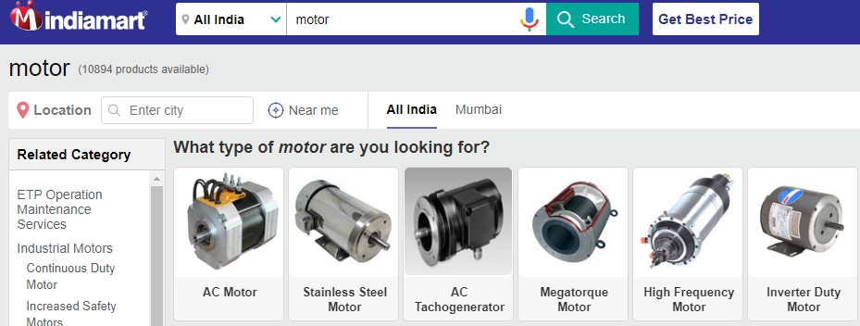
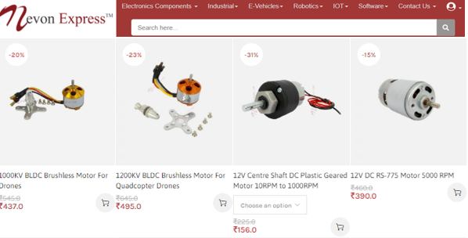
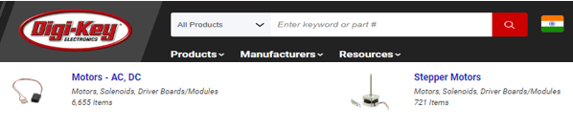
Motors
The word "motor" refers to any power unit that generates motion, that is a "prime mover", while "electric motor" refers to a "prime mover using electricity.“ An electric motor is a device used to convert electrical energy into mechanical energy. One can buy them easily online from websites like www.nevonexpress.in, www.digikey.in, www.indiamart.com,etc.

Slide 15
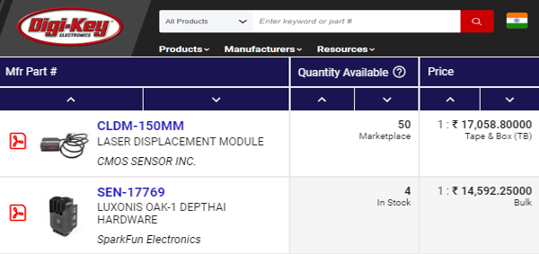
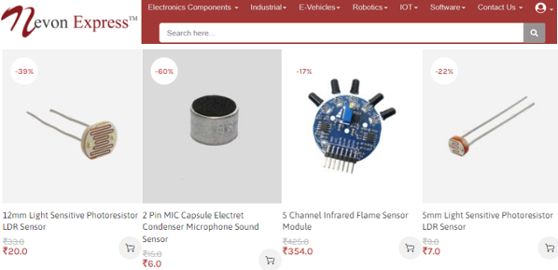
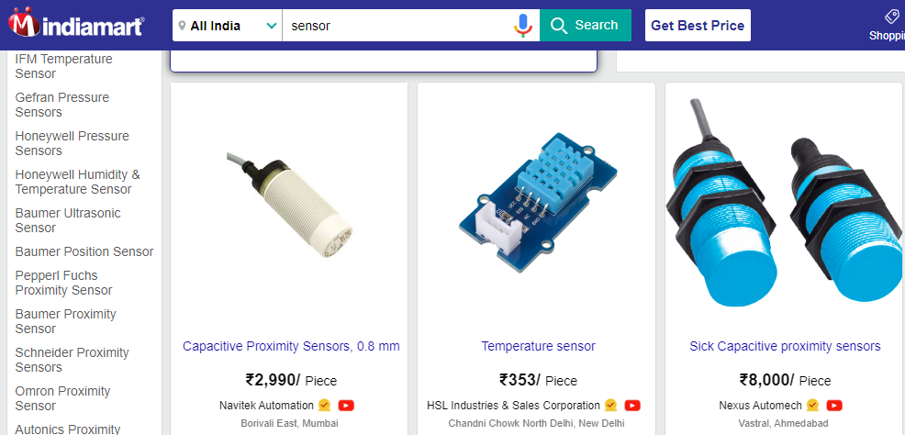
Sensors & Modules
Sensors and modules (having extra electronic circuitry along with sensor) are Electronic devices that detect and respond to some type of input from the physical environment. One can buy them easily online from websites like www.nevonexpress.in, www.digikey.in, www.indiamart.com,etc.

Slide 16
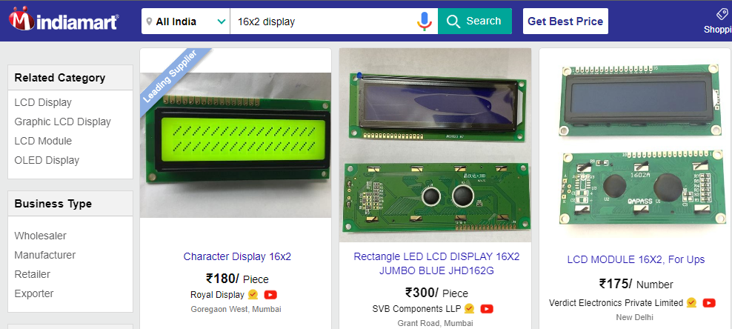
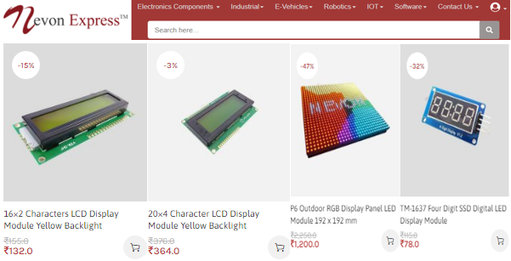
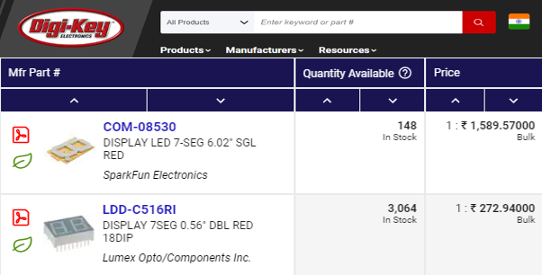
LED/LCD Displays
An LCD (Liquid Crystal Display) screen is an electronic display module and has a wide range of applications. A 16x2 LCD display is very basic module and is very commonly used in various devices and circuits. One can buy them easily online from websites like www.nevonexpress.in, www.digikey.in, www.indiamart.com,etc.

Slide 17
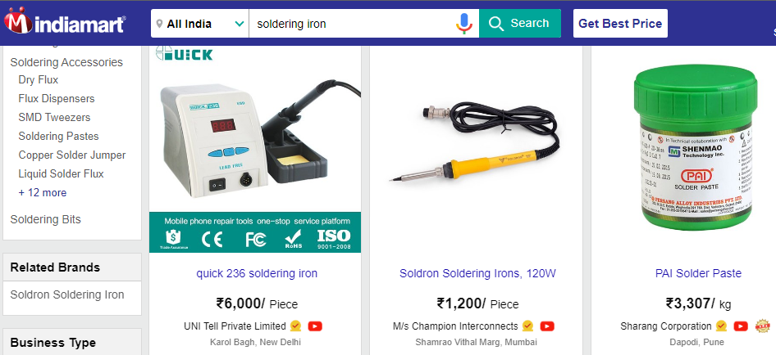
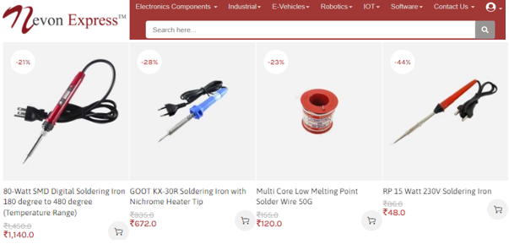
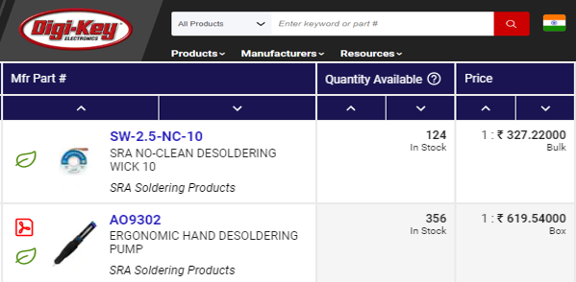
Soldering Iron & Accessories
Soldering is a process used for joining metal parts to form a mechanical or electrical bond. One can buy them easily online from websites like www.nevonexpress.in, www.digikey.in, www.indiamart.com,etc.

Slide 18
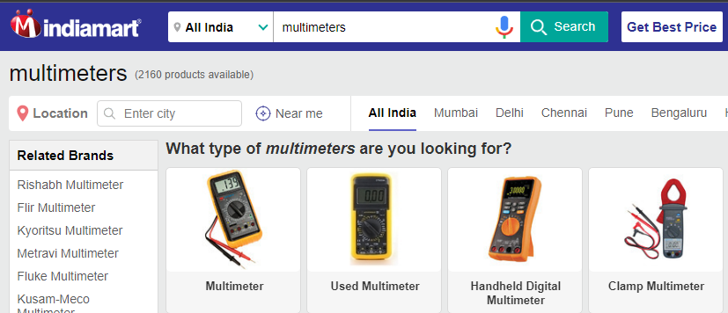
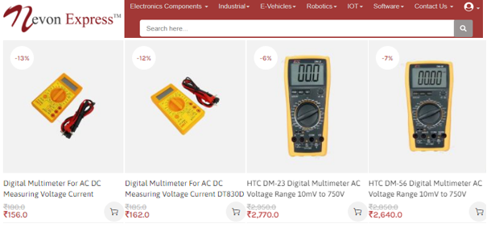
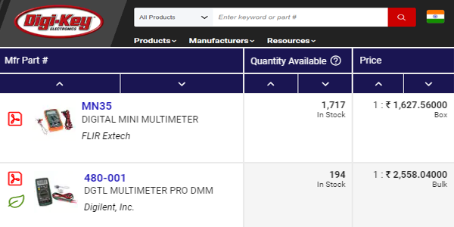
Testing & Troubleshooting Equipment
Multimeters are the most versatile of the electrical testers and, as the name implies, they are capable of many different testing functions. One can buy them easily online from websites like www.nevonexpress.in, www.digikey.in, www.indiamart.com,etc

Slide 19
CONCLUSION
Adopting this technology will be highly useful as this system is used to control and measure the BLDC motor speed by using an IR speed sensor mechanism.

Slide 20
REFERENCES
https://www.ieee.org/
https://en.wikipedia.org/
https://nevonexpress.in/
https://www.digikey.in/en

Slide 21
THANKYOU

