Slide 1
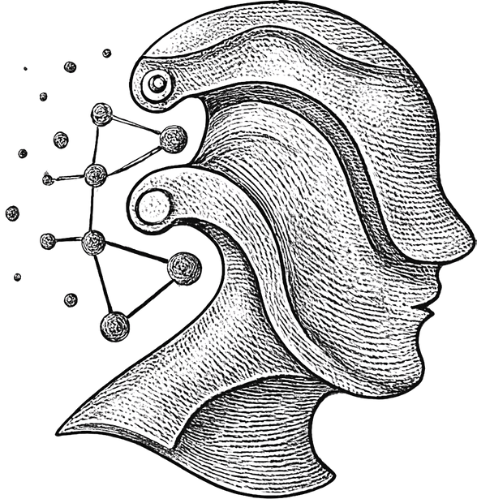
DeepFakeDetect
A Robust ResNet-50
System for Real-Time Fake Image Detection and Mobile APP Deployment
TEAM:
Kuladeep (23bds021)
Harshith (23bds058)
Sadan (23bds048)
Bharath (23bds012)
Guru Sai Harsha (23bds005)
Sudharshana (23bds059)

Slide 2
The Problem & Our Objective
The Threat:
The rapid progress of generative models (like GANs and diffusion) has made hyper-realistic forged images widely available.This threatens trust, privacy, and safety, making automatic detection critical for content moderation and forensics
The "In-the-Wild" Challenge:
Modern fakes minimize the low-level artifacts older detectors relied on.& Images "in the wild" suffer from compression, resizing, and noise from being processed by social media platforms.
Our Objective:
To build a practical, end-to-end system that is robust to these "in-the-wild" degradations.

Slide 3
The DeepFake-Detect Pipeline
Model:
A fine-tuned ResNet-50 backbone for powerful feature extraction.
Classifier:
A custom regularized classifier head to replace the original, reducing overfitting
Deployment (Backend):
A FastAPI inference service for high-speed, scalable deployment.
Deployment (Client):
A React Native mobile client for a practical, real-world interface.

Slide 4
Dataset & Preprocessing
Source:
Data Splits:
Kaggle Deepfake Image Detection dataset.
https://www.kaggle.com/datasets/saurabhbagchi/deepfake-image-detection/data
Training: 882 images
Validation: 47 images
Testing (Held-out): 49 images (27 fake, 22 real)
Preprocessing:
Augmentations for Robustness:
All images resized to 224 * 224 .
Normalized with ImageNet mean and standard deviation26.
Standard: RandomResizedCrop, RandomHorizontalFlip.
Real-World Simulation:
ColorJitter (brightness, contrast, saturation)
Gaussian Blur (to simulate focus/motion blur)
Random JPEG compression (to model social-media re-encoding)

Slide 5
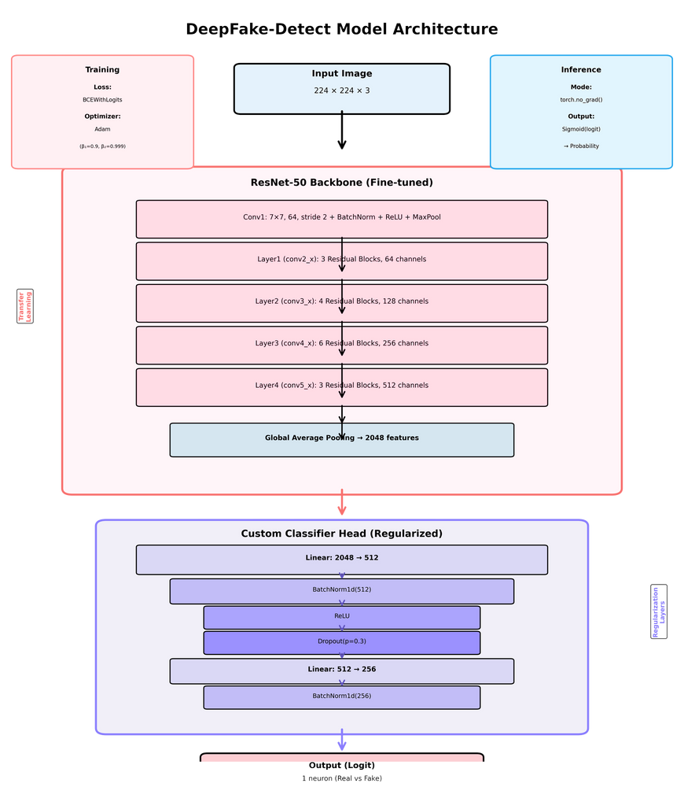
Model Architecture
Performance on Held-Out Test Set (49 images):
Chosen for its excellent trade-off between representational capacity and computational cost.
Residual connections help capture sophisticated artifacts
Custom Classifier Head:
The original 1000-class head was replaced.
Our head is a compact, regularized multi-layer perceptron:
Linear(2048 → 512) → BN → ReLU → Dropout(0.3)
Linear(512 → 256) → BN → ReLU → Dropout(0.2)
Linear(256 → 1) (Logit Output)
Training Details:
Loss: BCEWithLogitsLoss (for numerical stability).
Optimizer: Adam (lr = 1e-4, weight decay = 1e-5).
Batch Size: 32
Hardware: NVIDIA RTX-class GPU, PyTorch, Mixed-Precision Training (AMP).

Slide 6
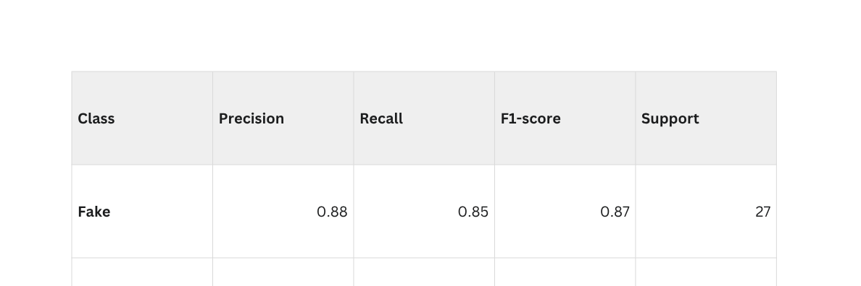
Results: quantitative Analysis
Backbone: ResNet-50
Accuracy: 85.71%
Macro F1-Score: 0.86
Confusion Matrix:
True Negatives (Real): 23
False Positives (Real -> Fake): 4
True Positives (Fake): 19
False Negatives (Fake -> Real): 3

Slide 7
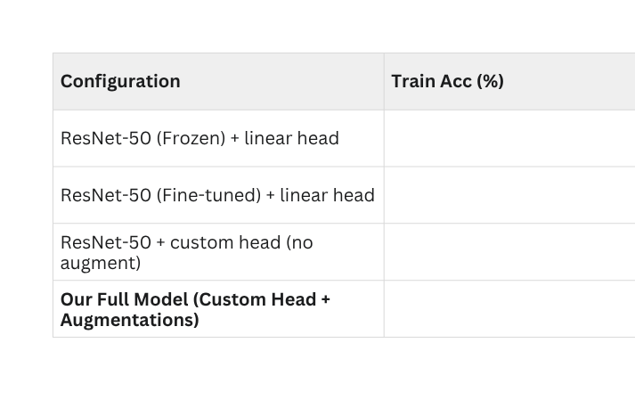
Results: Ablation Study (Proof Our Method Works)
Question
Did our custom head and augmentations actually help?
Ablation Study Results (Table II):
Key Insight: The "no augment" model had 96.5% training accuracy but only 78.2% test accuracy—it was overfitting.
Conclusion: Our augmentations reduced training accuracy slightly but significantly improved test-set generalization, boosting it from 78.2% to 85.71%.

Slide 8
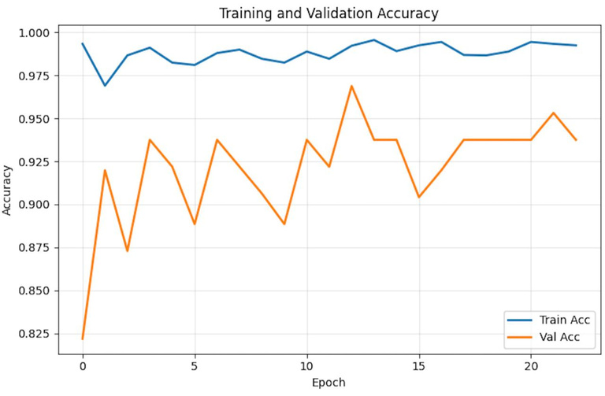
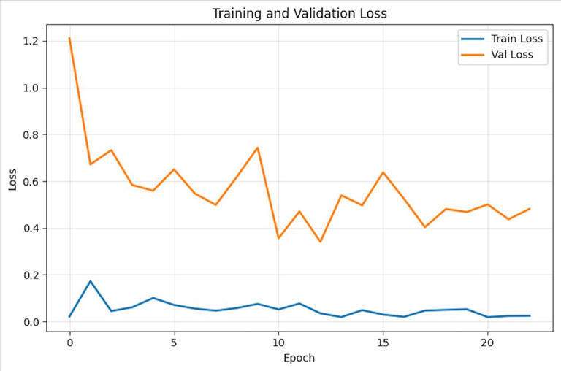
Results: Training Curves
Visuals:
Analysis:
The curves show steady convergence.
Training accuracy is high (blue line, top chart) while validation accuracy (orange line) follows the trend.
Crucially, the validation loss (orange line, bottom chart) does not diverge from the training loss (blue line).
This demonstrates that our regularization (custom head + augmentations) was successful in preventing severe overfitting.

Slide 9
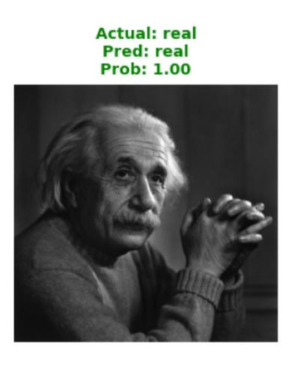
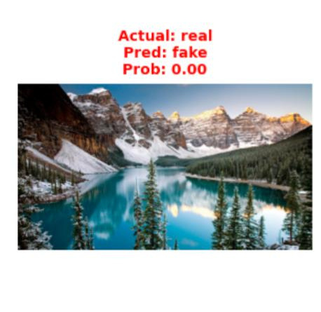
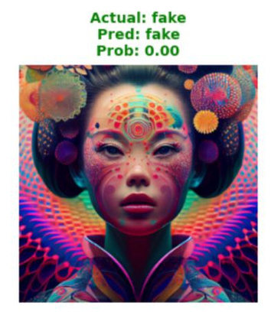
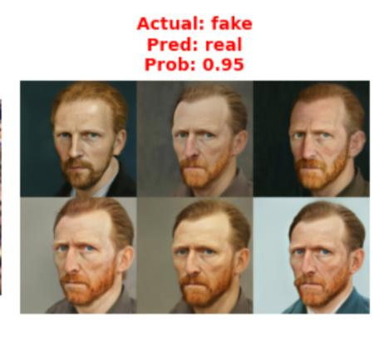
Results: Qualitative Analysis (Where it Fails)
Visuals
Success
Fail

Slide 10
Deployment: Server (FastAPI)
Technology: Python, FastAPI, and Uvicorn workers.
Endpoint: A clean /predict endpoint.
Workflow:
Receives an uploaded image (multipart/form-data).
Preprocesses the image (resize, normalize).
Performs inference in torch.no_grad() mode.
Moves model and tensors to CUDA if a GPU is available.
Returns a clean JSON response with:
Predicted label ("Real" or "Fake")
Confidence score (sigmoid of the logit)
Inference time (in milliseconds)

Slide 11
Deployment: Client (React Native)
Technology: Deployment: Client (React Native)
Purpose: Consumes the FastAPI inference service
User Features:
Image picker to select from camera or gallery.
Asynchronous upload with a progress indicator.
Clear results view with a color-coded label and percentage confidence.
Option to save history and export logs for forensic analysis

Slide 12
Limitations & Future Work
Current Limitations:
Image-Only: The system is not designed for video, which requires temporal consistency checks.
Dataset Scale: The held-out test set of 49 images is small. A larger, more diverse benchmark is needed for stronger statistical claims.
Future Directions:
Frequency-Domain Features: Incorporate DCT coefficients to find artifacts invisible in the spatial domain.
Adversarial Training: Actively train the model against perturbations designed to fool it.
Explainability: Add GRAD-CAM overlays to highlight which parts of the image the model thinks are fake.
On-Device Inference: Create a quantized model that can run directly on the phone for privacy and speed.

Slide 13
Conclusion
We Proved: A fine-tuned ResNet-50 combined with a custom regularized head and targeted augmentations (JPEG, blur) improves robustness against realistic degradations.
We Presented: DeepFake-Detect, a complete, end-to-end pipeline.
Our Result: 85.71% accuracy and a deployed FastAPI + React Native application.
Acknowledgements: We thank our course instructor, Dr. Animesh Chaturvedi, for his guidance and feedback.

