Slide 1

Git-Github
Presented by-
Nancy Malhotra

Slide 2
INTRODUCTION
Git is a free and open source distributed version control system designed to handle everything from small to very large projects with speed and efficiency
Unlike other client server system, every Git directory is a full fledged repository on every computer with complete history and tracking abilities
Git is independent of network access or a central server
Git is a free software which can be downloaded from following Url: http://git-scm.com/downloads

Slide 3
GOALS
Share Code easily
Keep track of any changes we make
Maintain multiple version of the same project/code base
Clearly communicate what changes have been made

Slide 4
ADVANTAGES
Resilience
No one repository has more data than any other
Speed
Very fast operations compared to other VCS
Space
Compression can be done across repository not just per file
Minimizes local size as well as push/pull data transfers
Simplicity
Object model is very simple

Slide 5
GIT HUB
GitHub is a web-based Git or version control repository and Internet hosting service. It is mostly used for code. Git hub is webhosting service where source code project is uploaded. It offers all of the distributed version control and source code management (SCM) functionality of Git as well as adding its own features. It provides access control and several collaboration features such as bug tracking, feature requests, task management, and wikis for every project.
GitHub offers both plans for private and free repositories on the same account which are commonly used to host open-source software projects. As of April 2017, GitHub reports having almost 20 million users and 57 million repositories, making it the largest host of source code in the world.

Slide 6
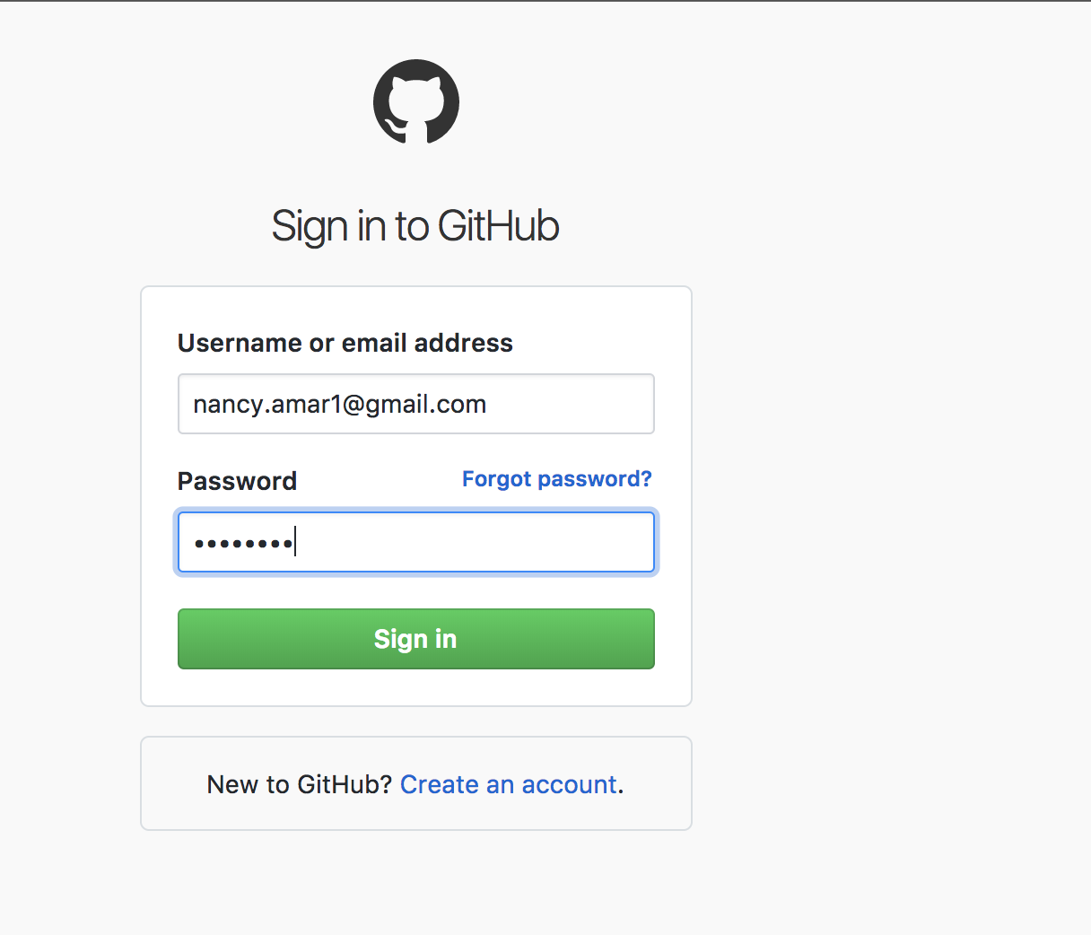

Slide 7
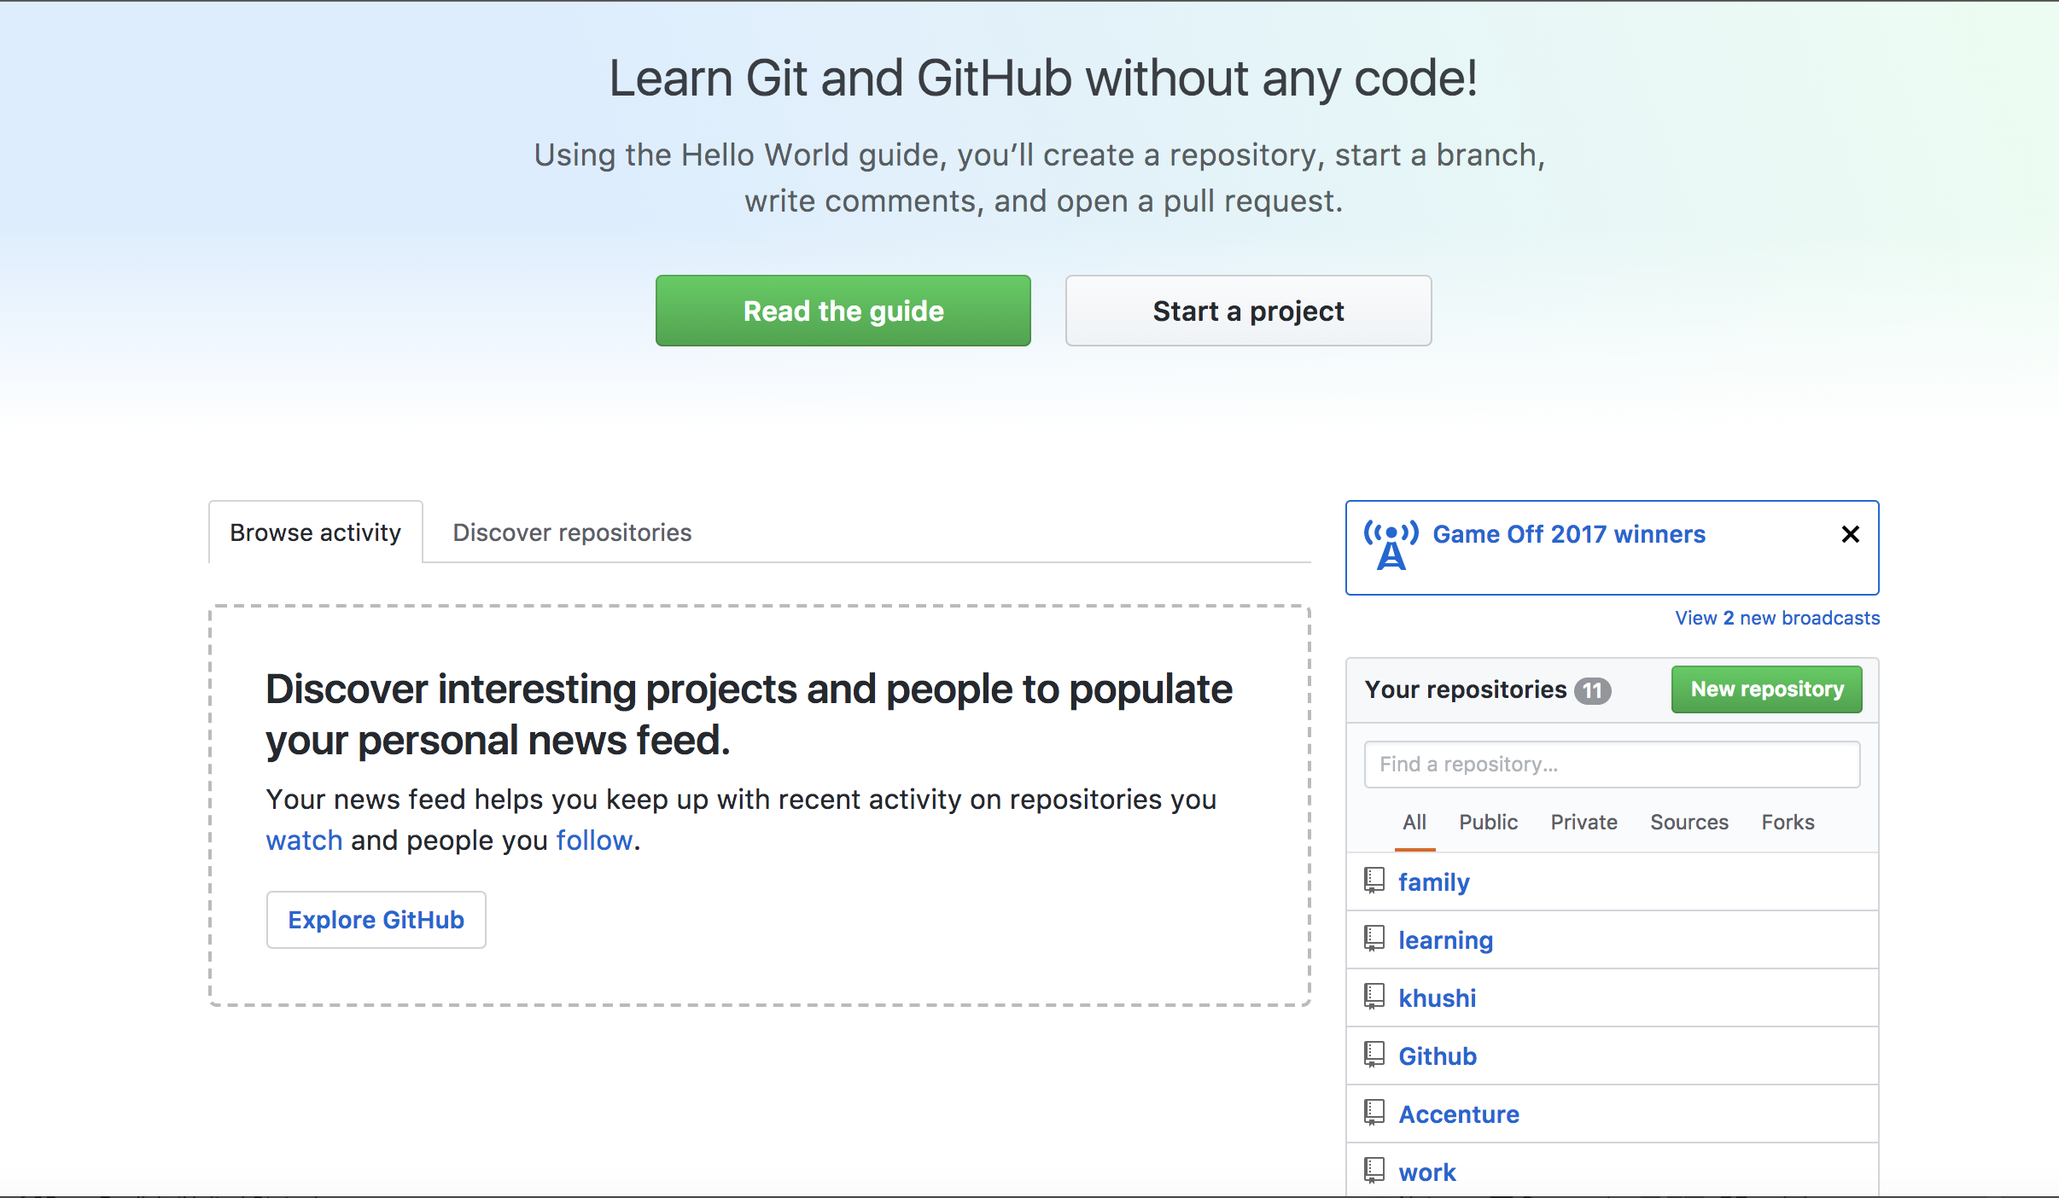

Slide 8
Introduce yourself to Git
Enter these lines (with appropriate changes):
git config --global user.name “nancy"
git config --global user.email nancy.amar1@gmail.com
You only need to do this once
If you want to use a different name/email address for a particular project, you can change it for just that project
Cd to the project directory
Use the above commands, but leave out the --global

Slide 9
Create and fill a repository
cd to the project directory you want to use
Type in git init
This creates the repository (a directory named .git)
You seldom (if ever) need to look inside this directory
Type in git add .
The period at the end is part of this command!
Period means “this directory”
This adds all your current files to the repository
Type in git commit –m "Initial commit"
You can use a different commit message, if you like

Slide 10
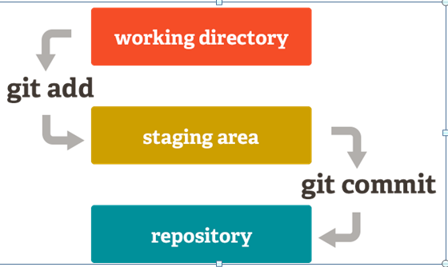

Slide 11
Viewing What Has Changed
git log
Note the hash code for each commit.
git show <OBJECT>
Can use full or shortened hash
git reflog to see all changes that have occurred

Slide 12
GIT COMMANDS :
git config
Sets configuration values for your user name, email, gpg key, preferred diff algorithm, file formats and more.
Examples : git config --global user.name "My Name"
git config --global user.email "user@domain.com"
git init
Initializes a git repository – creates the initial .git directory in a new or in an existing project.
Example: git init
Initialized empty Git repository in /home/username/GIT/.git/
git clone
Creates a GIT repository copy from a remote source. Also adds the original location as a remote so you can fetch from it again and push to it if you have permissions.
Example: git clone git@github.com:user/test.git

Slide 13
git add
Adds files changes in your working directory to your index. Example:
git add .
git rm
Adds files changes in your working directory to your index. Example:
git rm filename
git commit
Takes all of the changes written in the index, creates a new commit object pointing to it and sets the branch to point to that new commit. Examples:
git commit -m ‘committing added changes’
git commit -a -m ‘committing all changes, equals to git add and git commit’
git status
Shows you the status of files in the index versus the working directory. It will list out files that are untracked (only in your working directory), modified (tracked but not yet updated in your index), and staged (added to your index and ready for committing). Example:
git status
# On branch master #
# Initial commit #
# Untracked files: #
# (use "git add <file>..." to include in what will be committed) #
README

Slide 14
git branch
Lists existing branches, including remote branches if ‘-a’ is provided. Creates a new branch if a branch name is provided.
Example: git branch -a * master remotes/origin/master
git merge
Merges one or more branches into your current branch and automatically creates a new commit if there are no conflicts. Example: git merge newbranchversion
git reset
Resets your index and working directory to the state of your last commit.
Example: git reset --hard HEAD
git tag
Tags a specific commit with a simple, human readable handle that never moves.
Example: git tag -a v1.0 -m 'this is version 1.0 tag’
git pull
Fetches the files from the remote repository and merges it with your local one.
Example: git pull origin
git push
Pushes all the modified local objects to the remote repository and advances its branches.
Example: git push origin master
git remote
Shows all the remote versions of your repository.
Example: git remote origin

Slide 15
git log
Shows a listing of commits on a branch including the corresponding details.
Example:
git log commit
84f241e8a0d768fb37ff7ad40e294b61a99a0abe Author: User <user@domain.com> Date: Mon May 3 09:24:05 2010 +0300 first commit
git diff
Generates patch files or statistics of differences between paths or files in your git repository, or your index or your working directory.
Example: git diff
git archive
Creates a tar or zip file including the contents of a single tree from your repository.
Example : git archive --format=zip master^ README >file.zip
git gc
Garbage collector for your repository. Optimizes your repository. Should be run occasionally.
Example: git gc
Counting objects: 7, done.
Delta compression using up to 2 threads.
Compressing objects: 100% (5/5), done.
Writing objects: 100% (7/7), done.
Total 7 (delta 1), reused 0 (delta 0)

Slide 16
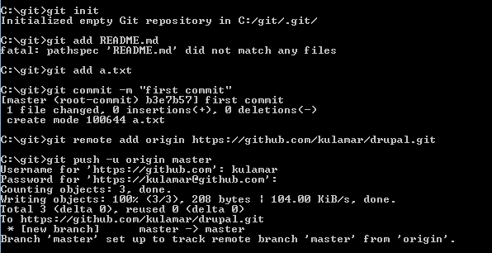

Slide 17
Branching
Git branching is lightweight
Tools for helping merge branches and changes easily
You are ALWAYS on a branch
Branches can be local or remote
Key commands
git branch
git merge
git cherry-pick
Allows you to choose specific commits to apply
You can edit the commits while cherry picking

Slide 18
Using Branches
git checkout -b branch
git checkout -b devel/branch
git branch
Lists all local branches available
We can now make changes in one branch and propagate change using
git merge
git cherry-pick

Slide 19
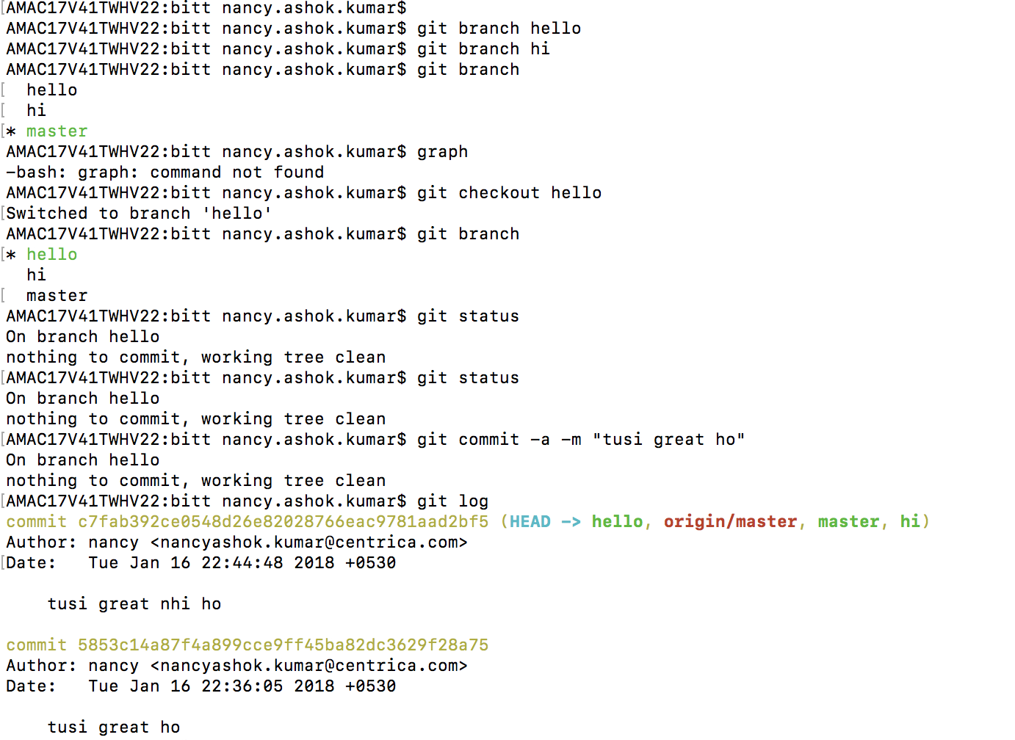

Slide 20
Thanks

