Slide 1
Meta classifier for virus detection

Slide 2

Proposed cascading classifier
ARCHITECTURE VIEW
CLASSIFIER VIEW
STAGE 1
Training data, model configuration etc.
User intentions – reduce false positives
Naive Bayes
Model training /
testing
Update model
parameters
Predictions, parameters
updated parameters
Trickle down training set
STAGE 2
More complex and specific model
SVM (using String /
Graph kernels

Slide 3


Cascading [2]
Sequence of classifiers gj. The posterior probability estimate of class i for input x by classifier at stage j -
Confidence function at stage j
We consult classifier gj if all of its preceding classifiers are not confident in their output
During the training of classifer gj+1 we use a converted training set where patterns are drawn with probability proportional to
Theta (per stage threshold) required during testing

Slide 4
Questions
Add bias towards reducing false positives
Number of stages? 2 stages? NB at stage 1 (fast learner) and SVM at stage 2
What features? What classifiers at different stage?
Parametric vs non-parametric classifiers based on number of features vs instances
What gets trickled down? All false positives? Plus some more training data proportional to (1-deltaj)
Combine with interactive approach?
  Tradeoff between iteration at stage j vs passing on to stage (j+1)

Slide 5
Ideas on reducing false positives
define a different threshold for each class. Specifically, for a two class problem like virus classification, where the intention is to reduce false positives, threshold for +ve class > threshold for -ve class at all stages in the multistage classifier system
During training of stage(j+1) remove high probability true negatives
Cross-training – use prediction by one classifier as feature in the next (in case of high theta for positive)

Slide 6



Stage 1 – an interactive approach for updating model parameters [1]
Data points X
True class labels t
Model parameters Θ
Bias up / down
Interactive confusion matrix
Model training
N-fold cross
validation
50 | 12
22 | 45
Current state pi
Target state si
Update model
parameters

Slide 7
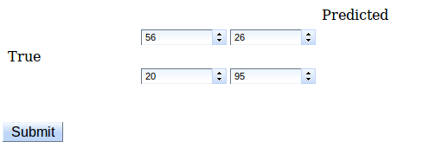
Interactive confusion matrix
Users interact with individual cells of the confusion matrix to provide Up / Down bias

Slide 8
What should constitute training set in stage 2?
Use converted training set where patterns are drawn with probability proportional to (1-delta) – [refer slide 4]
During training of stage(j+1) remove high probability true negatives [3]
Use all false positives from stage 1 along with one of the above options

Slide 9
Stage 2

Slide 10
References
[1] Kapoor, A., Lee, B., Tan, D., & Horvitz, E. (2012). Performance and Preferences : Interactive Refinement of Machine Learning Procedures. Twenty-Sixth AAAI Conference on Artificial Intelligence, 1578-1584.
[2] ﻿Kaynak, C. (2000). MultiStage Cascading of Multiple Classifiers : One Man’s Noise is Another Man’s Data. ICML.
[3] ﻿Yih, W.-tau, Goodman, J., & Hulten, G. (n.d.). Learning at Low False Positive Rates.

