Slide 1
RightFit
Using Data Science to Reduce Returns Due to Incorrect Product Size

Slide 2
Motivation
Jabong honors 25-30 thousand sales orders on an average every day
30% of these get either exchanged or returned
Over 65% of these are attributed to incorrect size
Missed daily revenue of over ₹1 crore
Cost of reverse logistics, customer dissatisfaction, marred experience and their potential churn!
Can data science help?

Slide 3
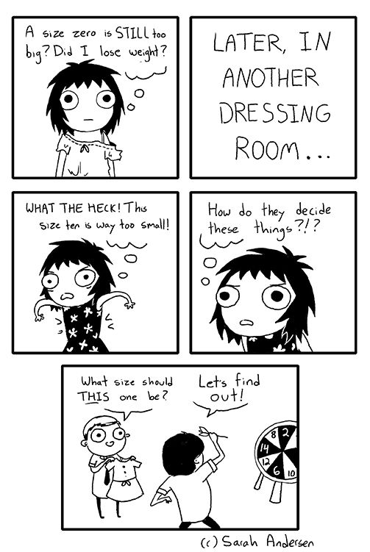
What makes fit so difficult?
lack of standardization in cross-brand sizing: brands design clothes differently using proprietary style specifications
vanity sizing (size inflation): brands size the product lower to appeal to customers’ ego
No two sizes feel the same across brands!

Slide 4
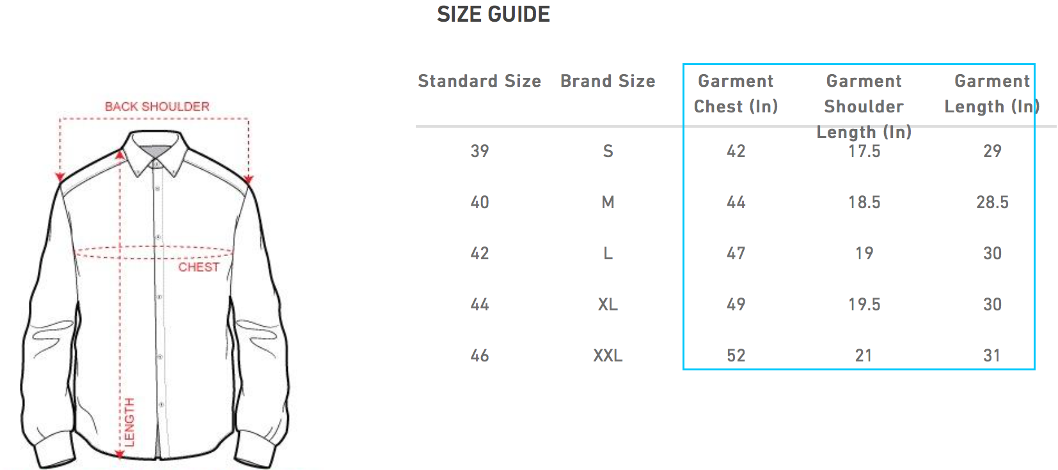
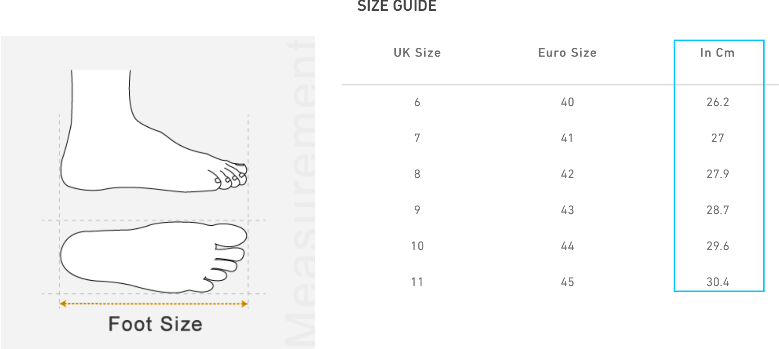
Our approach
Sizing standard-based data is noisy; use the actual size instead
A successful sale not resulting into a return / exchange is an indication of right fit
A return / exchange marked with “size issue” is an indication of incorrect fit

Slide 5


Overall design
k-medoids clustering
clusters
product-cluster closeness scoring
product-cluster closeness matrix
catalog size chart data
sales data
customer-cluster support scoring
customer-cluster support matrix
returns data
combined scoring

Slide 6
Data Sources
Catalog data
catalog_simple, catalog_config, catalog_attribute_set
catalog_simple_shoes, catalog_attribute_option_shoes_sh_size
catalog_distinct_sizechart, catalog_sizechart
Sales data
sales_order, sales_order_item, sales_order_item_status
Returns data
CRM_TicketDetails, CRM_ProductDetails, CRM_TicketProducts

Slide 7


Catalog clustering
Men
catalog size chart for shoes simples
k-medoids clustering
Women
Kids
clusters of shoes simples
k-medoids clustering
used to partition the catalog data into groups of similar sized shoe simples
uses “size in cm” feature and squared Euclidean distance as the distance measure
minimizes sum of pairwise dissimilarities
uses an implementation of clara - a variation of PAM (Partitioning Around Medoids) algorithm for large scale clustering
The choice of ‘k’ is a function of the range of sizes of shoe simples; currently set to 11 for men, 10 for women and 18 for kids.

Slide 8
Product-cluster closeness scoring
c₁
c₂
c_{k}
d₁
d₂
p₁
d_{k}
r
product-cluster closeness score between shoe simple p₁ and cluster c₁ is computed as: s₁₁ = 1 - d₁ / r, where, d₁ is the Euclidean distance of the simple from the medoid of cluster c₁ and r is the maximum distance between the clusters and acts as a normalizer.
The above scoring is used to compute the product-cluster closeness matrix comprising closeness scores for all shoes simples from the clusters;
There is one such matrix each for men, women and kids.
 | c₁ | … | c_{k}
p₁ | s₁₁ |  | s_{1k}
…
…
p_{n} |  |  | s_{nk}

Slide 9
Customer-cluster support scoring
customer | simple | cluster | sales_count | score
x₁ | p₁ | c₂ | 4 | 0.67
x₁ | p_{i} | c_{j} | 1 | 0.33
… | … | … | … | …
x_{m}
 | c₁ |  | c_{k}
x₁
x_{m}
From the item sales data, we filter out the items returned or exchanged, to retain only the successful item sales;
This data is augmented with the item cluster membership (Refer to ‘cluster’ column) by combining it with the output of our clustering;
We then group this data by customer and cluster to obtain sales_count, the number of times a customer bought a shoe simple from that cluster;
Finally, the customer-cluster support score is computed as:
(sales_count + 2) / (sum(sales_count) + 4), where, sum(sales_count) is the total number of sales for the customer and the score is adjusted as per Wald’s method to account for sparseness.

Slide 10
Support-closeness combined scoring
 | c₁ | … | c_{k}
p₁
…
…
p₈
 | c₁ | … | c_{k}
p₁
…
…
p₈
 | c₁ | … | c_{k}
x₁
order simples by row-wise max
For a given SKU, get the closeness vectors for each of its simples to create a closeness matrix M;
For a given customer, get the support vector V from the customer-cluster support matrix;
The element-wise multiplication M * V, gives the combined scores;
We apply row-wise max on M * V and order the simples by decreasing scores.
In the absence of information on which “profile” (cluster) the customer is buying for, we return the simple with the maximum score;
If we have the knowledge of his/her profile, we return the simple with the max score in the column corresponding to that profile (cluster) in the final matrix.

