Slide 1
Iterator pattern
Made by
Kulbitski Mikita

Slide 2
Which problems does it solve?
The iterator pattern provides a way to access the elements of an aggregate object without exposing its underlying representation.
Polymorphic bypass in arrays of different structures.

Slide 3
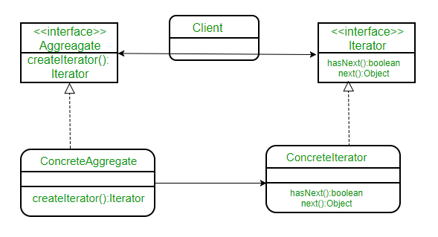
Class Diagram

Slide 4
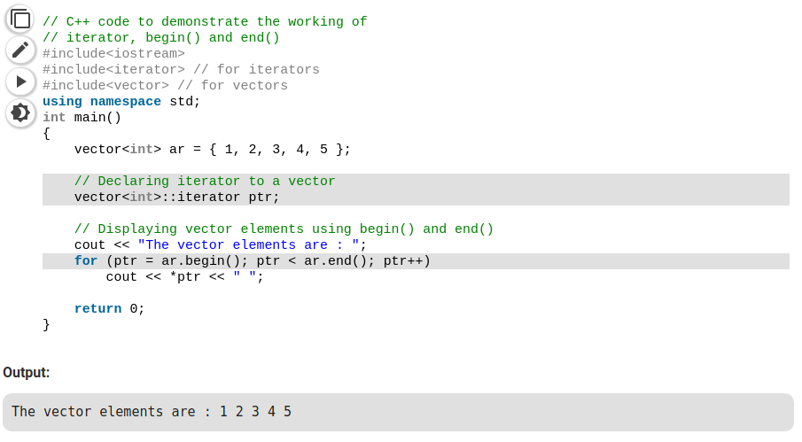
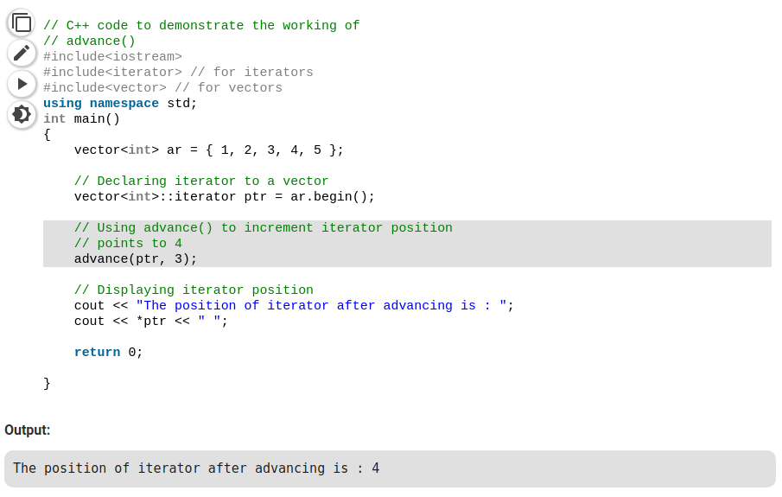
Code Example

Slide 5
Connection to other patterns
Iterator can be used to bypass the complex structures created by Composite.
To create an instance of the Iterator subclass, polymorphic iterators use the Factory Method.
Often Memento and Iterator are shared. Iterator can use Memento to save the iteration state and contains it inside itself.

