Slide 1
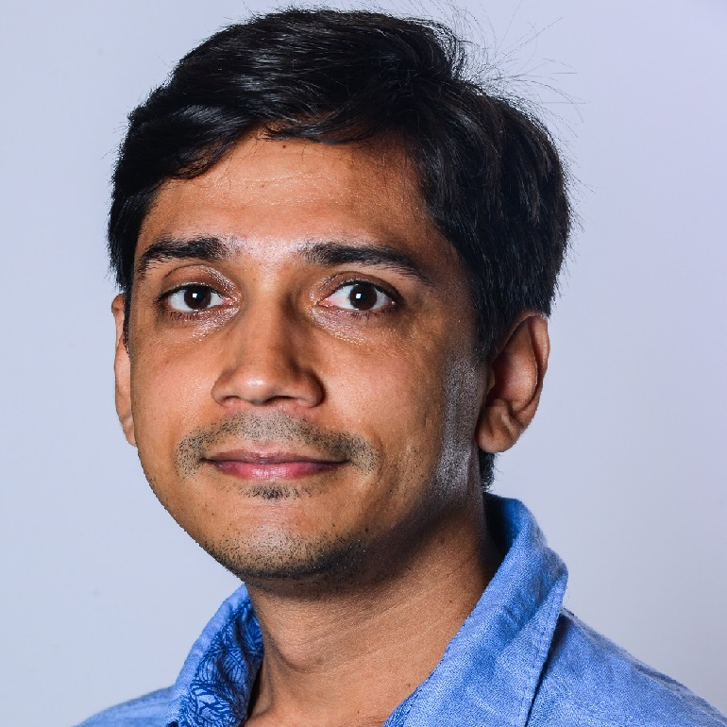












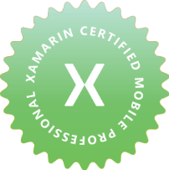


Kuldeep Singh
Programmer / Lead / Consultant
Passionate lead/developer with 7+ years of experience in consulting, designing, developing and delivering solutions to enterprises using Microsoft Technologies.
in.singhkuldeep@gmail.com
+44 7779563361
www.linkedin.com/in/kuldeepsingh-k
London, United Kingdom
WORK EXPERIENCE
SKILLS
Microsoft
Customer Engineer
July 2019 – Present Reading, UK
Enabling Microsoft Premier customers to make the most use of Microsoft technologies, by providing them trainings and workshops.
Consultant
Jan 2016 – July 2019 Hyderabad, India
Lead the database team of $42M auditing application, along with a team of 100+ for GTI. GTI is one of the leading audit, tax and advisory ﬁrm.
Responsibilities included designing, developing and delivering solutions that helped customers in doing their Audit in eﬀective ways.
Improved SQL Database performance, which brought down the resource consumption cost from $16k /month to $3.6k /month.
Designed a methodology of continuous migration which ensures the schema changes made post-production release is appropriately versioned and continuously migrated with daily builds.
Bring in the best minds to the organization via interviews conducted across the country.
.net (C#)
Azure Web/ Compute
SQL Azure
Cosmos DB
Solution Design
Azure Storage
Azure DevOps
Power BI
Xamarin
Azure Data Factory
Agile / Scrum
PowerShell
CERTIFICATIONS
Aon Hewitt
Software Executive
Aug 2015 – Jan 2016 Gurgaon, India
Developed a web application ‘Hewitt Gateway’ with the team of 50+ distributed across the globe which helped in managing projects, employee, client and their distribution related information worldwide.
Lead the activity of migration of applications from Windows Server 2003 to Windows Server 2008, which enables the customer to use the latest features of windows server 2008.
Icertis
Software Analyst
Aug 2012 – Jan 2015 Pune, India
Responsibilities included gathering customer requirement, architecting, developing and delivering solutions
Design, develop and deliver a web application ‘Retail process automation’, which streamlines the process of opening Microsoft stores.
Developed a native windows phone application, HelpBridge. This helps you connect with your loved ones during natural disasters. It also enables you to give your money, time and resources to support relief and rebuilding eﬀorts.
HONOR AWARDS
Team Star Award
April 2020, Microsoft
Best Consultant
June 2018, Microsoft
Microsoft Spot Award
Feb 2018, Microsoft
Peer Recognition award
Aug 2016, Microsoft
Microsoft Spot Award
March 2016, Microsoft
Microsoft Spot Award
Feb 2016, Microsoft
EDUCATION
Bachelor of Engineering
University of Pune 2008-2012

