Slide 1
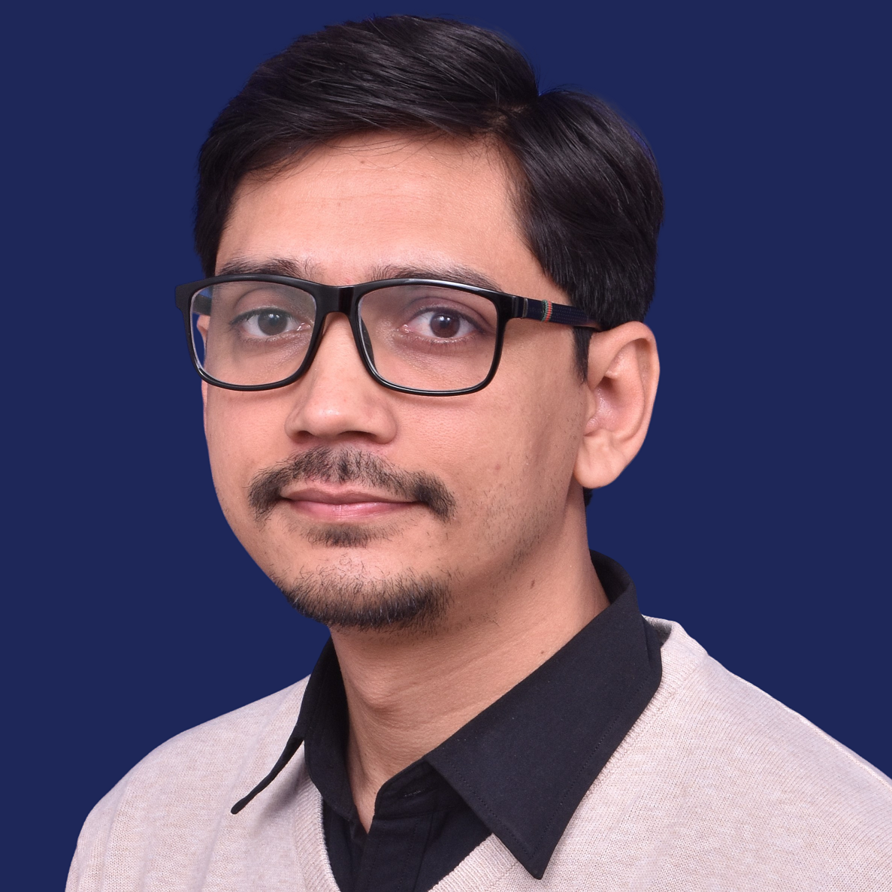




















Kuldeep Singh
Architect / Lead / Consultant
Passionate architect/consultant with 8+ years of experience in consulting, designing, developing and delivering solutions to enterprises using Microsoft Technologies.
in.singhkuldeep@gmail.com
+44 7779563361
https://kuldeep.azurewebsites.net
linkedin.com/in/kuldeepsingh-k
London, United Kingdom
WORK EXPERIENCE
SKILLS
Microsoft
Customer Engineer
July 2019 – Present London, UK
Delivered training and services to end customers, focusing on cloud technologies as well as troubleshooting, strategy and best practices.
Worked with customers to plan, deploy, operate and optimize their modern cloud applications and helped them in accomplishing their business needs.
Synthesized customer feedback to facilitate continuous product/services improvement in close co-operation with Product/Engineering teams
Consultant
Jan 2016 – July 2019 Hyderabad, India
Lead the database team for a $42M auditing application developed for one of the leading audits, tax and advisory ﬁrm in London.
Improved SQL Database performance, which brought down the resource consumption cost from $16k /month to $3.6k /month.
Designed a methodology of continuous migration which ensures the schema changes made post-production release is appropriately versioned and continuously migrated with daily builds.
Bring in the best minds to the organization via interviews conducted across the country.
.net (C#)
Azure Web/ Compute
SQL Azure
Cosmos DB
Solution Design
Azure Storage
Azure DevOps
Power BI
Xamarin
Azure Data Factory
Agile / Scrum
PowerShell
CERTIFICATIONS
Aon Hewitt
Software Executive
Aug 2015 – Jan 2016 Gurgaon, India
Developed a web application ‘Hewitt Gateway’ with a team of 50+ distributed across the globe.
Lead the activity of migration of applications from Windows Server 2003 to Windows Server 2008.
Icertis
Software Analyst
Aug 2012 – Jul 2015 Pune, India
Responsibilities included gathering customer requirement, architecting, developing and delivering solutions
Design, develop and deliver a web application ‘Retail process automation’, which streamlines the process of opening Microsoft stores.
HONOR AWARDS
Team Star Award
April 2020, Microsoft
Best Consultant
June 2018, Microsoft
Microsoft Spot Award
Feb 2018, Microsoft
Peer Recognition award
Aug 2016, Microsoft
EDUCATION
Bachelor of Engineering
University of Pune 2008-2012

