Slide 1
Computer Architecture
Dr. Ashok Kumar Turuk
Notes:
ECE6130: Computer Architecture, T.T.U

Slide 2
Recommended Book::
Computer Architecture: A Quantitative Approach (Fifth Edition) by
John L Hennessy
David A Patterson

Slide 3
Performance
What do we mean when we say one computer is faster than the other?
  Response Time
    The time between the start and completion of an event (also known as execution time)
  Throughput
    The total amount of work done in a given time

Slide 4
Performance
We relate the performance of two different computers (say X and Y) in comparing design alternatives
The phrase “X is faster than Y”
  The execution time or response time of a given task is lower on X than on Y

Slide 5
Performance
"X is n times faster than Y" means
ExTime(Y) Performance(X)
--------- = --------------- = n
ExTime(X) Performance(Y)
Notes:
ECE6130: Computer Architecture, T.T.U
1350 / 610 = 2.2X
286,700/ 178,200 1.6X

Slide 6
Performance
The “throughput of X is 1.3 times higher than Y”
  Number of tasks completed per unit time on X is 1.3 times the number completed on Y

Slide 7
Computer Performance:
Response Time (latency)
  How long does it take for my job to run?
  How long does it take to execute a job?
  How long must I wait for the database query?
Notes:
ECE6130: Computer Architecture, T.T.U

Slide 8
Computer Performance:
Throughput
  How many jobs can the machine run at once?
  What is the average execution rate?
  How much work is getting done?
Notes:
ECE6130: Computer Architecture, T.T.U

Slide 9
Computer Performance:
If we upgrade a machine with a new processor what do we increase?
If we add a new machine to the lab what do we increase?
Notes:
ECE6130: Computer Architecture, T.T.U

Slide 10
Execution Time
Execution time can be defined in different ways depending on what we count
Elapsed Time (wall-clock time, response time)
  Latency to complete a task
  Counts everything (disk and memory accesses, I/O , etc.)
  A useful number, but often not good for comparison purposes
Notes:
ECE6130: Computer Architecture, T.T.U

Slide 11
Execution Time
CPU time
  Doesn't count I/O or time spent running other programs
  Can be broken up into system time, and user time
Our focus: User CPU time
  Time spent executing the lines of code that are "in" our program
Notes:
ECE6130: Computer Architecture, T.T.U

Slide 12
Quantitative Principles
Guidelines and principles that are useful in the design and analysis of computers
Take advantage of parallelism: Important method to improve performance
  System level
    To improve the throughput performance of a typical server, using multiple processor and multiple disk
  Individual processor
    Parallelism among instruction is critical to achieving high performance
    Pipelining

Slide 13
Quantitative Principles
  Digital Design
    Set-associate cache uses multiple banks of memory that are searched in parallel to find the desired data item
    Carry-Look ahead adder

Slide 14
Quantitative Principles
Principle of Locality
  Programs tend to reuse data and instructions they have used recently
  Programs spend 90% of its execution time in only 10% of the code.
Temporal Locality
  Recently accessed items are likely to be accessed in the near future
Spatial Locality
  Items whose addresses are near to one another tend to be referenced close together in time

Slide 15
Quantitative Principles
Focus on the Common Case
  Make the common case Fast and Other Parts Correct
  In making a design trade-off, favor the frequent cases over the infrequent case.
  In a CPU with rare overflow events, optimize the normal “add” part (more than 90% typically) rather than considering priority on overflow parts

Slide 16
Amdahl's Law
Amdahl's Law states that the performance improvement to be gained from using some faster mode of execution is limited by the fraction of time the faster mode can be used.
Amdahl's Law defines the speedup that can be gained by using a particular feature

Slide 17
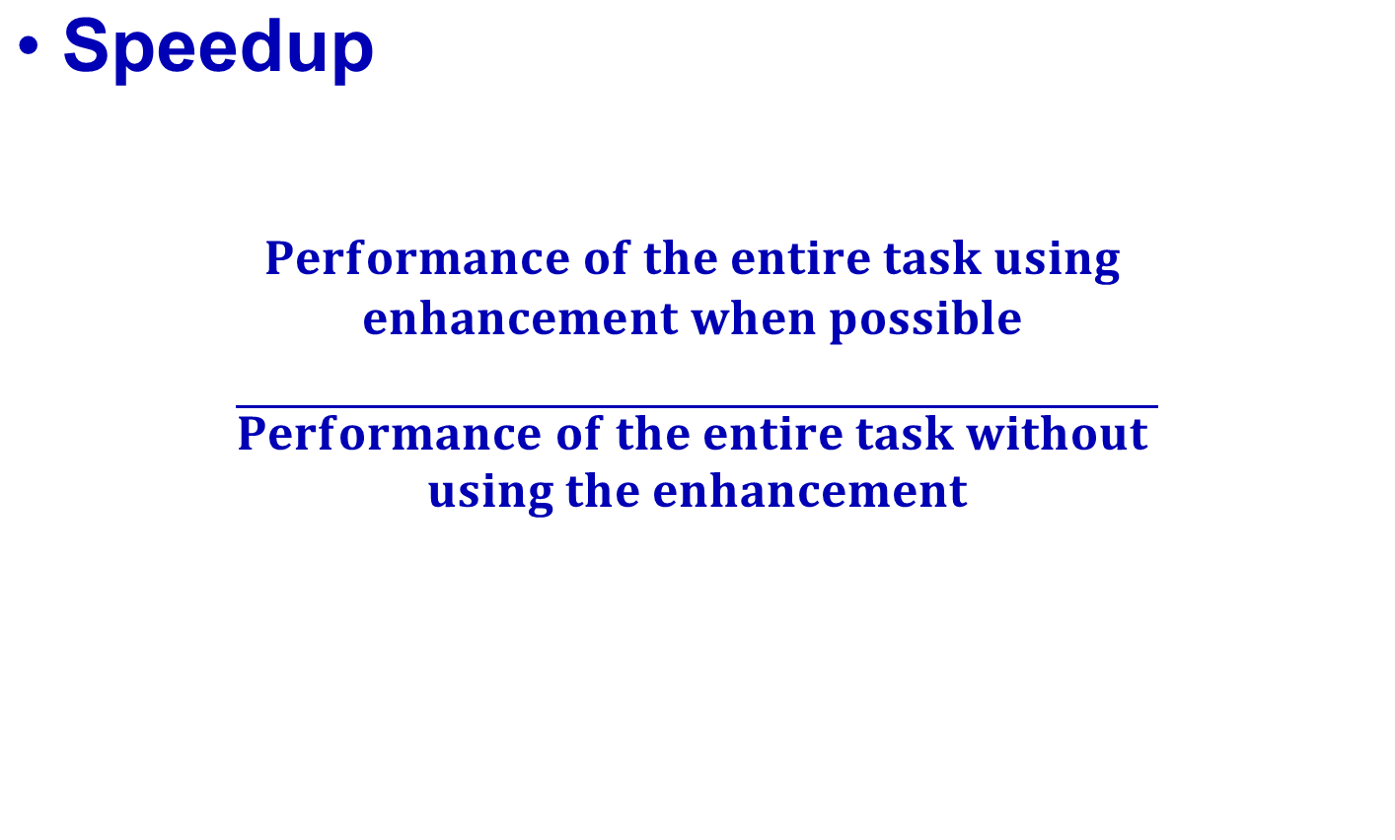
Amdahl's Law

Slide 18
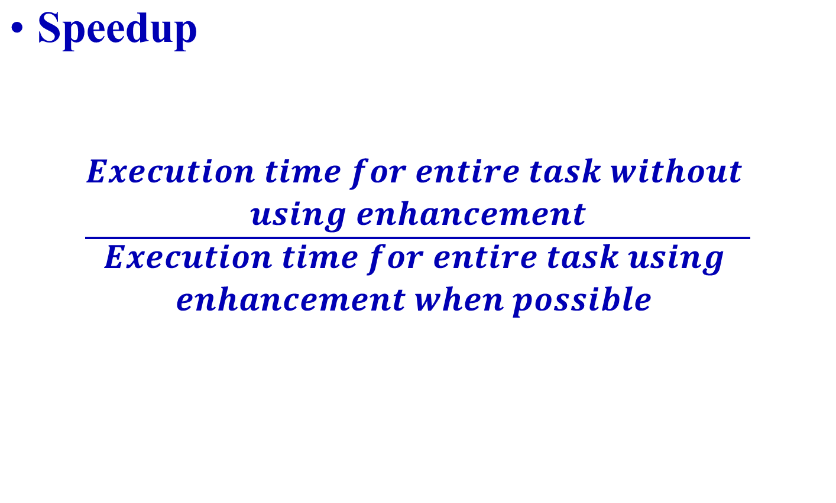
Amdahl's Law

Slide 19
Speedup
Speedup tells us how much faster a task will run using the computer with the enhancement as opposed to the original computer.
Amdahl's Law gives us a quick way to find speedup from some enhancement.
Speedup depends on two factors
  Fraction_{enhanced}
  Speedup_{enhanced}

Slide 20
Speedup
  Fraction_{enhanced}
    The fraction of the computation time in the original computer that can be converted to take advantage of the enhancement. Fraction_{enhanced} is always less than 1.
  Speedup_{enhanced}
    The improvement gained by the enhanced execution mode; that is how much faster the task would run if the enhanced mode were used for the entire program. Speedup_{enhanced} is always greater than 1. Ratio of the time in the original mode over the time of the enhanced mode

Slide 21
Speedup
The execution time using the original computer with the enhanced mode will be the time spent using the unenhanced portion of the computer plus the time spent using the enhancement

Slide 22
Amdahl’s Law
ExTime_{new} = ExTime_{old} x (1 - Fraction_{enhanced}) + Fraction_{enhanced}
Speedup_{enhanced}
1
ExTime_{old}
ExTime_{new}
Speedup_{overall} =
=
(1 - Fraction_{enhanced}) + Fraction_{enhanced}
Speedup_{enhanced}

Slide 23
Amdahl’s Law
The maximum speedup, which can be obtained by using a faster mode of execution, is limited by the fraction of the time the faster mode can be used. Examples include:
  Improving your Web-surfing speed
  Parallelization of computer programs
  Performance of symmetric-multiprocessor systems

Slide 24
Amdahl’s Law
Floating point instructions improved to run 2X; but only 10% of actual instructions are FP
ExTime_{new} =
Speedup_{overall}
=

Slide 25
Amdahl’s Law
Floating point instructions improved to run 2X; but only 10% of actual instructions are FP
ExTime_{new} = ExTime_{old} x (0.9 + .1/2) = 0.95 x ExTime_{old}
1
Speedup_{overall}
=
=
1.053
0.95
What’s the overall performance gain if we could improve the non-FP instructions by 2x?

Slide 26
Amdahl’s Law
A program spent 90% time on doing computing jobs, and other 10% time on disk accesses. If we use a 100X faster CPU, how much speedup we gain?

Slide 27
Amdahl’s Law
A program spent 90% time on doing computing jobs, and other 10% time on disk accesses. If we use a 100X faster CPU, how much speedup we gain?
ExTimenew = ExTimeold x (0.1 + 0.9/100) = 0.109 x ExTimeold
1
Speedup_{overall}
=
=
9.17
0.109

Slide 28
Metrics of Performance
Application
Answers per month
Operations per second
Programming
Language
Compiler
(millions) of Instructions per second: MIPS
(millions) of (FP) operations per second: MFLOP/s
ISA
Datapath
Control
Megabytes per second
Function Units
Transistors
Wires
Pins
Cycles per second (clock rate)

Slide 29
Performance
Performance is determined by execution time
Do any of the other variables equal to performance?
  # of cycles to execute program?
  # of instructions in program?
  # of cycles per second?
  average # of cycles per instruction?
  average # of instructions per second?
Common pitfall: thinking one of the variables is indicative of performance when it really isn’t.
Notes:
ECE6130: Computer Architecture, T.T.U

Slide 30
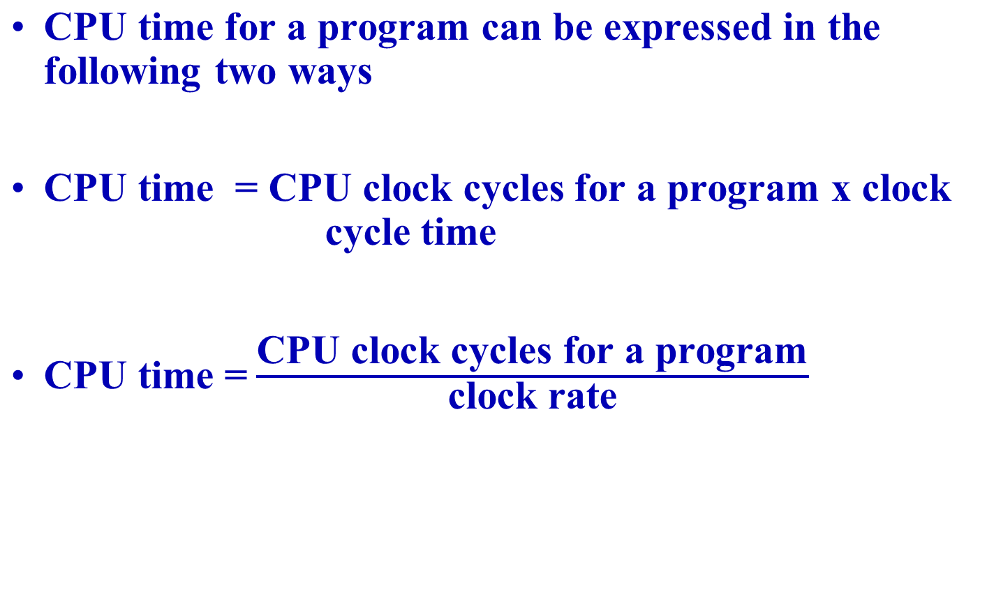
CPU Performance Equation

Slide 31
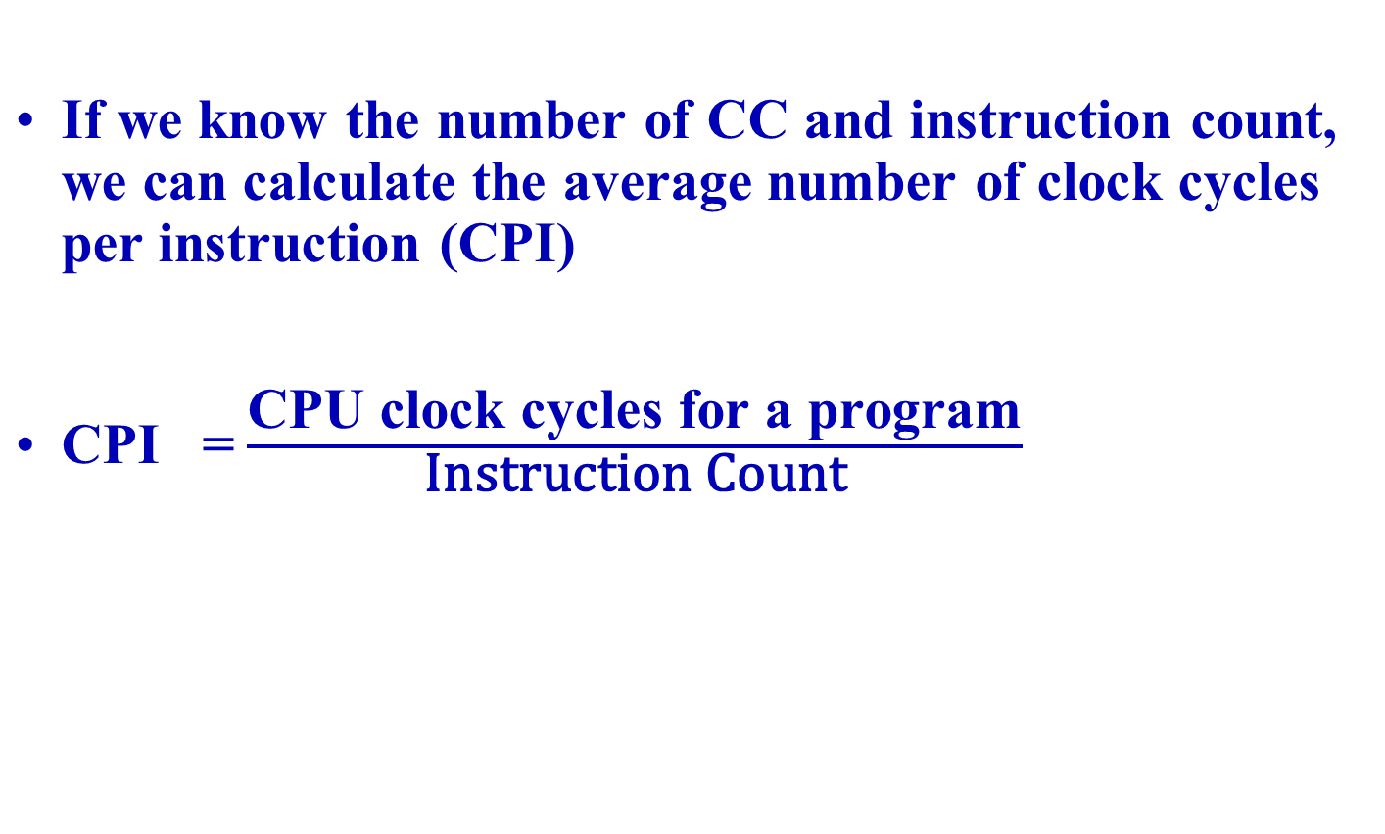
CPU Performance Equation

Slide 32
CPU Performance Equation
CPU time = CPU clock cycles for a program x Clock Cycle Time
CPU time = Instruction Count x Cycles Per Instruction x Clock Cycle Time
CPU time = Seconds = Instructions x Cycles x Seconds
Program Program Instruction Cycle

Slide 33
CPU Performance Equation
CPU time is equally depend on these three characteristics:
  A 10% improvement in any one of them leads to 10% improvement in CPU time.
Unfortunately, it is difficult to change one parameter in complete isolation from others because the basic technologies involved in changing each characteristics are interdependent:
  Clock Cycle Time : Hardware technology and Organization
  CPI : Organization and Instruction set architecture
  Instruction count : Instruction set architecture and Compiler technology

Slide 34
CPU Performance Equation
CPU time =CPU clock cycles for a program x clock cycle time
CPU time =CPU clock cycles for a program/(clock rate)
CPU time = Seconds = Instructions x Cycles x Seconds
Program Program Instruction Cycle

Slide 35
Cycles Per Instruction
Average Cycles per Instruction
  CPI = (CPU clock cycles for a program) / Instruction Count
  CPU Time = Instruction Count x Cycles per Instruction x clock cycle time
CPU time = IC x CPI/ (clock rate)
Notes:
ECE6130: Computer Architecture, T.T.U

Slide 36
CPU Performance Equation
CPU performance is dependent on three characteristic: Clock cycle (rate), clock cycles per instructions, and instruction count
CPU time = Instruction Count x Cycles per Instruction x clock cycle time
CPU time = Seconds = Instructions x Cycles x Seconds
Program Program Instruction Cycle

Slide 37
CPU Performance Equation
Components of Performance | Units of Measure
CPU execution time for a program | Seconds for the program
Instruction count | Instructions executed for the program
Clock cycle per instruction (CPI) | Average number of clock cycles per instruction
Clock cycle time | Seconds per clock cycle

Slide 38
Understanding Program Performance
Performance of a program depends on
  The algorithm,
  The language,
  The compiler,
  The architecture, and
  The actual hardware

Slide 39
H/W or S/W Component | Affects What? | How?
Algorithm | IC, Possibly CPI | The algorithm determines the number of source program instruction executed and hence the number of processor instructions executed The algorithm may also affect the CPI by favoring slower or faster instructions. Ex. if the algorithm uses more FP operations, it will tend to have a higher CPI

Slide 40
H/W or S/W Component | Affects What? | How?
Programming Language | IC, CPI | The programming language affects the IC since the statement in the language are translated to processor instructions, which determines the IC The language may also affect the CPI because of its feature; for ex a language with heavy support for data abstraction (e.g java) will require indirect calls, which will use higher CPI instrcutions.

Slide 41
H/W or S/W Component | Affects What? | How?
Compiler | IC, CPI | The efficiency of the compiler affects both the instruction count and average cycles per instruction, since the compiler determines the translation of the source language instruction to computer instructions. The compiler’s role can be very complex and affects the CPI in complex ways.

Slide 42
H/W or S/W Component | Affects What? | How?
Instruction set architecture | IC, CPI, Clock rate | The instruction set architecture affects all three aspects of CPU performance, since it affects the instructions needed for a function, the cost in cycle of each instruction, and the overall clock rate of the processor.

Slide 43
CPU Performance Equation
CPU time = Seconds = Instructions x Cycles x Seconds
Program Program Instruction Cycle
Inst Count CPI Clock Rate
Program X
Compiler X X
Inst. Set. X X X
Organization X X
Technology X

Slide 44
Cycles Per Instruction
CPI = (CPU clock cycles for a program) / Instruction Count
n
CPU Clock Cycle = ∑ CPI_{i} x IC_{i}
where IC_{i} represents number of times instruction i is executed in a program, and CPI_{i} average number of clock per instruction for instruction i.
i = 1
Notes:
ECE6130: Computer Architecture, T.T.U

Slide 45
Cycles Per Instruction
n
CPU time = Clock Cycle Time x ∑ CPI_{i} * IC_{i}
i = 1
n
CPI = ∑ CPI_{i} * IC_{i}
i = 1
Instruction Count
Notes:
ECE6130: Computer Architecture, T.T.U

Slide 46
Cycles Per Instruction
n
CPI = ∑ CPI_{i} * IC_{i}
i = 1
Instruction Count
n
* CPI_{i}
CPI = ∑ IC_{i}
i = 1
Instruction Count
Notes:
ECE6130: Computer Architecture, T.T.U

Slide 47
Example: Calculating CPI
Base Machine (Reg / Reg)
Op Freq Cycles CPI(i) (% Time)
ALU 50% 1 .5 (33%)
Load 20% 2 .4 (27%)
Store 10% 2 .2 (13%)
Branch 20% 2 .4 (27%)
1.5
Typical Mix
Notes:
ECE6130: Computer Architecture, T.T.U

Slide 48
Example
Suppose we have the following measurements:
  Frequency of FP operation = 25 %
  Average CPI of FP operations = 4.0
  Average CPI of other instructions = 1.33
  Frequency of FPSQR = 2%
  CPI of FPSQR = 20
Assume that the two design alternatives are to decrease the CPI of FPSQR to 2 or to decreases the average CPI of FP operations to 2.5. Compare these two design alternatives using the processor performance equation.

Slide 49
More on CPI
Is CPI a good metric to evaluate CPU performance
  Yes, when clock rate is fixed, CPI is a good metric in comparing pipelining machines since higher instruction level parallelism results in smaller CPI
  No, small CPI does not mean a faster processor since clock rate may vary and compiler may generate program codes in different lengths

Slide 50
More on CPI
Can CPI be less than 1?
  Yes. Multiple-issue processors like superscalar, allowing multiple instructions to issue in a clock cycle

Slide 51
Amdahl’s Law for Multiprocessor
Let T the total execution time of a program on a uniprocessor workstation
Let the program has been parallelized or partitioned for parallel execution on a cluster of many processing nodes
Assume that a fraction α of the code must be executed sequentially, called sequential bottleneck
1 – α of the code can be compiled for parallel execution by n processor
Total execution time of the program = αT + (1- α)T/n

Slide 52
Amdahl’s Law for Multiprocessor
Speedup (S) = T / [αT + (1 – α)T/n] = 1/[α + (1- α)n]
The maximum speedup of n is achieved only if the sequential bottleneck α is reduced to zero or the code is fully parallelizable with α = 0.

Slide 53
Power and Energy
Problem: Get power in, get power out
Three primary concern from the designers point of view
  What is the maximum power a processor requires ?
    Modern processors provide voltage indexing methods that allow the processor to slow down and regulate voltage within a wider margin
  What is the sustained power consumption ?
    Widely called the Thermal Design Power (TDP)
    Used as target for power supply and cooling system
    Lower than peak power, higher than average power consumption
  Energy and energy efficiency
Notes:
The University of Adelaide, School of Computer Science
September 18, 2019
Chapter 2 — Instructions: Language of the Computer

Slide 54
Dynamic Energy and Power
Dynamic energy
  Capacitive load x Voltage²
  Transistor switch from 0 -> 1 or 1 -> 0
  ½ x Capacitive load x Voltage²
Dynamic power
  ½ x Capacitive load x Voltage² x Frequency switched
Reducing clock rate reduces power, not energy
Trends in Power and Energy
Copyright © 2012, Elsevier Inc. All rights reserved.
Notes:
The University of Adelaide, School of Computer Science
September 18, 2019
Chapter 2 — Instructions: Language of the Computer

Slide 55
Reducing Power
Techniques for reducing power:
  Do nothing well
  Dynamic Voltage-Frequency Scaling
  Low power state for DRAM, disks
  Overclocking, turning off cores
Trends in Power and Energy
Copyright © 2012, Elsevier Inc. All rights reserved.
Notes:
The University of Adelaide, School of Computer Science
September 18, 2019
Chapter 2 — Instructions: Language of the Computer

Slide 56
Static Power
Static power consumption
  Current_{static} x Voltage
  Scales with number of transistors
  To reduce: power gating
Trends in Power and Energy
Copyright © 2012, Elsevier Inc. All rights reserved.
Notes:
The University of Adelaide, School of Computer Science
September 18, 2019
Chapter 2 — Instructions: Language of the Computer

