Slide 1
The Story so far:
  Instruction Set Architectures
  Performance issues
  ALUs
  Single Cycle CPU
  Multicycle CPU: datapath; control
  Microprogramming
  Exceptions
  Pipelining
    Basic datapath
    Control for pipelining
    Structural hazards: memory
    Data hazards: forwarding, stalling
    Branching hazards: prediction, exceptions
    Out of order execution, speculative execution
    Superscalar machines etc.

Slide 2
CPU
Pipelining

Slide 3
Laundry
6 PM
7
8
9
10
11
12
1
2 AM
T
a
s
k
O
r
d
e
r
30
30
30
30
30
30
30
30
30
30
30
30
30
30
30
30
A
Time
B
C
D
30
30
30
30
30
30
30
A
B
C
D

Slide 4
Pipelining Lessons
Pipelining doesn’t help latency of single task, it helps throughput of entire workload
Multiple tasks operating simultaneously using different resources
Potential speedup = Number pipe stages
Pipeline rate limited by slowest pipeline stage
Unbalanced lengths of pipe stages reduces speedup
Time to “fill” pipeline and time to “drain” it reduces speedup
Stall for Dependences

Slide 5
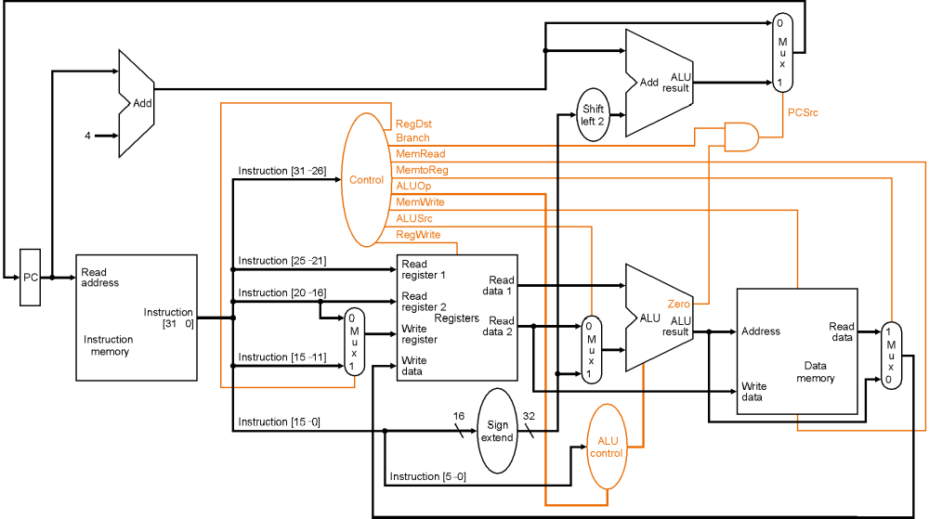
Single Cycle CPU

Slide 6
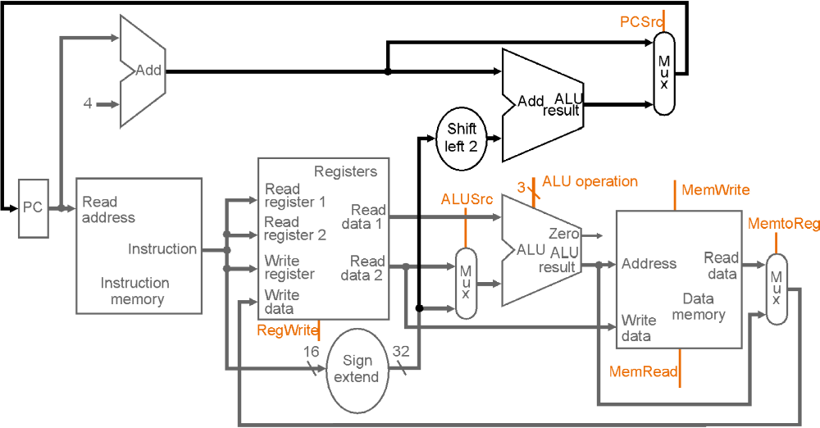
Multicycle CPU
IF ID Ex Mem WB

Slide 7
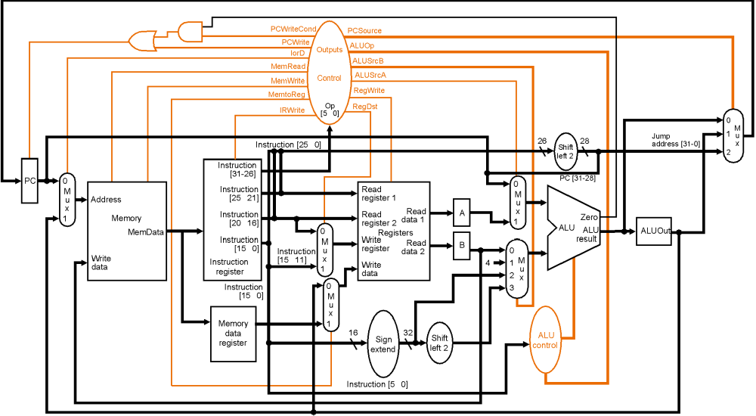
Multi-Cycle CPU

Slide 8
Instruction Latencies
Single-Cycle CPU
Load
Ifetch
Reg/Dec
Exec
Mem
Wr
Multiple Cycle CPU
Cycle 1
Cycle 2
Cycle 3
Cycle 4
Cycle 5
Load
Ifetch
Reg/Dec
Exec
Mem
Wr
Add
Ifetch
Reg/Dec
Exec
Wr

Slide 9
The Multicycle Processor
The Five Stages of Load
Cycle 1
Cycle 2
Cycle 3
Cycle 4
Cycle 5
Load
Ifetch
Reg/Dec
Exec
Mem
Wr
Ifetch: Instruction Fetch
Reg/Dec: Registers Fetch and Instruction Decode
Exec: Calculate the memory address
Mem: Read the data from the Data Memory
Wr: Write the data back to the register file

Slide 10
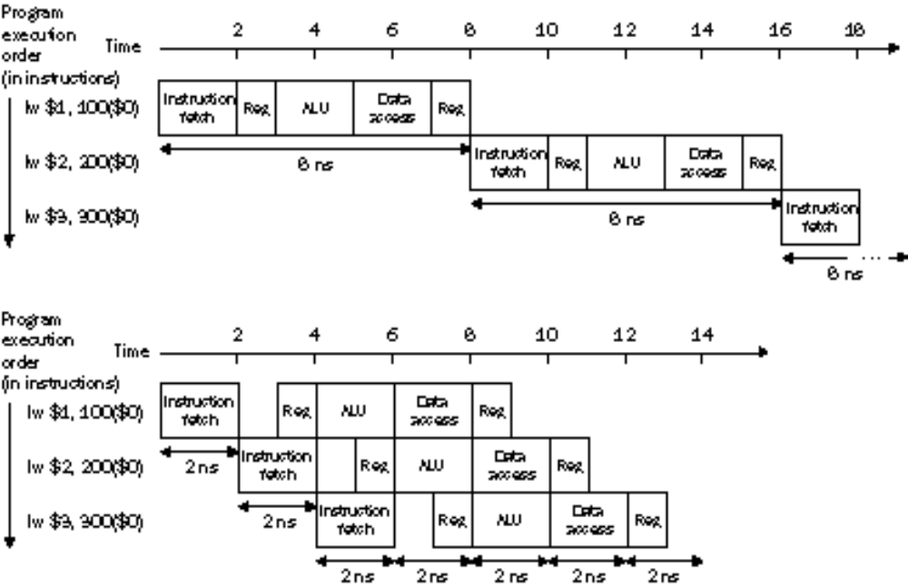
Pipelining
Improve perfomance by increasing instruction throughput
Ideal speedup is number of stages in the pipeline. Do we achieve this?

Slide 11
Single Cycle, Multiple Cycle, vs. Pipeline
Cycle 1
Cycle 2
Clk
Single Cycle Implementation:
Load
Store
Waste
Cycle 1
Cycle 2
Cycle 3
Cycle 4
Cycle 5
Cycle 6
Cycle 7
Cycle 8
Cycle 9
Cycle 10
Clk
Multiple Cycle Implementation:
Load
Store
R-type
Ifetch
Reg
Exec
Mem
Wr
Ifetch
Reg
Exec
Mem
Ifetch
Pipeline Implementation:
Load
Ifetch
Reg
Exec
Mem
Wr
Store
Ifetch
Reg
Exec
Mem
Wr
R-type
Ifetch
Reg
Exec
Mem
Wr

Slide 12
Conventional Pipelined Execution Representation
Time
IFetch
Dcd
Exec
Mem
WB
IFetch
Dcd
Exec
Mem
WB
IFetch
Dcd
Exec
Mem
WB
IFetch
Dcd
Exec
Mem
WB
IFetch
Dcd
Exec
Mem
WB
Program Flow
IFetch
Dcd
Exec
Mem
WB
Suppose we execute 100 instructions, CPI=4.6, 45ns vs. 10ns cycle time.
Single Cycle Machine: 45 ns/cycle x 1 CPI x 100 inst = 4500 ns
Multicycle Machine: 10 ns/cycle x 4.6 CPI (due to inst mix) x 100 inst = 4600 ns
Ideal pipelined machine: 10 ns/cycle x (1 CPI x 100 inst + 4 cycle drain) = 1040 ns

Slide 13
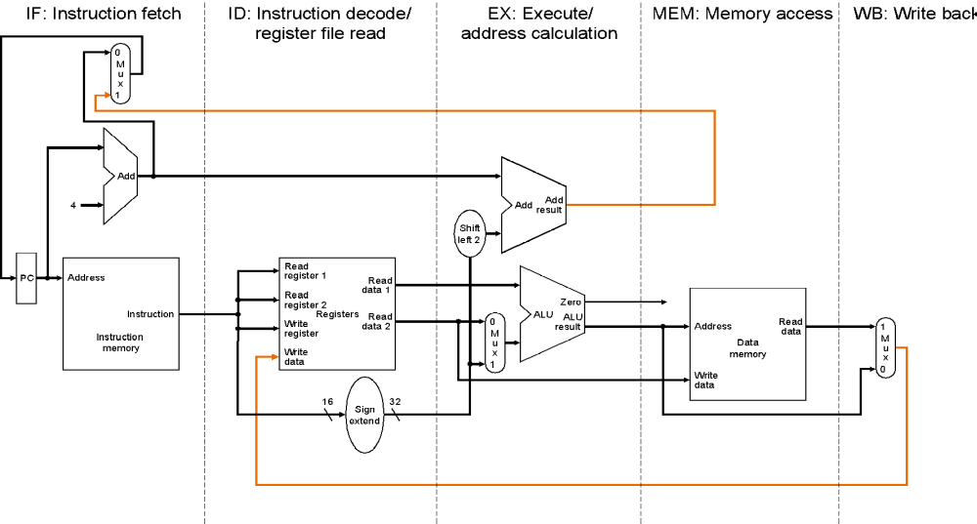
Basic Idea
What do we need to add to actually split the datapath into stages?

Slide 14
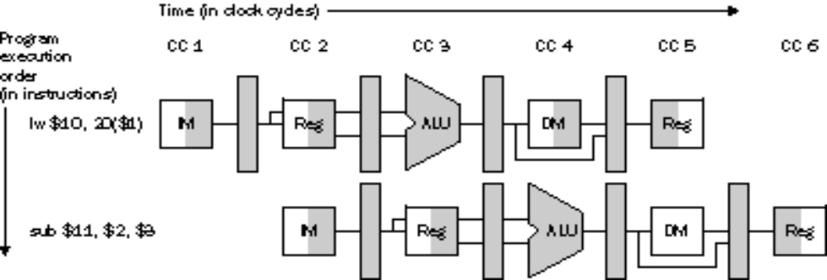
Graphically Representing Pipelines
Memory Read
Reg Write
Can help with answering questions like:
  how many cycles does it take to execute this code?
  what is the ALU doing during cycle 4?
  use this representation to help understand datapaths

Slide 15
Pipelined execution
CC1
CC2
CC3
CC4
CC5
CC6
CC7
CC8
CC9
IF
ID
EX
MEM
WB
lw
IM
Reg
ALU
DM
Reg
IF
ID
EX
MEM
WB
lw
IM
Reg
ALU
DM
Reg
lw
IM
Reg
ALU
DM
Reg
lw
IM
Reg
ALU
DM
Reg
lw
IM
Reg
ALU
DM
Reg
steady
state

Slide 16
Mixed Instructions in Pipeline
CC1
CC2
CC3
CC4
CC5
CC6
lw
IM
Reg
ALU
DM
Reg
add
IM
Reg
ALU
Reg

Slide 17
Principles of pipelining
All instructions that share a pipeline must have the same stages in the same order.
  therefore, add does nothing during Mem stage
  sw does nothing during WB stage
All intermediate values must be latched each cycle.
There is no functional block reuse
  So, like the single cycle design, we now need two adders + one ALU ☹
IF ID EX MEM WB
IM
Reg
ALU
DM
Reg

Slide 18
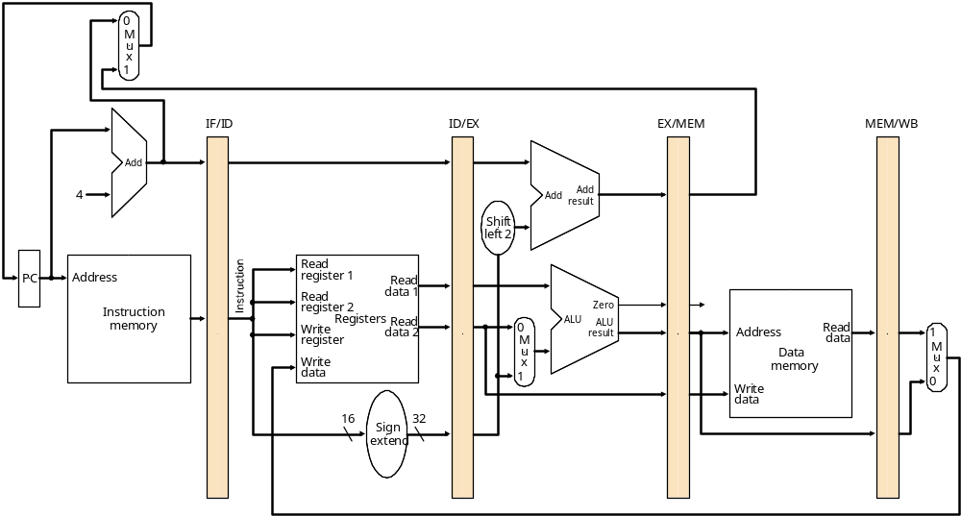
Pipelined Datapath
Instruction Fetch
Instruction Decode/
Register Fetch
Execute/
Address Calculation
Memory Access
Write Back
registers!

Slide 19
Pipelined Datapath
add $10, $1, $2
Instruction Decode/
Register Fetch
Execute/
Address Calculation
Memory Access
Write Back

Slide 20
Pipelined Datapath
lw $12, 1000($4)
add $10, $1, $2
Execute/
Address Calculation
Memory Access
Write Back

Slide 21
Pipelined Datapath
sub $15, $4, $1
lw $12, 1000($4)
add $10, $1, $2
Memory Access
Write Back

Slide 22
Pipelined Datapath
Instruction Fetch
sub $15, $4, $1
lw $12, 1000($4)
add $10, $1, $2
Write Back

Slide 23
Pipelined Datapath
Instruction Fetch
Instruction Decode/
Register Fetch
sub $15, $4, $1
lw $12, 1000($4)
add $10, $1, $2

Slide 24
Pipelined Datapath
Instruction Fetch
Instruction Decode/
Register Fetch
Execute/
Address Calculation
sub $15, $4, $1
lw $12, 1000($4)

Slide 25
What about control?
can’t use microprogram
FSM not really appropriate
Combinational Logic!
  signals generated once, but follow instruction through the pipeline
control
instruction
IF/ID
ID/EX
EX/MEM
MEM/WB

Slide 26
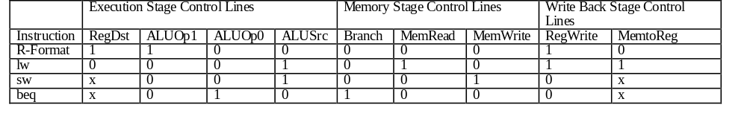
What about control?

Slide 27
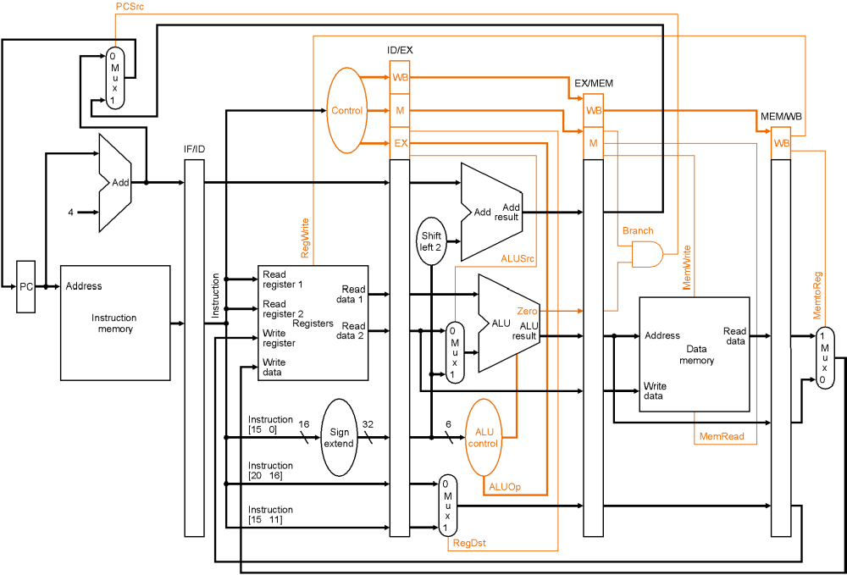
Pipelined system with control logic

Slide 28
Pipelined execution: mixed instructions?
Remember mixed instructions?
CC1
CC2
CC3
CC4
CC5
CC6
lw
IM
Reg
ALU
DM
Reg
add
IM
Reg
ALU
Reg

Slide 29
Can pipelining get us into trouble?
Yes: Pipeline Hazards
  structural hazards: attempt to use the same resource two different ways at the same time
  data hazards: attempt to use item before it is ready
    instruction depends on result of prior instruction still in the pipeline
  control hazards: attempt to make a decision before condition is evaulated
    branch instructions
Can always resolve hazards by waiting
  Worst case the machine behaves like a multi-cycle machine!
  pipeline control must detect the hazard
  take action (or delay action) to resolve hazards

Slide 30
Single Memory is a Structural Hazard
Data Read
Time (clock cycles)
I
n
s
t
r.
O
r
d
e
r
Load
Mem
Reg
ALU
Mem
Reg
Instr 1
Mem
Reg
ALU
Mem
Reg
Instr 2
Mem
Reg
ALU
Mem
Reg
Instr 3
Mem
Reg
ALU
Mem
Reg
Instr 4
Mem
Reg
ALU
Mem
Reg
Instruction Fetch
Detection is easy in this case! (right half highlight means read, left half write)

Slide 31
Data Hazards
Suppose initially, register i holds the number 2i
  $10 <= 20
  $11 <= 22
  $3 <= 6
  $7 <= 14
  $8 <= 16
What happens when...
  add $3, $10, $11 - this should add 20 + 22, putting result 42 into r3
  lw $8, 50($3) - this should load r8 from memory location 42+50 = 92
  sub $11, $8, $7 - this should subtract 14 from that just-loaded value

Slide 32
Data Hazards
lw $8, 50($3)
add $3, $10, $11
Execute/
Address Calculation
Memory Access
Write Back
20
22

Slide 33
Data Hazards
sub $11, $8, $7
lw $8, 50($3)
add $3, $10, $11
Memory Access
Write Back
Ooops! This should have been “42”!
But register 3 didn’t get updated yet.
6
16
20
22
42
50

Slide 34
Data Hazards
add $10, $1, $2
sub $11, $8, $7
lw $8, 50($3)
  add $3, $10, $11
Write Back
And this should be value
from memory (which hasn’t
even been loaded yet).
Recall: this should
have been “92”
16
14
6
50
56
42

Slide 35
Data Hazards
When a result is needed in the pipeline before it is available,
a “data hazard” occurs.
R2 Available
CC1
CC2
CC3
CC4
CC5
CC6
CC7
CC8
sub $2, $1, $3
IM
Reg
ALU
DM
Reg
IM
Reg
ALU
DM
Reg
and $12, $2, $5
IM
Reg
ALU
DM
Reg
or $13, $6, $2
R2 Needed
IM
Reg
ALU
DM
Reg
add $14, $2, $2
IM
Reg
ALU
DM
sw $15, 100($2)

Slide 36
Data Hazard on r1:
Dependencies backwards in time are hazards
Time (clock cycles)
IF
ID/RF
EX
MEM
WB
add r1,r2,r3
Im
Reg
ALU
Dm
Reg
I
n
s
t
r.
O
r
d
e
r
sub r4,r1,r3
Im
Reg
ALU
Dm
Reg
and r6,r1,r7
Im
Reg
ALU
Dm
Reg
or r8,r1,r9
Im
Reg
ALU
Dm
Reg
xor r10,r1,r11
Im
Reg
ALU
Dm
Reg

Slide 37
Data Hazards
In Software
  inserting independent instructions
In Hardware
  inserting bubbles (stalling the pipeline)
  data forwarding
Data Hazards are caused by instruction dependences. For example, the add is data-dependent on the subtract:
subi $5, $4, #45
add $8, $5, $2

Slide 38
Handling Data Hazards
Transparent register file eliminates one hazard.
  Use latches rather than flip-flops in Reg file
    First half-cycle of cycle 5: register 2 loaded
    Second half-cycle: new value is read into pipeline state
CC1
CC2
CC3
CC4
CC5
CC6
CC7
CC8
sub $2, $1, $3
IM
Reg
ALU
DM
Reg
R2 Available
IM
Reg
ALU
DM
Reg
and $12, $6, $5
IM
Reg
ALU
DM
Reg
or $13, $6, $8
IM
Reg
ALU
DM
Reg
add $14, $2, $2

Slide 39
Handling Data Hazards: Software
CC1
CC2
CC3
CC4
CC5
CC6
CC7
CC8
sub $2, $1, $3
IM
Reg
ALU
DM
Reg
nop
IM
Reg
ALU
DM
Reg
IM
Reg
ALU
DM
Reg
nop
IM
Reg
ALU
DM
Reg
add $12, $2, $5
Insert enough no-ops (or other instructions that don’t
use register 2) so that data hazard doesn’t occur,
Remember the “out-of-order” execution
on the Power4 from last class?

Slide 40
Handling Data Hazards: Software
sub $2, $1,$3
and $4, $2,$5
or $8, $2,$6
add $9, $4,$2
slt $1, $6,$7
Assume a standard 5-stage pipeline,
How many data-hazards in this piece of code?
How many no-ops do you need?
Where?
What if you are allowed to execute out-of-order?

Slide 41
Handling Data Hazards: Hardware: Bubbles
CC1
CC2
CC3
CC4
CC5
CC6
CC7
CC8
sub $2, $1, $3
IM
Reg
DM
Reg
and $12, $2, $5
IM
Bubble
Bubble
Reg
DM
Reg
or $13, $6, $2
IM
Reg
DM
Reg
IM
Reg
DM
add $14, $2, $2

Slide 42
Handling Data Hazards: Hardware: Pipeline Stalls
To insure proper pipeline execution in light of register dependences, we must:
  Detect the hazard
  Stall the pipeline
    prevent the IF and ID stages from making progress
      the ID stage because we can’t go on until the dependent instruction completes correctly
      the IF stage because we do not want to lose any instructions.
    insert“no-ops” into later stages

Slide 43
Handling Data Hazards: Hardware: Pipeline Stalls
How to stall a pipeline in two quick steps !
Prevent the IF and ID stages from proceeding
  don’t write the PC (PCWrite = 0)
  don’t rewrite IF/ID register (IF/IDWrite = 0)
Insert “nops”
  set all control signals propagating to EX/MEM/WB to zero

Slide 44
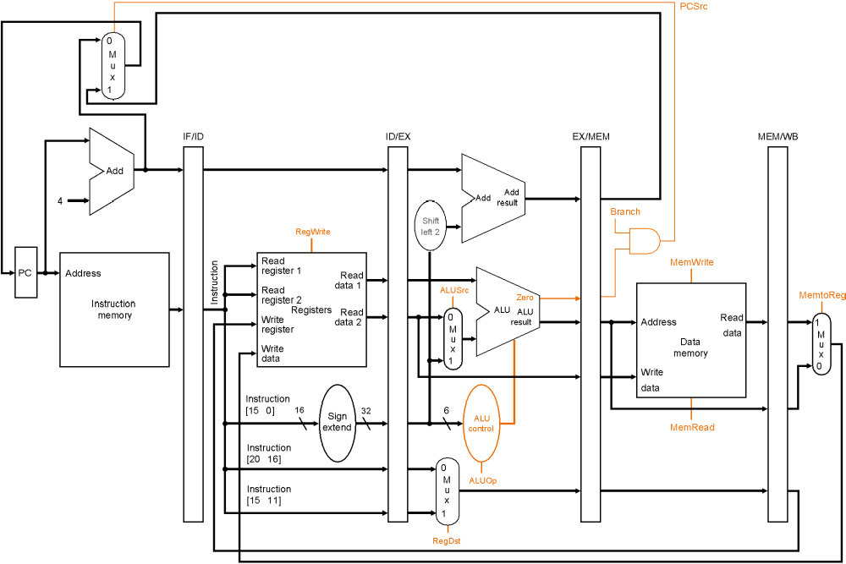
Handling Data Hazards: Hardware: Pipeline Stalls

Slide 45
Handling Data Hazards: Forwarding
add $2, $3, $4
IM
Reg
ALU
DM
Reg
or $5, $3, $2
IM
Reg
ALU
DM
Reg
We could avoid stalling if we could get the ALU output from “add” to ALU input
for the “or”
ID/EX
EX/MEM
MEM/WB
Registers
ALU
Data
Memory
0
1

Slide 46
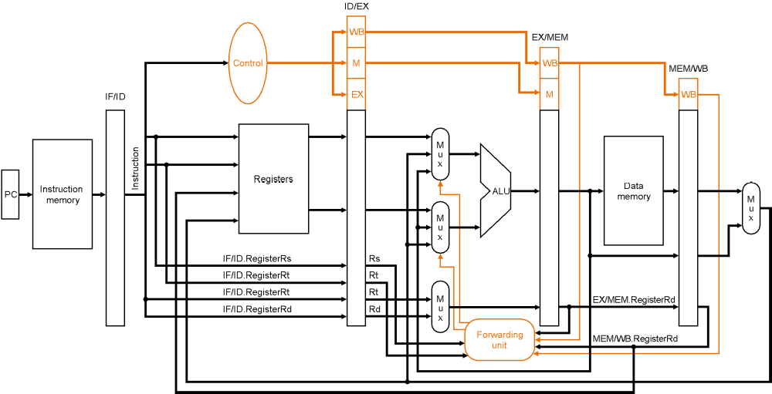
Handling Data Hazards: Forwarding
EX Hazard:
if (EX/MEM.RegWrite
and (EX/MEM.RegisterRd != 0)
and (EX/MEM.RegisterRd = ID/EX.RegisterRs)) ForwardA = 10
if (EX/MEM.RegWrite
and (EX/MEM.RegisterRd != 0)
and (EX/MEM.RegisterRd = ID/EX.RegisterRt)) ForwardB = 10
(similar for the MEM stage)

Slide 47
Handling Data Hazards: Forwarding
Forwarding (just shown) handles two types of data hazards
  EX hazard
  MEM hazard
We’ve already handled the third type (WB) hazard by using a transparent reg file
  if the register file is asked to read and write the same register in the same cycle, the reg file allows the write data to be forwarded to the output.

Slide 48
Data Hazard Solution:
“Forward” result from one stage to another
“or” OK if define read/write properly
Time (clock cycles)
IF
ID/RF
EX
MEM
WB
add r1,r2,r3
Im
Reg
ALU
Dm
Reg
I
n
s
t
r.
O
r
d
e
r
sub r4,r1,r3
Im
Reg
ALU
Dm
Reg
and r6,r1,r7
Im
Reg
ALU
Dm
Reg
or r8,r1,r9
Im
Reg
ALU
Dm
Reg
xor r10,r1,r11
Im
Reg
ALU
Dm
Reg

Slide 49
Data Hazard Solution: With Forwarding
CC1
CC2
CC3
CC4
CC5
CC6
CC7
CC8
sub $2, $1, $3
IM
Reg
ALU
DM
Reg
IM
Reg
ALU
DM
Reg
and $6, $2, $5
IM
Reg
ALU
DM
Reg
or $13, $6, $2
IM
Reg
ALU
DM
Reg
add $14, $2, $2
IM
Reg
ALU
DM
sw $15, 100($2)

Slide 50
Data Hazard Solution: What about this stream?
CC1
CC2
CC3
CC4
CC5
CC6
CC7
CC8
lw $2, 10($1)
IM
Reg
ALU
DM
Reg
IM
Reg
ALU
DM
Reg
and $12, $2, $5
IM
Reg
ALU
DM
Reg
or $13, $6, $2
IM
Reg
ALU
DM
Reg
add $14, $2, $2
IM
Reg
ALU
DM
sw $15, 100($2)
Solve this using forwarding?

Slide 51
Data Hazard Solution: What about this stream?
CC1
CC2
CC3
CC4
CC5
CC6
CC7
CC8
lw $2, 10($1)
IM
Reg
ALU
DM
Reg
IM
Reg
Bubble
ALU
DM
Reg
and $12, $2, $5
IM
Reg
ALU
DM
Reg
or $13, $6, $2
Bubble
IM
Reg
ALU
DM
add $14, $2, $2
IM
Reg
ALU
sw $15, 100($2)
Still need bubbles !!!
Loads are always the problem?

Slide 52
Forwarding (or Bypassing):
Dependencies backwards in time are hazards
Can’t solve with forwarding:
Must delay/stall instruction dependent on loads
Time (clock cycles)
IF
ID/RF
EX
MEM
WB
lw r1,0(r2)
Im
Reg
ALU
Dm
Reg
sub r4,r1,r3
Im
Reg
ALU
Dm
Reg

Slide 53
Data Hazards: Compiler Help?
How many No-ops?
sub $2, $1,$3
and $4, $2,$5
or $8, $2,$6
add $9, $4,$2
slt $1, $6,$7
With re-ordering?
sub $2, $1,$3
and $4, $2,$5
or $8, $3,$6
add $9, $2,$8
slt $1, $6,$7
sub $2, $1,$3
or $8, $3,$6
slt $1, $6,$7
and $4, $2,$5
add $9, $2,$8

Slide 54
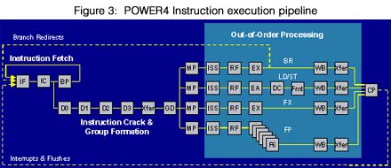
Data Hazards: Key points
Pipelining provides high throughput, but does not handle data dependencies easily.
Data dependencies cause data hazards.
Data hazards can be solved by:
  software (nops)
  hardware stalling
  hardware forwarding
All modern processors, use a combination of forwarding and stalling.

Slide 55
Branch Hazards
or
“Which way did he go?”

Slide 56
Dependencies
Data dependence: one instruction is dependent on another instruction to provide its operands.
Control dependence (aka branch dependences): one instructions determines whether another gets executed or not.
Control dependences are particularly critical with conditional branches.
add $5, $3, $2
sub $6, $5, $2
beq $6, $7, somewhere
and $9, $3, $1
data dependences
somewhere: or $10, $5, $2
add $12, $11, $9
...
control dependence

Slide 57
When are branches resolved?
Instruction Fetch
Instruction Decode
Execute/
Address Calculation
Memory Access
Write Back
Branch target address is put in PC during Mem stage.
Correct instruction is fetched during branch’s WB stage.

Slide 58
When are branches resolved?
CC1
CC2
CC3
CC4
CC5
CC6
CC7
CC8
beq $2, $1, here
IM
Reg
ALU
DM
Reg
add ...
IM
Reg
ALU
DM
Reg
IM
Reg
ALU
DM
Reg
sub ...
These instructions
shouldn’t be executed!
IM
Reg
ALU
DM
Reg
lw ...
IM
Reg
ALU
DM
here: lw ...
Finally, the right instruction

Slide 59
Dealing with branch hazards
Software solution
  insert no-ops (Not popular)
Hardware solutions
  stall until you know which direction branch goes
  guess which direction, start executing chosen path (but be prepared to undo any mistakes!)
    static branch prediction: base guess on instruction type
    dynamic branch prediction: base guess on execution history
  reduce the branch delay
Software/hardware solution
  delayed branch: Always execute instruction after branch.
    Compiler puts something useful (or a no-op) there.

Slide 60
Control Hazards: The stall solution
Delay for 3 bubbles EVERY time you see a branch instruction!
CC1
CC2
CC3
CC4
CC5
CC6
CC7
CC8
beq $4, $0, there
IM
Reg
DM
Reg
and $12, $2, $5
Bubble
Bubble
Bubble
IM
Reg
DM
Reg
or ...
IM
Reg
DM
Reg
IM
Reg
DM
add ...
IM
Reg
sw ...
All branches waste 3 cycles.
  Seems wasteful, particularly when the branch isn’t taken.
It’s better to guess whether branch will be taken
  Easiest guess is “branch isn’t taken”

Slide 61
Control Hazards: Speculative Execution
Case 0: Branch not taken
works pretty well when you’re right – no wasted cycles
CC1
CC2
CC3
CC4
CC5
CC6
CC7
CC8
beq $4, $0, there
IM
Reg
DM
Reg
and $12, $2, $5
IM
Reg
DM
Reg
or ...
IM
Reg
DM
Reg
IM
Reg
DM
add ...
IM
Reg
sw ...

Slide 62
Control Hazards: Speculative Execution
Case 1: Branch taken
Same performance as stalling
CC1
CC2
CC3
CC4
CC5
CC6
CC7
CC8
beq $4, $0, there
IM
Reg
DM
Reg
Whew! none of these
instruction have changed
memory or registers.
and $12, $2, $5
IM
Reg
Flush
or ...
IM
Reg
Flush
IM
Flush
add ...
IM
Reg
there: sub $12, $4, $2

Slide 63
Control Hazards:Strategies for static speculation
Assume backwards branch is always taken, forward branch never is
  “backwards” = negative displacement field
  loops (which branch backwards) are usually executed multiple times.
  “if-then-else” often takes the “then” (no branch) clause.
Compiler makes educated guess
  sets “predict taken/not taken” bit in instruction
Static speculation: look at instruction only

Slide 64
Reducing the cost of the branch delay
it’s easy to reduce stall to 2-cycles

Slide 65
Reducing the cost of the branch delay
it’s easy to reduce stall to 2-cycles

Slide 66
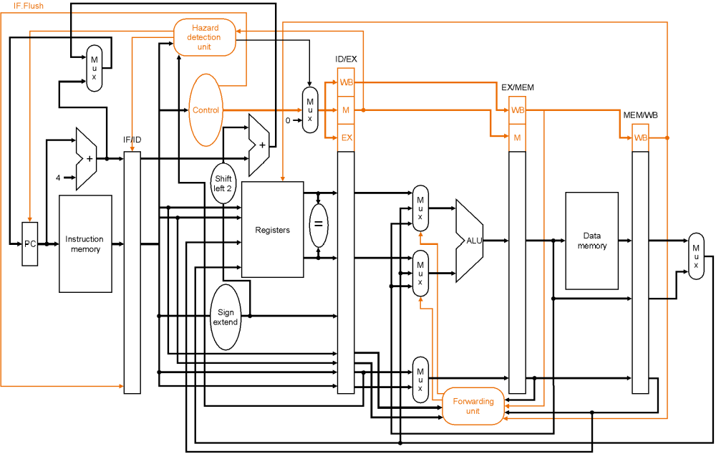
Mis-prediction penalty is down to one cycle!
Target computation & equality check in ID phase.
  This figure also shows flushing lines.

Slide 67
Stalling for branch hazards with branching in ID stage
CC1
CC2
CC3
CC4
CC5
CC6
CC7
CC8
beq $4, $0, there
IM
Reg
DM
Reg
and $12, $2, $5
Bubble
IM
Reg
DM
Reg
or ...
IM
Reg
DM
Reg
IM
Reg
DM
add ...
IM
Reg
sw ...
There’s no rule that says we have to branch immediately. We could wait an extra instruction before branching.
The original SPARC and MIPS processors used a branch delay slot to eliminate single-cycle stalls after branches.
The instruction after a conditional branch is always executed in those machines, whether the branch is taken or not!

Slide 68
Branch Delay slots!
CC1
CC2
CC3
CC4
CC5
CC6
CC7
CC8
beq $4, $0, there
IM
Reg
DM
Reg
and $12, $2, $5
IM
Reg
DM
Reg
there: xor ...
IM
Reg
DM
Reg
IM
Reg
DM
add ...
IM
Reg
sw ...
Branch delay slot instruction (next instruction after a branch) is
executed even if the branch is taken.

Slide 69
Branch Delay slots!
The branch delay slot is only useful if you can find something to put there.
  Need earlier instruction that doesn’t affect the branch
If you can’t find anything, you must put a nop to insure correctness.
Worked well for early RISC machines.
  Doesn’t help recent processors much
  E.g. MIPS R10000, has a 5-cycle branch penalty, and executes 4 instructions per cycle.
  Still works for the ARM7 (3 stage pipe)
    But not for the ARM9/10 (5/7 stage pipes)
Delayed branch is a permanent part of the MIPS ISA.

Slide 70
Branch Prediction: non-static or dynamic
Static branch prediction isn’t good enough when mispredicted branches waste 10 or 20 instructions .
Dynamic branch prediction keeps a brief history of what happened at each branch.
Branch-history tables and such like machinery !

Slide 71
Back to branch prediction
Always assuming the branch is not taken is a crude form of branch prediction.
What about loops that are taken 95% of the time?
  we would like the option of assuming not taken for some branches, and taken for others, depending on ???
Mispredict because either:
  Wrong guess for that branch
  Got branch history of wrong branch when index the table
4096 entry table programs vary from 1% misprediction (nasa7, tomcatv) to 18% (eqntott), with spice at 9% and gcc at 12%
4096 about as good as infinite table, but 4096 is a lot of HW
program counter
1
0
1

Slide 72
Branch Prediction: dynamic
Branch history table
program counter
1
0000
0001
0010
0010
0011
0100
0101
...
1
for (i=0;i<10;i++) {
...
...
}
0
1
1
0
...
...
add $i, $i, #1
beq $i, #10, loop
This ‘1’ bit means, “the
last time the program
counter ended with 0100
and a beq instruction
was seen, the branch
was taken.” Hardware guesses it will be taken again.

Slide 73
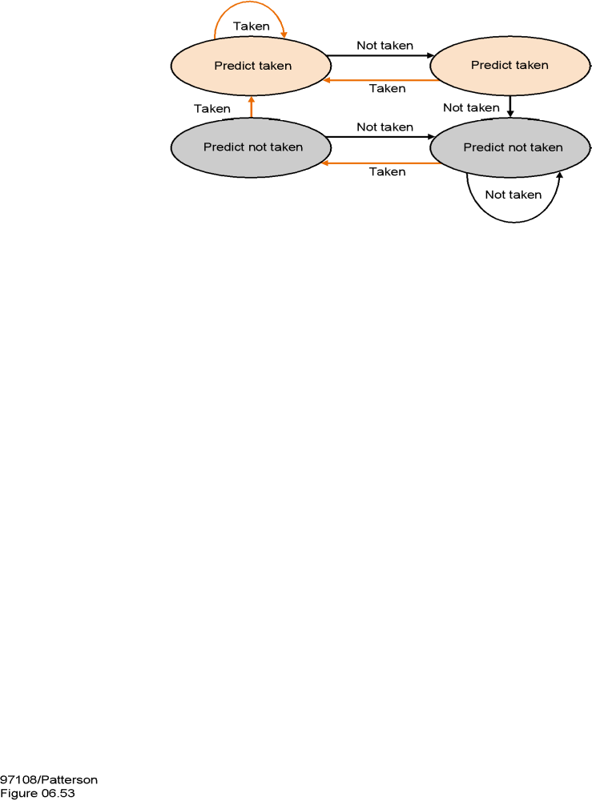
Dynamic Branch Prediction: Two bit are better than one !
this state means, “the last
two branches at this
location were taken.”
This one means, “the
last two branches at this
location were not taken.”
Research goes on, in this space.

Slide 74
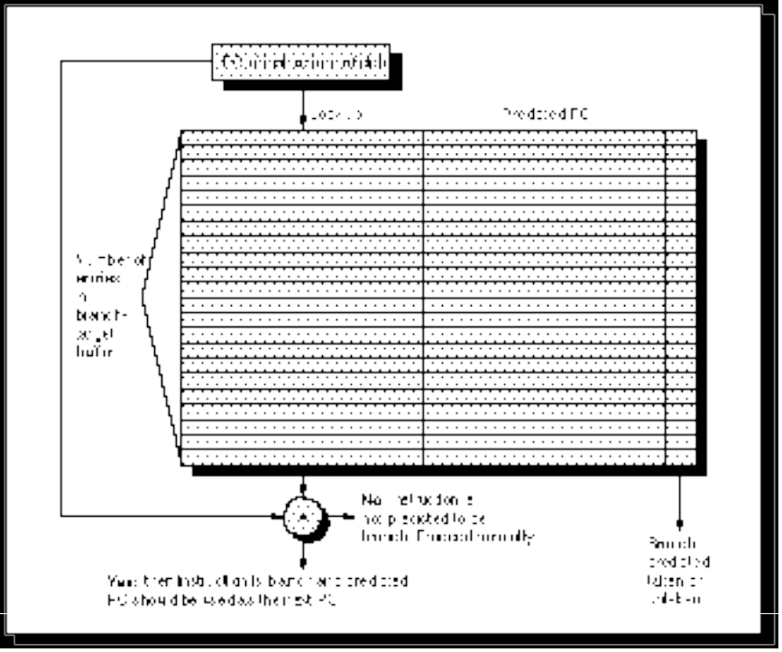
Need Address @ Same Time as Prediction
Branch Target Buffer (BTB): Address of branch index to get prediction AND branch address (if taken)
  Note: must check for branch match now, since can’t use wrong branch address
Return instruction addresses predicted with stack
Branch Prediction:
Taken or not Taken
Predicted PC

Slide 75
Dynamic Branch Prediction: The POWER4
Branch Prediction: To help mitigate the effects of the long pipeline necessitated by the high frequency design, POWER4 invests heavily in branch prediction mechanisms.
In each cycle, up to eight instructions are fetched from the direct mapped 64 KB instruction cache.
The branch prediction logic scans the fetched instructions looking for up to two branches each cycle.
Depending upon the branch type found, various branch prediction mechanisms engage to help predict the branch direction or the target address of the branch or both.
Branch direction for unconditional branches are not predicted.
All conditional branches are predicted, even if the condition register bits upon which they are dependent are known at instruction fetch time.
Branch target addresses for the PowerPC branch to link register (bclr) and branch to count register (bcctr) instructions can be predicted using a hardware implemented link stack and count cache mechanism, respectively.
Target addresses for absolute and relative branches are computed directly as part of the branch scan function.
As branch instructions flow through the rest of the pipeline, and ultimately execute in the branch execution unit, the actual outcome of the branches are determined. At that point, if the predictions were found to be correct, the branch instructions are simply completed like all other instructions.
In the event that a prediction is found to be incorrect, the instruction fetch logic causes the mispredicted instructions to be discarded and starts refetching instructions along the corrected path.

Slide 76
Branch Hazards: Summary
Branch (or control) hazards arise because we must fetch the next instruction before we know if we are branching or not.
Branch hazards are detected in hardware.
We can reduce the impact of branch hazards through:
      computing branch target and testing early
      branch delay slots
      branch prediction – static or dynamic

Slide 77
What about Interrupts, Traps, Faults?
Exceptions represent another form of control dependence.
Therefore, they create a potential branch hazard
Exceptions must be recognized early enough in the pipeline that subsequent instructions can be flushed before they change any permanent state.
As long as we do that, everything else works the same as before.
Exception-handling that always correctly identifies the offending instruction is called precise interrupts.
External Interrupts:
  Allow pipeline to drain,
  Load PC with interupt address
Faults (within instruction, restartable)
  Force trap instruction into IF
  disable writes till trap hits WB
  must save multiple PCs or PC + state

Slide 78
Interrupts, Traps, Faults?
IAU
npc
I mem
detect bad instruction address
Regs
lw $2,20($5)
PC
detect bad instruction
B
A
im
n
op
rw
alu
detect overflow
S
D mem
detect bad data address
m
Regs
Allow exception to take effect

Slide 79
One Solution: Freeze & Bubble
IAU
npc
I mem
freeze
Regs
op rw rs rt
PC
bubble
B
A
im
n
op
rw
alu
S
n
op
rw
D mem
m
n
op
rw
Regs

Slide 80
Interrupts, Traps, Faults?
Exceptions/Interrupts: 5 instructions executing in 5 stage pipeline
  How to stop the pipeline?
  Restart?
  Who caused the interrupt?
Stage Problem interrupts occurring
IF Page fault on instruction fetch; misaligned memory access; memory-protection violation
ID Undefined or illegal opcode
EX Arithmetic exception
MEM Page fault on data fetch; misaligned memory access; memory-protection violation; memory error
Load with data page fault, Add with instruction page fault?
Solution 1: interrupt vector/instruction 2: interrupt ASAP, restart everything incomplete

Slide 81
What about the real world?
Not fundamentally different than the techniques we discussed
  Deeper pipelines
Pipelining is combined with
  superscalar execution
  out-of-order execution
  VLIW (very-long-instruction-word)

Slide 82
Deeper Pipelines
How much deeper is productive? What are the limiting effects?
  Pipeline latching overhead
  Losses due to stalls and hazards
  Clock Speeds achievable

Slide 83
Superscalar Execution
IM
Reg
ALU
DM
Reg
IM
Reg
ALU
DM
Reg
IM
Reg
ALU
DM
Reg
IM
Reg
ALU
DM
Reg
IM
Reg
ALU
DM
Reg
IM
Reg
ALU
DM
Reg
IM
Reg
ALU
DM
Reg
IM
Reg
ALU
DM
Reg
IM
Reg
ALU
DM
Reg
IM
Reg
ALU
DM
Reg
IM
Reg
ALU
DM
Reg

Slide 84
Superscalar Execution
To execute four instructions in the same cycle, we must find four independent instructions
If the four instructions fetched are guaranteed by the compiler to be independent, this is a VLIW machine
If the four instructions fetched are only executed together if hardware confirms that they are independent, this is an in-order superscalar processor.
If the hardware actively finds four (not necessarily consecutive) instructions that are independent, this is an out-of-order superscalar processor.

Slide 85
Example: Simple Superscalar
independent int and FP issue to separate pipelines
I-Cache
Int Reg
Inst Issue
and Bypass
FP Reg
Operand /
Result
Busses
Int Unit
Load /
Store
Unit
FP Add
FP Mul
D-Cache
Single Issue Total Time = Int Time + FP Time
Max Speedup: Total Time
MAX(Int Time, FP Time)

Slide 86
Example: Simple Superscalar
Superscalar DLX: 2 instructions, 1 FP & 1 anything else
  – Fetch 64-bits/clock cycle; Int on left, FP on right
  – Can only issue 2nd instruction if 1st instruction issues
  – More ports for FP registers to do FP load & FP op in a pair
Type Pipe Stages
Int. instruction IF ID EX MEM WB
FP instruction IF ID EX MEM WB
Int. instruction IF ID EX MEM WB
FP instruction IF ID EX MEM WB
Int. instruction IF ID EX MEM WB
FP instruction IF ID EX MEM WB
1 cycle load delay expands to 3 instructions in SS
  instruction in right half can’t use it, nor instructions in next slot

Slide 87
Example: Complex Superscalar: Multiple Pipes
IR0
IR1
Issues:
  Reg. File ports
  Detecting Data
  Dependences
  Bypassing
  RAW Hazard
  WAR Hazard
  Multiple load/store ops?
  Branches
Register
File
A
B
B
A
R
R
D$
D$
T
T

Slide 88
Unrolled Loop that Minimizes Stalls for Scalar
1 Loop: LD F0,0(R1)
2 LD F6,-8(R1)
3 LD F10,-16(R1)
4 LD F14,-24(R1)
5 ADDD F4,F0,F2
6 ADDD F8,F6,F2
7 ADDD F12,F10,F2
8 ADDD F16,F14,F2
9 SD 0(R1),F4
10 SD -8(R1),F8
11 SD -16(R1),F12
12 SUBI R1,R1,#32
13 BNEZ R1,LOOP
14 SD 8(R1),F16 ; 8-32 = -24
14 clock cycles, or 3.5 per iteration
LD to ADDD: 1 Cycle
ADDD to SD: 2 Cycles

Slide 89
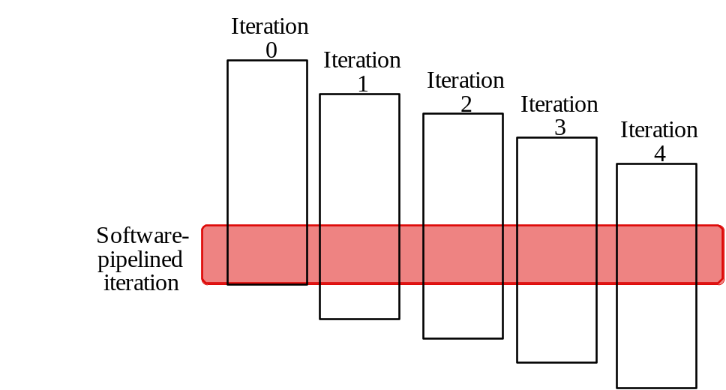
Software Pipelining
Observation: if iterations from loops are independent, then can get ILP by taking instructions from different iterations
Software pipelining: reorganizes loops so that each iteration is made from instructions chosen from different iterations of the original loop

Slide 90
Software Pipelining
Before: Unrolled 3 times
1 LD F0,0(R1)
2 ADDD F4,F0,F2
3 SD 0(R1),F4
4 LD F6,-8(R1)
5 ADDD F8,F6,F2
6 SD -8(R1),F8
7 LD F10,-16(R1)
8 ADDD F12,F10,F2
9 SD -16(R1),F12
10 SUBI R1,R1,#24
11 BNEZ R1,LOOP
After: Software Pipelined
1 SD 0(R1),F4 ; Stores M[i]
2 ADDD F4,F0,F2 ; Adds to M[i-1]
3 LD F0,-16(R1); Loads M[i-2]
4 SUBI R1,R1,#8
5 BNEZ R1,LOOP

Slide 91
Out of order execution
Issues (begins execution of) an instruction as soon as all of its dependences are satisfied, even if prior instructions are stalled.
lw $6, 36($2)
add $5, $6, $4
lw $7, 1000($5)
sub $9, $12, $5
sw $5, 200($6)
add $3, $9, $9
and $11, $7, $6
Reservation stations:
Used to manage dynamic scheduling
result bus
ALU op
rs
rs value
rt
rt value
rdy
Execution
Unit

Slide 92
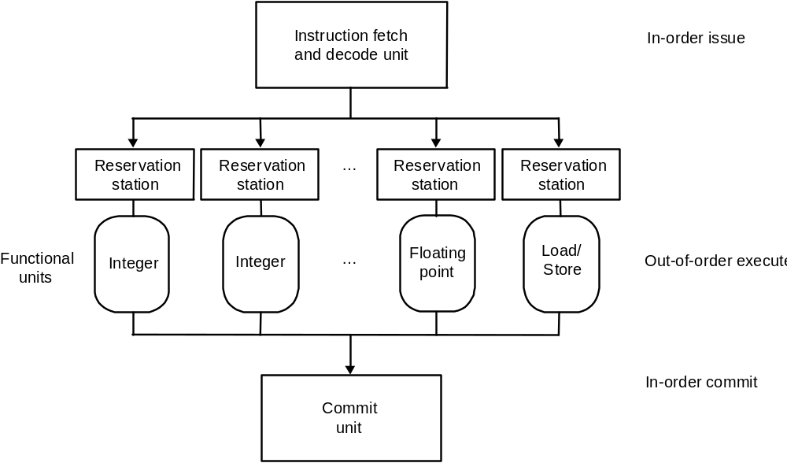
Out of order execution
Out of order execution at the hardware level

Slide 93
Issues in pipeline design
Limitation
° Pipelining
IF
D
Ex
M
W
IF
D
Ex
M
W
IF
D
Ex
M
W
Issue rate, FU stalls, FU depth
° Super-pipeline
IF
D
Ex
M
W
- Issue one instruction per (fast) cycle
- ALU takes multiple cycles
IF
D
Ex
M
W
IF
D
Ex
M
W
Clock skew, FU stalls, FU depth
IF
D
Ex
M
W
IF
D
Ex
M
W
° Super-scalar
IF
D
Ex
M
W
Hazard resolution
- Issue multiple scalar
IF
D
Ex
M
W
instructions per cycle
IF
D
Ex
M
W
IF
D
Ex
M
W
° VLIW (“EPIC”)
- Each instruction specifies
IF
D
Ex
M
W
Packing
multiple scalar operations
- Compiler determines parallelism
Ex
M
W
Ex
M
W
Ex
M
W
° Vector operations
IF
D
Ex
M
W
Applicability
- Each instruction specifies
Ex
M
W
series of identical operations
Ex
M
W
Ex
M
W

Slide 94
Issues in pipeline design
Pipelines pass control information down the pipe just as data moves down pipe
Forwarding/Stalls handled by local control
Exceptions stop the pipeline
MIPS I instruction set architecture made pipeline visible (delayed branch, delayed load)
More performance from deeper pipelines, parallelism
ET = Number of instructions * CPI * cycle time
Data hazards and branch hazards prevent CPI from reaching 1.0, but forwarding and branch prediction get it pretty close.
Data hazards and branch hazards need to be detected by hardware.
Pipeline control uses combinational logic. All data and control signals move together through the pipeline.
Pipelining attempts to get CPI close to 1. To improve performance we must reduce CycleTime (superpipelining) or CPI below one (superscalar, VLIW).

