Slide 1

H26HLT02
Environmental–Health Risk Fusion
Pollution + Chronic Disease
TEAM
Kuldeep Pal
Team Lead
Ekansh Pal
Team Member
Gaurav Verma
Team Member
National Institute of Technology, Tiruchirappalli

Slide 2
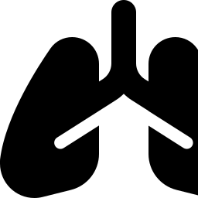
Problem Statement
Why one AQI number fails the people who need it most
The gap
Objectives
1
Collect and integrate environmental measurements, including air-quality and other relevant pollution indicators.
Air pollution and declining environmental quality are increasingly affecting people with chronic respiratory and cardiovascular conditions. Although cities collect air-quality information through monitoring stations, sensors, and satellite observations, these environmental measurements are rarely connected with local patterns in healthcare utilization. As a result, existing systems can indicate that pollution levels are unsafe but often cannot identify when and where vulnerable populations are likely to experience a health deterioration.
Identify relationships between environmental exposure and changes in local disease patterns.
2
3
Generate neighbourhood-level risk predictions for conditions such as asthma attacks, respiratory complications, and cardiac events.
4
Provide early warnings for periods with elevated health risk, particularly for vulnerable groups such as children with asthma, older adults.
5
Provide interpretable risk factors so that users can understand which environmental conditions are contributing most to the warning.
H26HLT02 · Vaayu — Environmental–Health Risk Fusion
2

Slide 3



Existing Solutions & Identified Gaps
What today’s AQI tools do — and where they stop
Govt. AQI portals
Consumer AQI apps
Health-outcome studies
CPCB / SAFAR dashboards publish live station readings and forecasts, city-wide.
IQAir, AQI.in and similar apps show a number, a color, and generic tips.
Academic work links pollution to disease trends — at a population level, after the fact.
Identified gaps —
Most systems report current pollution conditions or existing health statistics instead of forecasting possible health risks several days in advance.
Current systems often display environmental indicators without translating them into clear health-risk information or preventive recommendations.
Most systems report current pollution conditions or existing health statistics instead of forecasting possible health risks several days in advance.
H26HLT02 · Vaayu — Environmental–Health Risk Fusion
3

Slide 4
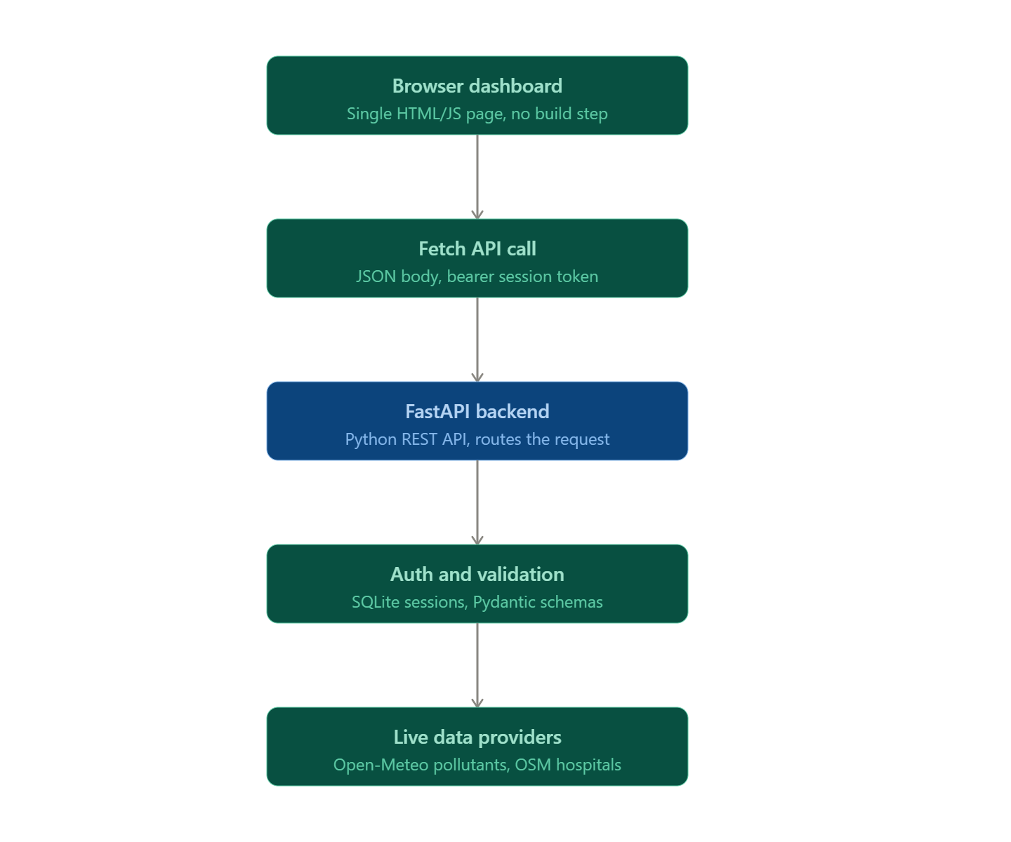
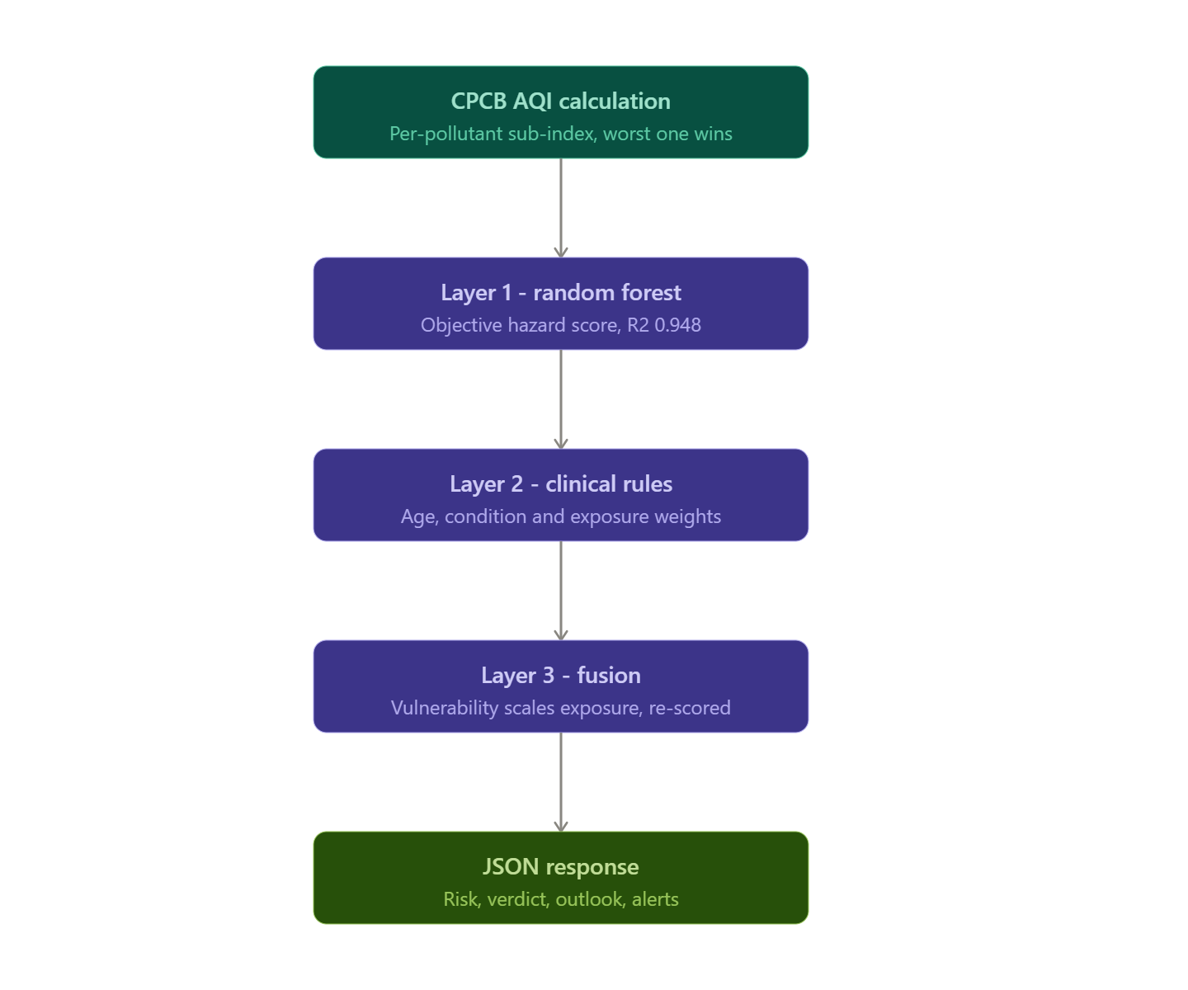
System Design

Slide 5

Implementation Progress
● Functional prototype
Working prototype — backend, model and UI are live
Functionalities completed
Preliminary results — risk model
Signup / login — salted PBKDF2 password hashing
0.948
1.50
0.483
5,811
State + city selection across all of India
R² (test)
MAE, points
Macro-F1
Training rows
Live pollutant & weather retrieval by location
Macro-F1 reported (not raw accuracy) against a 0.181 majority-class baseline — minority severity classes are honestly weak, which is why the regression score leads.
CPCB National AQI (own breakpoints, not US EPA)
3-layer fused personal risk score, per profile
Go / avoid verdict with best time window
Demonstration — same air, different lungs (CPCB AQI 104, live run)
5-day outlook and recovery-date projection
Arjun · 24, healthy
Meera · 6, asthma
Lakshmi · 68, COPD + HTN
Cumulative exposure ratio vs. WHO guideline
51.7
74.9
88.8
Personal-risk alerts with cooldown windows
Nearby hospitals via OpenStreetMap + routing
Moderate
High
Severe
air alone: 70.8
air alone: 70.8
air alone: 70.8
no amplification
+4.1 from profile
+18.0 from profile
H26HLT02 · Vaayu — Environmental–Health Risk Fusion
5

