Slide 1

DATA VISUALIZATION (CSE3020)
SLOT: B2/ L11+L12
J COMPONENT REVIEW 3
ANALYSIS OF COVID-19 AND ITS EFFECT ON THE ECONOMY
<number>

Slide 2
GROUP MEMBERS:
BHARAT JOSHI (18BCE0003)
LAKSHYA SADANA (18BCE0074)
KULDEEP PATEL (18BCE0079)
<number>

Slide 3
DOMAIN LEVEL
PROBLEM STATEMENT
The economic impact of the 2020 coronavirus pandemic in India has been largely disruptive. India's growth in the fourth quarter of the fiscal year 2020 went down to 3.1% according to the Ministry of Statistics.
It becomes very important to analyse the effect of covid 19 on economy and then understand the pattern to find it solution with the help of data visualization tools.
<number>

Slide 4
WHY OUR SOLUTION IS REQUIRED?
There were some common gaps that we identified between our project and the proposed researches in our literature survey. Some of them are as follows:
None of the research taken in the survey related the corona virus cases in a structured format with the effect of this pandemic on the stock market and economy of the world
We used data visualization tool instead of algorithmic research to show it to the common man like investors and office workers.
Our algorithmic calculation take place in backend and hence it make the process easier for the common man to relate with our project and research.
We related the cases of Covid 19 in all phases with the stock price corresponding to that phase unlike other researches. This will not only help present investors but will also help the future investors in case of similar pandemic situation. They can recreate the stock market rates using our software analysis.
<number>

Slide 5
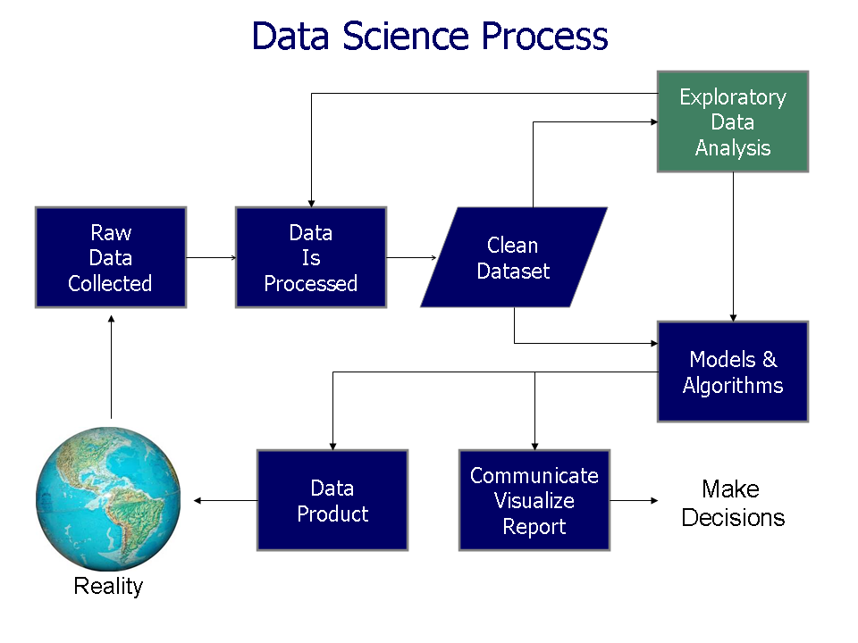
<number>

Slide 6
TASK ABSTRACTION LEVEL
WHAT TO SHOW?
Our main focus is to analyse and display the covid 19 data in animated and graphical form so that user can easily grab the pattern. We will also relate the covid 19 data with effects on economy with the help of data visualization tools. We aim to cover following objectives through our project:-
Geographical Visualization:
The main and the most compelling reason for this visualization is so that we can visualize the spread of the virus for China to the rest of the world
This graph shows the sudden rise in the number of cases in countries like the US, Italy, Iran.
<number>

Slide 7
Epidemiology curve
An "epidemic curve" shows the frequency of new cases over time based on the date of onset of disease.
The shape of the curve in relation to the incubation period for a particular disease can give clues about the source.
Logistic Graph
We will be plotting a line graph of confirmed cases Vs. confirmed cases per day of CoViD19 across the world to visualize whether we are actually winning or losing from this disease.
This graph shows all countries travelling along the trajectory of exponential growth and it makes it easy to depict which countries have managed to stop the exponential spread of the disease.
<number>

Slide 8
Spread Plots of Covid
The Covid19 data needs to be efficiently conveyed to people, since in the event of a pandemic like this, intuition cannot substitute for facts to understand how the spread is advancing.
Visualizing collected data can make its interpretation easy, and can help others understand quickly what has taken others so long to collect and analyze. After all, a picture is worth a thousand words.
Line, Spread, Ratio and Color bar plot of Stock Market
The damage caused by COVID-19 is not confined to only select pockets of businesses but it is a widespread malady that is expected to keep the economy sick for a longer time
With these visualizations we can have the magnitude of impact on each sector and which sector have suffered the most and continue to suffer.
<number>

Slide 9

<number>

Slide 10
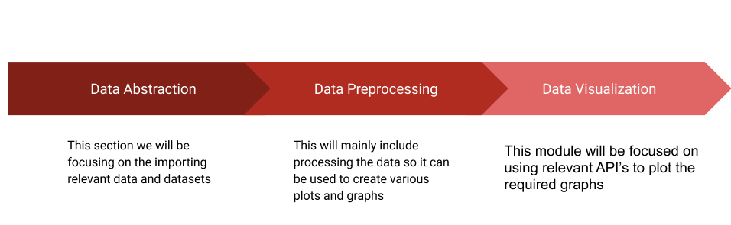
PROPOSED WORK
We can divide our project into three distinct modules, that is Data Abstraction, Data Preprocessing and Data Visualization.
<number>

Slide 11
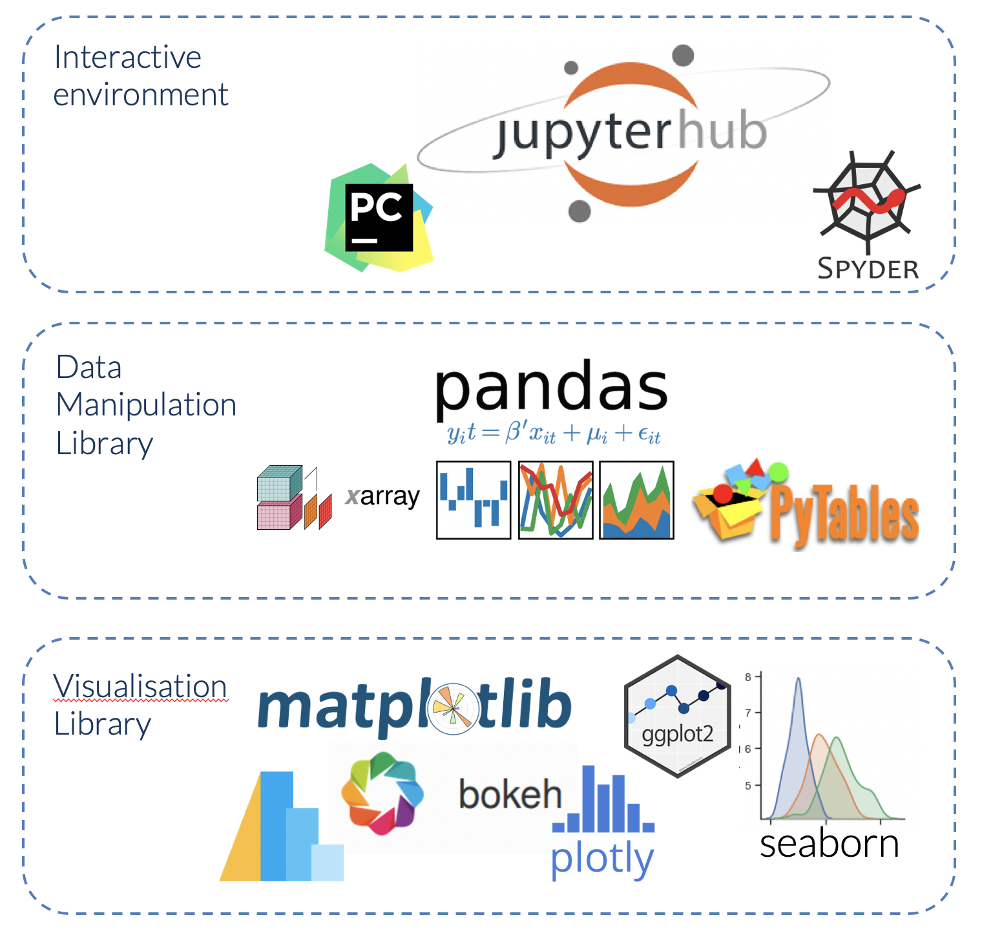




Tools Used:-
<number>

Slide 12
ENCODING AND INTERACTION LEVEL
HOW TO SHOW?
<number>

Slide 13
CHLOROPLETH VISUALIZATION
ANALYTICS:
The main and the most compelling reason for this visualization is so that we can visualize the spread of the virus for China to the rest of the world
This graph shows the sudden rise in the number of cases in countries like the US, Italy, Iran.
This also shows how countries are dealing with the pandemic in comparison to other countries by giving us a direct contrast in the number of cases and in each country.
By showing a visualization in time, it also shows which countries are improving and which in countries the situation is deteriorating.
This also helps us get a peek into the healthcare facilities by showing us the number of fatalities and recoveries of a given country.
This graph also shows where India stands globally in being able to manage the pandemic
<number>

Slide 14
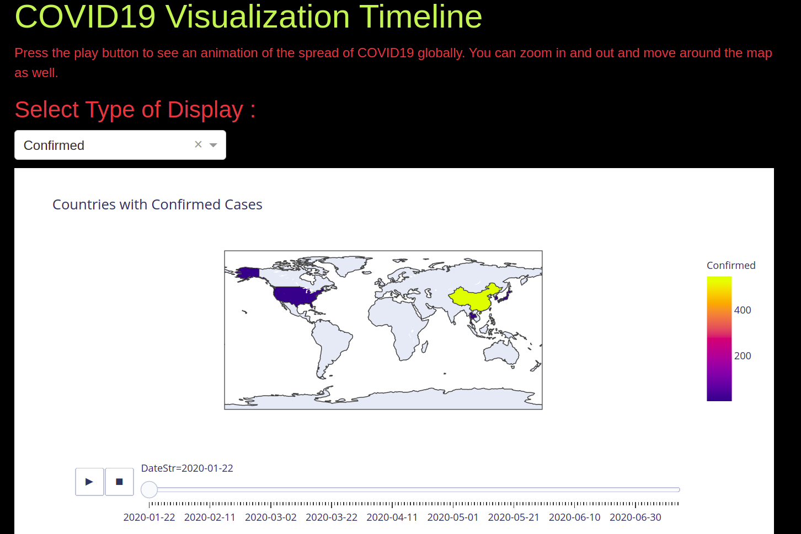
<number>

Slide 15
EPIDEMIOLOGY CURVE ANALYTICS: An "epidemic curve" shows the frequency of new cases over time based on the date of onset of disease. The shape of the curve in relation to the incubation period for a particular disease can give clues about the source. There are three basic types of epidemic curve : Point source outbreaks (epidemics) Continuous common source epidemics Propagated (or progressive source) epidemic. | In our case we are plotting Continuous common source epidemics. These types of curves may also rise to a peak and then fall, but the cases do not all occur within the span of a single incubation period. This implies that there is an ongoing source of contamination. The down slope of the curve may be very sharp if the common source is removed or gradual if the outbreak is allowed to exhaust itself. Each country is assigned a different color which makes it clear to visualize which country is suffering more from covid19. We can also visualize for an individual country by selecting that country.
<number>

Slide 16
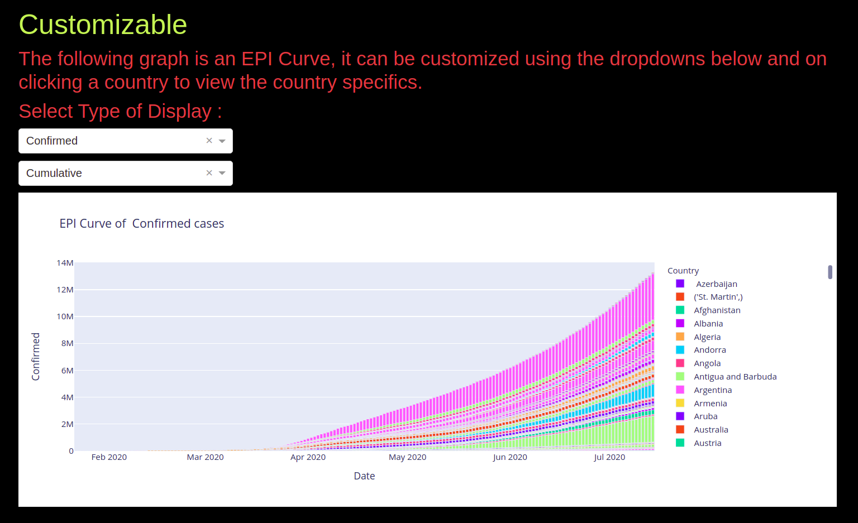
<number>

Slide 17
Logistic Graph ANALYTICS: We are plotting a line graph of confirmed cases Vs confirmed cases per day of CoViD19 across the world to visualize whether we are actually winning or losing from this disease. This graph shows all countries travelling along the trajectory of exponential growth and it makes it easy to depict which countries have managed to stop the exponential spread of the disease. | The general trend in this graph is crystal clear as all countries follow the path of exponential growth. This is clearly seen in countries like the US, India, Iran, etc. The countries that have managed to control this pandemic are clearly visualized as breaking off from this trend and falling downwards. This behaviour is seen in countries like South Korea, Hong Kong, Luxemburg. This graph also makes it clear even if a country doesn’t have a lot of cases right now, covid19 is probably going to follow the same trajectory there and end up spreading.
<number>

Slide 18
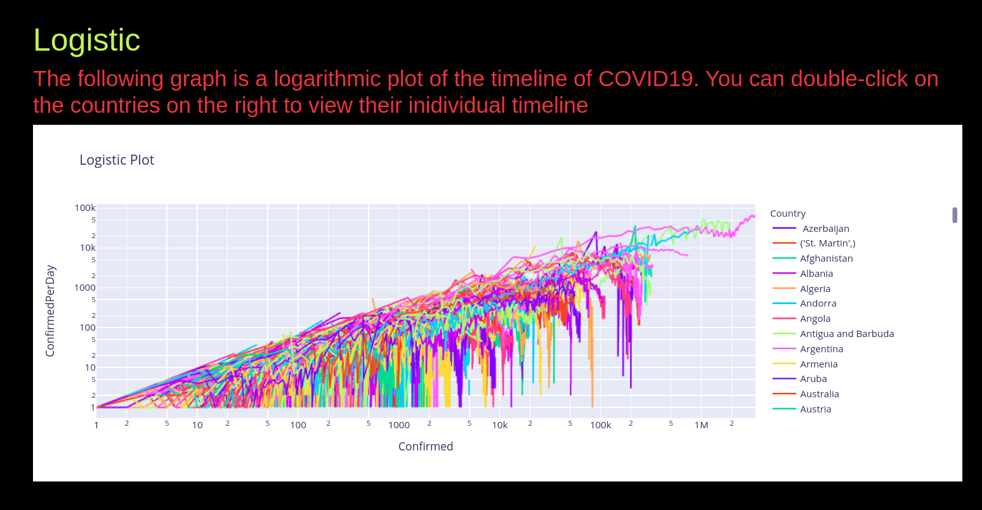
<number>

Slide 19
Spread Plots ANALYTICS: The Covid19 data needs to be efficiently conveyed to people, since in the event of a pandemic like this, intuition cannot substitute for facts to understand how the spread is advancing. | Visualizing collected data can make its interpretation easy, and can help others understand quickly what has taken others so long to collect and analyze. After all, a picture is worth a thousand words. With these plots We can visualize the number of Active , Recovered and Death cases in a particular country. We have also plotted a spread between the Confirmed and recovered cases which will help us to predict whether we are actually winning or losing from this disease.
<number>

Slide 20
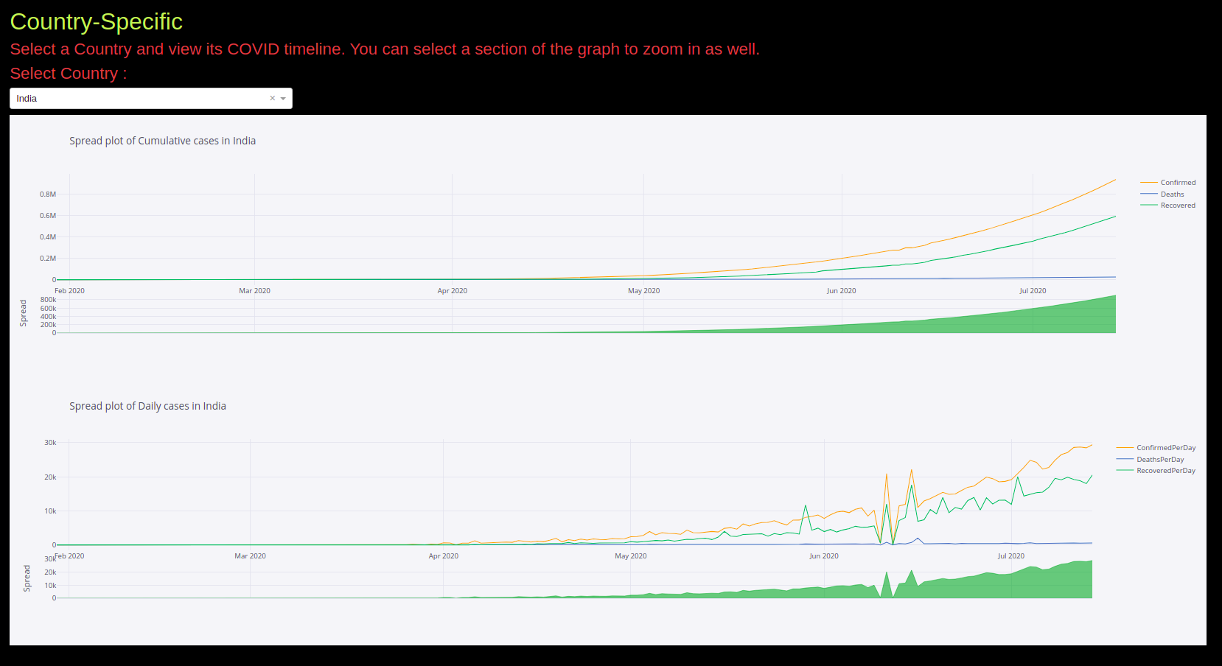
<number>

Slide 21
Stock Market Plot ANALYTICS: The damage caused by COVID-19 is not confined to only select pockets of businesses but it is a widespread malady that is expected to keep the economy sick for a longer time | With these visualizations we can have the magnitude of impact on each sector and which sector have suffered the most and continue to suffer. According people can invest in stocks. Decision making in stock investment is often made based on current events in the market and the analysis of historical data on specific stocks. So these visualizations can help stock investors in putting their money in the right place.
<number>

Slide 22
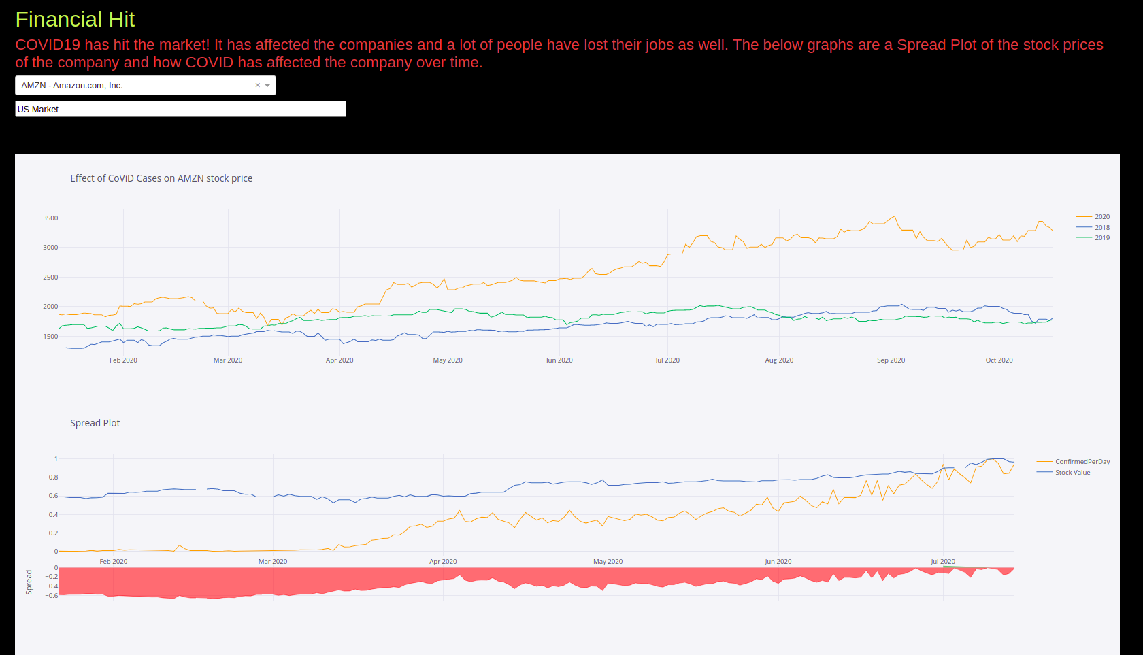
<number>

Slide 23
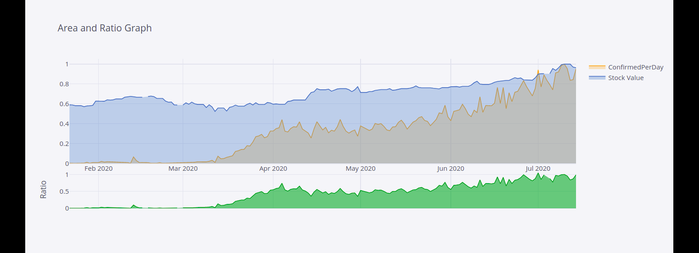

Slide 24
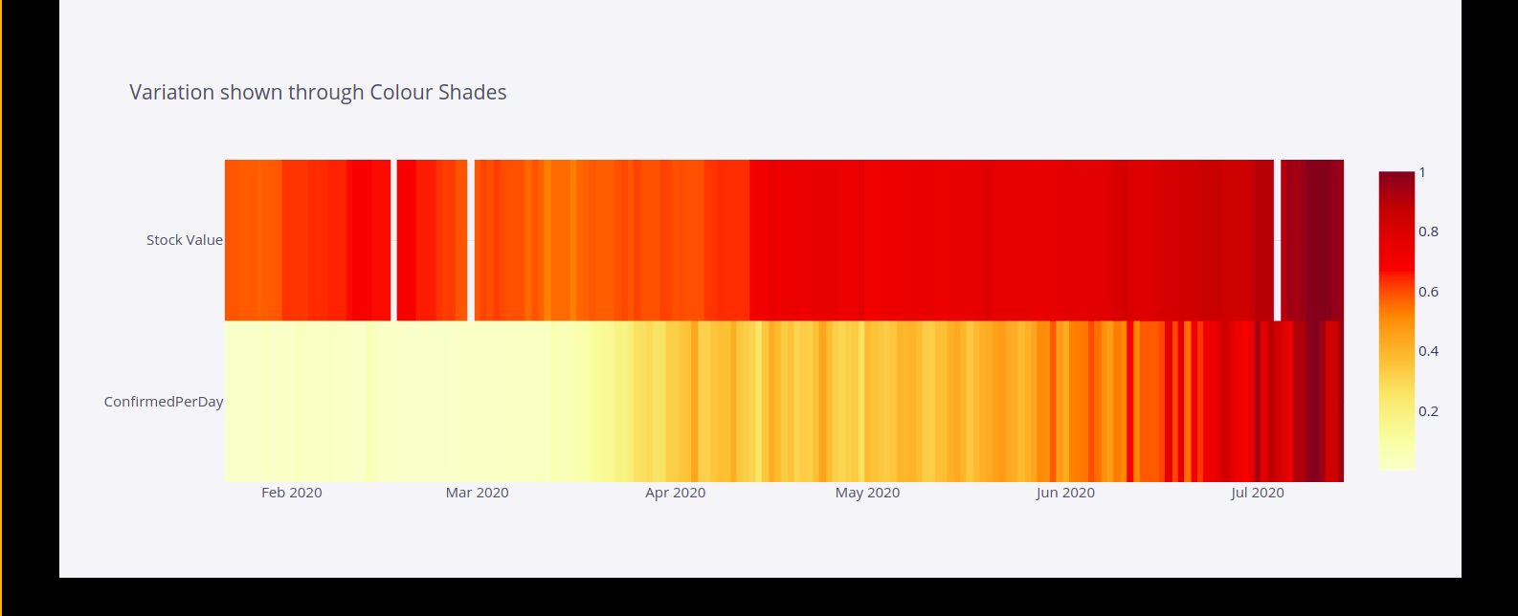

Slide 25
Prediction Model Analytics
Our goal in this project is to use ETFs to predict the value of one composite stock. The premise for this is that, we can think of an ETF as a representative for the entire industry. Banking and financial firms are all pretty much correlated to each other as even a minor policy change could potentially affect all of them. Thus, by using the performance of the ETF to train our Machine Learning models, we can arrive at a healthy and reasonable prediction for target stock : JP Morgan(JPM)
One way we can go about doing this is differencing the data. But since this is financial data, the quantmod package has a lot technical indicator functions which we can use to generate indicator data that more or less gets rid of seasonality.
Some of the indicators, we have used are:
<number>

Slide 26
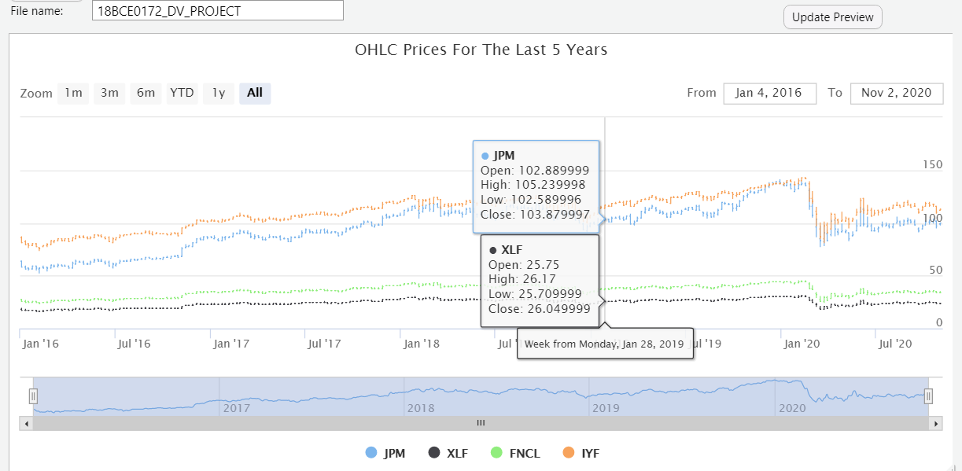
Visualization of Price History:
The highcharter library is a brilliant tool for generating visually appeasing and interactive charts. Although it's free for non-commercial/academic use, it requires a license for commercial use though. This is the first time we are playing with this library and we got to say, it's really neat. The following chart was generated using highcharter.
<number>

Slide 27
ALGORITHMIC LEVEL

Slide 28
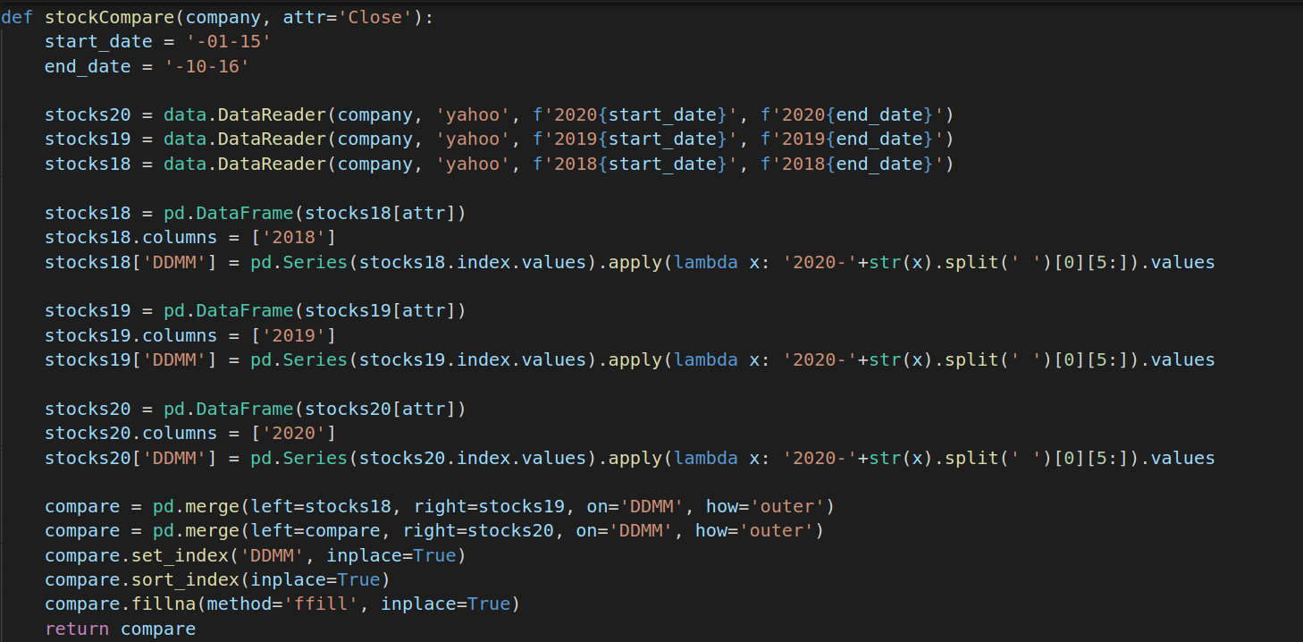
Stock Comparision

Slide 29
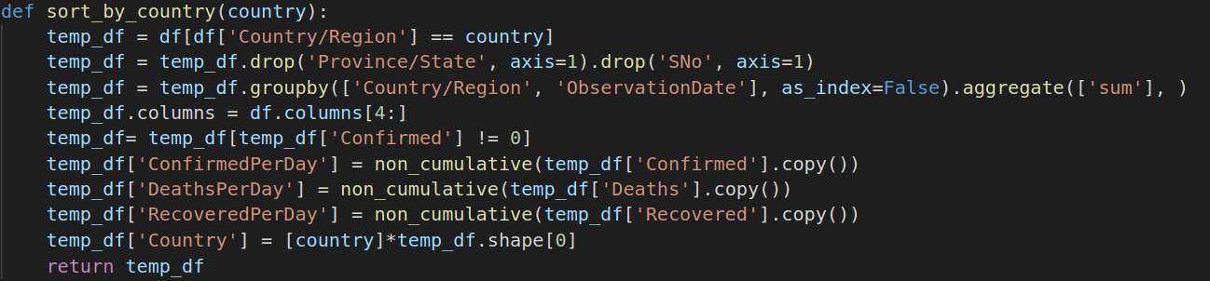
Covid Data Frame Creation

Slide 30
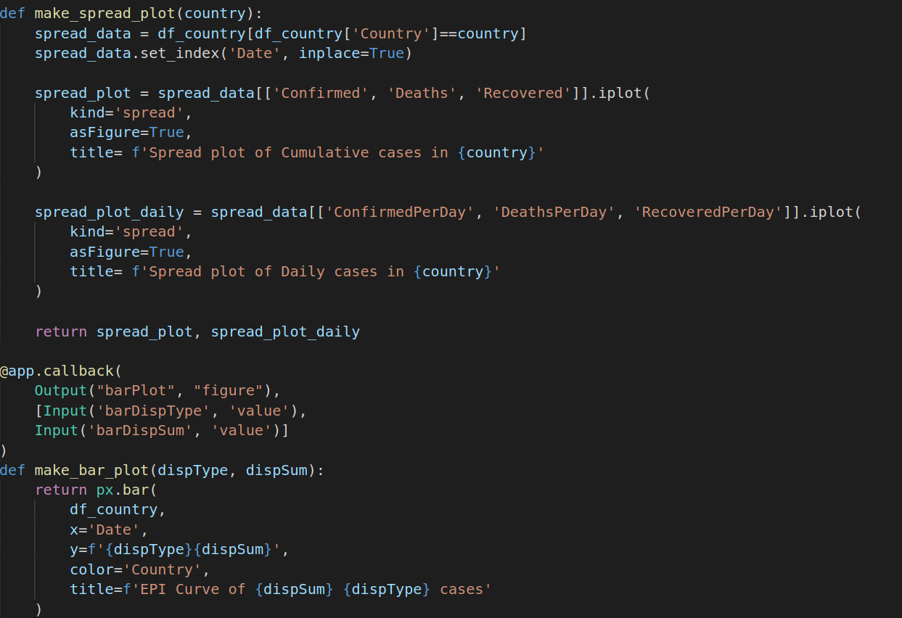
Graph Function

Slide 31
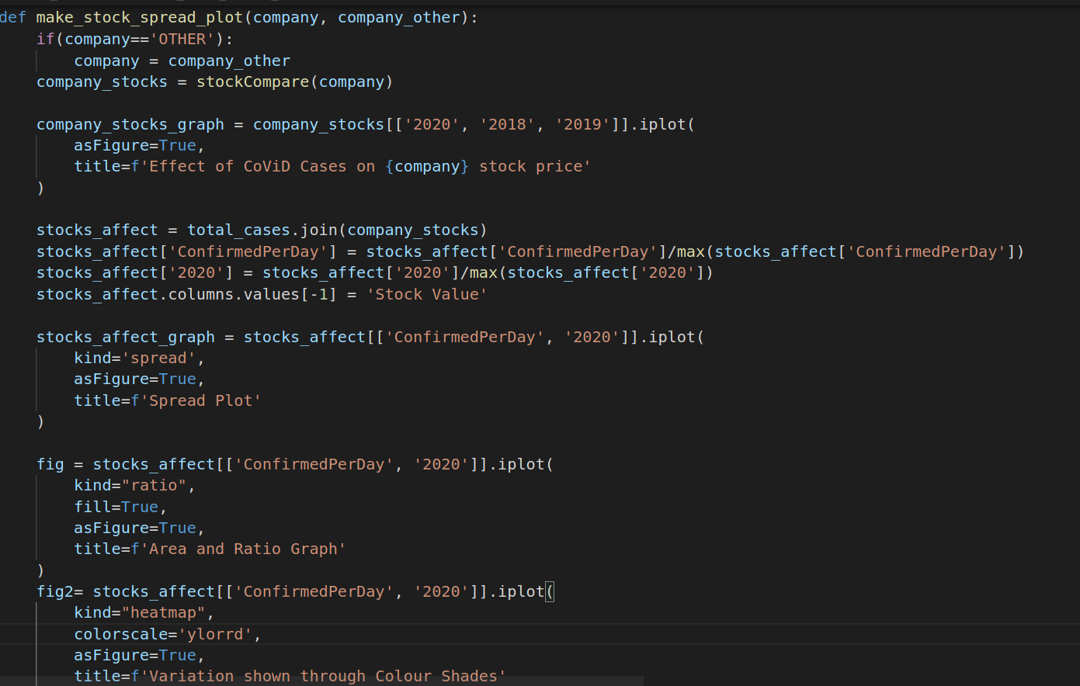
Stock Plot Functions

Slide 32
REFERENCES
[1] Thorbecke, W. (2020). The Impact of the COVID-19 Pandemic on the U.S. Economy: Evidence from the Stock Market. Journal of Risk and Financial Management, 13(10), 233.
[2] Marcus R. Keogh-Brown, Henning Tarp Jensen, W. John Edmunds, Richard D. Smith, The impact of Covid-19, associated behaviours and policies on the UK economy: A computable general equilibrium model.SSM - Population Health,2020
[3] Parupudi V.S Raghu Ram Kishore, Swati and Bhimarasetty Charish (2020); IMPACT OF COVID-19 ON FDI INFLOWS INTO INDIA Int. J. of Adv. Res. 8 (Sep). 633-640] (ISSN 2320-5407).
[4] DasT., & GuhaP. (2020). COVID 19-Induced Lockdown 2.0 and Looming Crisis across Sectors of Economy: Evidence from the Indian States . Space and Culture, India, 8(2), 5-13.
[5] Debakshi Bora, Daisy Basistha, The Outbreak of COVID-19 Pandemic and Its Impact on Stock Market Volatility: Evidence from a Worst-affected Economy, Research square 2020
<number>

Slide 33
[6] Cepoi C. O. (2020). Asymmetric dependence between stock market returns and news during COVID-19 financial turmoil. Finance research letters, 36, 101658.
[7] Akhtaruzzaman, Md and Boubaker, Sabri and Sensoy, Ahmet, Financial Contagion During COVID–19 Crisis (March 30, 2020), Finance Research Letters
[8] Scott R Baker, Nicholas Bloom, Steven J Davis, Kyle Kost, Marco Sammon, Tasaneeya Viratyosin, The Unprecedented Stock Market Reaction to COVID-19, The Review of Asset Pricing Studies
[9] Sharif, Arshian, Aloui, Chaker and Yarovaya, Larisa (2020) COVID-19 pandemic, oil prices, stock market, geopolitical risk and policy uncertainty nexus in the US economy: fresh evidence from the wavelet-based approach. International Review of Financial Analysis, 70
[10] Fernandes, Nuno, Economic Effects of Coronavirus Outbreak (COVID-19) on the World Economy, SSRN (March 22, 2020)
<number>

Slide 34
THANK YOU
<number>

