Slide 1
Triage
1
Model ranks every account
2
LLM explains, from checked facts
Who to call this week, and why: churn-risk triage for Customer Success teams
3
CSM decides and sends
Solution brief · Kuldeep Chouhan · October 2026
Notes:
Triage is a churn-risk triage system for CSM teams. The one-line design principle: a fitted model ranks, the LLM only explains from checked facts, and a human decides and sends. Everything in the walkthrough is built around keeping those three roles separate.

Slide 2
The request, reframed
The VP asked for a red/yellow/green health score and an automatic email when an account goes red
“
Asked for | What Triage does | Why
Health score | Chance of not renewing, with the reasons | A colour alone doesn't say what to do
Red / yellow / green | Red call · Amber watch · Green healthy · Grey can't see | Red is set by CSM capacity, and missing data is never green
Auto-email on red | Email drafted from facts; CSM edits, approves and sends | At a ~10% hit rate, an automatic email mostly reaches healthy customers
Nothing slips | Weekly ranked list per CSM, a can't-see section, team view | Coverage without noise
A health score per account, red / yellow / green. If an account goes red, the system should email them. That way nothing slips.
The failure behind it: two renewals lost while the warning signs sat in Zendesk and product data
Notes:
I kept the intent (nothing slips) and changed the mechanism. A colour has no action attached; capacity is the real constraint, so red means 'in your top 15 this week'. I refused auto-send: the list's precision is about 10% per slot, so an automatic 'we noticed a problem' email would mostly go to healthy customers and can accelerate churn.

Slide 3
Results on six months the model never saw
Weekly replay of the call list: 3 companies, 38 weeks, 167 lost renewals, 15 calls per CSM per week
75%
95%
0.75
105
of churners listed 14–90 days before renewal
of churned revenue listed early
ranking accuracy: how often a churner is ranked above a renewer (0.5 = coin flip)
days of warning on Kestrel Health, one of the two lost renewals
Red/yellow/green rules: 55%
Rules: 81%
Rules 0.59
Rules never listed it
Brightline Logistics (no product data, support storm) was listed from February; the rules waited until May. Hit rate is 9.4% of call slots, against 16% with perfect foresight: few accounts in any 15-call list actually churn.
Notes:
The headline is an operational metric, not AUC: of the renewals that were lost in the last six months, how many sat on a CSM's 15-call list between 14 and 90 days before renewal. Same capacity and the same revenue weighting for every method; only the risk estimate changes. Precision looks low until you compare it with perfect foresight, which is why I report the ceiling next to it.

Slide 4
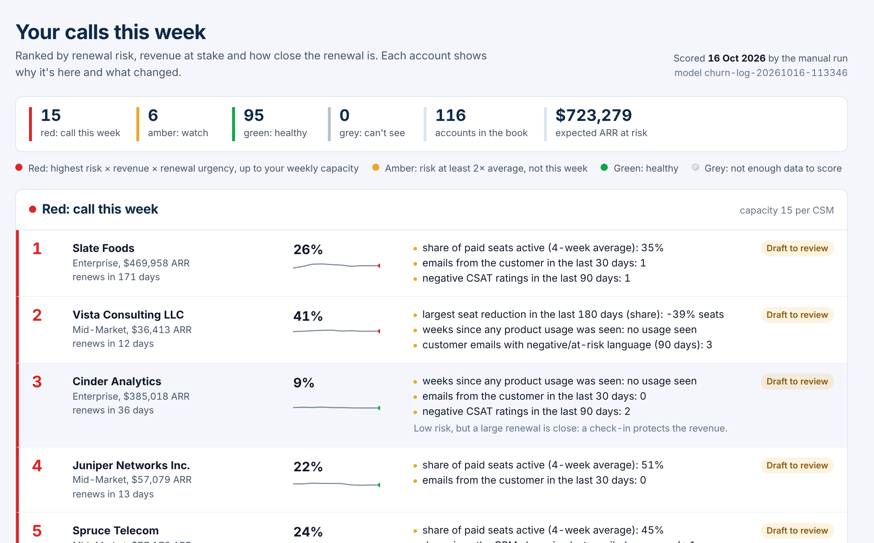
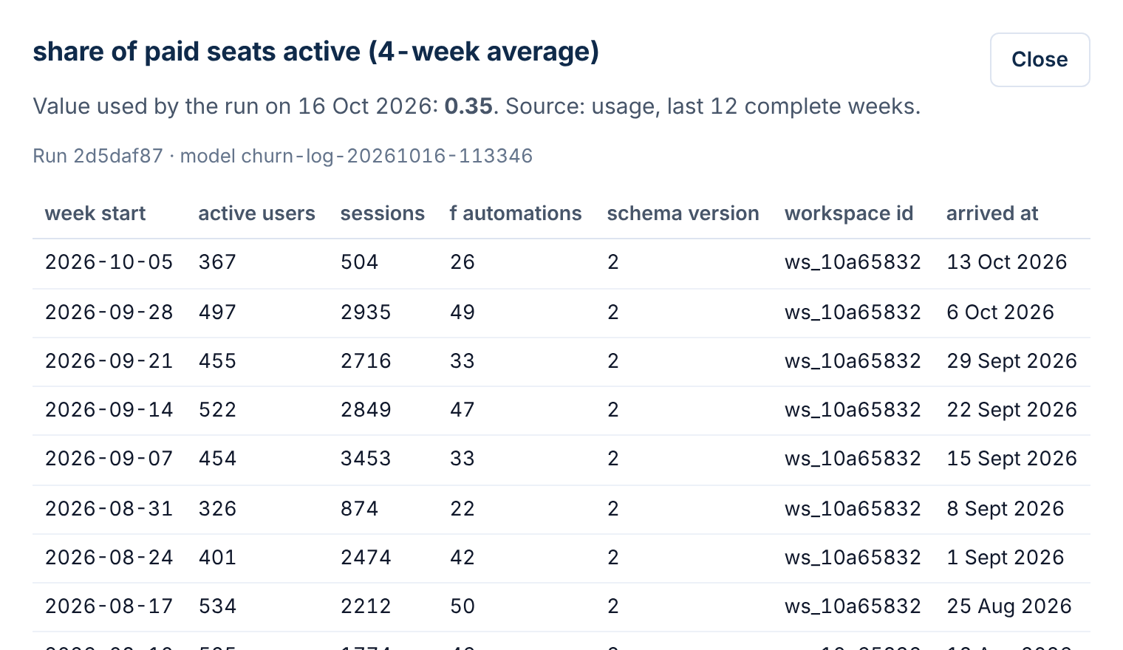
What a CSM sees
Every number on screen traces back to the run, the model version and the source rows behind it
Evidence. Click any reason to see the rows the run used, and when each row arrived
Each note points to the fact it came from (F3, E1)
Draft email: approve, then Open in Gmail
Managers: team view, runs, model card
Call list. Ranked by risk × revenue × renewal urgency, with the top reasons, the 12-week trend and the draft's status
Notes:
Two screens carry the product. The call list answers who and why; the evidence drawer answers 'can I trust this number'. Rows that arrived after the run are shown but hatched as unused, which is how I prove the score only used what it could see at the time.

Slide 5
Stack and architecture
A batch pipeline feeding a read-mostly app; one Postgres is the system of record for data, decisions and audit
5 sources
Landing zone
Ingest + match
Postgres 16
Nightly agent run
FastAPI + React
Salesforce · Zendesk · Gmail · product · Stripe
JSONL, partitioned by arrival date
remove duplicates, fix time zones and formats, link records to accounts
the database keeps each company's data apart
features → model → priority → diff → briefs
call list, account, evidence, runs, model
Backend | Python 3.12, FastAPI, pandas, scikit-learn
Data | Postgres 16, with per-company data isolation built into the database
LLM | OpenAI gpt-4o-mini behind a grounding validator; template fallback
Frontend | React + TypeScript (Vite), served by the API
Runtime | Docker Compose on one AWS server: database, app, scheduler, HTTPS proxy
Observability | Structured logs; every request has an ID that links it to its log lines
Why this shape
The decision is weekly, so a batch run fits; no stream to operate
One database keeps scores, evidence and audit joinable
Nothing AWS-specific: the same compose file runs anywhere
Notes:
Deliberately boring infrastructure. One Postgres holds raw records, normalised tables, identity decisions, scores, briefs and the audit trail, so every claim on screen is a join away from its evidence. The API serves the built React app, so there is one deployable image used by both the api and scheduler containers.

Slide 6
Messy data, handled on purpose
Synthetic, but generated from a hidden weekly health process, so outcomes are learnable and the mess is realistic
1.19M
What the data does | How Triage handles it
Duplicates: webhook retries, same email in two mailboxes | Checked at three levels (file, exact copy, same event), so reloading changes nothing
Late and out-of-order data (2-week telemetry outage backfilled) | Every record keeps when it arrived; a score only uses data that had arrived by its date
5 timestamp conventions, 3 schema changes | Each source is converted to one time zone (UTC) and one format
IDs that don't match across systems | Matched by ID, then email, then domain, then a close name match; if unsure, left for review. 2 wrong out of ~14k checked
Stale CRM renewal dates (~15%) | Fall back to contract anniversary, flagged in the UI
Sparse accounts with no usage or contact | Shown as Grey (can't see), never scored as healthy
raw records
5,000
accounts
3
companies, 3 years
956
bad lines rejected with a reason
Notes:
A wrong identity match mixes two customers' data, which is worse than a missing match, so uncertain matches go to an unresolved queue with the best candidate kept as evidence. Late data is the subtle one: the telemetry outage is backfilled a month later, and because every row keeps arrived_at, a replayed run sees exactly what the original run saw.

Slide 7
Data model
26 tables in five layers. Every row is tagged with its company; history is added to, never overwritten
Raw
Normalised
Identity
Decisions
Audit
landing_files
raw_records (sha256)
rejected_records
crm_account_versions
accounts · crm_contacts
crm_opportunities
tickets · emails
usage_weekly
billing_events
identity_links
method + confidence
+ evidence per link
models
agent_runs (steps, heartbeat)
feature_snapshots
account_scores
briefs · outreach_drafts
audit_log (who did what)
api_requests (user, trace_id, latency)
1
Replayable
2
Reproducible
3
Isolated
Every record keeps when it happened and when it arrived; CRM changes are kept as versions
Each score records which run and model version produced it, and the exact inputs used
The database itself hides other companies' rows; if no company is set, it returns nothing
Notes:
Raw records are kept verbatim with a hash, so any normalisation bug can be replayed. The decision layer never overwrites: a new run writes new score rows, which is what makes 'what changed since last week' a simple diff and keeps old screens reproducible.

Slide 8
How an account's state is represented
State is not a stored status; it is recomputed each run from what was known at that moment
A snapshot of 24 signals, as of the scoring date
Each run writes one score row per account
Only data that had happened and had arrived by that date: no peeking at the future
Risk: chance of not renewing, e.g. 26%
Reasons: how much each signal raised or lowered it
What changed since the previous run
Coverage: which sources we can see
Priority, colour, rank + which run and model made it
6
Usage seat use, active-user trend, weeks since usage
6
Support tickets, urgent tickets, bad CSAT, export requests
6
Email inbound trend, champion silence, negative language
2
Billing failed payments, seat contraction
Red top 15 by priority per CSM
Amber risk at least 2× the average
4
CRM ARR, tenure, segment
Green everything else
Grey no usage and no contact in 90 days
Notes:
I don't store a mutable 'health' field. An account's state is the snapshot of 24 signals computed as of the run date, using only data that had both happened and arrived. The score row adds the decision: probability, contributions, what changed, and the band. Grey is a first-class state, because 'we can't see this account' is exactly how quiet churn gets lost.

Slide 9
What the model predicts
Will this renewal be lost? The model answers that; a separate policy decides who to call this week
1
Label
Policy, not model
Renewal opportunity Closed Lost in the CRM. Downgrades are a signal, not the label
priority = risk × √revenue × urgency
2
Training set
29,000+ snapshots taken 1–4 months before each past renewal, using only what was known then
√revenue: a $500k account can't bury every $20k account
Urgency peaks 15–120 days before renewal
Renewal timing is left out of the model so it isn't counted twice
3
Model
Logistic regression (each signal gets a weight; weights add up to a probability). A signal that pushes the wrong way, e.g. more usage = more risk, is removed
4
Tenancy
Where the LLM sits
One model learns from all companies, then its percentages are adjusted per company (the smallest has only ~100 renewals)
After ranking, only for accounts on the call list. Scores and ranks are identical with the LLM switched off.
5
Split
By time: train → validate (12–6 months ago) → test (last 6 months, used once)
Notes:
Logistic regression won on validation and gives exact per-account contributions, which become the 'Why' bars. Gradient boosting would have had to beat it clearly to justify losing that. The sign constraint came from a real bug: collinearity gave rising usage a positive risk weight, which produced explanations like 'usage up 34%' as a reason to worry. Dropping those signals cost 0.007 AUC and improved churners caught early from 71% to 75%.

Slide 10
How it is evaluated
Judged by replaying the weekly call list: the real decision is who fills a CSM's 15 slots each week
Ranking accuracy
0.75 vs 0.59 for rules (0.5 = coin flip). Finds churners about 3× better than random
Honest percentages
When it says 20%, about 1 in 5 of those accounts really don't renew
Fair comparison
Same 15 slots per CSM for every method; only the risk estimate changes
Hit rate
9.4% of call slots were real churners; even perfect foresight gets only 16%
Real cases
Kestrel listed 105 days early; the rules never listed it
Notes:
Three layers of evaluation. Ranking quality (AUC, PR-AUC) on renewal snapshots. Calibration, because the UI shows percentages and a CSM should be able to read 20% as one in five. And the operational replay: rebuild each week's list on the test period and ask whether the lost renewals were on it in time. Thresholds such as 'no probability floor on the call list' were chosen on validation, not test: a floor of 0.07 cut churned ARR caught early from 93% to 64%.

Slide 11
How the unattended work is triggered
A scheduler container starts one run per company at 02:00 in that company's timezone; no human in the loop
load new data
match records
load model
build signals
score
save scores
write notes
Each step is timed and logged; the run reports it is alive every few seconds; notes are saved in batches of 50
When it fails
Safety rails
Why nightly, not real-time
Resumed once automatically, from the failed step
Steps already done, and notes already written, are skipped
Still failing: alert, then a manager clicks Resume
A database lock per company: never two runs at once
Each job is a child process: a crash can't kill the scheduler
Morning check (06:30 UTC): closes stuck runs, starts missing ones
The job is weekly prioritisation; churn builds over weeks (median 86-day lead)
Urgent events already have owners: support, dunning
A stable list keeps CSMs focused during the day
Notes:
The trigger is a long-running scheduler process in its own container. It reads each company's timezone from the database every loop, so a new tenant needs no config change. I deliberately allow exactly one automatic retry: it recovers transient failures without hiding real ones. Resume skips completed durable steps and briefs already written, so a retry costs no duplicate LLM spend, and it keeps the model version the run started with.

Slide 12
Trust: grounded, isolated, traceable
The places where a wrong answer would hurt a customer relationship got the most engineering
1
Grounded writing
2
Isolated companies
3
Traceable numbers
The AI writer (LLM) sees only a numbered list of facts
Every talking point must cite one; every number must appear in the cited facts
The email can't mention risk, churn or scores
Anything unsupported is removed, or falls back to a template
Nothing is sent automatically
Every row is tagged with its company
The database itself filters to the signed-in user's company
If no company is set, it returns nothing (fails safe)
Model and audit pages are filtered per company too
Tests prove cross-tenant reads and writes fail
Each score links to its run, model version and exact inputs
Evidence drawer shows the exact source rows
Data that arrived after the run is shown, marked unused
Each record-to-account match shows how sure it is
Every request is logged: from a user's name to their exact request
Notes:
A hallucinated fact in a customer email is the worst failure mode, so validation is mechanical, not a prompt instruction: citations must exist and numbers must match. Tenant isolation is enforced by the database rather than by remembering a WHERE clause; a request with no tenant set sees nothing.

Slide 13
Edge cases anticipated
Each of these has a test, a guard or a visible state in the product
1
Data arrives late
2
Same record delivered twice
Scores use only what had arrived by their date
Detected at three levels; reloading changes nothing
3
No data for an account
4
Wrong identity match
Grey band, never green
Unresolved queue instead of a guess
5
Stale renewal date in CRM
6
LLM invents a number
Use the contract anniversary, flagged in the UI
Claim removed; template fills the gap
7
Run crashes halfway
8
Two runs at once
Detected, resumed once automatically, then by a manager
A per-company lock; the second request is refused
9
Tiny company, little history
10
A signal points the wrong way
Shared model, percentages adjusted per company
Removed and refit, so no absurd reasons are shown
Notes:
None of these were in the brief. They come from asking what would make a CSM stop trusting the list, or what would page someone at 2 a.m. Each maps to a test, a database constraint, or a state the UI shows explicitly.

Slide 14
Trade-offs I chose
Each one gives something up; this is what and why
Chose | Over | Because
Nightly batch | Real-time scoring | Weekly decision; median 86-day lead; a stable list
Simple model (logistic regression) | Complex model (gradient boosting) | Scored better on validation and explains each account exactly
One shared model, adjusted per company | One model per company | The smallest company has only ~100 renewals
Drafts a human approves | Automatic email on red | ~10% hit rate; an email can speed up churn
No minimum-risk cut-off for the call list | Only 'clearly risky' accounts | A cut-off dropped lost revenue caught early from 93% to 64%
Unresolved identity queue | Best-guess matching | Mixing two customers is worse than a gap
One AWS server + Docker Compose | Managed AWS services | Small scale; portable; one-command deploy and rollback
Notes:
The one I'd most expect to be challenged is the missing probability floor: some Red accounts are low-risk but very high-value. I chose that on validation because big accounts carry most of the revenue, and the UI labels those rows as 'low risk, but a large renewal is close' so the CSM knows why they are there.

Slide 15
Built to own and operate
Validated end to end in the production Docker setup before deployment
24
automated tests: data isolation, no duplicates, traceability, permissions, AI fact-checks
Operational defaults
Refuses to start in production with weak secrets
Sign-in throttling; demo password hidden in production
HTTPS and browser security headers; only web ports open
Non-root containers, health checks, capped logs
Database updates applied on start; one-command, re-runnable setup
Every log line carries the request ID, user and run
Manual runs start as separate processes, so the API stays responsive
50 + 26
API checks and browser walkthrough steps through the full stack
293 → 18 ms
account page load time after query tuning
64%
of briefs reused the next night when facts are unchanged
Notes:
Running the real compose stack end to end found two bugs the unit tests didn't: a double click on Run now could start two runs, and the sign-in page showed the development password in production. Both are fixed and covered. The briefs step went from about 127 seconds to roughly 30 by slicing source data once per run and reusing briefs whose facts haven't changed.

Slide 16
Glossary
Terms used in this brief, in plain words
CSM | Customer Success Manager: looks after a set of customer accounts
ARR | Annual recurring revenue: what a customer pays per year
Churn | A customer not renewing
CRM | The sales system (e.g. Salesforce) where accounts and renewals live
CSAT | The customer's good/bad rating on a support ticket
Tenant | One customer organisation using Triage (Northwind, Helios, Quill)
LLM | Large language model (e.g. GPT): writes the notes, never ranks
Ranking accuracy | How often a churner is ranked above a renewer (ROC AUC); 0.5 = coin flip
Hit rate | Share of call-list slots that were real churners (precision)
Honest percentages | "20%" really means about 1 in 5 (calibration)
Logistic regression | A simple model: each signal gets a weight; weights add up to a probability
Row-level security | A database feature that hides other companies' rows automatically
Notes:
A reference slide; I won't present it, but it's here so every term in the deck has a plain-language meaning.

Slide 17
Limits, open questions and next steps
Not in v1
Questions for the business
Next
Live connections to real systems (the synthetic feeds use the same format)
Sending email; single sign-on
Per-company models, expansion scoring
A screen to resolve unmatched records
Does a downgrade count as churn?
Source of truth for ARR and renewal date
Real CSM capacity and playbooks
Is a missed churn worse than a wasted call?
Same-day interrupt for critical events, on top of the nightly run
Automatic tests and build on every code push
Match only new records, for 10× more data
Retrain on real outcomes; watch that percentages stay honest
Code, decisions log and setup: csm-triage repository · DECISIONS.md lists every choice with its reason
Notes:
I'd want answers to these four questions before tuning anything further, because they change the label and the thresholds. The next engineering step is a same-day interrupt for critical events, layered on top of the nightly run rather than replacing it, since the nightly reconcile is needed anyway.

