Slide 1
EcoConnectAI
A Satellite-Driven Framework for Coastal Ecosystem Connectivity
and Conservation Decision Support
Presented by
Kuldeep Raj (1DS23CS112)
Ruhinaaz (1DS23CS187)
Guided by
Dr. Anusha Preetham (Associate Professor)
Department of Computer Science and Engineering
Dayananda Sagar College of Engineering
Final Year Project Evaluation · 2026
Notes:
Good morning. Our project is EcoConnectAI — a tool that uses satellite images and AI to find mangrove habitat, and then works out which habitat patches matter most for keeping the coastal ecosystem connected.

Slide 2
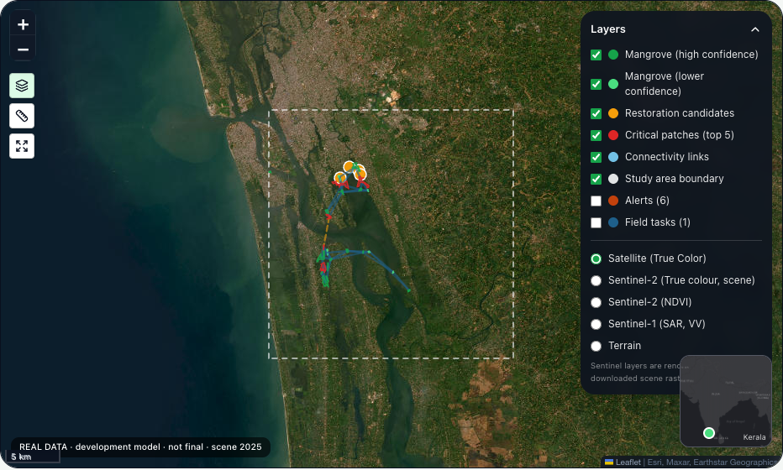
Abstract
EcoConnectAI uses satellite images and AI to find mangroves, then studies them as a connected network to see which patches matter most.
1
Detect mangroves
from Sentinel-1 satellite images, pixel by pixel
2
Divide into patches
group nearby mangrove pixels into habitat patches
3
Connect the patches
link nearby patches to form a network
4
Find important patches
remove one patch at a time and see what is lost
Our working dashboard — mangrove patches and links, Vembanad–Kol (Kerala)
5
Support decisions
test patch loss and restoration on a web dashboard
In short: from “where are the mangroves?” to “which mangrove patch matters most?”
Notes:
In simple words: we detect mangroves from satellite images, split them into patches, connect nearby patches into a network, and remove one patch at a time to see how much connectivity is lost. The dashboard lets an officer test what happens if a patch is lost, or if an area is restored.

Slide 3
Problem and Objective
!
Problem
✓
Objectives
Maps show where mangroves are — not which patches matter.
Detect mangrove habitat
Identify habitat patches
Two patches can look alike, but one may be the only link between others.
Find important connecting patches
If that small link is lost, the whole network can break apart.
Support protection & restoration decisions
Existing approach
Satellite map
Where is habitat?
Our approach
Satellite map
Where is habitat?
How is it connected?
Which patches matter?
Notes:
The problem: finding where mangroves are is not enough. Two patches may look the same on a map, but one may be the only bridge between two groups. Our objective is to detect the habitat, split it into patches, find the important connecting patches, and help conservation teams decide what to protect or restore.

Slide 4
Data and Methodology
Sentinel-1 satellite radar
Free ESA images; radar sees through cloud (VV + VH, 10 m)
Satellite images
Sentinel-1, 2020
1
Image tiles
256 × 256 pixels
4 coastal study areas
Vembanad–Kol (Kerala) · Sundarbans (WB) · Gulf of Mannar (TN) · Bhitarkanika (Odisha)
2
Reference labels
Global Mangrove Watch
Global Mangrove Watch 2020
Used as reference labels to train the model — not field-verified
3
AI model
learns what mangrove looks like
1,373 image tiles (256 × 256)
Current run: 800 training · 195 validation · 200 test
4
Mangrove probability map
chance of mangrove per pixel
Notes:
Our input is Sentinel-1 radar imagery for four coastal areas. For training labels we use Global Mangrove Watch 2020 — these are reference labels from a published map, not field ground truth. We cut the images into 1,373 tiles; this run used 800 for training, 195 for validation and 200 for testing. The model outputs a probability of mangrove for every pixel.

Slide 5
System Architecture
How the analysis works
Sentinel-1 satellite data
Preprocessing
AI mangrove detection
Connectivity network
Habitat patch extraction
Mangrove probability map
Critical patches + what-if
Restoration priority
Web dashboard
Software that runs it
Python + PyTorch
AI model
FastAPI
backend server
SQLite
database
Next.js + React
web frontend
Leaflet + React Flow
map + network view
Notes:
Top: the analysis flow. Satellite data is prepared, the AI model detects mangrove and gives a probability map, we extract habitat patches, connect them into a network, find the critical patches, run what-if tests, rank restoration options and show everything on a web dashboard. Bottom: the software — Python and PyTorch for the AI, a FastAPI backend with a SQLite database, and a Next.js/React frontend with a Leaflet map and a React Flow network view.

Slide 6
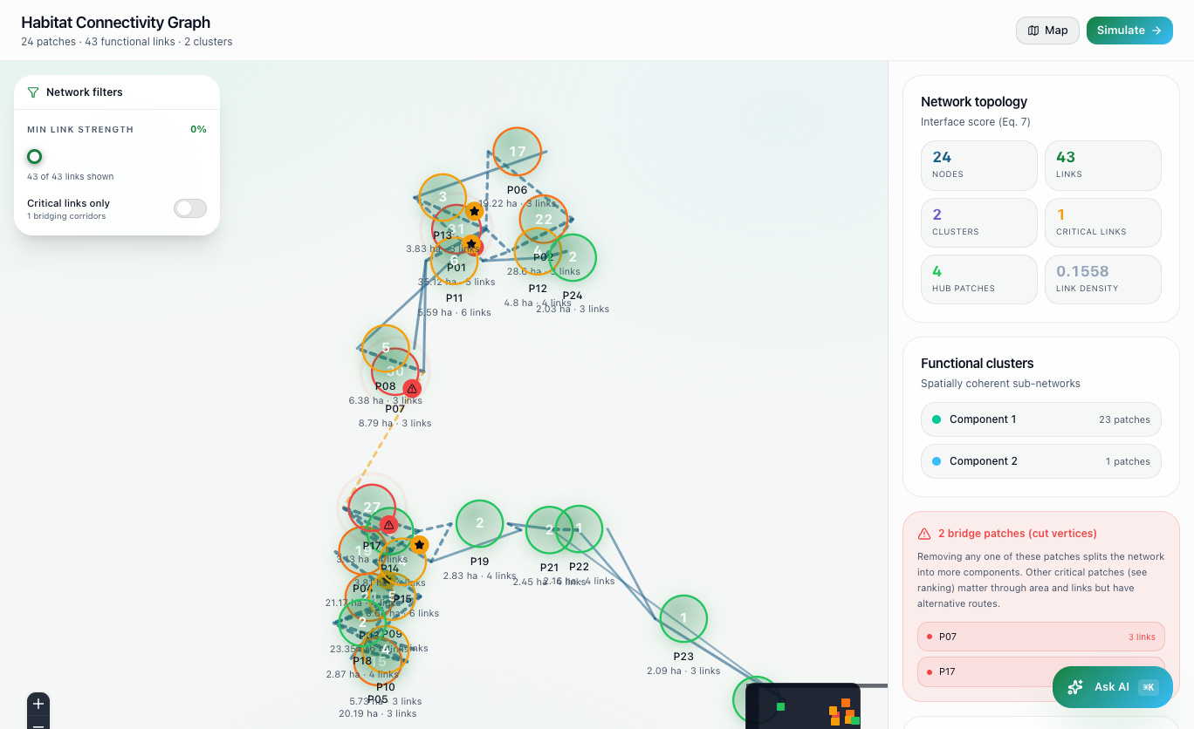
Implementation
1
Mangrove detection
A deep-learning model marks mangrove pixels in the image.
2
Patch extraction
Touching mangrove pixels are grouped into habitat patches.
3
Connectivity analysis
Each patch links to its nearest patches (within 5 km).
Network view in our app: each circle is a patch, lines are links
Built with
4
Criticality analysis
Remove one patch at a time and measure how much connectivity drops.
Python
PyTorch
FastAPI
SQLite
Next.js
React
Leaflet
React Flow
5
Decision support
Dashboard shows important patches, what-if results and restoration options.
Model: U-Net with EfficientNet-B0 (≈ 6.25 M parameters)
Notes:
We implemented five parts. A deep-learning model marks mangrove pixels. Touching pixels are grouped into patches. Each patch is linked to its nearest patches within 5 km — that forms the network. Then we remove one patch at a time and measure how much connectivity drops. Finally the dashboard shows the important patches, the what-if results and restoration options. The model is a U-Net with an EfficientNet-B0 encoder; the larger B7 version from the research paper is future work.

Slide 7
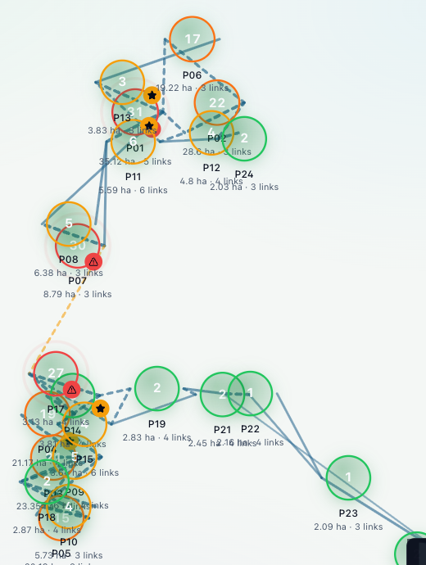
Results and Key Findings
0.842
0.914
Development model result
Measured on 200 test tiles against Global Mangrove Watch reference labels — not field accuracy. Strongest on Sundarbans; weaker on thin Kerala mangrove strips.
Test IoU
overlap with reference map
Test F1 score
balance of precision & recall
Size alone does not tell us which patch is important
P01 — largest patch
P17 — small bridge patch
35.1 ha
#1 by size
3.1 ha
only #17 by size
−30.7%
connectivity if removed
−27.0%
connectivity if removed
No split
other routes still connect
2 → 3 groups
network breaks apart
Network in our app — P17 and P07 are the only “bridge” patches
Notes:
Our development model reaches a test IoU of 0.842 and an F1 of 0.914 on 200 test tiles. These are measured against Global Mangrove Watch reference labels, not field surveys, and most of the strength comes from the Sundarbans. The 95.56% figure in the literature belongs to the foundation paper, not to us. The key finding: P01 is the biggest patch, but patch P17 is only 3.1 hectares and 17th by size — yet removing it cuts connectivity by 27% and splits the network into three groups. Size alone does not show importance. (Kerala 2025 analysis run, development model.)

Slide 8
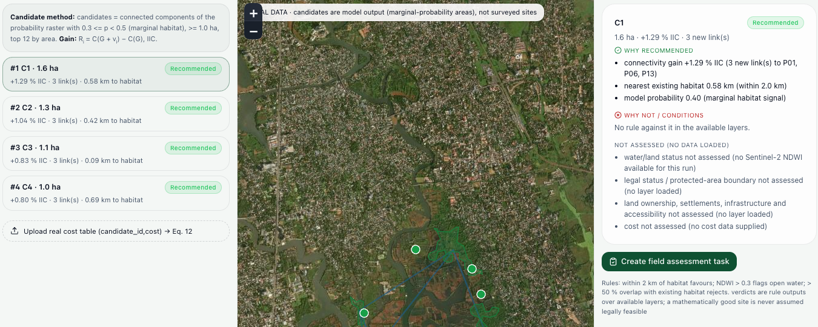
What-if and Restoration
What happens if a patch is lost?
What happens if we restore an area?
Candidate C1 (1.6 ha)
Added to the network
+1.29% connectivity · 3 new links
P17 is tiny but costs almost as much connectivity as the biggest patch.
Simulated scenario under project assumptions.
Potential candidates from model outputs — not field-confirmed.
No cost data yet, so candidates are ranked by connectivity gain.
Notes:
Left: what if a patch is lost? Removing P17 loses only 1.4% of the habitat but 27% of connectivity. Removing the largest patch P01 loses 16% of the habitat and 30.7% of connectivity. These are simulations under our assumptions, not predictions. Right: restoration works the other way — we add a candidate area to the network and measure the gain. Candidate C1 adds 1.29% connectivity with three new links. Candidates come from model outputs and are not field-confirmed, and since we have no cost data they are ranked by connectivity gain.

Slide 9
Conclusion and Future Work
Satellite data
+
AI habitat detection
+
Connectivity analysis
+
What-if scenarios
Support for coastal conservation decisions
!
Limitations
✓
Future Work
Current model is a development version
Improve the model for each region (full UNB7 model)
Reference labels are not field-verified ground truth
Add field validation
Use real restoration cost information
Field validation and real restoration cost data still needed
Prepare the system for larger-scale use
From mapping habitat to understanding which habitat matters.
Notes:
To conclude: EcoConnectAI combines satellite data, AI habitat detection, connectivity analysis and what-if scenarios to support coastal conservation decisions. Our limitations: the model is still a development version, the labels are reference labels rather than field-verified ground truth, and we still need field validation and real cost data. Next we want to improve the model per region, add field validation, use real cost information and prepare the system for larger-scale use. From mapping habitat to understanding which habitat matters. Thank you.

