Slide 1
EcoConnectAI
A Satellite-Driven Framework for Coastal Ecosystem Connectivity
and Conservation Decision Support
Presented by
Kuldeep Raj (1DS23CS112)
Ruhinaaz (1DS23CS187)
Guided by
Dr. Anusha Preetham (Associate Professor)
Department of Computer Science and Engineering
Dayananda Sagar College of Engineering
Final Year Project Evaluation · 2026
Notes:
Good morning. Our project is EcoConnectAI — a tool that uses satellite images and AI to find mangrove habitat and then works out which habitat patches matter most for keeping the coastal ecosystem connected.

Slide 2
Abstract
Problem overview
Mangrove maps show where habitat is, but not which patches hold the coastal network together. Losing one small linking patch can cut the network apart.
Proposed solution
Detect mangroves from Sentinel-1 satellite images with a deep-learning model, split them into patches, connect nearby patches into a network, and remove one patch at a time to see how much connectivity is lost. A web dashboard supports what-if and restoration questions.
Key results
Development model: test IoU 0.842, F1 0.914 against Global Mangrove Watch reference labels. Example: patch P17 is only 3.1 ha, yet removing it cuts connectivity by 27% — size alone does not show importance.
In short: from “where are the mangroves?” to “which mangrove patch matters most?”
Notes:
Problem: maps show where mangroves are, not which patches matter. Our solution: detect mangroves from radar images, turn them into a network of patches, and test what is lost if each patch disappears. Key result: our development model reaches IoU 0.842 against reference labels, and a 3.1-hectare patch turned out to be one of the most important in Kerala.

Slide 3
Literature Survey (1/7)
Mangrove & habitat mapping
Author & Year | Methodology | Key Findings | Limitations
Ghorbanian et al., 2025 IEEE JSTARS ★ foundation paper | Weakly supervised U-Net + EfficientNet-B7 (UNB7) on time-series Sentinel-1 radar (VV/VH). | About 95.56% overall accuracy on their 2020 data; clean maps even from imperfect labels. | Gives a habitat map only — no patch or network analysis; sparse mangroves harder.
Bunting et al., 2018 Remote Sensing (Global Mangrove Watch) | Classified ALOS radar + Landsat images to map mangrove extent worldwide. | First consistent global mangrove baseline map; widely used by researchers and agencies. | Shows where mangroves are, not how important each area is for connectivity.
Notes:
Literature survey part 1 of 7 — Mangrove & habitat mapping. For each paper: what they did, what they found, and what is missing that our project addresses.

Slide 4
Literature Survey (2/7)
Deep-learning segmentation models
Author & Year | Methodology | Key Findings | Limitations
Ronneberger et al., 2015 MICCAI (U-Net) | Encoder–decoder network with skip connections that labels every pixel. | Accurate pixel-level segmentation even with little training data; now a standard model. | Built for medical images; needs labelled masks; no idea of habitat networks.
Tan & Le, 2019 ICML (EfficientNet) | Scales network depth, width and image size together (models B0 to B7). | Higher accuracy with fewer parameters than earlier image-recognition networks. | Large versions (B7) need a lot of GPU memory; it is a backbone, not a full mapping system.
Notes:
Literature survey part 2 of 7 — Deep-learning segmentation models. For each paper: what they did, what they found, and what is missing that our project addresses.

Slide 5
Literature Survey (3/7)
Transformers & change detection
Author & Year | Methodology | Key Findings | Limitations
Liu et al., 2021 ICCV (Swin Transformer) | Vision transformer that looks at the image in shifted windows at several scales. | Strong results in classification, detection and segmentation benchmarks. | Needs heavy compute and large data; general vision model, not habitat-specific.
Yu et al., 2025 IEEE JSTARS (review) | Survey of deep-learning change detection: CNN, Siamese and transformer methods. | Organises methods and datasets for finding change between two satellite images. | Survey only; finds change but does not measure its effect on habitat connectivity.
Notes:
Literature survey part 3 of 7 — Transformers & change detection. For each paper: what they did, what they found, and what is missing that our project addresses.

Slide 6
Literature Survey (4/7)
Graph-based landscape connectivity
Author & Year | Methodology | Key Findings | Limitations
Urban & Keitt, 2001 Ecology | Represents a landscape as a graph: habitat patches as nodes, movement links as edges. | Graph measures show which patches and links keep a landscape connected. | Patches entered by hand; no satellite images or automation.
McRae et al., 2008 Ecology (circuit theory) | Treats the landscape like an electrical circuit to model all possible movement paths. | More realistic corridor modelling than a single shortest path. | Computationally heavy for large areas; needs a prepared resistance map.
Notes:
Literature survey part 4 of 7 — Graph-based landscape connectivity. For each paper: what they did, what they found, and what is missing that our project addresses.

Slide 7
Literature Survey (5/7)
Connectivity indices
Author & Year | Methodology | Key Findings | Limitations
Pascual-Hortal & Saura, 2006 Landscape Ecology | Compared graph connectivity indices and proposed the Integral Index of Connectivity (IIC). | IIC can rank patches by how much connectivity is lost when each is removed. | Needs habitat patches already mapped; not linked to satellite AI.
Saura & Pascual-Hortal, 2007 Landscape & Urban Planning | Probability of Connectivity (PC) index using the chance of movement between patches. | Basis of the Conefor tool, widely used in conservation planning. | Needs dispersal distances per species and pre-made habitat maps.
Notes:
Literature survey part 5 of 7 — Connectivity indices. For each paper: what they did, what they found, and what is missing that our project addresses.

Slide 8
Literature Survey (6/7)
Graph learning on networks
Author & Year | Methodology | Key Findings | Limitations
Liu et al., 2022 IEEE TGRS | Spatio-temporal graph neural network on long-term satellite image series. | Detects how landscape patterns change over time. | Finds the type of change only; does not rank which patches are critical.
Liu & Liu, 2025 IEEE Access (review) | Systematic review of graph neural networks for infrastructure reliability and resilience. | Graph models can estimate node importance and how a network survives failures. | Engineering networks only — not ecology or satellite habitat maps.
Notes:
Literature survey part 6 of 7 — Graph learning on networks. For each paper: what they did, what they found, and what is missing that our project addresses.

Slide 9
Literature Survey (7/7)
Explainable AI in remote sensing
Author & Year | Methodology | Key Findings | Limitations
Naceur et al., 2025 IEEE TGRS | U-Net on spectral indices with SHAP explanations for change detection. | Robust change detection that explains which image bands drove the change. | Explains pixels and bands, not the role of a habitat patch in a network.
Klotz et al., 2025 IEEE JSTARS | Benchmark of explanation methods (Occlusion, LIME, Grad-CAM, LRP, DeepLIFT). | How useful an explanation method is varies a lot by method and metric. | Explains image-level predictions, not network-level decisions.
Research gap: these works map habitat, model connectivity or explain pixels separately. None turn satellite predictions into an explained network of patches for what-if and restoration decisions — that is what EcoConnectAI adds.
Notes:
Literature survey part 7 of 7 — Explainable AI in remote sensing. For each paper: what they did, what they found, and what is missing that our project addresses.

Slide 10
Problem Statement and Objectives
!
Problem Statement
✓
Objectives
Maps show where mangroves are — not which patches matter.
Detect mangrove habitat from satellite images
Divide the habitat into patches
Two patches can look alike, but one may be the only link between others.
Find the important connecting patches
If that small link is lost, the whole network can break apart.
Support protection & restoration decisions
Existing approach
Satellite map
Where is habitat?
Our approach
Satellite map
Where is habitat?
How is it connected?
Which patches matter?
Notes:
The problem: finding where mangroves are is not enough. Our objectives: detect the habitat, split it into patches, find the important connecting patches, and support protection and restoration decisions.

Slide 11
Existing System — Architecture
How mangrove habitat is studied today (Google Earth Engine, ArcGIS / QGIS, Global Mangrove Watch)
Satellite images
Landsat / Sentinel
GIS software
Earth Engine, ArcGIS, QGIS
Manual analysis
by a trained GIS expert
Static habitat map
e.g. Global Mangrove Watch
Report
maps and area statistics
What the existing system answers
✓ Where is the mangrove? How much area is there?
✗ Which patch keeps the network connected? What if it is lost? Where to restore first?
Output is a static map. Each habitat patch is shown on its own, with no information about how patches are connected.
Notes:
Today, habitat is studied with tools like Google Earth Engine, ArcGIS or QGIS: an expert processes the images and produces a static habitat map such as Global Mangrove Watch. This answers where the mangroves are, but not which patches matter.

Slide 12
Existing System — Drawbacks and Limitations
!
Shows location, not importance
A map says where habitat is, not which patch holds the network together.
!
No what-if analysis
Cannot test what happens if a patch is lost to a road, port or cyclone.
!
No restoration ranking
Does not suggest which area to restore first.
!
Needs GIS experts
Hard for forest officers and policymakers to use directly.
!
Optical images blocked by cloud
Monsoon cloud hides the coast for weeks in optical satellite images.
!
No evidence or follow-up
No explanation of results and no link to field verification.
Notes:
The main drawbacks: existing tools show location but not importance, cannot run what-if tests, do not rank restoration sites, need GIS experts, depend on cloud-free optical images, and give no explanation or link to field verification.

Slide 13
Proposed System — Architecture
How the analysis works
Sentinel-1 satellite data
Preprocessing
AI mangrove detection
Connectivity network
Habitat patch extraction
Mangrove probability map
Critical patches + what-if
Restoration priority
Web dashboard
Software that runs it
Python + PyTorch
AI model
FastAPI
backend server
SQLite
database
Next.js + React
web frontend
Leaflet + React Flow
map + network view
Notes:
Top: the analysis flow from satellite data to the web dashboard. Bottom: the software — Python and PyTorch for the AI, a FastAPI backend with a SQLite database, and a Next.js/React frontend with a Leaflet map and a React Flow network view.

Slide 14
Proposed System — Advantages
✓
Shows which patches matter
Ranks every patch by how much connectivity is lost without it.
✓
Instant what-if tests
Remove or restore a patch and see the new result straight away.
✓
Restoration ranking
Candidate areas ranked by the connectivity they would add.
✓
Works through cloud
Radar images (Sentinel-1) see through monsoon cloud.
✓
Explains every result
Plain-language reason with the numbers behind each ranking.
✓
Easy to use
One web dashboard with roles, alerts, field tasks and reports.
Notes:
Compared with the existing system, ours shows which patches matter, runs what-if tests instantly, ranks restoration areas, works through cloud, explains every result, and is usable through one dashboard.

Slide 15
Proposed System — Module Explanation
1
Data acquisition
Downloads free Sentinel-1 radar scenes for each study area and cuts them into tiles.
2
Mangrove detection
A deep-learning model marks mangrove pixels and gives a probability map.
3
Patch extraction
Touching mangrove pixels are grouped into habitat patches (at least 2 ha).
4
Connectivity network
Each patch is linked to its nearest patches within 5 km.
5
Criticality & what-if
Removes patches one at a time, or on request, and measures the change.
6
Restoration & dashboard
Ranks candidate areas; map, network view, alerts, field tasks and reports.
Notes:
The system has six modules: data acquisition, mangrove detection, patch extraction, the connectivity network, criticality and what-if analysis, and restoration with the dashboard.

Slide 16
Proposed System — Algorithms Used
Algorithm | Used for | In simple words
U-Net with EfficientNet-B0 | Mangrove detection | A deep-learning model that labels each 10 m pixel as mangrove or not.
Connected-component labelling | Patch extraction | Groups touching mangrove pixels into one patch; removes tiny pieces.
Nearest-neighbour network (5 km) | Connectivity network | Links each patch to its 3 nearest patches if they are within 5 km.
Integral Index of Connectivity (IIC) | Connectivity score | One number for the network: large patches reachable in few steps score high.
Remove-one-patch test | Criticality | Delete a patch, recompute the score; the bigger the drop, the more critical.
Add-one-candidate test | Restoration priority | Add a candidate area, recompute; rank areas by the gain.
Tested at 3, 5 and 8 km to check the 5 km choice; the model threshold was tuned on test tiles.
Notes:
The main algorithms: a U-Net deep-learning model for mangrove detection, connected-component labelling to form patches, a nearest-neighbour network within 5 km, the Integral Index of Connectivity as the network score, a remove-one-patch test for criticality, and an add-one-candidate test for restoration.

Slide 17
Results — Mangrove Detection
0.842
0.914
Development model result
200 test tiles, measured against Global Mangrove Watch reference labels — not field accuracy.
Test IoU
overlap with reference map
Test F1 score
precision + recall
Comparison: test IoU of our development models
What this means
Training on all four areas works far better than Kerala alone.
Most of the score comes from the Sundarbans; thin Kerala mangrove strips are still hard.
95.56% is the published foundation-paper result, not ours.
Notes:
Our development model scores test IoU 0.842 and F1 0.914 on 200 test tiles, measured against Global Mangrove Watch reference labels. The comparison shows that training on four areas is much better than Kerala only. Most of the strength comes from the Sundarbans; thin Kerala mangroves remain difficult.

Slide 18
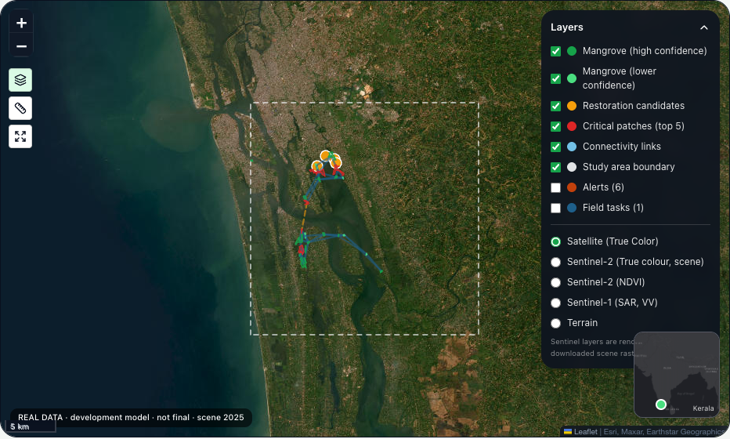
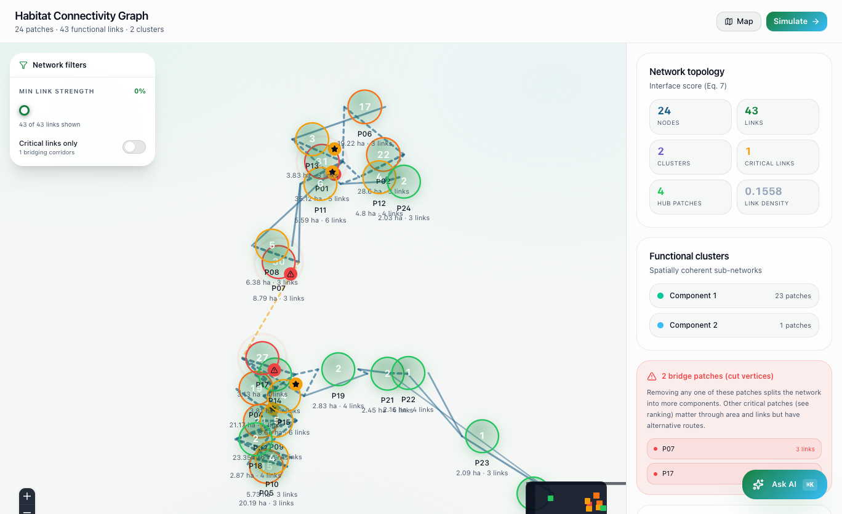
Results — System Outputs
Dashboard map: patches, links, critical patches, candidates
Network view: 24 patches, 43 links, 2 groups (Kerala)
24
43
≈ 220 ha
4
habitat patches
connectivity links
mangrove mapped
restoration candidates
Kerala (Vembanad–Kol) latest analysis run — development model, not final.
Notes:
These are real screens from our application for the Kerala study area: the dashboard map with patches and links, and the network view. The run found 24 patches, 43 links, about 220 hectares of mangrove and 4 restoration candidates.

Slide 19
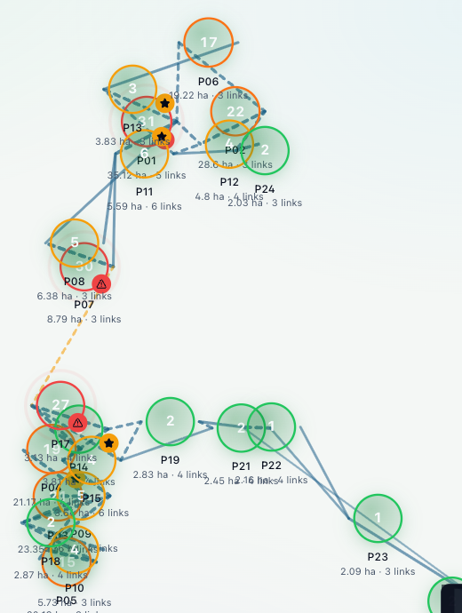
Results — Which Patch Matters?
Size alone does not tell us which patch is important
P01 — largest patch
P17 — small bridge patch
35.1 ha
#1 by size
3.1 ha
only #17 by size
−30.7%
connectivity if removed
−27.0%
connectivity if removed
No split
other routes still connect
2 → 3 groups
network breaks apart
P17 and P07 are the only “bridge” patches
Discussion
• Two of the top-3 critical patches are small (P07 8.8 ha, P17 3.1 ha) — position in the network matters, not just size.
• In Odisha, a 55.6 ha patch ranks above a 910 ha patch for the same reason.
• The ranking stayed stable when the link distance was changed to 3 km or 8 km (correlation ≥ 0.96 in Kerala).
Notes:
The key finding: P01 is the largest patch, but P17 is only 3.1 hectares and 17th by size — yet removing it cuts connectivity by 27% and splits the network into three groups. The same pattern appears in Odisha. And the ranking stays stable when we change the 5 km link distance to 3 or 8 km.

Slide 20
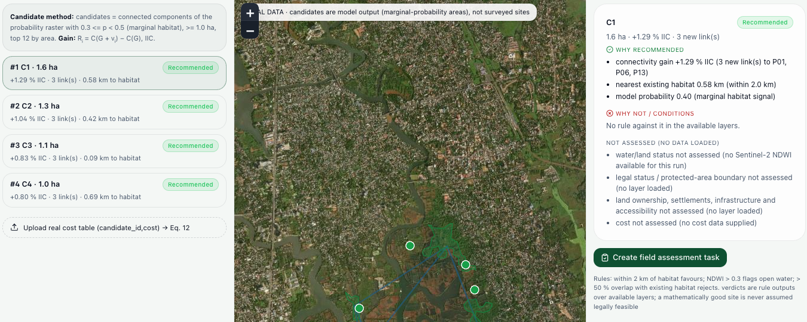
Results — What-if and Restoration
What happens if a patch is lost?
What happens if we restore an area?
Candidate C1 (1.6 ha)
Added to the network
+1.29% connectivity · 3 new links
P17 is tiny but costs almost as much connectivity as the biggest patch.
Simulated under project assumptions.
Candidates come from model outputs — not field-confirmed.
No cost data yet, so ranking is by connectivity gain.
Notes:
Left: removing P17 loses only 1.4% of habitat but 27% of connectivity; removing P01 loses 16% of habitat and 30.7% of connectivity. These are simulations. Right: adding candidate area C1 improves connectivity by 1.29% with three new links. Candidates are not field-confirmed and there is no cost data yet.

Slide 21
Conclusion
Summary
EcoConnectAI combines satellite radar images, AI mangrove detection, a network of habitat patches and what-if analysis to help decide which coastal habitat to protect or restore first.
Key findings
Future scope
Working end-to-end system on real data for 4 coastal areas
Train the full UNB7 model on a GPU
Field validation of results
Development model: IoU 0.842 vs reference labels
Real restoration cost data
Small patches can be critical: P17 (3.1 ha) → −27% connectivity
Larger-scale deployment for forest departments
From mapping habitat to understanding which habitat matters.
Notes:
To summarise, EcoConnectAI goes from satellite images to a decision-support network. Our key findings are the working system, the development model result and the fact that small patches can be critical. Next: train the full UNB7 model, validate in the field, add cost data and scale up.

Slide 22
Co-guide Meeting Proof
Co-guide: [Name, Designation] · Guide: Dr. Anusha Preetham (Associate Professor)
Date | Discussion | Signature
[dd-mm-2026] | [Topic discussed / feedback received]
[dd-mm-2026] | [Topic discussed / feedback received]
[dd-mm-2026] | [Topic discussed / feedback received]
Insert meeting photo / screenshot here
Insert meeting photo / screenshot here
Notes:
Replace the bracketed fields with your co-guide's name, meeting dates and discussion points, and insert the meeting photos or signed log.

Slide 23
SDG Goal
EcoConnectAI maps to three of the 17 UN Sustainable Development Goals
14
13
15
SDG 14: Life Below Water
SDG 13: Climate Action
SDG 15: Life on Land
Mangroves are nurseries for fish and protect coastal marine life. We help find and protect the most important patches.
Mangroves store carbon and shield coasts from storms. Keeping them connected keeps these services working.
Stopping habitat fragmentation and guiding restoration of degraded ecosystems.
Notes:
Our project maps mainly to SDG 14, Life Below Water, because mangroves support coastal marine life; SDG 13, Climate Action, because mangroves store carbon and protect coasts; and SDG 15, Life on Land, because we address habitat fragmentation and restoration.

Slide 24
Project Stakeholders & Existing Application Gap
C
CLIENT
U
CUSTOMER / END USER
Who requested, sponsors, or provides the problem statement
Who will actually use the proposed system
Problem source: research gap found in the foundation paper
Intended client: coastal forest & wetland departments
Target Users: forest range officers, GIS analysts, researchers
User Need: know which patches matter and test protect / restore options
S
STAKEHOLDERS
!
HOW IS OUR PROJECT DIFFERENT?
People/organizations affected by or involved in the project
Comparison with existing applications/solutions
Coastal communities (fishing, storm protection)
Conservation NGOs and ecologists
Policymakers and coastal planning authorities
Existing: GMW / Earth Engine maps show where it is
Our Project: ranks patches; what-if and restoration
Key Improvement: “which habitat matters?”
KEY DIFFERENTIATOR: EcoConnectAI turns a satellite habitat map into a network and measures how much connectivity is lost when each patch is removed — so a small but critical patch is found, explained and testable before it is lost.
Notes:
Client: the problem comes from the research gap; the intended client is coastal forest and wetland departments — they are not sponsors. End users are range officers, GIS analysts and researchers. Other stakeholders are coastal communities, NGOs and policymakers. Our difference: existing tools show where mangroves are; ours shows which patches matter and lets you test loss and restoration.

Slide 25
References
[1] A. Ghorbanian, A. Ghorbanian, S. A. Ahmadi, A. Mohammadzadeh, and A. Naboureh, “Weakly supervised semantic segmentation of mangrove ecosystem using Sentinel-1 SAR and deep convolutional neural networks,” IEEE J. Sel. Topics Appl. Earth Observ. Remote Sens., vol. 18, pp. 17497–17512, 2025.
[2] P. Bunting et al., “The Global Mangrove Watch — a new 2010 global baseline of mangrove extent,” Remote Sensing, vol. 10, no. 10, p. 1669, 2018.
[3] O. Ronneberger, P. Fischer, and T. Brox, “U-Net: Convolutional networks for biomedical image segmentation,” in Proc. MICCAI, 2015, pp. 234–241.
[4] M. Tan and Q. Le, “EfficientNet: Rethinking model scaling for convolutional neural networks,” in Proc. ICML, 2019, pp. 6105–6114.
[5] Z. Liu et al., “Swin transformer: Hierarchical vision transformer using shifted windows,” in Proc. IEEE/CVF ICCV, 2021, pp. 10012–10022.
[6] C. Yu et al., “Deep learning-based change detection in remote sensing: A comprehensive review,” IEEE J. Sel. Topics Appl. Earth Observ. Remote Sens., vol. 18, pp. 24415–24437, 2025.
[7] D. Urban and T. Keitt, “Landscape connectivity: A graph-theoretic perspective,” Ecology, vol. 82, no. 5, pp. 1205–1218, 2001.
[8] B. H. McRae, B. G. Dickson, T. H. Keitt, and V. B. Shah, “Using circuit theory to model connectivity in ecology, evolution, and conservation,” Ecology, vol. 89, no. 10, pp. 2712–2724, 2008.
[9] L. Pascual-Hortal and S. Saura, “Comparison and development of new graph-based landscape connectivity indices,” Landscape Ecology, vol. 21, no. 7, pp. 959–967, 2006.
[10] S. Saura and L. Pascual-Hortal, “A new habitat availability index to integrate connectivity in landscape conservation planning,” Landscape and Urban Planning, vol. 83, no. 2–3, pp. 91–103, 2007.
[11] M. Liu et al., “Hybrid spatiotemporal graph convolutional network for detecting landscape pattern evolution from long-term remote sensing images,” IEEE Trans. Geosci. Remote Sens., vol. 60, pp. 1–16, 2022.
[12] T. Liu and F. Liu, “Graph neural networks for evaluating the reliability and resilience of infrastructure systems: A systematic review,” IEEE Access, vol. 13, pp. 164883–164904, 2025.
[13] Y. Naceur, S. Bouzidi, and M. Zaouali, “U-Net for remote sensing: A spectral index-based approach with explainable AI for robust change detection,” IEEE Trans. Geosci. Remote Sens., vol. 63, pp. 1–7, 2025.
[14] J. Klotz, T. Burgert, and B. Demir, “On the effectiveness of methods and metrics for explainable AI in remote sensing image scene classification,” IEEE J. Sel. Topics Appl. Earth Observ. Remote Sens., vol. 18, pp. 27764–27780, 2025.
Notes:
References in IEEE style.

Slide 26
Thank You
Queries?
EcoConnectAI
Kuldeep Raj (1DS23CS112) · Ruhinaaz (1DS23CS187)
Notes:
Thank you. We are happy to take questions.

