Slide 1
OBJECT ORIENTED PROGRAMMING CSE 2ND SEMESTER 2020
MADE BY: HARDIK(24)
KULDEEP(36)
KUNAL(37)

Slide 2
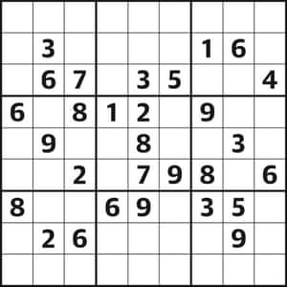
PROJECT:- SUDOKU PUZZLE SOLVER

Slide 3
WHAT IS SUDOKU
Sudoku is a logic-based, combinatorial number-placement puzzle. The objective is to fill a 9*9 grid with digits so that each column, each row, and each of the nine 3*3 subgrids that compose the grid contain all of the digits from 1 to 9.

Slide 4
Algorithm used: backtracking
Like all other Backtracking problems, Sudoku can be solved by one by one assigning numbers to empty cells. Before assigning a number, check whether it is safe to assign. Check that the same number is not present in the current row, current column and current 3X3 subgrid. After checking for safety, assign the number, and recursively check whether this assignment leads to a solution or not. If the assignment doesn’t lead to a solution, then try the next number for the current empty cell. And if none of the number (1 to 9) leads to a solution, return false and print no solution exists.

Slide 5
USAGE INSTRUCTIONS
The puzzle is typed in a separate text file as in the given below example:
530070000
600195000
098000060
800060003
400803001
700020006
060000280
000419005
000080079
Then the program is started in which we have to input the name of our text file and the program will output its solution.

Slide 6
Thank you

