Slide 1
ME609 (Optimization Methods for Engineers)
Programming Project Phase-1
Group-11
Abhijeet(234103001)
Kuldeep Singh(234103005)

Slide 2
Bounding Phase & Interval Half Methods
Demonstration using an example
Max f(x) = 8 + x³ - 2x - e^{x} in (-2,1)
Using Duality Principle, we changed this maximization problem into minimization one by multiplying it with -1.
Therefore, above problem can be written as:
Min g(x) = -f(x) = -8 - x³ + 2x + e^{x} in (-2,1)
NOTE: Optimal point will remain SAME but function value will be OPPOSITE SIGN

Slide 3
Delta = 0.01,E=0.001
Initial guess values at particular instant of time
Initial Guess X0 10 initial guesses | No. of iterations bounding, interval halving (a,b) | No. of function evaluation (bounding, Interval half) | Bounding Interval | Accurate Interval | Optimal Point x* | Function Value g(x*)
-0.041499 | (7,10) | (14,20) | (-0.351499,-1.311499) | (-0.960406,-0.959468) | -0.960406 | -8.269478
0.713298 | (8,11) | (16,22) | (0.083298, -1.836702) | (-0.960608,-0.959671) | -0.960608 | -8.269478
-1.850875 | (7,10) | (14,20) | (-1.540875, -0.580875) | (-0.960562,-0.959625) | -0.960562 | -8.269478
0.507450 | (8,11) | (16,22) | (-0.122550, -2.042550) | (-0.960675,-0.959737) | -0.960675 | -8.269477
-1.617646 | (7,10) | (14,20) | (-1.307646, -0.347646) | (-0.960771,-0.959833) | -0.960771 | -8.269477
-0.181462 | (7,10) | (14,20) | (-0.491462, -1.451462) | (-0.960681,-0.959744) | -0.960681 | -8.269477
-1.229043 | (6,9) | (12,18) | (-1.079043, -0.599043) | (-0.960449,-0.959511) | -0.960449 | -8.269478
-0.341925 | (7,10) | (14,20) | (-0.651925, -1.611925) | (-0.960831,-0.959894) | -0.960831 | -8.269477
-0.062601 | (7,10) | (14,20) | (-0.372601, -1.332601) | (-0.960414,-0.959476) | -0.960414 | -8.269478
-1.562255 | (7,10) | (14,20) | (-1.252255, -0.292255) | (-0.960692,-0.959755) | -0.960692 | -8.269477

Slide 4
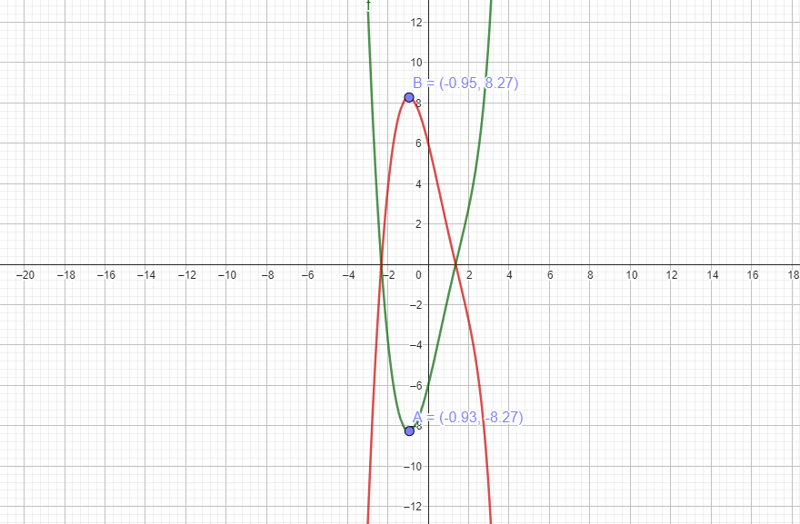
We can safely say that maxima will lie in (-0.960692,-0.959755) and we have chosen lower limit i.e. -0.960692 as the point of maxima.
x* = -0.960692
g(x*) = -8.269477
f(x*) = -g(x*) = 8.269477
Min function
Max function

Slide 5
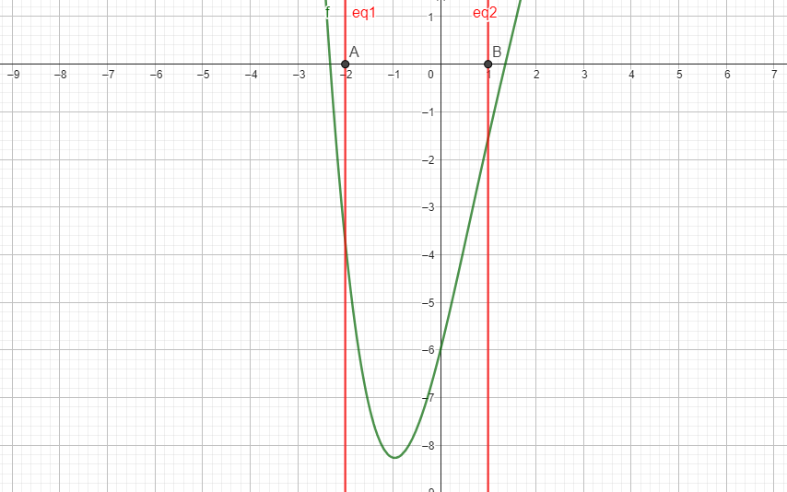
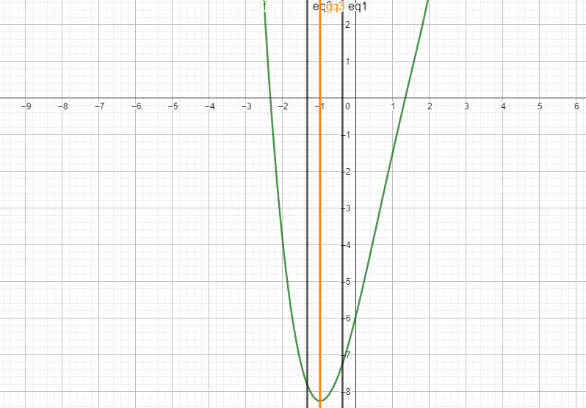
Interval from interval hf method, points so close
Interval from Bounding Phase method

Slide 6
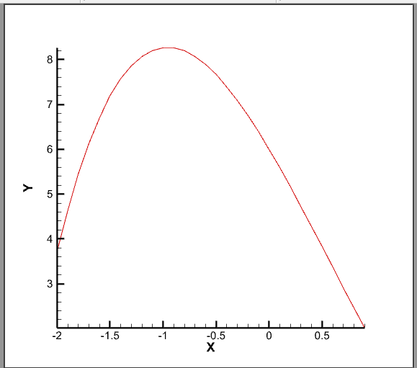
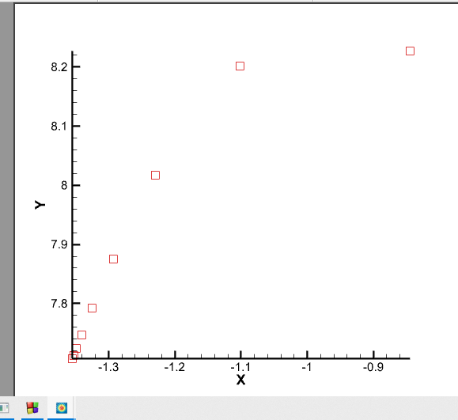

Slide 7
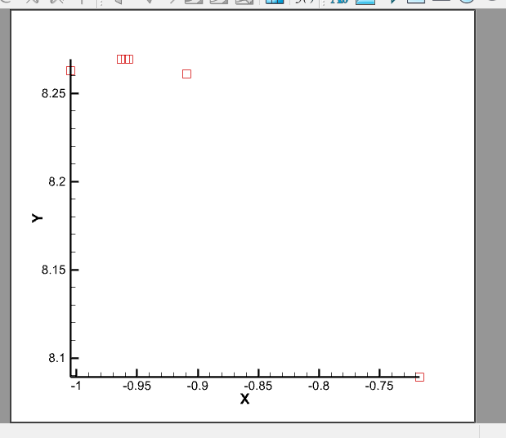

Slide 8
Observations
Bounding Phase Method | Interval Half Method
Bounding the optimal point in a large size interval. | Bounding the optimal point in a very NARROW size interval.
Taking less number of iterations | Comparatively, taking more iterations to bound the optimal point.
NOTE: In terms of NUMBER of FUNCTION EVALUATIONS, In worst case both are doing 2 function evaluations per iteration.

Slide 9
Conclusion
If the flatness of the curve is more, it will take MORE NUMBER of iterations and computation time.
If the initial guess is close to the optimal point then will take less time to converge.
Increasing the step-size(delta) will increase the accuracy BUT takes more time (iterations) & functions evaluations.

