Slide 1
ME609 (Optimization Methods for Engineers)
Solving Constrained Optimization Problem
Group-11
Abhijeet(234103001)
Kuldeep Singh(234103005)

Slide 2
Penalty Function Method
Interior penalty methods:-These methods works for feasible points and penalize points that are closed to the constraint boundary.
Exterior penalty method:- These methods works for infeasible points and penalize infeasible points.
Penalty function methods work in a series of sequence, each time modifying a set of penalty parameters and starting a sequence with the point obtained in the previous sequence.
In the questions we have used Exterior penalty method that is bracket operator.

Slide 3
Initializing problem
Defining penalty function
Taking initial value of x
Minimize penalty function using newton gradient method
Obtaining alpha optimum using bounding phase + interval halving method
Checking Termination condition(difference in penalty function value )
Optimum solution

Slide 4
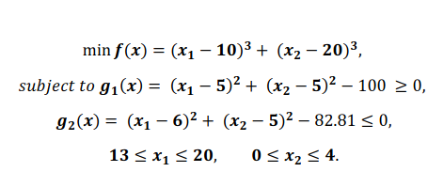
Q1

Slide 5
Results
Point (x) | Function value f(x) | Number of function evaluations | Iteration Number
13,0 | -7971.790000 | 9 | 1
Direction isn't Descent, with value = 12199.699363 Change the INITIAL Point in the INPUT FILE The Optimal Point x[0] = 13.000000 x[1] = 0.000000

Slide 6
Point (x) | Function value f(x) | Number of function evaluations | Iteration Number
14,1 | -6794.910000 | 9 | 1
Direction isn't Descent, with value = 10390.360492 Change the INITIAL Point in the INPUT FILE The Optimal Point x[0] = 14.000000 x[1] = 1.000000

Slide 7
Point (x) | Function value f(x) | Number of function evaluations | Iteration Number
17,1 | -6486.634439 | 9 | 1
Direction isn't Descent, with value = 10094.490567 Change the INITIAL Point in the INPUT FILE The Optimal Point x[0] = 17.000000 x[1] = 1.000000

Slide 8
Point (x) | Function value f(x) | Number of function evaluations | Iteration Number
17,2 | -5466.731039 | 9 | 1
Direction isn't Descent, with value = 8476.235649 Change the INITIAL Point in the INPUT FILE The Optimal Point x[0] = 17.000000 x[1] = 2.000000

Slide 9
Point (x) | Function value f(x) | Number of function evaluations | Iteration Number
4.09500000000000064, 0.8429607892154795668 | -7930.735009 | 9 | 1
Direction isn't Descent, with value = 12192.140093 Change the INITIAL Point in the INPUT FILE The Optimal Point x[0] = 14.095000 x[1] = 0.000000

Slide 10
Point (x) | Function value f(x) | Number of function evaluations | Iteration Number
15,4 | -3971.000000 | 9 | 1
Direction isn't Descent, with value = 5956.388160 Change the INITIAL Point in the INPUT FILE The Optimal Point x[0] = 15.000000 x[1] = 4.000000

Slide 11
Point (x) | Function value f(x) | Number of function evaluations | Iteration Number
15.2,4.1 | -3879.001304 | 9 | 1
Direction isn't Descent, with value = 5883.314604 Change the INITIAL Point in the INPUT FILE The Optimal Point x[0] = 15.200000 x[1] = 4.100000

Slide 12
Point (x) | Function value f(x) | Number of function evaluations | Iteration Number
19,2 | -5012.388639 | 9 | 1
Direction isn't Descent, with value = 7944.063595 Change the INITIAL Point in the INPUT FILE The Optimal Point x[0] = 19.000000 x[1] = 2.000000

Slide 13
Point (x) | Function value f(x) | Number of function evaluations | Iteration Number
20,,4 | -2965.606439 | 9 | 1
Direction isn't Descent, with value = 4813.951301 Change the INITIAL Point in the INPUT FILE The Optimal Point x[0] = 20.000000 x[1] = 4.000000

Slide 14
Point (x) | Function value f(x) | Number of function evaluations | Iteration Number
20,,3.7 | -3198.772856 | 9 | 1
Direction isn't Descent, with value = 5181.649750 Change the INITIAL Point in the INPUT FILE The Optimal Point x[0] = 20.000000 x[1] = 3.700000

Slide 15
Observations
Hessian of the penalty function is coming out to be negative definite and the search direction is coming non decent for all initial values in the domain.

Slide 16
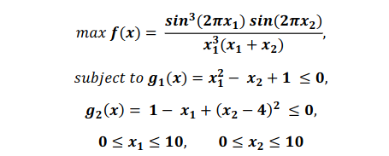
Q2

Slide 17
Results
Point (x) | Function value f(x) | Number of function evaluations | Iteration Number
1, 1 | 0.820000 | 63 | 1
 | 0.269080 | 51 | 2
 | -0.002279 | 9 | 3
Comment | Direction isn't Descent, with value = 0.005243 Change the INITIAL Point in the INPUT FILE

Slide 18
Point (x) | Function value f(x) | Number of function evaluations | Iteration Number
1,2 | 0.160000 | 67 | 1
 | -191.066730 | 59 | 2
 | -126.231569 | 67 | 3
 | 543.420337 | Search Directions are Linearly Dependent The Optimal Point x[0] = -0.018511 x[1] = 1.241275

Slide 19
Point (x) | Function value f(x) | Number of function evaluations | Iteration Number
5,2 | 5.760000 | 63 | 1
 | -34.270748 | 59 | 2
 | -3.349567 | 67 | 3
 | 308.361056 | 59 | 4
Search Directions are Linearly Dependent The Optimal Point x[0] = 0.003482 x[1] = 6.212576

Slide 20
Point (x) | Function value f(x) | Number of function evaluations | Iteration Number
1.227, 4.245 | -0.095819 | 63 | 1

Slide 21
Point (x) | Function value f(x) | Number of function evaluations | Iteration Number
2.5,4 | 0.105625 | 67 | 1
 | 0.360239 | 39 | 2
 | -0.012485 | 9 | 3
Direction isn't Descent, with value = 3.004245 Change the INITIAL Point in the INPUT FILE The Optimal Point x[0] = 1.136016 x[1] = 4.448366

Slide 22
Point (x) | Function value f(x) |  | Number of function evaluations | Iteration Number
2.5,2.5 | 0.231250 |  | 59 | 1
 | 1.339851 |  | 59 | 2
 | 3.983186 |  | 67 | 3
 | 6.975470 |  | 67 | 4
 | 147.651042 |  | 51 | 5
 | 482.448158 |  | 55 | 6
 | -0.059572 |  | 59 | 7
 | -0.095782 |  | 63 | 8
 |  |  | 480
The Optimal Point x[0] = 1.227974 x[1] = 4.245376

Slide 23
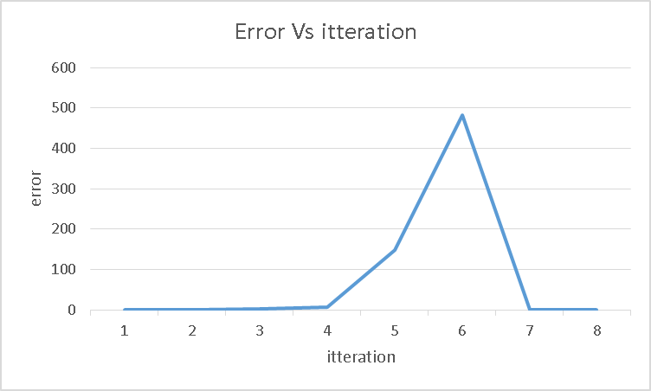

Slide 24
Point (x) | Function value f(x) | Number of function evaluations | Iteration Number
3,3 | 0.490000 | 67 | 1
 | 1.917137 | 51 | 2
 | -19.553787 | 9 | 3
Direction isn't Descent, with value = 60.265636 Change the INITIAL Point in the INPUT FILE The Optimal Point x[0] = 0.140334 x[1] = 4.086260

Slide 25
Point (x) | Function value f(x) | Number of function evaluations | Iteration Number
5,5 | 4.410000 | 67 | 1
 | 38.323832 | 39 | 2
 | 3.069247 | 67 | 3
 | 2.591652 | 9 | 4
Direction isn't Descent, with value = 29.548990 Change the INITIAL Point in the INPUT FILE The Optimal Point x[0] = -0.237038 x[1] = 4.119540

Slide 26
Point (x) | Function value f(x) | Number of function evaluations | Iteration Number
5,6 | 4.000000 | 63 | 1
 | 2.851001 | 51 | 2
 | -0.000386 | 9 | 3
Direction isn't Descent, with value = 0.000520 Change the INITIAL Point in the INPUT FILE The Optimal Point x[0] = 1.448974 x[1] = 4.032935

Slide 27
Point (x) | Function value f(x) | Number of function evaluations | Iteration Number
1,9 | 6.250000 | 67 | 1
 | 52.327802 | 51 | 2
 | 0.146541 | 59 | 3
 | -0.071988 | 67 | 4
 | -0.095552 | 67 | 5
The Optimal Point x[0] = 1.227960 x[1] = 4.245360

Slide 28
Observations
Getting near optimal solution in 5 to 10 iterations if the search direction linearly independency does not occurs.

Slide 29
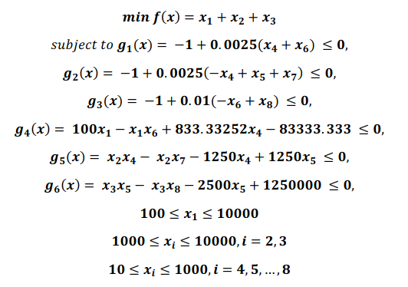
Q3

Slide 30
Results
Point (x) | Function value f(x) | Number of function evaluations | Iteration Number
200 1100 1000 1001 100 100 100 100 | 156354950987.681793 | 480 | 1
 | 592075135428980352.000000 | 474 | 2
 | 309791918909757366739858860106473617227776.0000 | 480 | 3
 | 886129737959405144677253904141938458115150877214698416834443284116905528320442369377541472654383299113206761390080.00000 | 482 | 4
Source of error | Matrix is singular. Cannot find the inverse.

Slide 31
Point (x) | Function value f(x) | Number of function evaluations | Iteration Number
500 1300 5000 150 300 200 280 400 | 376394231800.100586 | 480 | 1
 | 24466736004376629248.0 | 474 | 2
 | 21875362937998273020053119244707651710605066240.00 | 452 | 3
 | 87730004847212859067736260608.000000 | 396 | 4
Source of Error | Matrix is singular. Cannot find the inverse.

Slide 32
Point (x) | Function value f(x) | Number of function evaluations | Iteration Number
1000 1300 5000 150 300 200 280 400 | 376394232300.100586 | 480 | 1
 | 24466736004376633344.000000 | 474 | 2
 | 21875362937998273020053119244707651710605066240.0000 | 452 | 3
 | 87730004551020329881066012672.000000 | 396 | 4
Source of Error | Matrix is singular. Cannot find the inverse.

Slide 33
Point (x) | Function value f(x) | Number of function evaluations | Iteration Number
1000 2000 5000 500 300 200 280 400 | 333054433622.394775 | 480 | 1
 | 3144684664698.609863 | 474 | 2
 | 40741.825605 | 480 | 3
 | 115662.343158 | 480 | 4
 | 175741.067675 | 299 | 5
Source of Error | Matrix is singular. Cannot find the inverse. Hessian Matrix is Negative Definite/semidefinte Direction isn't Desecent, with value = 18166.019767

Slide 34
Point (x) | Function value f(x) | Number of function evaluations | Iteration Number
1000 2000 5000 500 500 500 580 500 | 506250008000.245239 | 480 | 1
 | 84924753918108303360.000000 | 474 | 2
 | 91675502605200179944520235395515488950225469440.000000 | 476 | 3
Source of Error | Matrix is singular. Cannot find the inverse.

Slide 35
Point (x) | Function value f(x) | Number of function evaluations | Iteration Number
1500 2500 5000 500 500 500 580 500 | 506250009000.245239 | 480 | 1
 | 84913505221688066048.00000 | 474 | 2
 | 91651272768429038497181837327883261654650060800 | 476 | 3
Source of Error | Matrix is singular. Cannot find the inverse.

Slide 36
Point (x) | Function value f(x) | Number of function evaluations | Iteration Number
1500 2500 5000 1000 1000 500 580 500 | 1168749984700.842285 | 480 | 1
 | 2744552431999166447616.0000 | 486 | 2
 | 25810021.47210 | 448 | 3
Source of Error | Matrix is singular. Cannot find the inverse.

Slide 37
Point (x) | Function value f(x) | Number of function evaluations | Iteration Number
1500 2500 5000 1000 1000 1000 1000 1000 | 756250009001.825073 | 480 | 1
 | 409462000183556243456.00000 | 474 | 2
 | 10283286874002009459969480126031743031577203965952.0000 | 476 | 3
Source of Error | Matrix is singular. Cannot find the inverse.

Slide 38
Point (x) | Function value f(x) | Number of function evaluations | Iteration Number
1500 5000 5000 1000 1000 1000 1000 1000 | 756250011501.8250 | 480 | 1
 | 409417034887324368896.00000 | 474 | 2
 | 10281012738901486108142730451846884925650684084224.00000 | 476 | 3
Source of Error | Matrix is singular. Cannot find the inverse.

Slide 39
Point (x) | Function value f(x) | Number of function evaluations | Iteration Number
579.3167 1359.943 5110.071 182.0174 295.5985 217.9799 286.4162 395.5979 | 380065704190.296265 | 480 | 1
 | 27714248354.73465 | 442 | 2
Source of Error | Hessian Matrix is Negative Definite/semidefinite Matrix is singular. Cannot find the inverse.

Slide 40
Observations
The value of omega function is coming very large
Hence value of penalty function is also coming very high
The hessian inverse is coming very small near to zero
Not able to converge

