Slide 1




Internship Seminar
6 Month Industry Internship 2022-2023

Slide 2

Presented By:
Kuldeep Sonkusare

Slide 3

Company: City Bridge Softwares Pvt. Ltd
Title of Project: Educational Organization Governance System

Slide 4

Educational Organization Governance System
The great combination of technologies for building a website for an educational organization. HTML, CSS, Bootstrap, and ASP.NET are commonly used technologies
Users can log in using their respective credentials, which include a username and password. The system supports three types of users: admin, student, and trainer. Trainers who are not yet registered can click on the "Trainer Registration" button on the login page. This allows them to create an account by providing the required details.

Slide 5
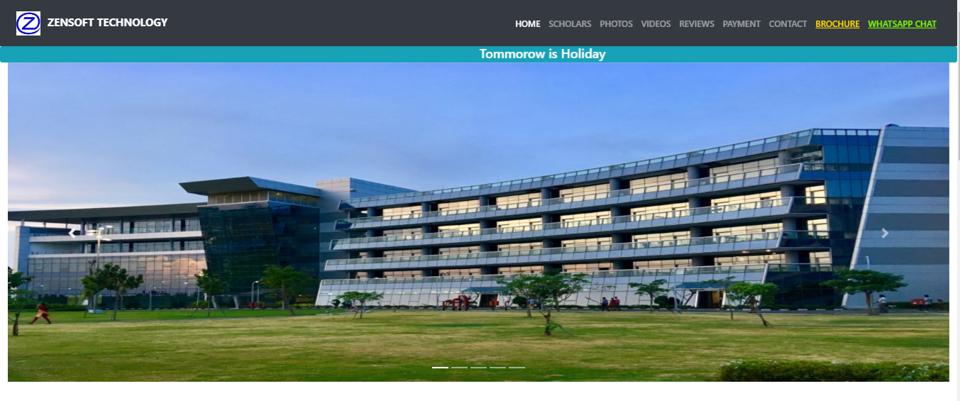

Add a section header
Landing Page:

Slide 6

Add a section header

Slide 7
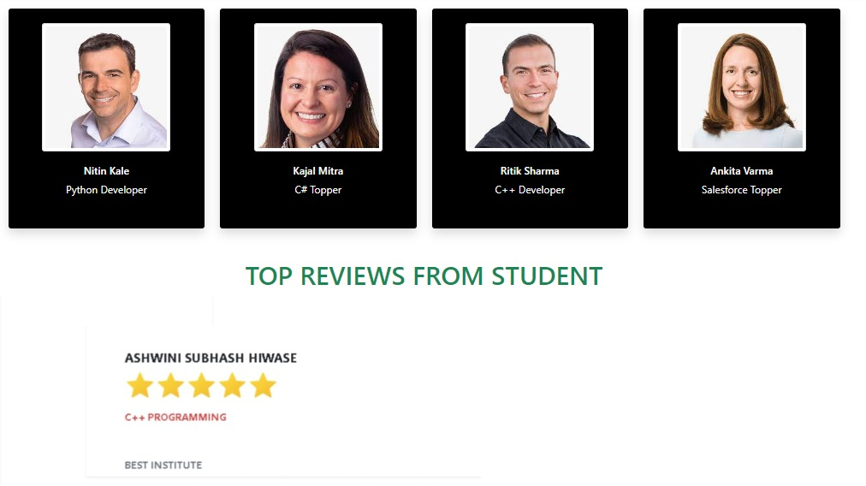
Add a section header

Slide 8
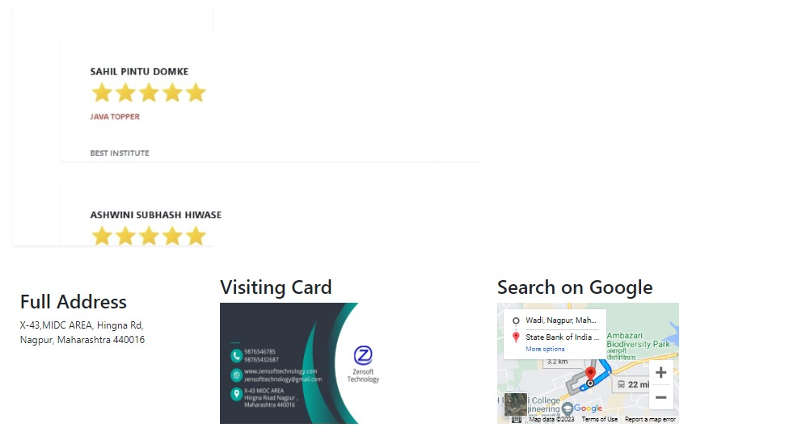
Add a section header

Slide 9
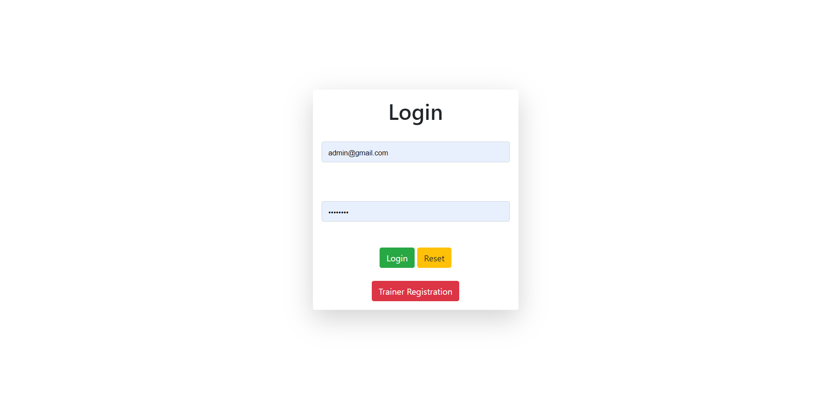
Add a section header
Login Page for Admin, Student, and Trainer

Slide 10
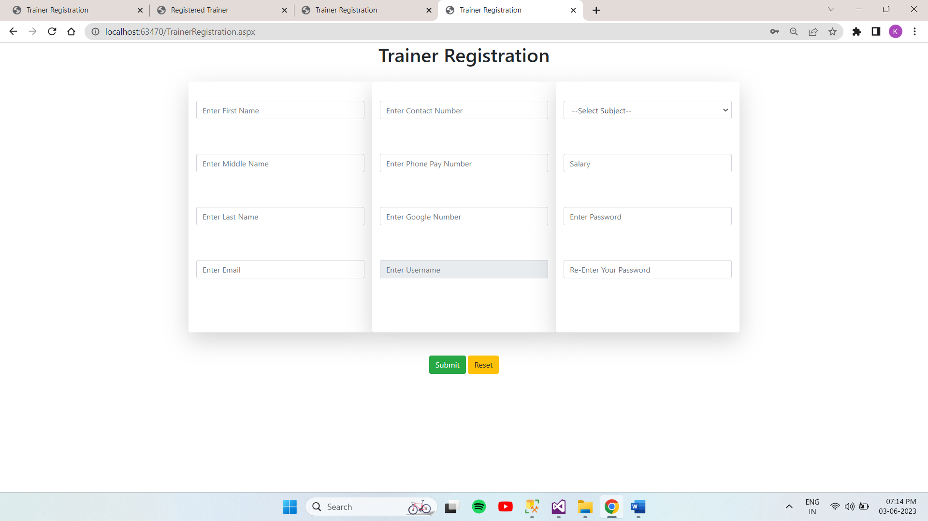
Add a section header

Slide 11
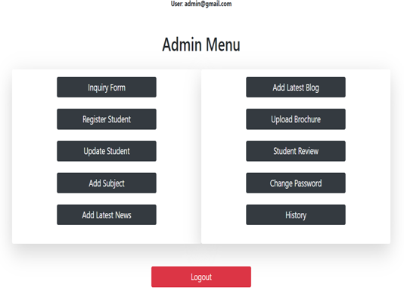
Add a section header
Admin Dashboard
The admin dashboard provides various administrative functionalities, including:
Inquiry Management: The admin can send inquiry emails to interested students.
Student Management: The admin can register new students, update their information, and view admission history.
Subject Management: The admin can add subjects provided by the institute.
News and Blogs: The admin can add the latest news and blogs to keep students updated.
Institute Brochure: The admin can upload the institute brochure for students to download.
Student Review: The admin can analyze student reviews.
Password Management: The admin can change their password for security purposes.
History: The admin can view the history, including inquiry history, admission history, and trainer registration history.

Slide 12
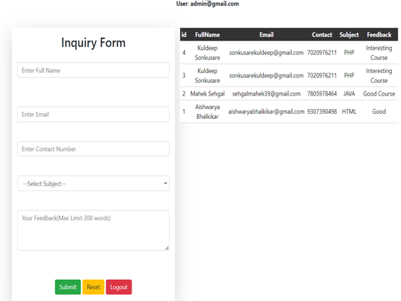
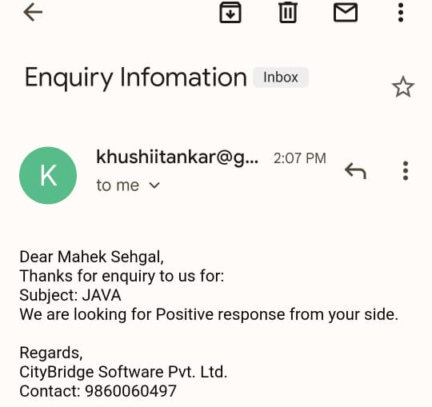
Add a section header
Inquiry Form
Inquiry Mail Received by Interested Student

Slide 13
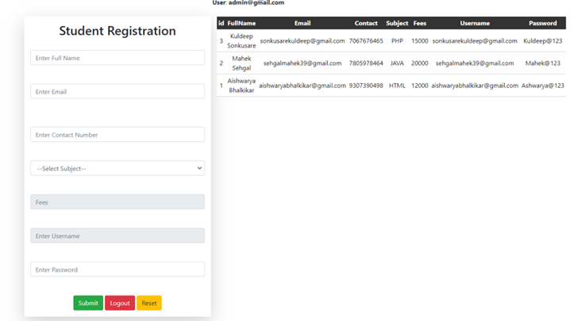
Add a section header
Student Registration

Slide 14
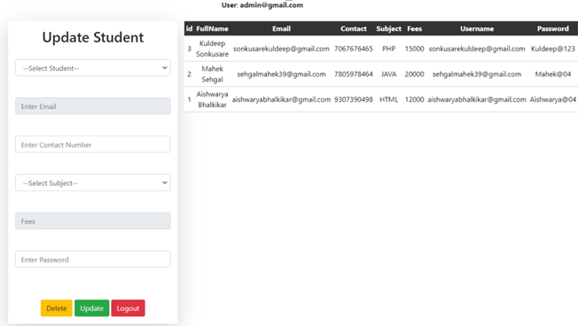
Add a section header
Update Student

Slide 15
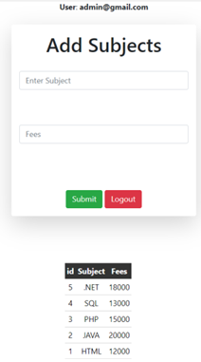
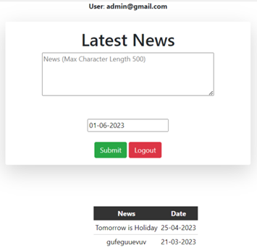
Add a section header
Add Subject
Latest News

Slide 16
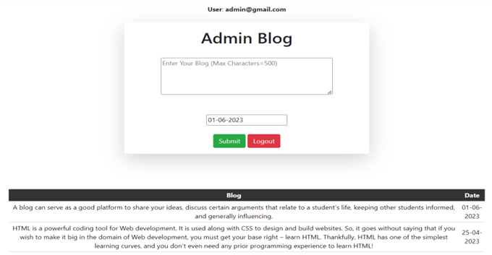
Add a section header
Admin Blog

Slide 17
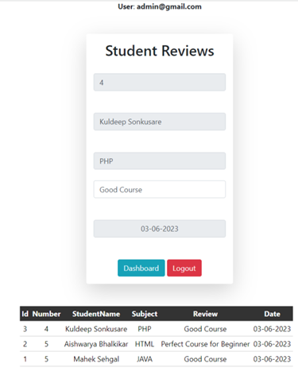
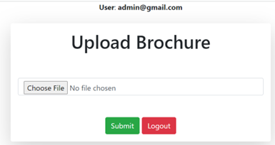
Add a section header
Upload Brochure
Student Review

Slide 18
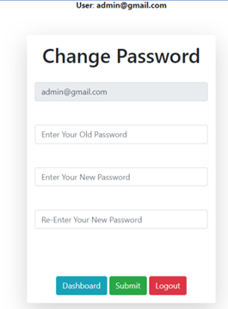
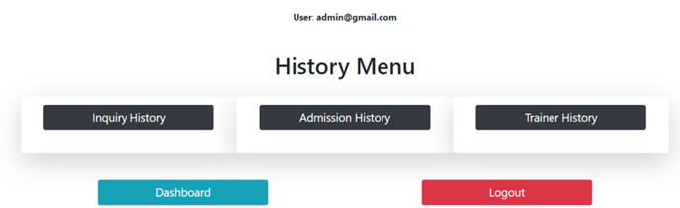
Add a section header
Change Password
History

Slide 19
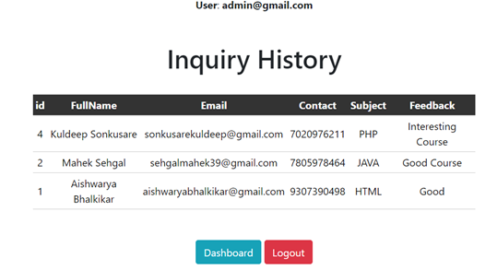
Add a section header
Inquiry History

Slide 20
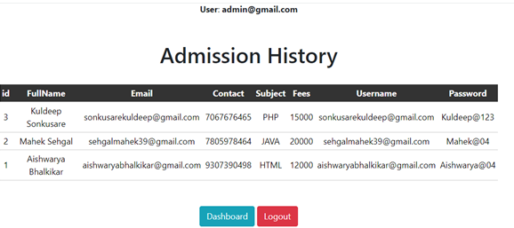
Add a section header
Admission History

Slide 21
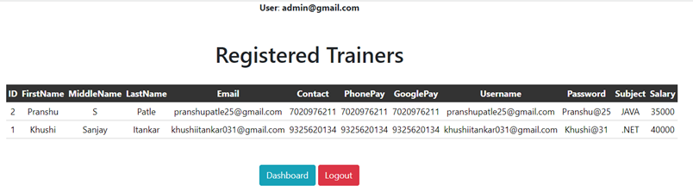
Add a section header
Trainer History

Slide 22
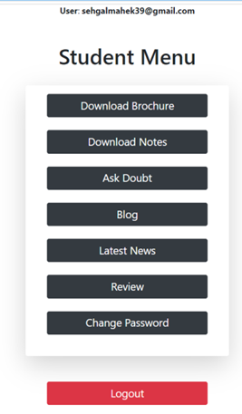
Add a section header
Student Dashboard
The student dashboard offers the following functionalities to students:
Notes Download: Students can download the notes of their enrolled subjects.
Doubt Section: Students can ask doubts related to their subjects.
News and Blogs: Students can access the latest news and blogs posted by the admin.
Password Management: Students can change their passwords as needed.
Review Section: Students can review to their subjects.

Slide 23
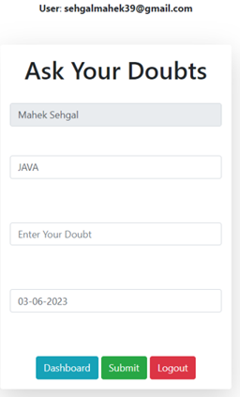
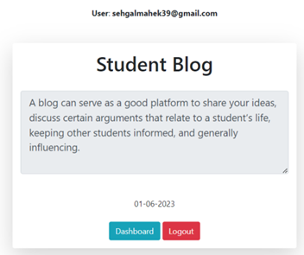
Add a section header
Doubt Section
Blog Section

Slide 24
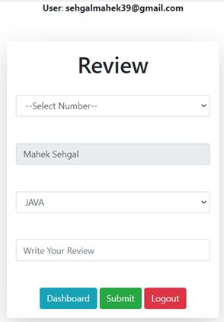
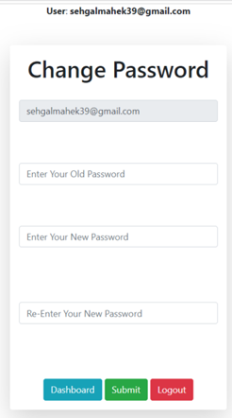
Add a section header
Review Section
Change Password

Slide 25
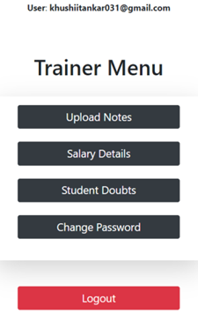
Add a section header
Trainer Dashboard
The trainer dashboard provides the following features for trainers:
Notes Upload: Trainers can upload notes for the subjects they are assigned to teach.
Salary Details: Trainers can view their salary details.
Doubt Resolution: Trainers can solve student doubts by providing explanations and guidance.
Password Management: Trainers can change their passwords for security reasons.

Slide 26
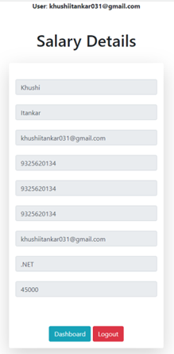
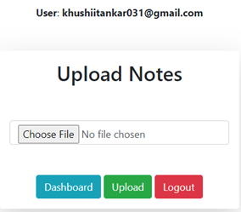
Add a section header
Upload Notes
Salary Details

Slide 27
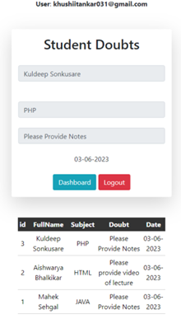
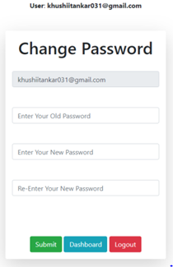
Add a section header
Students Doubt
Change Password

Slide 28

Thank You!

