Slide 1
Work/Job Analysis
Stack Overflow 2018 Survey

Slide 2
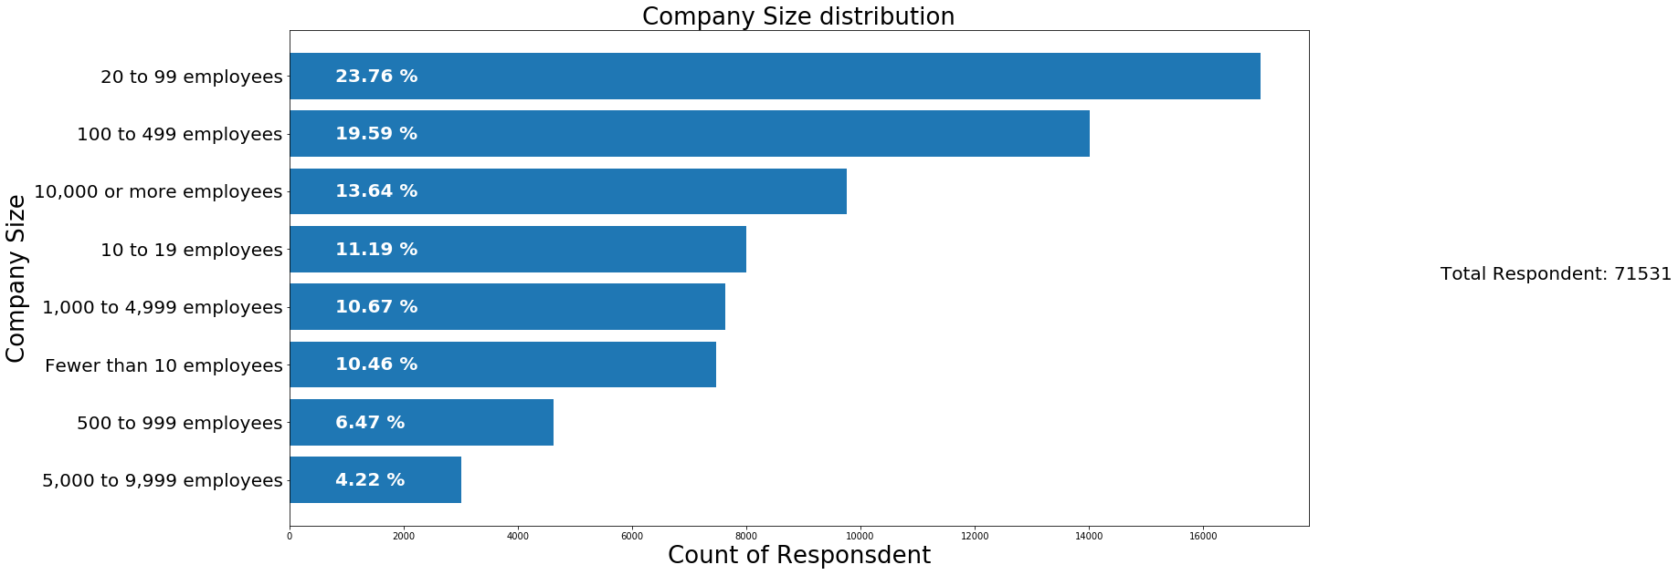
Respondents Distribution by Company Size

Slide 3
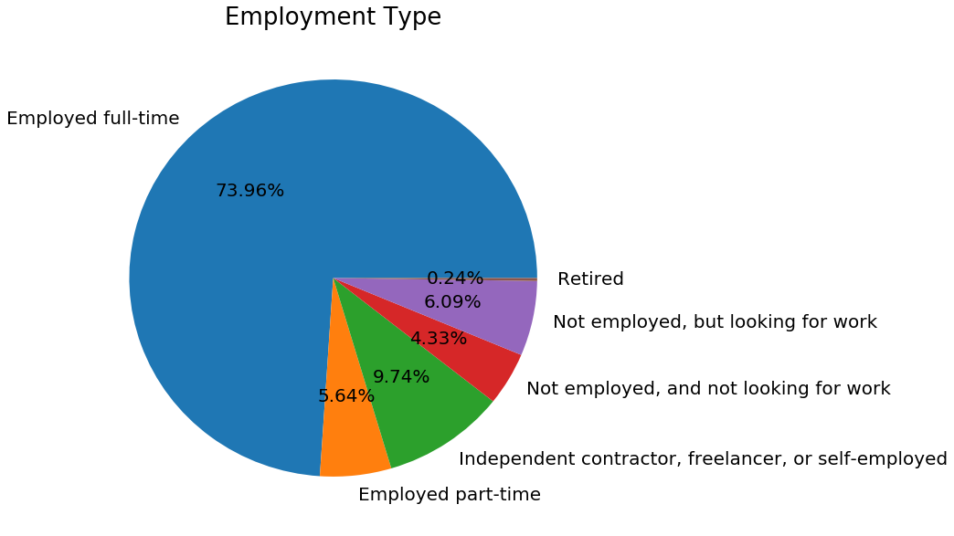
Employment Status Distribution

Slide 4
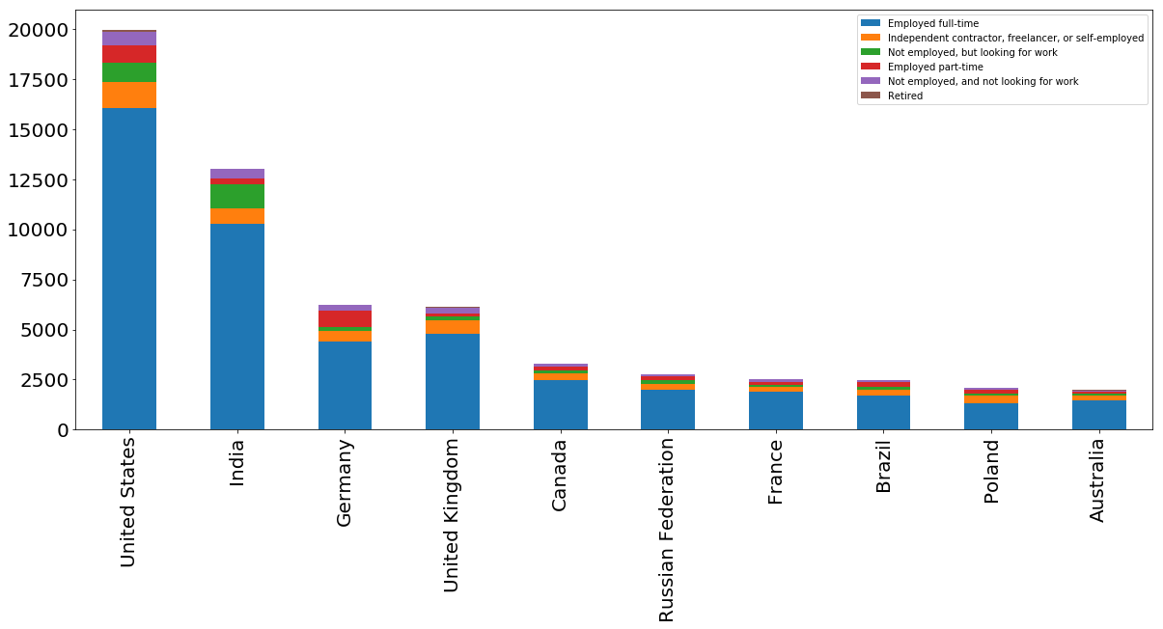
Employment Status by Country

Slide 5
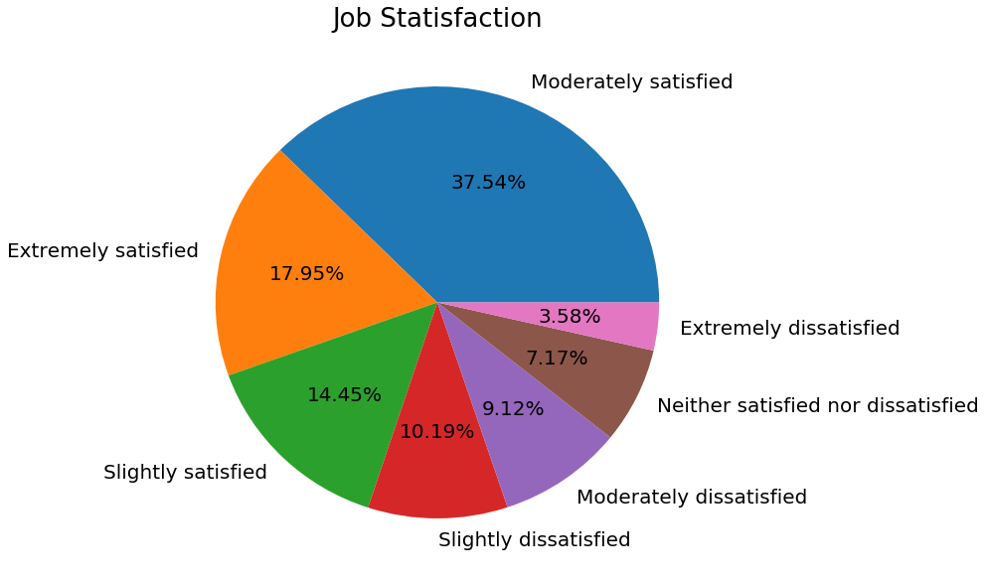
Job Satisfaction

Slide 6
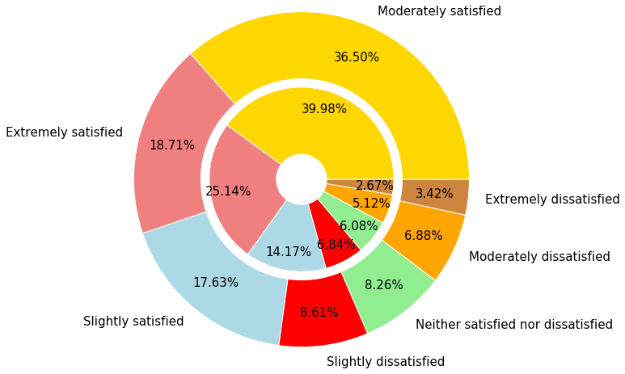
Career Satisfaction – Global vs US
Global – Outer pie
US – Inner pie

Slide 7
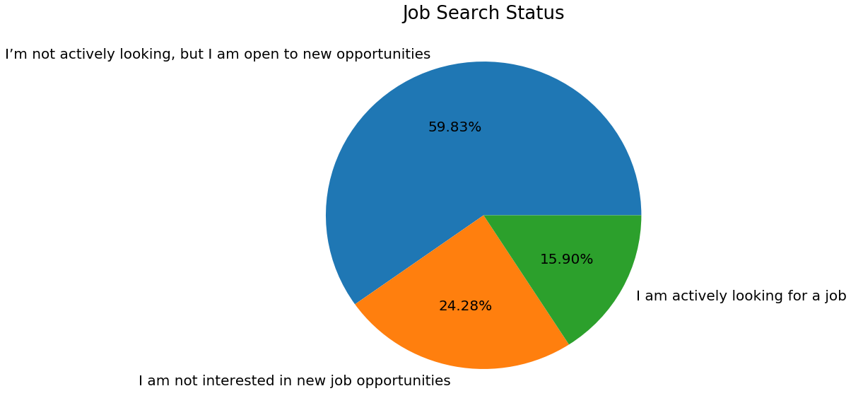
Job Search Status

Slide 8
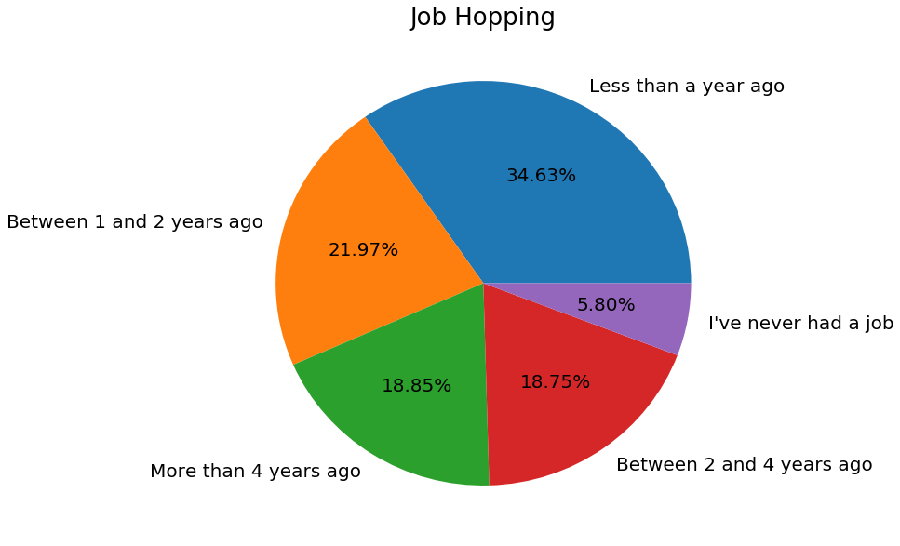
Job Hopping

Slide 9
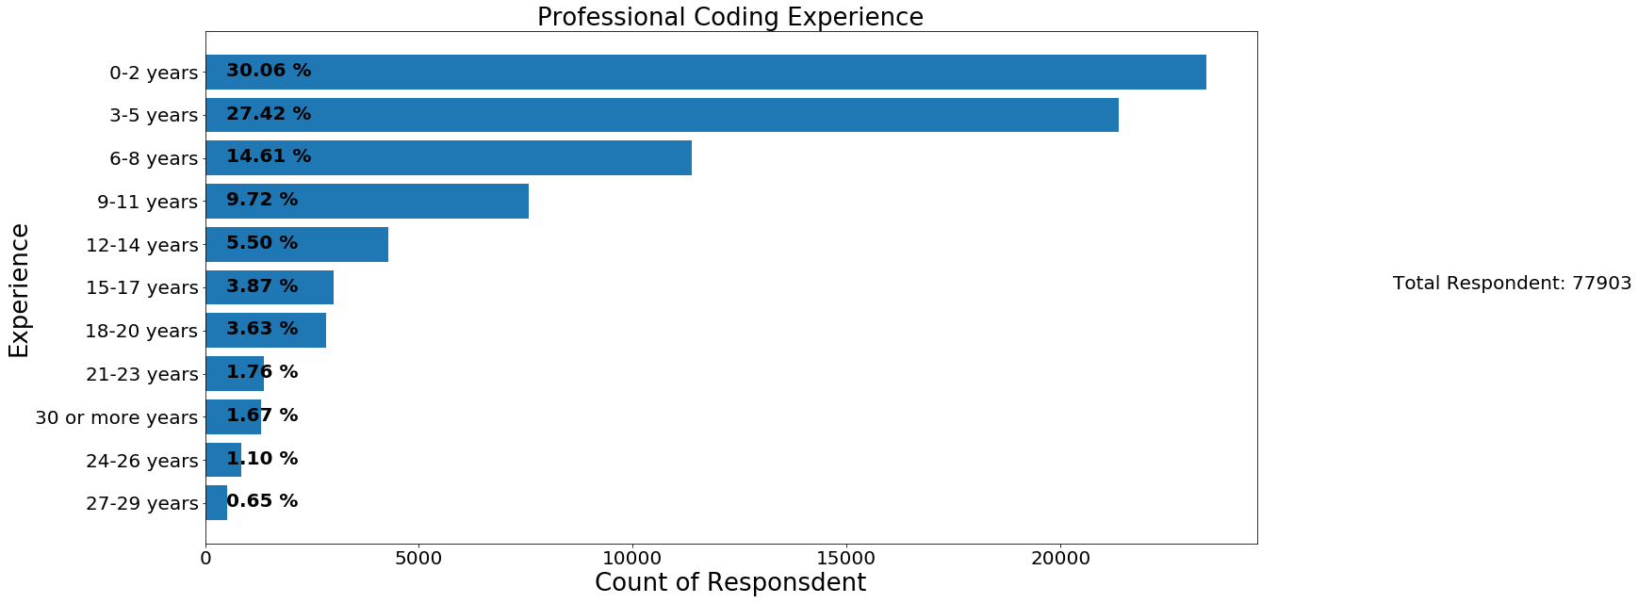
Professional Coding Experience

