Slide 1
Tech Nerds Data Analysis
Stack Overflow 2018 Survey
Team Members
Kuldeep
Madhukara
Shameetha

Slide 2
Core Message
Each year, Stack overflow conducts a survey within the developer community about everything from their favorite technologies to their job preferences.
Over 100,000 developers took the 30-minute survey.
We have analyzed the data from this survey for 2018 to identify few interesting trends.
This could be used by industry leaders to make decisions on their opportunity costs
Help students decide on the classes that could be useful when they graduate or to identify technology leaders by country.

Slide 3
Questions
Since we are developers ourselves our group found it interesting to answer the following questions:
What are important trends in the software industry today?
What languages and technologies associated with this trend?
How developers working in these areas are benefiting?
What is a typical successful developer profile look like?

Slide 4
Data exploration and cleanup process
Data Source: Kaggle
Data Size:
Columns: 129
Rows: ~ 100,000
File size: ~ 189 MB
File format: csv
Tried to analyze a subset of data relevant to our class project.
So cleaned up many extraneous data columns.
Columns: 43
File size: ~ 88 MB
Then in our individual branches, we removed NaN type of data before starting the analysis.

Slide 5
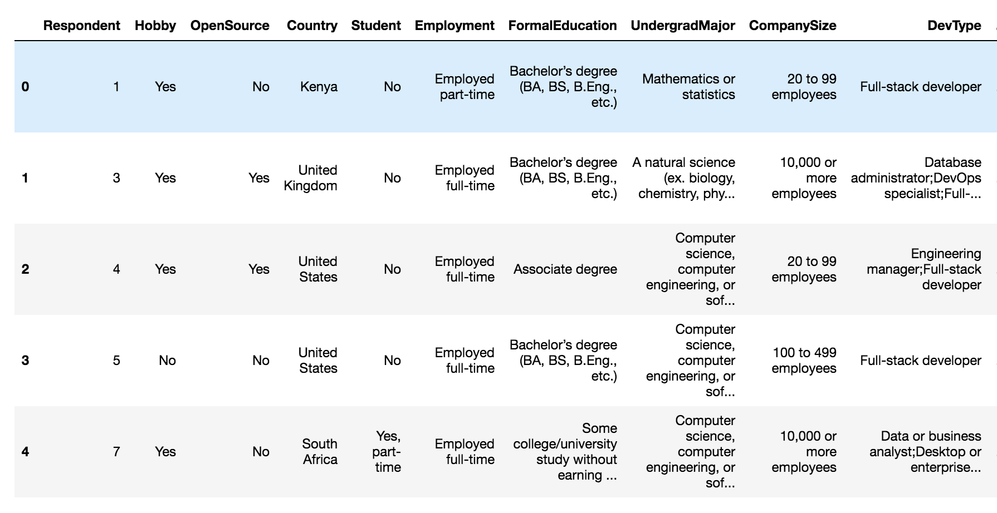
Sample data

Slide 6
Process of data analysis and synthesizing
Technology
Work
Developer Profile
Demographics
Developer Roles
Education
Popular languages
Worldwide technology development
Company size
Career satisfaction
Remuneration

Slide 7
Developer Profile

Slide 8
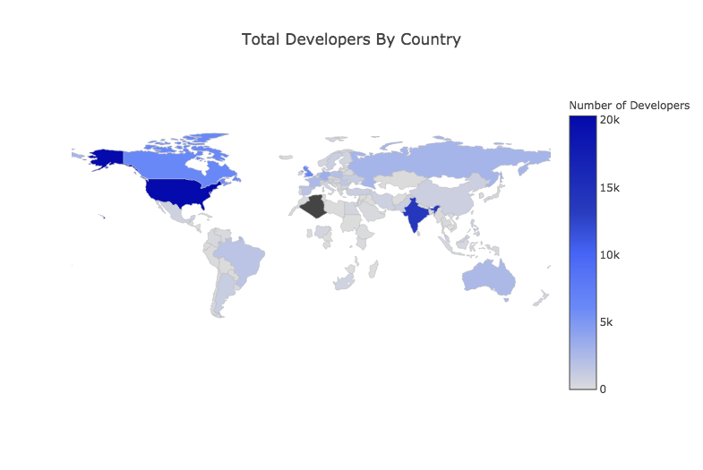
Geography

Slide 9
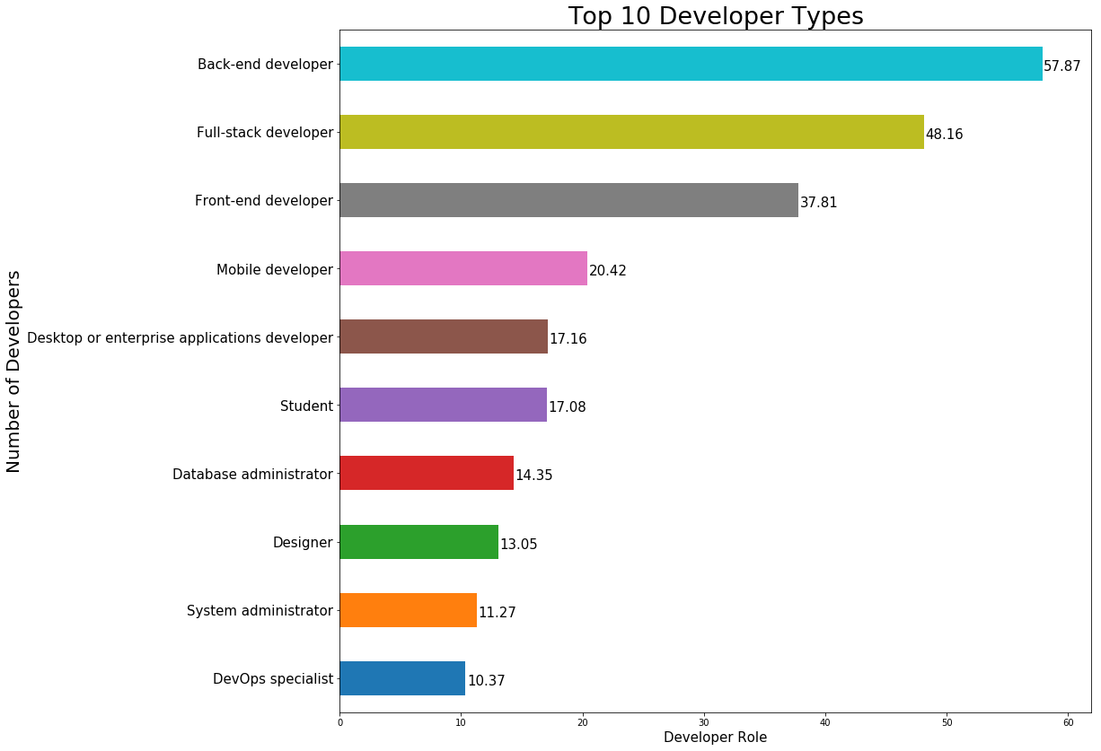
Developer Roles

Slide 10
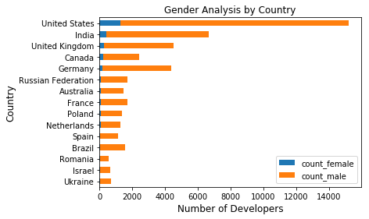
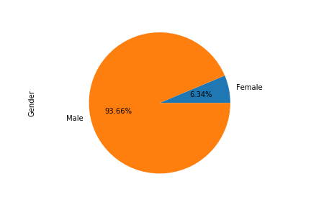
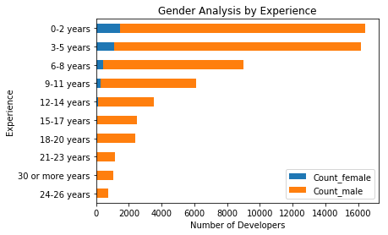
Demographics: Gender

Slide 11
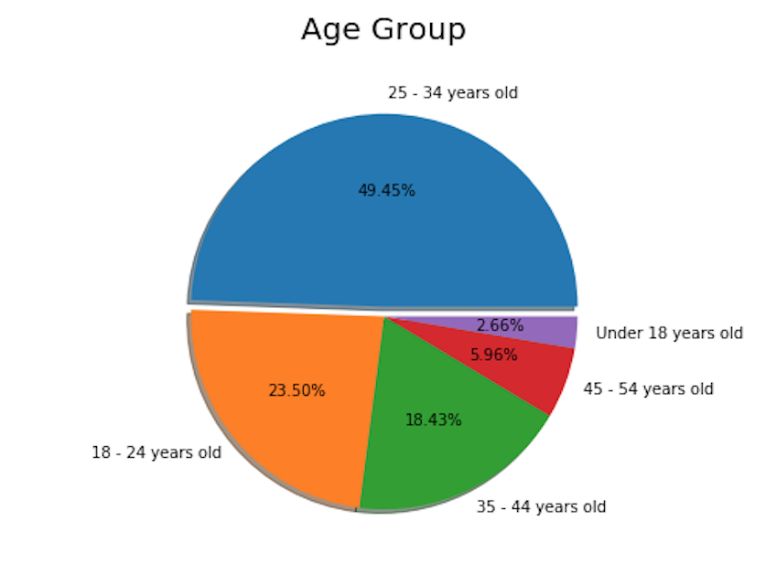
Demographics: Age

Slide 12
Demographics: Education

Slide 13
Technology

Slide 14
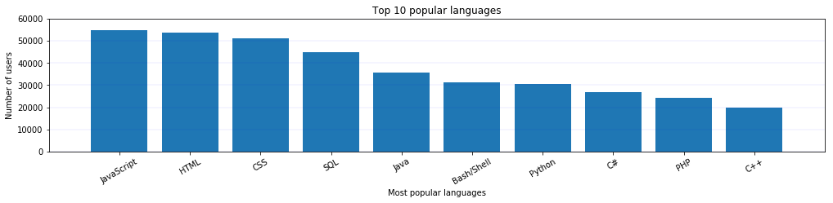
Popular programming language

Slide 15
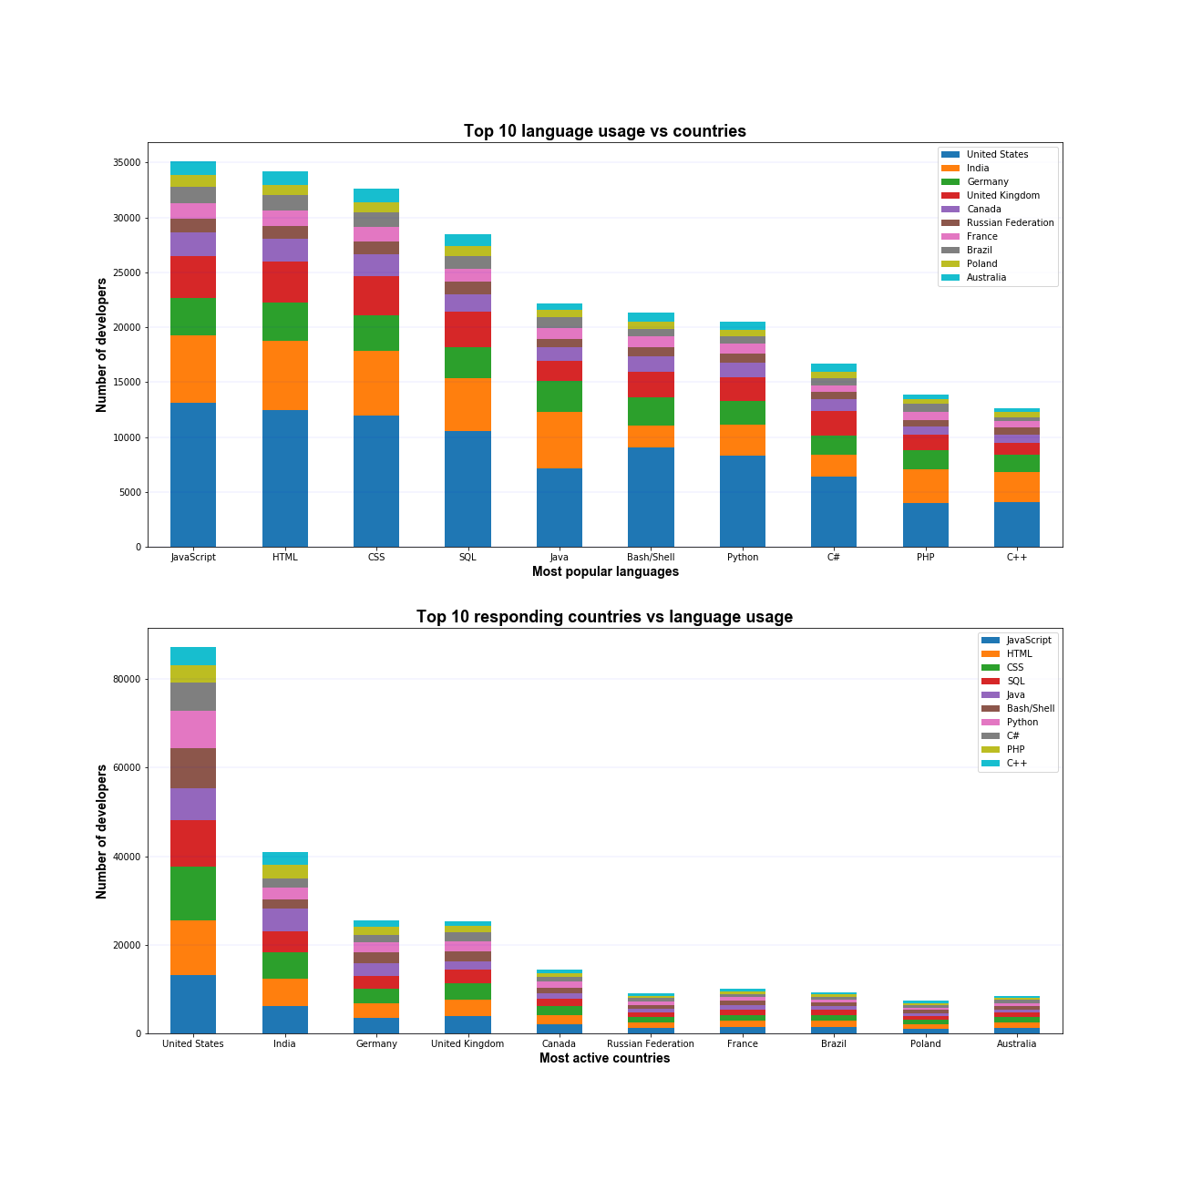
Language vs Country

Slide 16
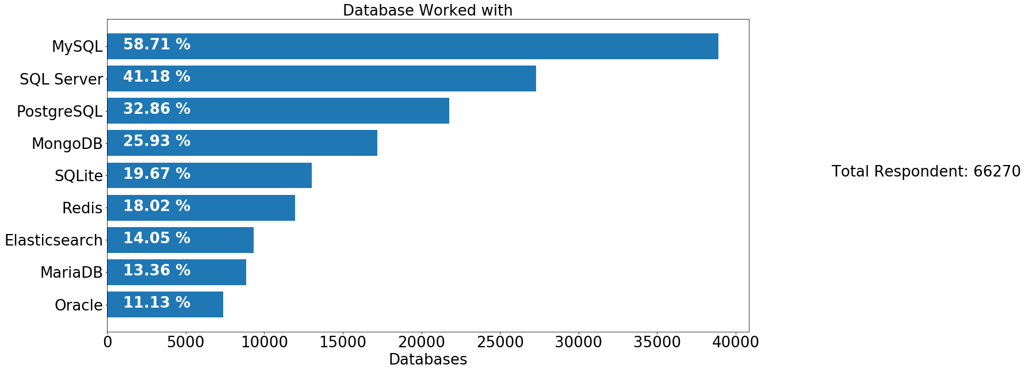
Top 10 Database

Slide 17
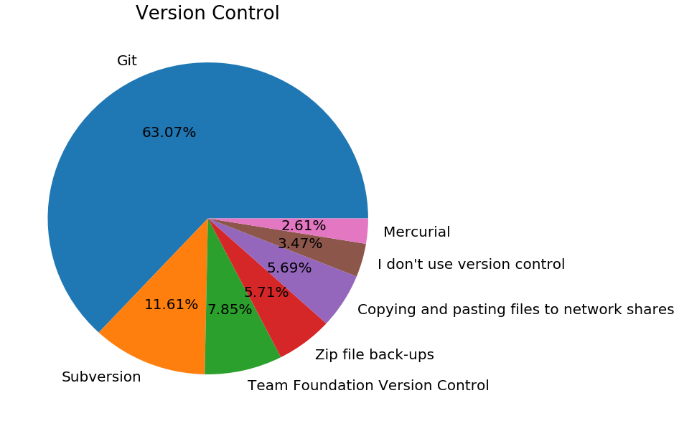
Version Control & Commit

Slide 18
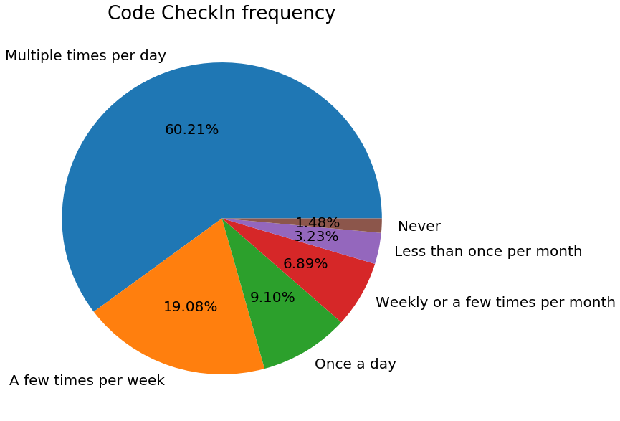
Commit Frequency

Slide 19
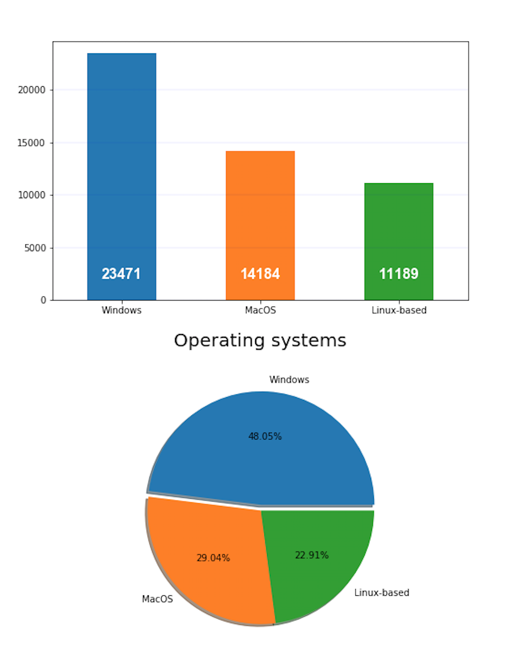
Operating System

Slide 20
Work

Slide 21
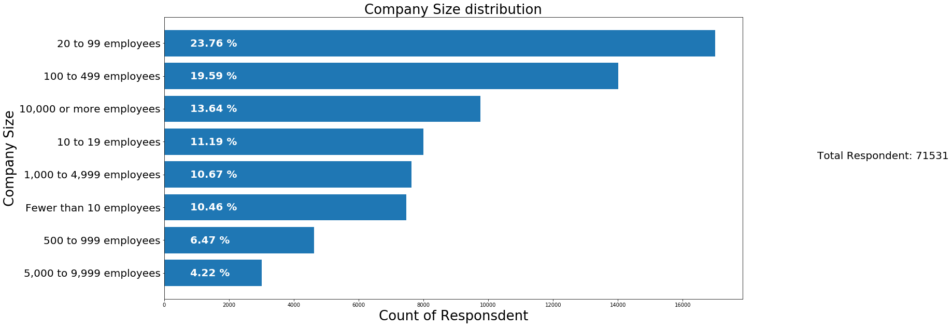
Respondents Distribution by Company Size

Slide 22
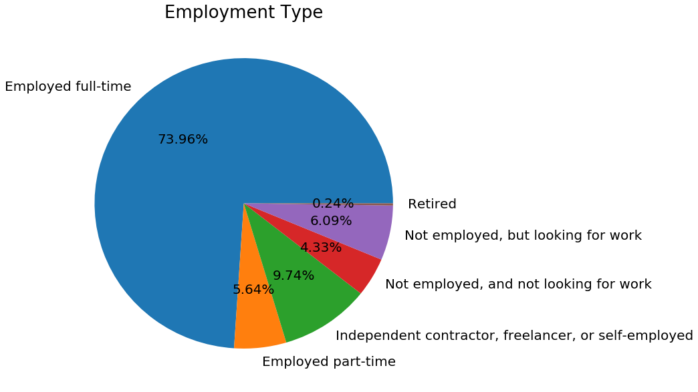
Employment Status Distribution

Slide 23
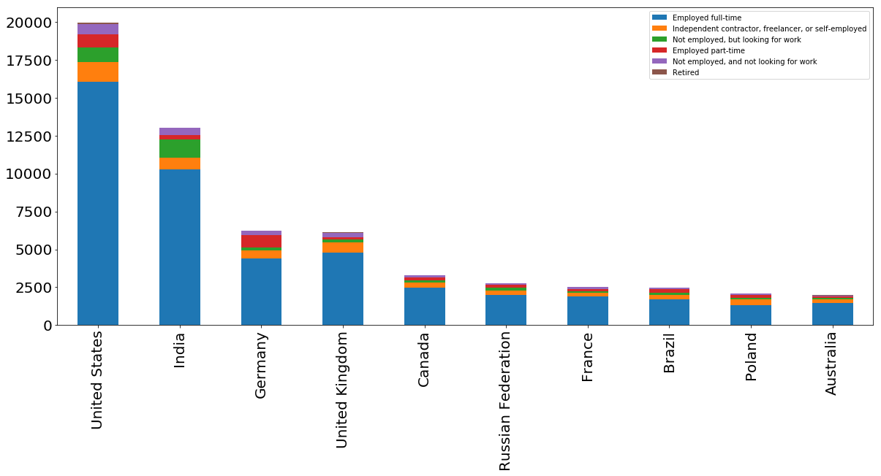
Employment Status by Country

Slide 24
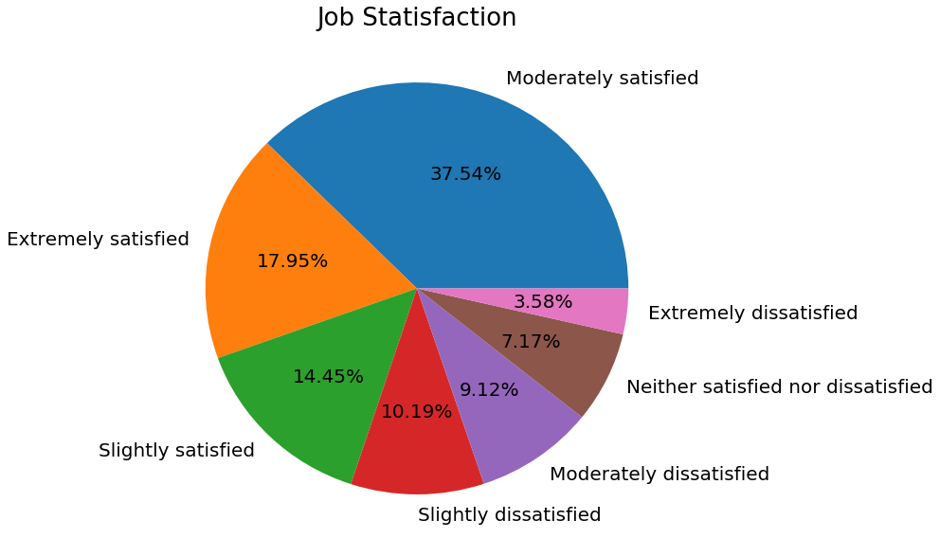
Job Satisfaction

Slide 25
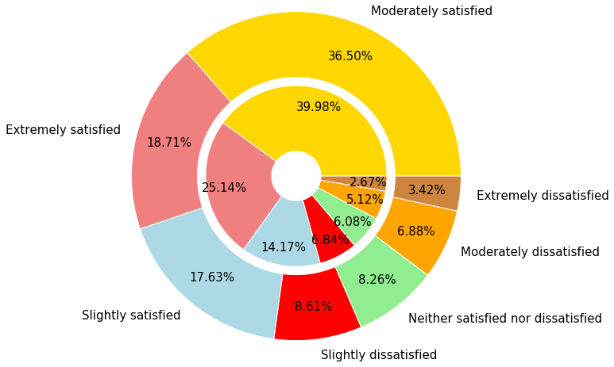
Career Satisfaction – Global vs US
Global – Outer pie
US – Inner pie

Slide 26
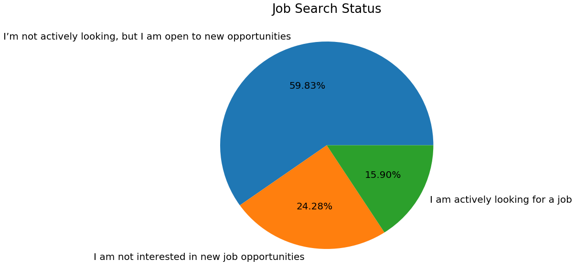
Job Search Status

Slide 27
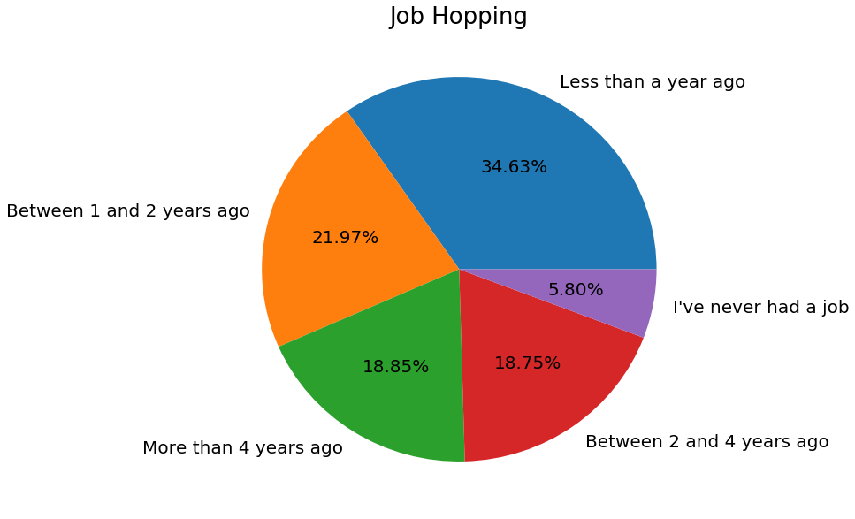
Job Hopping

Slide 28
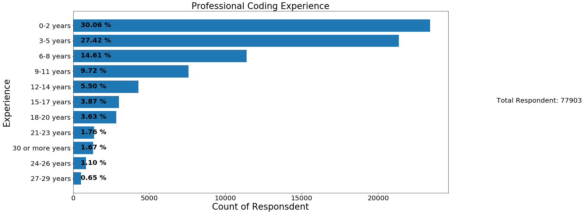
Professional Coding Experience

Slide 29
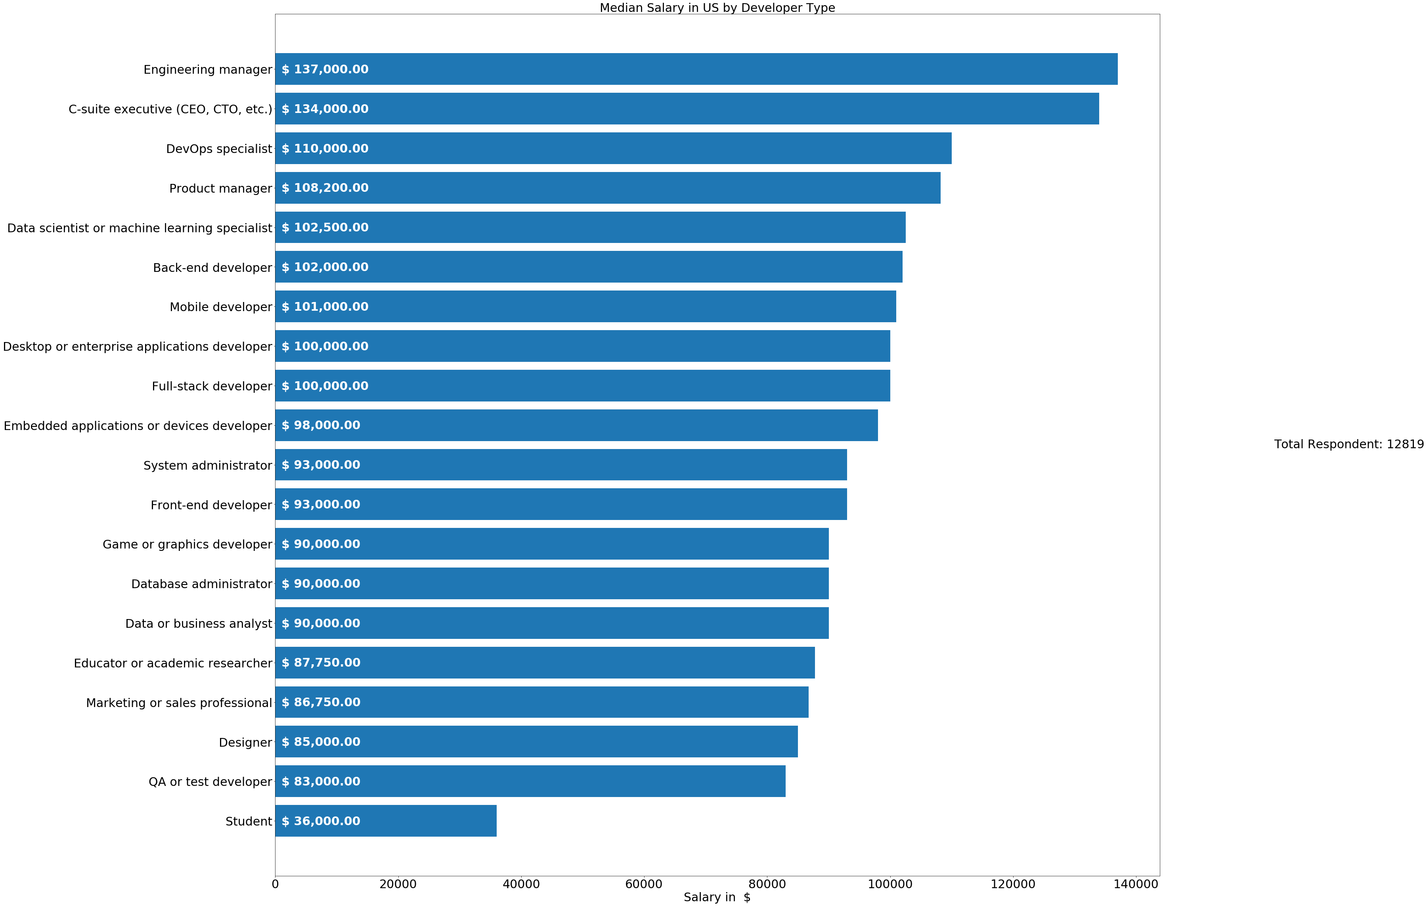
Salary by Job Title

Slide 30
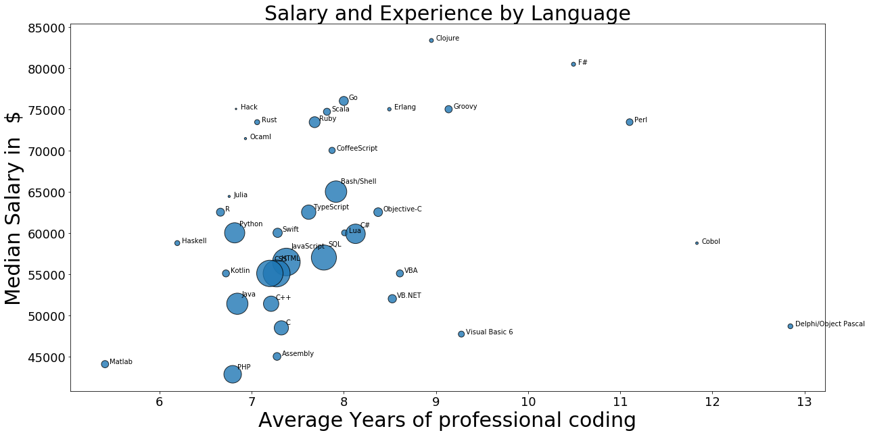
Salary and Experience by Language: Global

Slide 31
Conclusion
Emerging trends in technology:
Web-Technologies: Javascript, HTML and CSS are most popular languages
MySQL is the most popular database engine
Git is an extremely popular version control system worldwide
United States and India emerged as two top most technology countries, while UK and Germany are following.
Popular platforms – Windows and Mac while Linux is not way behind
Career satisfaction – Moderately satisfied both globally and in US.
Most developers preferred to switched job within 1 year.
Popular age group: 24- 35 years

Slide 32
Thank you! Q & A?

