Slide 1
Tech Nerds Data Analysis
Stack Overflow 2018 Survey
Team Members
Kuldeep
Madhukara
Shameetha

Slide 2
Core Message
Each year, Stack overflow conducts a survey within the developer community about everything from their favorite technologies to their job preferences.
Over 100,000 developers took the 30-minute survey.
We have analyzed the data from this survey for 2018 to identify few interesting trends.
This could be used by industry leaders to make decisions on their opportunity costs
Help students decide on the classes that could be useful when they graduate or to identify technology leaders by country.

Slide 3
Questions
Since we are developers ourselves our group found it interesting to answer the following questions:
What are important trends in the software industry today?
What languages and technologies associated with this trend?
How developers working in these areas are benefiting?
What is a typical successful developer profile look like?

Slide 4
Data exploration and cleanup process
Data Source: Kaggle
Data Size:
Columns: 129
Rows: ~ 100,000
File size: ~ 189 MB
File format: csv
Tried to analyze a subset of data relevant to our class project.
So cleaned up many extraneous data columns.
Columns: 43
File size: ~ 88 MB
Then in our individual branches, we removed NaN type of data before starting the analysis.

Slide 5
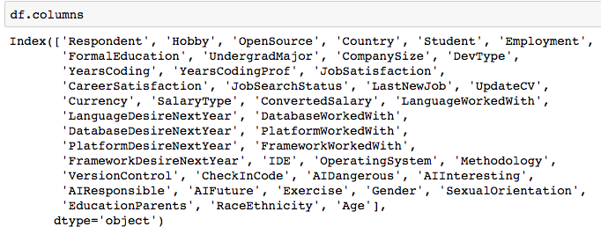
Columns

Slide 6
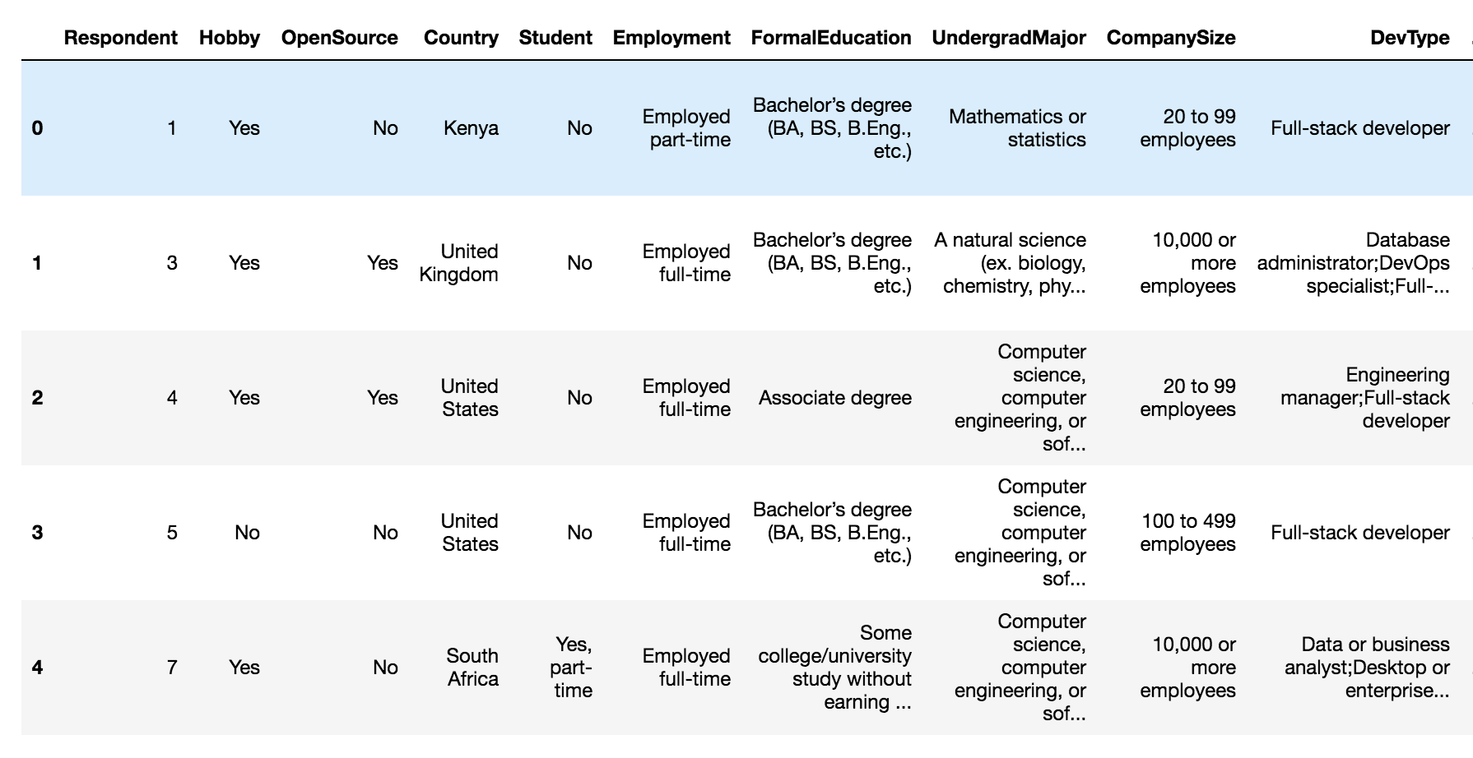
Sample data

Slide 7
Process of data analysis and synthesizing
Technology
Work
Developer Profile
Demographics
Developer Roles
Education
Popular languages
Worldwide technology development
Company size
Career satisfaction
Remuneration

Slide 8
Developer Profile

Slide 9
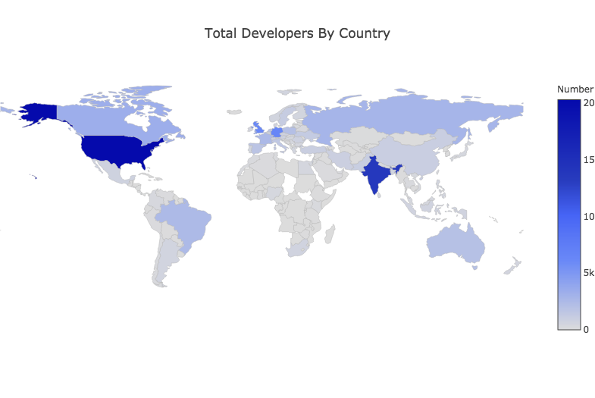
Geography

Slide 10
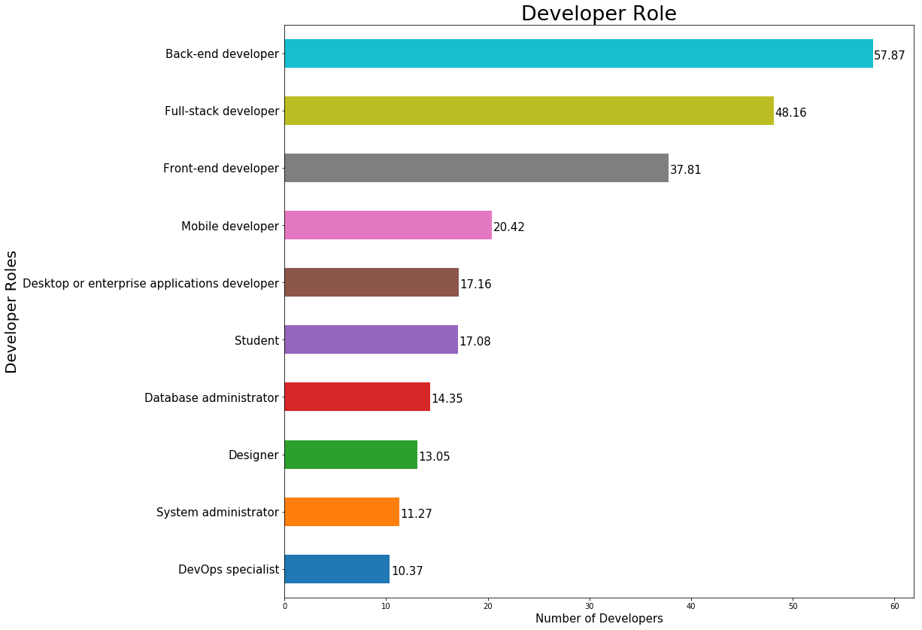
Developer Roles

Slide 11
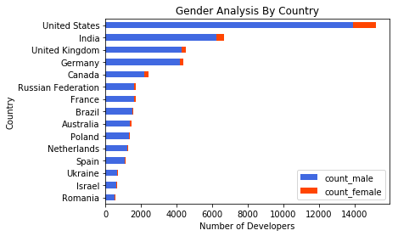
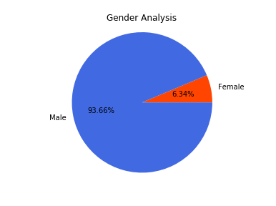
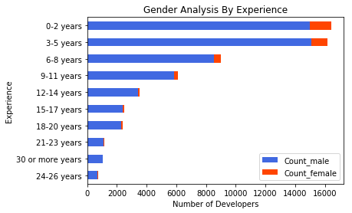
Demographics: Gender

Slide 12
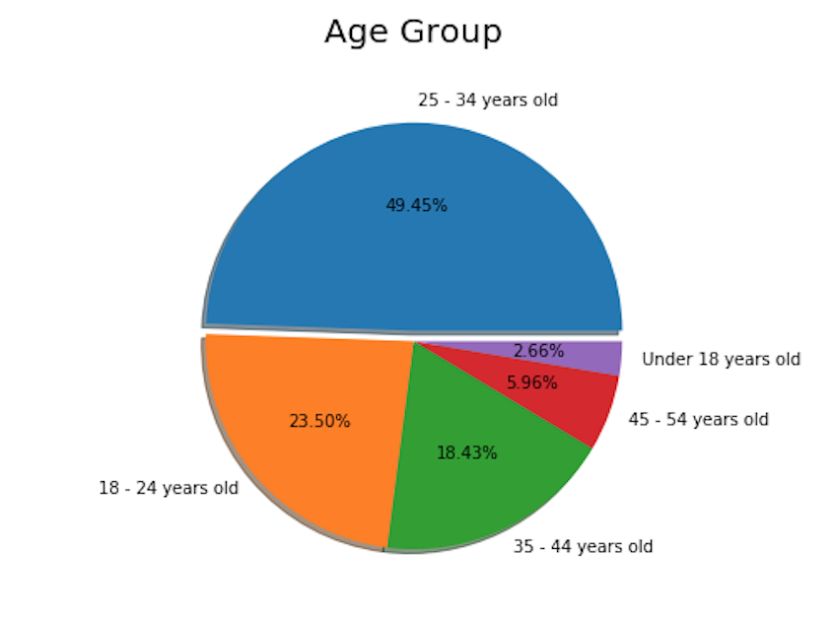
Demographics: Age

Slide 13
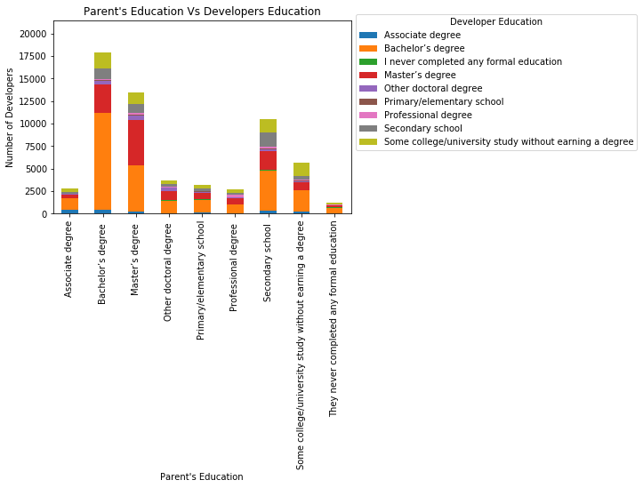
Demographics: Education

Slide 14
Technology

Slide 15
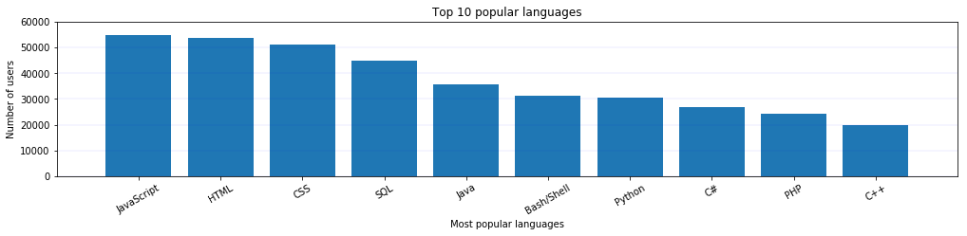
Popular programming language

Slide 16
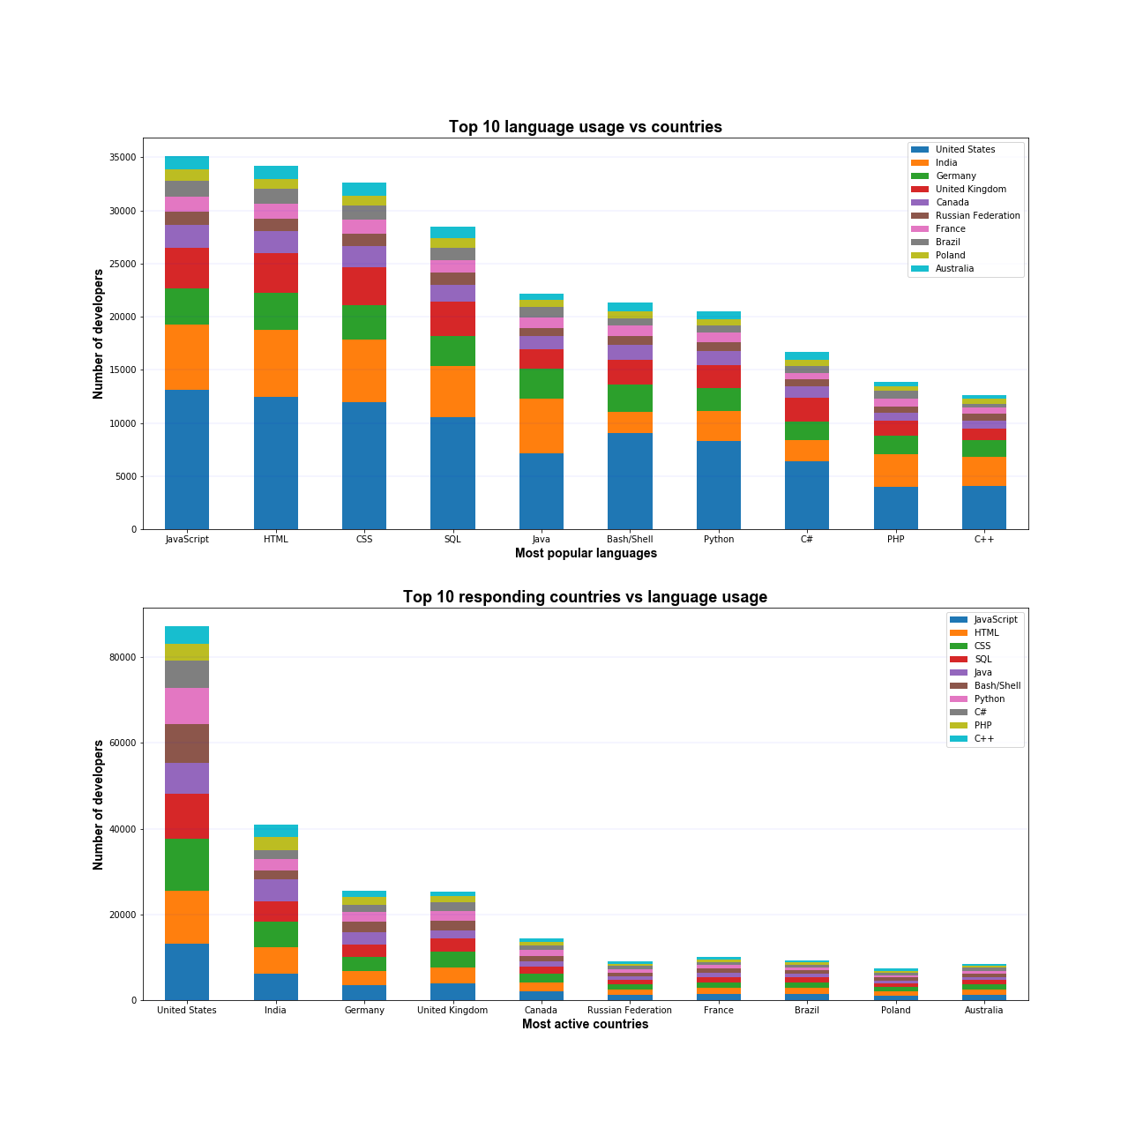
Language vs Country

Slide 17
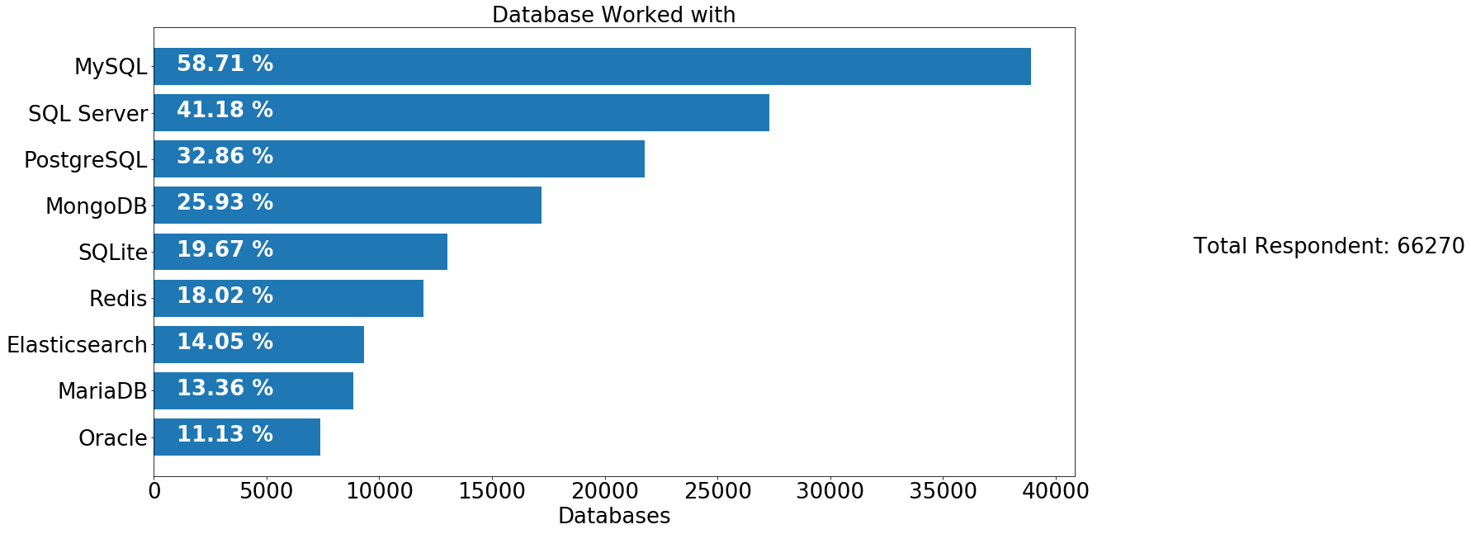
Top 10 Database

Slide 18
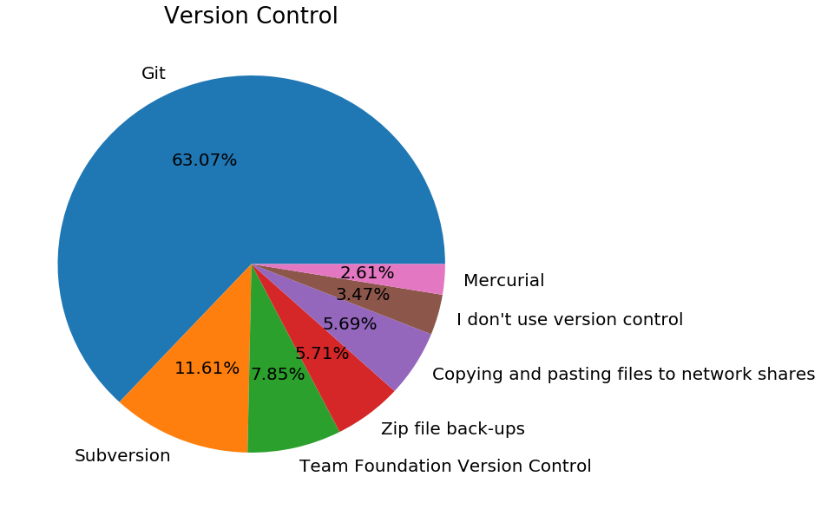
Version Control & Commit

Slide 19
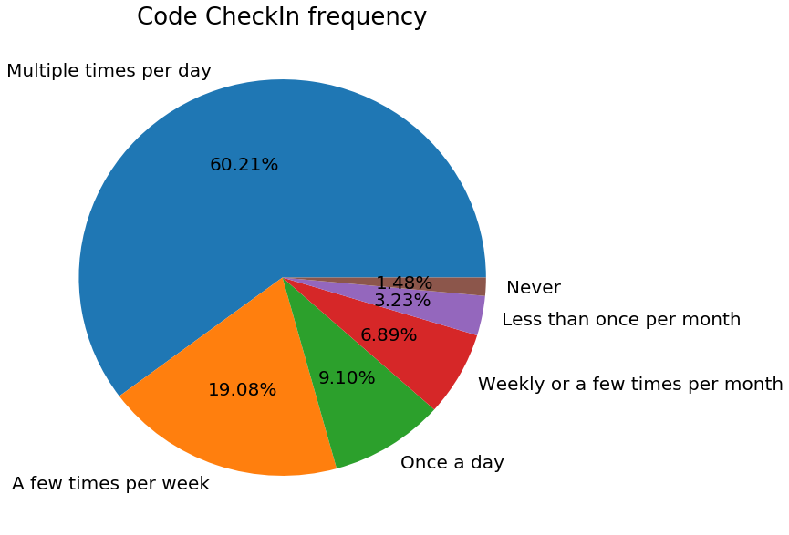
Commit Frequency

Slide 20
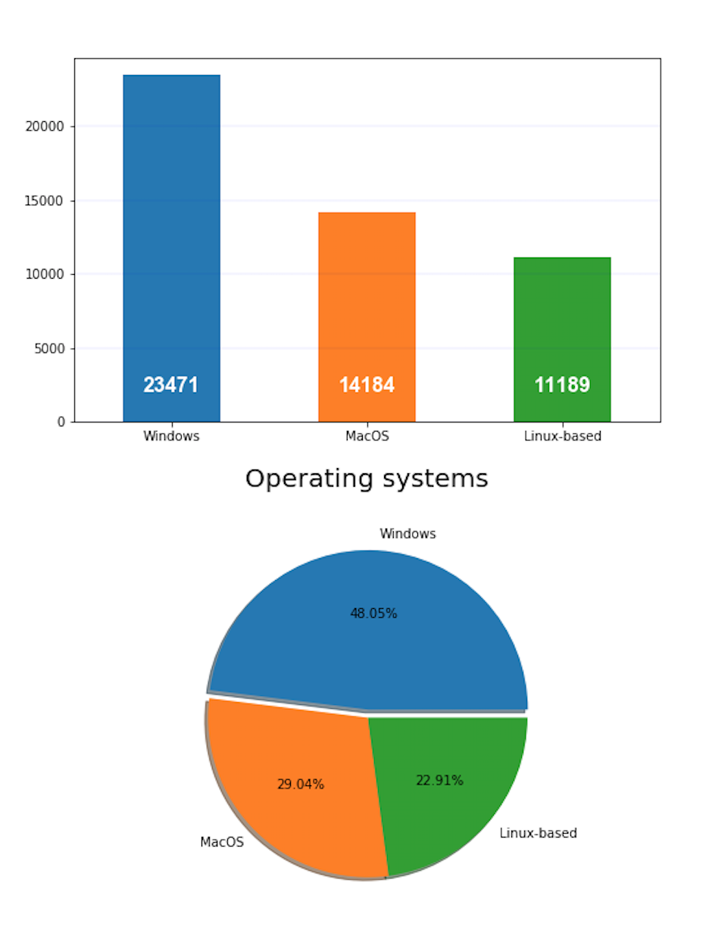
Operating System

Slide 21
Work

Slide 22
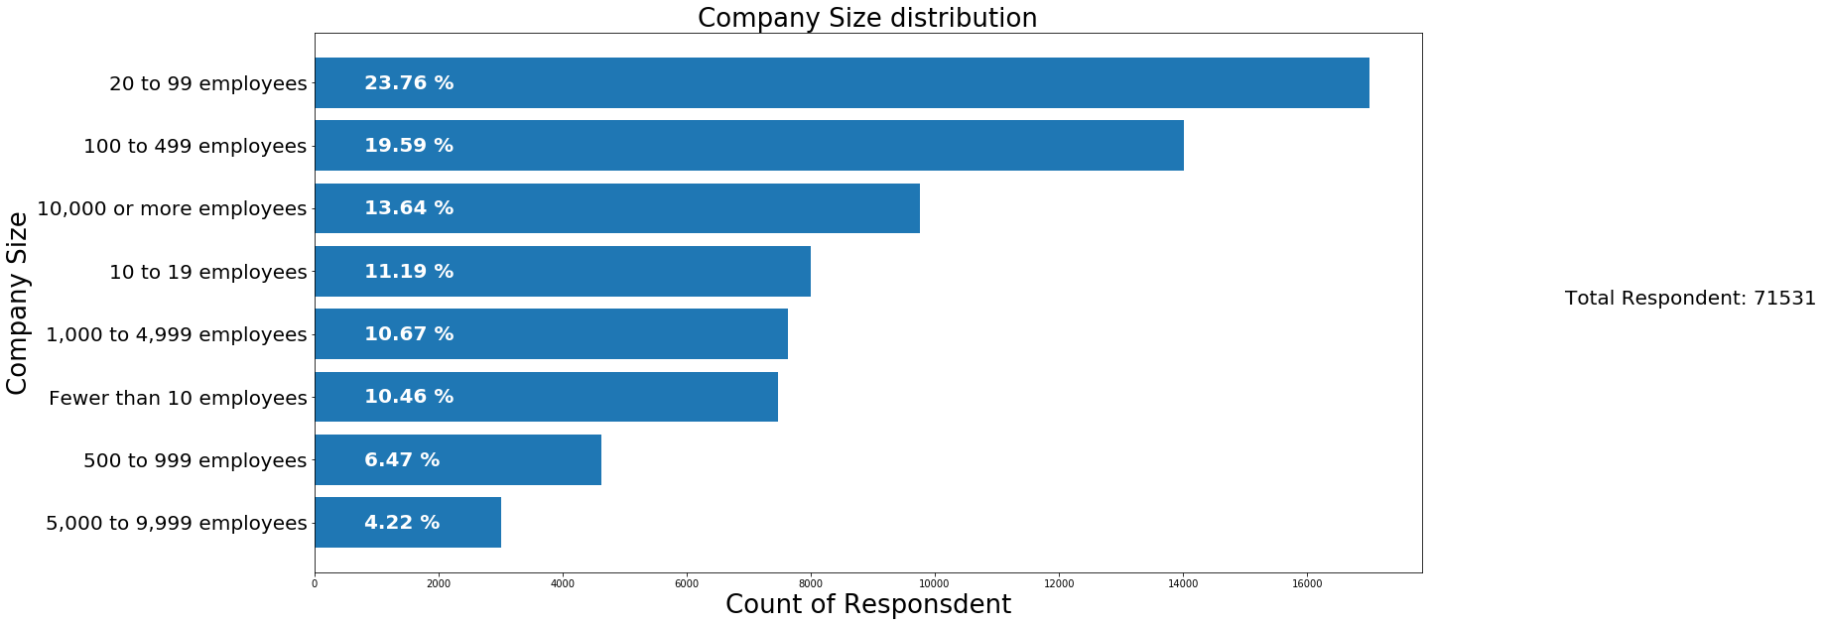
Company Size

Slide 23
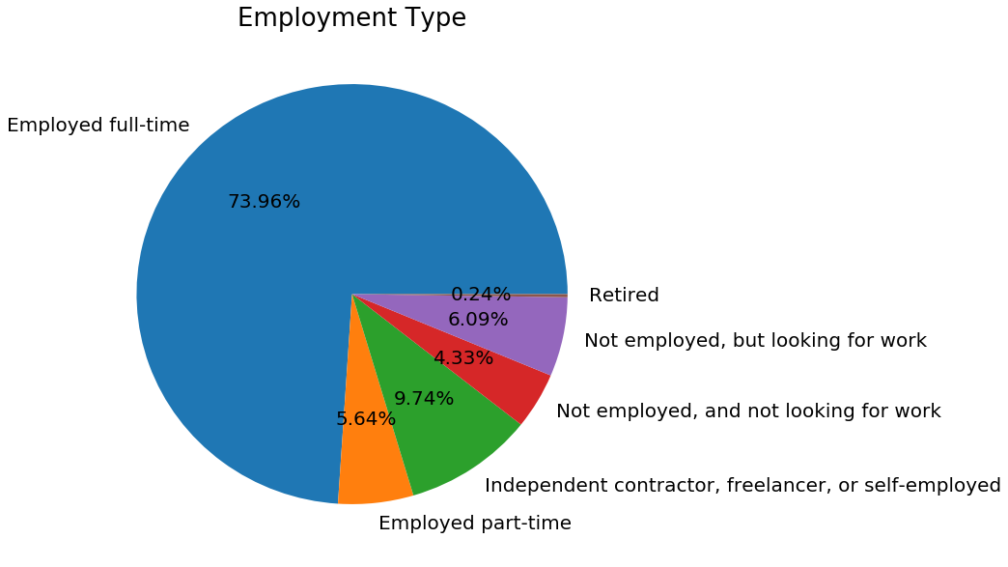
Employment Status

Slide 24
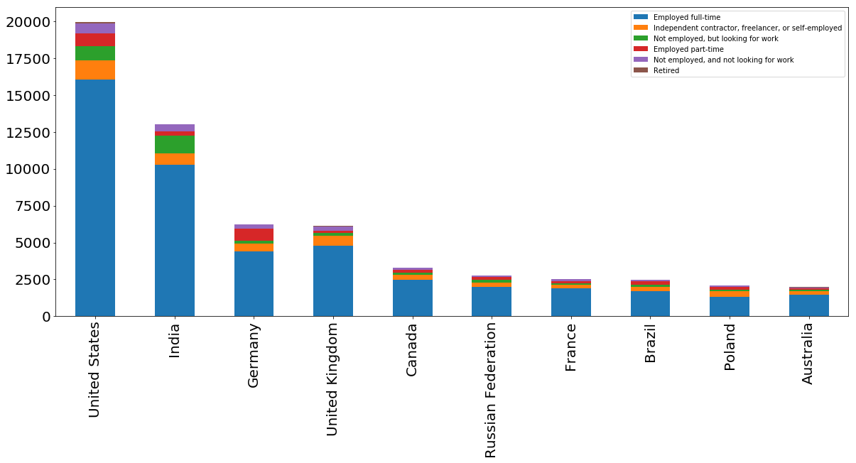
Employment Status by Country

Slide 25
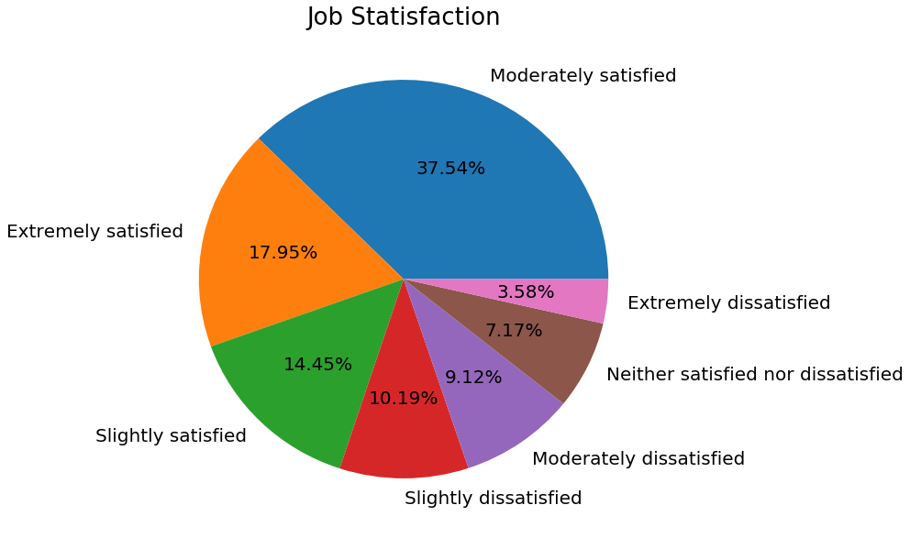
Job Satisfaction

Slide 26
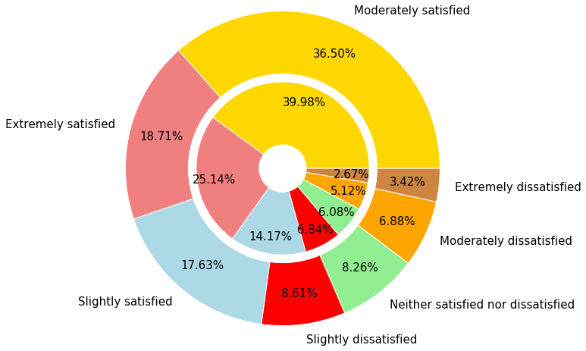
Career Satisfaction – Global vs US
Global – Outer pie
US – Inner pie

Slide 27
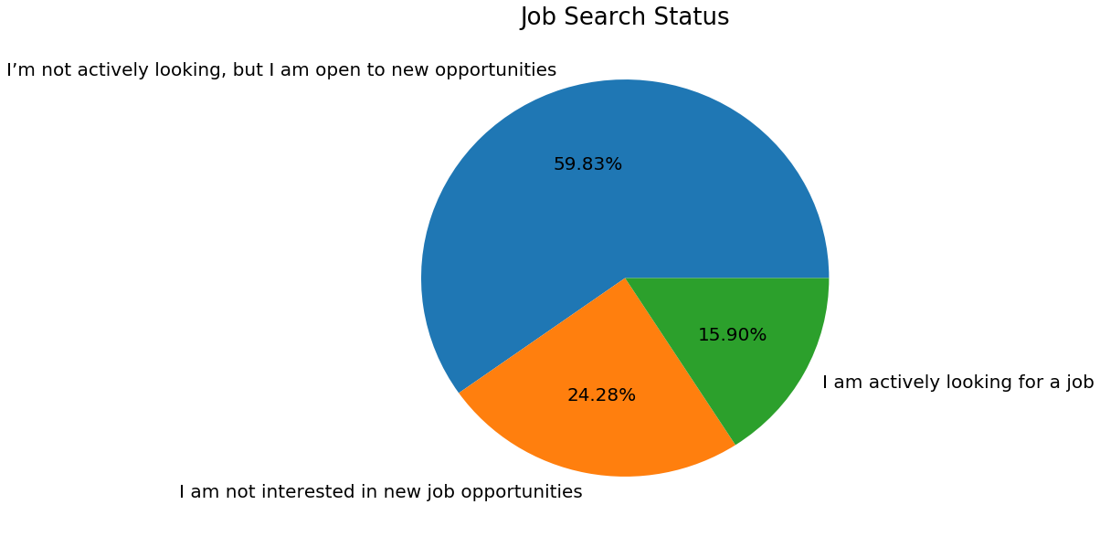
Job Search Status

Slide 28
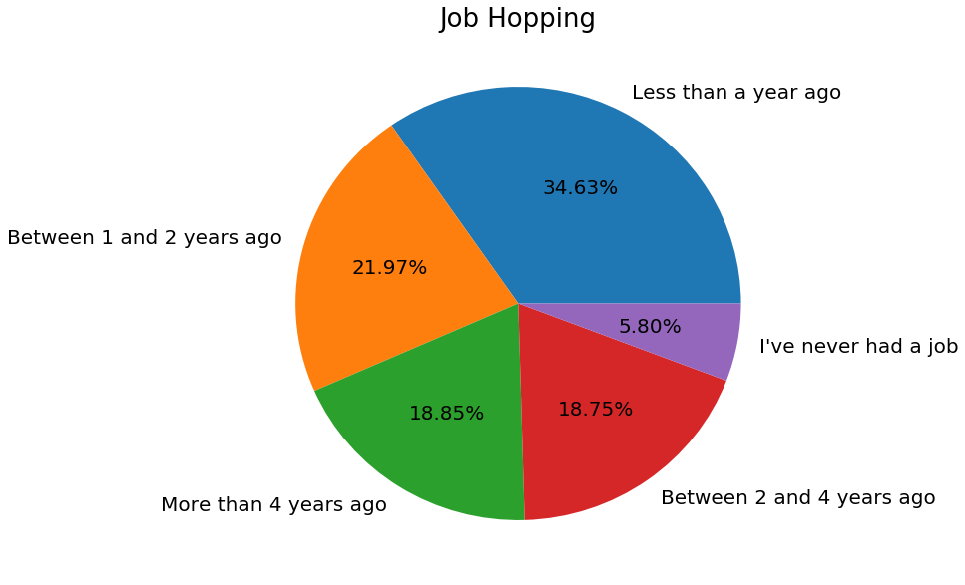
Job Hopping

Slide 29
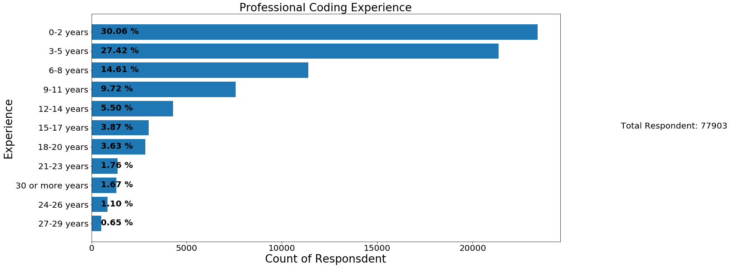
Professional Coding Experience

Slide 30
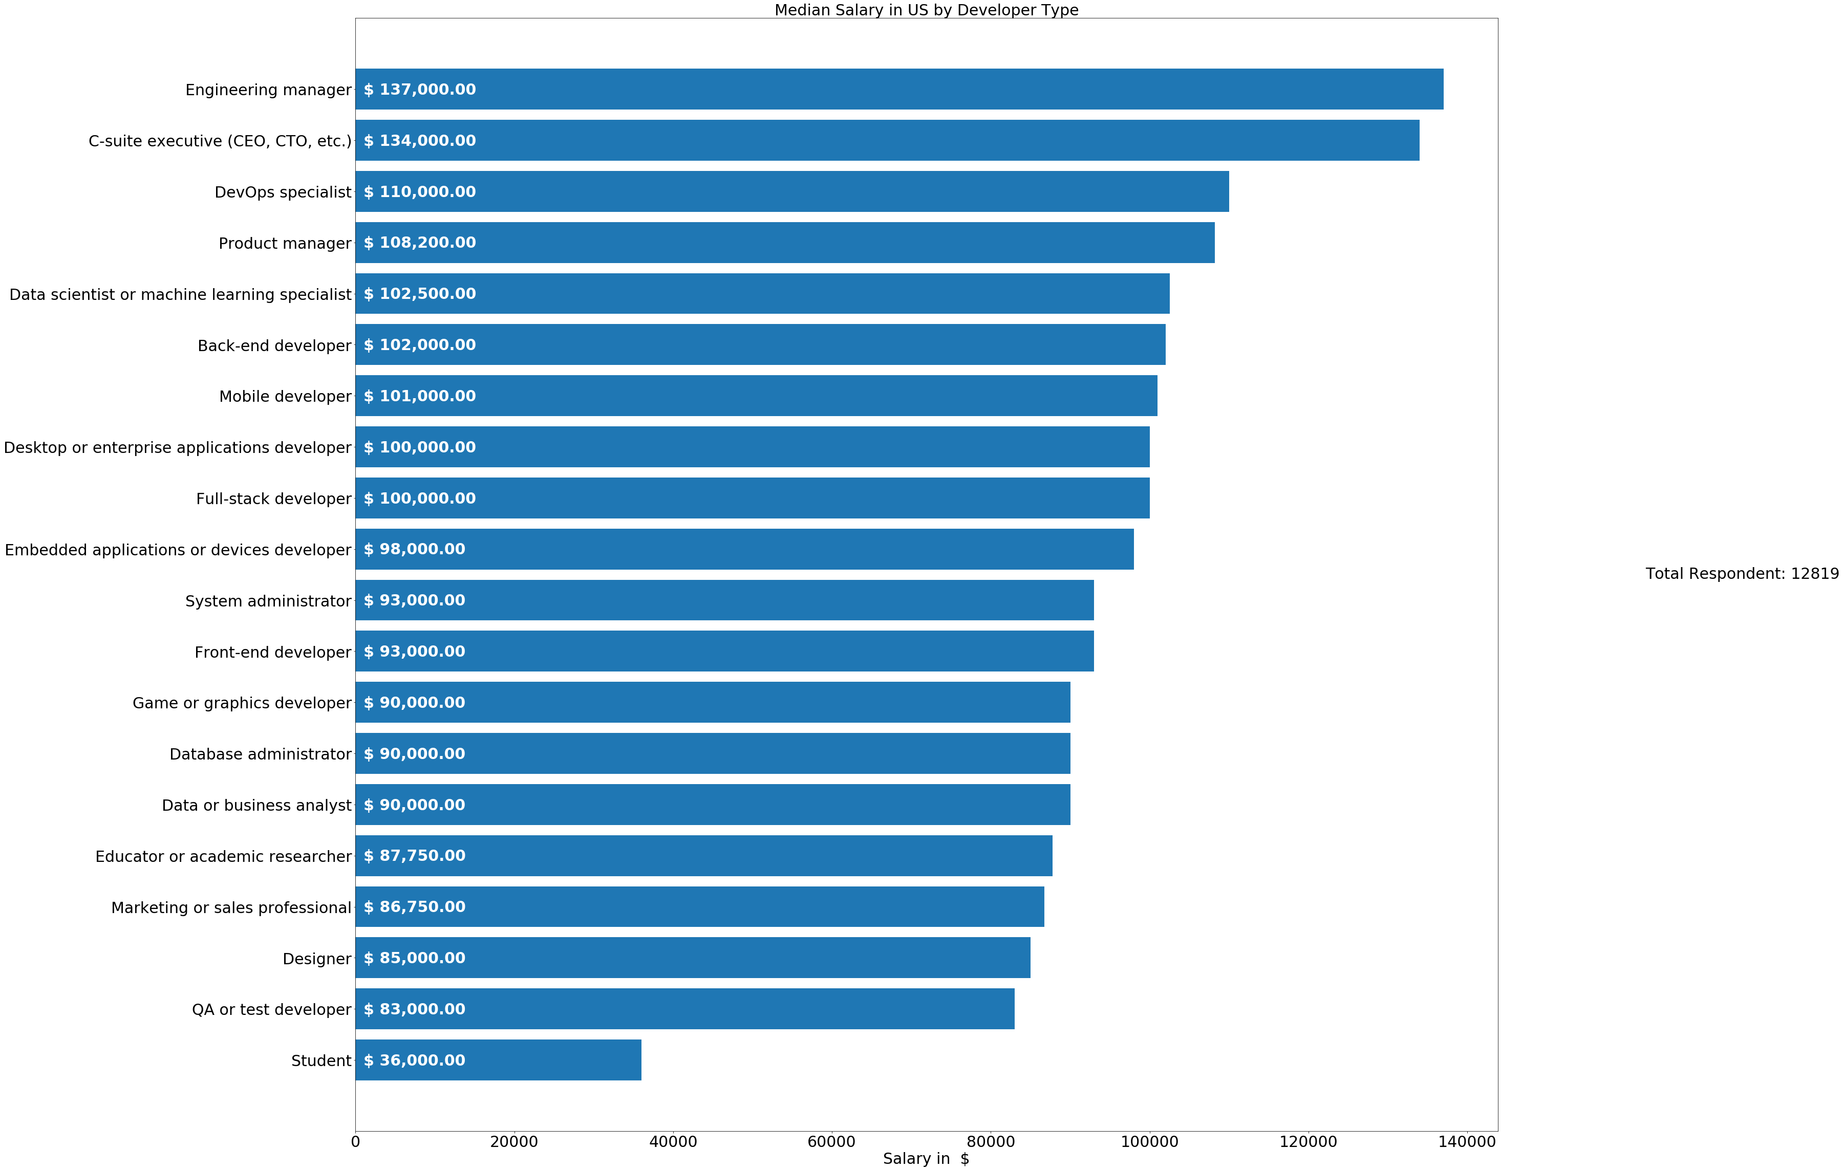
Salary by Job Title

Slide 31
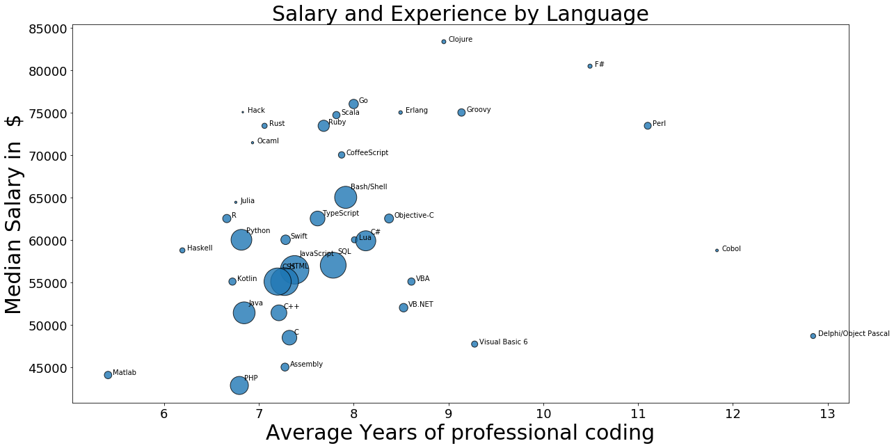
Salary and Experience by Language: Global

Slide 32
Conclusion
Emerging trends in technology:
Popular age group: 24- 35 years
Web-Technologies: Javascript, HTML and CSS are most popular languages
MySQL is the most popular database engine
Git is an extremely popular version control system worldwide
United States and India emerged as two top most technology countries, while UK and Germany are following.
Popular platforms – Windows and Mac while Linux is not way behind
Career satisfaction – Moderately satisfied both globally and in US.
Most developers preferred to switched job within 1 year.

Slide 33
Thank you! Q & A?

