Slide 1
Name : Kuldeep Kirit Prajapati Registered No: STU687e5838d7ca81753110584 NMID: STU687e5838d7ca81753110584 Department : Computer Science and Engineering College : Drs. Kiran and Pallavi Patel Global University Vadodara (KPGU)

Slide 2
Interactive digital Portfolio

Slide 3
OUTLINE
Problem Statement
System Development Approach (Technology Used)
Algorithm & Deployment (Step by Step Procedure)
Result
Conclusion
Future Scope (Optional)
References

Slide 4
Problem Statement
Students and professionals often struggle to showcase their skills, projects, and achievements in an engaging way.
Traditional resumes and static portfolios are not interactive, visually appealing, or easily accessible.
There is a need for a dynamic and user-friendly online portfolio that effectively highlights individual skills and projects, while being easy to update and share.

Slide 5
System Approach
Frontend Technologies:
HTML5 – Structure of the portfolio website
CSS3 – Styling and responsive layouts
JavaScript – Interactive elements (navigation, filtering, animations)
Design Approach:
Modern and minimal UI/UX design
Mobile-first responsive design
Clear separation of HTML, CSS, and JS files for modularity

Slide 6
Algorithm & Deployment
Portfolio Content Creation – Collect personal details, skills, projects, and achievements.
Frontend Design – Layout with HTML and CSS (sections for About, Skills, Projects, Contact).
Interactive Features – Smooth navigation, project filtering, modal views, contact form integration.
Testing – Browser compatibility, responsiveness on different devices.
Deployment – Host using GitHub Pages / Netlify for free and easy access.

Slide 7
Result
A fully functional Interactive Portfolio Website.
Screenshots of homepage, skills section, projects, and contact form.
GitHub Link: https://github.com/kuldeepin3

Slide 8
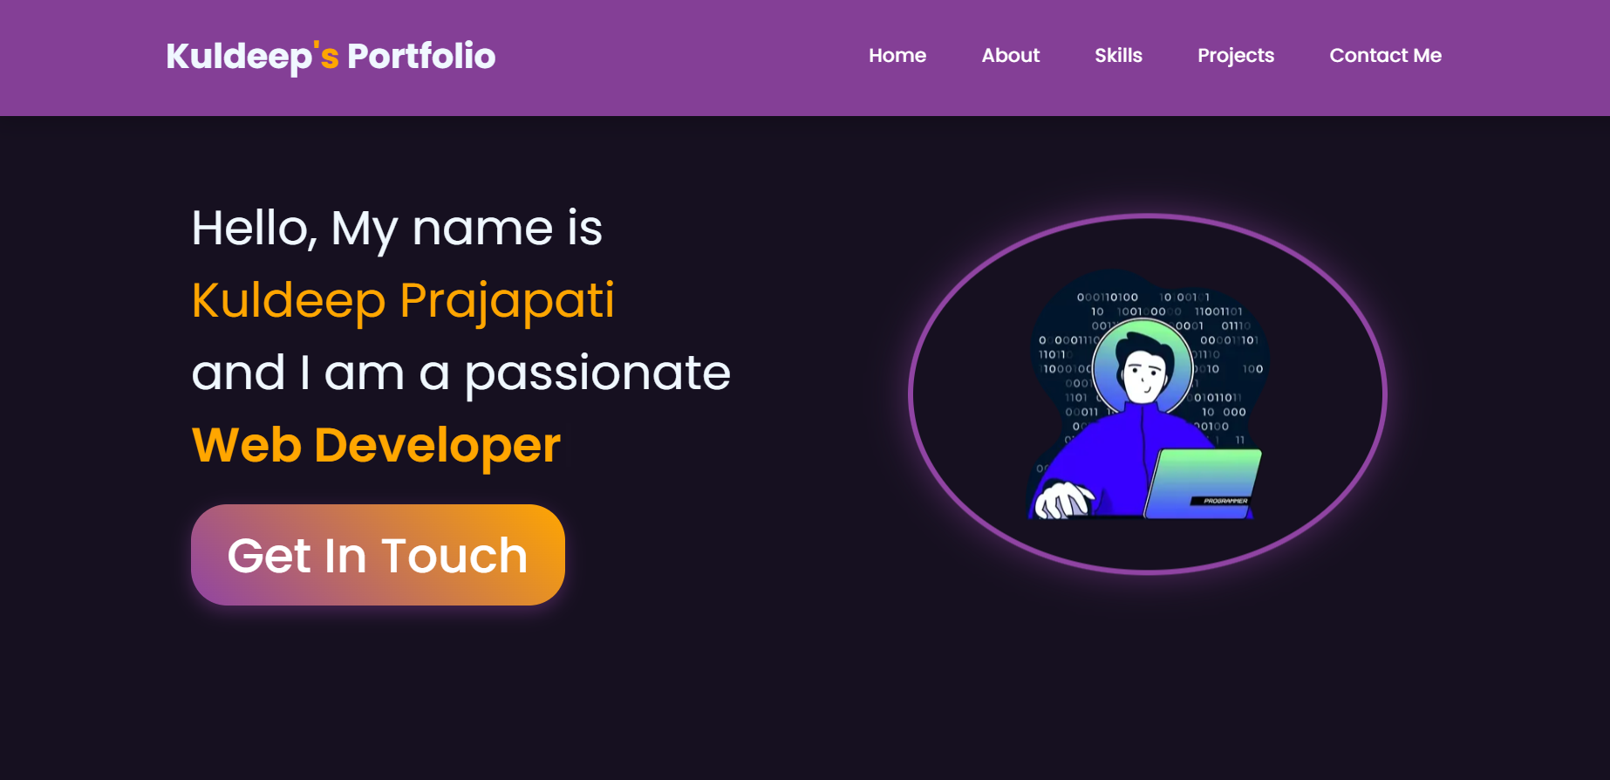
Homepage

Slide 9
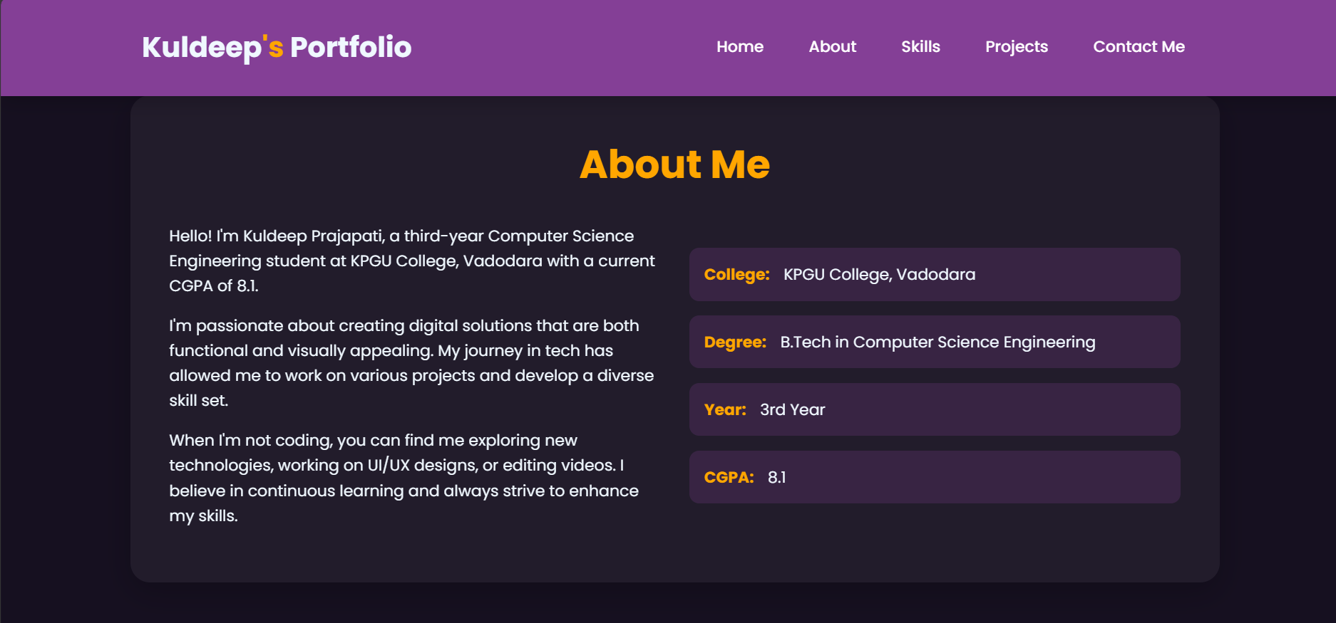
About me

Slide 10
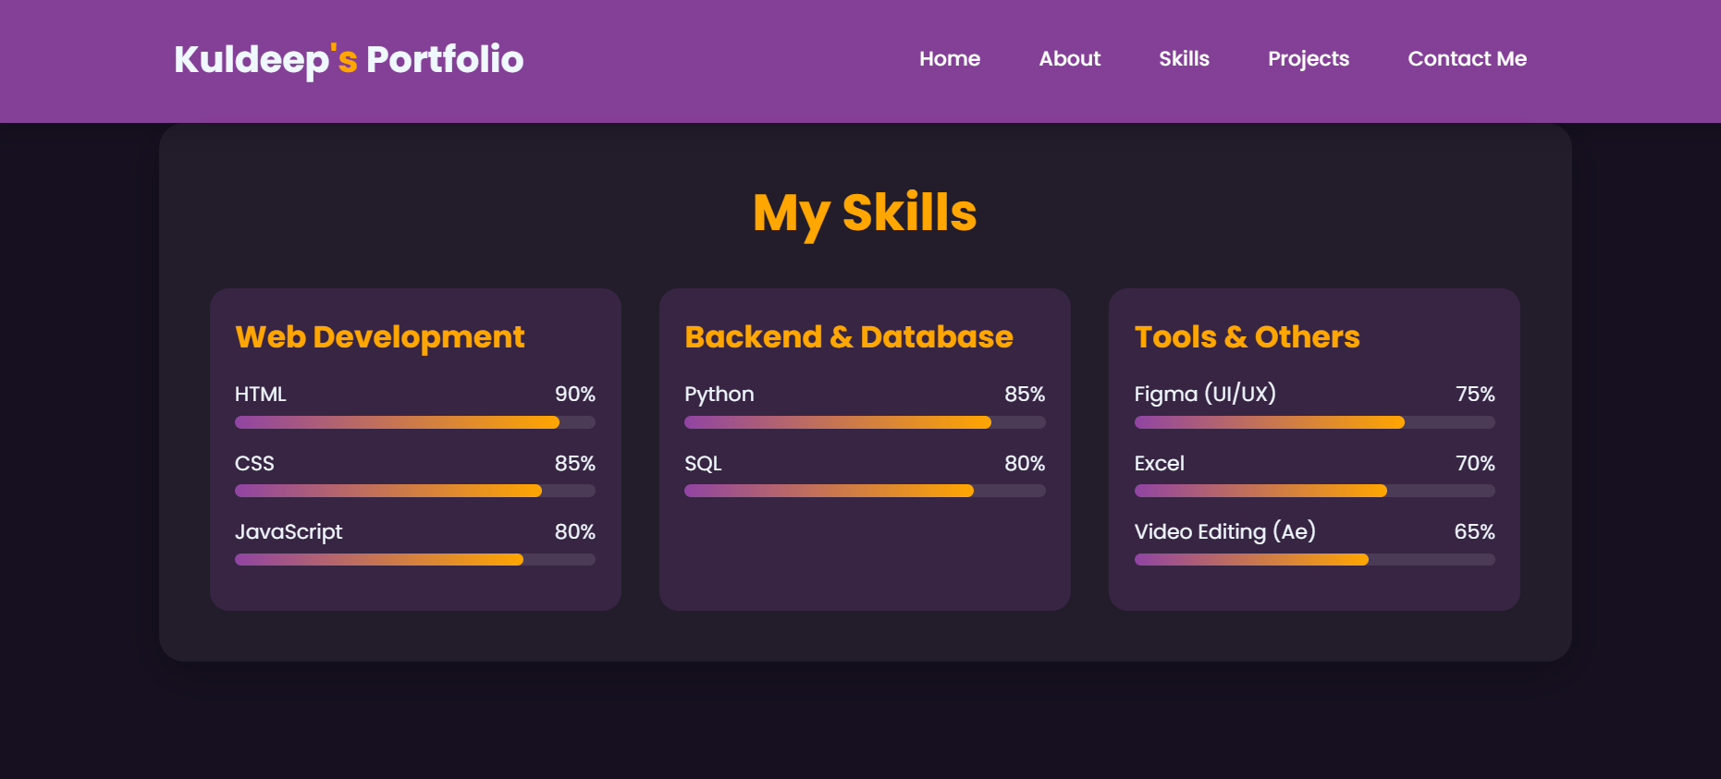
skills

Slide 11
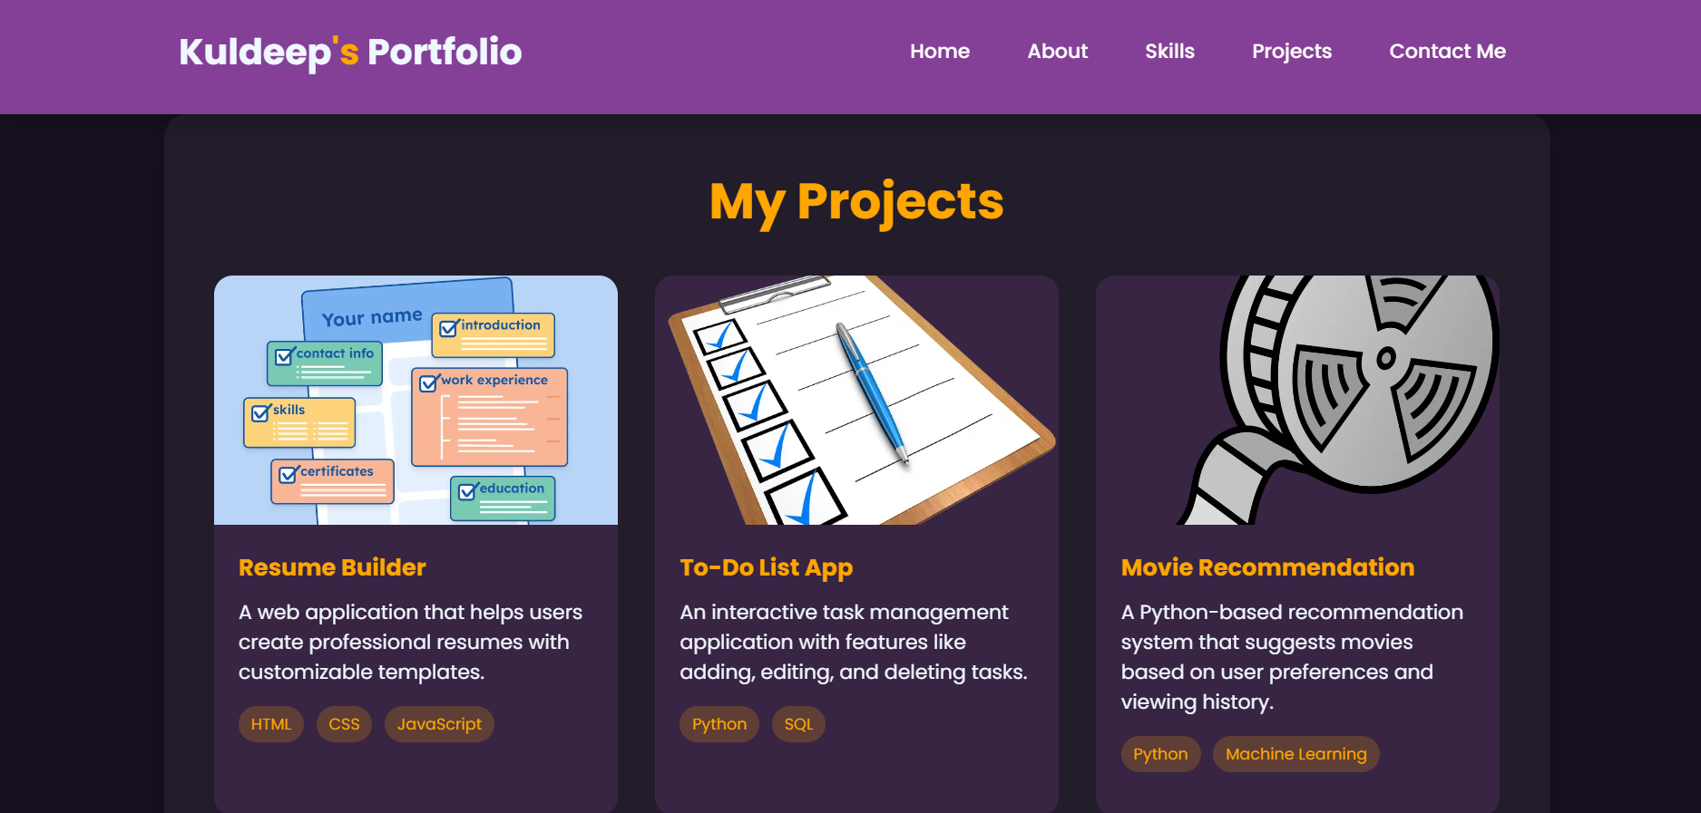
projects

Slide 12
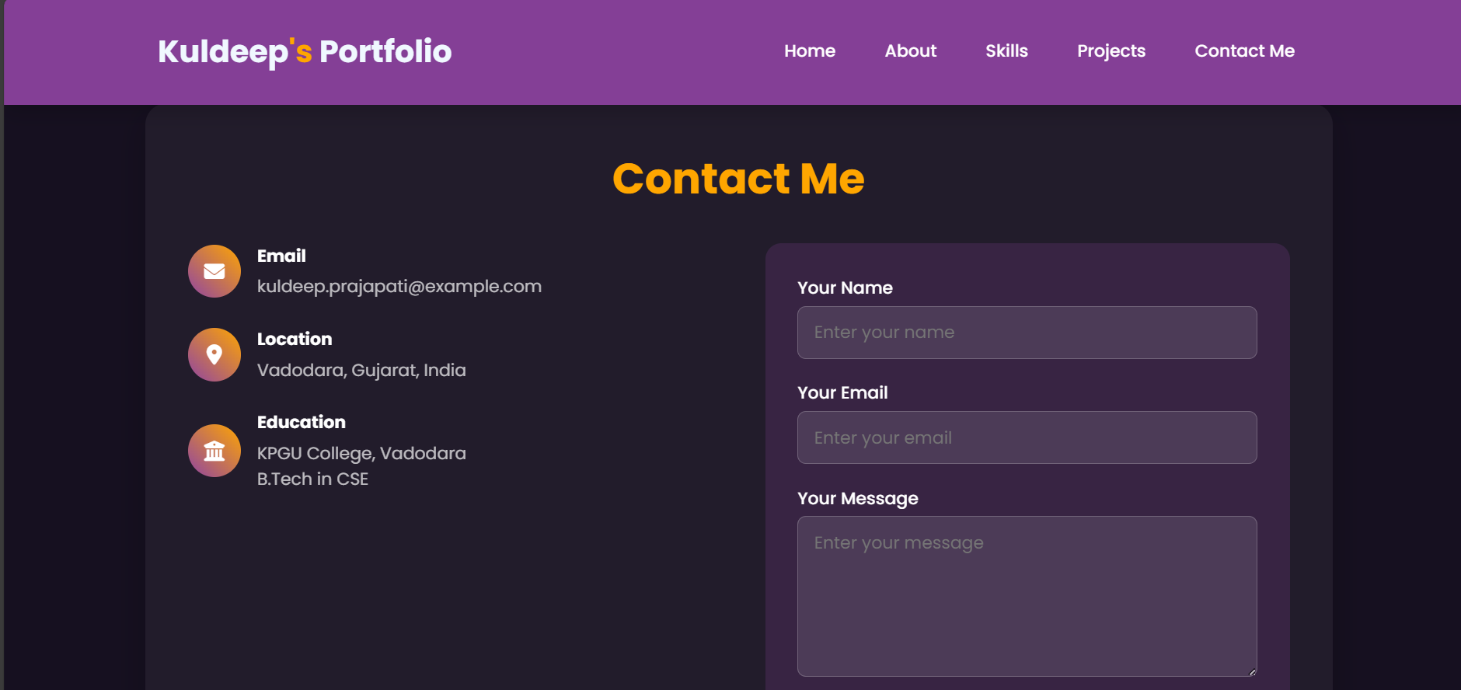
Contact me

Slide 13
Conclusion
Provides a professional online presence.
Makes resumes more interactive and engaging.
Showcases projects, skills, and achievements effectively.
Easily shareable with recruiters and peers.

Slide 14
References
Bootstrap v5.3 Documentation
W3Schools HTML/CSS/JavaScript Resources
GitHub – Hosting Guides
FreeCodeCamp – Responsive Web Design Curriculum

Slide 15
THANK YOU

