Slide 1
GOOGLE COLAB LIVE DEMO • 15 MINUTES
From reading to running
Cloud Python, zero setup
THE HANDOFF
The numbers we just verified in the notebook (top-10 SWE-bench Verified scores, AI Index p. 101) become a chart here.
Session 2 (15:00 – 30:00)
Cloud compute, code from prompts, and quick sanity checks
Notes:
TIMING: 15:00 (about 30 seconds)
SAY: In the notebook, we found the top ten SWE-bench Verified scores and checked them against the report. Now let's turn those numbers into a chart, and see what it takes to run code without installing anything locally.
SETUP CHECK: Colab tab open, T4 runtime already connected, Cells 1 and 2 already run so df is loaded (see slide notes for why).

Slide 2


SESSION 2: WHY COLAB (15:00 – 18:00)
The problem, and the fix
Local setup pain
What Colab does
“Works on my machine” — environment and dependency clashes
No dedicated GPU on most laptops
CUDA drivers, cuDNN, compilation toolchains
Code runs on a remote VM in the cloud
Your browser is only the interface
PyTorch, TensorFlow, Pandas, Matplotlib pre-installed
Live: check what machine we're actually on
Notes:
TIMING: 15:00 to 18:00
LIVE: Run Cell 1 (architecture check). Point at the Linux distro, core count and RAM, none of which come from the presenter's laptop.
SAY: Runs in the cloud, browser as the interface, not 'executes entirely in your browser.' That distinction matters because it's why the files disappear when the session ends, which is why we mount Drive next.
CAUTION: Don't say 'full Jupyter stack runs in your browser' — it runs on the remote VM.

Slide 3
SESSION 2: HARDWARE & GEMINI (18:00 – 21:00)
Free GPU, and code from a prompt
CPU
T4 GPU
L4 / A100
64.2x
Zero cost. Scripts and light analysis.
Free. Subject to availability.
Priority tiers. Subject to availability.
faster on T4 (4096×4096 matrix multiply)
HOW TO GENERATE CODE FROM A PROMPT
▶ Start coding or generate with AI.
Click an empty code cell, click generate, type your prompt, press Enter.
Notes:
TIMING: 18:00 to 21:00
LIVE: Runtime > Change runtime type > T4 GPU. Run the GPU timing cell. Point at the printed CPU vs GPU time and the speedup line.
SAY: Not a promise of instant GPU access, it's 'subject to availability' on every tier. This run happened to get a Tesla T4 and a 64x speedup on a basic matrix multiply.
SAY (code gen): Click an empty cell, click 'generate,' type what you want, press Enter. That's it, no Ctrl+Space shortcut.
ACTUAL NUMBERS: CUDA available: True; GPU: Tesla T4; CPU 2.5324s; GPU 0.0394s; 64.2x speedup.

Slide 4

SESSION 2: DATA (21:00 – 24:00)
Mount Drive, load the verified numbers
TWO LINES
ai_index_coding.csv
from google.colab import drive
drive.mount('/content/drive')
10 rows: model, score_pct, source
Read from Figure 2.5.1, AI Index 2026, p. 101
Falls back to a sample dataset if the path isn't found, so the demo never dead-ends
Opens a one-time permission popup. Grants the running session access to your Drive files, separate from saving the notebook file itself.
Notes:
TIMING: 21:00 to 24:00
LIVE: Run Cell 2. Show the Drive permission popup (pre-authorized already, so this should be instant). Show df.head() with the 10 rows.
SAY: Mounting gives this running session access to Drive. It's different from saving the notebook file, which we'll cover in a minute. This CSV is the exact table we cited from the report a few minutes ago.
BACKUP: If Drive is slow, the fallback dataset (California housing) loads automatically.

Slide 5
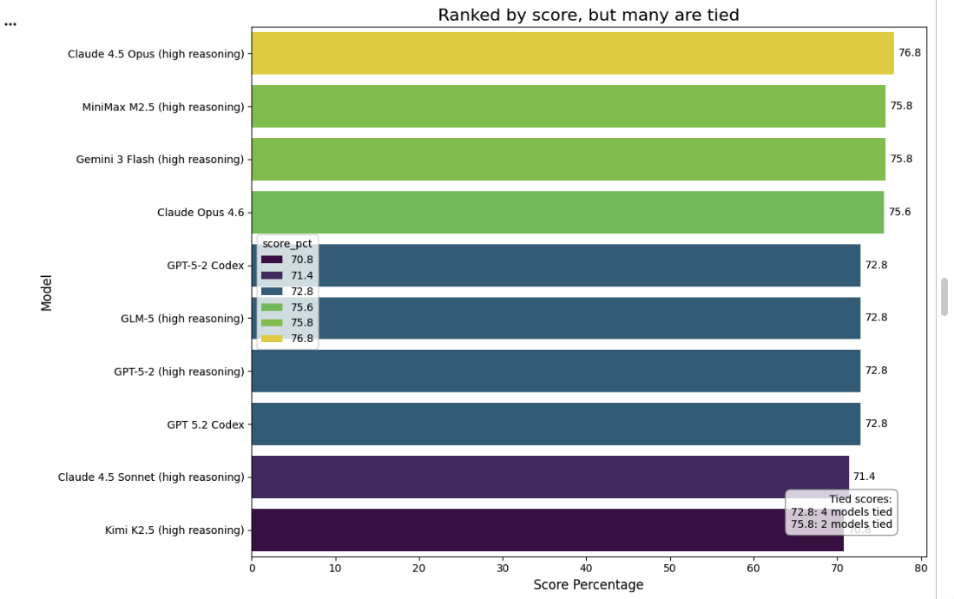
SESSION 2: PROMPT TO PLOT (24:00 – 26:00)
One prompt, a chart that makes the point
THE PROMPT
"Color the bars by score so models with the same score share a color, and add a note showing how many models are tied at each shared score."
THE POINT
4 models tied at 72.8%
2 models tied at 75.8%
“Pick the top-ranked tool” is choosing among near-equals, not a clear winner.
Notes:
TIMING: 24:00 to 26:00
LIVE: In an empty cell, click 'generate,' paste the base plot prompt (horizontal bar chart of score_pct by model, zero-based axis, gap annotation). Run it, show the chart. Then run the ties/color variation prompt shown on this slide and show that chart instead, or alongside.
SAY: Same idea as the citations we clicked in the notebook: check what a chart actually shows. Four of the ten are exact ties, two more are tied, and the top four span just 1.2 points.
CAUTION: Gemini's generated code can vary run to run. If it produces something off, use the fallback matplotlib cell (see backup slide) rather than debugging live.

Slide 6

SESSION 2: EXPLAIN ERROR (26:00 – 27:00)
When code breaks, ask before you fix
THE MISTAKE (ON PURPOSE)
Explain Error
df['scor_pct'].max()
Diagnoses the failed cell
Suggests a fix you review before applying
This is Colab explaining Colab's own error, not a source citation
The column is score_pct. This typo raises a KeyError.
Confirmed: the Explain Error button appears under the failed cell's output.
Notes:
TIMING: 26:00 to 27:00
LIVE: Run the planted-typo cell, let it fail, click Explain Error under the output.
SAY: In the notebook half, every claim pointed to a passage in a source. Here, 'Explain Error' is different: it's the tool explaining its own mistake, which is useful, but it's not evidence about anything outside this cell. Good for debugging, not for facts.

Slide 7




SESSION 2: SAVE & SHARE (27:00 – 28:00)
Where does this notebook actually live?
Save a copy in Drive
Locate in Drive
Download .ipynb
File → Save, or Save a copy in Drive. Defaults to the Colab Notebooks folder, or back to wherever it was opened from.
File → Locate in Drive. Opens Drive and highlights the exact file, so you can confirm where it landed.
File → Download → Download .ipynb. Saves a local snapshot to your laptop's Downloads folder.
The Share button generates a link for collaborators, confirmed working. Mounting Drive (slide 4) gives the running session access to files; saving the notebook is about the file itself.
Notes:
TIMING: 27:00 to 28:00
LIVE: Open the File menu, point at Save a copy in Drive and Locate in Drive. Mention the Share button was tested and works, without actually sharing on stage.
SAY: Two different things: mounting Drive lets THIS running session read your files, like the CSV we loaded. Saving or downloading is about the notebook FILE itself, code, markdown and outputs. Keep a local .ipynb download as backup before any live demo.

Slide 8


SESSION 2: COMPUTE TIERS (28:00 – 29:00)
Check current prices and limits live
WHAT TO COMPARE
Free vs. Pro vs. Pro+ price
colab.research.google.com
Compute units per month
Prices, compute units, and timeout rules change, so read them live rather than from a frozen slide.
Idle and max-session timeouts
GPU availability is never guaranteed on any tier.
Background execution limits
Notes:
TIMING: 28:00 to 29:00
LIVE: Open colab.research.google.com pricing info (open beforehand). As of this deck's last check: Free $0 (~90 min idle timeout, 12-hour max session); Pro $9.99 (100 compute units/month); Pro+ $49.99 (500 compute units/month, background execution). RECHECK THESE NUMBERS THE DAY OF.
SAY: I'd rather read current numbers than put stale ones on a slide. Free covers everything we did today.

Slide 9



DECISION MATRIX (29:00 – 29:30)
Pick the tool by the job, not the hype
Gemini Notebook
Google Colab
General chatbots
GROUNDED SYNTHESIS
COMPUTE AND CODE
OPEN-ENDED HELP
Answers from your own documents, every claim citable back to a source.
Running, plotting and iterating on code, with a free GPU when you need one.
Useful and often honest about their limits, as we saw. But no access to your private sources.
Notes:
TIMING: 29:00 to 29:30
SAY: When our own chatbot baseline ran earlier, it didn't invent our policy. It said plainly that it couldn't see our playbook. That's a point in its favor, not against it: the real gap isn't recklessness, it's that it has no access to sources you haven't given it. Pick Notebook when the answer has to trace back to a document, Colab when you need to compute or visualize something, and a general chatbot for open-ended help where private grounding doesn't matter.

Slide 10
TAKEAWAYS AND Q&A (29:30 – 30:00)
Three habits to take with you
Connect the runtime before you need it.
1
Check what generated code actually does before you trust it.
2
Verify a chart's axis; it can hide or exaggerate a gap.
3
Ready for questions
notebook.google.com • colab.research.google.com
Notes:
TIMING: 29:30 to 30:00
SAY: Connect the runtime before you need it, check generated code before trusting it, and verify a chart's axis. Same spirit as this morning: click the citation, check the chart.
CLOSE: Both tools have a free tier that covers everything shown today.

Slide 11
BACKUP
Presenter cheat sheet
What | How
Save the notebook file | File → Save a copy in Drive
Confirm where it saved | File → Locate in Drive
Local backup copy | File → Download → Download .ipynb
Generate code from a prompt | Click empty cell → click “generate” → type prompt → Enter
Switch to T4 GPU | Runtime → Change runtime type → T4 GPU
Fix a broken cell | Run it, let it fail, click Explain Error
CSV source for the chart | Figure 2.5.1, AI Index 2026, p. 101
GPU test result (this run) | CPU 2.5324s → GPU 0.0394s → 64.2x, Tesla T4
Fallback plot cell (if a generated chart looks wrong): see the matplotlib version saved alongside the demo notebook.
Notes:
PRESENTER CHEAT SHEET (not for the audience).
GPU numbers and the ties chart are from the actual dry run. Recheck compute-tier prices and timeouts the day of, since they change.

