Slide 1

GEMINI NOTEBOOK LIVE DEMO • 15 MINUTES
formerly NotebookLM
Answers you can check
Choosing AI coding tools from your own sources
Session 1 (0:00 – 15:00)
Grounded synthesis with citations
Three sources
Playbook • Tool video • AI Index 2026
Notes:
TIMING: 0:00 (about 30 seconds)
SAY: We all use AI for research, but there is a trust problem: how do you know an answer is real? For the next 15 minutes I will show a tool built around that question. It is Gemini Notebook. You may know it as NotebookLM; Google renamed it in July.
SETUP CHECK: Notebook tab open with all sources loaded and the saved notes visible. Chatbot baseline screenshot ready.

Slide 2


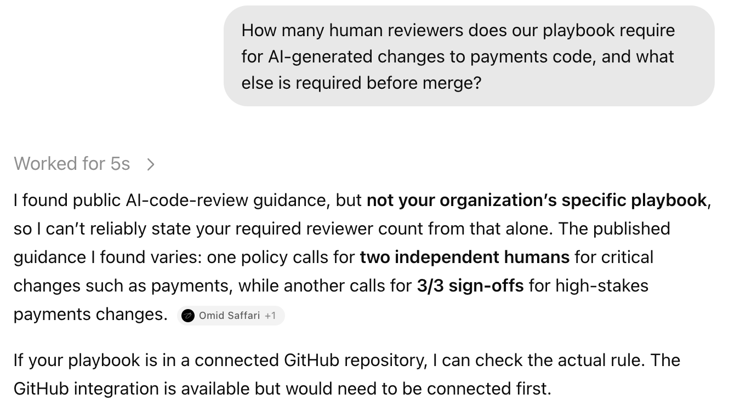
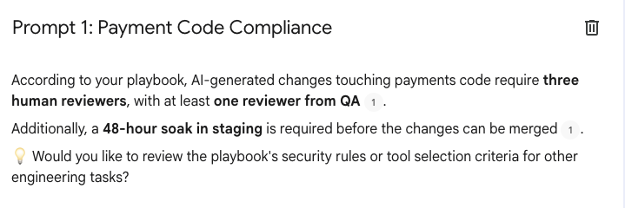
SESSION 1: WHY GROUNDING (0:00 – 3:00)
Same question, two very different answers
General chatbot
Gemini Notebook
Our rule, with a citation.
Click the chip and the Doc opens at the exact line.
Honest but generic: it can't see our playbook.
Grounding reduces made-up answers and lets you check every claim.
Notes:
TIMING: 0:30 to 3:00
LIVE: (1) Show the ChatGPT screenshot. (2) Switch to the notebook and show the saved note 'Payment Code Compliance'. (3) Click the citation chip so the Doc opens at Section 2.
SAY (left): To its credit, the chatbot does not make up our policy. It says it can't state our reviewer count and gives a range from public guidance. Useful in general, but I still don't have OUR rule.
SAY (right): Same question, grounded in our playbook: three reviewers, one from QA, plus a 48-hour staging soak. And every claim points to a passage I can check.
CAUTION: Say 'reduces', never 'eliminates'. Do not repeat the chatbot's '3/3 sign-offs' as fact; it came from a third-party web page.
BACKUP: If the notebook is slow, show the saved note screenshot.

Slide 3



SESSION 1: INGESTION (3:00 – 6:00)
Three source types, one notebook
Team playbook
Tool comparison video
AI Index Report 2026
Google Doc, synced from Drive
Claude Code vs. Codex vs. Cursor vs. Local Models (2026)
Stanford HAI, 425 pages
A sample policy for this demo, with review rules and a planted benchmark rule.
The notebook indexes the spoken transcript, so you can cite a moment in the video.
About 149,000 words of dense benchmark tables and charts.
Drive-synced
Added live
Uploaded PDF
Notes:
TIMING: 3:00 to 6:00
LIVE: Show the two pre-loaded sources (PDF, Drive Doc). Then ADD THE YOUTUBE LINK LIVE in the scratch notebook and open its auto-summary. If the import is slow, switch to the fully loaded notebook's video summary.
SAY: Three very different formats: a Google Doc that syncs from Drive, a YouTube video whose transcript gets indexed, and a 425-page PDF. The playbook is a sample I wrote for this demo, with a few deliberate flaws.
CAUTION: Auto-captions contain errors ('Sonar Cube', 'C-pilot', 'Codeex'). Don't read caption text aloud.

Slide 4
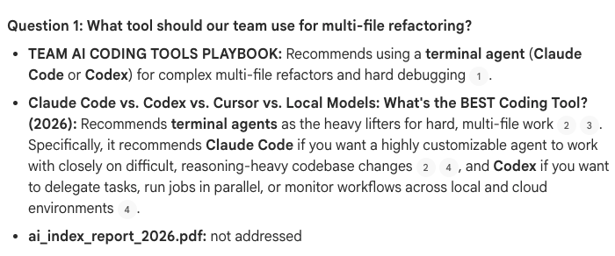
SESSION 1: LIVE SYNTHESIS (6:00 – 8:30)
One question, three sources, every claim cited
THE PROMPT (ABRIDGED)
(1) What tool should our team use for multi-file refactoring? (2) What does each source say about how much weight public benchmark scores deserve? Include a source only if it directly addresses the question.
Playbook
Section 3: a terminal agent for multi-file refactors.
Video, 3:23
The 'heavy lifters' chapter: Claude Code and Codex.
AI Index report
Not addressed. It stays silent instead of guessing.
Notes:
TIMING: 6:00 to 8:30
LIVE: Open the saved note 'Refactoring and Benchmarks' (do NOT re-run the prompt). Click ONE chip per source: playbook, then the video (transcript at 3:23, the 'heavy lifters' chapter), then point out the report is 'not addressed'.
SAY: The playbook and the video agree on terminal agents for multi-file work. The AI Index says nothing about specific tools, and the notebook says so instead of guessing.
SAY (transparency): I ran this earlier so we don't wait.
CAUTION: Rehearse the exact chip clicks. Video chips sometimes don't scroll; if so, open the YouTube transcript at 3:23 instead.

Slide 5
SESSION 1: TRUST TESTS (8:30 – 10:00)
Where do the sources disagree?
Benchmark rule
Number of tools
Quality gates
PLAYBOOK
PLAYBOOK
PLAYBOOK
Rule 4: pick the tool with the top public benchmark score.
Standardize on one tool per team.
No automated gates beyond normal code review.
AI INDEX
VIDEO
VIDEO
Scores don't always reflect real-world use (p. 79). The top ten on SWE-bench Verified sit within about 6 points (p. 100–101).
A 2026 survey it cites says experienced developers use about two (about 9:39).
Sonar's own survey research: SonarQube users reported 44% fewer AI-related outages (3:30). Vendor research, not proof of cause.
BOUNDARY TEST “Which cloud provider hosts our staging environment?” → Not in the sources, so it says so.
Notes:
TIMING: 8:30 to 10:00
LIVE: Show the saved notes 'Where Sources Disagree' and 'Boundary Test'. Don't re-run.
SAY (benchmarks): Our playbook says pick by leaderboard rank. The AI Index says benchmark scores don't always reflect real-world use, and the top ten SWE-bench Verified models are within about 6 points of each other.
SAY (tools): The playbook says one tool; the video cites a 2026 survey of about two.
SAY (gates): The video cites Sonar's own survey research; users reported 44% fewer AI-related outages. That's vendor research and a correlation.
SAY (boundary): The staging soak is in the sources, but the cloud provider isn't, so it says so.
CAUTION: The 42% invalid-question figure (p. 72) is from a MATH benchmark (GSM8K), not a coding benchmark. Say 'raises serious doubts', not 'gameable'. Say 'reported 44% fewer', not 'reduces outages by 44%'.

Slide 6




SESSION 1: STUDIO (10:00 – 11:00)
Studio: turn sources into shareable outputs
Audio Overview
Quiz
More formats
A two-host conversation about your sources.
Source-based questions, each with a cited explanation.
Reports, flashcards, mind maps, slide decks and more.
Example: “Why Your AI Playbook Is Broken”
Example: what our playbook requires for payments code
Same sources, different formats
Audio has no clickable citations. Use it for orientation, then verify in the cited notes.
Notes:
TIMING: 10:00 to 11:00
LIVE: Open the Studio panel. Play the pre-generated Audio Overview from your cued 30-second start point. Then show ONE quiz question (the payments question is the cleanest) and click its citation.
SAY: Same sources, different outputs. This audio is great for orientation, but it has no clickable citations, so I wouldn't quote it. The cited notes are where I verify.
SETUP CHECK: Listen to the whole clip beforehand. Any number the hosts state must match a source; skip clips with claims stronger than the sources.

Slide 7


SESSION 1: PLANS (11:00 – 13:00)
Check the plans page for current limits
WHAT TO COMPARE
Sources per notebook
notebook.google/plans
Notebooks per account
Limits and prices change, so we read them live instead of freezing numbers on a slide.
Daily Audio Overviews
Code execution and team features
Workspace accounts have their own limits and admin controls.
Notes:
TIMING: 11:00 to 13:00
LIVE: Open notebook.google/plans in a browser tab (open it beforehand). Point at the four things to compare: sources per notebook, notebooks per account, daily Audio Overviews, and code execution and team features.
SAY: Limits and prices change often, so I'd rather read them live than put stale numbers on a slide. Free is enough to try everything I showed today.
SETUP CHECK: The plans page loads (confirmed it exists), but I could not read the limits from it. Look at the page yourself and note the free-tier and Plus/Pro numbers you'll quote.

Slide 8

SESSION 1: BOUNDARIES (13:00 – 14:30)
Where it fits, and where it doesn't
Good fit
Not a substitute for
Answers that live in your own documents
Policy and standards audits, literature reviews
Briefing a team from long PDFs, docs and videos
Checking the citation: grounding reduces errors, it doesn't remove them
Live data and breaking news your sources don't contain
Judgment: it summarizes what your sources say
Notes:
TIMING: 13:00 to 14:30
SAY: It shines when the answer lives in your own documents: audits, literature reviews, briefing a team. It's not a substitute for checking. Grounding reduces the risk of made-up answers, but it can still stretch a source, and in my own testing it did.
OPTIONAL STORY: Early in my testing, one answer credited the video with a view on benchmarks that it never expressed. Prompting it to say 'not addressed' when a source is silent fixed that.
TRANSITION: Now the other half: what if the answer needs code and compute? That's Colab.

Slide 9
TAKEAWAYS AND Q&A (14:30 – 15:00)
Three habits to take with you
Ground the answer in your own sources.
1
Click the citation before you trust it.
2
Tell it to say “not addressed” when the sources are silent.
3
Ready for questions
notebook.google.com • notebook.google/plans
Notes:
TIMING: 14:30 to 15:00, then hand over to Colab.
SAY: Three habits: ground the answer in your own sources, click the citation before you trust it, and tell it to say 'not addressed' when the sources are silent.
TRANSITION: Next, what happens when the answer needs code and compute: Google Colab.

Slide 10
BACKUP
Where to click: claims and their sources
Claim | Source | Where
Three reviewers (one from QA) and a 48-hour staging soak | Team playbook | Section 2
Terminal agents for multi-file refactors | Playbook and video | Section 3; video 3:23
Pick tools by top benchmark score | Team playbook | Section 4, Rule 4
Benchmark scores don't always reflect real-world use | AI Index 2026 | p. 79
Top ten SWE-bench Verified within about 6 points (70.8% to 76.8%) | AI Index 2026 | p. 100–101
Up to 42% invalid questions (GSM8K, a math benchmark) | AI Index 2026 | p. 72
Experienced developers use about two tools | Video | About 9:39
SonarQube users reported 44% fewer AI-related outages | Video | 3:30
Notes:
PRESENTER CHEAT SHEET (not for the audience).
Page numbers refer to the ai_index_report_2026.pdf you uploaded (PDF page = printed page).
Video timestamps: 3:23 heavy-lifters chapter; 3:30 Sonar 44% line; about 9:39 two-tools survey. Confirm the exact seconds in YouTube's transcript before presenting.
Wording: the 44% is Sonar's own survey research, reported and correlational; the 42% is a math benchmark (GSM8K).

