Slide 1
Evolent | Take home Project | NLP
By Kuldeep Patel

Slide 2
Data Analysis
Data Cleaning and Preprocessing
Handle null values of columns - review_profileName, review_text, beer_ABV
Change data type - review_time
Term
beer_ABV - Alcohol by volume (abbreviated as ABV, abv, or alc/vol) is a standard measure of how much alcohol (ethanol) is contained in a given volume of an alcoholic beverage (expressed as a volume percent).

Slide 3
1. Rank top 3 Breweries which produce the strongest beers?
Brewer Id is given, brewer name is not there in the data. So, we will consider only beer_brewerId.
Took mean of beer ABV for brewer id.
beer_brewerId | beer_ABV
6513 | 19.228824
736 | 13.750000
24215 | 12.466667

Slide 4
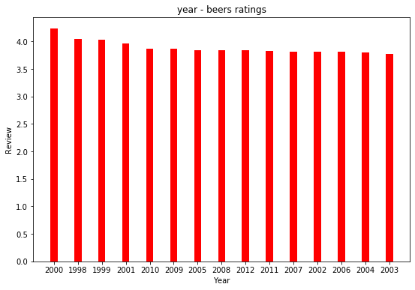
2. Which year did beers enjoy the highest ratings?
We have considered the overall rating to get the details on a beer is good or not,
year | review_overall
2000 | 4.233333

Slide 5
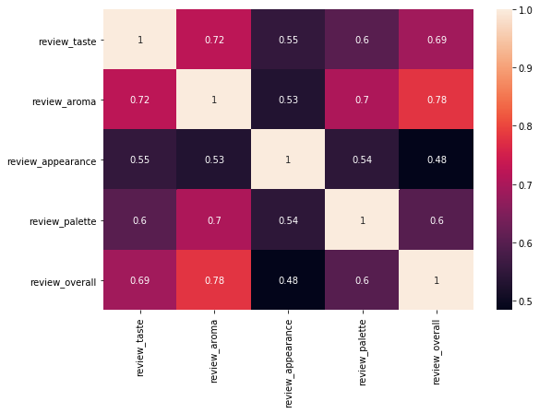
3. Based on the user’s ratings which factors are important among taste, aroma, appearance, and palette?
Correlation between all the factors mentioned with overall review.
The review_aroma feature is more correlated with the review_overall feature. So, aroma is an important factor.

Slide 6
4. If you were to recommend 3 beers to your friends based on this data which ones will you recommend?
Based on the beer ABV and overall review below are the recommend beers.
beer_name | review_overall | beer_ABV
AleSmith Speedway Stout - Oak Aged | 5 | 12
Pilot Series Imperial Sweet Stout - Palm Ridge Reserve Barrel Aged | 5 | 12
Bees Knees Barleywine | 5 | 11.2

Slide 7
5. Which Beer style seems to be the favorite based on reviews written by users?
Get the sentiment score using VADER SentimentIntensityAnalyser.
Based on sum of sentiment score of the review text.
beer_style | review_text_sentiment_score
American IPA | 32767.87

Slide 8
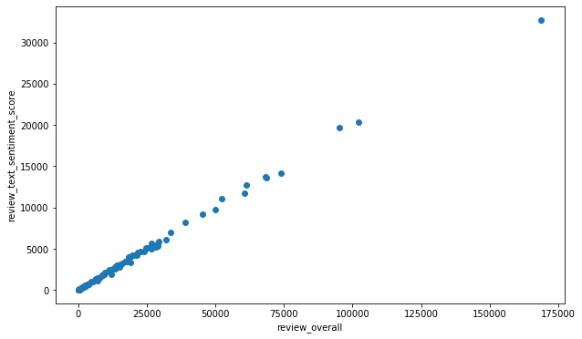
6. How does written review compare to overall review score for the beer styles?
Calculated sentiment score of the review text.
Written review and overall review - both are aligned.

Slide 9
7. How do find similar beer drinkers by using written reviews only?
Trained DOC2VEC model on the review texts.
We can give any review text as an input for specific record and can get the similar records which we can say as similar beer drinkers.
We can do clustering as well to get the similar kind of beer drinkers

