Slide 1
Cloudera Partner Solutions Engineer: Assessment L2

Slide 2
Preface
- INTRODUCTION
- What I have done?
- RESOURCES USED (References)
- What I could have done more (to improve the solution and/or automate it)?
- Q & A

Slide 3
Introduction
This is a second-level assessment for Cloudera Partner SE Role (DevOps Team)
The task requires candidates to develop a solution to deploy Cloudera Data Platform (CDP) Public Cloud infrastructure/environment and one of the Data Services (CDW, CDE, CML) using automation tools like Terraform, Ansible, Docker etc. where candidates can take help of Cloudera Public Cloud documentation & documentation of Cloudera Automation frameworks to complete the task.
CDP Public Cloud Access
Cloudera PSE team will provide access to the CDP tenant through Keycloak . Candidates can use this tenant for a specific time period to deploy their solution. Candidates need to go through the Cloudera documentation to understand how to deploy & configure the CDP infrastructure.
Requirements
Candidates need to bring their own AWS account with administrative privileges and a machine where they can install & configure different automation frameworks & associated dependencies.

Slide 4
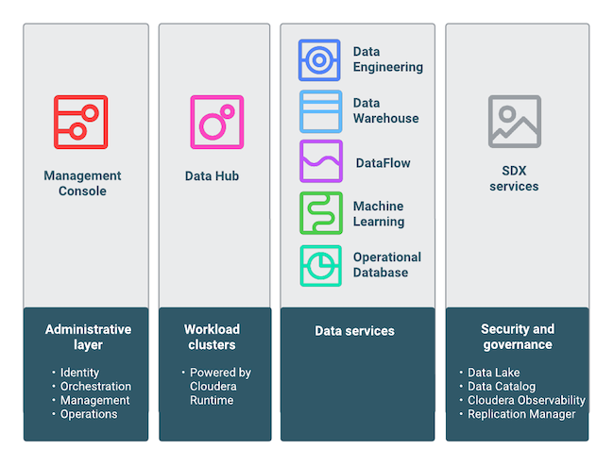
Introduction to cdp public cloud
CDP Public Cloud is an integrated analytics and data management platform deployed on cloud services. It offers broad data analytics and artificial intelligence functionality along with secure user access and data governance features.

Slide 5
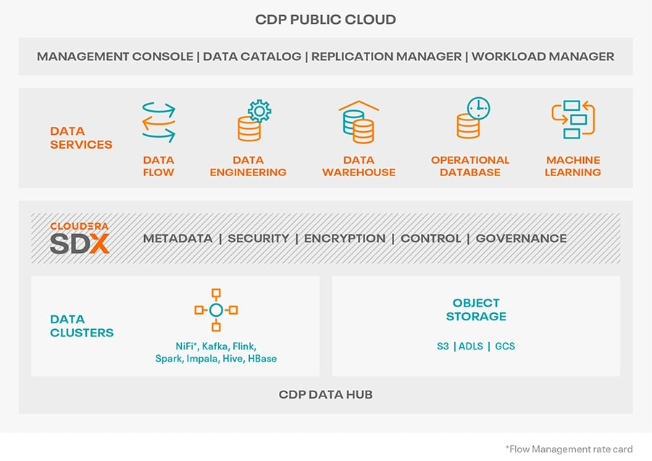
To add

Slide 6
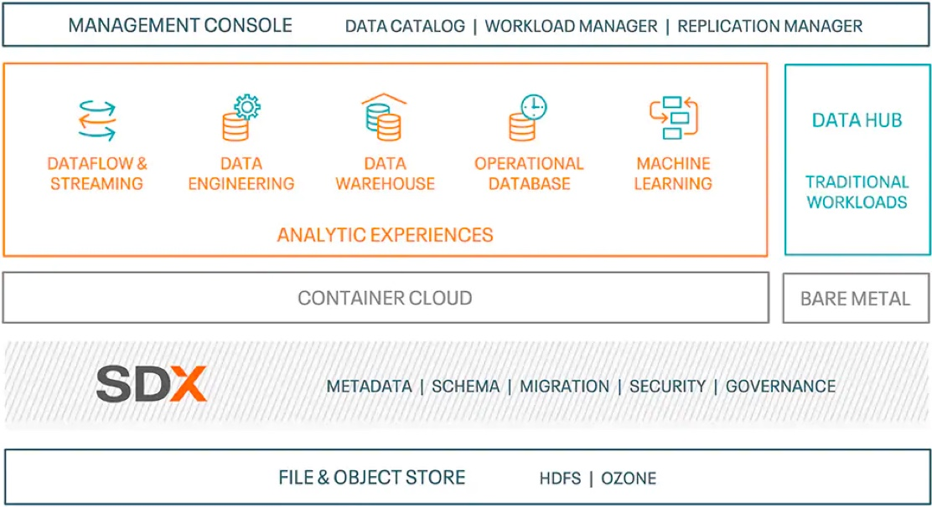
To add

Slide 7
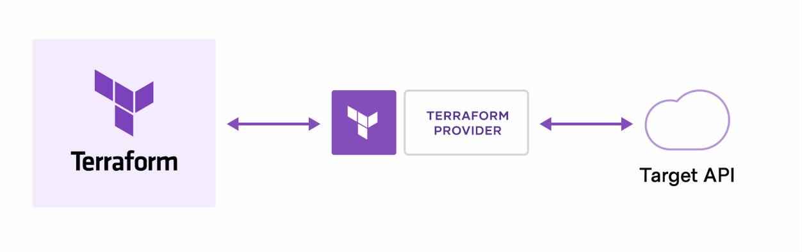
Introduction to terraform
HashiCorp Terraform is an infrastructure as code tool that lets you build, change, and version both cloud and on-prem resources in human-readable configuration files that you can version, reuse, and share safely and efficiently
Terraform can manage low-level components like compute, storage, and networking resources, as well as high-level components like DNS entries and SaaS features.
Helps managing infrastructure on on-premise environment as well as popular cloud providers: Amazon Web Services, Azure, Google Cloud Platform, Oracle Cloud Infrastructure, and Docker.
Terraform creates and manages resources on cloud platforms and other services through their application programming interfaces (APIs). Providers enable Terraform to work with virtually any platform or service with an accessible API.

Slide 8
Introduction to Ansible
Ansible provides open-source automation that reduces complexity and runs everywhere. Using Ansible lets you automate virtually any task.
Ansible uses simple, human-readable scripts called playbooks to automate your tasks. You declare the desired state of a local or remote system in your playbook. Ansible ensures that the system remains in that state.
As automation technology, Ansible is designed around the following principles:
Agent-less architecture
Low maintenance overhead by avoiding the installation of additional software across IT infrastructure.
Automation playbooks use straightforward YAML syntax for code that reads like documentation. Ansible is also decentralized, using SSH to access to remote machines
Scalability and flexibility
When the system is in the state your playbook describes Ansible does not change anything, even if the playbook runs multiple times.

Slide 9
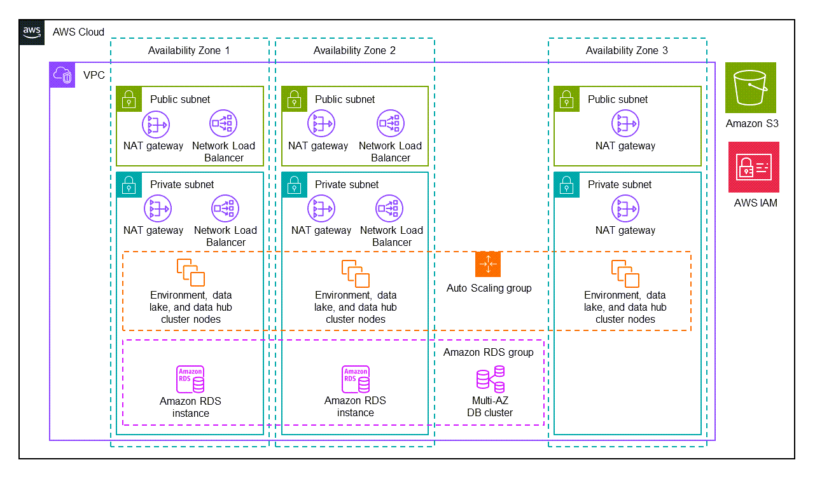
To add

Slide 10
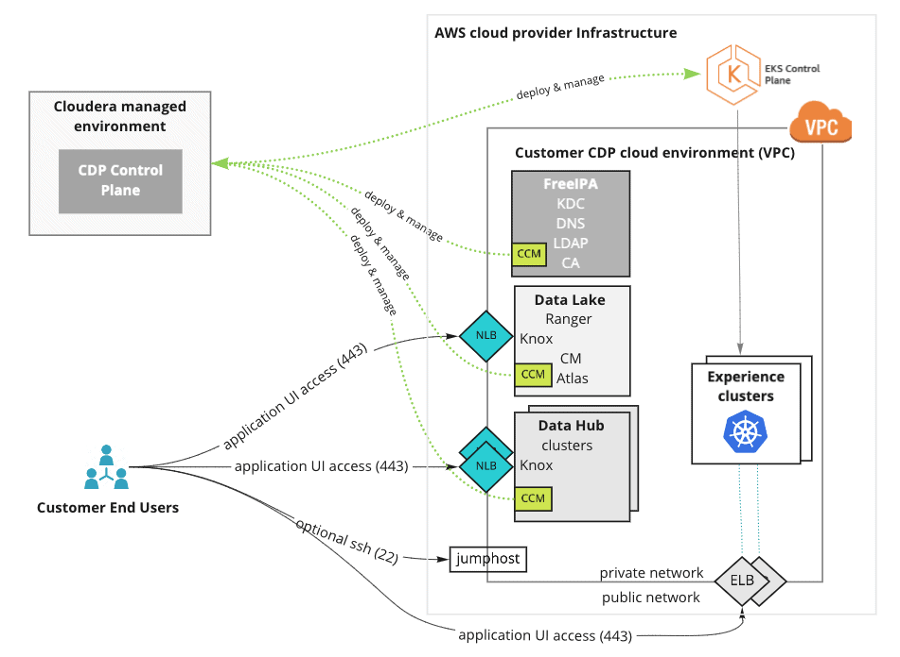
To add

Slide 11
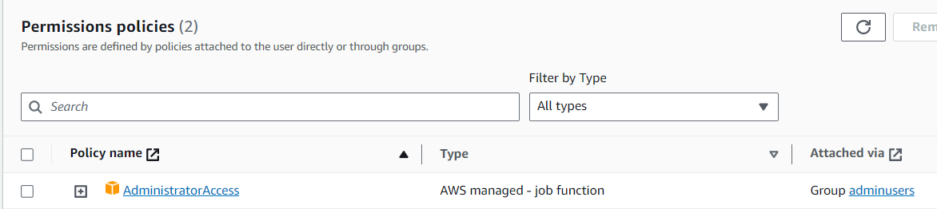
Pre-requisites setup
AWS Account Setup:
Create an AWS account
https://us-east-1.console.aws.amazon.com/
Using IAM service, create a group, attach required administrative policies (root level permissions),

Slide 12

Pre-requisites setup .. Cont (2)
Create a non-root admin user to be used for this case study, add user to the admin group created previously
Setup MFA for both root and non-root user as a best practice
https://240356362593.signin.aws.amazon.com/console
Generate AWS access and secret key credentials for the user for programmatic/API access and download the credentials for later use

Slide 13
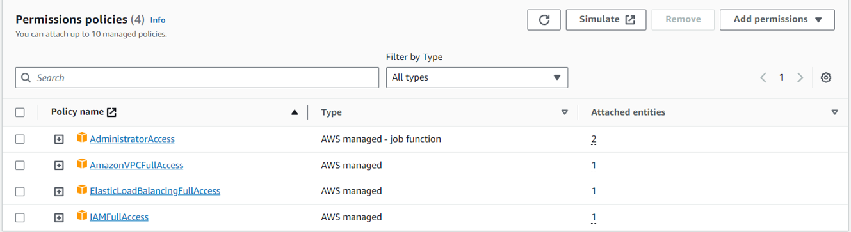
Pre-requisites setup .. Cont (3)
EC2 Server Setup:
Create a KeyPair (for EC2 instance SSH) and download the .pem file for authentication (Same will be used for CDP resources)
Create a Security Group with required in-bound and out-bound rules (e.g. port 22 for SSH)
Under EC2 service, create an EC2 instance, attaching the Keypair and Security Group created in above step
Create a role, attach the required managed policies (for Terraform provisioning using instance i.e. FullAccess) for required AWS services and attach to EC2 instance

Slide 14
Pre-requisites setup .. Cont (3)
Setting up the environment under EC2 server:
Login to instance using the .pem file (SSH Client), EC2 Instance Connect or AWS Session Manager
Yum Update And Python Installation:-
Docker Installation-
yum update –y yum install python3.11 python3.11-pip –y pip3 install --upgrade 'requests<2.28.1'
yum install docker newgrp docker sudo usermod -a -G docker ec2-user systemctl start docker systemctl enable docker systemctl status docker docker version pip3 install docker docker-compose docker-compose version

Slide 15
Pre-requisites setup .. Cont (4)
AWS CLI Installation & Configuration:-
Terraform Installation-
Ansible & Ansible-Navigator Installation-
pip3 install awscli aws version aws configure aws s3 ls
sudo yum install -y yum-utils sudo yum-config-manager --add-repo https://rpm.releases.hashicorp.com/AmazonLinux/hashicorp.repo sudo yum -y install terraform terraform –version
pip3 install ansible ansible-navigator ansible --version

Slide 16

Access to lab environment
Please follow the following steps to access the lab environment:
Provide Cloudera Team with the Public Static IP of the machine from where you would want to access the environment.
Upon receiving confirmation on whitelisting, please open the below URL on Chrome Browser. http://3.109.161.118/auth/realms/workshop/protocol/saml/clients/samlclient
Enter the credentials provided by Cloudera team to sign-in.
If you are able to sign-in to Cloudera Management Console, you are good to go for executing the assignment in this lab environment.
If you are not able to see the above (mentioned in 6th Step) page, please verify the static Public IP of your machine again and reshare the changed one with us for whitelisting
It is RECOMMENDED that candidates prefix their name while creating any new record.**

Slide 17
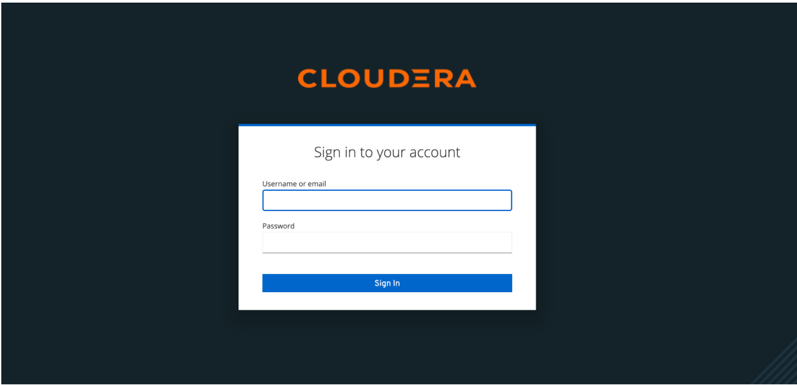
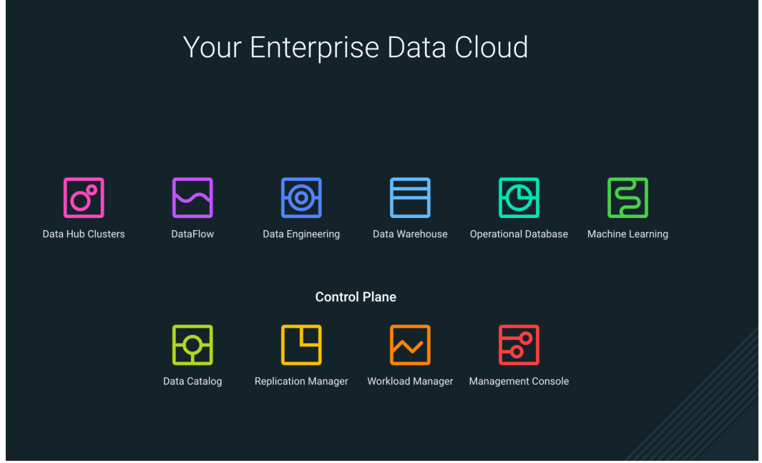

Login to Cloudera Console

Slide 18
Generate CDP Access Key
Sign in to the CDP console and then select Profile.
On the profile page, click Generate Access Key.
CDP will generate the key and display it on the screen.
Copy the access key and private key to a text file. You can optionally download the credentials file containing the access key information.
Click OK to exit the access key window.
Once you've generated the access key, you can configure CDP CLI, SDK, or other utilities that require it.

Slide 19
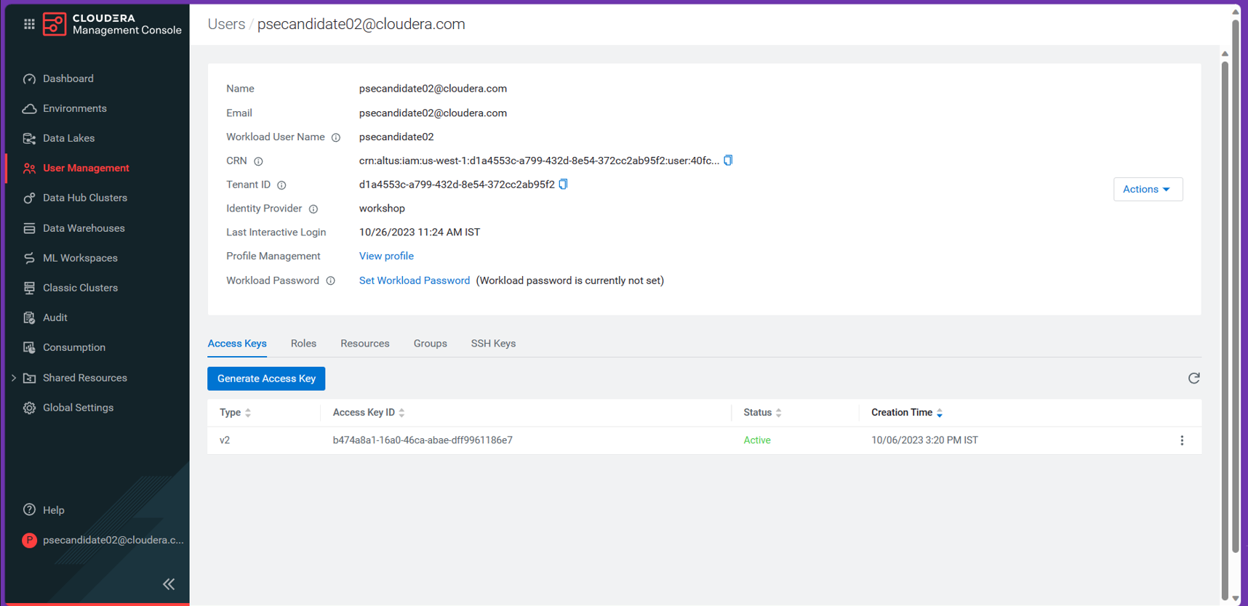

Slide 20
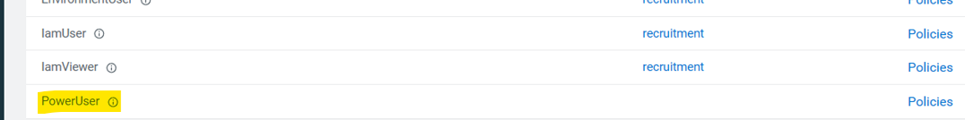
Pre-requisite
Make sure your user is assigned with PowerUser permission, if you are going to use Terraform.
(see User Management Section in Cloudera Management Console)

Slide 21
CDP-Cli Installation & Configuration
CDP-CLI Installation
Configuring CDP client
After you generate the access key, run the following commands to configure the CDP client:
Enter CDP Access key and CDP Private key. , generated in the Management Console, at the prompt.
The configuration utility creates the following file to store your user credentials (Default to us-west-1):
To, optionally, configure the CDP client to use the correct Control Plane region:
pip3 install cdpcli
cdp configure
cat ~/.cdp/credentials
cat > ~/.cdp/config cdp_region = <CONTROL_PLANE_REGION>

Slide 22
VERIFY THE CDP ACCESS
cdp iam get-user { "user": { "userId": "40fc3452-1196-4392-915a-45314848ede7", "crn": "crn:altus:iam:us-west-1:d1a4553c-a799-432d-8e54-372cc2ab95f2:user:40fc3452-1196-4392-915a-45314848ede7", "email": "psecandidate02@cloudera.com", "firstName": "", "lastName": "", "creationDate": "2023-10-05T10:30:39.917000+00:00", "accountAdmin": false, "identityProviderCrn": "crn:altus:iam:us-west-1:d1a4553c-a799-432d-8e54-372cc2ab95f2:samlProvider:workshop/db52d7f9-20da-4373-87a3-30d8427aa085", "lastInteractiveLogin": "2023-10-07T10:13:43.809000+00:00", "workloadUsername": "psecandidate02", "status": "ACTIVE", "workloadPasswordDetails": { "isPasswordSet": false } } }

Slide 23
DEPLOY cdp public cloud on aws – Using terraform
Clone the Cloudera Terraform Framework Git repo:
Go to the cloned repo example AWS deployment code:
Create a tfvars input file by copying sample tfvars and edit using vi
Edit the tfvars file
git clone https://github.com/aws-ia/terraform-cloudera-cdp.git
cd terraform-cloudera-cdp/examples/ex01-minimal_inputs/
cp terraform.tfvars.sample terraform.tfvars
vi terraform.tfvars # ------- Global settings ------- env_prefix = "kuldeep-cdpdemo" # Required name prefix for cloud and CDP resources # ------- Cloud Settings ------- aws_region = "us-east-1" # Change this to specify Cloud Provider region aws_key_pair = "cdpdemo" # Change this with the name of a pre-existing AWS keypair # ------- CDP Environment Deployment ------- deployment_template = "public" # Options are public, semi-private or private # ------- Network Settings ------- ingress_extra_cidrs_and_ports = { cidrs = ["0.0.0.0/32"], ports = [443, 22] }

Slide 24
DEPLOY cdp public cloud on aws – Using terraform
Executing Terraform lifecycle commands to provision the Cloudera's CDP Public Cloud Infrastructure environment on AWS:
To optionally, deprovision (teardown or destroy) the created infrastructure environment using Terraform, execute:
terraform init terraform plan -var-file terraform.tfvars -out terraform-plan.output > terraform-plan-output.log terraform apply -var-file=terraform.tfvars -auto-approve
terraform destroy -var-file=terraform.tfvars -auto-approve

Slide 25
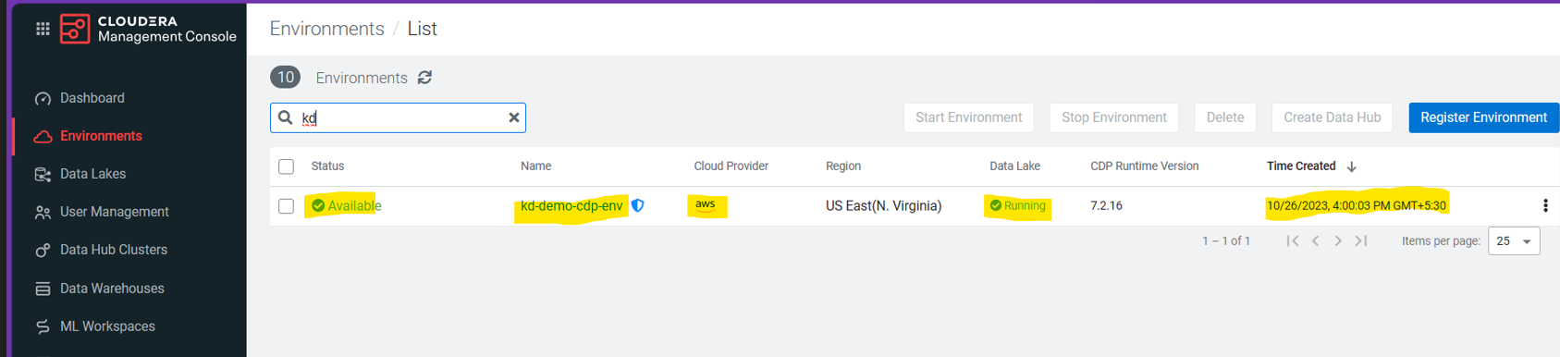
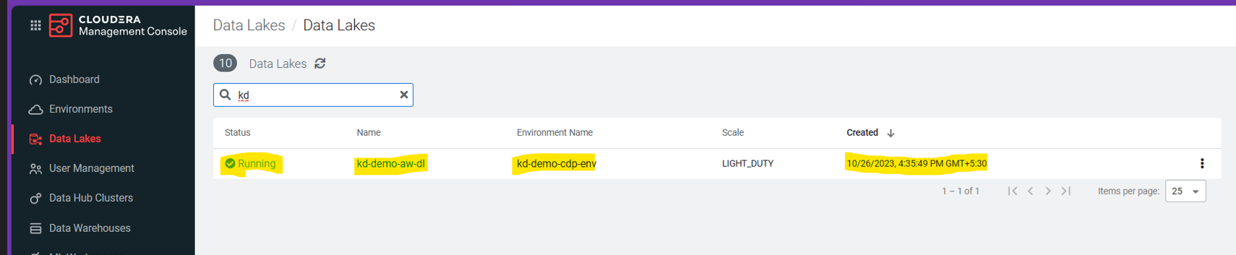

Slide 26
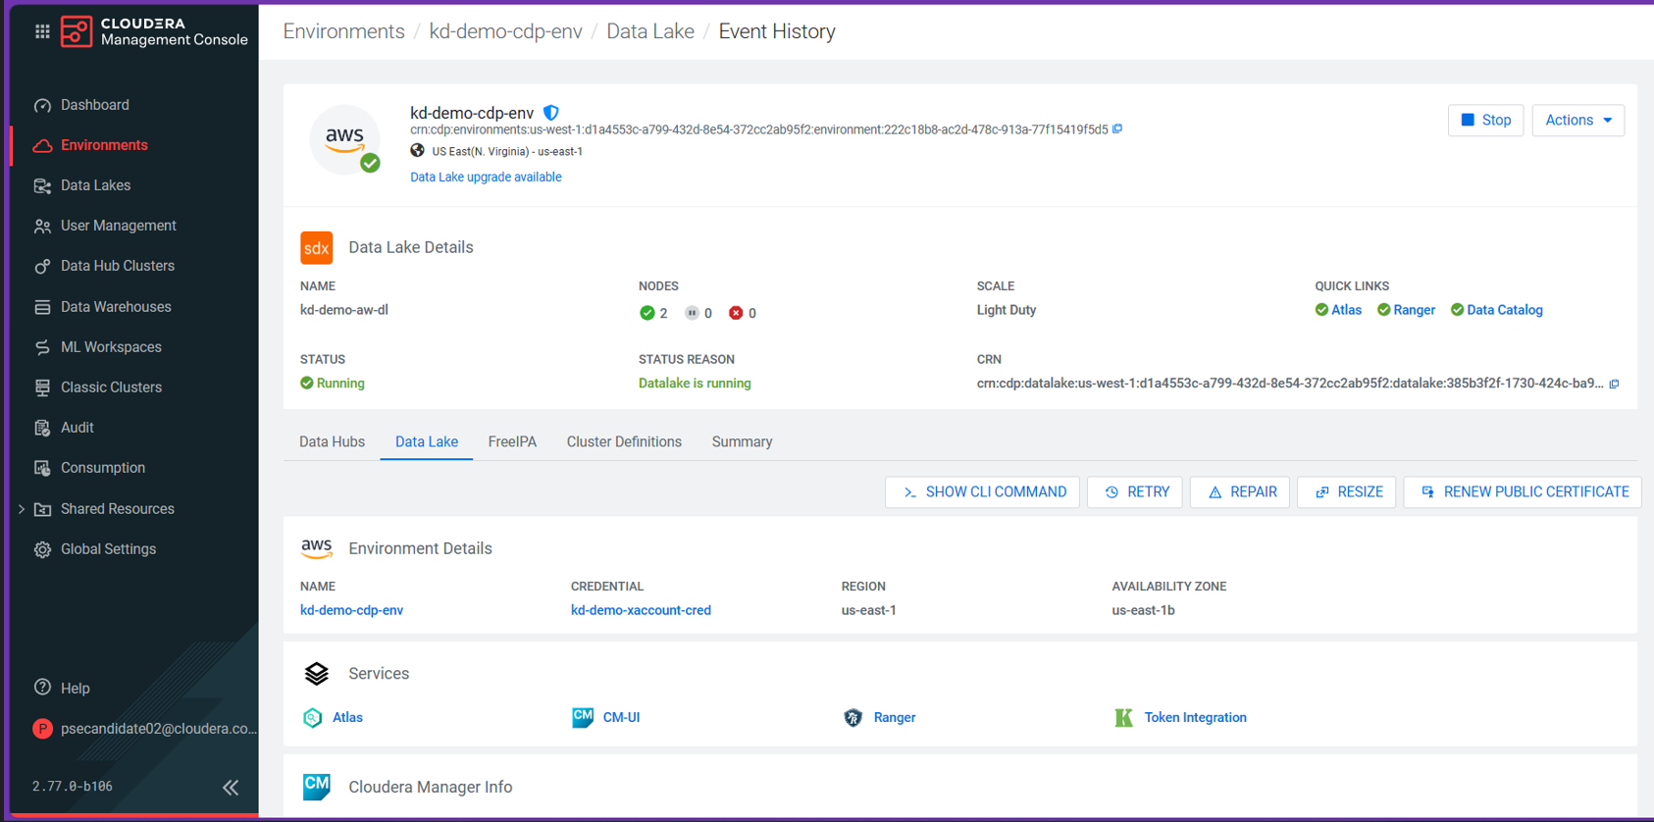

Slide 27
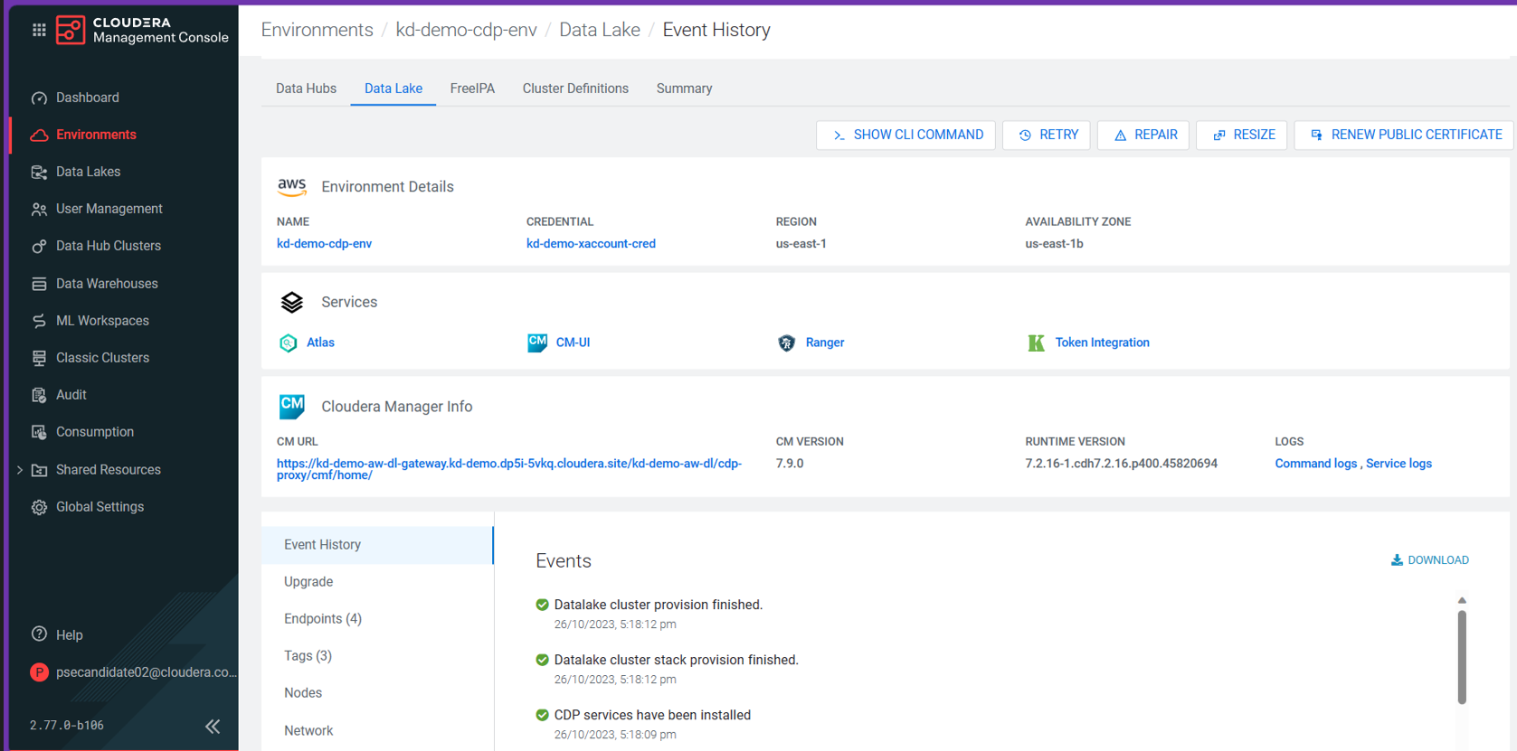

Slide 28
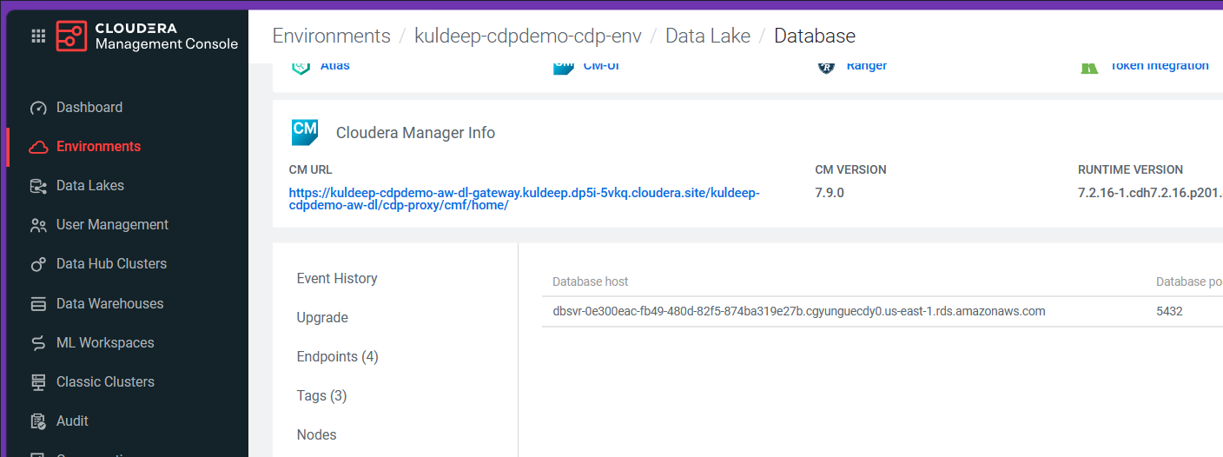

Slide 29
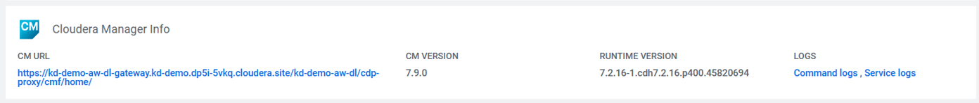
How to access the environment:

Slide 30
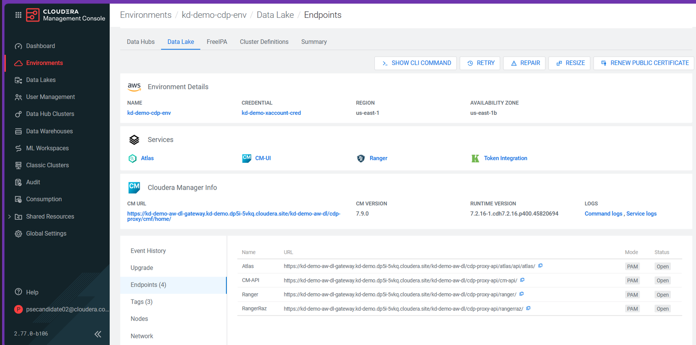

Slide 31
Deploy Cloudera data service (cde) – Using ansible
Clone the Cloudera Ansible Framework Git repo:
Clone the playbook(pbc_setup.yml) and roles (runtime) from cloudera.exe repo (as we need to add some tags to the role task and playbook for better control on CDP data service deployment using this framework). We will need this playbook pbc_setup.yml and initialize_setup.yml/setup.yml tasks from runtime role to deploy cde data service.
Update the bashrc to add the aws and cdp profile to be used by ansible-navigator for deploying ds
git clone https://github.com/cloudera-labs/cloudera-deploy.git
git clone https://github.com/cloudera-labs/cloudera.exe.git cp ~/cloudera.exe/playbooks/pbc_setup.yml ~/cloudera-deploy/public-cloud/aws/cde/ mkdir -p ~/cloudera-deploy/public-cloud/aws/cde/roles/ cp -r ~/cloudera.exe/roles/runtime ~/cloudera-deploy/public-cloud/aws/cde/roles/ cd cloudera-deploy/public-cloud/aws/cde/
cat ~/.bashrc | tail -2 export AWS_PROFILE=default export CDP_PROFILE=default

Slide 32
Deploy Cloudera data service (cde) – Using ansible
Update the ansible-navigator.yml file (was facing some issue in mounting .aws and .cdp inside the container, so used a workaround.
Use the below command sto test if cdpcli and awscli commands are accesible for ansible-navigatror inside from container
vi ansible-navigator.yml . . . volume-mounts: - src: "~/.ssh" dest: "~/.ssh" options: "Z" - src: "/root/.cdp" dest: "~/.cdp" options: "Z" - src: "/root/.aws" dest: "~/.aws" options: "Z“ . . .
ansible-navigator exec -- cdp iam get-user ansible-navigator exec -- aws iam get-user ansible-navigator exec -- aws s3 ls

Slide 33
Deploy Cloudera data service (cde) – Using ansible
Update the definition.yml to provide the parameters needed to execute ansible to deploy cde data service on cdp public cloud:
vi definition.yml . . . name_prefix: kuldeep # You must specify a name prefix admin_password: Move!@34 # You must specify an admin password infra_region: us-east-1 # CSP region for infra infra_type: aws # CSP public_key_id: cdpdemo . . . de: definitions: # customize the parameters as required - name: "{{ name_prefix }}-aws-example" instance_type: 'm5.2xlarge' minimum_instances: 1 maximum_instances: 4 minimum_spot_instances: 0 maximum_spot_instances: 0 enable_public_endpoint: yes . . .

Slide 34
Deploy Cloudera data service (cde) – Using ansible
Edit the playbook main.yml and add a tag deploy_ds to pbc_setup task and also update the import_playbook (temporarily) to refer playbook from local
vi main.yml . . . - name: Set up CDP Public Cloud (CDE example) # ansible.builtin.import_playbook: cloudera.exe.pbc_setup.yml ansible.builtin.import_playbook: pbc_setup.yml tags: deploy_ds . . .

Slide 35
Deploy Cloudera data service (cde) – Using ansible
Edit the playbook pbc_setup.yml and add a tag deploy_ds to setup and initialize_setup tasks and also update the import_role (temporarily) to refer runtime role from local
vi pbc_setup.yml . . . - name: Initialize Data Services setup ansible.builtin.import_role: #name: cloudera.exe.runtime name: runtime tasks_from: initialize_setup tags: - initialize - run - deploy_ds - name: Set up Data Services ansible.builtin.import_role: #name: cloudera.exe.runtime name: runtime tasks_from: setup tags: - run - deploy_ds # (By default, Ansible looks for roles in the roles subdirectory relative to the playbook file or the system directory /etc/ansible/roles) . . .

Slide 36
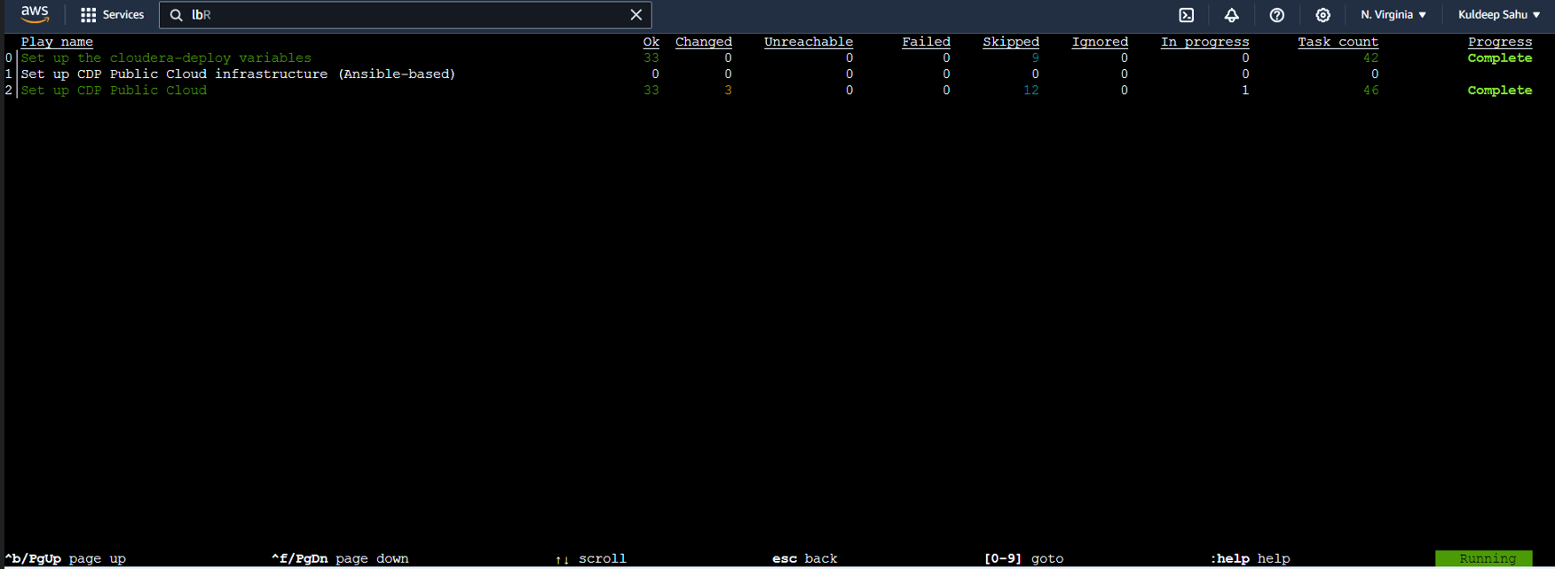
Deploy Cloudera data service (cde) – Using ansible
Deploy CDE data-service using ansible on CDP public cloud enviroment on AWS, previously provisioned with the help of Terraform
ansible-navigator run main.yml -e @definition.yml --tags deploy_ds,de

Slide 37
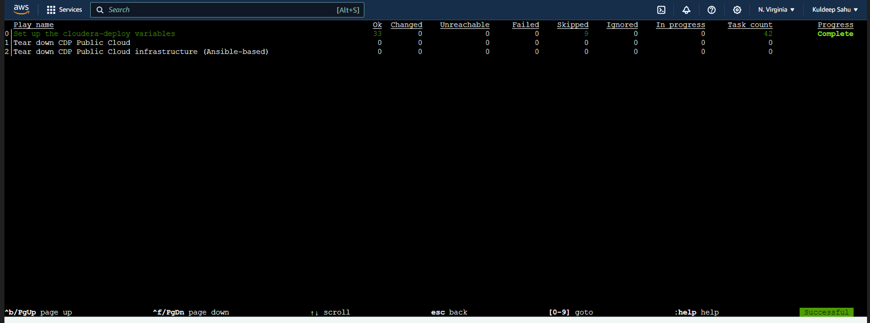
Deploy Cloudera data service (cde) – Using ansible
To optionally, deprovision (teardown or destroy) the created infrastructure environment using ansible-navigator, execute:
ansible-navigator run teardown.yml -e @definition.yml --tags deploy_ds,de

Slide 38
Add-ons
Automate the execution (multiple ways)
Shell scripting
Jenkins pipeline (CI/CD)
Terraform
Can be further orchestrated with help of a Docker image which includes pre-setup environment for terraform provisioning
Ansible
Will be used for CDP data service deployment
Can also be used as a standalone for complete setup (CDP public cloud +CDP data services .. One or all)
Using awscli and cdpcli (Can be used with Jenkins pipeline or shell script or both)
(Pipeline will take the aws account credentials from the profile on the EC2 machine and create/setup CDP public cloud environments based on Build parameters passed during execution (i.e. env name, region, key name etc)
Keypair creation, sg, policy attachment and ec2 instance creation, environment setup steps can also be automated with help of either or a well prepared combination of AWS cli, CDP cli, shell scripting, ansible, and/or terraform

Slide 39
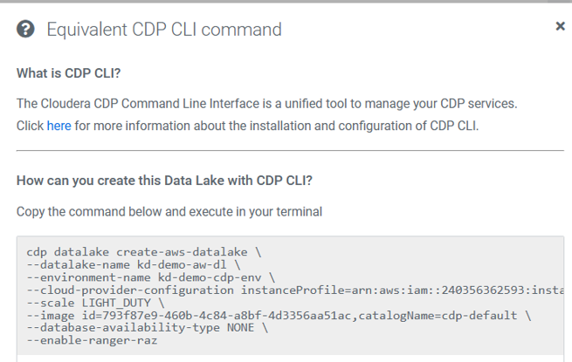

Slide 40
References
Cloudera Public Cloud: https://docs.cloudera.com/?tab=cdp-public-cloud
Cloudera Terraform : https://github.com/cloudera-labs/cdp-tf-quickstarts/tree/main
Cloudera Cloud Ansible : https://cloudera-labs.github.io/cloudera.cloud/
Cloudera CDP CLI: https://github.com/cloudera/cdpcli
https://docs.cloudera.com/cdp-public-cloud/cloud/cli/topics/mc-cli-generating-an-api-access-key.html
https://docs.cloudera.com/cdp-public-cloud/cloud/cli/topics/mc-configuring-cdp-client-with-the-api-access-key.html
https://github.com/aws-ia/terraform-cloudera-cdp.git
https://github.com/cloudera-labs/cloudera-deploy.git
https://github.com/cloudera-labs/cloudera.exe.git
https://ansible.readthedocs.io/projects/navigator/subcommands/#available-subcommands
https://www.redhat.com/sysadmin/ansible-tags-fast-playbook-runs
https://access.redhat.com/documentation/en-us/red_hat_ansible_automation_platform/2.0-ea/html/ansible_navigator_creator_guide/assembly-settings-navigator_ansible-navigator
https://docs.cloudera.com/cdp-public-cloud/cloud/getting-started/topics/cdp-deploy_cdp_using_terraform.html
https://cloudera.github.io/cdp-dev-docs/cli-docs/de/index.html

Slide 41


