Slide 1

Analysis of an inorganic-organic hybrid photoresist deposited by molecular atomic layer deposition for application of electron beam lithography using numerical methods
CME 502: Final Presentation
Matthew Yen

Slide 2
Research Topic
Creation of a negative tone, inorganic-organic hybrid photoresist for applications of electron beam lithography.
Analyze thickness difference using atomic force microscope after exposure to EBL.
Purpose is to create a code that will properly plot the remaining thickness data gained after Gwyddion analysis, fit all curves for each sample and determine the dose sensitivities.

Slide 3

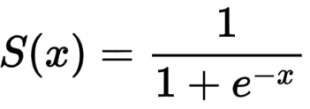
Atomic Force Microscope (AFM)
Measure 4 different samples exposed with EBL in a dose series pattern.
Use of Gwyddion software and Microsoft Excel to analyze images and put data into file that can be used in code.
Obtain the dose sensitivities (mC/cm^2) of each sample.
Curve-fit using the sigmoid function.

Slide 4
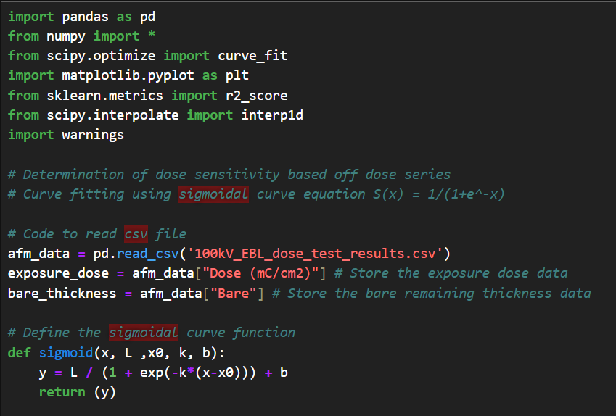
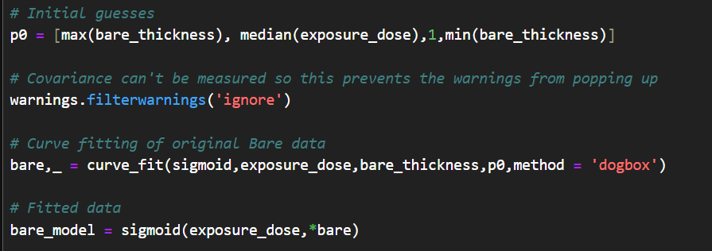
AFM Code

Slide 5
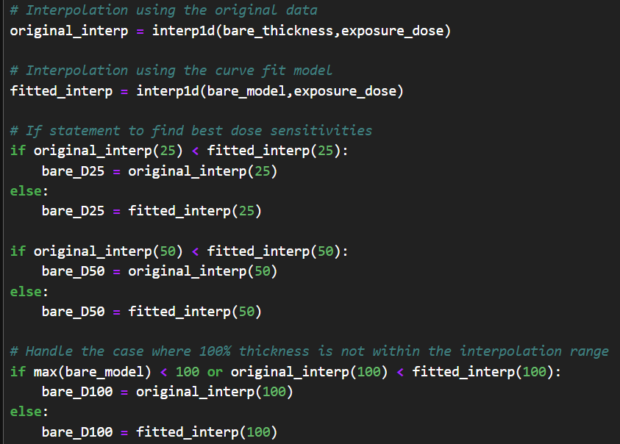
Interpolation

Slide 6
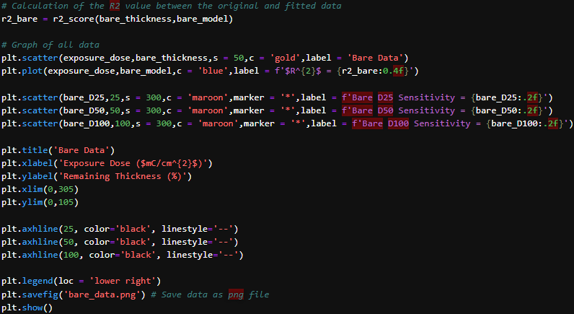
Graphing

Slide 7
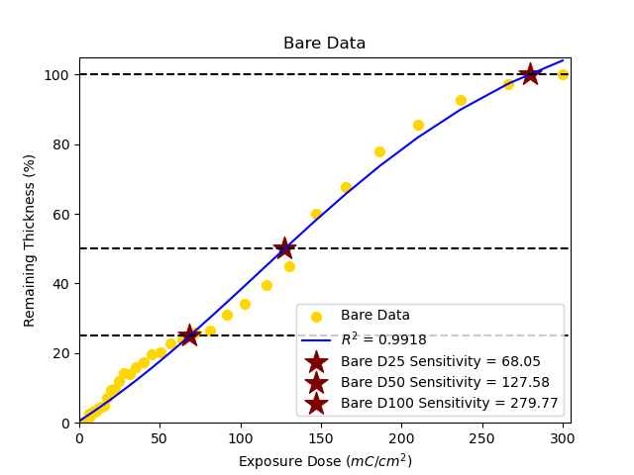
1) AFM: Bare Sample

Slide 8
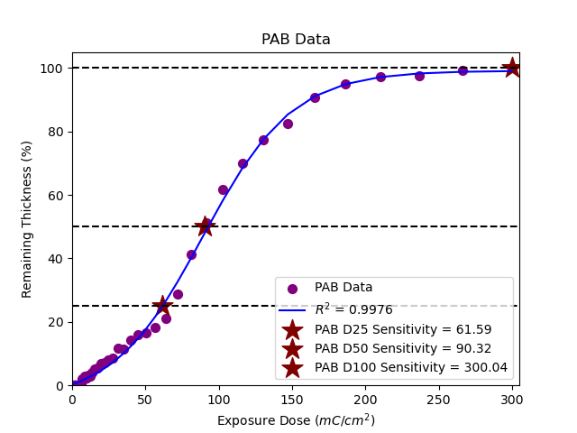
2) AFM: PAB Sample

Slide 9
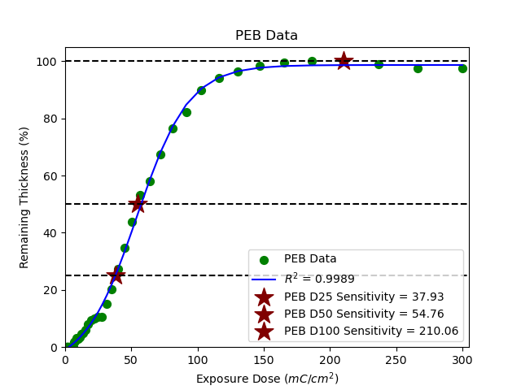
3) AFM: PEB Sample

Slide 10
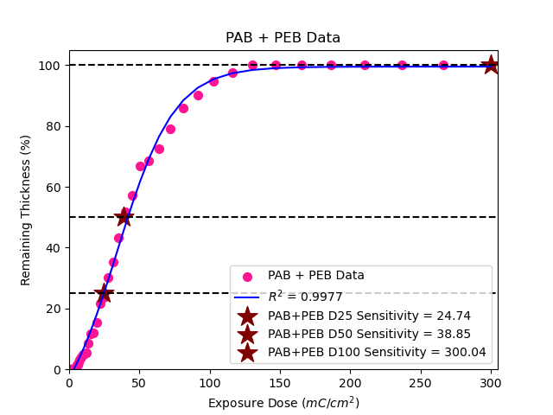
4) AFM: PAB + PEB Sample

Slide 11
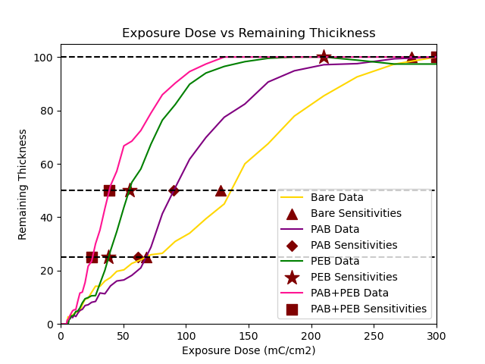
AFM: Completed Data
Dose (mC/cm2) | Bare | PAB | PEB | PAB+PEB
0 | 0 | 0 | 0 | 0
1 | 0 | 0 | 0 | 0
1.12618 | 0 | 0 | 0 | 0
1.26828 | 0 | 0 | 0 | 0
1.42831 | 0 | 0 | 0 | 0
1.60854 | 0 | 0 | 0 | 0
1.8115 | 0 | 0 | 0 | 0
2.04008 | 0 | 0 | 0 | 0
2.2975 | 0 | 0 | 0 | 0
2.58739 | 0 | 0 | 0 | 0
2.91387 | 0 | 0 | 0 | 0
3.28154 | 0 | 0 | 0 | 0
3.69561 | 0 | 0 | 0 | 0
4.16192 | 0 | 0 | 0 | 0
4.68707 | 0 | 0 | 0 | 0
5.27849 | 1.08213 | 0 | 0 | 1.49137
5.94452 | 2.7343 | 0 | 0 | 1.55416
6.69461 | 1.98068 | 2.08291 | 1.63952 | 2.31816
7.53933 | 2.74396 | 1.87563 | 2.15449 | 3.26531
8.49064 | 3.28019 | 2.81598 | 3.04256 | 4.0293
9.56199 | 3.30918 | 2.35086 | 2.99527 | 4.93982
10.76852 | 3.88406 | 3.23054 | 3.46821 | 5.31136
12.1273 | 4.41546 | 2.78059 | 4.69785 | 5.38462
13.65752 | 4.5942 | 3.96866 | 4.81871 | 8.472
15.38083 | 4.82609 | 5.091 | 6.03783 | 11.56986
17.32158 | 7.17391 | 5.46512 | 7.91908 | 11.91523
19.50721 | 9.29469 | 6.90597 | 9.45349 | 15.50497
21.96863 | 9.65217 | 7.18908 | 9.88439 | 21.64312
24.74064 | 11.85024 | 8.1092 | 10.56227 | 23.50078
27.86241 | 14.15942 | 8.44287 | 10.61482 | 30.03663
31.37809 | 14.09179 | 11.60768 | 15.134 | 35.16484
35.33738 | 16.08213 | 11.31446 | 20.12612 | 43.27577
39.79625 | 17.3913 | 14.25683 | 27.43037 | 51.80534
44.81774 | 19.72464 | 16.10212 | 34.62953 | 57.24751
50.47284 | 20.27536 | 16.48635 | 43.66789 | 66.719
56.8415 | 22.68116 | 18.21537 | 53.07409 | 68.49817
64.01376 | 24.05797 | 21.03134 | 58.06621 | 72.47514
72.09102 | 25.94203 | 28.76643 | 67.36731 | 79.01622
81.18747 | 26.47343 | 41.30435 | 76.35313 | 85.87127
91.4317 | 30.91787 | 51.06168 | 82.18602 | 90.21455
102.96855 | 34.00966 | 61.72902 | 89.80557 | 94.55782
115.96112 | 39.42029 | 69.86855 | 94.00946 | 97.38357
130.5931 | 44.97585 | 77.45197 | 96.47924 | 100
147.07134 | 60 | 82.40647 | 98.2659 | 100
165.6288 | 67.53623 | 90.64712 | 99.52706 | 100
186.52784 | 77.8744 | 94.84328 | 100 | 100
210.06392 | 85.45894 | 97.1183 | 100 | 100
236.56979 | 92.56039 | 97.52275 | 98.84393 | 100
266.42016 | 97.343 | 99.34277 | 97.37257 | 100
300.03706 | 100 | 100 | 97.37257 | 100
 | Bare | PAB | PEB | PAB+PEB
D25 | 68.05 | 61.59 | 37.93 | 24.74
D50 | 127.58 | 90.32 | 54.76 | 38.85
D100 | 279.77 | 300.04 | 210.06 | 300.04

Slide 12
Conclusions
Successfully created code to analyze AFM imaging data and graph Remaining Thickness vs Exposure Dose for each sample.
Analyzed the difference in interpolation data between the original data and the fitted data.
From each graph, the dose sensitivities can be obtained and used for future work.
Code can be utilized for many different experiments.

Slide 13
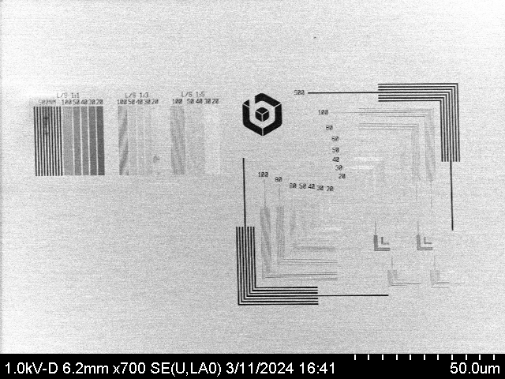
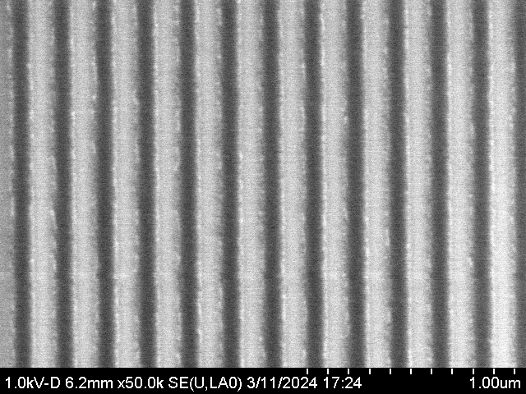
Future Work
With the D100 dose sensitivity data obtained from the AFM analysis, high-resolution line/space patterning using EBL can be achieved.
Repeat the same steps to create samples using dry-development instead of wet-development and use same characterization techniques.

