Slide 1
The relationship between thickness of active layer and membrane performance
Ping-Han Wu
CME502
Assessing the impact of membrane support and different amine monomer structures on the efficacy of thin‑film composite nanofiltration membrane for dye/salt separation
PH Wu, MR Gallardo, MBMY Ang, JC Millare, SH Huang, HA Tsai, KR Lee
Journal of Polymer Research 29 (7), 270
https://doi.org/10.1007/s10965-022-03126-y

Slide 2






Data process software

Slide 3
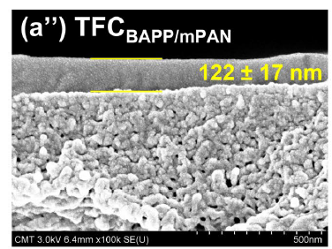
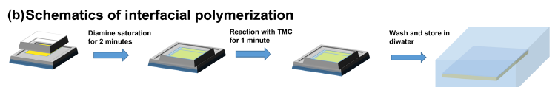
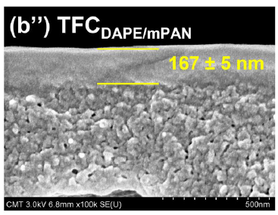
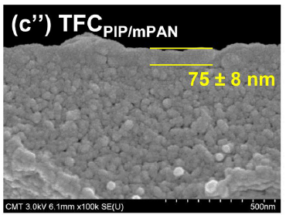
Interfacial Polymerization
Organic phase
Polyamide layer
Aqueous phase
PIP
BAPP
DAPE

Slide 4
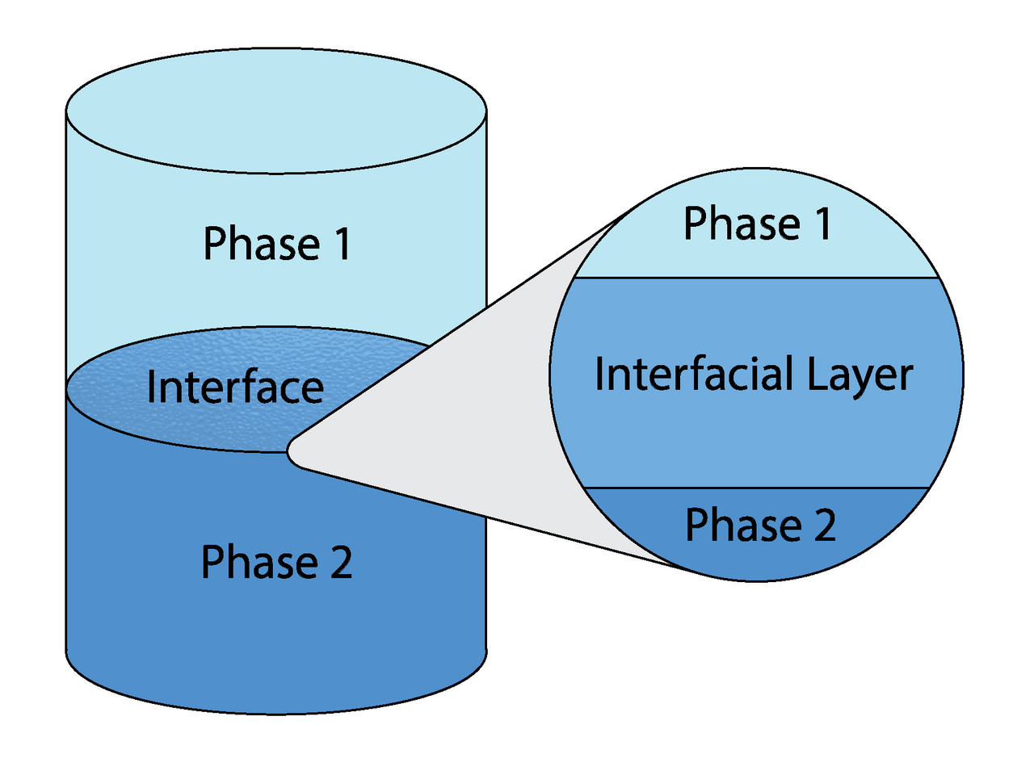
Light transmittance test
Light source
Organic phase
Polyamide layer
Aqueous phase
Sensor

Slide 5
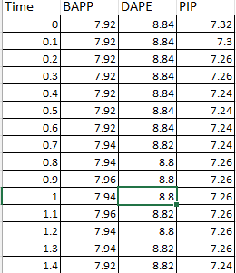
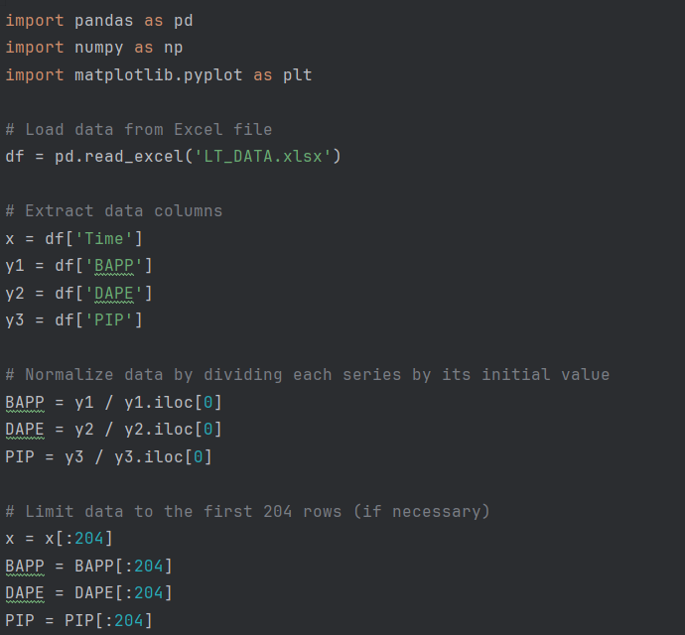

Data process for light transmittance
Import data from excel
I_{t} was the light intensity of contacting the organic
phase with aqueous phase after t seconds
I₀ was the light intensity of the aqueous phase before contacting with the organic phase

Slide 6
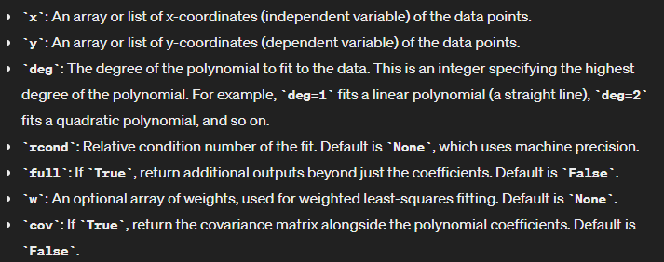
Polyfit function

Slide 7
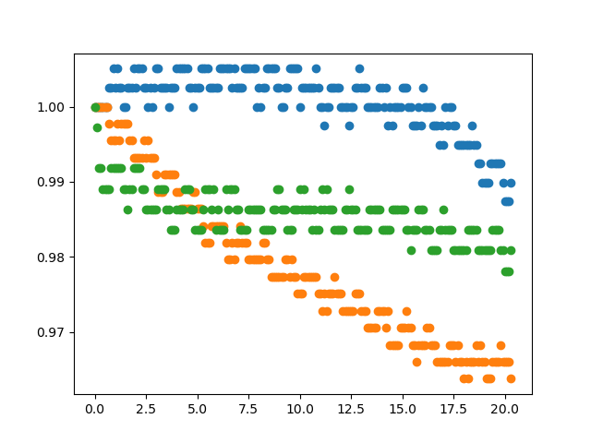
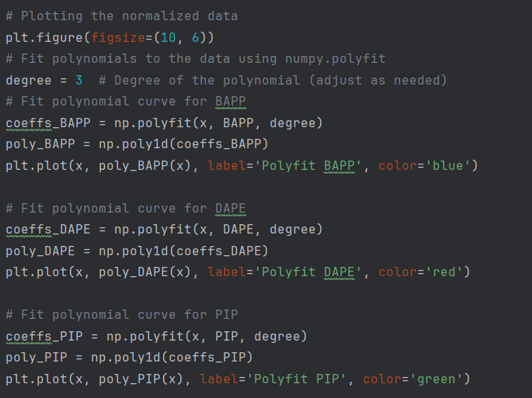
Data fitting to see smooth line instead of scattering distribution

Slide 8
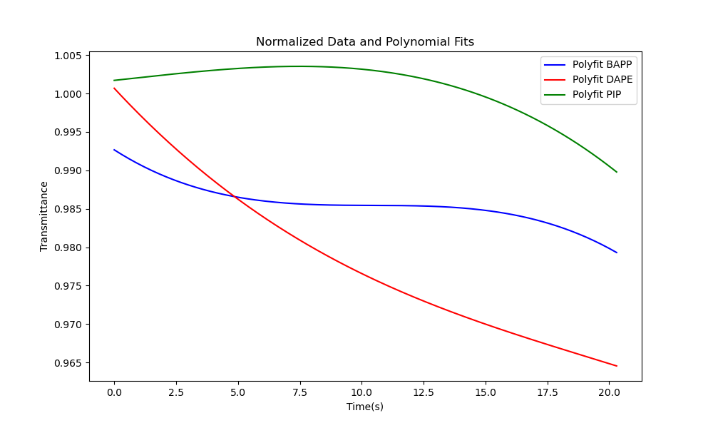
Result of data visualization

Slide 9
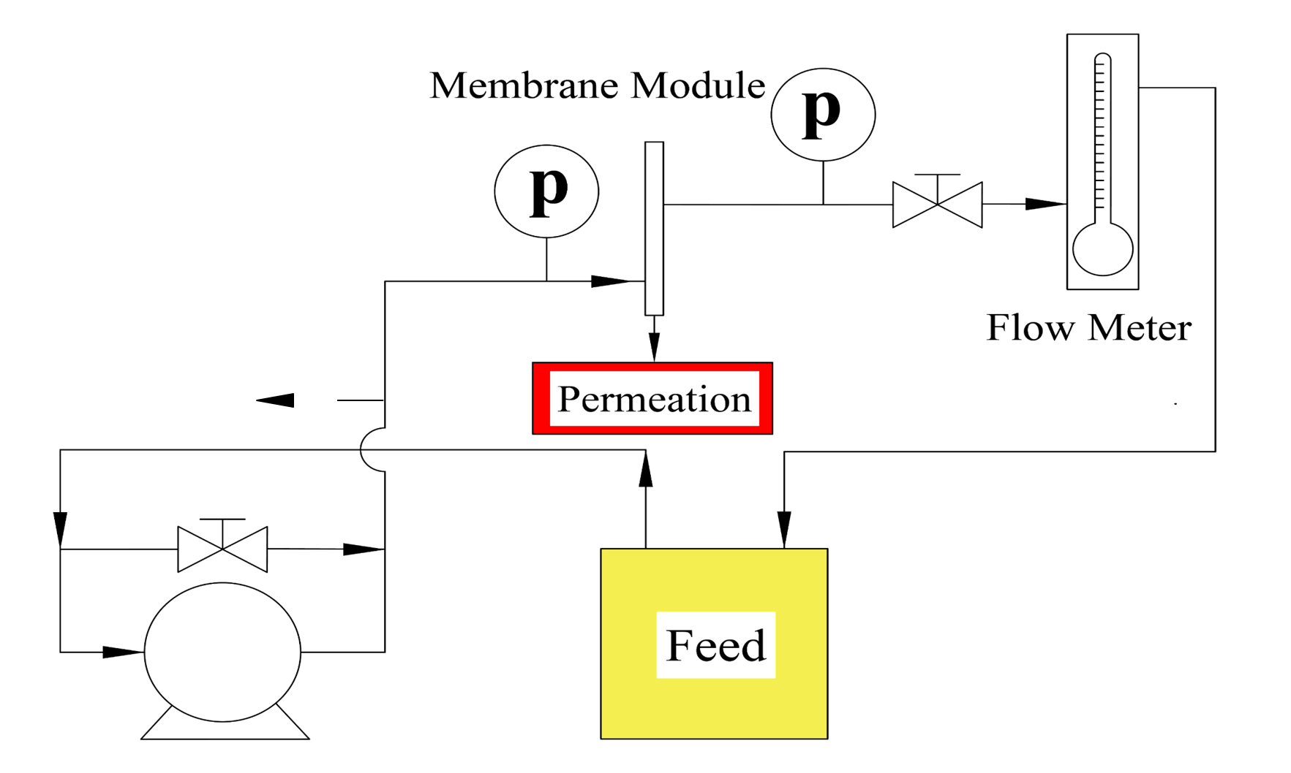
Experimental set-up for membrane performance

Slide 10

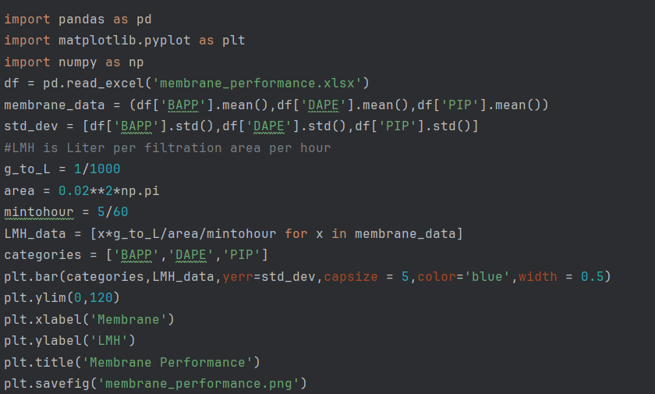

Membrane Performance
Import data from excel
m (kg) is the mass collected at sampling
ρ is the water density (1 kg/L)
A (m²) is the membrane effective area(0.02^2)*pi

Slide 11
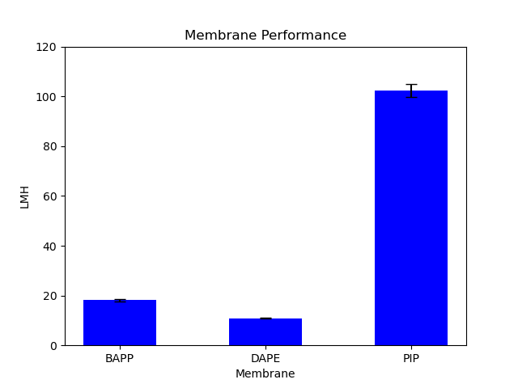
Data visualization

Slide 12
The correlation of thickness and flux

Slide 13
Conclusion
Light transmittance data reinforces the thickness observation form SEM cross-sectional image.
Thickness of active layer indicates the correlation to membrane flux.
Data process with python has better flexibility to deal with variety of data and finish calculation and plotting at the same time.

Slide 14
Thank you for listening

