Slide 1
Fund Accounting

Slide 2
Contents
Fund Accounting – Overview
Accounting Principles
  Pension Funds
  Derivatives
  Alternative Investments
Taxation and Accounting Standards
Process IT Model
Appendix
  Appendix I: Valuation Methodologies & Pricing Sources
  Appendix II: Interest Accrual Methods
  Appendix III: Fund Accounting Terminologies
© 2008, Cognizant Technology Solutions. Confidential

Slide 3
Fund Accounting – Overview
© 2008, Cognizant Technology Solutions. Confidential

Slide 4
Fund Accounting – Overview
Accounting types:
  Fund Accounting: is specifically applicable to funds like mutual funds
  Investment Accounting: includes accounting for funds, individual portfolios etc.
  Partnership Accounting: used for accounting in Hedge/Private Equity Funds which have partnership structures
Fund Accounting is a core component of portfolio management process, it constitutes:
  Accounting of trade
  Computation of Net Asset Value (NAV)
Provides inputs for portfolio performance analysis and other management decisions
Done in accordance with local laws, regulations and accounting standards
© 2008, Cognizant Technology Solutions. Confidential

Slide 5
Fund Accounting – Overview
Fund structure:
The role of the fund administrator includes accurate, timely, accounting valuation, compliance monitoring and reporting services.
Fund
(Fund Manager)
Portfolio 1
(Portfolio Manager)
Portfolio 2
(Portfolio Manager)
Portfolio 3
(Portfolio Manager)
Underlying Investments
© 2008, Cognizant Technology Solutions. Confidential

Slide 6
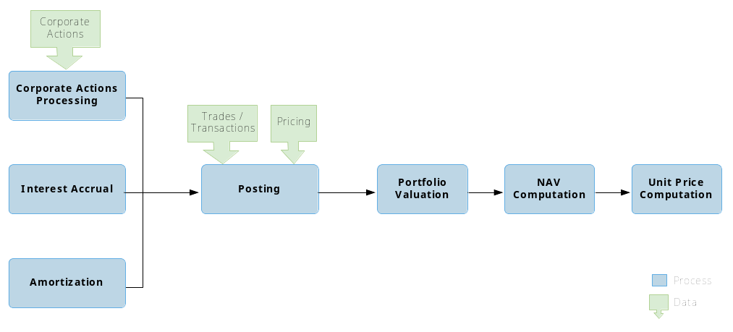
Process Overview
Any event that brings material change to a company & affects stakeholders. e.g. Splits, dividends, mergers, acquisitions, spinoffs. These are received from external sources (custodian/data vendors)
Corporate actions can be voluntary or mandatory
Voluntary: fund manager needs to decide e.g. buy-back
Mandatory: Necessarily needs to be processed
© 2008, Cognizant Technology Solutions. Confidential

Slide 7
Process Overview – Corporate Actions
Mandatory Corporate Actions: Mandatory corporate actions do not require any action from the shareholders. In mandatory corporate action the shareholders are not given an option or choice to choose.
Examples
Maturity Payment
Interest Payment
Dividend Payment
Stock split
Spin-off
Merger – no option (mandatory merger)
Consolidation/reverse stock split
© 2008, Cognizant Technology Solutions. Confidential

Slide 8
Process Overview – Corporate Actions
Voluntary Corporate Actions: These provide the shareholders an option to respond or select from a list of possible actions. All Voluntary corporate actions can be divided into two phases:
  Investor / fund manager is given the right to choose between various options
  Implementation of the option chosen by the investor / fund manager
Examples
Debenture buyback
Odd lot offer (odd lot buyback)
Voluntary conversion
Voluntary redemption
Rights offer
Repurchase offer
© 2008, Cognizant Technology Solutions. Confidential
Notes:
Debenture: A type of debt instrument that is not secured by physical asset or collateral. Debentures are backed only by the general creditworthiness and reputation of the issuer
Buyback: Companies will buyback shares either to increase the value of shares still available (reducing supply), or to eliminate any threats by shareholders who may be looking for a controlling stake. It could also be to increase promoter’s stake in case market value of the stock is too low.
Odd Lot: An amount of a security that is less than the normal unit of trading for that particular security. For stocks, any transaction less than 100 shares is usually considered to be an odd lot.
Odd Lot Theory: A technical analysis theory/indicator based on the assumption that the small individual investor is always wrong. Therefore, if odd lot sales are up - that is small investors are selling stock - it is probably a good time to buy.

Slide 9
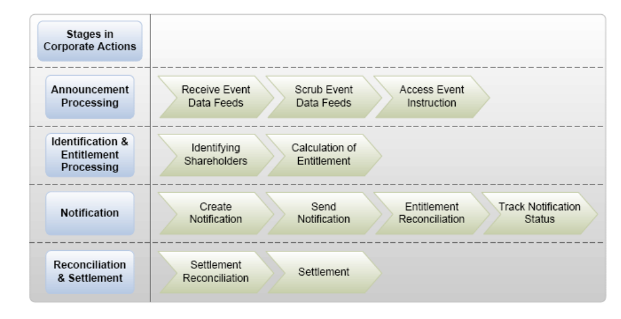
Process Overview – Corporate Actions
© 2008, Cognizant Technology Solutions. Confidential
Notes:
Corporation -> depository -> DPs & Custodians ->
US follows a T+3 settlement cycle for equities, i.e. for an equity which is traded on day T it will take 3 days for change of ownership to reflect in depositories book of records

Slide 10
Process Overview
  Calculating and posting the interest accruals in the account. The interest income due on bonds is calculated on periodic basis and accrued in the books. It can be expressed as:
  _{I = T * P * R}
  where T = no. of days in period / days in year
  _{P = principal}
  R = ‘annualized’ rate of interest
  On receiving the actual interest due, the accruals are reversed.
© 2008, Cognizant Technology Solutions. Confidential

Slide 11
Process Overview – Interest Accrual
On basis of interest payment, debt securities can be broadly classified into two types:
Fixed coupon payment instruments: pay fixed rate of interest during tenure of bond
Zero coupon instruments: issued at discount to the par value and don’t pay interest
The inputs required for this process are:-
Interest rates
Accrual class (interest method/formula to be used)
Interest frequency (frequency in which interest payments are made)
Withholding Tax: Interest income is subject to this tax depending upon the tax status of the account. The gross interest accrual is divided into
net income (after withholding tax)
reclaim (refundable withholding tax)
expenses (non-refundable withholding)
Interest accrual methods
© 2008, Cognizant Technology Solutions. Confidential
Notes:
Accrual Class:
Interest Frequency:

Slide 12
Process Overview
Amortization adjustments are adjustments to the cost basis of a bond bought at a premium or discount so that, at maturity the cost equals par (face value), thus recognizing income or expense over the life of the bond rather than realizing a gain or loss at maturity
© 2008, Cognizant Technology Solutions. Confidential

Slide 13
Process Overview - Amortization
Amortization: An accounting procedure that gradually decreases the book value of an asset through periodic cost adjustments entries
There are two standard types of amortization/accretion:
Market Premium (Amortization) - for bonds bought at a premium
Market Discount (Accretion) – for bonds bought at a discount
Amortization adjustments can be done in one of the frequencies via:
Daily amortization
Period-end amortization, which is initiated at the end of a defined period
Mid-Period adjustments - result in posting of amortization adjustments entries due to buy or sell of securities
© 2008, Cognizant Technology Solutions. Confidential

Slide 14
Process Overview - Amortization
There are two methods of calculation of amortization adjustments:
Straight- Line Method of Amortization:
The amount of the bond premium amortization is the same each month. Methodology:
Divide the number of months the bond exists in books during the year by number of months from the beginning of the tax year to the date of maturity (or earlier call date)
Multiply the result by the bond premium (reduced by any bond premium amortization claimed in earlier years)
e.g. (No. of months / 12) * [bond premium – (already amortized)]
Constant Yield Method:
The amount of the bond premium amortization decreases each month/period.
Determine Yield → Calculate accrual period → Calculate bond premium / discount for the accrual period
© 2008, Cognizant Technology Solutions. Confidential
Notes:
T-Bills and Mortgage Backed securities always use the Straight-Line method, but Fixed Income securities can use either method
Depreciation methods –
straight line: Annual depreciation = (cost of fixed asset – scrap value)/Life span in yrs
declining balance method: Annual Depreciation = Depreciation Rate * Book Value at Beginning of Year

Slide 15
Process Overview
  The details for the trades / cash transactions to be posted are provided from the bank statements
  For non-cash transactions, information is received from custodian, analysts, accountants
  Post buying and selling of securities
  Book management fees, admin charges, trustee/custodian fees
  Maintaining books for funds in conformity with local laws & regulation
  Maintaining lots for portfolio holdings (including tax lot)
© 2008, Cognizant Technology Solutions. Confidential

Slide 16
Process Overview – Posting transactions
Following are various kinds of transactions captured by the accountant:
Cash transactions
  Sale/purchase of bonds, securities, derivatives etc.
  Payment of management fee - charge levied by the investment manager for managing an investment fund
  Custodian fee: fee charged for covering the legal responsibility of customer's securities
  Admin charges: for incorporation of fund, legal & audit charges for the fund, auditing charges, miscellaneous expenses
Non-cash transactions
  Interest accruals
  Amortization
  Receivables / payables
  FX adjustments for foreign investments/receivables
  Deferred corporate actions – e.g. booking dividend receivable later
© 2008, Cognizant Technology Solutions. Confidential

Slide 17
Process Overview
Pricing of the current value of underlying investments need to be updated
periodically (mark to market). Pricing values can be received from:
External data vendors like Thomson Reuters, Bloomberg, Factset etc.
In case of Funds of Funds / Funds of Hedge Funds / Fund of Fund of
Funds, valuations are sent by the underlying investments as PCAP
(partner’s capital a/c statement)
Certain bonds & illiquid securities valued using yield-curves/in-house models
Pricing sources
© 2008, Cognizant Technology Solutions. Confidential

Slide 18
Process Overview
NAV of an investment company is the company’s total assets minus total liabilities
(Market Value of Investments + Income receivables – Expense payables)
Total No. of Fund Share Units Outstanding
Process through which the current realizable/marketable
value of a portfolio is computed
© 2008, Cognizant Technology Solutions. Confidential

Slide 19
Process Overview – Valuation
Valuation: The process of estimating the market value of a financial asset or liability. Following are few methods used in general:
Equities (not-listed) | Discounted Cash Flow (DCF) Capital Asset Pricing Model (CAPM) Relative valuation
Fixed income | Adjusted Cash Flow (ACF) Yield Curve
Derivatives | Options :Black-Scholes model, Monte Carlo model, Black model Futures: Futures contracting price Interest rate derivatives: Short-rate model, LIBOR Market model (BGM Model), Heath-Jarrow-Morton framework
Real estate | Cost method (summation approach) Sales comparison Income capitalization approach
Asset-wise valuation methods
© 2008, Cognizant Technology Solutions. Confidential
Notes:
DCF: It uses future free cash flow projections and discounts them (most often using the weighted average cost of capital) to arrive at a present value, which is used to evaluate the potential for investment
Free Cash Flow (FCF): A measure of financial performance calculated as operating cash flow minus capital expenditures. It can also be said to be the cash available for distribution among all the security holders of a company
CAPM: A model that describes the relationship between risk and expected return and that is used in the pricing of risky securities. The general idea behind CAPM is that investors need to be compensated in two ways: time value of money and risk. The time value of money is represented by the risk-free (rf) rate in the formula and compensates the investors for placing money in any investment over a period of time. The other half of the formula represents risk and calculates the amount of compensation the investor needs for taking on additional risk. This is calculated by taking a risk measure (beta) that compares the returns of the asset to the market over a period of time and to the market premium (Rm-rf).
Relative Valuation: It is a generic term that refers to the notion of comparing the price of an asset to the market value of similar assets. In equities, the concept separates into two areas—one pertaining to individual equities and the other to indices.
Yield to Maturity: The rate of return anticipated on a bond if it is held until the maturity date.
Black Scholes Model: The model is expressed as the following formula:
C = S * N(d1) - K * (e ^ -rt) * N (d2)
d1 = {ln (S / K) + (r + (sigma) ^ 2 / 2) * t }/ { sigma * sqrt(t) d2 = d1 - sigma * sqrt(t)}
Black Model: A variation of Black-Scholes model, its primary applications are for pricing bond options, interest rate caps / floors, and swaptions.
Short Rate model: describes the future evolution of interest rates by describing the future evolution of the short rate.
LIBOR Market model: for Bermudan swaptions, an extension of Black model
Cost method (summation approach): the value of a property can be estimated by summing the land value and the depreciated value of any improvements
Sales comparison: examines the price or price per unit area of similar properties being sold in the marketplace
Income capitalization approach: used to value commercial and investment properties; uses DCF

Slide 20
Process Overview – Valuation
Gains/Loss on positions on foreign currencies
Currency positions are marked to market to determine the unrealized gains/loss due to currency appreciation/ depreciation and not to account for any investments gain/loss
Valuation margin calculation: futures & options
Futures are marked-to-market every day. The current price is compared to the previous day's price, the profit/loss on the day of a position is then paid to or debited from the holder by the futures exchange.
Valuation cycle: It is dependant on the business cycles of the client and can be daily, weekly, bi-weekly, semi-monthly, monthly and valuation on demand. Following are cases of the frequent cycles”
  Daily Valuation: all securities position prices are updated at least once per day
  Intra Day Valuation: all positions are updated at least twice per day
  Real Time Valuation: all positions are updated in real time
  Gain/Loss = (Local currency * Valuation date spot exchange rate) –
  (Local currency * Average exchange rate)
© 2008, Cognizant Technology Solutions. Confidential

Slide 21

Process Overview - NAV
Inputs for calculating the Net Asset Value (NAV) are as shown:
© 2008, Cognizant Technology Solutions. Confidential

Slide 22
Process Overview - NAV
Valuation at beginning
Valuation after ‘X’ days (pricing updated)
 |  | Security 1 | 100 (100) |  |  |  | Security 1 | 95 (100)
FUND |  | Security 2 | 200 (100) |  | FUND |  | Security 2 | 180 (100)
 |  | Security 3 | 150 (200) |  |  |  | Security 3 | 165 (200)
 |  |  |  |  | Receivable: |  | 1,500
 |  | (10,000 + 20,000 + 30,000) / 6000 = 10 |  |  | Mgmt fee: |  | 200
NAV: |  |  |  |  | Misc exp.: |  | 300
 |  |  |  |  |  |  | [(9,500 + 18,000 + 33,000) + 1,500 - 500] / 6000 = 10.25
 |  |  |  |  | NAV:
Outstanding
units
Initial
NAV
Current
NAV
* Figures in brackets are the number of securities
© 2008, Cognizant Technology Solutions. Confidential

Slide 23
Fund Accounting
– Accounting principles for different funds
© 2008, Cognizant Technology Solutions. Confidential

Slide 24
Fund Accounting – Fund types
Different investment funds require specialized accounting for each kind, though some of the core fund accounting services remain the same. This section covers accounting treatment for the following:
Pension Funds: Fund established by an employer to facilitate and organize the investment of employees' retirement funds contributed by the employer and employees e.g. CalPERS
Derivatives: Contract between two or more parties whose price is dependent upon or derived from one or more underlying assets
Alternative Investments: AI is an investment product other than traditional investments such as stocks, bonds, money markets and cash. In AI, we will cover -
  Hedge Funds: It is a private, largely unregulated pool of capital whose managers can buy or sell any assets, bet on falling as well as rising assets
  Private equity funds: These invest in an asset class consisting of equity securities in operating companies that are not publicly traded on a stock exchange.
© 2008, Cognizant Technology Solutions. Confidential

Slide 25
Types of Pension Fund plans
Defined benefit plan: Employee knows the terms of the benefit that he will receive upon retirement. The company is responsible for investing in a fund in order to meet its obligations, hence, it bears the investment risk
Defined contribution plan or 401(k): The company makes contributions but does not promise the future benefit to the employee. As such, the employee bears the investment risk.
Career average or final pay pension plan: It bears a promise to pay retirees based on two factors: length of their service and their salary history at the time of retirement.
A pension plan has two primary elements:
  The future liabilities, or benefit obligations, created by employee service
  The pension fund, or plan assets, that are used to pay for retiree benefits
Funded Status = Plan Assets - Projected Benefit Obligation (PBO)
© 2008, Cognizant Technology Solutions. Confidential

Slide 26
Pension funds – Planned assets / PBO
Plan Assets
(Pension Fund)
Projected Benefit
Obligation (PBO)
Fair Value at the start of year
(+) return on plan assets
(+) employer contributions
(-) benefits paid
= Fair Value of planned assets
at the end of year
PBO at start of year
(+) service cost
(+) interest cost
(+/-) actuarial gain/loss
(+/-) plan amendment gain/loss
(-) benefits paid
= PBO at the end of year
Difference is the funded status of plan
Plan Assets > PBO = Overfunded plan
Plan Assets < PBO = Underfunded plan
© 2008, Cognizant Technology Solutions. Confidential

Slide 27
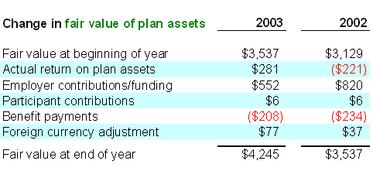
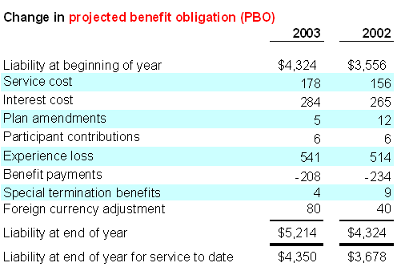
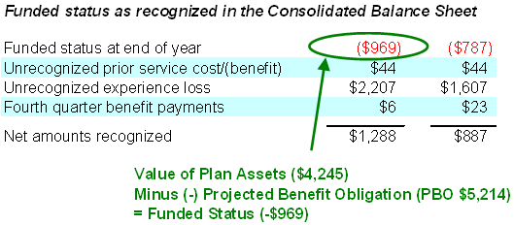
Pension funds – Planned assets / PBO example
© 2008, Cognizant Technology Solutions. Confidential

Slide 28
Pension Funds Accounting – Issues faced
Three things make pension fund accounting complicated
Estimation: The benefit obligation (i.e. future liabilities) is a series of payments that must be made to retirees far into future. Actuaries make estimates about the retiree population, salary increases and other factors in order to discount the future stream of estimated payments into a single present value.
Accruals: Measures the performance and position of a company by recognizing economic events regardless of when cash transactions occur. The current cash inflows/outflows are combined with future expected cash inflows/outflows to give a more accurate picture of a company's current financial condition.
The computation of the annual pension expense is based on rules that capture changing assumptions about the future.
Smoothing: Companies are required to smooth the year-to-year fluctuations in investment returns and actuarial assumptions so that pension fund accounts are not dramatically over/under stated when their investments produce a single year of above/below average performance.
© 2008, Cognizant Technology Solutions. Confidential

Slide 29
Fund Accounting – Alternative Investments
For hedge funds & private equity funds, more than one investors enter into a partnership. This partnership accounting involves following specific issues:
Maintenance of capital accounts of partners: The transactions relating to different partners are recorded in their respective capital accounts.
Ascertainment and allocation of profit/losses: the net profit (after charging interest on capital, partners' salary & commission etc) is to be shared by all the partners in the agreed profit sharing ratio
Adjustment for wrong allocation of profits/losses: After the final accounts have been prepared and the partners‘ capital account are closed, it is found that certain items have been wrongly treated. Necessary adjustments have to be made in the partners‘ capital account to adjust these.
© 2008, Cognizant Technology Solutions. Confidential

Slide 30
Fund Accounting – Alternative Investments
Allocation of profits involving minimum guaranteed profit to a partner: According to this if profit sharing ratio for an investor is less than the guaranteed amount, the deficient amount will be borne by the other partner's in their profit sharing or agreed ratio as the case may be.
Reconstitution of the partnership firm: It may involve the following
  Change in existing profit sharing ratio - as a result of this, some partners will gain in future profits while others will lose. The partner who gains by the change in the profit sharing ratio must compensate the partner who has made the sacrifice.
  Undistributed profits and reserves - distributed among the partners in their old profit sharing ratio.
Dissolution: It can happen both for the firm or partnership
  Partnership - The economic basis of relationship of partners is reconstituted without affecting the entity of the firm which continues to remain in business
  Firm - The business of the firm is closed, assets are sold & realized and liabilities are paid off; all books are closed
© 2008, Cognizant Technology Solutions. Confidential

Slide 31
Fund Accounting system
– Taxation & Accounting standards
© 2008, Cognizant Technology Solutions. Confidential

Slide 32
Taxation
Withholding Tax: Income tax withheld from employees' wages and paid directly to the government by the employer
  Domestic: applied to earned income where the payee might otherwise avoid declaring the income earned, e.g. people working on contract basis
  International: When a payment is made to a party in another country, the laws of the payer's country may require withholding tax to be applied to the payment. e.g. dividend income earned on shares in another country
Double taxation: when two different states impose a comparable tax on the same potential taxpayer on the same taxable item
Pass-through taxation: it allows the income or loss generated by the business to be reflected on the personal income tax return of the owners. This special tax status eliminates the possibility of double taxation.

Slide 33
Tax Heaven
Country that offers individuals and businesses little or no tax liability .e.g. Andorra has no personal income tax, Cayman Islands & BVI have no capital gain tax
Personal residency: wealthy individuals from high-tax jurisdictions relocate themselves in low-tax jurisdictions like Monaco
Asset holding: The company or trust will be formed in one tax haven and administered in another. By changing the ownership of the assets into an entity which is not resident in the high-tax jurisdiction, they cease to be taxable in that jurisdiction.
Trading and other business activity: businesses which do not require a specific geographical location or extensive labour e.g. reinsurance companies in Bermuda
Financial intermediaries: funds are deposited with the intermediary in the low-tax jurisdiction and the intermediary then on-lends or invests the money. e.g. in case of mutual funds and pension funds
  Special Purpose Vehicles: Can be formed to benefit from tax, mask identity of investors, bypass certain regulations
© 2008, Cognizant Technology Solutions. Confidential

Slide 34
Mutual Funds – Tax treatment
Four types of investment income for Mutual Funds (MF):
Interest income: earned from a debt security such as a bond. Fund distributes its net interest income to unit holders, who are taxed on this at their personal tax rate.
Dividend income: This income is subjected to pass-through tax treatment. MF generally distributes all of its earnings each year and is taxed only on amount it retains
Foreign investment income:
  When an investor receives income from foreign sources, tax is withheld at source, hence, taxable unit holders are allowed to deduct foreign tax paid on their tax return.
  Double Taxation: Countries have DTAA (Double Taxation Avoidance Agreements) signed so as to avoid income getting taxed at the source (foreign) as well as home location
© 2008, Cognizant Technology Solutions. Confidential
Notes:
Pass-through taxation allows the income or loss generated by the business to be reflected on the personal income tax return of the owners. This special tax status eliminates the possibility of double taxation.
Under current US law partnerships, S Corporations (small business corporations) and most LLCs qualify for pass-through tax status.

Slide 35
Mutual Funds – Tax treatment
Capital gains income:
  From the sale of units of a mutual fund: Unit holders are taxed on their personal net realized capital gains (difference between the market value of fund units bought & sold)
  Included in fund distributions: The fund will distribute its net realized capital gains (i.e., gains offset with losses) along with net income from interest, dividends and foreign investments.
Return of capital (ROC): It is portion of an individual/institution's investment given back. These distributions are not taxable
The Effect of Distributions on Unit Prices:
  When distribution is paid, the NAV per unit of the fund will fall by an amount equal to the distribution per unit.
  The value of the unit holder’s account (i.e. value of his investments) remains same as he will receive either a cash distribution or additional units of the fund.
© 2008, Cognizant Technology Solutions. Confidential

Slide 36
Pension Funds – Tax treatment
Pension Fund Taxation (UK)
Lifetime Allowance of £1.5 million for the amount of pension savings eligible for favourable tax treatment
Tax-free cash sum - tax regime allows members to take a tax-free lump sum of up to 25 per cent of the value of their pension on retirement (lifetime allowance)
If total retirement benefits are above the limit, excess will be subject to a Lifetime Allowance Charge of 25%
The maximum personal contribution eligible for tax relief will be 100% of earnings subject to an upper limit of £215,000
© 2008, Cognizant Technology Solutions. Confidential

Slide 37
Hedge Funds – Tax treatment
Taxation depends on the nature of entity (fund) incorporated:
Funds structured as U.S. partnerships (or foreign funds electing to be taxed as a U.S. partnership): These do not pay any U.S. income tax at the fund level, but must pass-through the fund’s income to the respective partners (the investors). These are required to file an annual fund level return with the IRS (Form 1065)
Offshore fund (treated as a corporation and not a partnership for U.S. income tax purposes): Investor is subject to tax under the passive foreign investment company (PFIC); investors can elect to:
  Defer their tax obligation: Investors taxed when they receive distribution or when they sell shares. In this case, income may be subject to significant deferred tax
  Current period taxable income inclusion: Investors must capture their share of the PFIC’s ordinary earnings and capital gains-regardless of whether a distribution is received.
© 2008, Cognizant Technology Solutions. Confidential

Slide 38
Fund Accounting – Taxation methods
Specific Share Identification | Dealer sells specific shares bought on specific dates, the cost of those specific shares becomes basis. Normally, shares with the highest basis are sold in order to minimize any taxable gain
First In-First Out | It is assumed that the first shares bought are the first shares sold. In a rising market, this yields the highest gain. Most of the funds incorporated have their mandates stating to use FIFO.
Last In-First Out | It is assumed that the shares bought last are the first shares sold. This strategy helps optimising taxes.
Average Basis | Total cost is taken and divided by the total number of shares held to get the average cost per share. Then multiply the per-share average cost by the number of shares sold. Average basis can be computed using: Single category method - long and short-term gains are not distinguished Double category method - long and short-term gains are separated
© 2008, Cognizant Technology Solutions. Confidential
Notes:
Single-category method: First, add up the cost of all the shares you own in the mutual fund. Divide that result by the total number of shares you own. This gives you your average per share. Multiply that number by the number of shares sold. You may have both short and long term gains or losses. Use the FIFO method to determine your holding period.
Double-category method: First, divide your shares into two categories, long-term and short-term. Then use the steps above to get an average basis for each category. The average basis for that category is then the basis of each share in the sale from that category.

Slide 39
Fund Accounting – Taxation methods
Tax Lots: These trace the dates of purchase and sale, cost basis, and transaction size for each security in portfolio. In Partnership Accounting, to ensure an equitable allocation of gain to each partner, following approaches are taken into consideration:
Tax Lot Layering:
It tracks each partner’s ownership in each tax lot. Realized gains on a particular lot are allocated in direct proportion to the unrealized appreciation each partner earned. This method creates an underlying unrealized gain/loss account for each partner's pro-rata share of each investment held by the partnership.
Aggregate Allocation
This method takes into account a partner’s share of any unrealized appreciation or depreciation within the partnership’s overall portfolio. This method does not require the tracking of partner ownership in each lot.
As the number of partners increase, the number of calculations required to layer and allocate each tax lot increase.
© 2008, Cognizant Technology Solutions. Confidential

Slide 40
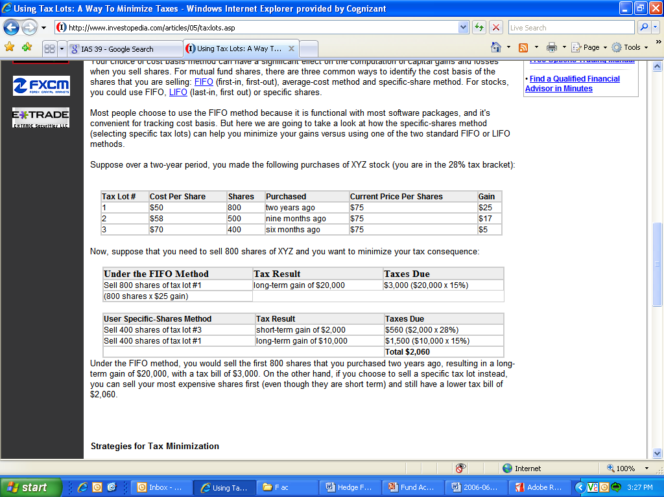
Fund Accounting – Taxation example
Tax lots can be used to minimize the net present value of current taxes by deferring the realization of capital gains and recognizing losses sooner. Taxation can use LIFO, FIFO, average-cost method, specific-share method etc. Following example illustrates how using tax lots, tax on realized gains be minimized.
Suppose over a 2 period, we made purchases of XYZ stock
(28% short-term and 15% long tern tax bracket):
If we need to sell 800 shares of XYZ and we want to minimize your tax consequence
© 2008, Cognizant Technology Solutions. Confidential

Slide 41
Tax Reporting
Form 1065 Reporting | Each fund is required to file an informational tax return on Form 1065
K1 Reporting | In order for a partner to know what its share of taxable income is, partnership must prepare a Form 1065, which includes individual Schedule K-1s (“Partner’s Share in Income, Credits, Deductions, etc.”) and provide to the respective partners.
W-8 BEN Reporting | If a US domestic fund has foreign partners, withholding requirements may arise. Generally, the income which is subject to withholding tax is withheld at a rate of 30% on US dividends (unless reduced by treaty)
PFIC Reporting | It will arise when a US taxable investor invests in a foreign feeder or a foreign fund
© 2008, Cognizant Technology Solutions. Confidential

Slide 42
Accounting standards
The accounting and reporting for the transactions/trades is carried out as per the following prevailing accounting standards:
IAS 32 Financial Instruments: Disclosure and Presentation
  IAS 39 requires that all assets and liabilities be classified into one of five categories, which dictate the accounting treatment, as shown in the table on next slide. Items are measured either at fair value, or at amortized cost so as to record a constant effective yield.
IAS 39 Financial Instruments: Recognition and Measurement guidelines
  A financial asset or liability is recognized when the entity becomes a party to the instrument contract
  A financial liability is de-recognized when the liability is extinguished i.e. contractual rights to the cash flows from the asset expire or entity transfers all the risks or entity transfers the asset
© 2008, Cognizant Technology Solutions. Confidential

Slide 43
Accounting standards – FAS No. 157
Financial Accounting Standards (FAS) 157: Guidelines used for pricing the shares using a market-based approach
Level 1 inputs — quoted price in an active market provides the most reliable evidence of fair value
Level 2 inputs — observable inputs other than quoted prices. Observable inputs are developed based on market data obtained from sources independent of the investment company
Level 3 inputs — These inputs are unobservable inputs based primarily upon the investment company’s assumption on the assumptions that market participants would use in pricing an asset. It is of least priority amongst the 3 levels of inputs
© 2008, Cognizant Technology Solutions. Confidential

Slide 44
OTC Derivatives Accounting standards
FAS 133 standards and rules are based upon the following standards
  FAS 52 – Foreign Currency Translation
  FAS 80 – Accounting for Futures Contracts
  FAS 105 – Disclosure of Information about Financial Instruments with Off-Balance-Sheet Risk and Financial Instruments with Concentrations of Credit Risk
  FAS 119 – Disclosure about Derivative Financial Instruments and Fair Value of Financial Instruments
  FAS 107 – Disclosures about Fair Value of Financial Instruments
© 2008, Cognizant Technology Solutions. Confidential

Slide 45
Fund Accounting system
– Process IT Model
© 2008, Cognizant Technology Solutions. Confidential

Slide 46
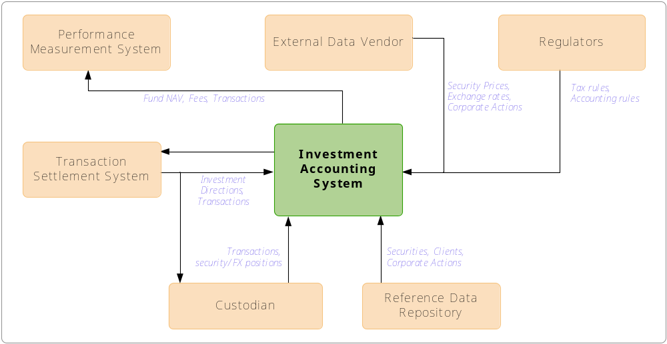
Fund Accounting – Process IT model
Eco System: The Investment accounting application will be interacting with various external entities for the purpose of information and data exchange.
© 2008, Cognizant Technology Solutions. Confidential

Slide 47
Fund Accounting – Process IT model
The Investment Accounting application receives/send information, data from –
Internal: Global Reference Data
External: Market data vendors, investment manager, corporate applications such as websites, MIS, third parties, etc.
Transaction Settlement System:
All transactions / investment directions are triggered by Fund Manager. The accounting system keeps track and generates NAV, taxes, fees. This information is passed to the fund manager for performance monitoring purpose.
Market Data Vendors:
For the Investment Accounting application, market data vendors provide security prices, exchange rates and also provide corporate actions data for adjusting relevant
accounting records.
© 2008, Cognizant Technology Solutions. Confidential

Slide 48
Fund Accounting – Process IT model
Reference Data Repository:
Static data such as security information, client information, third party and organization information etc. is usually maintained in a central reference data repository.
Performance Management System:
The accounting system holds the key data that is generated or maintained as part of the portfolio management function including accounts, portfolios, trades, cash flow transactions, fees and expenses, funds, NAVs etc. These data are the key input for performance calculations.
Regulators:
The regulators (like the IRS) provide the rules and guidelines for accounting and tax calculations.
Custodian:
Custodian holds stocks, bonds and other securities; related services include the collection of income on custodial securities, the settlement of transactions and the investment of cash overnight.
© 2008, Cognizant Technology Solutions. Confidential

Slide 49
Sample eco-system & trade flows
Order management system
Fund Administrator
Custodian
Trade matching / settlement
Corporate Action Mgt
Clients
Accounting Platform
Market Data Vendors
Data Repository
Performance
and Client Reporting
Risk Management
Tools
Counterparty
Internal system
External system

Slide 50
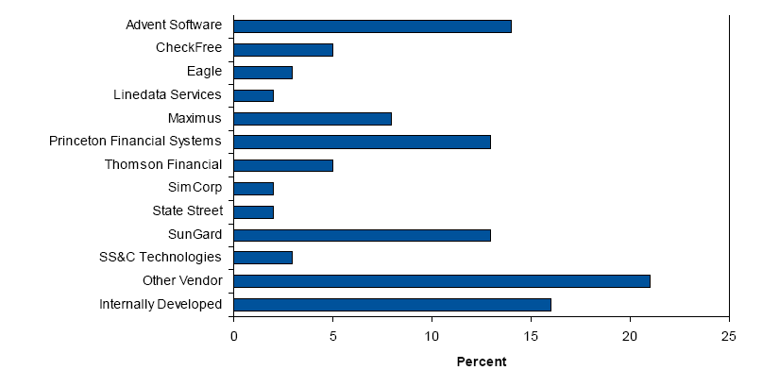
Fund Accounting products
Firm | Portfolio a/c product
Advent | Geneva, Axys
State Street | PAM
Eagle | Eagle PACE, Eagle STAR
Sungard | InvestOne, InvesTier, Investran
Market share:
© 2008, Cognizant Technology Solutions. Confidential

Slide 51
Appendix I: Pricing methodologies & sources
© 2008, Cognizant Technology Solutions. Confidential

Slide 52
Process Overview – Valuation
Asset Type | Valuation Methodology
Insurance Contracts and Short Term Assets (maturity is less than one year) | Book Value Alternatively, internally generated Matrix Pricing can be used for pricing (Eurodollar CDs, Banker Acceptances, Commercial Paper, T-Bills, FNMA/FHLMC, Other US Government obligations and Short-term municipals maturing within a year of issue)
US Fixed Income Assets | Bears Stearns evaluated prices (i.e. matrix prices) are derived using a benchmark security and a spread in basis points. The benchmarks (typically Treasuries or bellwether corporate issues) are updated real-time and reflect market conditions throughout the day. The spreads are assigned by Bears Stearns traders and are adjusted as market conditions change.
US Corporate Bonds | Bears Stearns evaluated prices. Corporate bond evaluations typically reflect the market as of 2.30 pm EST.
US Government Securities | Closing prices of US Treasuries as of 3.00 pm EST (Bear Stearns)
US Mortgaged Backed Securities | Bear Stearns Matrix/Seasoned Prices
© 2008, Cognizant Technology Solutions. Confidential

Slide 53
Process Overview - Valuation
Asset Type | Valuation Methodology
US Private Placements | Bear Stearns prices
US CMO’s and Asset Backed Securities | Priced based on evaluation model. The evaluation model considers factors such as underlying collateral characteristics, prepayment speed assumption, average life and benchmark spreads.
US Municipals | Prices supplied by JJ Kenny
Listed US Equities and Close-end funds | Composite close price i.e. avg. close price in all exchanges where the security is traded. In case a security is not traded on any particular day, the mean of the current bid and ask prices is used
Non-NASDAQ over the counter US Equities | Current bid price; if current bid weren’t available consider ask price
US Options | Last traded price, if the price falls between current bid and asked. If the last traded price is less than current bid, the bid price is considered official. If it is higher than the current ask price, the ask price is the official price. If the security did not trade, the mean of current bid and ask is the official price. If only a bid or an asked price is available for an option, the price is reviewed by the firm.
© 2008, Cognizant Technology Solutions. Confidential

Slide 54
Process Overview - Valuation
Asset Type | Valuation Methodology
UK and Other International Markets | For UK assets, the latest Jobber quote price or mid price is the official price. For non-UK, non-Canadian assets, the local exchanges reported price (latest available) is the official price.
Canadian Equities | The last available traded price or current bid from a local exchange. If the security is listed in more than one exchange it is priced based on volume or an exchange hierarchy (if no trading occurred).
Canadian Bonds | Priced by FRI evaluation model.
Over the counter International assets | Priced by IDC, Telesphere or FRI through their pricing contracts in the local markets or through Reuters contributor pages.
Over the counter Currency Options | Priced using Black-Scholes pricing model. This model takes into consideration the Option strike price, expiration date, market risk free rates and applicable volatilities.
Back
© 2008, Cognizant Technology Solutions. Confidential

Slide 55
Pricing sources example
Security Type | Official Vendor* | Other Vendors
Fixed Income Pricing - U.S.
Corporate Bonds Government Bonds | Bear Stearns | IDC Bloomberg Brokers Prudential American Securities
Mortgage-Backed ARMS | Bear Stearns | Bloomberg
CMO’s Asset Backed Securities | IDC Trepp Bear Stearns Street Software Technology, Inc. | Brokers Prudential American Securities Bloomberg
Municipals | J.J. Kenny (via Bear Stearns) | IDC
Treasury/GNMA Options | Bloomberg
Private Placements | Bear Stearns | Prudential American Securities
* generally accepted
© 2008, Cognizant Technology Solutions. Confidential

Slide 56
Pricing sources example
Security Type | Official Vendor* | Other Vendors
Equity Pricing – U.S. | IDC (includes exchange traded equity options)
Futures/Options on Futures | Reuters | Bloomberg
Open Ended Funds | IDC | Reuters Bloomberg
International Pricing | IDC Telesphere Reuters | FRI Corporation Morgan Stanley Bloomberg Financial Times
International Pricing - Canadian | FRI Corporation | Reuters Bloomberg IDC Telesphere Morgan Stanley Financial Times
Foreign Exchange Rates | Reuters | Bloomberg Morgan Stanley (WM Rates)
* generally accepted
© 2008, Cognizant Technology Solutions. Confidential

Slide 57
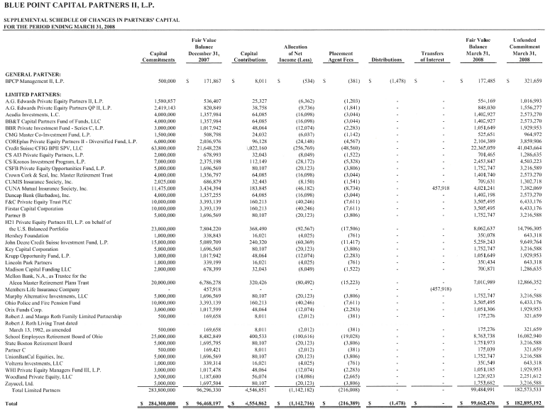
Pricing sources – PCAP from underlying fund
SAMPLE
Back

Slide 58
Appendix II: Interest Accrual methods
© 2008, Cognizant Technology Solutions. Confidential

Slide 59
Interest Accrual
Interest Accrual Class | Description | Formula
Class 00- No auto Accrual | No interest accruals are generated /posted by the system | Daily accrual amount = 0
Class 01- Actual/actual | This interest accrual class is primarily used for interest computation on treasury bonds | Daily accrual amount = (units * rate) / payments per year pay period end date - pay period start date where, Units = outstanding positions Rate= interest/income rate Payments per year = derived from payment frequency Pay period end/start date = derived from accrual dates
Class 02- Actual/366 | For interest computation on foreign bonds | Daily accrual amount = (units * rate)/ 366
Class 03- 30/360 day basis | For interest computation on corporate bonds | Daily accrual amount = (units * rate)/360
Class 04- actual receipts | No automated interest accrual, accounted on receipt basis | Daily accrual amount = 0
Class 05- Actual/360 discount | For interest income for discounted bonds | Daily accrual amount = (Discount amount)/ (Maturity date – Settlement date) where, Discount amount = Redemption value (par value * holdings) – Purchase cost
© 2008, Cognizant Technology Solutions. Confidential

Slide 60
Interest Accrual
Interest Accrual Class | Description | Formula
Class 06- Actual/360 | For interest accrual on interest bearing notes | Daily accrual amount = (units * rate)/ 360
Class 07- effective yield | For interest accrual on interest bearing notes bought at a discount. For these types of bonds no amortization is done | Daily accrual amount = (Units * effective yield)/ 360 where, Effective yield = discount rate + rate Discount rate = (Discount amount * 360)/ [(Units - discount amount) * (maturity date – settlement date)] Discount amount = (units – purchase cost)
Class 08- Actual/365 | This method too is commonly used for interest accrual on foreign bonds | Daily accrual =(units * rate)/365
Class 09- 30/360/actual | Interest is calculated on a 30/360 day basis, but the accrual amount is equally spread over the actual amount of days in the pay period. This accrual class is used for accruing interest income on corporate bonds | Daily accrual amount = (Units * rate * pay period days) / {360*(actual pay period days)} where, Actual pay period days = next interest payment date - last interest payment date
© 2008, Cognizant Technology Solutions. Confidential

Slide 61
Interest Accrual
Interest Accrual Class | Description | Formula
Class 10- actual/365 equal payments | These types of accruals are processed for Canadian bonds The annual interest is divided by 365 to compute the daily accrual Adjustment made at the end of each semi-annual pay period An adjustment is also made on day 183 of a 184 pay period to actually back off 1/2 day’s accrual to bring the amount to 181.5 days of accrual. | Daily accrual amount = (units* rate)/ 365
Class 11- calendar spread 30/360 | Interest is calculated on a 30/360-day basis but is then spread out over the actual amount of days in the month | Daily accrual amount = [(units * rate* 30)* days in month]/360
Class 12- 30e/360 | Under this method, the interest is calculated on a 30/360 day basis and interest is accrued 30 days per month, but months with 31 days do not accrue on 30th of the month and three days of accruals are done on February 28th and two days of accruals are done on February 29th (for leap year). | Daily accrual amount = (units * rate)/360
Back
© 2008, Cognizant Technology Solutions. Confidential

Slide 62
Appendix III: Fund Accounting terminologies
© 2008, Cognizant Technology Solutions. Confidential

Slide 63
Fund Accounting – terminologies
Entities description:
Asset Class - A specific category of assets or investments is referred to as asset class. Examples of asset class include Equity, Fixed Income, Cash, Real Estate, Convertibles etc.
Security - Security is a generic term used for all financial instruments in which investment can be made. Each security has a unique global identifier (such as CUSIP, ISIN, SEDOL) and belongs to one Asset Class (specific Issue Type too).
Portfolio - Portfolio is a list of constituent securities, a basket of investments designed to achieve certain investment goals for the investor. It may represent a fund or account.
Share Class - A management company can issue multiple classes of shares/units under a single Fund. Typically share classes, are differentiated by the charging structure, income distribution methodology and other factors.
© 2008, Cognizant Technology Solutions. Confidential

Slide 64
Fund Accounting – terminologies
Holdings
Holdings entity represents actual positions or investments that constitute a portfolio, in the form of securities, derivatives and currencies (cash). e.g. Cash Holdings and Security Holdings.
Transaction
This captures the changes to the portfolio. The changes could be either because of market transactions (buy or selling securities) or off-market transactions (move securities from another account) or book-keeping transactions (deposit/withdrawal of cash and securities) which could be triggered by many reasons such as contributions, booking of fees, corporate actions, interest income, dividend reinvestment, and so on.
Movement
A Movement involves flow of cash or security in or out of a holding. A Movement is caused by a transaction.
© 2008, Cognizant Technology Solutions. Confidential

Slide 65
Fund Accounting – US Processes
NAV calculation: In US, Section 2(a) of the Investment Company Act 1940 governs NAV calculation and reporting.
Multi-class share accounting (sector and class allocations): For funds issuing different share classes to investors, share class level pricing, accounting and disclosure is mandatory
SEC yield: Also known as standardized yield, this yield figure reflects the dividend and interest earned during the period of accounting. This yield gives the effective rate of interest that and investor can receive in the future. It also provides a measure of fair comparison of bond funds
529 Plan: It is a tax advantaged savings plan legally known as qualified tuition plans which are designed to encourage savings for future college costs. Such funds are governed by Section 529 of the Internal Revenue Code.
© 2008, Cognizant Technology Solutions. Confidential

Slide 66
Fund Accounting – US Processes
Tax equalization: This is very important for cross border funds and funds trading in international asset. The fund is required to pay the tax differential across different countries while charging the domicile country tax rates to the clients, ensuring that the clients are charged a single tax rate irrespective of the different country assets traded by the fund.
Fair value pricing: According to Financial Accounting Standards 157, funds are expected to price the shares using a market-based approach. Such calculation requires use of market information from transactions of similar assets in a principal market.
Stable value/traditional GICs: Stable Value funds forms a part of qualified retirement plans (401(k) plans) that protects principal and accumulated interests and provides penalty free liquidity. Guaranteed Income Contracts are Stable value products offered by insurance companies, which guarantees a principal payment and a fixed or floating interest payment to the investor. Such funds are governed by the pension investments regulations.
© 2008, Cognizant Technology Solutions. Confidential

Slide 67
Fund Accounting – US Processes
NAV trial balance: At the end of every reporting period it is to be ensured that the ledger entries (buy or sell of assets) in the funds books are mathematically correct.
Shareholder reports: Mutual funds are expected to provide Quarterly Shareholder’s reports and Portfolio Disclosures to its shareholders.
Rule 2a - 7 processing: This rule of the Investment Company Act of 1940, regulates the share price calculation of Money Market funds using the Amortized Cost method or Penny Rounding method and also governs the required procedure for each of this method of calculation.
© 2008, Cognizant Technology Solutions. Confidential

Slide 68
Accounting standards – IAS 32
Category | Description | Measured At Value | Measured at Amortized cost
Loans & Receivables | Unquoted loan, whether originated or acquired, where there is no intent to sell the asset in the short term |  | 
Held to Maturity (“HTM”) | Debt Assets acquired by the entity, to be held to maturity |  | 
Held ‘at fair value through profit and loss’ (‘FVP”) | All Derivatives (except for those eligible for hedge accounting). Other items intended to be actively traded. Any item designed as such at the origination, including liabilities. |  To P&L | Record at cost if fair value cannot be reliably measured (very limited use only for unquoted equity instruments and derivatives thereon)
Available for sale (“AFS”) | All assets not in the above categories | To equity-unless impaired-but interest is recorded in P&L based on the asset’s effective yield | Record at cost if fair value cannot be reliably measured (very limited use only for unquoted equity instruments and derivatives thereon)
Non Trading Liabilities | Other Liabilities |  | 
© 2008, Cognizant Technology Solutions. Confidential

Slide 69


Thank you
© 2008, Cognizant Technology Solutions. Confidential

