Slide 1

LPU Courier Finder

Slide 2
INTRODUCTION:
“LPU Courier Finder” is one of the most reputed and fast growing courier services to our clients.
Our services are widely acknowledge for their features like time saving and very efficient in use.
Sending the courier across the internet and no need to visit anywhere.
The system is used for daily activities such as track courier etc.

Slide 3
WHY THIS APPLICATION?:
If you have ordered any product online it will reach to the unimall.but the students are not aware that it is reached or not.
WORKING OF THE PROJECT:
There are end users they will be able to login via there details and after it service providers will feed the data and customers can track whether the product has reached to the destination or not.
ADVANTAGE:
Customers can get the details of product at their place instead of visiting unimall.

Slide 4
MAJOR MODULES:
There are some main modules in the project which are further classified into different sub-modules that are.
Login Module
1. Customer
2. Service provider
Sign In Module
Courier Module
1. Track Courier
2. Add products

Slide 5
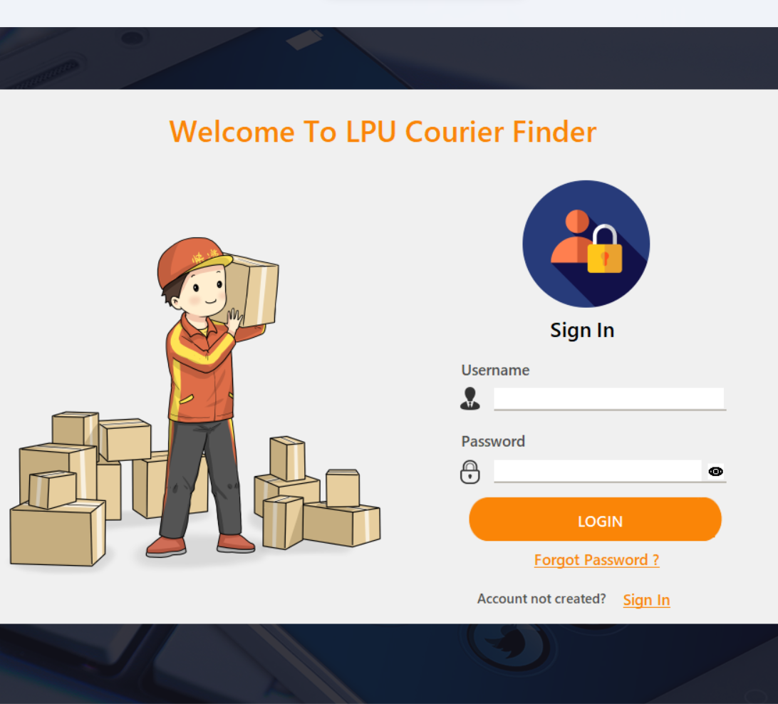
Login page:
If you are already a customer of service provider then you can directly login by providing your credentials. And if you are a new user here so simply you can go through sign in and then you can create your account on this platform.

Slide 6
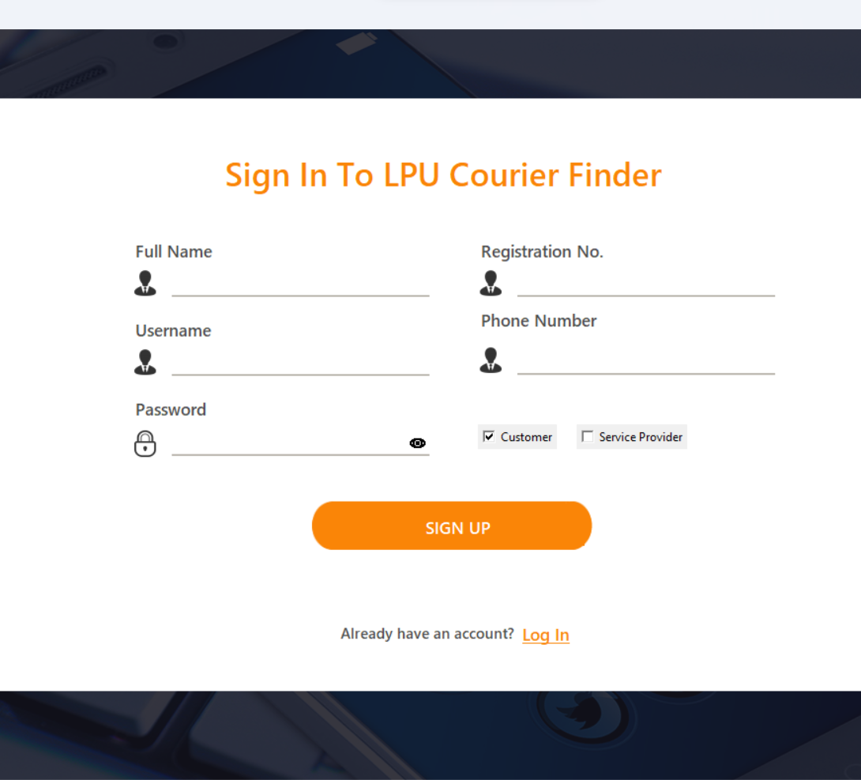
Sign In page:
From this sign in page you can create a new account on this platform by providing your details like reg. no., ph. no., username etc. Or if you are already a user then you can go to login page. By doing this step you will be able to use this application otherwise not.

Slide 7

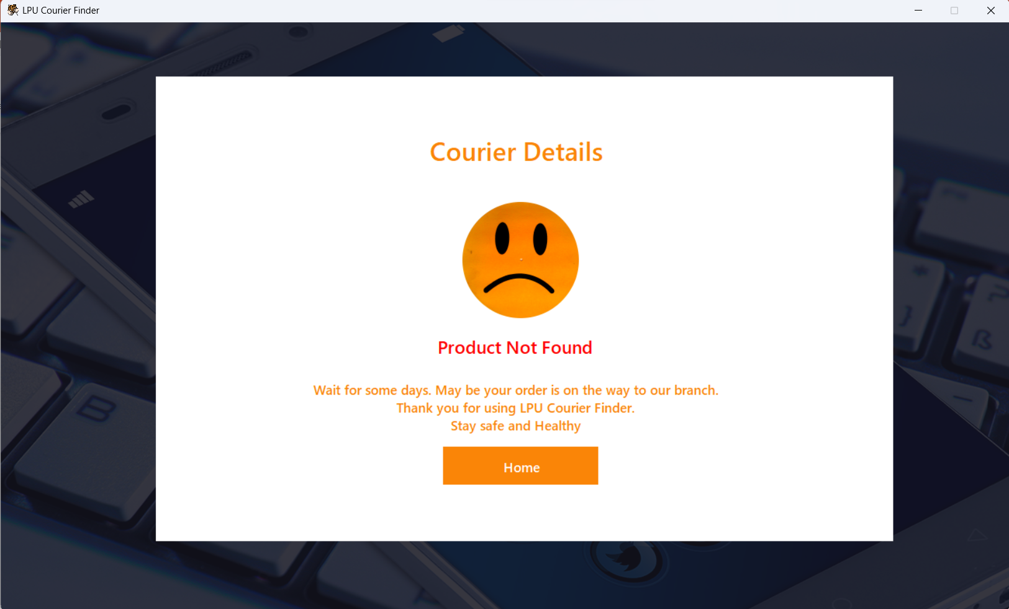
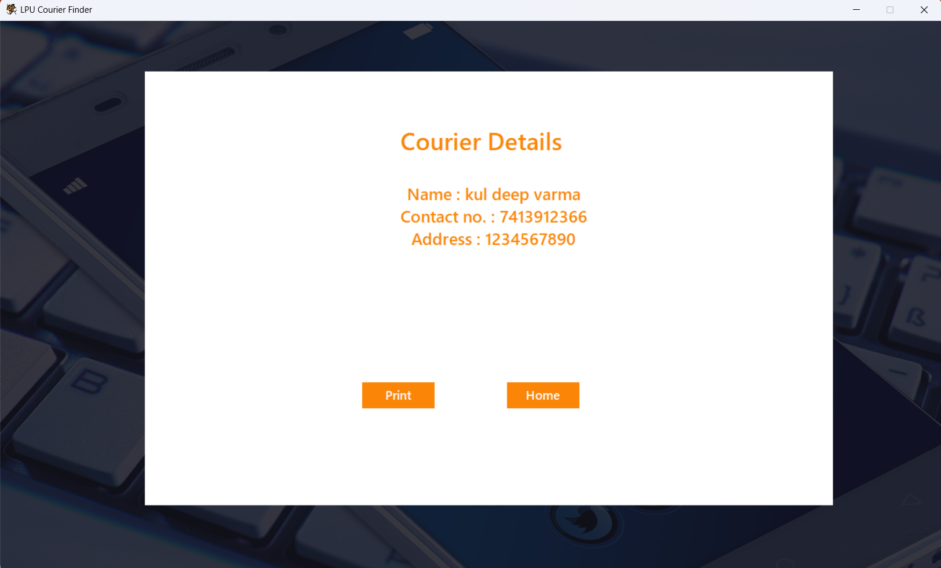
Customer side view:
After login or sign in as a customer you will come on home page (pic-1), here you are requested to provided full order id and phone no to search your product in unimall. If your product will found then you will get to know details of product (pic-3) otherwise you will be requested to wait for some time (pic-2).

Slide 8
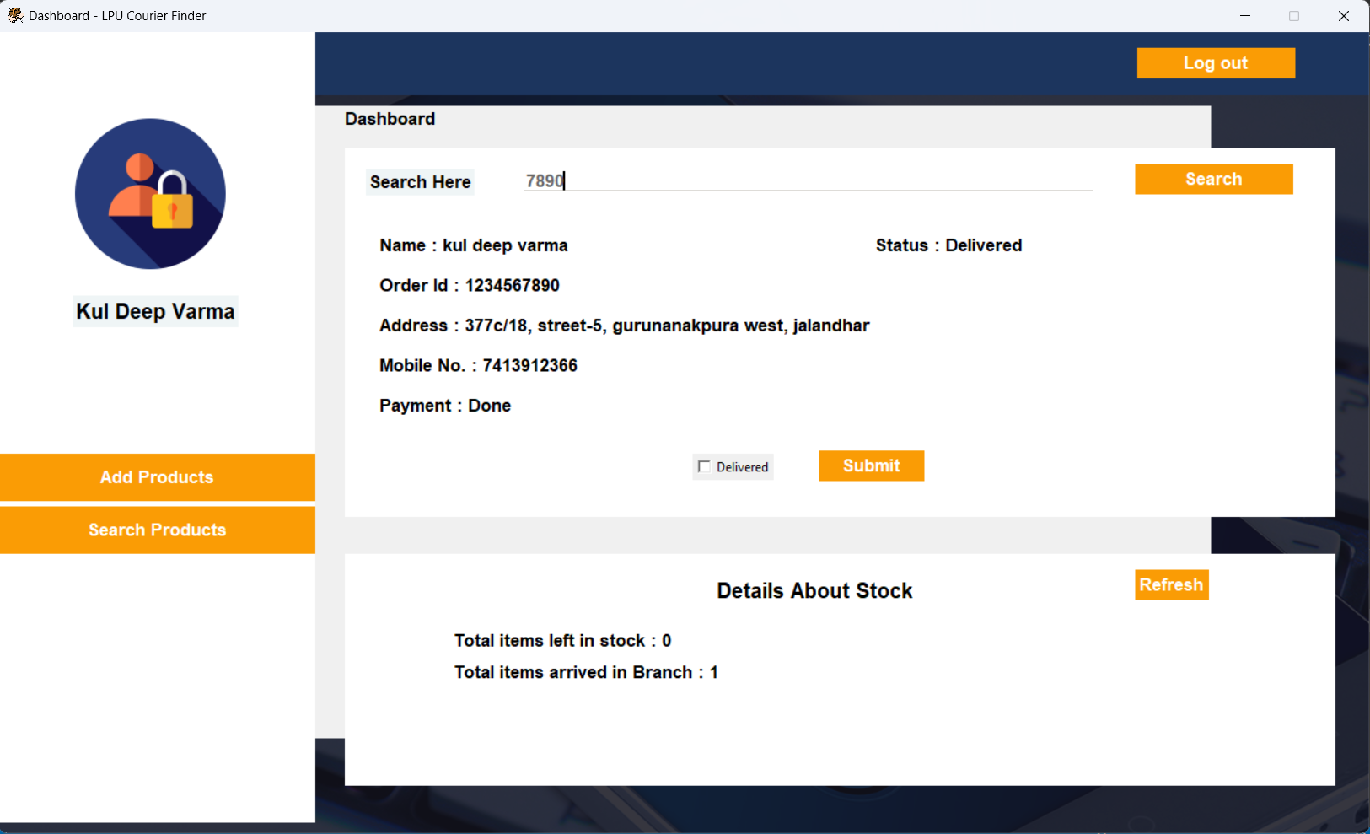
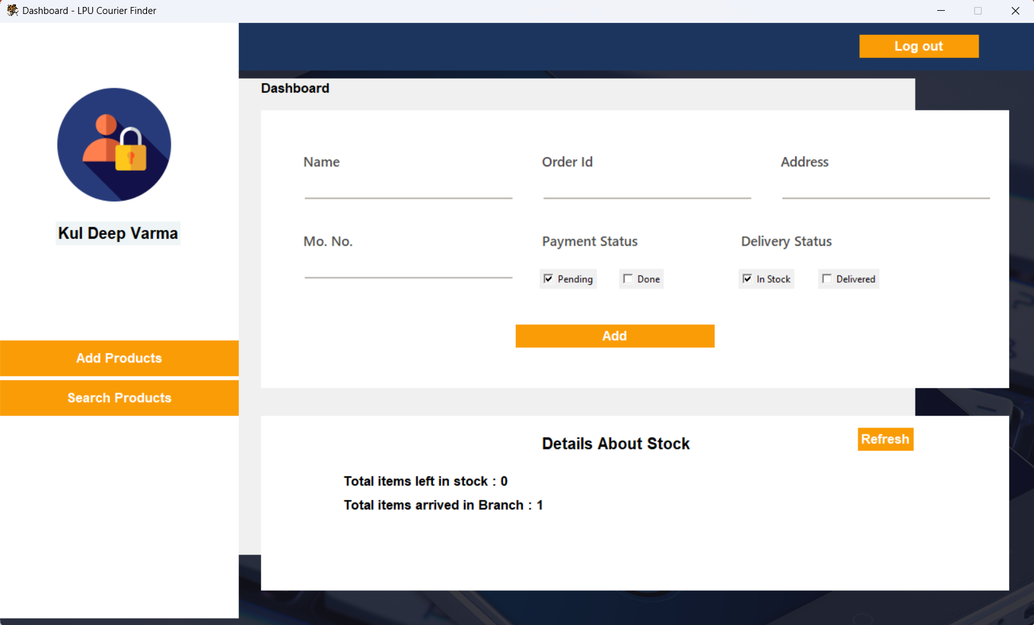
Service Provider side view:
This is service provider side preview, here you can search product by providing full or last digits of product id and will get details if product is in stock otherwise an window will let you know that product in not in stock. If product found then you can change delivery status as delivered by clicking on delivery and submitting that (pic-1). Another side you can add products to the server (new arrived products, pic-2).

Slide 9
THANK YOU

