Slide 1
Directions: Read the following information carefully and answer the questions given beside.
Certain number of persons (that does not exceed 15) are standing in a straight linear row facing towards the north. 5 persons stand between B and E, who is third to the left of A. U is to the right of A. Not more than 3 persons stand between U and T. B is third to the left of U. I is fifth to the right of T. 2 persons stand between E and F, who is sitting at the extreme left end of the row.. Three persons stand between A and L, who is towards the right of E.
How many persons are standing in the row?
A.15
B.13
C.14
D.12
Notes:
C

Slide 2

Solution :

Slide 3
Directions: These questions are based on the following information, read the comprehension carefully to answer the given questions.
Eight people A, B, C, D, E, F, G and H are sitting around a circular table but not necessarily in the same order. Some are facing inside and some are facing outside. Not more than two people facing same direction are sitting together. H sits third to the right of C who is not facing outside. Immediate neighbors of H are facing same directions with respect to each other but opposite direction with respect to H who is facing inside. B is the immediate neighbor of E and both are facing same direction. E sits second to the left of C who is not the immediate neighbor of B. There are equal number of persons facing inside and outside direction. B sits third to the left of A and both are facing opposite directions to each other. H sits to the immediate right of D. F sits second to the left of G.

Slide 4
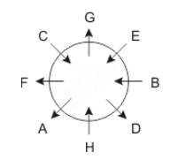
Solution :

Slide 5
Directions: Read the given information carefully and answer the questions given beside:
Seven friends B1 to B7 celebrated their birthday on different dates of same month. The date of the month is consecutive multiple of 4. B1 celebrated his birthday immediately before B4. Neither B5 nor B6 celebrated their birthday on 28th of the month. The difference between the days of B6 and B4 to celebrate their birthday is 12. No one celebrated their birthday between B2 and B5, who celebrated his birthday after B2. At most two people celebrated their birthday after B6. B3 celebrated his birthday after B7, who doesn’t celebrate his birthday before B1.

Slide 6
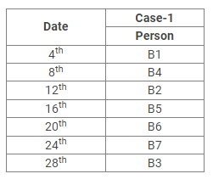
Solution :

Slide 7
Directions: These questions are based on the following information, read the comprehension carefully to answer the given questions. Six boxes are placed one above another and they all are Z, Y, X, W, V and U but not necessarily in the same order. All the boxes are having different number of chocolates in the range of 11 to 40.
There are only two boxes kept above the Z box. Only one box is kept between the Z box, which contains even-number chocolates but less than 15 and the box containing 12 chocolates which is placed at top. The X box, which contains 21 chocolates, is kept immediately above the V box. The difference between the number of chocolates in the Z and V box is 5 and there are one box between them. There are two boxes kept between the box Y and the box X. Box Y is kept at one of the places above box W which is not placed at bottom. Box U and W has odd number of chocolates above 30 with a difference of 8.

Slide 8
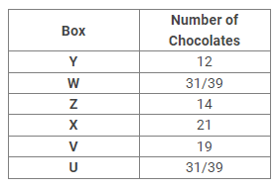
Solution:

Slide 9
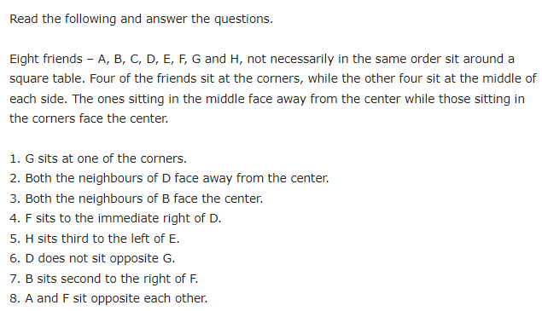

Slide 10
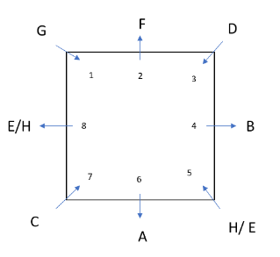

Slide 11
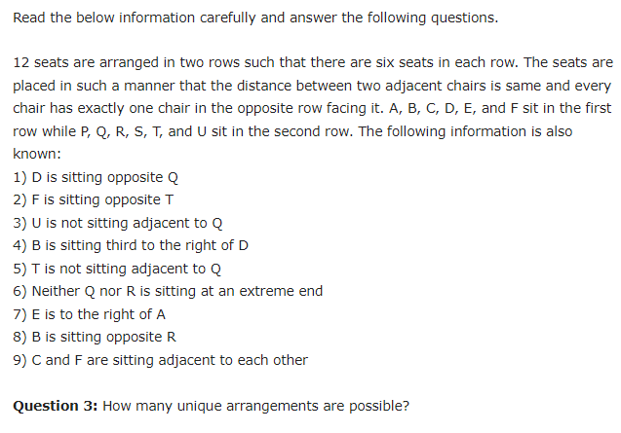

Slide 12
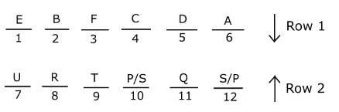

Slide 13
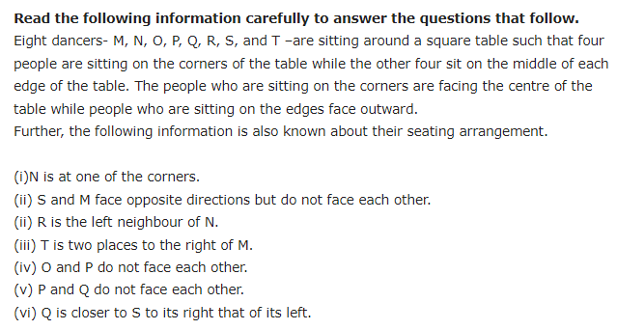

Slide 14
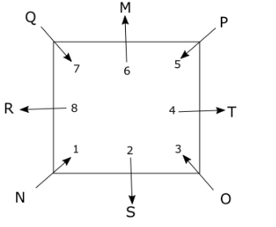

Slide 15
1) Statement
Only a few Ant is Bee
Some Bee is Bug
All Bug is Fly
Conclusion
I) Some Bee is Fly
II) Some Bug can be Ant
a) Only I follows
b) Either I or II follows
c) Only II follows
d) Both I and II follow
e) Neither I nor II follows
Notes:
D

Slide 16
2) Statement
Only a few Flea is Grub
All Grub is Tick
No Tick is Wasp
Conclusion
I) All Flea can never be Wasp
II) Some Grub can be Wasp
a) Only I follows
b) Either I or II follows
c) Only II follows
d) Both I and II follow
e) Neither I nor II follows
Notes:
A

Slide 17
3.tatements:
No apple is a plum.
All plums are oranges.
All oranges are mangoes.
Conclusions:
I. All plums are mangoes.
II. At least some mangoes are oranges.
Notes:
Both follows

Slide 18
4. Statements: All animals are mammals. No mammal is reptile. All reptiles are amphibians. Conclusions: I. All animals are amphibians. II. Some amphibians are mammals.
Notes:
None follows

Slide 19
5. Statement: Some schools are classes. Some classes are teachers. All teachers are students. Conclusions: I. Some students are classes. II. All schools being students is a possibility.
Notes:
Both follows

Slide 20
6. Statements: Some buses are cars. No car is ship. All ships are bikes. Conclusions: I. Some buses are not bikes. II. No bike is ship.
Notes:
None follows

Slide 21
7. Statements: All cups are saucers. All plates are cups. Some saucers are spoons. Conclusions: I. All plates being spoons is a possibility. II. All plates are not saucers.
Notes:
Only I follows

