Slide 1
TRADE BUDDY

Slide 2
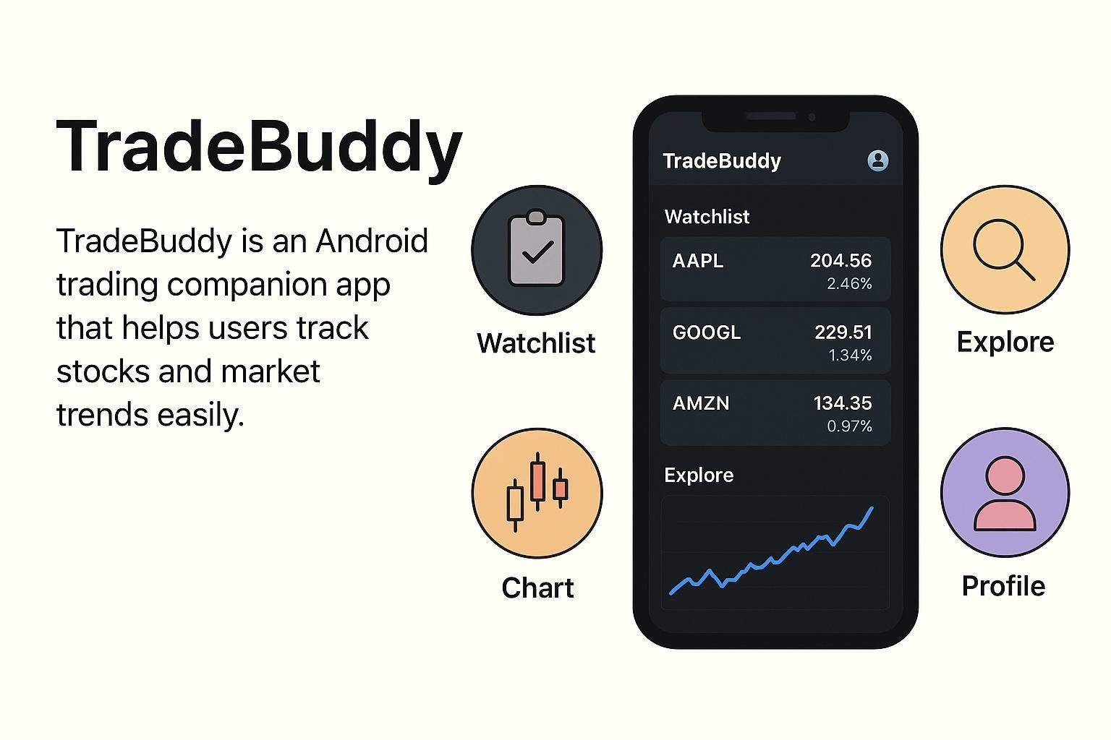
Introduction
TradeBuddy is an Android app designed to help users easily track stocks, view real-time charts, and read market news. It provides a simple and secure platform using Firebase for login and Firestore for storing user data. With features like a watchlist, live charts, and a clean user interface, the app makes stock monitoring fast, convenient, and user-friendly.

Slide 3
Purpose
The purpose of the TradeBuddy system is to provide users with a simple, reliable, and interactive platform for tracking stock market information. The system is designed to help both beginners and regular traders make informed decisions by offering essential trading tools in one place. TradeBuddy simplifies market monitoring by combining live stock charts, personalized watchlists, and the latest financial news into an easy-to-use Android application.

Slide 4
Existing System & New system
In the existing system, users rely on multiple apps and websites to check stock prices, view charts, read news, and manage watchlists. Switching between different platforms is inconvenient and makes trading information harder to access in one place.
The new system, TradeBuddy, provides all trading tools—live charts, watchlists, and market news—in one easy-to-use Android app. It gives users real-time, accurate information on a single platform, making stock tracking faster and more convenient.

Slide 5
PROJECT SCOPE
The scope of the TradeBuddy app is to provide users with an easy Android platform to track stock market trends. It includes secure login, personalized watchlists, real-time TradingView charts, and the latest financial news. The app focuses on delivering market information and visualization, without supporting live trading or financial transactions.

Slide 6
Key Function
Secure Login – Users can safely sign in using Firebase Authentication.
Personalized Watchlist – Add and manage favorite stocks easily.
Real-Time Charts – View live and interactive TradingView stock charts.
Market News – Get the latest financial and stock market updates.
Cloud Storage – Firestore securely stores user data and preferences.
User-Friendly UI – Simple, clean interface with smooth navigation.
Dark/Light Mode – Switch themes for better viewing comfort.
MVVM Architecture – Ensures organized code and efficient performance.
Explore Stocks – Discover trending stocks and market categories.
Profile Section – Manage user details and app settings

Slide 7
Problem Statement
Users face difficulty tracking stock market information because charts, news, and watchlist tools are spread across multiple platforms. Existing apps are often complex, not personalized, and lack smooth real-time updates. Therefore, a simple, unified, and secure mobile application is needed to help users easily monitor market trends and access essential trading insights in one place.

Slide 8
Advantages
Provides all trading information (charts, news, watchlist) in one app.
Offers real-time and interactive TradingView charts for better analysis.
Ensures secure login and safe user data storage using Firebase and Firestore.
Simple, user-friendly interface suitable for both beginners and experienced users.
Cloud synchronization allows access to user preferences across devices.

Slide 9
HARDWARE AND SOFTWARE REQUIREMENTS
Hardware Requirements
Android Smartphone (Minimum Android 7.0 or above)
Computer/Laptop for development
Processor: Intel i3 or above
RAM: Minimum 4GB (8GB recommended)
Storage: At least 10GB free for Android Studio & SDK
Internet Connection (Required for Firebase, APIs, and real-time charts)

Slide 10
Software Requirements
Operating System: Windows / macOS / Linux
Development IDE: Android Studio (Latest Version)
Programming Languages: Kotlin / Java
Database: Firebase Firestore
Authentication Service: Firebase Authentication
Charting Tool: TradingView Chart Widget
Version Control: Git & GitHub (optional but recommended)
Build Tools: Gradle
UI Framework: Android Jetpack Components (ViewModel, LiveData, Navigation)
Architecture Pattern: MVVM (Model–View–ViewModel)

Slide 11
Requirements for Users
Android Smartphone
Users must have an Android device running Android 7.0 (Nougat) or above to install and use the TradeBuddy app.
Stable Internet Connection
A working internet connection is required to load real-time stock charts, market news, and sync user data.
Valid Email ID
Users need a valid email address to register and log in through Firebase Authentication.
Basic Knowledge of Stock Market
Users should have basic understanding of stocks, charts, and market trends to use the app effectively.
Sufficient Storage Space
The device should have enough storage space for the app installation and cached data.
Google Play Services Enabled
The device must support and enable Google services for Firebase functionality.

Slide 12
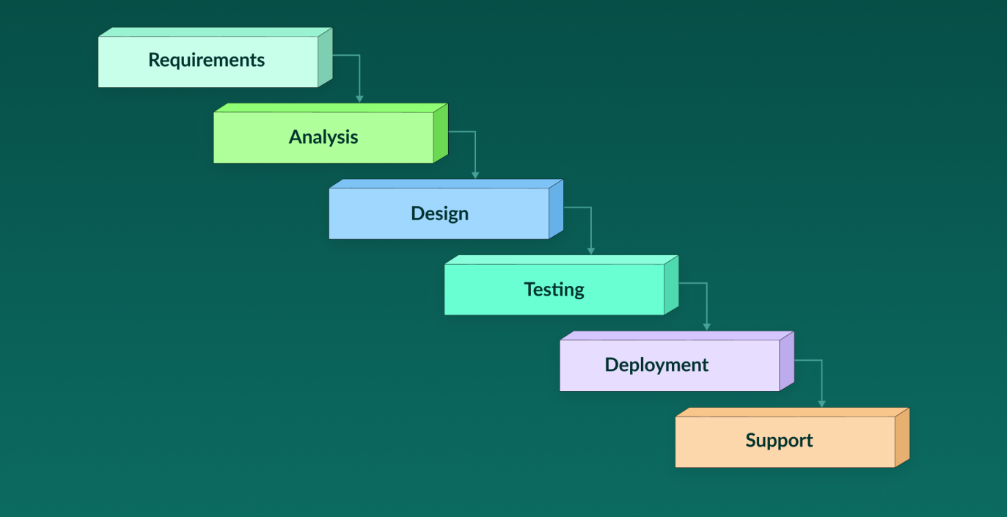
PROCESS MODEL
Requirements: Identify app features like login, watchlist, charts, and news.
Analysis: Understand system flow and how Firebase, Firestore, and TradingView work.
Design: Create UI screens, database structure, navigation, and MVVM layout.
Implementation: Develop the app in Android Studio using Kotlin.
Testing: Check each feature, fix bugs, and ensure smooth performance.
Deployment: Install and release the final app to users.
Maintenance: Update features, fix issues, and improve the app over time.

Slide 13
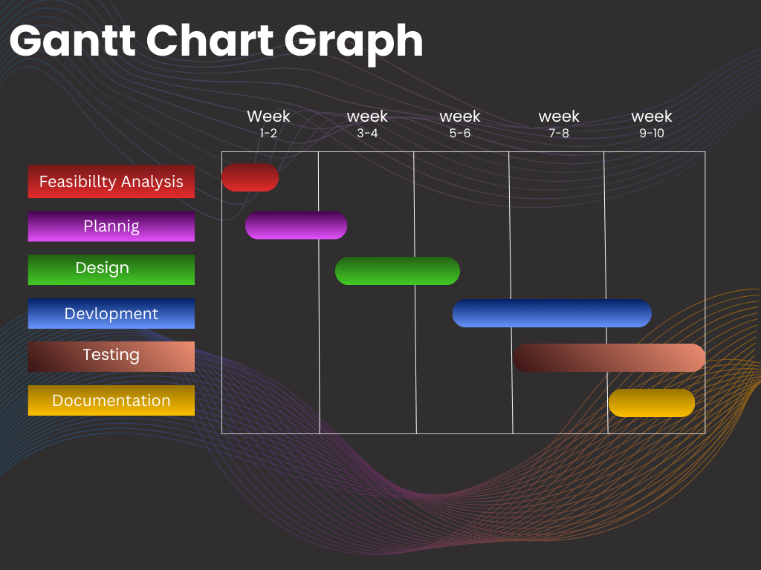
PROJECT PLAN

Slide 14
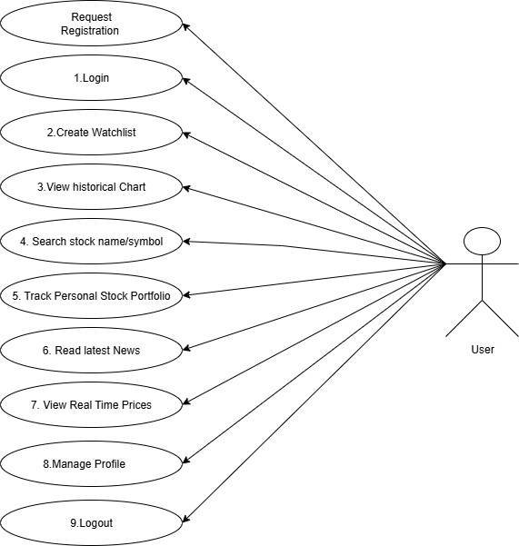
System Design
Use Case Diagram

Slide 15
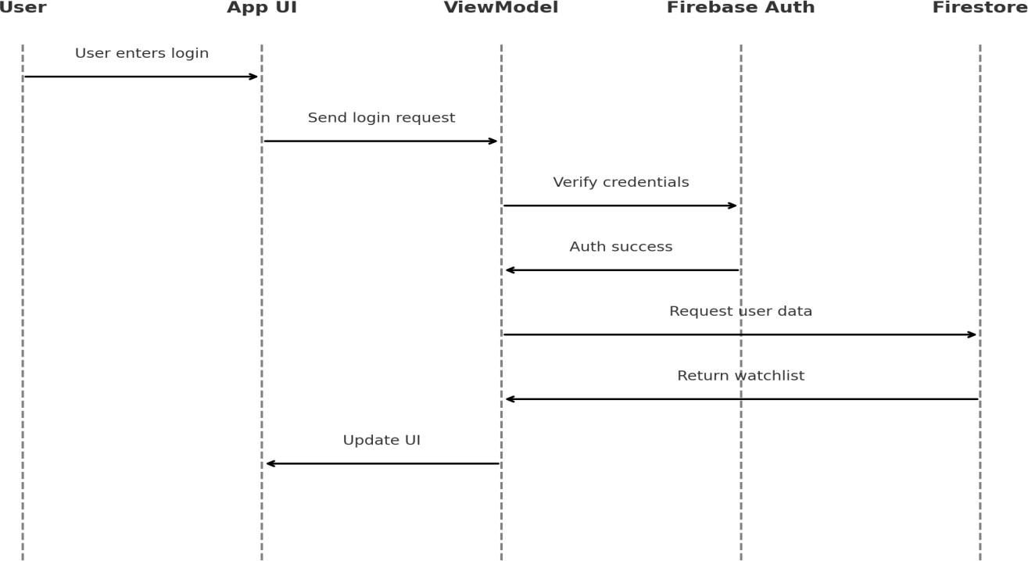
Sequence Diagram

Slide 16
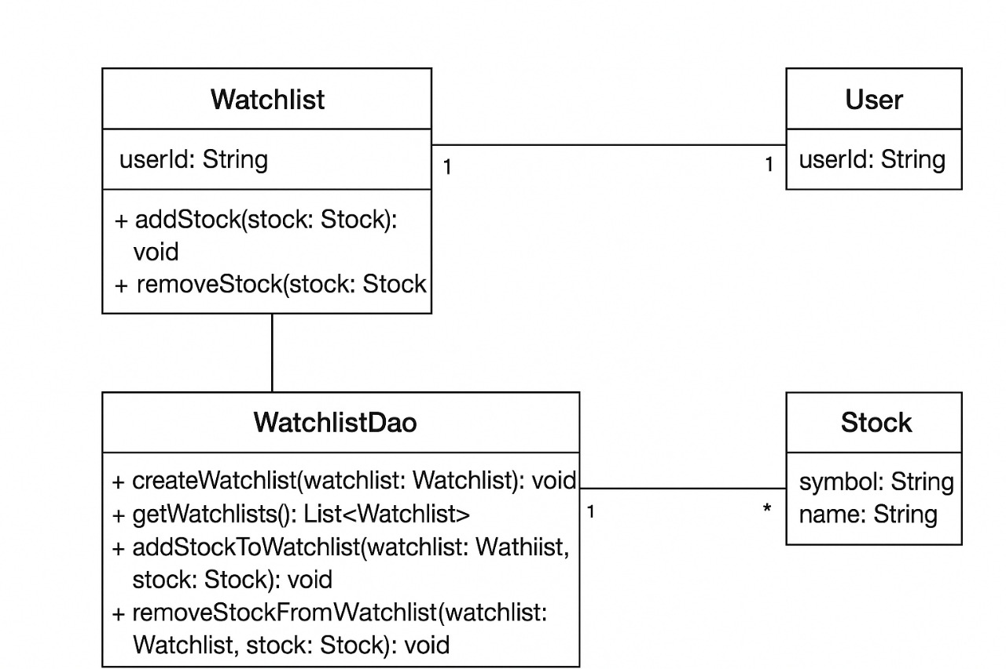
Class Diagram
*

Slide 17
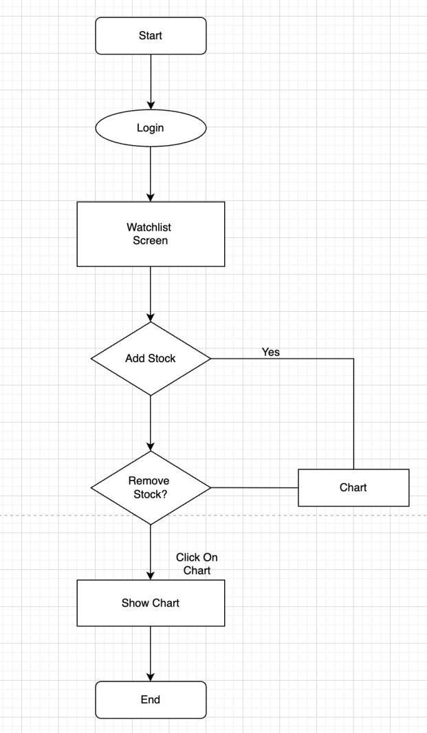
Activity Diagram

Slide 18
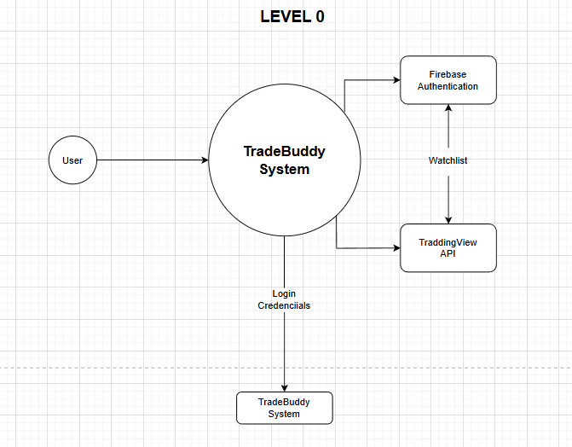
DFD

Slide 19
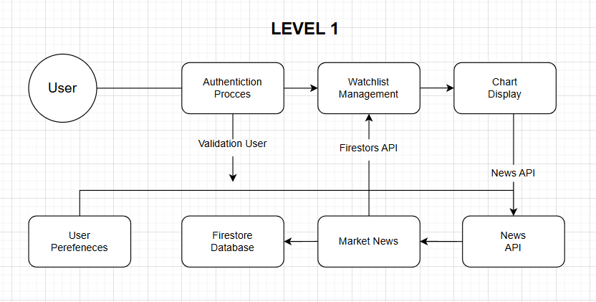

Slide 20
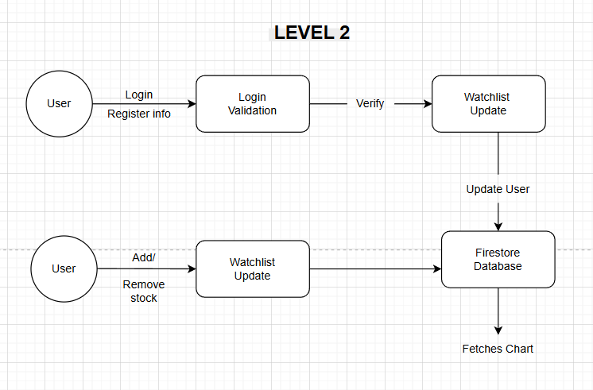

Slide 21
Data Dictionary
1.Users Collection
Path: /users/{userId}
Description: Stores details about each registered user.
Fields:-
name (String) → User’s full name
email (String) → User’s email
Uid → User’s unique id

Slide 22
2.Watchlist Path: /stocks/{stockId} Description: Stores stock data (if you plan to cache from APIs). Fields:- country(String) currency(String) exchange(String) instrument_name(String) symbol(String)

Slide 23
TESTING
No . | Test Case name | Test Case | Expected Result | Actual Result | Status
1 | Login | Enter correct email & password | User logs in successfully | User logs in | Pass
2 | Login | Enter wrong passwor d | Error message shown | Error message shown | Pass
3 | Signup | Create new account | Account created and saved in Firebase | Accounted created | Pass
4 | Profile | Open profile page | Shows user name and email | Shows the user details | Pass
5 | Edit Profil e | Change name/email | Updated info shown | Shows the updated profile | Pass
6 | Explore | Open news section | News headlines with images are displayed | Shows headlines with images | Pass
7 | Explore | No internet connectio n | Shows retry button or error | Shows error message | Pass
8 | Watchlist | Add stock | Stock added to list & Firebas e | Stocked Added | Pass
9 | Watchlist | Remove stock | Stock removed from list | Stock removed | Pass
10 | Chart | Open chart | Stock chart is displayed | Chart shown | Pass
11 | Chart | Change stock | Chart updates to selected stock | Chart Updated | Pass
12 | Settings | Change theme | Theme changes to dark/light mode | Theme changed successfully | Pass
13 | Logout | Tap logout button | User logged out & redirected to login | Logout Successful | Pass
14 | Notificatio n | Notification Popup | Notification Shown | Notification not shown | Fail

Slide 24
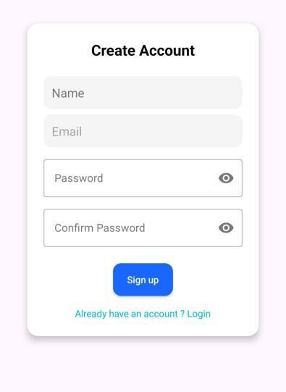
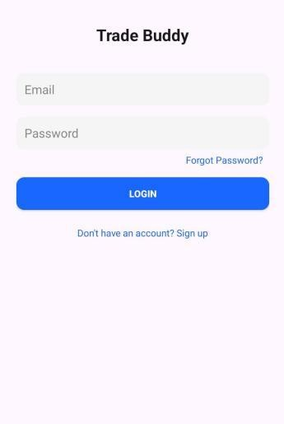
Application Running steps:
Login/Signup Page:

Slide 25
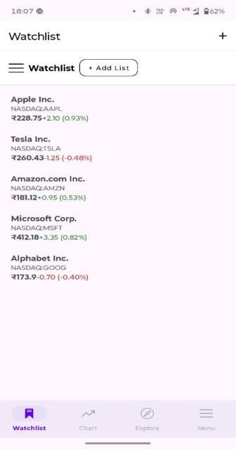
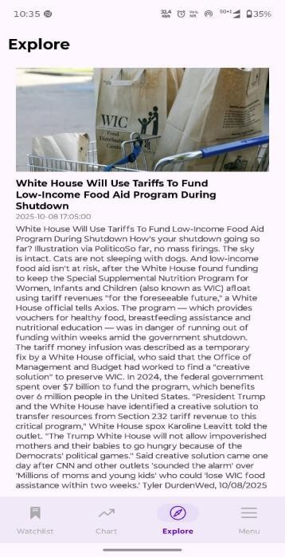
Watchlist:-
Explore:-

Slide 26
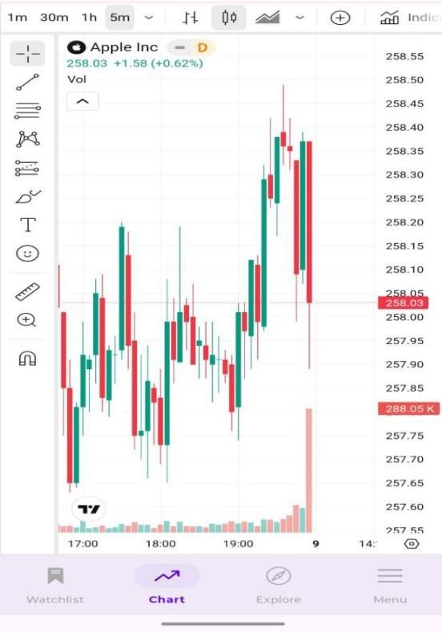
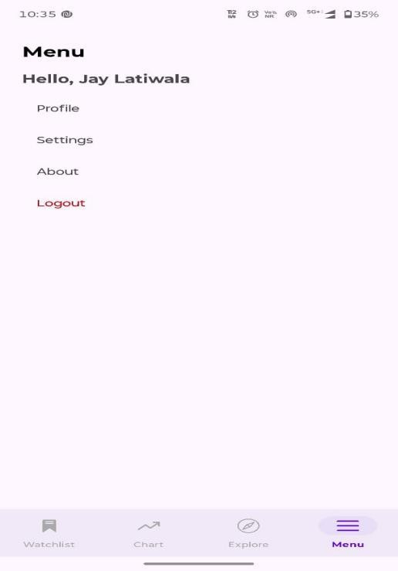
Live Chart:-
Menu:-

