Slide 1
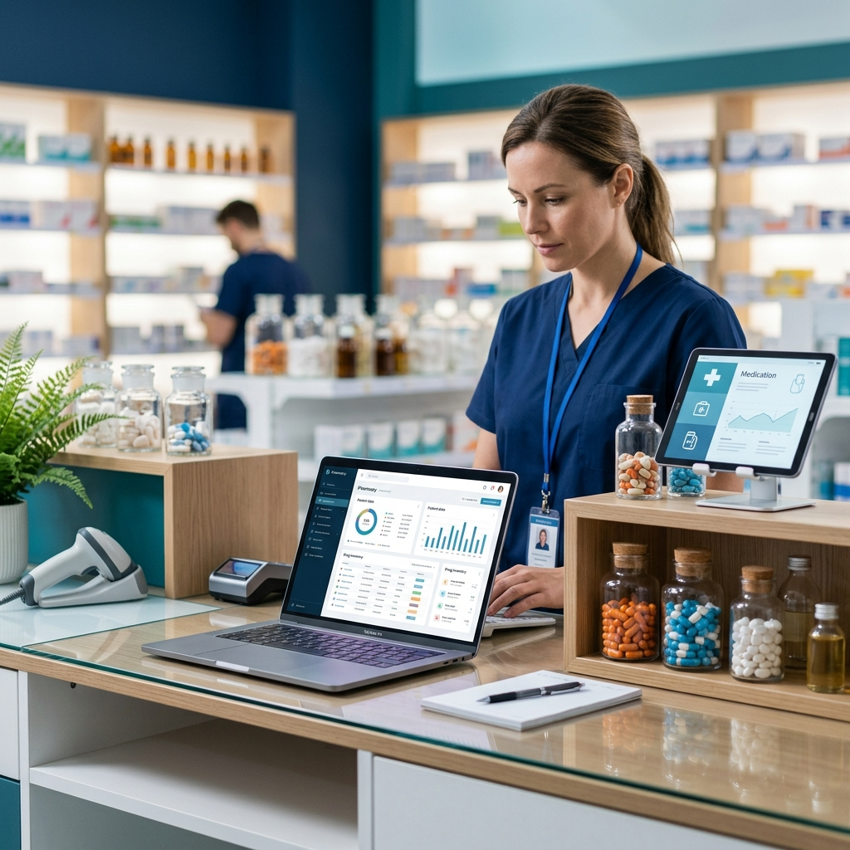
Pharmacy Management System
Presented By: Chauhan Kuldip
Roll No: 2401151012
Guided By: Ms. Jayna Rasania
JG University, School of Computing
(MCA Semester IV)

Slide 2
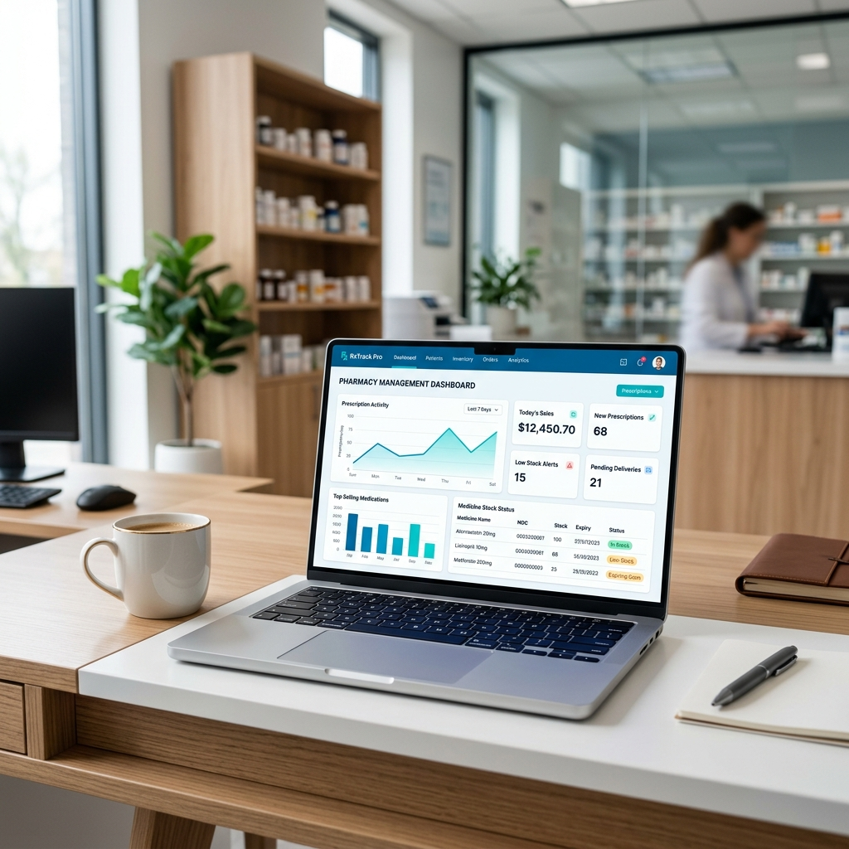
Project Overview & Abstract
Automated web application for hospital pharmacies.
Focuses on transaction accuracy and data consistency.
Built using Django's secure and scalable architecture.

Slide 3
Problem Statement
Manual tracking is prone to human error.
Lack of immediate stock visibility.
Difficulty in managing large medicine databases.
Inability to predict expiry dates in real-time.

Slide 4
Proposed Solution & Methodology
Centralized database for all medicine records.
Automated stock alerts for low-quantity items.
Digital payment integration for modern customers.
Clear reports for sales and inventory auditing.

Slide 5
Technology Stack
Frontend
HTML, CSS, JS, Bootstrap
Backend
Django (Python Framework)
Database
SQLite Relational Data Storage
Tools
VS Code, Git, Razorpay API

Slide 6
System Requirements
Software Requirements:
Python 3.x, Django 4.x, SQLite
Modern Browser (Chrome/Firefox/Edge)
Hardware Requirements:
Processor: Dual Core or higher
RAM: 4GB minimum
Storage: 10GB HDD/SSD

Slide 7
Software Development Life Cycle (SDLC)
Model Used: Iterative Waterfall / Agile.
Phases:
1. Planning & Analysis
2. Designing UI & Databases
3. Coding & Integration
4. Testing & Documentation

Slide 8
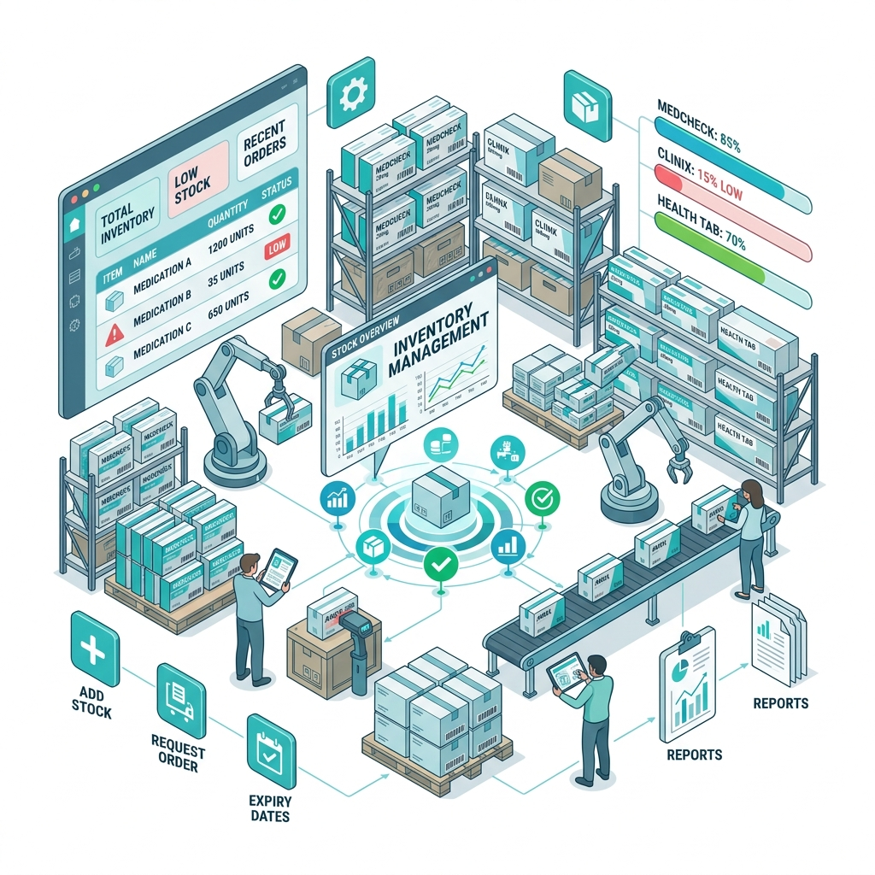
Key Features - Admin Module
Medicine Inventory Control (CRUD operations).
Supplier Management Portal.
Order Tracking & Status Updates.

Slide 9
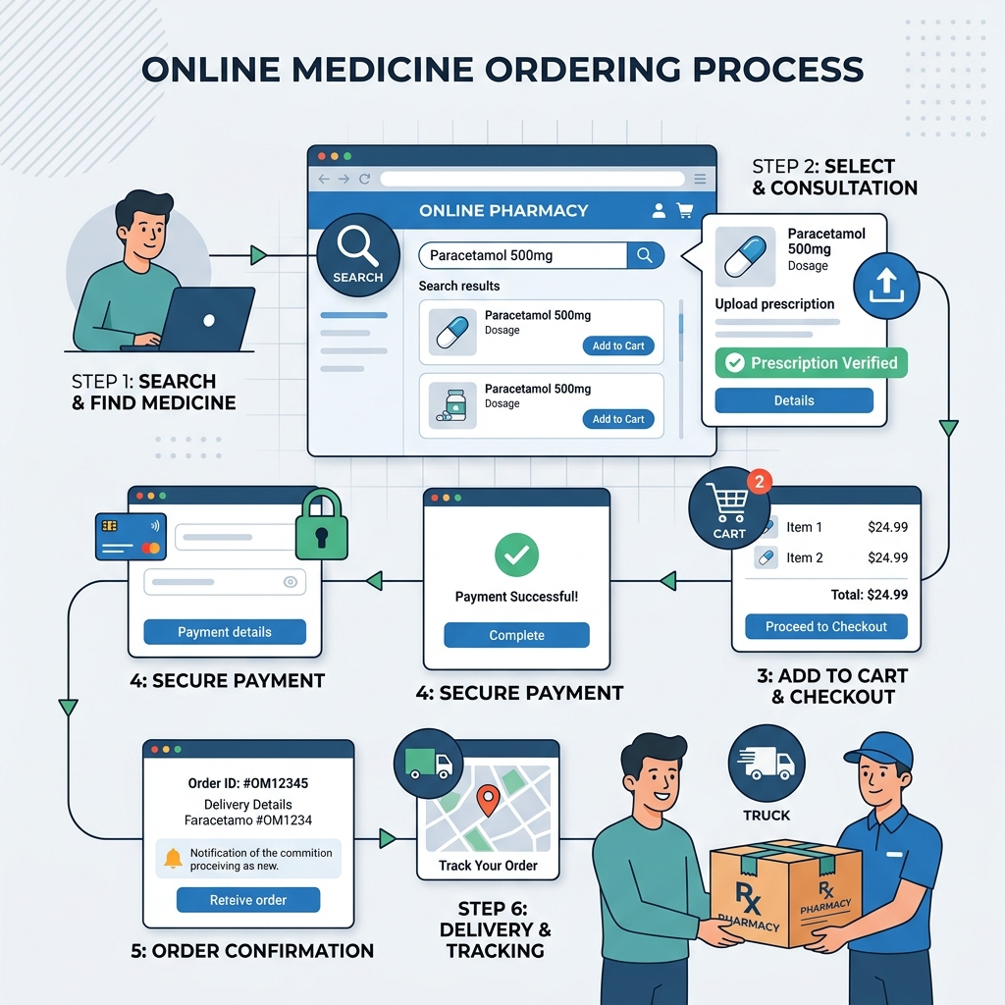
Key Features - Customer Module
Search medicines by Name/Category.
Secure Checkout & Order History.
Profile Management and User Dashboard.

Slide 10
System Design & UML Diagrams
Use Case Diagram: Interactions between User, Admin, and System.
Activity Diagram: Showing the path from Search to Order.
Class Diagram: Representing Data Entities and Methods.

Slide 11
Database Architecture (ER Perspective)
Relational Database Design with Primary & Foreign Keys.
Key Tables:
Products: id, name, category_id, stock, price, expiry.
Orders: id, user_id, amount, status, date.
Suppliers: id, contact, location, company.

Slide 12
Data Security & Privacy
Password Encryption: PBKDF2 with SHA256 hashing.
CSRF Protection: Protecting against web-based attacks.
OTP Verification: Two-factor authentication for higher security.
Session Management: Secure handling of user logins.

Slide 13
Testing & Quality Assurance
Unit Testing: Testing individual models and view functions.
Integration Testing: Verifying payment gateway and stock linkage.
Black Box Testing: Validating UI inputs and workflows.
Outcome: All test cases passed successfully.

Slide 14
Project Feasibility Study
Economic: Minimal cost due to open-source software.
Technical: Python/Django provides a stable dev environment.
Operational: Simplifies work for pharmacy staff and customers.

Slide 15

Conclusion & Future Scope
Conclusion: A robust digital solution for small to medium pharmacies.
Future Scope:
Mobile Application Development.
Automatic Email Notifications for Expiry.
Advanced Sales & Data Analytics.

