Slide 1
PHARMACY MANAGEMENT SYSTEM

Slide 2
Introduction
The Pharmacy Management System is a web-based application designed to streamline the operations of local pharmacies. It helps in tracking inventory, managing sales, and organizing supplier data, providing a more efficient alternative to traditional manual record-keeping.

Slide 3
Purpose
The purpose of this system is to provide a reliable and efficient platform for pharmacists to manage their medical stock. It aims to reduce human error, ensure the tracking of expired products, and provide automated sales reporting to assist in better decision-making.

Slide 4
Existing System
The existing pharmacy system is either fully manual or partially computerized.
Limitations of the Existing System:
Manual data entry and record keeping
No automatic low stock alert
Difficulty in tracking expired medicines
Time-consuming sales management
High chances of human error
No role-based access control
Poor report generation

Slide 5
New System
The proposed Pharmacy Management System is a modern web-based application designed to replace manual pharmacy operations. It is developed using the Django framework following the MVT architecture for better performance and scalability.
The system provides a secure platform for user registration and login. Customers can browse medicines, view details, add items to the cart, and place orders easily. It ensures a smooth and user-friendly shopping experience.

Slide 6
Project Scope
The scope includes secure user authentication, inventory management (CRUD), category and supplier management, placing orders , order tracking status, and a responsive user dashboard. It focuses on the core administrative and transactional needs of a pharmacy.

Slide 7
Problem Statement
Local pharmacies struggle with manual record management, leading to stock discrepancies, expired medicine waste, and inefficient sales tracking. There is a need for a centralized digital system that provides real-time visibility and automates routine administrative tasks.

Slide 8
Key Functions
Secure Login – Users can register and log in securely with authentication and OTP verification.
User-Friendly Interface – Simple and clean UI for easy navigation.
Browse Medicines – Users can view medicines with details like price, description, and images.
Category-Based Medicines – Medicines are organized into categories for easy searching.
Shopping Cart – Add, remove, and manage medicines before purchase.
Order Placement – Users can place orders with proper checkout process.
Order Tracking – Track order status such as placed, dispatched, or delivered.
Admin Dashboard – Admin can manage products, suppliers, and orders efficiently.
Inventory Management – Real-time stock tracking with low stock and expiry alerts.
Report Generation – Generates sales and inventory reports for better decision-making.

Slide 9
Advantages
Accuracy : Minimizes human errors in record-keeping.
Efficiency : Quick access to stock data and sales reports.
Expiry Management: Prevents health risks and revenue loss.
Centralized Data: Secured with a relational database.
Scalability: Modern tech stack for future growth.

Slide 10
Hardware Requirements
Android Smartphone or PC/Laptop
Processor: Intel i3 or above
RAM: Minimum 4GB (8GB recommended)
Storage: 500MB+ for installation & data
Internet Connection for real-time services

Slide 11
Software Requirements
Operating System : Windows / macOS / Linux
Backend : Python (Django Framework)
Frontend : HTML, CSS, JavaScript
Database : SQLite / PostgreSQL
Architecture : MVT (Model-View-Template)
Code Editor – VS Code

Slide 12
Requirements for Users
Valid Email ID for registration/login
Basic knowledge of pharmacy operations
Stable internet connection for system access
Proper browser support (Chrome/Firefox)

Slide 13
Process Model (MVT)
Requirements: Identify inventory and sales needs.
Analysis: Map data flow (Products/Suppliers/Orders).
Design: Create MVT structure and UI layouts.
Implementation: Develop using Django & Python.
Testing: Validate models and view response.
Deployment: Host on local/web server.

Slide 14
System Design & Diagrams

Slide 15
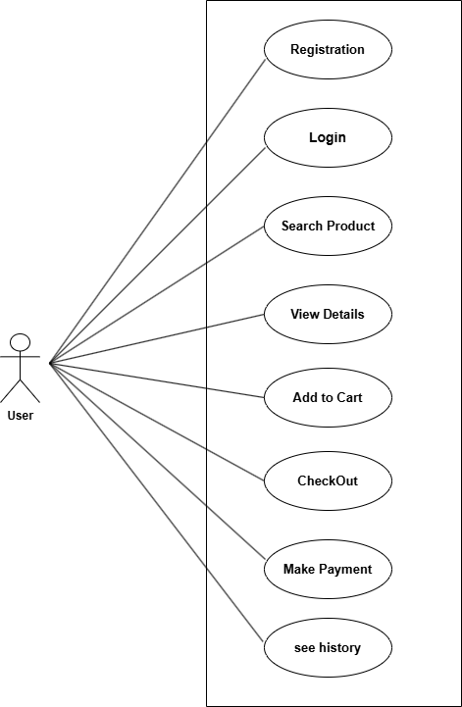
Use Case Diagram
User

Slide 16
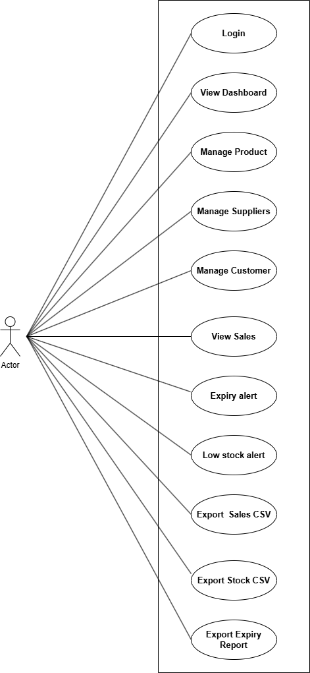
Admin

Slide 17
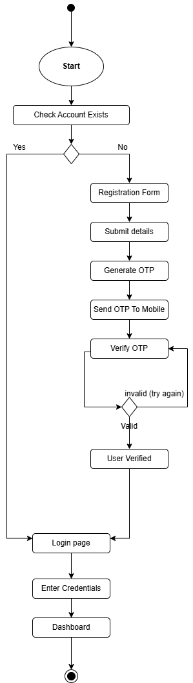
Activity Diagram
User Registration & Login flow

Slide 18
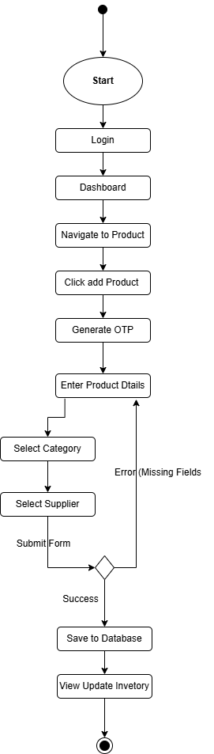
Activity Diagram
Admin Inventory flow

Slide 19
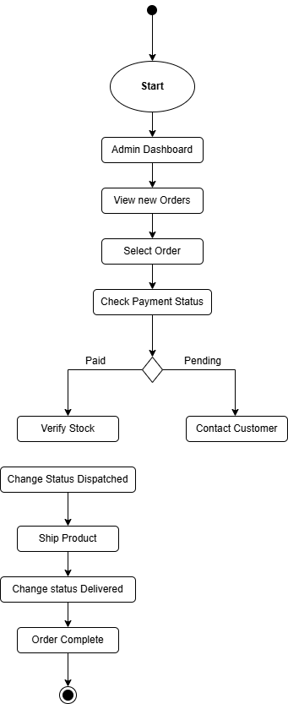
Activity Diagram
Order Fulfillment Flow

Slide 20
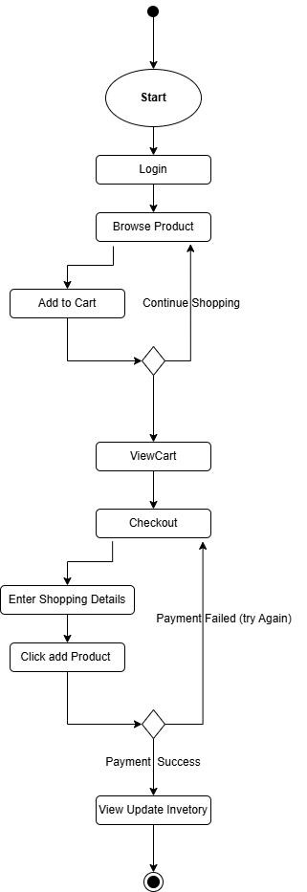
Activity Diagram
Shopping & Checkout Flow

Slide 21
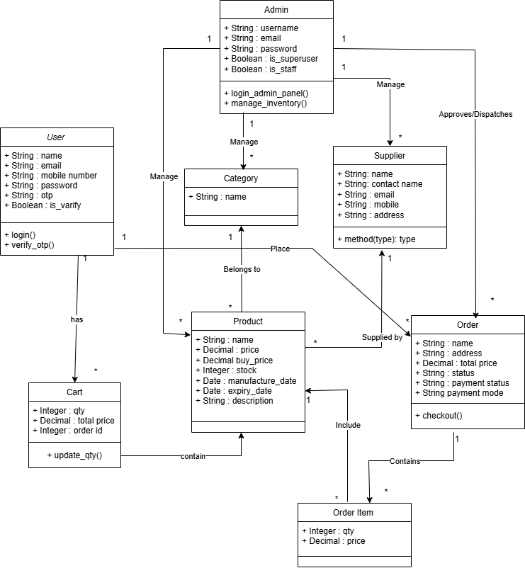
Class Diagram
.

Slide 22
Data Dictionary
Register Model : ID, name, email , mobile , password, OTP , is_verify
Category Model : ID , name
ProductModel: ID, name, image, price, stock, expiry_date , manufacture_date , categories_id
SupplierModel: ID, name, contact, address , mobile
OrderModel: ID, total_price, status, payment_status , user_id .
CartModel : ID, user_id , qty , total_price , order_id , product_id
Order Item Model : ID Order_id , Product_id , qty , price

Slide 23
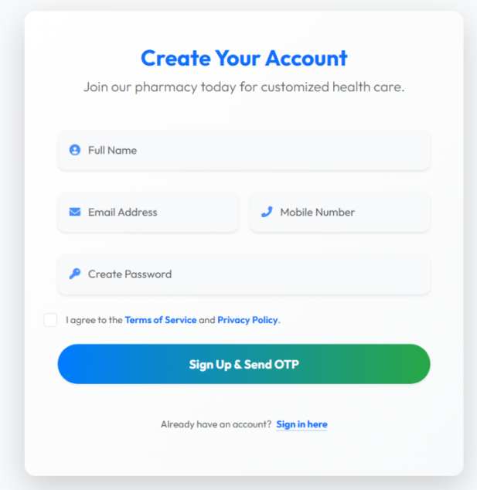
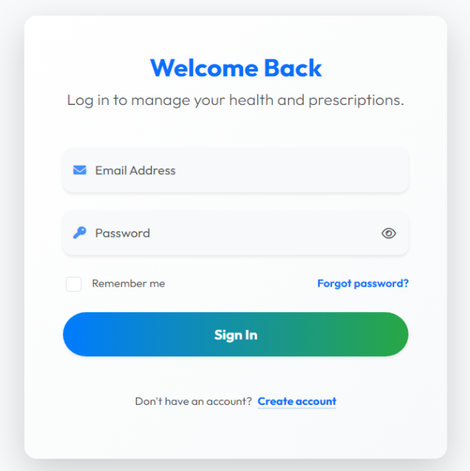
Application Running steps
Login/Signup Page:

Slide 24
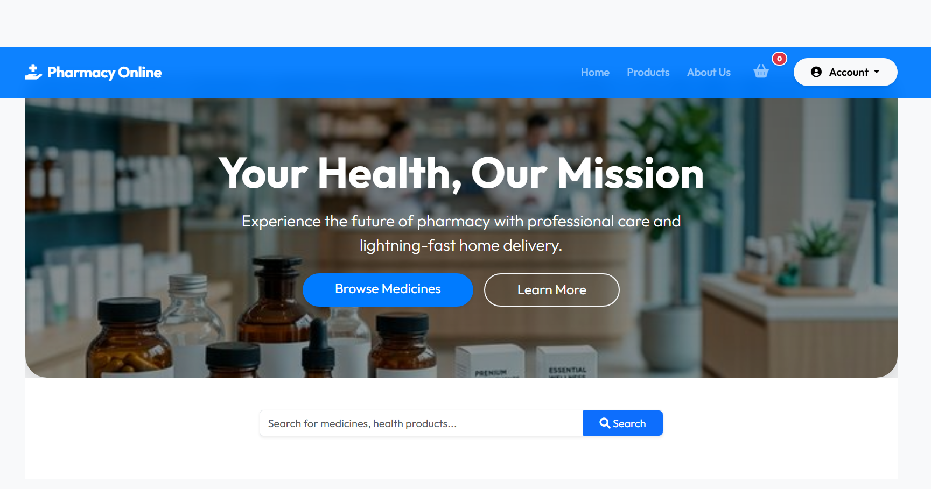
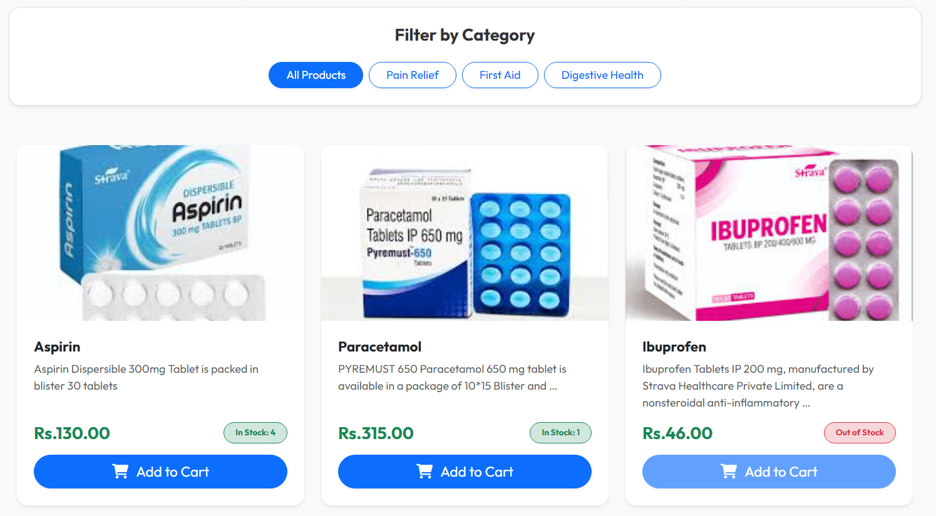
Home Page & Categories Page

Slide 25
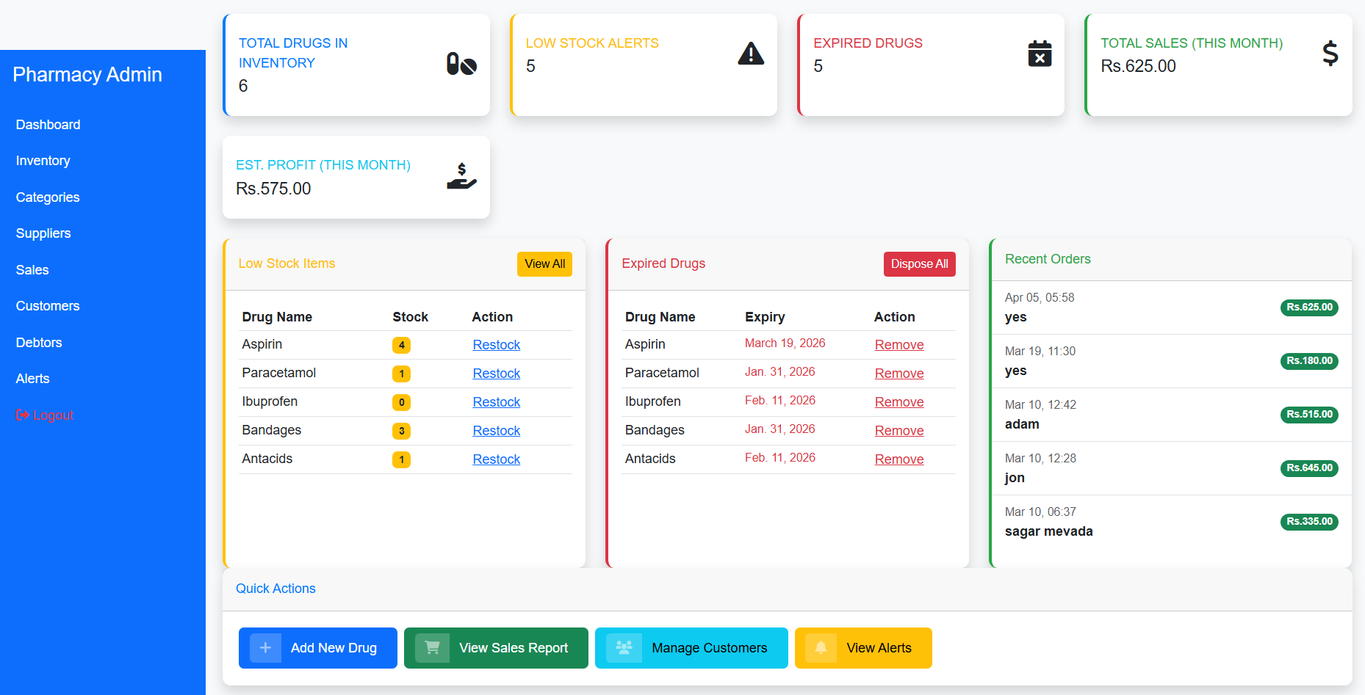
Admin Dashboard:

Slide 26
THANK YOU
Questions?

