Slide 1
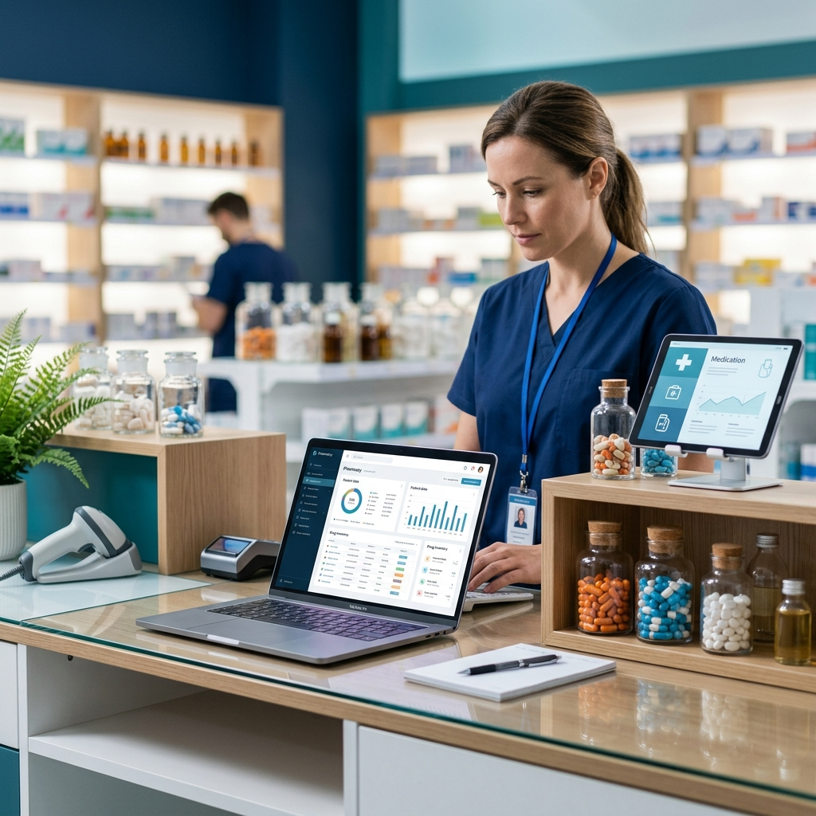
Pharmacy Management System
A Comprehensive Solution for Inventory & Sales

Slide 2
Introduction & Problem Statement
Manual inventory management leads to errors and revenue loss.
• Difficulty in tracking product expiry dates.
• Time-consuming sales report generation.
• Lack of real-time stock monitoring.

Slide 3
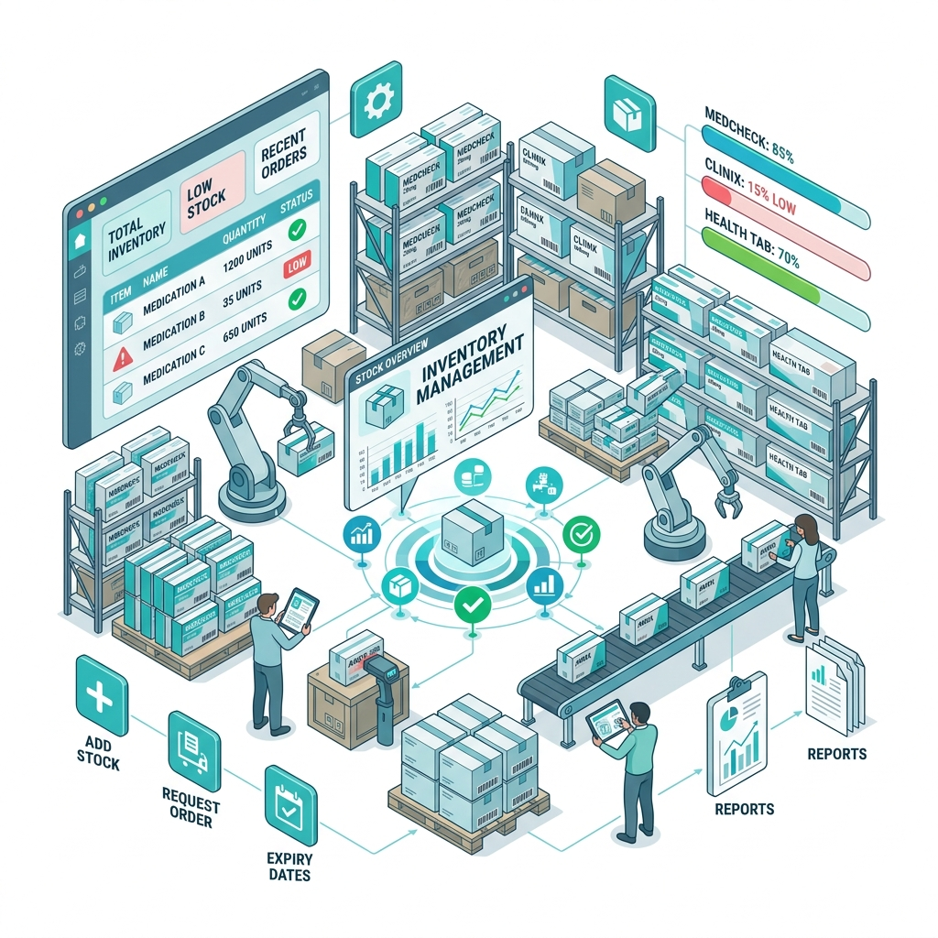
Key System Features
Automated Inventory Tracking
Secure User Authentication (OTP Based)
Shopping Cart & Digital Payments (Razorpay)
Dynamic Invoice Generation
Comprehensive Admin Dashboard

Slide 4
Technology Stack
Backend: Python with Django Web Framework
Frontend: HTML5, CSS3, JavaScript
Database: SQLite (Relational DB)
Payment Gateway: Razorpay Integration
Architecture: Model-View-Template (MVT)

Slide 5
System Architecture & UML
Designed for scalability and maintainability.
• Use Case Diagram: Admin and Customer roles.
• Class Diagram: Models for Products, Suppliers, and Orders.
• Activity Diagram: Seamless order placement workflow.

Slide 6
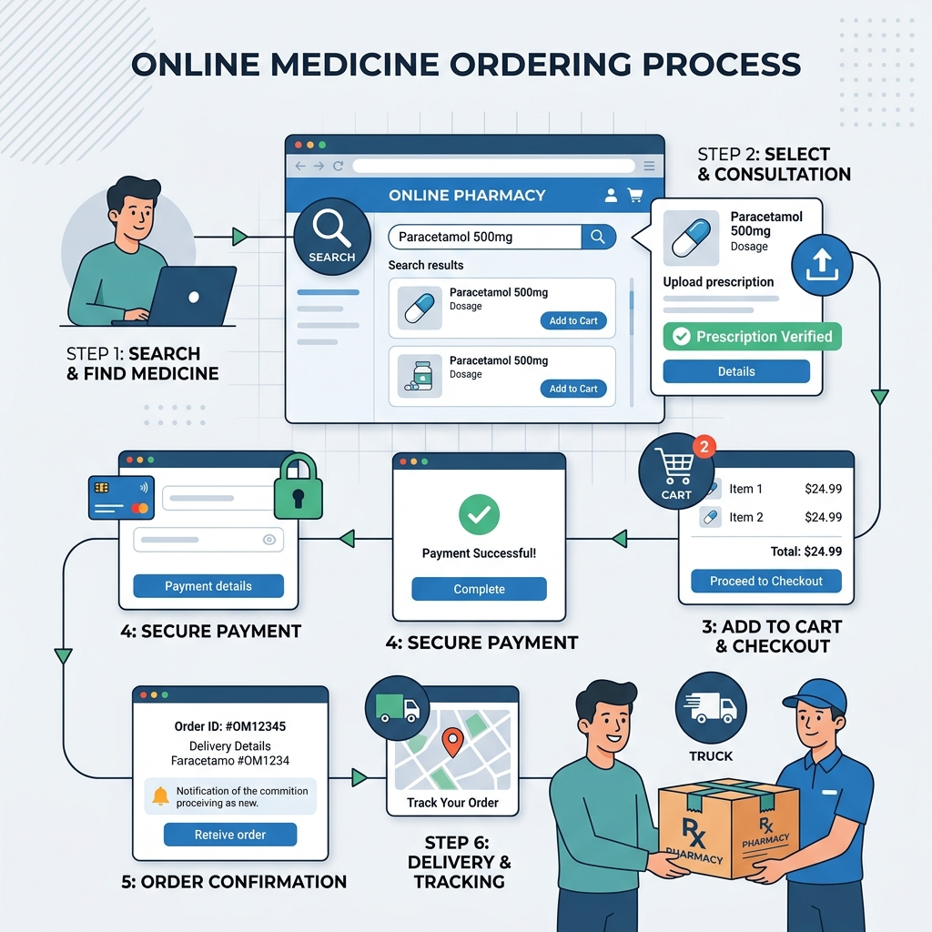
User Workflow
Intuitive user experience from browsing to checkout.

Slide 7

Checkout & Secure Payments
Multiple Payment Options: COD & Online
Seamless Razorpay integration for fast transactions.
Real-time stock adjustment upon order placement.
Instant order confirmation and history tracking.

Slide 8
Testing & QA
Unit Testing for database models.
Functional Testing for core views.
Status: ALL TESTS PASSED.
Ensuring data integrity and responsive UI.

Slide 9
Future Enhancements
Barcode scanning for rapid sales execution.
Automated email alerts for low-stock items.
Advanced analytics and sales forecasting.
Mobile Application for customers.

Slide 10
Conclusion
The Pharmacy Management System provides a robust, scalable solution for modern pharmacies, replacing inefficient manual processes with a streamlined digital experience.

