Slide 1
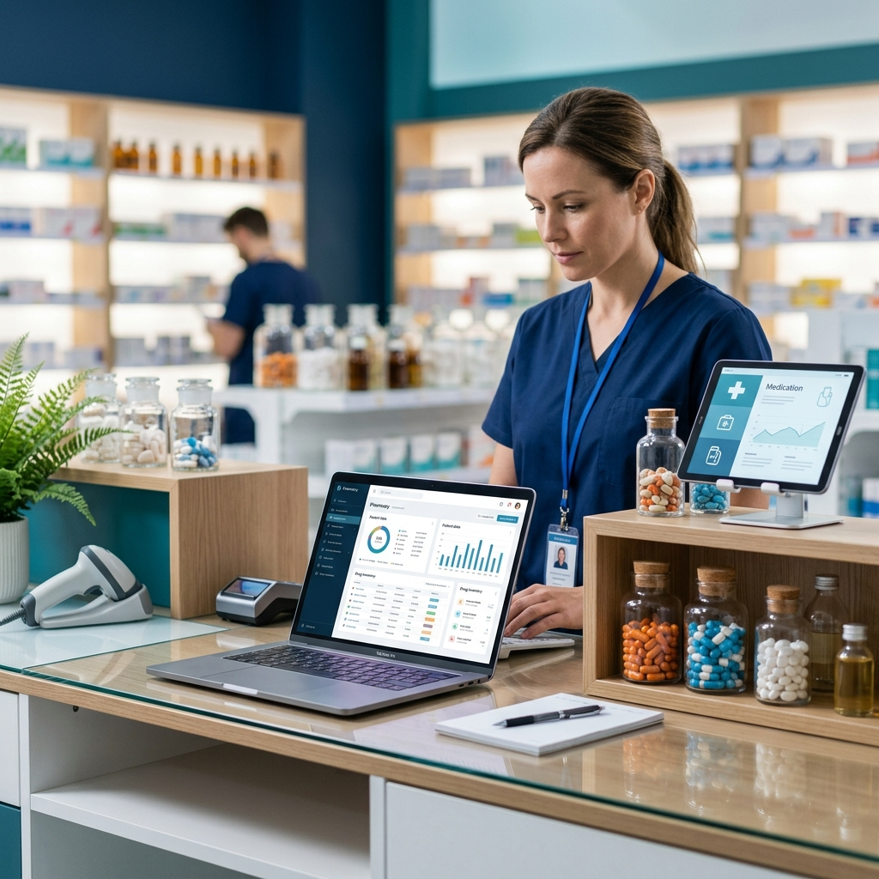
Pharmacy Management System
Presented By: Chauhan Kuldip
Roll No: 2401151012
Guided By: Ms. Jayna Rasania
JG University, School of Computing
(MCA Semester IV)

Slide 2
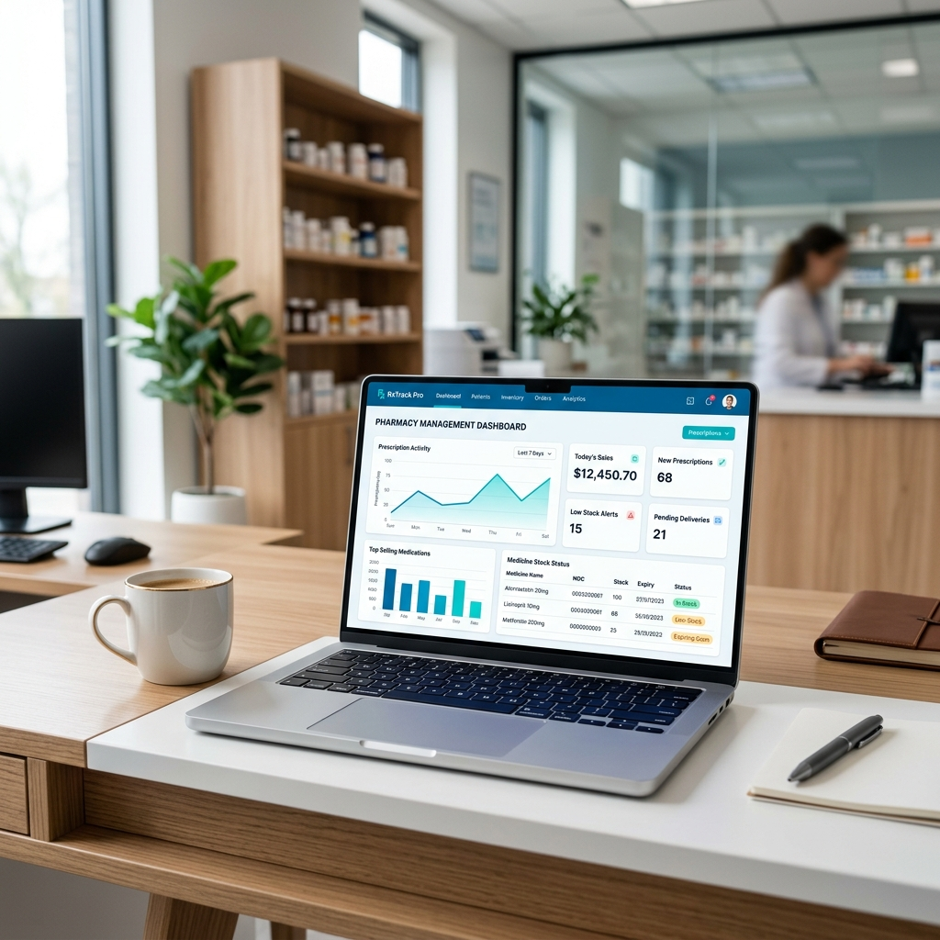
Project Overview & Abstract
A comprehensive web-based application to automate and digitize day-to-day pharmacy operations.
Goal: Replace traditional manual methods to reduce human error and improve efficiency.
Architecture: Follows the Model-View-Template (MVT) architecture for clean separation of concerns.

Slide 3
Problem Statement
Manual record-keeping of medicines, stock, and sales.
Difficulty in tracking expired medicines.
Lack of automatic alerts for low stock levels.
Time-consuming sales management and high error risk.

Slide 4
The Solution (Proposed System)
Automated Inventory: Real-time tracking and monitoring.
Role-Based Access: Dedicated modules for Customers and Administrators.
Smart Alerts: Automated notifications for low stock and near-expiry dates.
Efficiency: Faster billing and accurate financial reporting.

Slide 5
Technology Stack
Frontend
HTML, CSS, JavaScript, and Bootstrap
Backend Framework
Django (Python)
Database
SQLite
Development Tools
VS Code / PyCharm

Slide 6
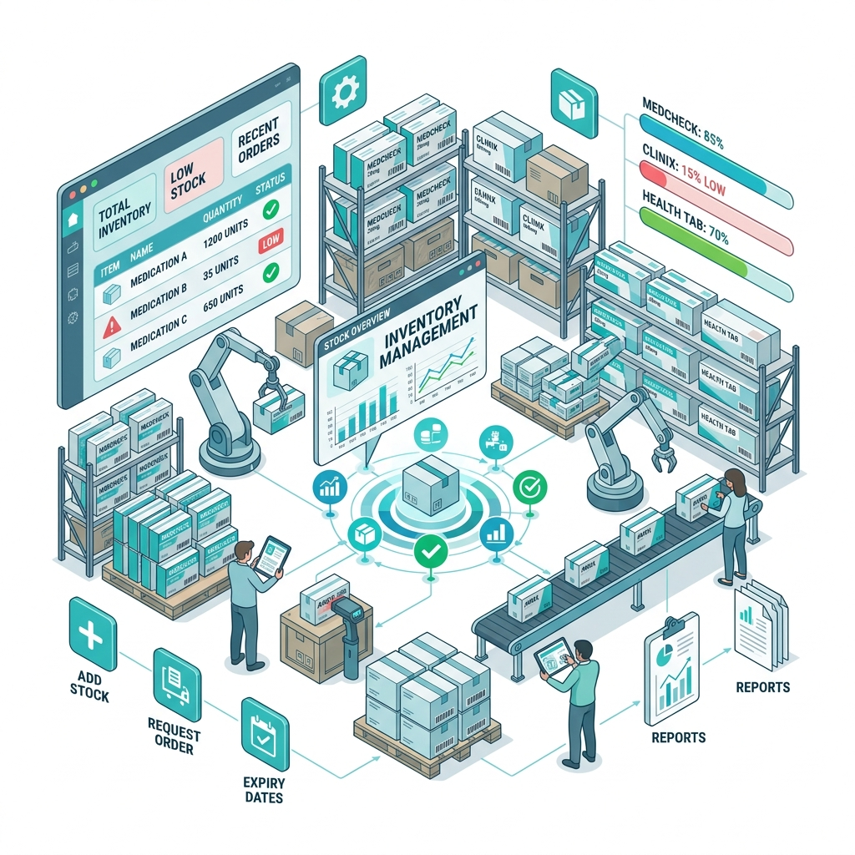
Key Features - Admin Module
Dashboard: Real-time sales and profit analysis.
Product Management: Add, update, and delete medicines.
Supplier Tracking: Manage supplier details and contact info.
Order Fulfillment: Update status (Placed, Dispatched, Delivered).

Slide 7
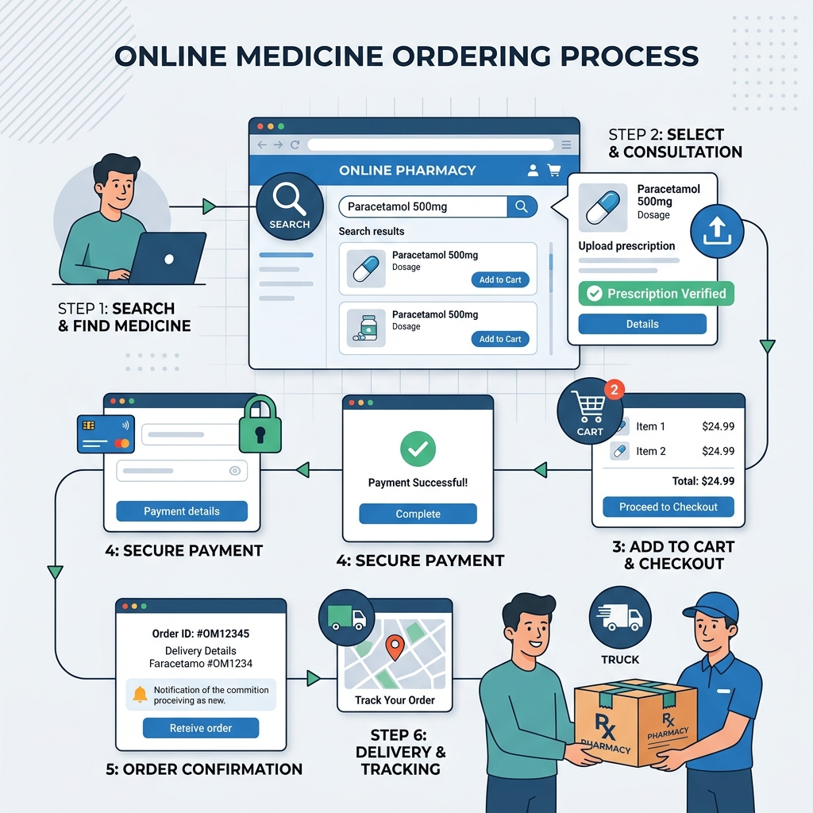
Key Features - Customer Module
Secure Authentication:
Login with OTP verification.
Product Browsing:
Navigate medicines by category.
Shopping Cart:
Add, remove, and manage items.
Order History:
Track current status and view past orders.

Slide 8
System Design (UML) & Data Dictionary
Use Case Diagram: Highlight actors (Customer, Admin, Payment System).
Key Models:
Product Model: Price, Stock, Expiry Date Attributes.
Order Model: Invoices and Payment Status tracking.
Registration Model: Secure User Credential storage.

Slide 9
Project Feasibility & Model
Development Model: Agile Methodology for iterative improvements.
Economic Feasibility: Open-source tech stack reduces costs.
Technical Feasibility: Python/Django provide reliable backend.
Operational Feasibility: User-friendly interface for non-tech users.

Slide 10
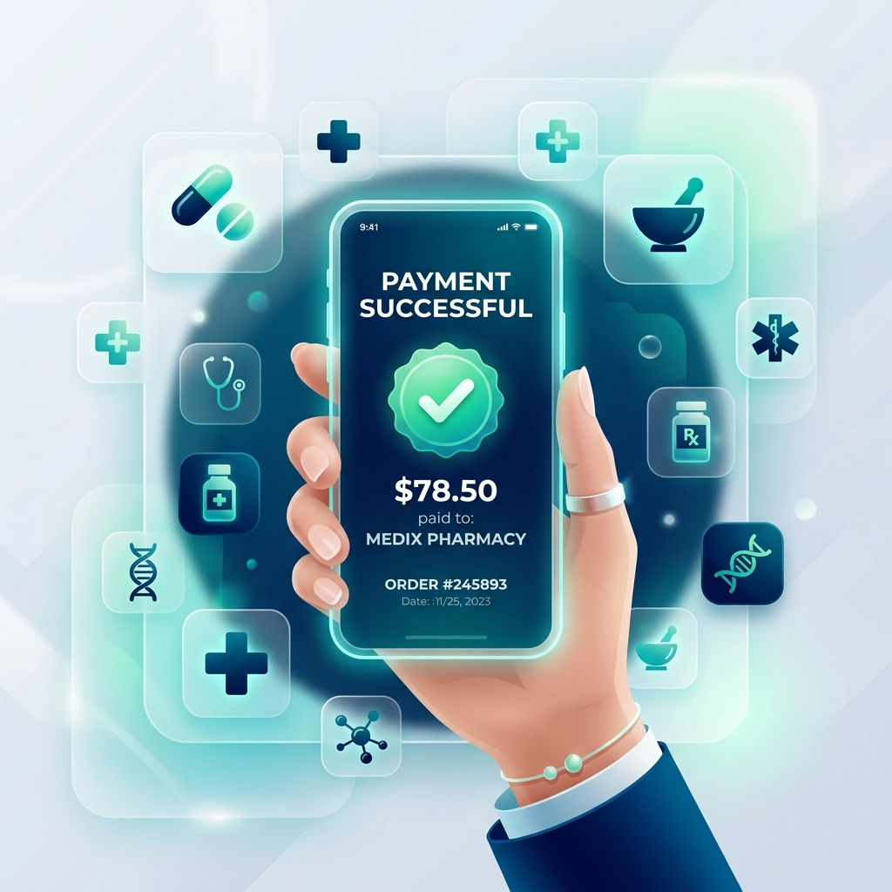
Conclusion & Future Scope
Summary: A secure and user-friendly platform enhancing pharmacy productivity.
Future Scope:
Integration of Barcode Scanning for fast billing.
Mobile App for iOS/Android platforms.
AI-driven demand forecasting for inventory.

