Slide 1

JSS ACADEMY OF TECHNICAL EDUCATION NOIDA
Department of Computer Science and Engineering
GROUP-48

Slide 2


A
PROJECT PRESENTATION
ON
Pneumonia Detection
&
Classification using Deep Learning

Slide 3
OUTLINE
Project Team
Problem Statement
Purpose
Sequence Diagram
Use Case Diagram
Activity Diagram
Level 0 Data Flow Diagram
Objective
Literature survey
Scope
Level 1 Data Flow Diagram
State Diagram
Algorithm and Techniques
Requirements
System Overview
Class Diagram
Implementation
Performance Analysis

Slide 4
Problem Statement
To Design and Implement Pneumonia Detection and Classification using Deep Learning.

Slide 5
Purpose
Pneumonia is a bacterial disease which people overlook at early stages.
Timely detection of this disease can help us to fast-track the process of recovery.
Extraction of Chest X-rays to identify any early symptoms of pneumonia.
A system that classifies the type of pneumonia (Viral or Bacterial).
To acquire the level of precision over manual human intervention.

Slide 6
Objectives
To learn different biomedical terms related to pneumonia disease.
To learn the different scenarios of pneumonia disease(viral or bacterial).
To learn different methods of data acquisition.
To know about different image processing pre-trained models.
To use a machine learning Model for feature extraction.
To develop a model to detect pneumonia
To build web/mobile-application to analyze Pneumonia disease using chest X-ray.

Slide 7
Semester-7 Work Plan
Collection of data set from various sources
Implementation of the deep learning models
Training the model with training data set
Testing model’s accuracy using testing data set

Slide 8
Semester-8 Work Plan
Building the front-end (UI) part of the mobile/web application
Integrating the model with the mobile/web application
In image processing, a different set of features can be used to extract the visual information from a given image.
Working on the improvement of model’s accuracy by training the model on large data set
Removing the bugs and completing the final project

Slide 9
Literature Survey
●Reference Title 1 - Transfer Learning from Pneumonia to COVID-19 (Hongen Lu et al., 2020)
●Proposed system -
In this paper, Transfer learning method utilized. Transfer learning generally refers to a process where a model trained on one problem is used in some way on a second related problem.
In deep learning, transfer learning is a technique whereby a neural network model is first trained on a problem similar to the problem that is being solved. One or more layers from the trained model are then used in a new model trained on the problem of interest.
Proposed model development approach by author is both efficient and effective. they achieved good outcomes in term of accuracy of 80% and 86% for transferred COVID-19 models based on ImageNet and EfficientNet respectively are achieved.
We define transfer learning as:

Slide 10
Reference Title 2 - Pneumonia and COVID-19 Detection using Convolutional Neural Networks - (Sammy V. Militante et al., Dec 2020)
Methodology -
Dataset used - Kaggle chest X-ray database is an incredibly popular database containing 15,798 chest X-ray images of normal or healthy, viral, and bacterial pneumonia ranging from 800 pixels to 1900 pixels resolution
The components and structure of the VGG-16 CNN model applied
1) Convolutional Layer
2) Batch Normalization
3) Pooling Layer
4) Activation
5) Dropout
6) Dense Layers

Slide 11
● Reference Title 3 - Pneumonia Detection through Adaptive Deep Learning Models of Convolutional Neural Networks - (Nanette V. Dionisio et al., Nov 2020)
● In this paper author made use of CNN architectures for modeling pneumonia disease detection, and performed analysis of available image processing models
1.VGGNet-16 model
2.GoogLeNet model
3.LeNet model
4.StridedNet model
5.ResNet-50 model
These are all pre-trained models for feature extraction.

Slide 12
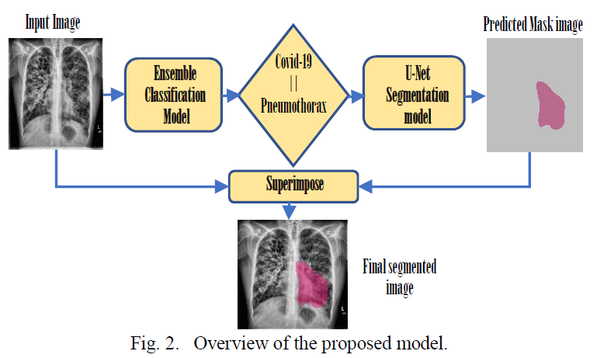
Reference Title 4 - Deep Learning based Detection and Segmentation
of COVID-19 & Pneumonia on Chest X-ray Image - (Md Shahin Alom et al., Jun 2021)
● Proposed Methodology
In this paper for classifying the 3 types of X-ray images author used ensemble method. During prediction, each image is passed through the classification layer where they checked whether an image is COVID-19, pneumonia or normal.

Slide 13
Scope
Module 1 - (Image acquisition)
We are going to use X-ray dataset to diagnose pneumonia.
Image will be taken from external source or optical device.
Currently we are planning to take a dataset of maximum possible images from an open source dataset platform(Kaggle).
Module 2 - (Preprocessing )
Image will be resized in 224x224 format.
The size chosen is sufficient to maintain most image details.
While also limiting the memory load imposed by convolutional neural network training.

Slide 14
Module 3 - (Development)
We are going to develop a web/mobile based application that will take X-ray images as an input and predict whether it is pneumonia case or not.
We are going to develop this project with the help of Google Colab/Jupyter Notebook.
We are going to train the dataset that we are going to take from Kaggle.
Module 4 - (Classification)
It will classify the images of pneumonia with the help of filtering and pooling.
This system will be going to classify the images according to the heatmaps.

Slide 15
Requirements
Hardware -
Intel Core i5 @4Ghz
NVIDIA GTX 1650
8GB RAM
Software and tools –
Google Colab
Jupyter Notebook
Kaggle Datasets

Slide 16
System Overview
Proposed System -
1
2
3
4
Image acquisition
Preprocessing
Development
Classification
Fig. 2

Slide 17
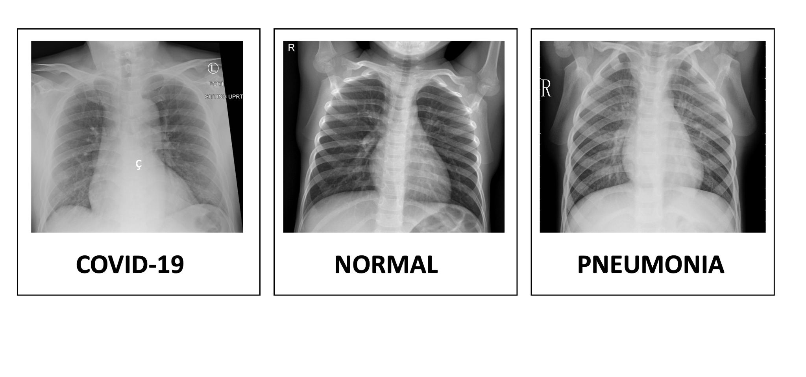
Normal
Pneumonia

Slide 18
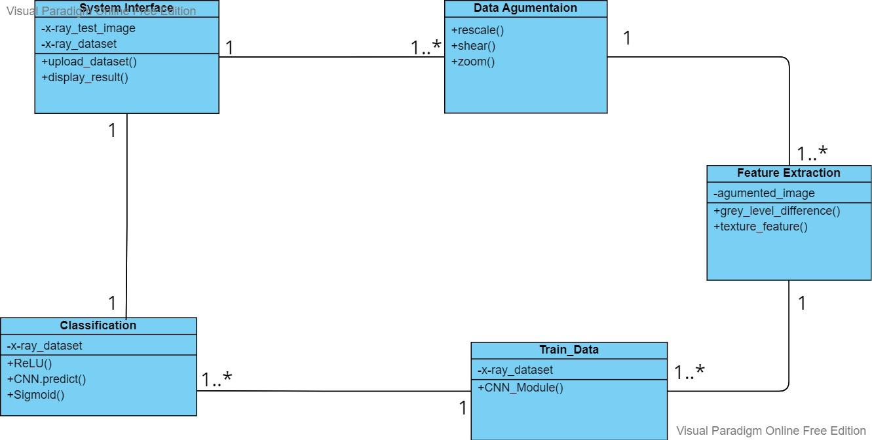
Class Diagram
Fig. 3

Slide 19
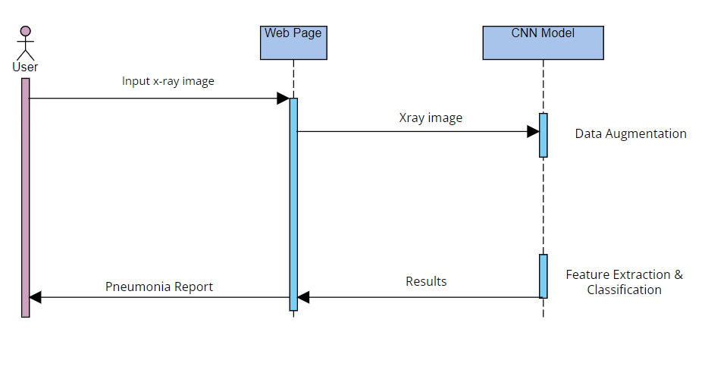
Sequence Diagram

Slide 20
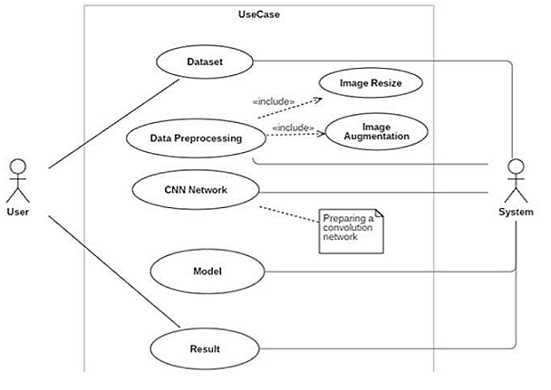
Use Case Diagram

Slide 21
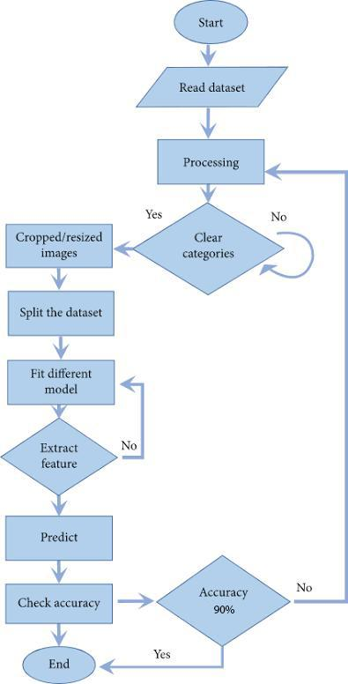
Activity Diagram

Slide 22
Level 0 Data Flow Diagram
Input image
CNN MODULE
User

Slide 23
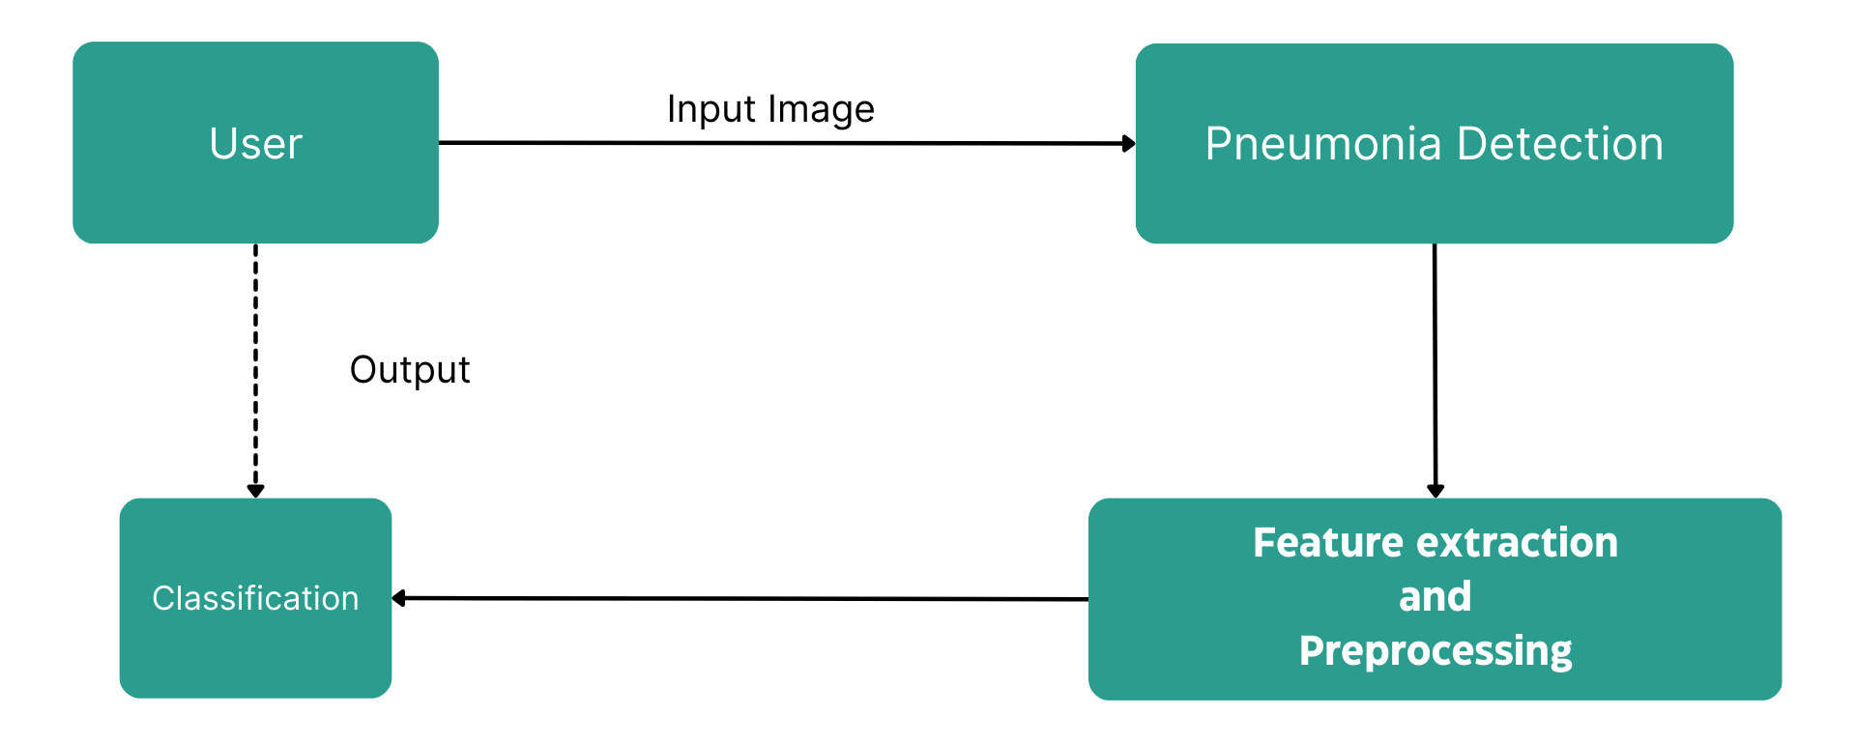
Level 1 Data Flow Diagram

Slide 24
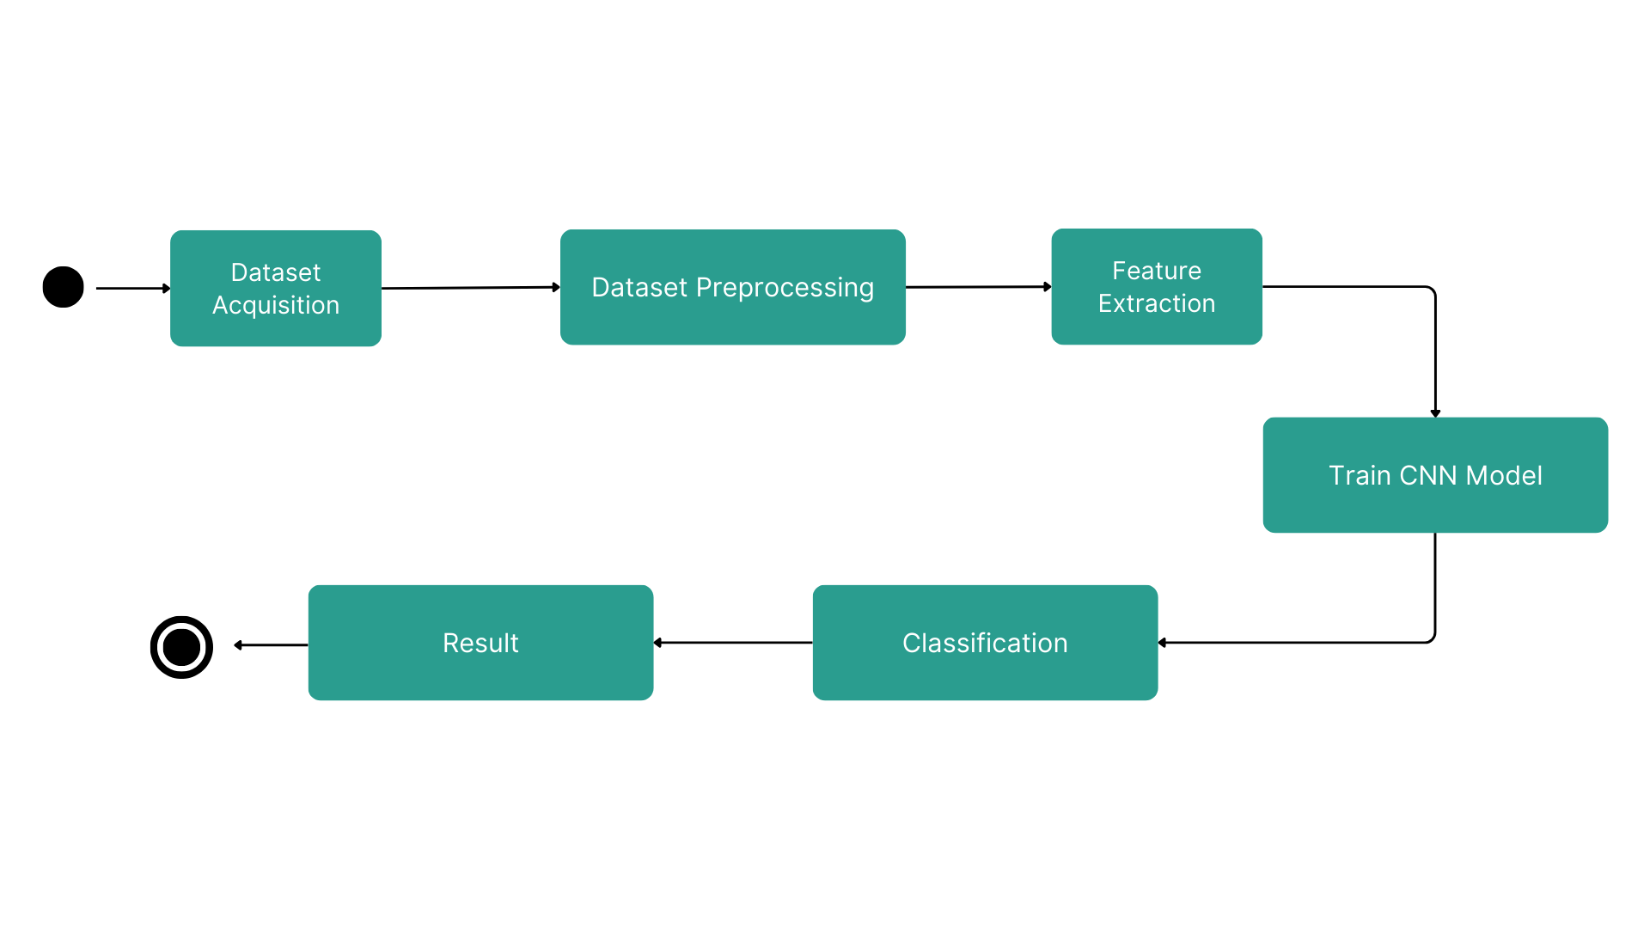
State Diagram

Slide 25
Algorithms & Techniques
Keras:
Keras is an Open Source Neural Network library written in Python that runs on top of Tensorflow. It is designed to be modular, fast and easy to use. Keras High-Level API handles the way we make models, defining layers, or set up multiple input-output models.
Tensor Flow:
It is an open source artificial intelligence library, using data flow graphs to build models. It allows developers to create large-scale neural networks with many layers. TensorFlow is mainly used for: Classification, Perception, Understanding, Discovering, Prediction and Creation.

Slide 26
Feature Extraction
In image processing, a different set of features can be used to extract the visual information from a given image.
Because digital mammographic images are specific, not all visual features can be used to correctly describe the relevant image.
All classes of suspected tissue are different by their shape and tissue composition. That is why the most suitable visual feature descriptors for this kind of images are the ones based on shape and texture.
different feature descriptors are: GLDM (Gray Level Difference Method), LBP (Local Binary Patterns), GLRLM (Grey Level Run Length Method), texture features, etc.

Slide 27
Popular feature extraction techniques
GLDM(Gray Level Difference Method) : GLDM calculates the Gray level Difference Method Probability Density Functions for the given image. This technique is usually used for extracting statistical texture features of a digital mammogram.
GLCM (Gray Level Co-occurrence Matrix): The GLCM is a tabulation of how often different combinations of pixel brightness values (grey levels) occur in an image.
Gabor Texture Feature : Gabor texture feature is a linear filter used for edge detection, Features are extracted directly from grayscale character images by Gabor filters which are specially designed from statistical information of character structures. An adaptive sigmoid function is applied to the outputs of Gabor filters to achieve better performance on low-quality images.

Slide 28
What is kaggle?
Kaggle, a subsidiary of Google LLC, is an online community of data scientists and machine learning practitioners. Kaggle allows users to find and publish data sets, explore and build models in a web-based data-science environment, work with other data scientists and machine learning engineers, and enter competitions to solve data science challenges.
Our Dataset
In 2017 Dr. Paul Mooney started a competition on Kaggle on viral and bacterial pneumonia classification. It contained 5,863 pediatric images, hence it is very different from the other datasets. We are referring to the revised version of this dataset.
(https://www.kaggle.com/paultimothymooney/chest-xray-pneumonia/version/2)

Slide 29
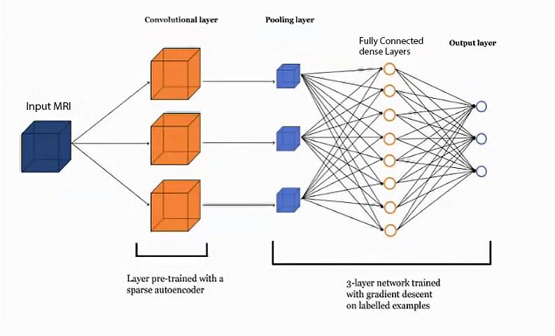
CNN Architecture

Slide 30
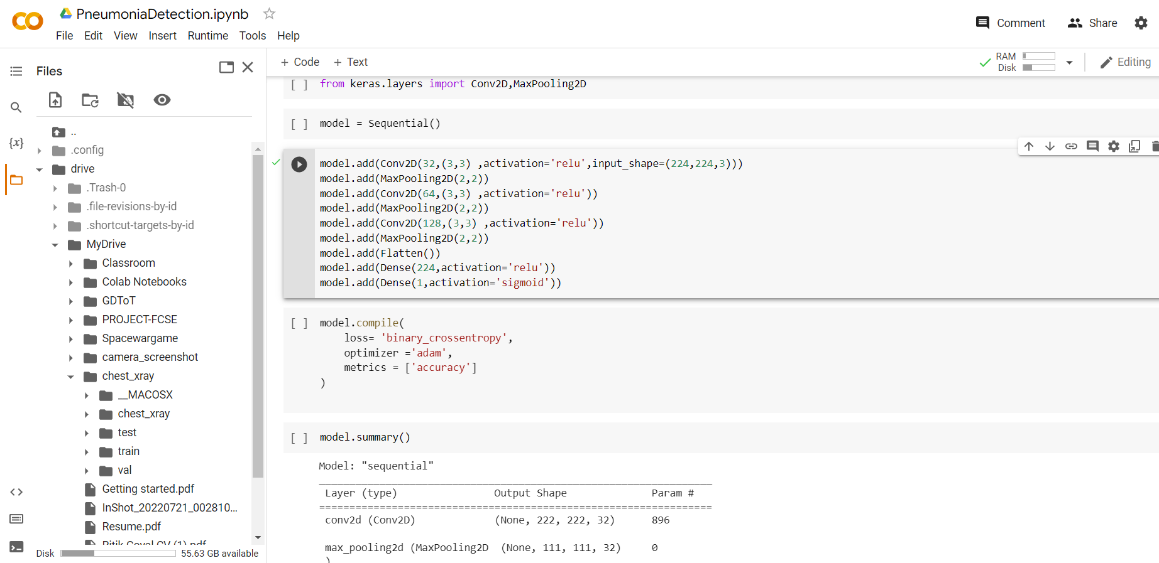
Custom CNN Model

Slide 31
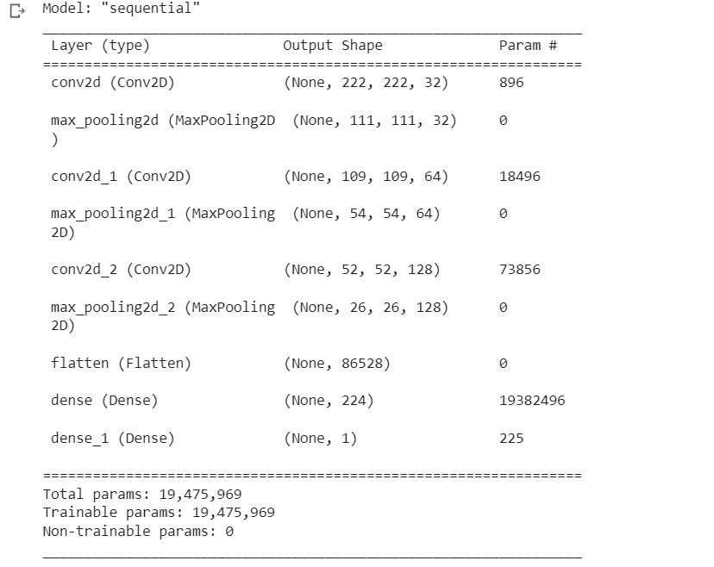

Slide 32
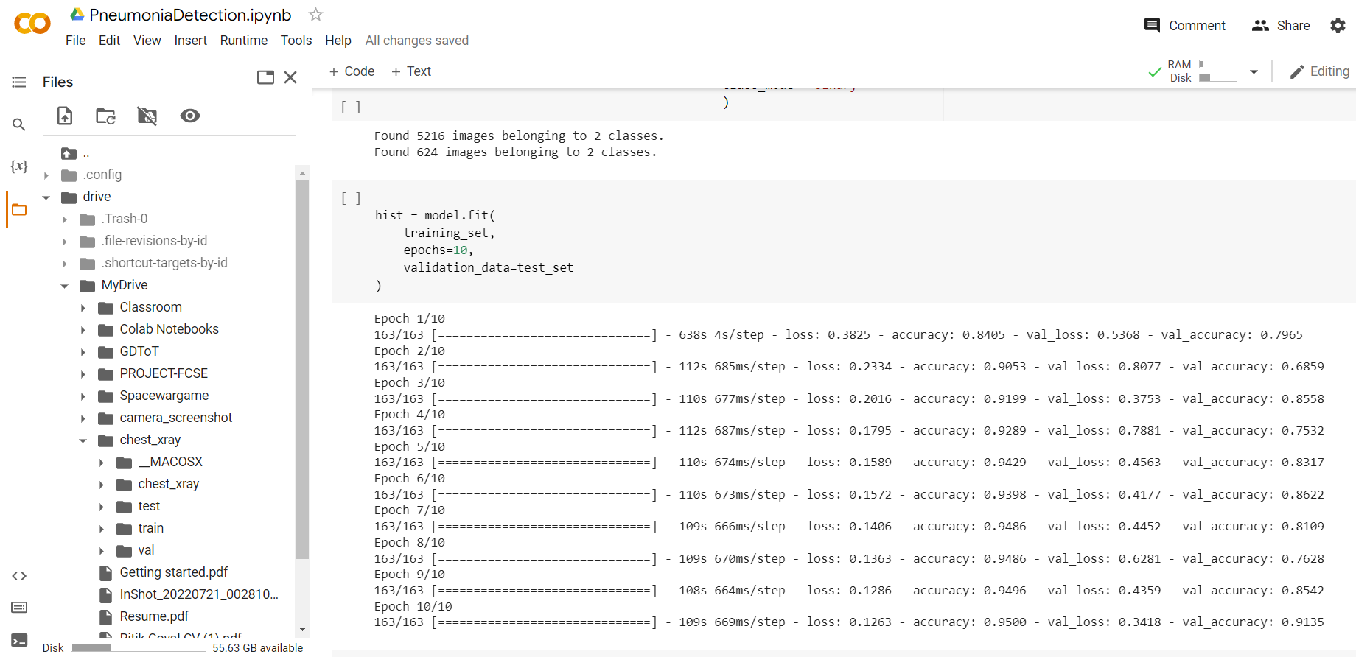
CNN Model Accuracy

Slide 33
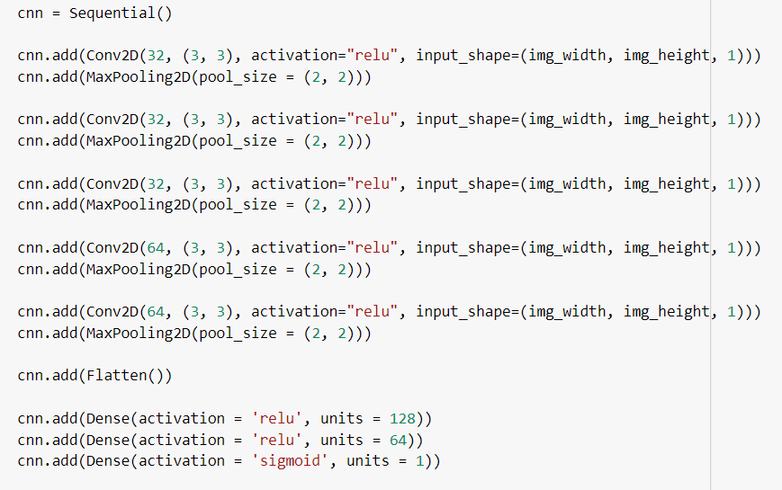
CNN model sequence algorithm :
layer 1 conv
layer 1 pool
layer 2 conv
layer 2 pool
layer 3 conv
layer 3 pool
layer 4 conv
layer 4 pool
layer 5 conv
layer 5 pool
Dense
Layers/
ANN layers
33

Slide 34
Dataset Preprocessing (Defining some of the Image Data Generator parameters)
rescale —higher pixel range image results in greater loss and a lower learning rate should be used, lower pixel range image would require a higher learning rate.
shear_range — The shape of the image is the transformation of the shear. It fixes one axis and stretches the image at a certain angle known as the angle of the shear.
zoom_range — The image is enlarged by a zoom of less than 1.0. The image is more than 1.0 zoomed out of the picture.
horizontal_flip —Some images are flipped horizontally at random
vertical_flip — Some images are flipped vertically at random
roataion_range — Randomly, the image is rotated by some degree in the range 0 to 180.
width_shift_range — Shifts the image horizontally.
height_shift_range — Shifts the image vertically.
brightness_range — brightness of 0.0 corresponds to absolutely no brightness, and 1.0
corresponds to maximum brightness
fill_mode — Fills the missing value of the image to the nearest value or to the wrapped value
or to the reflecting value.

Slide 35
Convolutional neural networks refer to a sub-category of neural networks: they, therefore, have all the characteristics of neural networks. However, CNN is specifically designed to process input images. Their architecture is then more specific: it is composed of two main blocks.
Conv Layers
The first block makes the particularity of this type of neural network since it functions as a feature extractor. To do this, it performs template matching by applying convolution filtering operations. The first layer filters the image with several convolution kernels and returns “feature maps”, which are then normalized (with an activation function) and/or resized.
Pool Layers
The second block is not characteristic of a CNN: it is in fact at the end of all the neural networks used for classification. The input vector values are transformed (with several linear combinations and activation functions) to return a new vector to the output. This last vector contains as many elements as there are classes: element i represents the probability that the image belongs to class i. Each element is therefore between 0 and 1, and the sum of all is worth 1. These probabilities are calculated by the last layer of this block (and therefore of the network), which uses a Sigmoid function (binary classification) or a RELU function (multi-class classification) as an activation function.

Slide 36

Activation Function : It decides whether the neuron should be activated or not.
relu : Rectified linear unit is most widely used and preferred activation function right now which ranges from 0 to infinity, All the negative values are converted into zero.
f(x)=max(0,x)
sigmoid: The sigmoid function also called a logistic function. having a characteristic that can take any real value and map it to between 0 to 1
it decides which value to pass as output and what not to pass.

Slide 37
Convolutional Layer
Pooling Layer
The Kernel/filter size is 3x3 and the pool size is 2x2 for all the layers.
37

Slide 38
Convolved feature
(feature Map)
Image

Slide 39
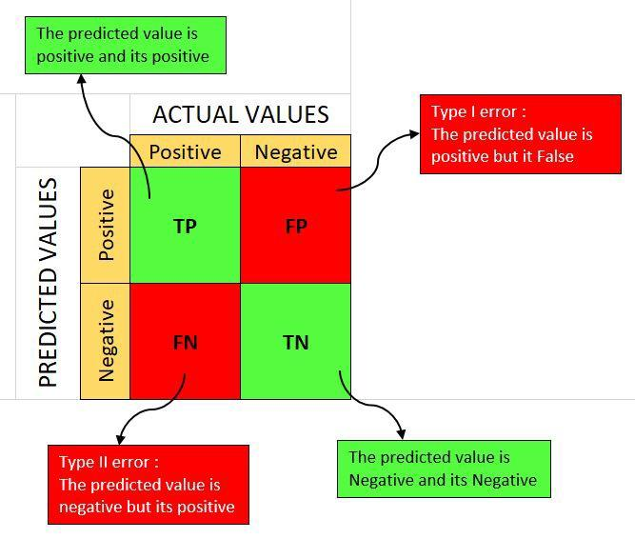
Mathematical Model
Let’s interpret the output of the confusion matrix. The upper left (TP) denotes the number of images correctly predicted as normal cases and the bottom right (TN) denotes the correctly predicted number of images as cases of pneumonia. As Pneumonia case, the upper right denotes the number of incorrectly predicted images but were actually normal cases and the lower left denotes the number of incorrectly predicted Normal case images but were actually Pneumonia case.
39

Slide 40
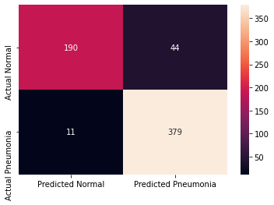

Slide 41
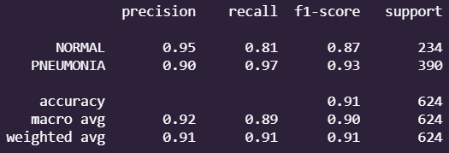
Classification Report
Precision = TruePositives / (TruePositives + FalsePositives)
Recall = TruePositives / (TruePositives + FalseNegatives)
F1 = (2 * Precision * Recall) / (Precision + Recall)

Slide 42
Implementation
Fit Model
Early Stopping is called to stop the epochs early based on some metric It helps to avoid overfitting the model. Over here we are telling to stop based on val_loss metric, we need it to be minimum.
patience says that after a minimum val_loss is achieved then after that in next iterations if the val_loss increases in any the 3 iterations then the the training will stop at that epoch.

Slide 43
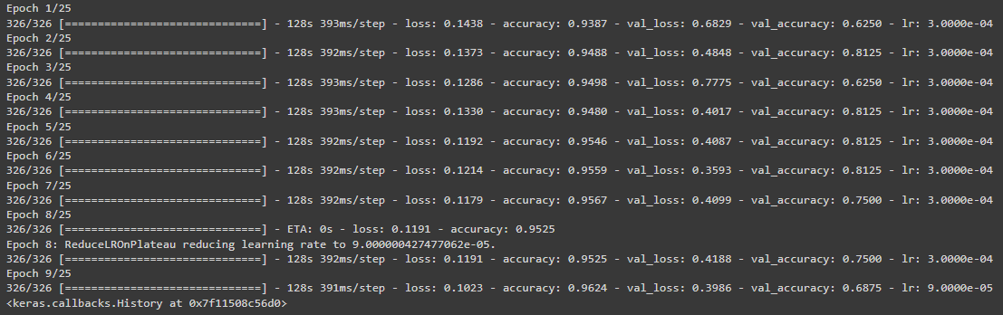
In our training session the Early Stopping stopped at 9th epoch at val_loss =39.8% and val_accuracy = 68.7%. when patience set to 3

Slide 44
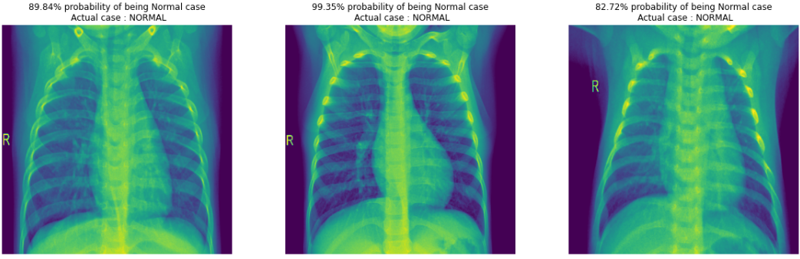
Performance Analysis:
Eventual test set results on model with 91.98% accuracy.

Slide 45
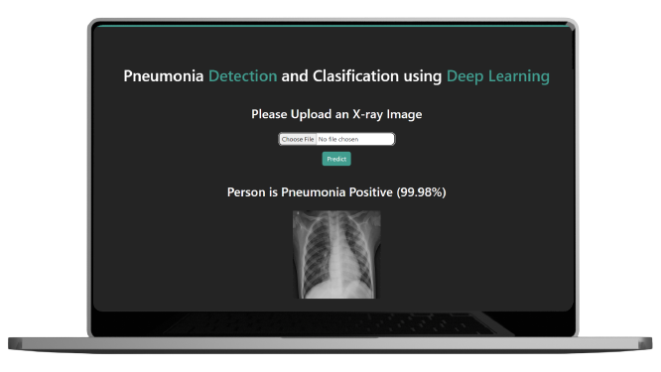
Frontend Interface

Slide 46
References
Vandecia Fernandes et al., “Bayesian convolutional neural network estimation for pediatric pneumonia detection and diagnosis”, Computer Methods and Programs in Biomedicine, Elsevier, 2021
Hongen Lu et al., “Transfer Learning from Pneumonia to COVID-19”, Asia-Pacific on Computer Science and Data Engineering (CSDE), 2020 IEEE.
Sammy V. Militante et al., “Pneumonia and COVID-19 Detection using Convolutional Neural Networks”, 2020 the third International on Vocational Education and Electrical Engineering (ICVEE), IEEE, 2021
Nanette V. Dionisio et al., “Pneumonia Detection through Adaptive Deep Learning Models of Convolutional Neural Networks”, 2020 11th IEEE Control and System Graduate Research Colloquium (ICSGRC 2020), 8 August 2020
Md. Jahid Hasan et al., “Deep Learning based Detection and Segmentation of COVID-19 & Pneumonia on Chest X-ray Image”, 2021 International Information and Communication Technology for Sustainable Development (ICICT4SD), 27-28 February 2021

Slide 47
Thank You

