Slide 1
FLIPKART GRIDLOCK 2.0 · PROBLEM STATEMENT 1
AI-Driven Spatial Intelligence
for Parking-Induced Congestion
From Reactive Ticketing to Proactive Congestion Prevention
Detect (HDBSCAN) · Quantify (Physics + XGBoost) · Prescribe (Knapsack Optimization)
Bengaluru Traffic Police · 298,277 violation records · Jan–May dataset
Notes:
Open by framing the shift: from reactive patrol to predictive, prescriptive AI dispatch.

Slide 2
PROBLEM STATEMENT
Why Parking Enforcement Fails Today
Reactive, Not Predictive
◷
Officers patrol blind. Deployment happens after congestion has already formed — no advance warning system exists.
No Visibility on Impact
◎
No tool links a parked vehicle to the actual traffic flow degradation it causes downstream.
No Prioritization Logic
▦
Every zone gets equal attention. Limited tow trucks and officers aren't allocated to where they matter most.
Flipkart Gridlock 2.0 · PS1 · AI Parking Intelligence
2
Notes:
Three gaps. Our system is engineered to close all three simultaneously.

Slide 3
SOLUTION OVERVIEW
An End-to-End AI Dispatch System
We built a system that processes nearly 300,000 historical traffic violations to automatically detect localized parking hotspots, calculate the actual physical traffic jam (shockwave) caused by parked vehicles, and predict when congestion will peak next. It then acts as a digital dispatcher — generating an optimized schedule that tells police exactly which zones to send limited tow trucks to, in order to maximize city-wide traffic flow recovery.
◎
◷
▤
DETECT
QUANTIFY
PRESCRIBE
HDBSCAN spatial clustering
Physics + XGBoost forecast
Knapsack-optimized dispatch
Flipkart Gridlock 2.0 · PS1 · AI Parking Intelligence
3
Notes:
This is the one-paragraph pitch. Everything downstream proves this claim with data.

Slide 4
ARCHITECTURE
The 4-Stage AI Pipeline
1
2
3
4
Spatial Clustering
Congestion Quantification
Predictive Forecasting
Prescriptive Optimization
HDBSCAN
Greenshields + LWR Physics
XGBoost + SHAP
0-1 Knapsack
→
→
→
Density-based clustering maps GPS violations into exact bottleneck zones — no hardcoded city polygons.
Real traffic-flow physics translates static tickets into dynamic lane capacity loss and queue length.
Temporal lag features forecast congestion severity 1–3 hours ahead, fully explainable via SHAP.
Patrol deployment framed as constrained optimization — maximize recovery given limited tow trucks.
312 hotspot zones identified
Up to 94% capacity loss quantified
1h / 2h / 3h forecasts, all zones
Ranked dispatch schedule output
Flipkart Gridlock 2.0 · PS1 · AI Parking Intelligence
4
Notes:
Four stages, each building on the last. Detection alone is descriptive — physics + forecasting + optimization make it prescriptive.

Slide 5
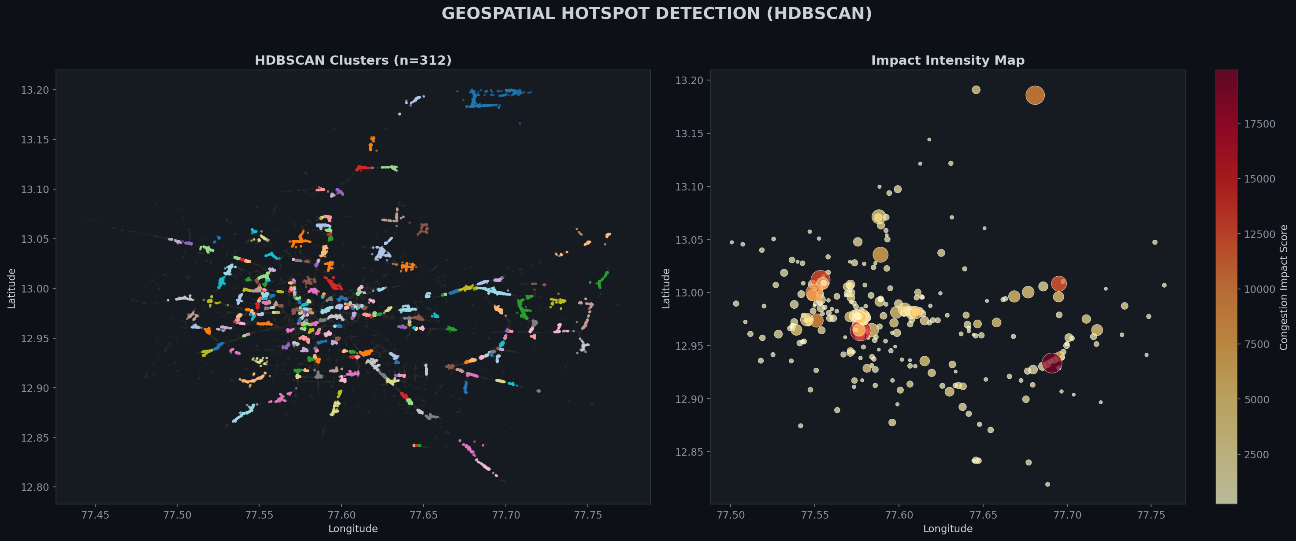
STAGE 1 — HOTSPOT DETECTION
312 Zones Identified via HDBSCAN
Records analyzed
298,277
Hotspot zones found
312
Noise points filtered
74,391 (24.9%)
Method
Density-adaptive, no preset K
Flipkart Gridlock 2.0 · PS1 · AI Parking Intelligence
5
Notes:
HDBSCAN advantage: no need to guess cluster count upfront, adapts to Bengaluru's mixed density automatically.

Slide 6
STAGE 2 — CONGESTION PHYSICS
Causal, Not Correlative
Instead of just plotting colored dots on a map, we applied the Greenshields Fundamental Diagram and Lighthill–Whitham–Richards (LWR) Shockwave Theory — the same physics used in real traffic engineering — to calculate the actual lane capacity lost and the upstream queue length triggered by each illegally parked vehicle.
94.0%
15.75 km
2
Worst-case capacity loss (Electronic City)
Upstream queue length triggered
Road lanes assumed per zone
KEY INSIGHT
A single illegally parked vehicle doesn't just block a lane — it triggers a backward-propagating shockwave that reduces arterial capacity for kilometers upstream. This is why naive violation-count ranking misses the real-world impact.
Flipkart Gridlock 2.0 · PS1 · AI Parking Intelligence
6
Notes:
This is the scientific differentiator. Most teams will count violations. We measured physical capacity loss.

Slide 7
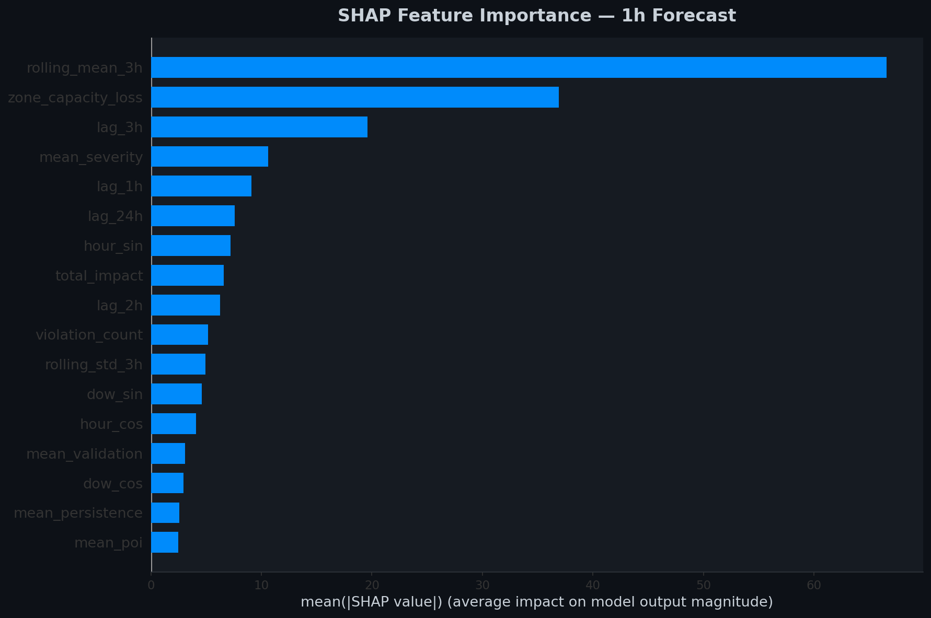
STAGE 3 — PREDICTIVE FORECASTING
Knowing What Happens Next, Not Just Now
XGBoost + Temporal Lag Features
A Gradient Boosted Decision Tree model trained on autoregressive lag features predicts congestion impact 1–3 hours into the future for every zone — shifting strategy from reactive to proactive.
Example — Electronic City forecast:
Capacity loss: 261 → 263 (1h ahead)
Forecast confidence backed by SHAP explainability
SHAP keeps every prediction explainable to officers — not a black box.
Flipkart Gridlock 2.0 · PS1 · AI Parking Intelligence
7
Notes:
SHAP chart on the right shows which features actually drive the forecast — full transparency for BTP officers.

Slide 8
STAGE 4 — PRESCRIPTIVE OPTIMIZATION
0-1 Knapsack: Where to Send Limited Resources
Identifying hotspots is easy. Deploying limited tow trucks optimally is hard. We framed patrol deployment as a constrained optimization problem — given N trucks and a shift window, maximize total capacity recovered network-wide.
Priority | Zone | Dispatch Value | Violations | Travel Time
#1 | Pulikeshinagar (F.Town) | 313.29 | 245 | 18 min
#2 | Bellandur | 277.65 | 123 | 59 min
#3 | K.R. Pura (Zone A) | 191.03 | 129 | 71 min
#4 | K.R. Pura (Zone B) | 190.71 | 282 | 60 min
#5 | Malleshwaram | 190.10 | 134 | 18 min
WHY THIS ISN'T JUST SORTED BY SEVERITY
Dispatch value accounts for predicted impact AND travel cost — the optimizer can rank a lower-severity-but-closer zone above a higher-severity-but-distant one, maximizing total city-wide recovery per truck-hour.
Flipkart Gridlock 2.0 · PS1 · AI Parking Intelligence
8
Notes:
Important nuance: rank ≠ raw severity sort. This is the optimizer outsmarting naive ranking — frame as a strength, not an inconsistency.

Slide 9
RESULTS
What the Numbers Say
298,277
312
94%
Records Processed (post-cleaning)
Hotspot Zones (HDBSCAN)
Worst-Case Capacity Loss
₹9.2 Cr
10.5%
552
Est. Annual Cost (Top 20 zones)
City-wide Impact Cut (Top 5 zones)
Chronic Repeat Offenders
Flipkart Gridlock 2.0 · PS1 · AI Parking Intelligence
9
Notes:
Top 5 zones eliminating 10.5% of city-wide impact is the single number to remember.

Slide 10
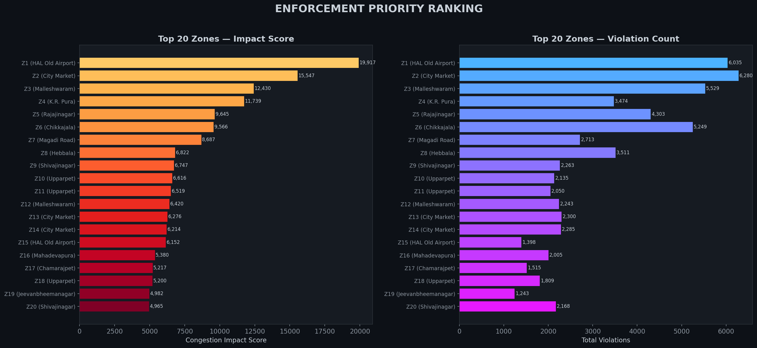
PROTOTYPE
Police Command Center — Live Dashboard
• White-mode layout — built for daylight legibility in the field, not a dark cinematic demo
• Live risk badges: CRITICAL / HIGH / ELEVATED / CLEAR, updating in real time
• Live Priority Queue counter — immediate top zones requiring action
• Command Log Ticker — chronological dispatch events
• Leaflet map with impact-sized zone markers
★ THE WOW MOMENT
A Historical Replay Slider (12 AM–11 PM). Scrub it — clock, map, priority queue, and risk badges all update together, live.
Flipkart Gridlock 2.0 · PS1 · AI Parking Intelligence
10
Notes:
Demo this live. The synchronized replay slider is the moment that separates us from a static dashboard.

Slide 11
DIFFERENTIATION
Why This Solution Is Different
01
Causal, Not Correlative
LWR shockwave theory calculates actual lane capacity lost — not just colored dots on a map.
02
Prescriptive, Not Just Descriptive
Knapsack optimization tells the city exactly where to deploy limited tow trucks to maximize ROI.
03
Field-Ready Engineering
A production-ready dispatch_schedule.csv feeds directly into a daylight-readable command center — no notebook required in the field.
Flipkart Gridlock 2.0 · PS1 · AI Parking Intelligence
11
Notes:
Closing differentiation slide before the ask/close.

Slide 12
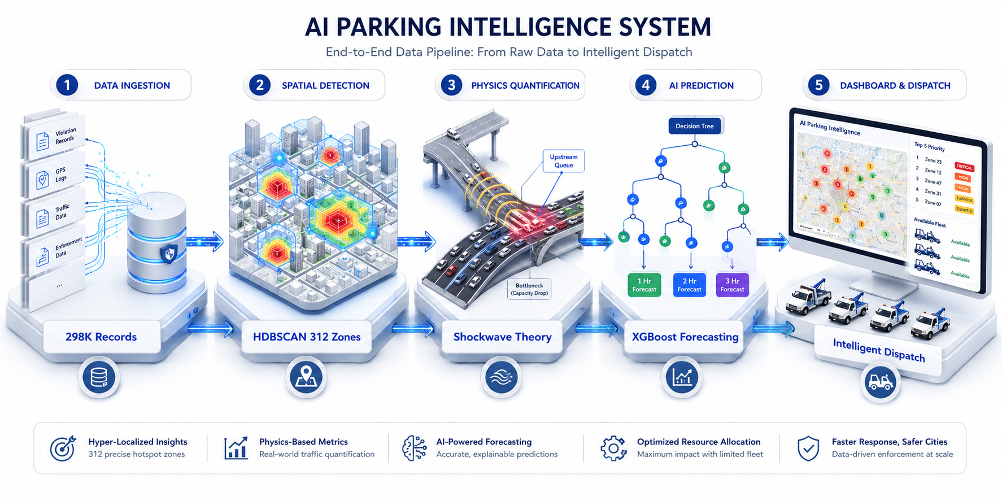
PRODUCTION ARCHITECTURE
Built to Scale, Not Just Demo
Flipkart Gridlock 2.0 · PS1 · AI Parking Intelligence
12
Notes:
Ingestion → spatial DB → AI engine (HDBSCAN + physics + XGBoost) → knapsack optimizer → command center dashboard.

Slide 13
What We Delivered
◎
◷
▤
DETECT
QUANTIFY
PRESCRIBE
312 hotspots via HDBSCAN spatial clustering
Physics-based capacity loss + 1-3h XGBoost forecast
Knapsack-optimized dispatch + live command center
Illegal parking in Bengaluru is chronic, physically quantifiable, and costly.
With causal AI and prescriptive dispatch, BTP can cut 10.5% of city-wide congestion impact by acting on just 5 zones.
Built with HDBSCAN · Greenshields & LWR Physics · XGBoost · SHAP · 0-1 Knapsack · Leaflet
Notes:
Close on the 10.5%-from-5-zones number. That's the one stat judges should remember.

