Slide 1
The game of tennis
Created by Kozlova Ulyana, Berdyugin Mikhail, Litasova Anna

Slide 2
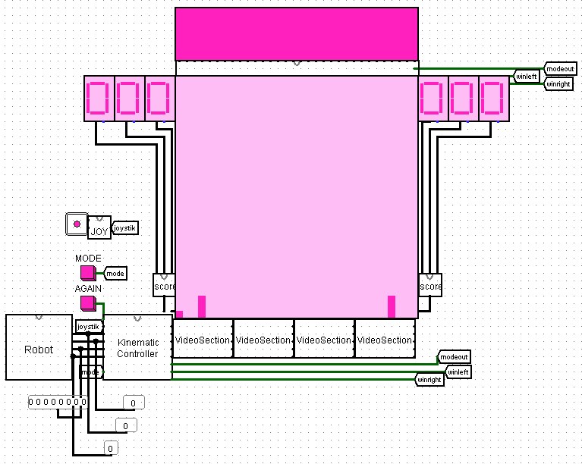
System architecture

Slide 3
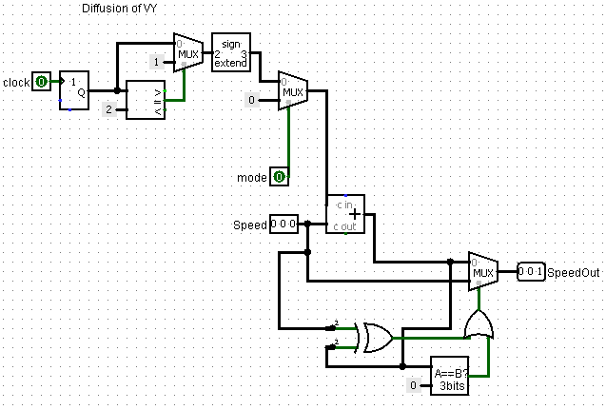
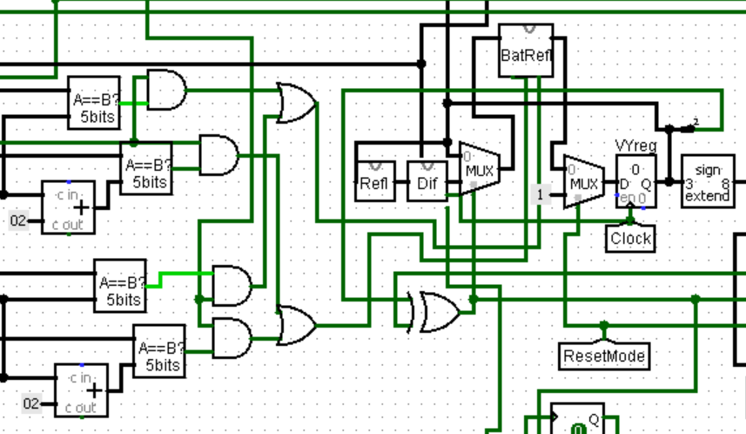
Diffusion
Subcircuit “Dif”
VY speed control path

Slide 4
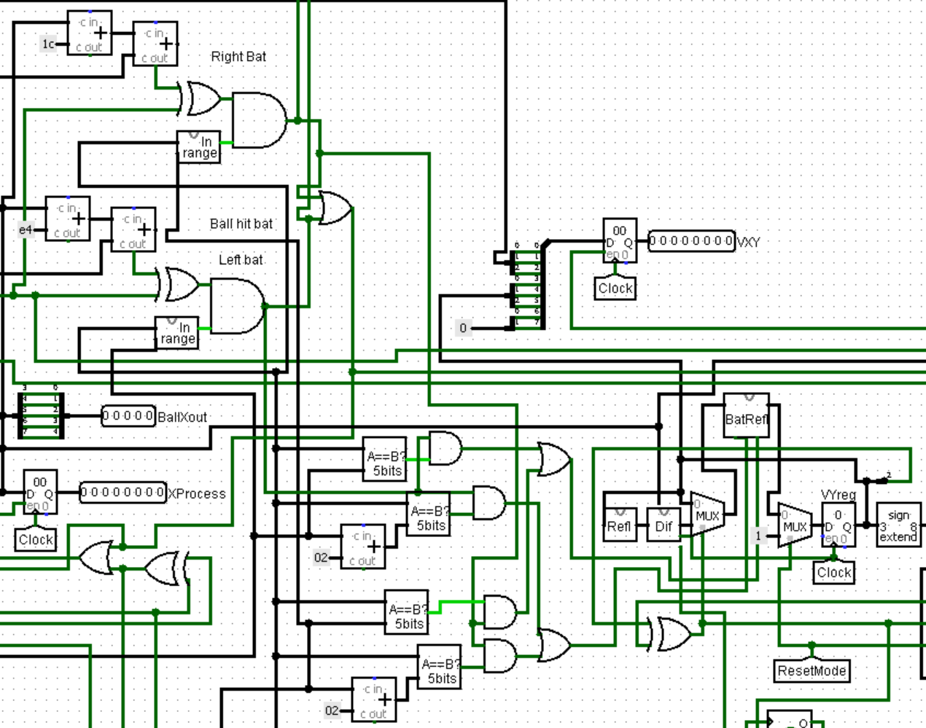
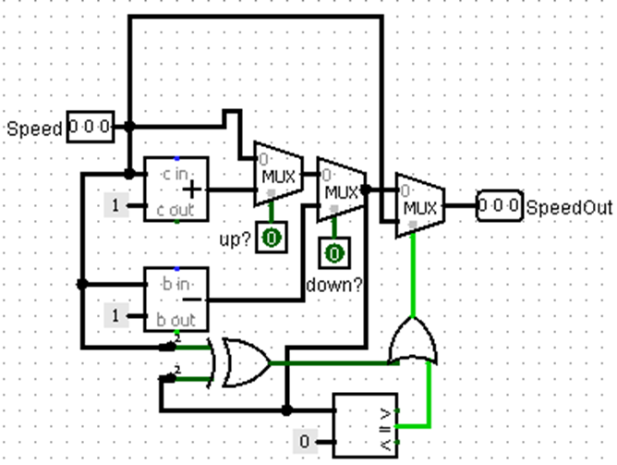
BatReflectVy
VY speed control path
Subcircuit “BatRefl”

Slide 5
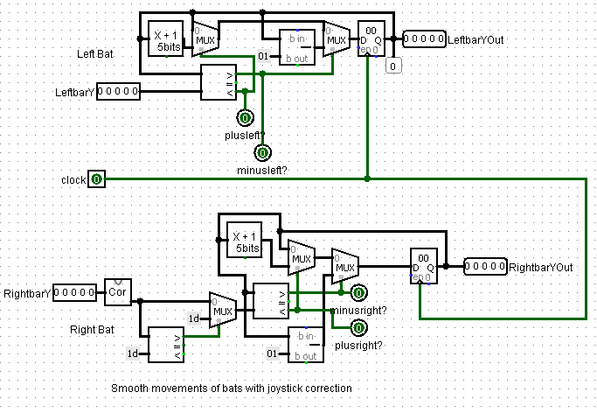
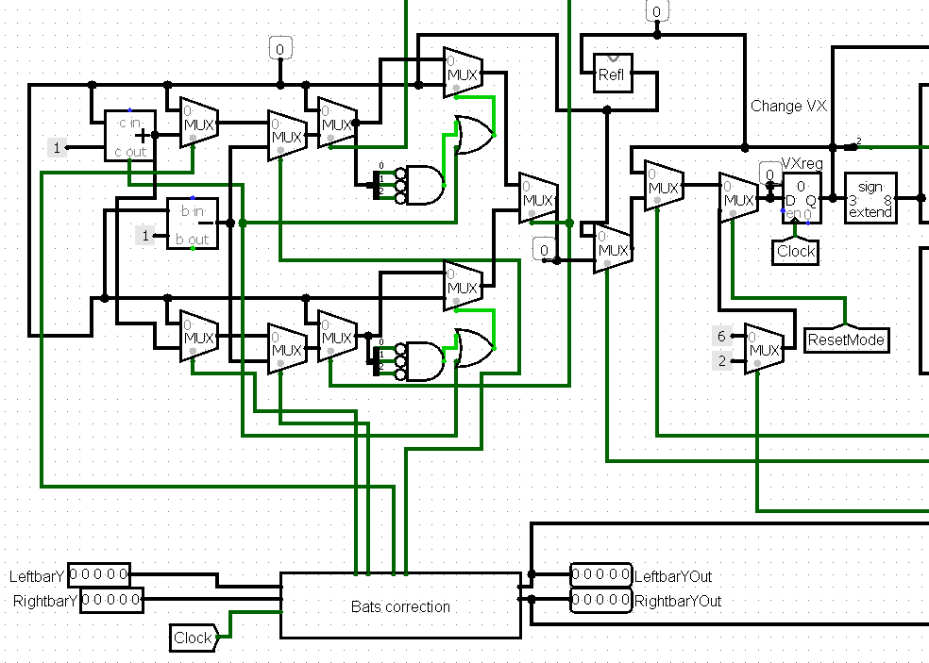
Bats
Subcircuit “Bats correction”
VX speed control path

Slide 6
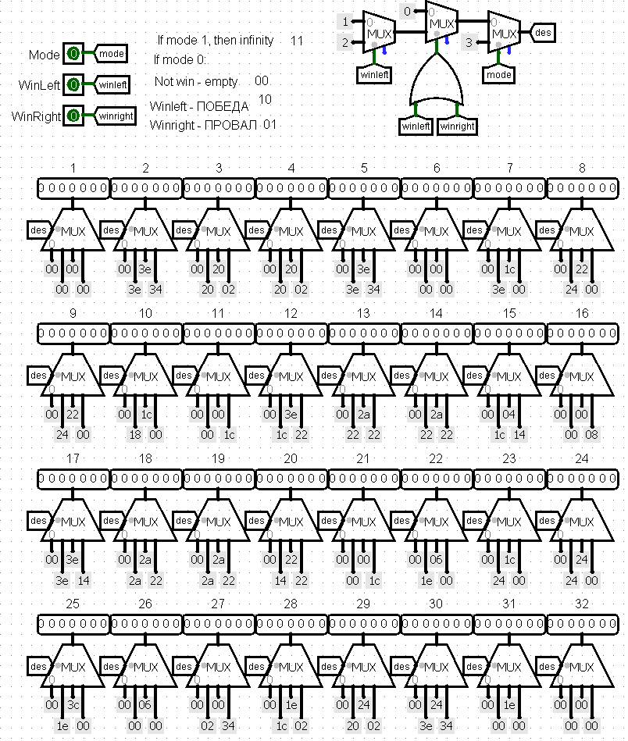
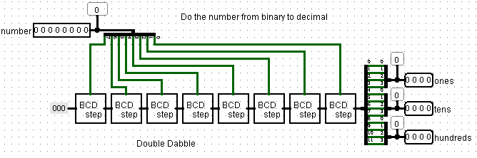
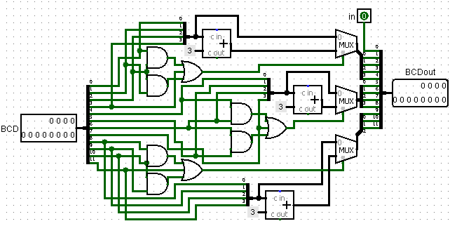
Displaying the mode/result on the screen
Binaryto3Dig
BCDstep

Slide 7
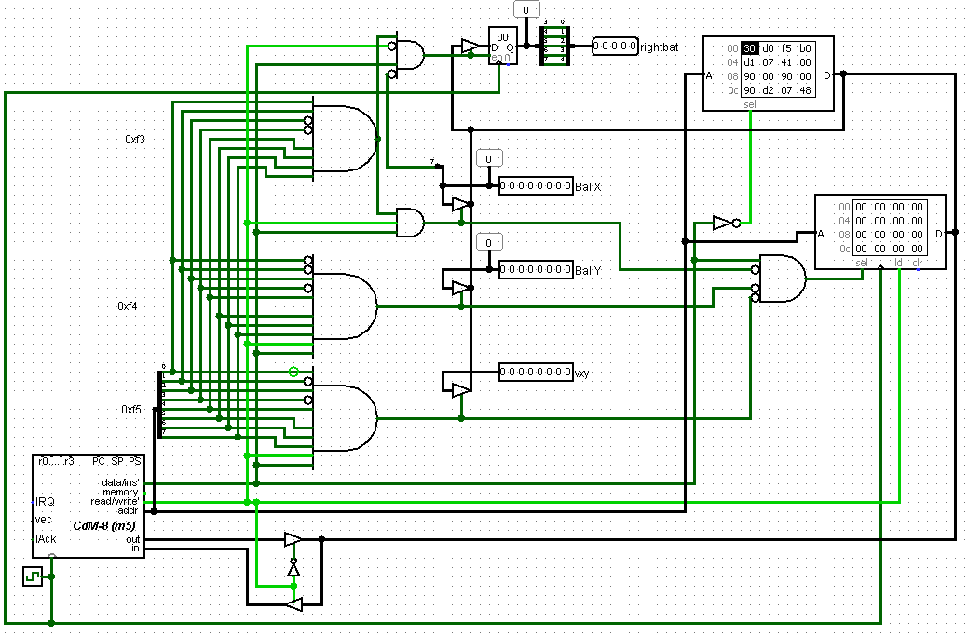
AI
Process

Slide 8
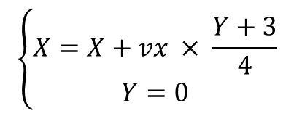

AI algorithm
Start
Get x, y, vx, vy
$$Y_{rightbat} =Y+\left(224 −X\right)× \frac{vy}{vx}$$
Calculate |vy|,
res = 224 - x
|vy| == vx?
Yes
$$\left\{\begin{aligned}X=X+vx × \frac{Y+3}{4} \\ Y=0\end{aligned}\right.$$
No
|vy| == 4 and hit is closer than bat??
Yes
Calculate coordinates of hit, put it to x, y; vy = 3
No
res = res * |vy| / vx
res = y - res
No
vy > 0
Yes
res = y + res
older byte of res is odd?
No
Yes
res = not res
store the result

Slide 9
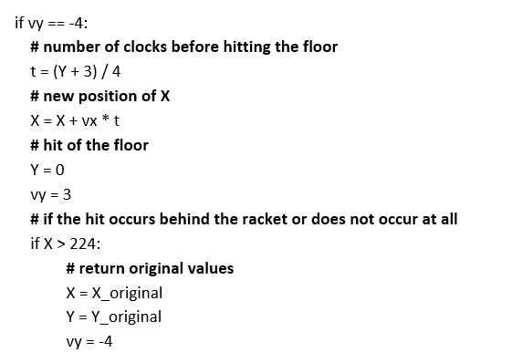
vy = -4

Slide 10
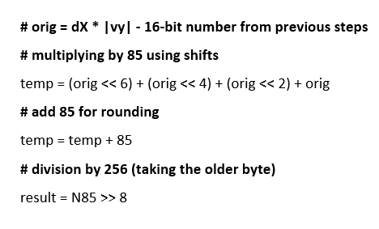
vx = 3

Slide 11
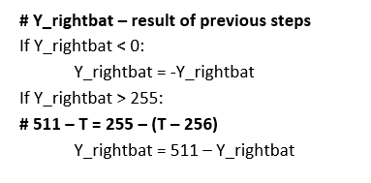
Accounting for hits

Slide 12
Thanks for attention!

