Slide 1
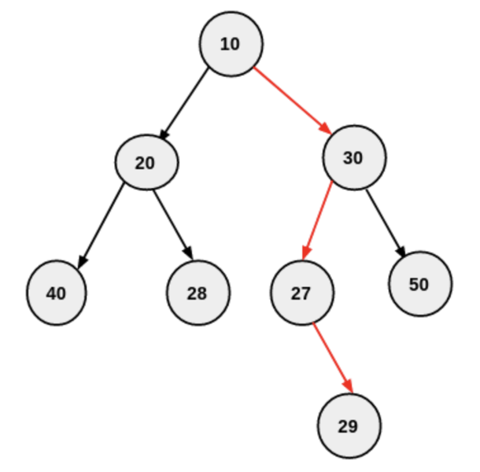
B
Get all combinations of the elements in the list
A
B
C
A
C
At every node, take the decision if you want to add element to the list or skip
Do no add (skip) ==> traverse left
Add to the list ==> traverse right
[]
Start with an empty list
Total Elements = n
Total Combinations = 2^{n}
Do not add
Add to the list
The recursive function in binary tree calls itself N number of times, where N is the max depth of the binary tree, which is also equals to the number of elements in the list.
[]
[A]
Do not add
Add to
the list
Do not add
Add to
the list
Max depth of BT is equals to the number of edges between root and the farthest leaf node.
[]
[B]
[A]
[A,B]
Number of elements in the list in above example are 3
Max depth of above BT = 3 Hence, Time complexity of above solution = 2^3
Do not add
Do not add
Add
Do not
add
Add
Add
Do not
add
Add
max depth = 3
[]
[C]
[B]
[B,C]
[A]
[A,C]
[A,B]
[A,B,C]
Combinations without first element
Add first element to each combination on left

