Slide 1
RIVERTY · SOFTWARE ENGINEER (RAG) CASE STUDY
Contract Intelligence
Which contracts lack a clause the guideline requires?
Which still name the company by its old name?
A knowledge-graph pipeline that finds, a strong model that verifies, a lawyer who decides — on the PDF itself.
SharePoint · upload
→
Read
→
Neo4j graph
→
Check
→
Decide
→
Contract storage
Gaurav Kulkarni · September 2026 · 10 minutes, then 5 minutes live
Contract Intelligence · Riverty case study
1 / 10

Slide 2
THE PROBLEM
Open · search · verify — by hand, 15,000 times
SharePoint
most contracts, PDF
Which contracts do NOT contain passage X?
QUESTION 1
Which contracts still name the OLD company?
QUESTION 2
Scans
no text layer
Today, per contract and question
× 15,000
Handwritten JPEGs
really old contracts
open the PDF
search, in two languages
verify yourself
Contract storage
REST · store a copy only
≈ 15 min · scans 20–40 · handwriting 30–60 or skipped
“Agents like Claude often fail due to the sheer size and complexity of the environments” — so this is not an agent. It is a pipeline with model nodes.
Contract Intelligence · Riverty case study
2 / 10

Slide 3
THE ESTIMATION
How much work is it — and what does it cost?
15,000
40,000
12–20
1–3
active contracts
documents in the archive
new contracts per day
sweeps a year
1,800 merchants × ~3 docs, vendors, mandates, NDAs
incl. arvato · infoscore · AfterPay entities
20–30 % of the stock turns over a year
rebrand 2022–23 · the bank 2026 · DORA · a guideline change
Rename sweep over 15,000 contracts
Daily flow · 15 contracts a day
manual · 15 min each
manual · 45–60 min each
3,750 h ≈ 2.3 FTE-years ≈ €340k 5 people · 5 months
1.6 FTE ≈ €240k a year
with the tool · 3 min per finding, spot checks
with the tool
250 h lawyer time + €900 model calls 1–2 weeks
0.2 FTE + €250 model + €3k infrastructure
Gemini 3.1 Pro $2 / $12 per 1M tokens → ≈ $0.06–0.10 per contract. The tool costs ~1 % of the lawyer time it replaces; the time that remains is the part only a lawyer can do. Estimates: docs/cost-benefit.md.
Contract Intelligence · Riverty case study
3 / 10

Slide 4
THOUGHT PROCESS
Retrieval finds what is there. It cannot prove what is not.
search
structure
chunks
similarity
top-k
clauses, typed
guideline REQUIRES
absence = lookup
“nothing similar above 0.6” … is that absence? → a guess with a score
register (GLEIF)
RENAMED_TO
identity = edge
“Arvato Systems” ≈ “Arvato Payment Solutions” to a vector → identity is not similarity
an agent that opens and searches for itself fails in a big, messy environment — the statement says so
rules FIND (recall) → a model VERIFIES (precision) → a person DECIDES
Four versions in ten days
26–27 Aug · v1 workbench
question cards, matrix, review queue, chat — every feature defensible, the sum not what a legal team reaches for: cut
29 Aug · v2 file converter
drop in → one result line → findings on the PDF → corrected copy: lawyers trust what they see on the page
5 Sep · v3 knowledge graph
Neo4j as the RAG store beside Postgres; register from GLEIF; the models read the graph’s selection
5 Sep · v4 graph only
Neo4j the sole database; scoped-then-full verification; three steps + a Technik page: one system, precision restored
Contract Intelligence · Riverty case study
4 / 10

Slide 5
THE WORKFLOW
One contract, end to end — 14 stages, three phases
READ
CHECK · LangGraph
load · text layer or page image
rules · guideline gaps, old names
ocr · Tesseract → Gemini vision
Neo4j
contracts · clauses · names guideline · register · decisions vector + full-text index
cross_check · Pro, two reads
DECIDE
SharePoint
upload · delta sync
segment · clauses by structure
place · box on the page
decide
classify · keywords + Flash
draft · name or clause
correct
entities · register + GLEIF
policy · carry-over, spot checks
screen · injection guard
contract storage
embed · vector + full-text
decisions become precedents
So funktioniert es and Technik render this same stage list from GET /api/pipeline — the explanation cannot drift from the code
Contract Intelligence · Riverty case study
5 / 10

Slide 6
THE GRAPH
The database is the knowledge graph
database-first
ContractType
merchant agreement
REQUIRES
ClauseType
liability_cap
Seeded from files and registers, not from a model: the guideline (Legal’s file), the taxonomy, GLEIF — the public LEI register records Arvato Payment Solutions GmbH as the previous name of Riverty GmbH — and the team’s decisions.
IS_A
OF_TYPE
Entity
Arvato Payment Sol. GmbH
MENTIONS
Contract
ClauseType
anti_corruption
retrieval inside the graph
RENAMED_TO
HAS_CLAUSE
no IS_A path → the gap
Every clause carries its embedding (768 d, cosine, Cypher SEARCH) and its text (Lucene). Hybrid = reciprocal rank fusion of both; scoped by graph filters.
Entity
Riverty GmbH · LEI
Clause
§ 4 · vector · text
(Decision)-[:ON]->(Contract), (Decision)-[:ABOUT]->(ClauseType): the team’s decisions live in the same graph as precedents
why not …
Postgres + pgvector (v1–v3): the questions became joins over label tables. Cosmos DB Gremlin: no native vectors. AGE on Azure PostgreSQL: the Microsoft runner-up — swaps in for two modules.
MATCH (c)-[:OF_TYPE]->()-[:REQUIRES]->(t) WHERE NOT EXISTS { (c)-[:HAS_CLAUSE]->()-[:IS_A]->(t) }
“which contracts lack a required clause” — one pattern, no search, no model
Contract Intelligence · Riverty case study
6 / 10

Slide 7
CHECK · DECIDE
Rules for recall, the model for precision
candidates from the rules
required type without a certain clause · active old-name mention — recall 0.95, precision 0.43
A person decides — the review rate falls with evidence
100 %
read 1 · what the graph selects
outline (every clause, type, page) + the 6 most relevant clauses + every clause of the type; Gemini Pro, thinking high → confirmed | refuted | partial + page + quote + reason
20 %
10 %
still “missing”?
refuted → present
8 agreeing · ≥ 95 %
24 in a row
a dismissal → reset
deterministic spot checks (SHA-256), at least one per contract; only cross-checked findings are automated; decisions carry over per file and become precedents
read 2 · the whole contract
skipped when read 1 already covered ≥ 90 % · the cheap error (a false alarm) is caught here
a false alarm, reviewed
a false edit, filed
€4.50
€1k–100k
confirmed → the page · precision 1.00 · recall 0.91 (CUAD, 22 absences)
3 minutes on the page
rework, dispute — a document with legal effect
only the verifier may remove a candidate · Pro for verify and handwriting, Flash for labels and drafts, Flash-Lite for screening · Foundry behind the same switch
Contract Intelligence · Riverty case study
7 / 10

Slide 8
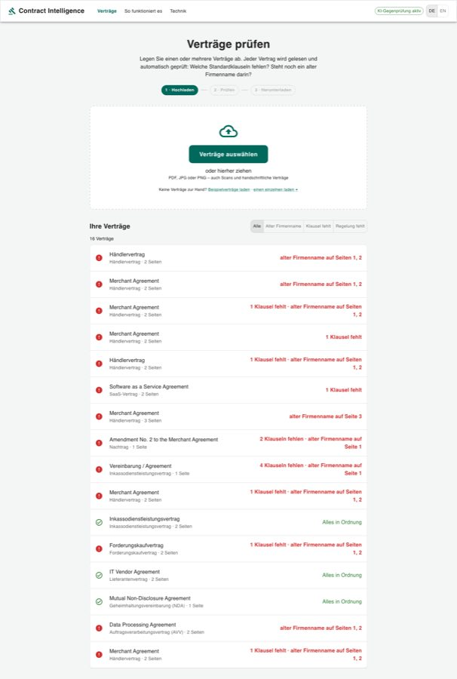
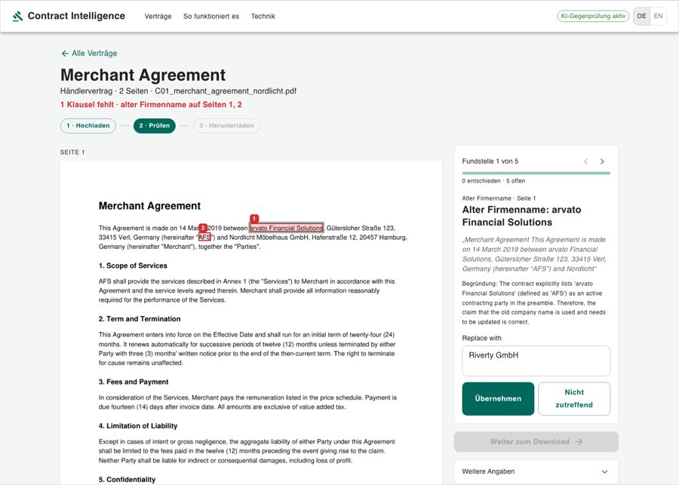
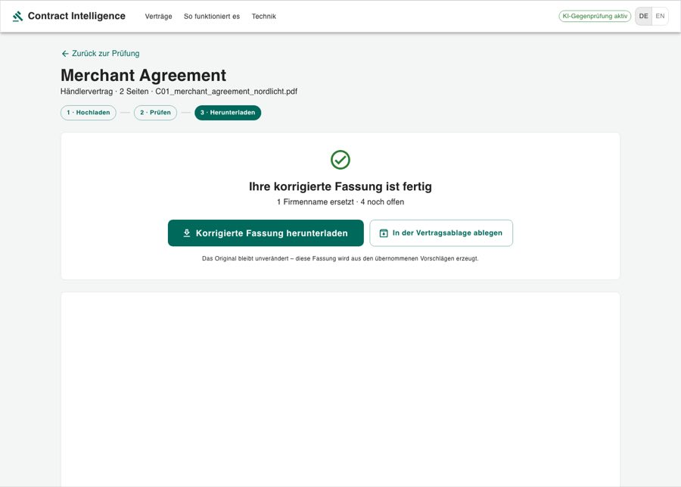
THE UI
Three steps — the PDF is the interface
1 · Hochladen
2 · Prüfen
3 · Herunterladen
drop one or many · one result line each · a filter for “which contracts lack X”
markers on the page · one finding at a time · Übernehmen / Nicht zutreffend
what was applied · the copy · preview · filing
Why one finding at a time.
The only clicks are decisions; a decision moves on; the marker on the page is verified with a glance — a list would send the lawyer back into the PDF.
Why no numbers for lawyers.
No confidences, no traces on these pages — quote, reason, marker, and whether it was cross-checked. German first, English one click.
Why a Technik page.
Engineers get the same 14 stages with module, model, thresholds, the graph’s live counts and a trace of one contract — generated, so it cannot drift.
Contract Intelligence · Riverty case study
8 / 10

Slide 9
INFRASTRUCTURE · THE PROBLEM STATEMENT
Azure — and the statement, checked
Against the problem statement
Azure · Container Apps · Terraform
✓
basic pipeline · front-end · end-to-end workflow
SharePoint
Graph delta
API
FastAPI · LangGraph internal ingress
Neo4j
AuraDB (Marketplace) or the container
✓
contracts without a passage · old company name
✓
scans and handwritten JPEGs · Tesseract → vision
Blob · working copies
✓
best-of-breed vs Microsoft: one switch each
Gemini
Vertex · EU
Web
React · Entra ID sign-in
✓
Azure · Foundry/Gemini · containers · FastAPI · Terraform · React/TS · LangChain/LangGraph
Key Vault
◐
SharePoint: Graph delta sync written, not run against a tenant
Foundry
GPT-5 · Data Zone
Log Analytics
◐
contract storage: idempotent filing, mocked API
Contract storage
Idempotency-Key
Document Intelligence
◐
guidelines · best interests: guideline file, drafts, no playbook yet
documents never leave the tenant; only the checked contract’s pages go to the model
Switches: LLM gemini | foundry · OCR tesseract | document_intelligence · source folder | sharepoint · database Neo4j | AGE + pgvector on Azure PostgreSQL
Contract Intelligence · Riverty case study
9 / 10

Slide 10
ADOPTION · LIVE DEMO
Adoption — then five minutes live
1 · Pilot on the next sweep
the bank rename, two lawyers, measured against the manual sample
2 · Legal owns the rules
the guideline file, the register, the clause types — no engineer needed
3 · Decide on the page
every decision teaches: precedents, the review rate as the trust meter
4 · Routine
sweeps on events, the daily flow, spot checks, the corrected copy filed
trust: the original is never touched, every decision is a named person’s, the audit log answers who accepted what · learning: So funktioniert es and Technik, generated from the code · measure: minutes per contract, review rate per class, precision/recall against the answer key
Six beats
Next
1
drop a contract → “Wird gelesen … Wird geprüft …” → the result line
· SharePoint against the real tenant
· the contract storage’s real API — an adapter
· Entra ID sign-in, structured logging, metrics
· a playbook of preferred positions for the drafts
· parallel ingestion behind a queue for sweeps
· a pairwise “compare two contracts” view
2
open it: the box on the page, the quote, the model’s reason, Übernehmen / Nicht zutreffend
3
Weiter zum Download: the corrected copy, the preview, filing under an idempotency key
4
the start page filter: which contracts lack a limitation of liability?
5
Technik: the stages with their models, the graph’s live counts, the gap query, a trace
6
the Neo4j browser: the contract as a graph
docs/architecture-decisions.md · docs/cost-benefit.md · docs/ps-coverage.md
Contract Intelligence · Riverty case study
10 / 10

