Slide 1
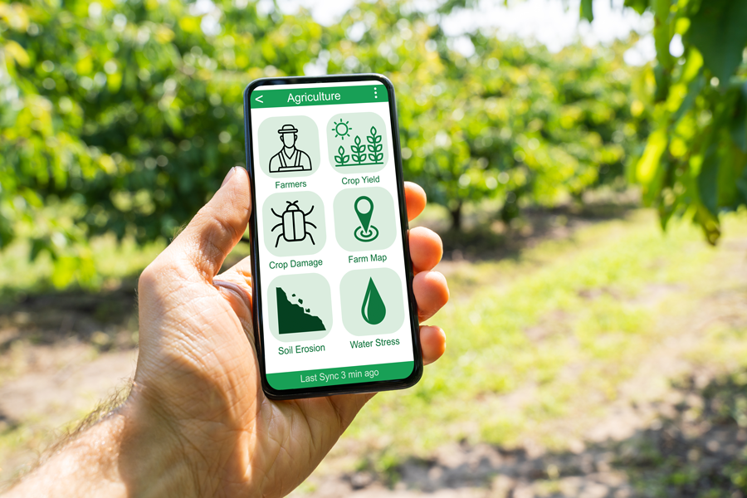



JalTantra- Smart irrigation system
Enigma Engineer’s

Slide 2

The Problem
The Challenge of Water Management in Indian Agriculture
Customer Pain
Customer / Persona
Inefficient Water Usage
Time-Consuming Manual Irrigation
Water Wastage
Crop Health Risks
Manual Labor Intensive
Cost of Operations
Small to Medium-Scale Farmers
Agri-Tech Innovators
Water-Scarce Region Farmers
Large-Scale Farms and Cooperatives
Water Crisis in Agriculture
High Water Usage: Agriculture consumes 80% of India’s freshwater. (Source: IWA Publishing)
Inefficient Irrigation: India's 38% irrigation efficiency is far below the 50–60% in developed
nations. (Source: National Water Mission)
Aging Infrastructure: 1,065 dams are over 50 years old, impacting water storage.
(Source: United Nations University, Economic Times, Indiaspend)
Climate Impact: Droughts & floods cause 0.25% GDP loss annually. (Source: ScienceDirect)
Farmer Struggles: Outdated irrigation leads to low yields & financial instability.
LEARN NOW

Slide 3


Our Solution – JalTantra Smart Agriculture System
Solutions’s
🌱 1. AI-Driven Smart Irrigation System "Precision irrigation with real-time weather and soil monitoring."
🤖 2. AI-Powered Crop Disease Detection "Early disease detection for healthier crops and higher yields."
📊 3. AI-Enabled Crop Health Monitoring "Stay ahead with real-time insights on crop conditions."
🗣️ 4. Multi-Regional Language Support "Breaking language barriers to make technology accessible for every farmer."
🌿 5. AI-Powered Future Crop Planning "Smart suggestions for choosing the right crops at the right time."
🔩 6. Sustainable & Cost-Effective Hardware "Durable and affordable IoT solutions built for Indian farms."
📈 7. Real-Time Market Analysis & Insights "Empowering farmers with AI-driven market intelligence."
🛒 8. Marketplace for Farmers – Direct Selling & Buying "Connecting farmers directly to buyers for better profits."
JalTantra – Unique Features
✅ AI-Driven Smart Irrigation ✅ AI Crop Disease Detection ✅ Real-Time Crop Health ✅ Multi-Language ✅ Sustainable IoT Hardware. ✅ Real-Time Market Analytics

Slide 4



Market & Analysis
TAM
2.1 B$
Total Available Market
-India
SAM
50M$
Serviceable Available Market
Market Size & Growth
-Maharashtra
Current Market Size (2024): The smart irrigation market is estimated to be worth $1.8 billion.
Projected Market Size (2025): The market is expected to reach $2.1 billion by 2025, growing at a Compound Annual Growth Rate (CAGR) of approximately 15.3%
10M$
SOM
-Pune
Serviceable Obtainable Market

Slide 5
Market & Analysis
Customer Pain
Targeted Costmer
Limited Digital Literacy
Weather Dependency
Infrastructure Gaps
Lack of Skilled Workforce
Perceived Risk of Technology Failure
Small to Medium-Scale Farmers
Agri-Tech Innovators
Water-Scarce Region Farmers
Large-Scale Farms and Cooperatives
Government & Rural Development Agencies
🚀 Why JalTantra is a Game-Changer in This Market?
✅ Addresses a $218.9M+ Smart Agriculture Market with massive growth potential. ✅ Solves critical farmer challenges like water wastage, unpredictable weather, and
manual labor. ✅ Scalable from Pune to Maharashtra to Pan-India, ensuring long-term expansion. ✅ AI-driven, IoT-based, and mobile-integrated solution tailored for Indian farmers.
LEARN NOW

Slide 6


Competitive Landscape
Competitors | IoT app (regional lang.) | Solar power System | Plant disease detection using AI | Weather forecast | Sustainability Solutions | Real-time Analytics
Mobitech Wireless Solution
Ecozen Solutions in India
Jain Irrigation Systems Ltd
JalTantra
LEARN NOW

Slide 7
Product/Service Overview – Transforming Agriculture with JalTantra
What is JalTantra?
JalTantra is an AI-powered Smart Agriculture Solution designed to empower farmers with technology. By integrating smart irrigation, AI-driven crop monitoring, and real-time market insights, we help farmers optimize water usage, improve crop health, and increase profits.
🌟 Key Features & Benefits
📢 Why Choose JalTantra? ✅ Increase Yield ✅ Reduce Costs ✅ Save Water ✅ Enhance Profits
Smart Irrigation: AI & IoT-based automated watering reduces water wastage by 30%.
AI Crop Health Detection: Real-time scanning & instant alerts for early disease detection.
Future Crop Planning: AI-driven best crop selection & smart fertilization for higher yield.
Multi-Language Support: Available in regional languages for easy adoption.
Sustainable IoT Hardware: Low-cost, weather-resistant sensors with solar & battery backup.
AI Market Insights & Direct Selling: Real-time price tracking & farm-to-market model for better profits.

Slide 8
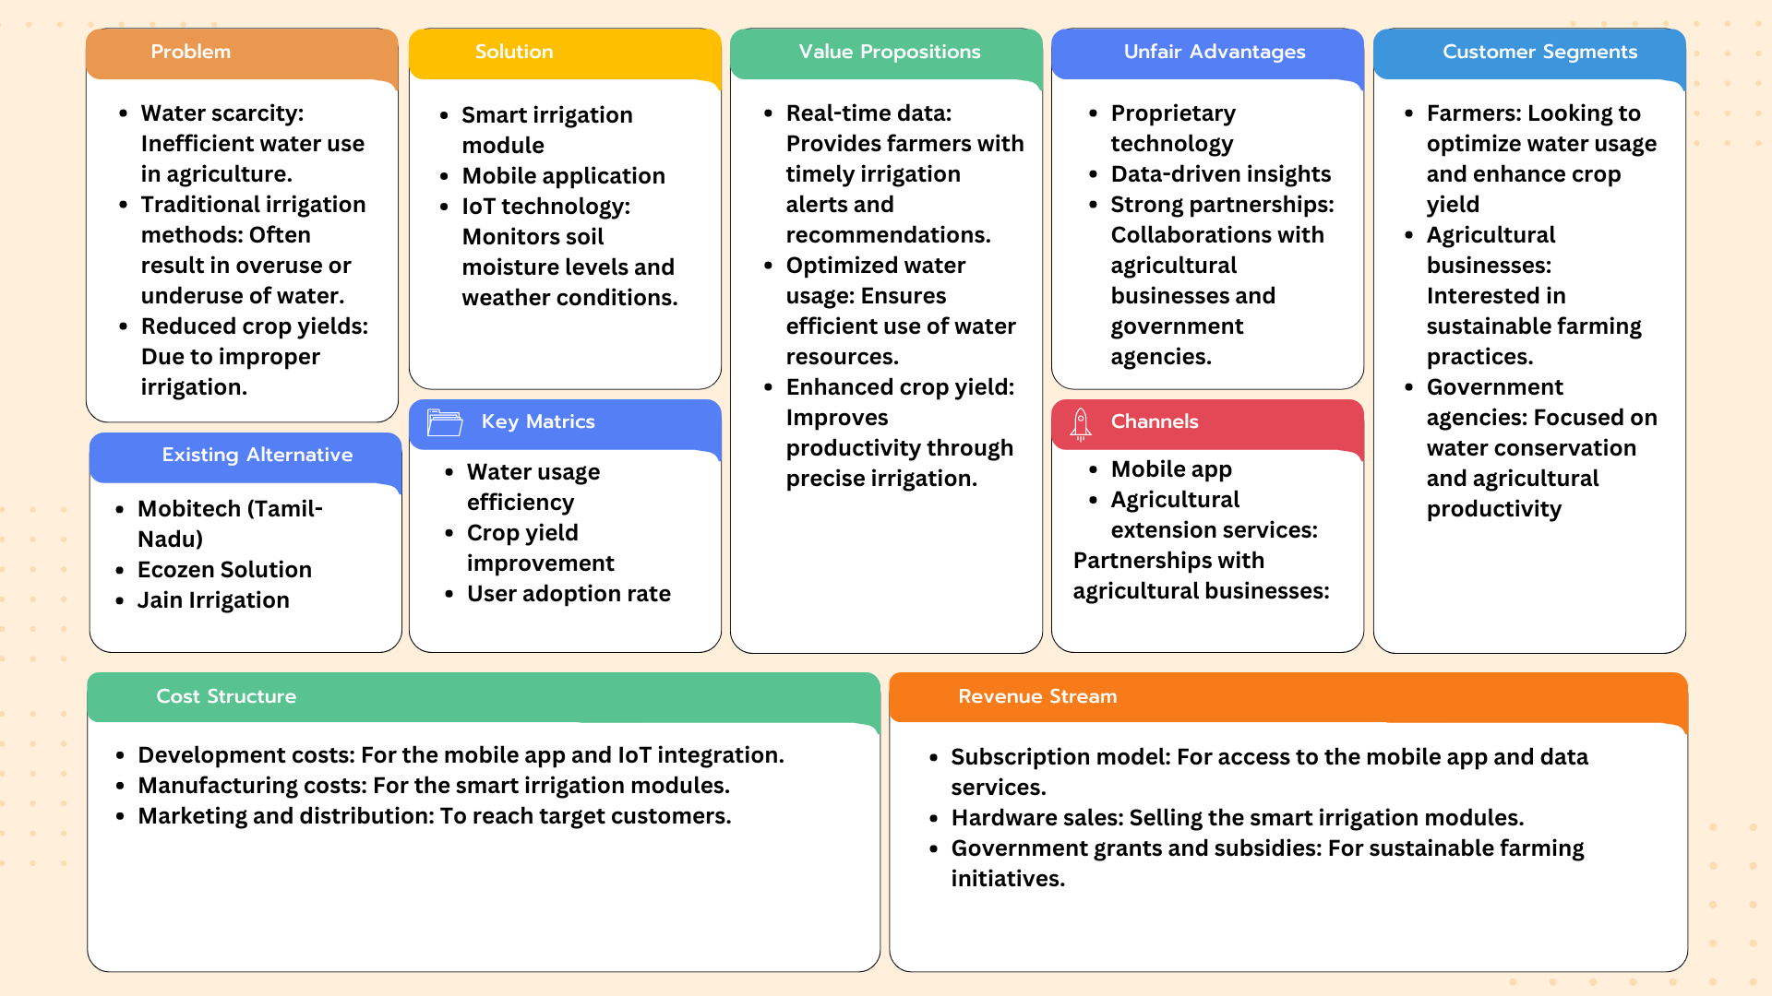
LEAN CANVAS
LEARN NOW

Slide 9
JalTantra Business Model
Planning to make Money
Strategic Plan
🛠 Revenue Streams – How We Make Money
1️⃣ IoT Device Sales (One-Time Revenue) – Primary Revenue Model
JalTantra Smart Irrigation Kit (IoT sensors, controller, and mobile app integration).
Farmers pay a one-time cost of ₹15,000 - ₹30,000 depending on farm size.
Revenue Share: 50% of total earnings from hardware sales.
2️⃣ Subscription-Based Mobile App (Recurring Revenue) – SaaS Model
Basic App: Free (limited monitoring).
Premium Plan: ₹199/month or ₹1999/year (Advanced AI automation, remote control, analytics).
Revenue Share: 25% of total revenue from subscriptions.
3️⃣ B2B Partnerships (Government & AgriTech Firms) – Bulk Sales
Partnering with Government & NGOs under smart agriculture programs.
Collaboration with AgriTech companies for integration with their products.
Revenue Share: 15% of total revenue from institutional sales.
4️⃣ Data Monetization & Insights – Selling Agri-Intelligence Data
Selling anonymized agricultural data & analytics to research organizations, weather forecasting agencies, and precision farming companies.
Revenue Share: 10% of total revenue from data analytics.
Year 1: Maharashtra Pilot & Market Penetration ✅ Focus on Pune, Nashik, Ahmednagar, Aurangabad. ✅ Onboard 500+ farmers via cooperatives & govt. schemes. ✅ Marketing: Field demos, WhatsApp campaigns, Agri
influencers. ✅ Revenue Target: ₹80 Lakhs.
Year 2-3: Statewide Expansion & B2B Growth ✅ Expand across Maharashtra, Gujarat & Karnataka. ✅ 2,500+ farmers, B2B partnerships with AgriTech firms. ✅ Marketing: KVK tie-ups, referral programs, SEO & digital ads. ✅ Revenue Target: ₹3 Crores.
Year 4-5: National & Global Scale-up ✅ Pan-India expansion (Rajasthan, UP, MP, Tamil Nadu, Telangana). ✅ Go international (Southeast Asia & Africa). ✅ Govt. bulk orders, AI-driven smart irrigation system launch. ✅ Revenue Target: ₹15 Crores+.
LEARN NOW

Slide 10




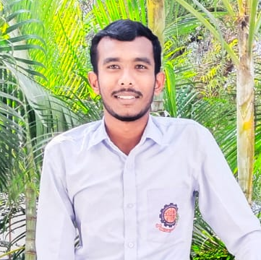
OUR TEAM
Advisor : Prof. A. R. Landge
Mr. Shubham M. K.
Co. Founder & CEO
Software Developer
Mr. Aniket N. G.
Co. Founder & CFO
Hardware Developer
Mr. Yadnynesh K. D.
Co. Founder & CMO
UI/UX
JalTantra

Slide 11

Call to Action
At JalTantra, we are not just building a product; we are creating a sustainable future for Indian agriculture. Now, we invite YOU to join us in making this vision a reality!
📌 Our Ask:
We are seeking ₹15 Lakhs for 5% equity to: ✅ Scale our smart irrigation technology across multiple farming regions. ✅ Enhance our AI-driven water management and crop disease detection system. ✅ Expand our IoT-enabled sensor network for better water conservation. ✅ Strengthen our mobile app and chatbot, ensuring accessibility for all farmers.
🌟 Why Join Us?
✔️ A High-Impact Market – India has over 126 million farmers who need better irrigation solutions. ✔️ Proven Technology – Successfully tested in pilot farms, showing 30% water savings. ✔️ Government Synergy – Aligned with PM-Kisan, NABARD, and India’s Vision 2030 for water conservation. ✔️ Scalable & Profitable – Revenue potential through subscription models, AgriTech partnerships, and direct
farmer sales.
LEARN NOW
🚀 Let’s Grow Together!

